Slide 1
Virgo update
Raffaele Flaminio
CNRS/LAPP
for the Virgo Collaboration

Slide 2
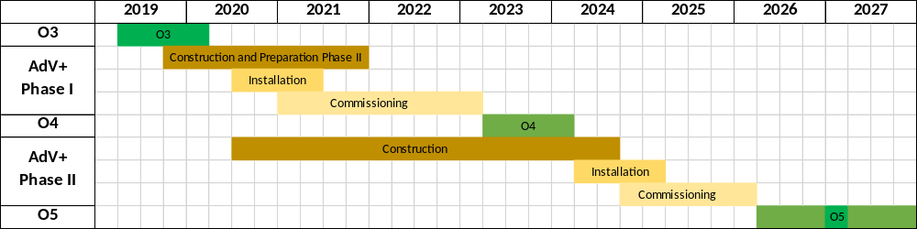
Advanced Virgo+: content & schedule
Two phases project
  Phase I (before O4 run/2023-24)
    Mainly an upgrade to reduce quantum noise: no mirrors change
    Reduction of technical noises
    Preparation of Phase II
  Phase II (before O5 run/2026-27)
    More invasive upgrade to reduce thermal noise: mirrors change
Approval
of Phase I
Approval
of Phase II

Slide 3
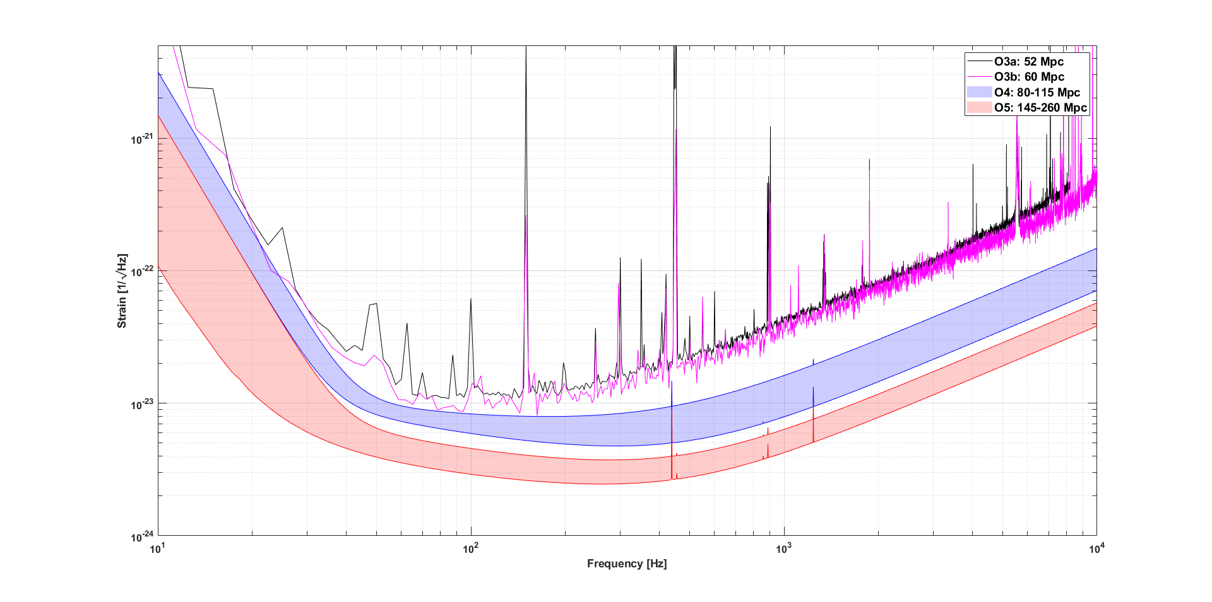
Advanced Virgo+ design sensitivity
Phase I: reduce quantum noise, hit against thermal noise. BNS range: 100 Mpc’s
Phase II: lower the thermal noise wall. BNS range: 200 Mpc’s or more

Slide 4
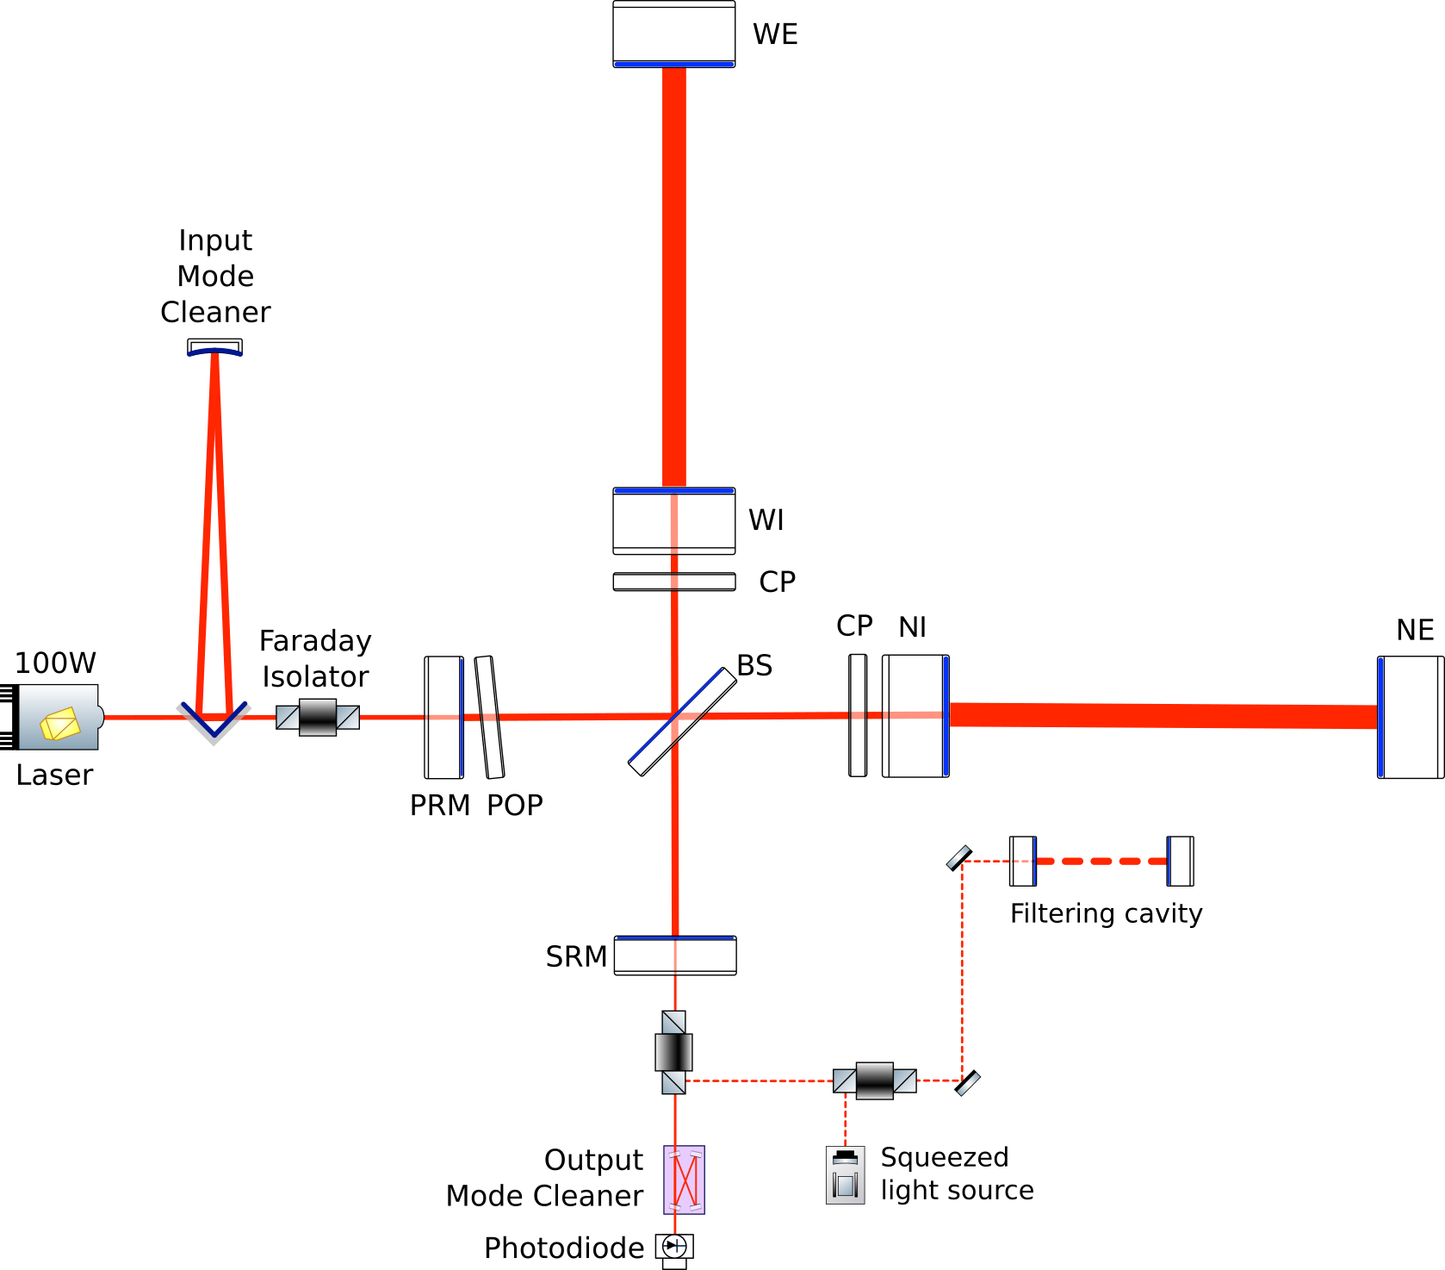
Advanced Virgo+ Phase I
Configuration during O3

Slide 5
Advanced Virgo+ Phase I
New IMC payload ✓
+
Instrumented baffle ✓
Newtonian Noise cancellation ✓
Auxiliary lasers ✓
HVAC noise reduction ✓
Air pressure
reduction in CITF
✓
Laser Upgrade ✓
SR mirror ✓
Frequency
Dependent
Squeezing
(QNR system)
✓
New Output Mode Cleaner ✓
Scattered light mitigation ✓
New photodiode electronics

Slide 6
Reminder
Installation completed in the first semester of 2021
First 2-hours operation of signal recycled interferometer in November 2021
  33W input power
Frequency dependent squeezed vacuum source operated for long periods in the first semester of this year
  Frequency dependent squeezing observed down to 25 Hz
Main issues until this fall:
  Reproducibility of interferometer operation
  Interferometer frequency response

Slide 7
Last news
The good news
  Reproducible operation with signal recycling cavity achieved
    Interferometer has the expected larger bandwidth provided by signal recycling
  Able to operate the interferometer over long periods
    Routinely run at night
    Two-days engineering run done early November
  First sensitivity curves measured
    Noise hunting just started
The less good news
  One suspension fiber break mid-November
    Happened during a venting (understood)
    Repair already done
  Now working to recover the interferometer
    Trying to keep the delay below one month

