Slide 1


Molecular Dynamics simulations of microscopic dissipation in Ta₂O₅
F. Puosi, F. Fidecaro, S. Capaccioli, D. Pisignano and D. Leporini
Physics Department “E. Fermi”, University of Pisa
INFN-Pisa

Slide 2
Ta₂O₅ model and simulation details
Classical MD simulations
Interatomic potential:
  - BKS potential (Coulomb + exponential repulsion + VdW attraction)
  - covalent bonding (Morse potential)
  [Trinastic et al., JCP 2013]
  - optimization: Wolf truncation with cut-off
  [Damart et al. JAP 2016]
Ta
O

Slide 3
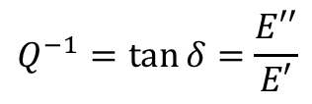
Mechanical loss in Ta₂O₅ glass
Molecular Dynamics – Mechanical Spectroscopy (MD-MS)
testo
- apply numerical strain and compute stress
$$Q^{−1}=\tan{δ}=\frac{E′′}{E′}$$
F. Puosi et al., Phys. Rev. Res., in press

Slide 4
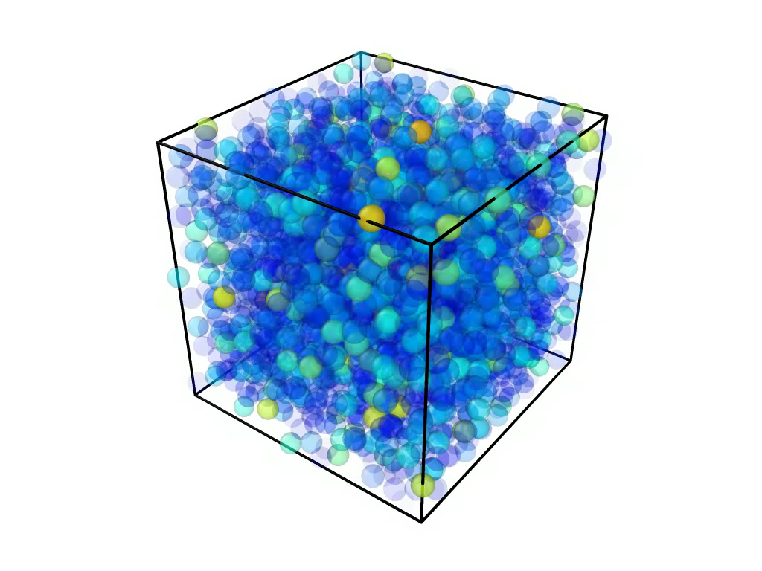

Microscopic perspective on dissipation
We focus on $T=300K$ and $f=1GHz$
Color code: magnitude of instantaneous velocity

Slide 5
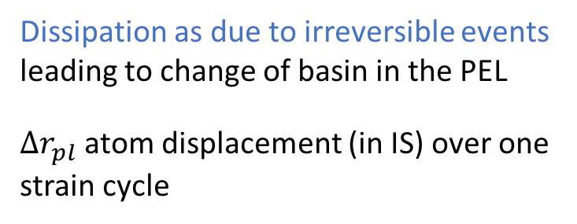
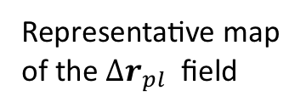
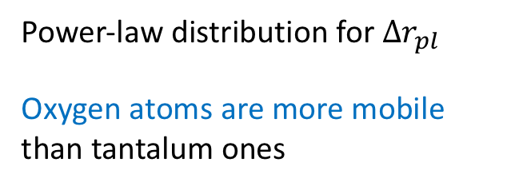
Statistics of plastic atomic rearrangements
Representative map of the ${Δr}_{pl}$ field
Dissipation as due to irreversible events leading to change of basin in the PEL
${Δr}_{pl}$ atom displacement (in IS) over one strain cycle
Power-law distribution for ${Δr}_{pl}$
Oxygen atoms are more mobile than tantalum ones

Slide 6
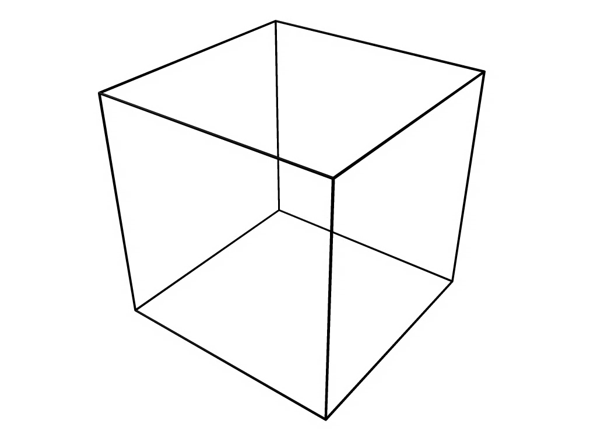
Statistics of plastic atomic rearrangements
Focus on polyhedra centered on the 5% Ta atoms with largest plastic displacement

Slide 7
Statistics of plastic atomic rearrangements
cluster analysis
- Plastic events involves dozens of atoms
  importance of medium range order.
slope = -2.3
Corner
Corner sharing connections dominates in plastically rearranging cluster
Edge
Face

Slide 8
Summary
Modeling and simulations can be of valuable help in the selection and design of advanced materials for coatings application as they can:
- provide a quick estimate of losses (Q) *
- give a microscopic insight in the dissipation mechanisms,
* F. Puosi et al., Phys. Rev. Res., in press
Thanks for your attention

