Slide 1




Annealing effects on the mechanical losses of fluorides thin films
Amato Alex¹
Bischi Matteo^{2,3}
Forest Danièle¹
Granata Massimo¹
Guidi Gianluca Maria^{2,3}
Martelli Filippo^{2,3}
Mereni Lorenzo¹
Piergiovanni Francesco^{2,3}
¹LMA, CNRS
²Università di Urbino
³INFN
Matteo Bischi GRASS, Padova 17.10.2019

Slide 2
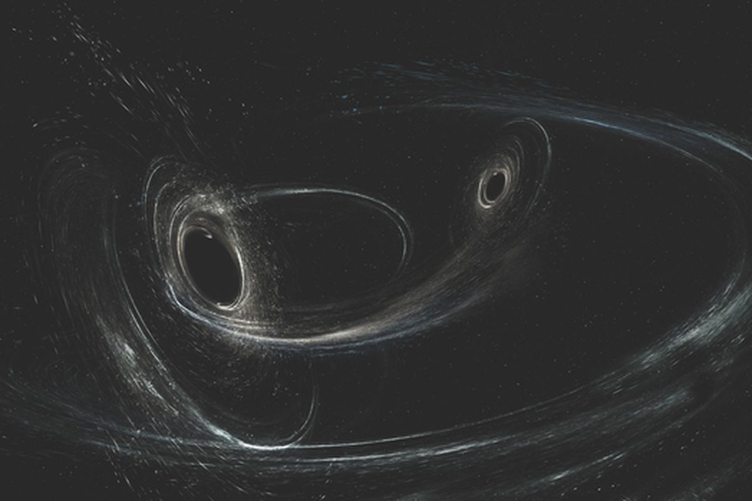
Outlook
Why using Fluorides?
Experimental work
What is left to do
Conclusions
Matteo Bischi GRASS, Padova 17.10.2019

Slide 3
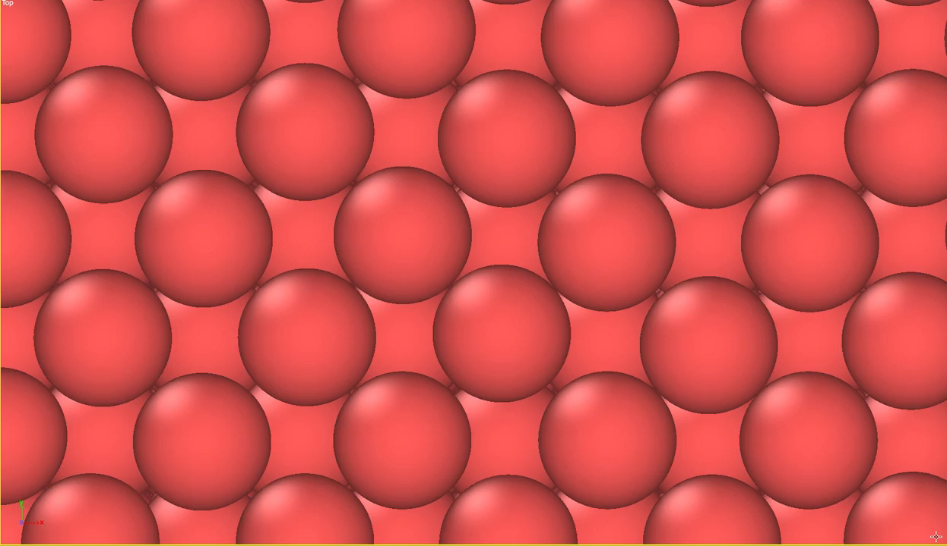
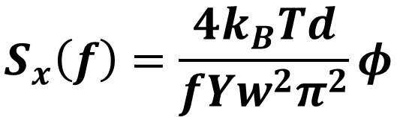
Why using Fluorides?
Coating thickness
Temperature
$$S_{x}\left(f\right)=\frac{4k_{B}Td}{fYw^{2}π^{2}}φ$$
Loss angle
Frequency
Laser beam width
Young’s Modulus
Ti(20%):Ta₂O₅ n = 2.07 φ = 3 x 10⁻⁴
SiO₂ n = 1.45 φ = 4 x 10⁻⁵
Matteo Bischi GRASS, Padova 17.10.2019

Slide 4
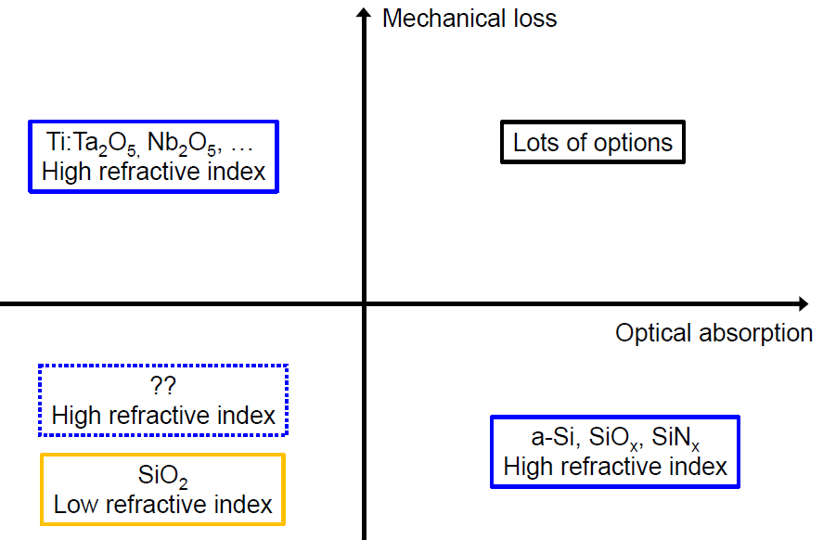
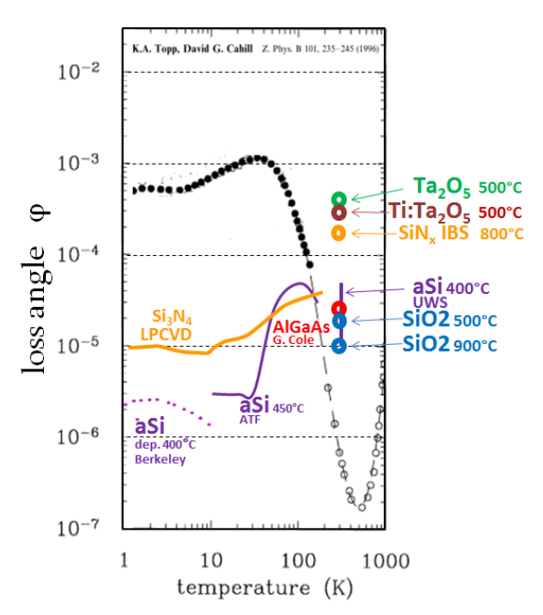
Why using Fluorides?
Fluorides like MgF₂ have the lowest refractive index (n = 1.4) among the known coating materials
Room Temperature
Matteo Bischi GRASS, Padova 17.10.2019

Slide 5
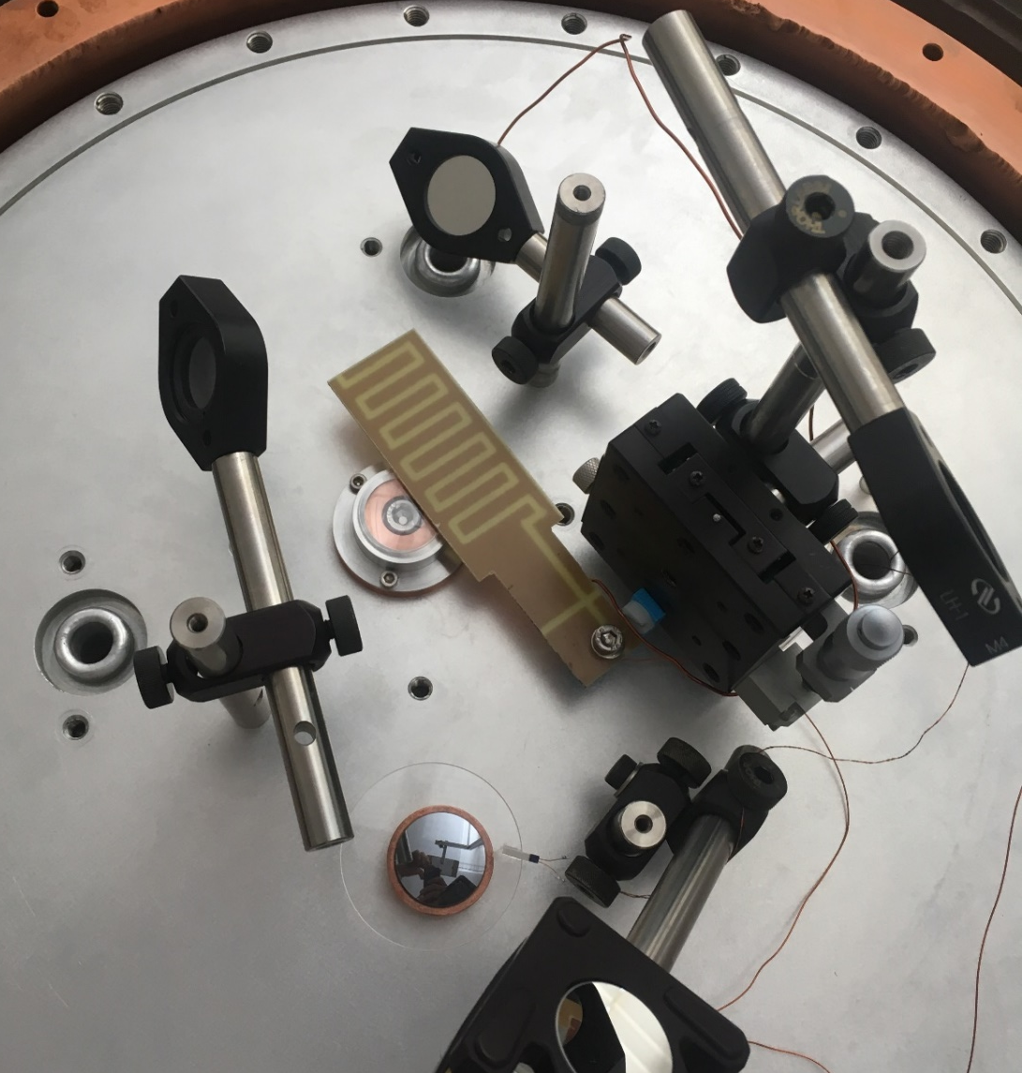
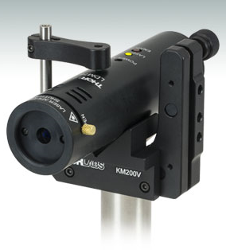
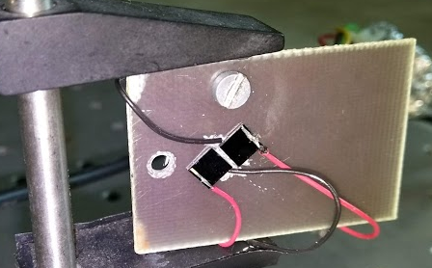
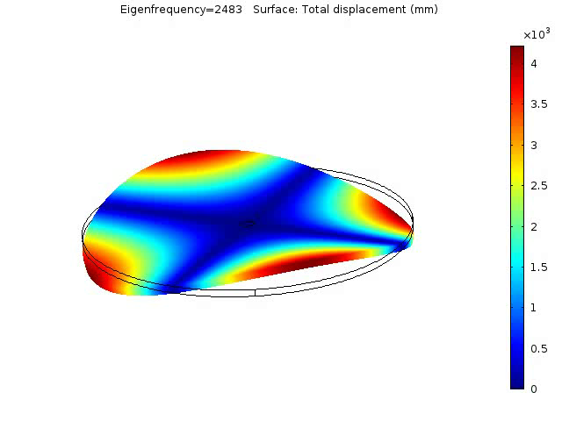
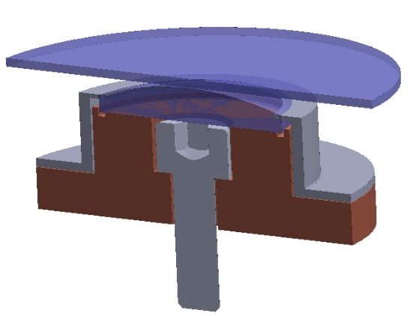
Experimental Work - GeNS
Matteo Bischi GRASS, Padova 17.10.2019

Slide 6
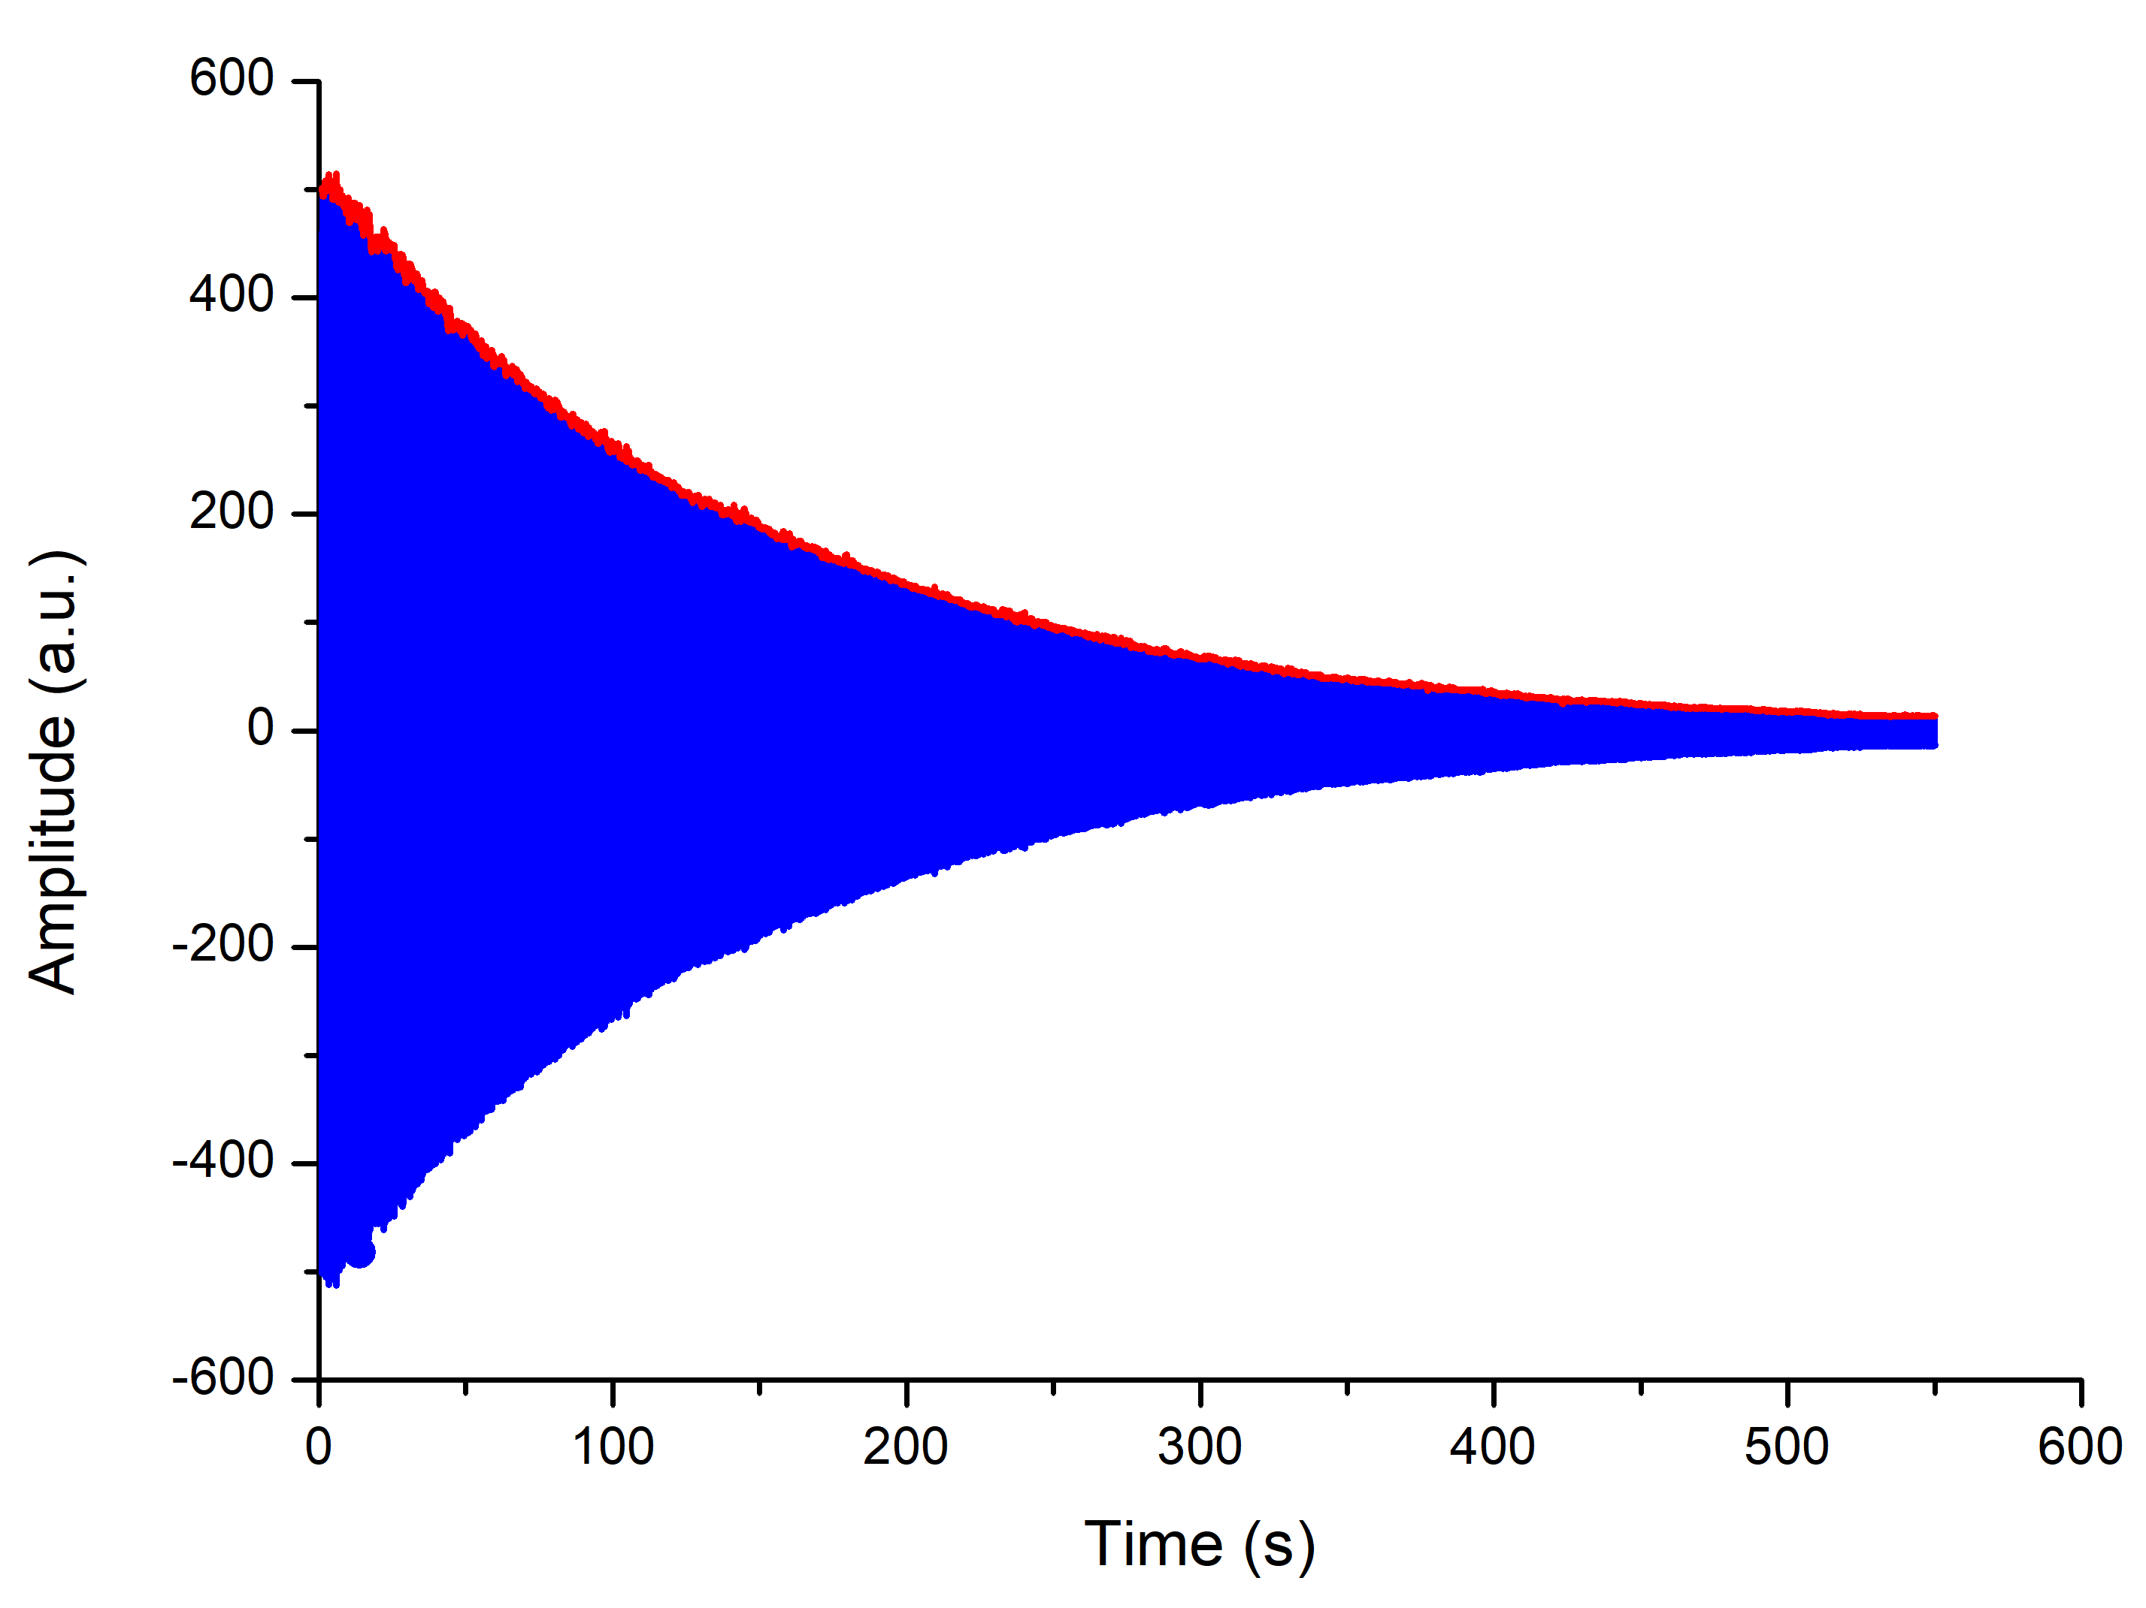
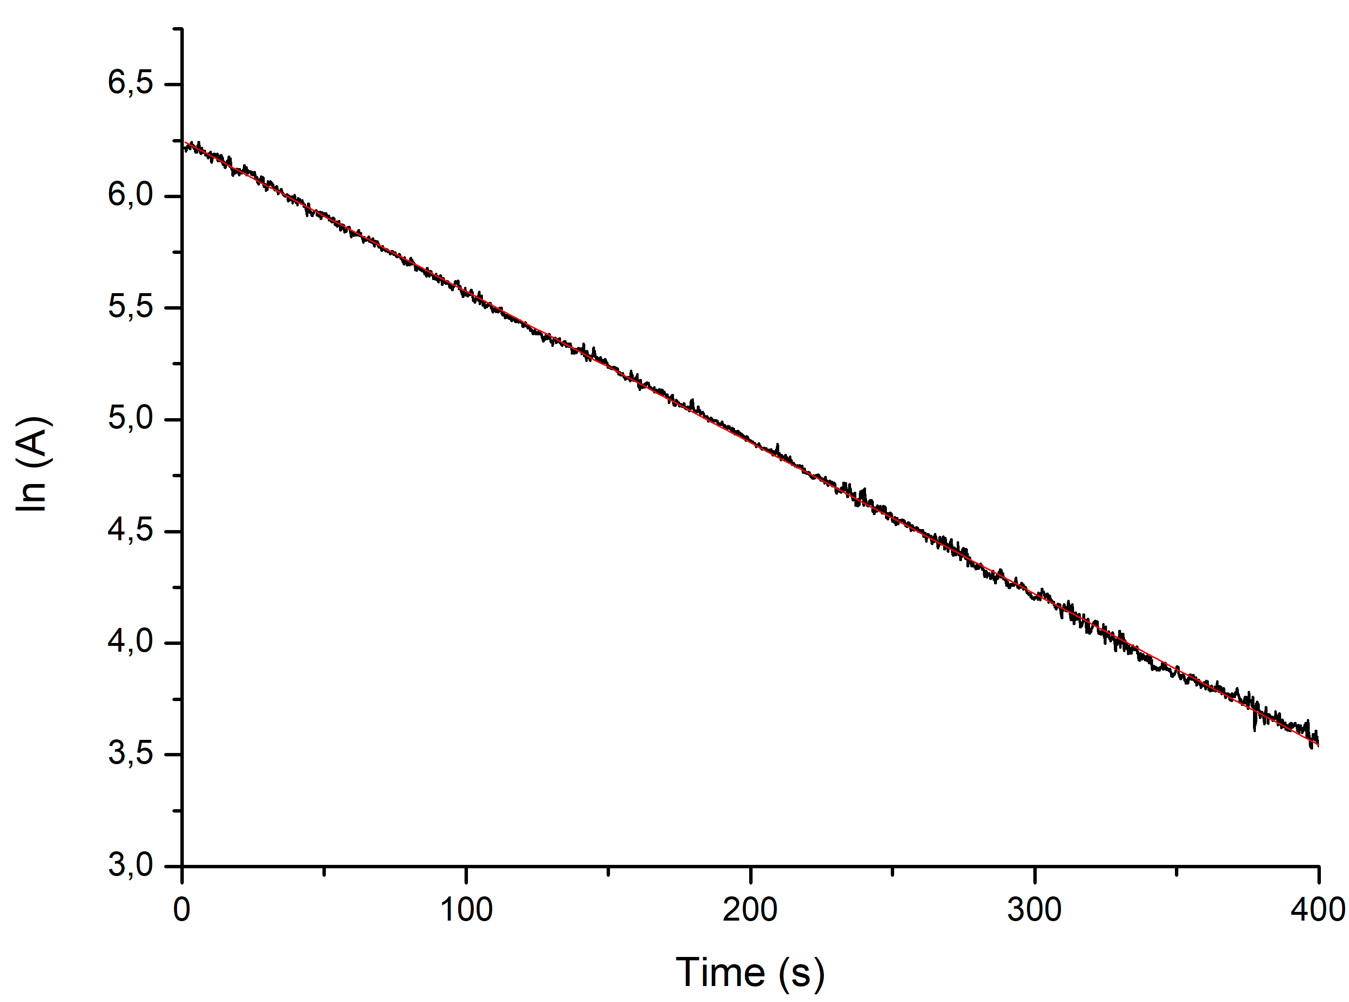
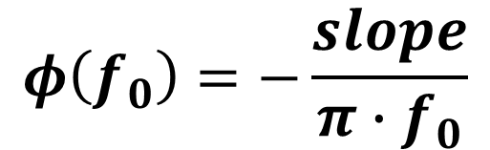

Experimental Work - GeNS
Exponential decay of the amplitude
Linear fit
$$A(t){=A}_{0}e^{−πφ(f_{0})∙f_{0}t}$$
$$φ\left(f_{0}\right)=−\frac{slope}{π∙f_{0}}$$
Matteo Bischi GRASS, Padova 17.10.2019

Slide 7
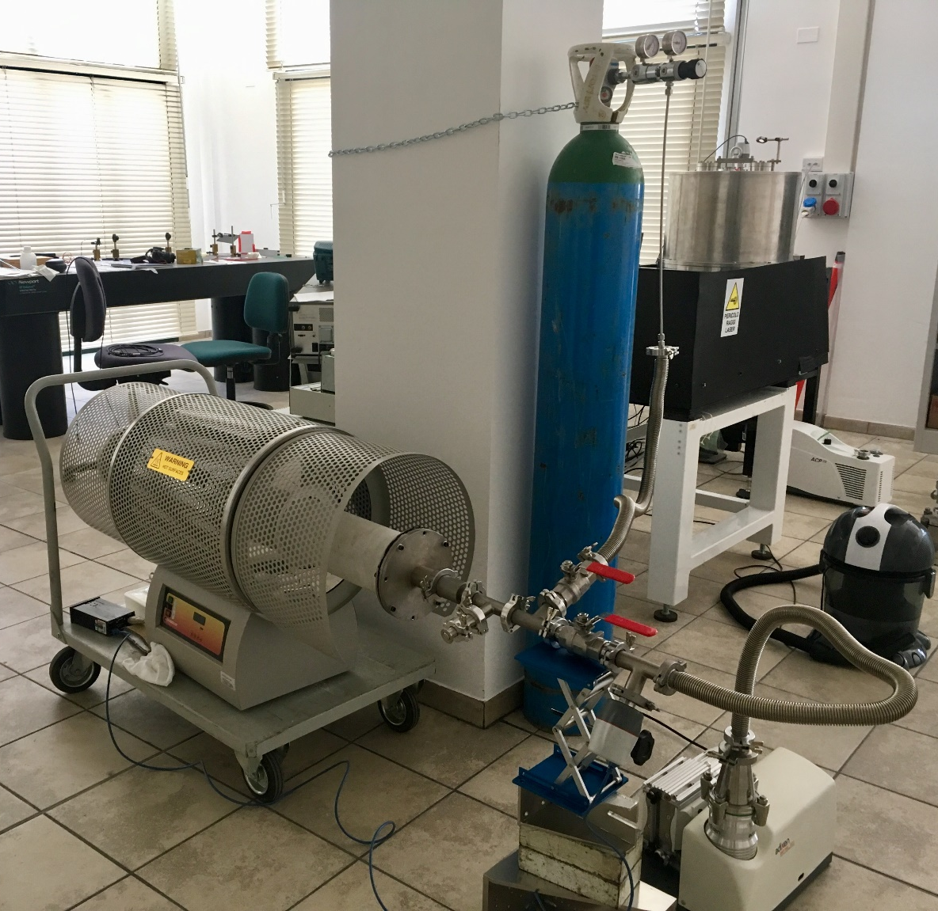
Experimental Work - Annealing
A succession of annealing treatments were performed on silica disks coated with MgF₂ on both sides. The annealing was done inside a tube furnace in a controlled Argon atmosphere, in order to prevent the oxidation of the coating.
After each annealing cycle, the loss angle and the weight of the sample were measured, in order to extract the coating losses.
Matteo Bischi GRASS, Padova 17.10.2019

Slide 8
Experimental Work - Samples
MgF₂ thin layers were deposited on both sides of silica substrates by ion beam sputtering at the Laser Zentrum Hannover. The measured thickness of each layer is 206 nm. The samples were also edge-polished using a CO₂ laser.
Substrate thickness | 1 mm
Substrate diameter | 50 mm
Substrate mass | (4.6158 ± 0.0001)g
Coating thickness (on each side) | 206 nm
Total mass (substrate + coating) | (4.6179 ± 0.0001)g
Matteo Bischi GRASS, Padova 17.10.2019

Slide 9
Experimental Work
Two kinds of experiments performed on two different samples:
Same annealing time but different annealing temperatures
Same annealing temperature but different annealing times
Matteo Bischi GRASS, Padova 17.10.2019

Slide 10
Experimental Work – C21025
Annealing treatments on the first sample of MgF₂ (C21025)
 | Run #1 | Run #2 | Run #3 | Run #4 | Run #5
Annealing Temperature (T_{max}) | 200°C | 300°C | 400°C | 430°C | 500°C
Duration (T_{max}) | 10h | 10h | 10h | 10h | 10h
Matteo Bischi GRASS, Padova 17.10.2019

Slide 11
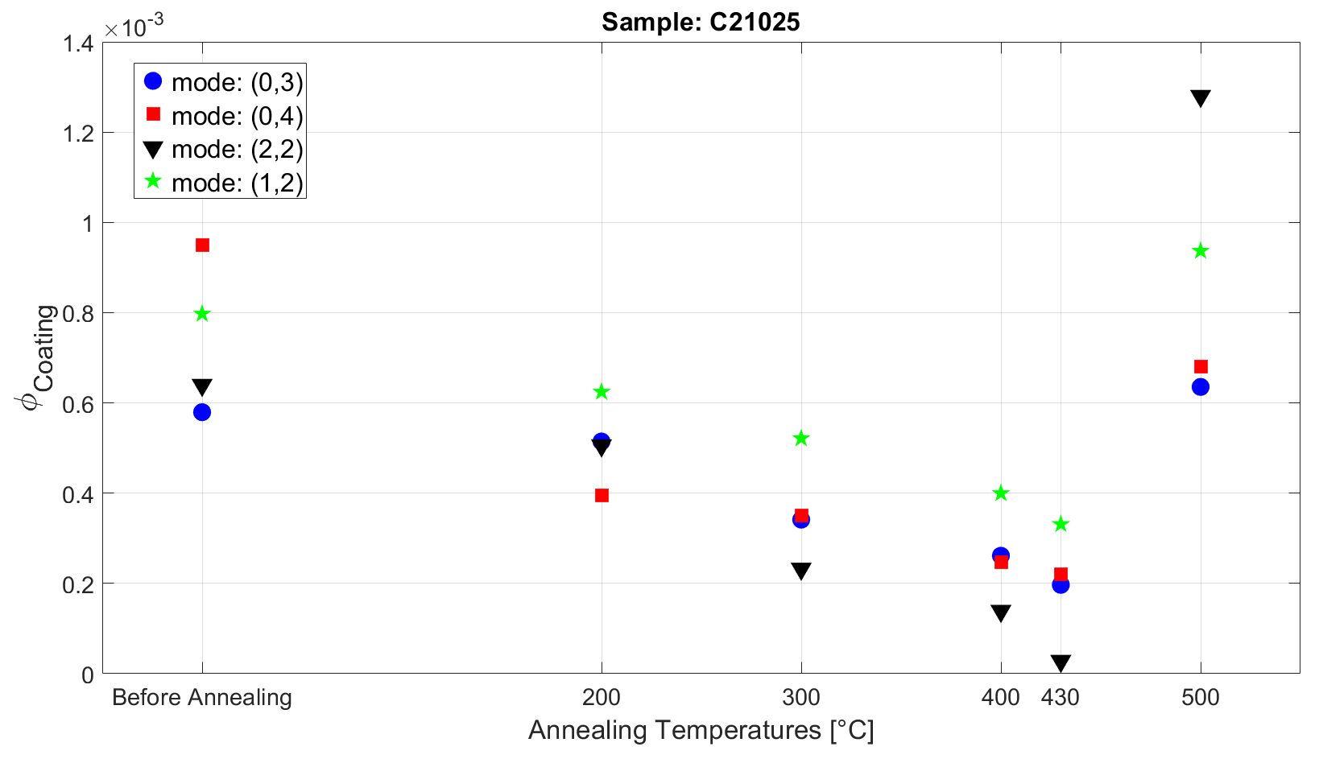
Experimental Work – C21025
Matteo Bischi GRASS, Padova 17.10.2019

Slide 12
Experimental Work – C21011
Annealing treatments on the second sample of MgF₂ (C21011)
 | Run #1 | Run #2 | Run #3 | Run #4
Annealing Temperature (T_{max}) | 400°C | 400°C | 400°C | 400°C
Duration (T_{max}) | 10h | 20h | 30h | 64h
Cumulative duration (T_{max}) | 10h | 30h | 60h | 124h
Matteo Bischi GRASS, Padova 17.10.2019

Slide 13
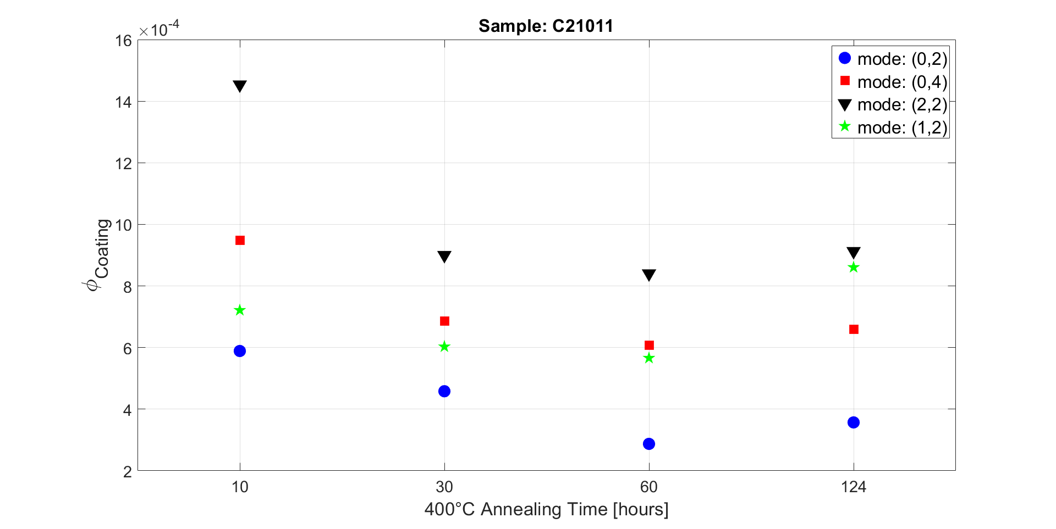
Experimental Work – C21011
Matteo Bischi GRASS, Padova 17.10.2019

Slide 14
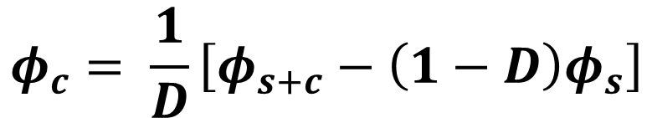
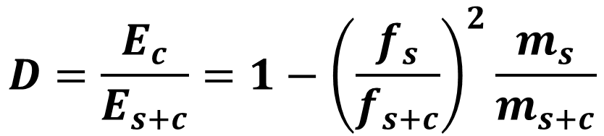
Experimental Work
We can find the loss angle of the coating (c) measuring the bare substrate (s) and the coated substrate (s+c):
Where «D» is called Dilution Factor and is evaluated by:
$$φ_{c}= \frac{1}{D}\left[φ_{s+c}−\left(1−D\right)φ_{s}\right]$$
$$D=\frac{E_{c}}{E_{s+c}}=1−{\left(\frac{f_{s}}{f_{s+c}}\right)}^{2}\frac{m_{s}}{m_{s+c}}$$
Matteo Bischi GRASS, Padova 17.10.2019

Slide 15
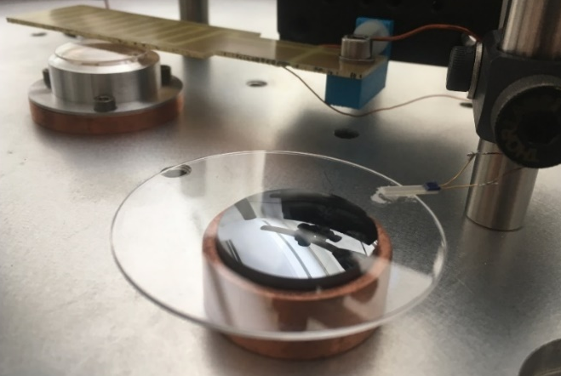
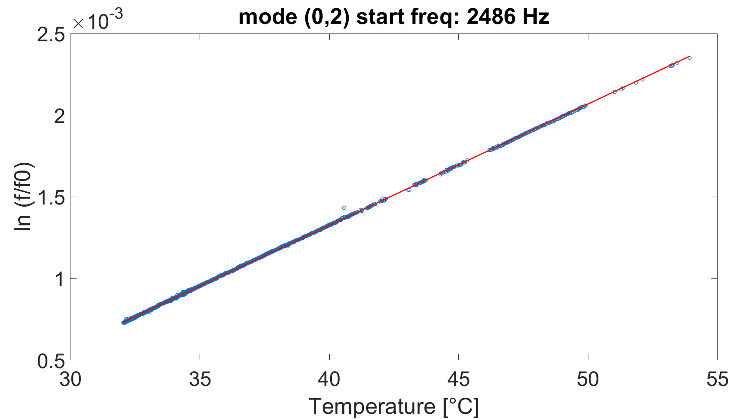
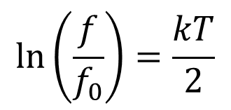
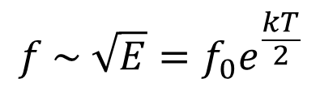

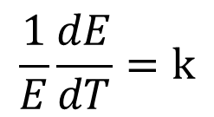
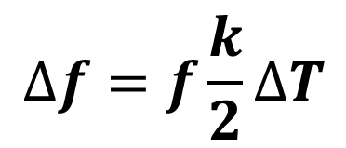
Experimental Work
Resonance frequency variation due to temperature variation
$$\frac{1}{E}\frac{dE}{dT}=k$$
$$f \sim \sqrt{E}=f_{0}e^{\frac{kT}{2}}$$
$$\ln\left(\frac{f}{f_{0}}\right)=\frac{kT}{2}$$
$$E=E_{0}e^{kT}$$
From the slope we obtained:
k = 1.58 x 10⁻⁴
And we can correct the values of the resonance frequencies by an amount:
$$∆f=f\frac{k}{2}∆T$$
Matteo Bischi GRASS, Padova 17.10.2019

Slide 16
What is left to do
Understand why the loss angle of the coating increases at annealing temperatures above 430°C
Hypothesys:
Crystallization of MgF₂ took place (a new XRD analysis will be repeated soon)
Cracks on the surface of the MgF₂ films due to differences of thermal expansion coefficients between the substrate and the coating
Matteo Bischi GRASS, Padova 17.10.2019

Slide 17
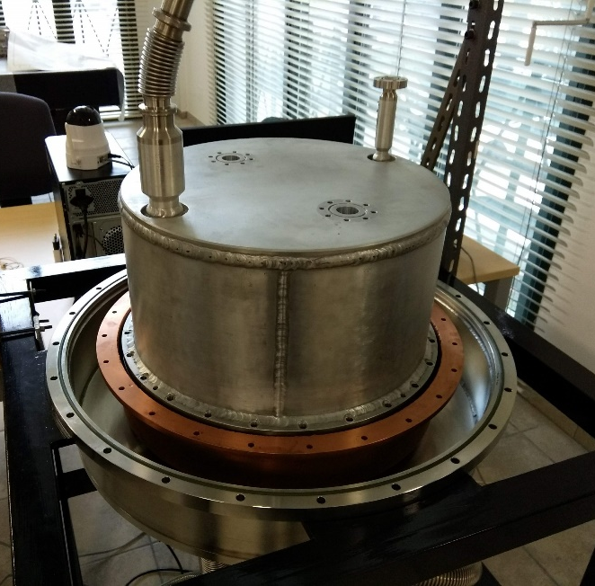
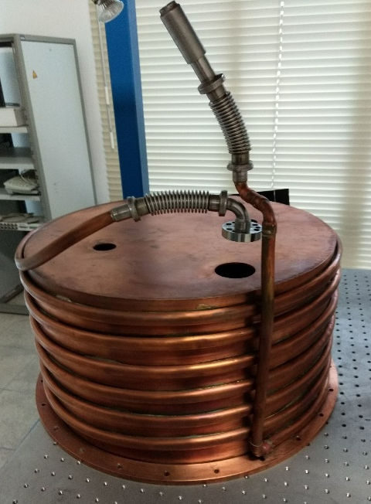
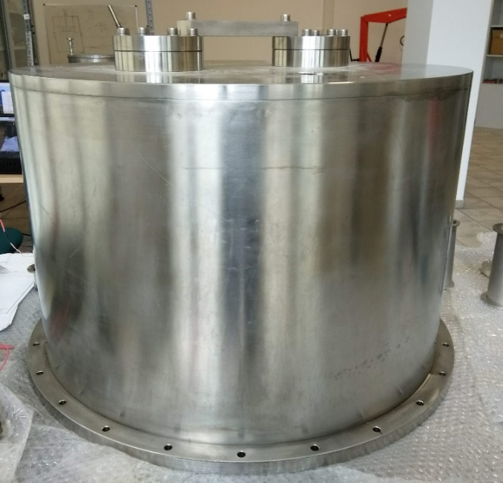
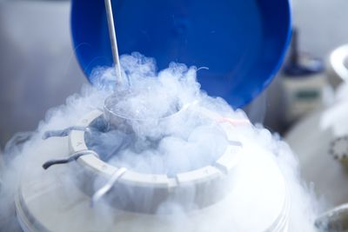
What is left to do
Upgrade of the GeNS system to operate at cryogenic temperatures and measure another set of samples coated with MgF₂.
Inner tank
Copper shield
Outer tank
Liquid nitrogen/helium
Matteo Bischi GRASS, Padova 17.10.2019

Slide 18
Conclusions
First Sample (C21025): after each annealing cycle the loss angle of the MgF₂ coating decreases until the treatment at 430°C. Above this temperature φ increases.
Second Sample (C21011): after each annealing cycle the loss angle of the coating decreases until 60 hours of cumulative time.
Mechanical loss values of MgF₂ coating are more than an order of magnitude higher than silica at room temperature, but we need to repeat measurements at cryogenic temperatures.
Matteo Bischi GRASS, Padova 17.10.2019

Slide 19
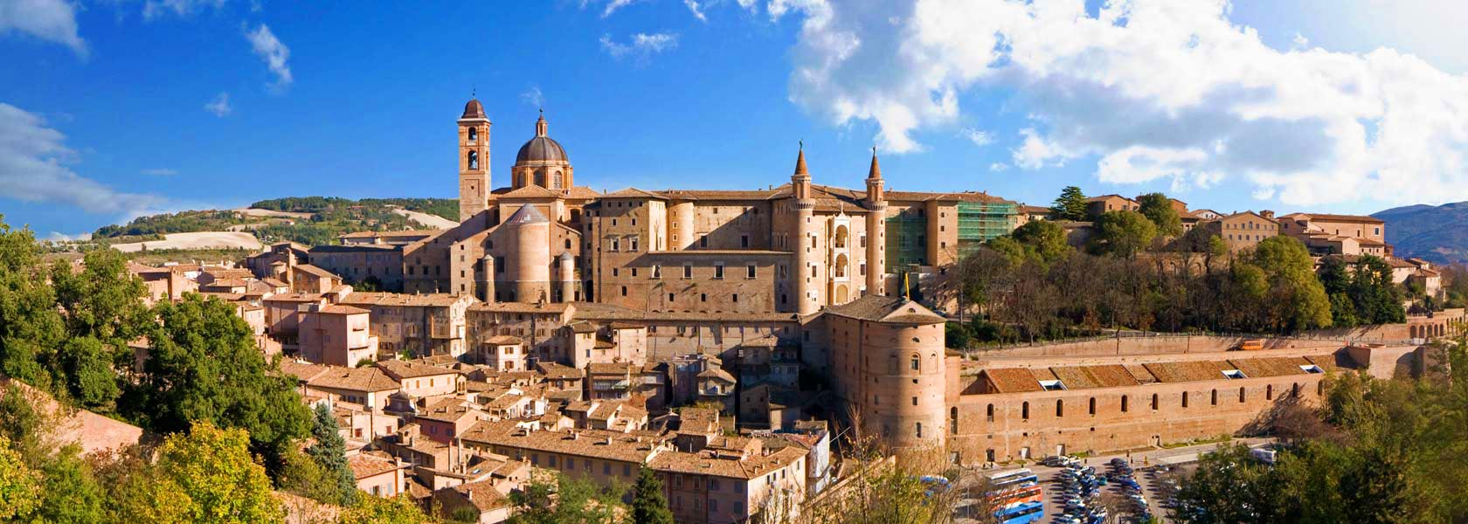
Thank you!
Matteo Bischi GRASS, Padova 17.10.2019

