Slide 1


ENV Training Session part 2: Experimental techniques
(stimuli and signals generation)
Federico Paoletti on behalf of the ENV team
VIR-0949A-19
Virgo Training Sessions – 26 Sep. 2019

Slide 2
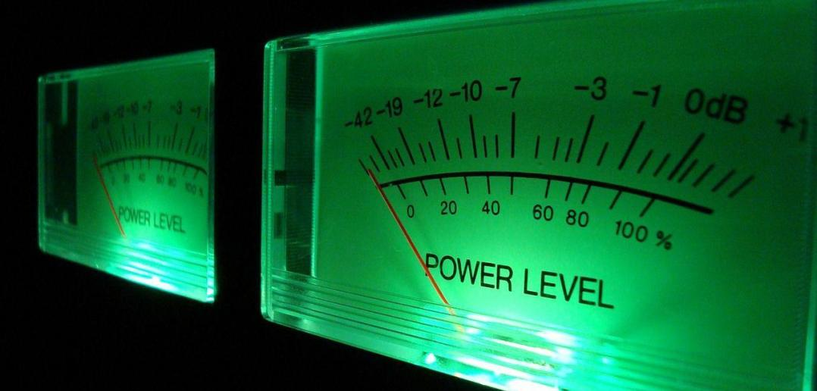
Outline of this session:
Very often it is necessary to GENERATE stimuli for the ITF
WHY ?
Example1: to excite and find critical “points” of the ITF that are not evident in standard working conditions
ALSO
Example2: to have a projection of the noise level read by environmental sensors
AND …
many other situation (non linear analysis, etc.)

Slide 3
How to excite: noise families
Seismic
Acoustic
Magnetic
ElectroMagnetic (RF)
…

Slide 4
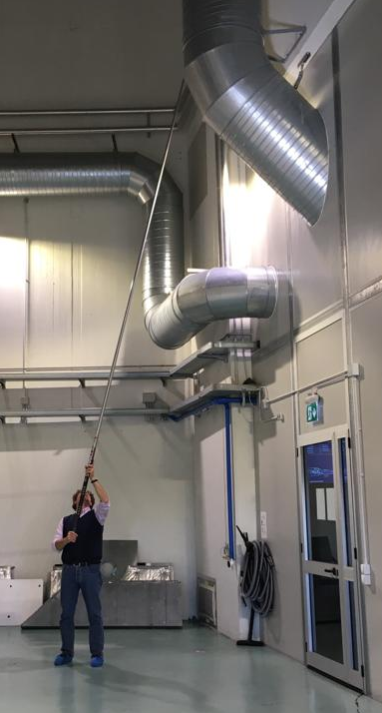

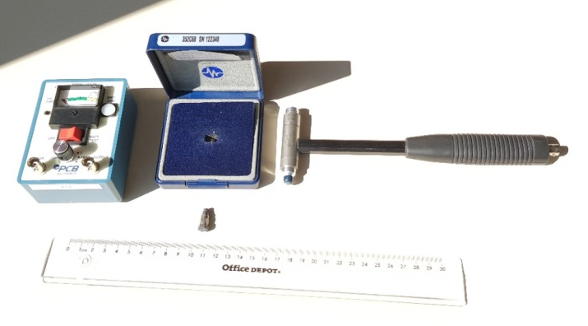
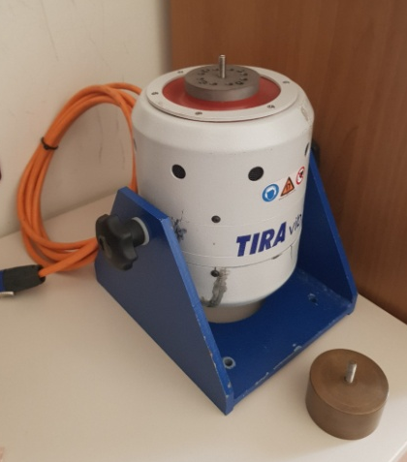
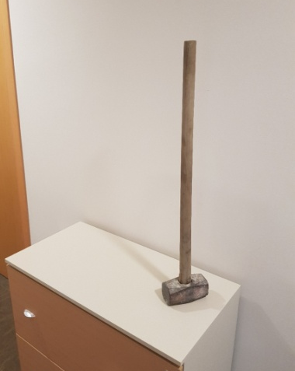



How to excite: seismic tools
tapping
(aka ”the piano player”)
hammering gently
shaking
hammering hard
walking and jumping in uncorrelated way (requires the collaboration of some young performing researchers)
Courtesy of farmers
(although not always required ...)
The fishing rod
(tapping far far away)

Slide 5

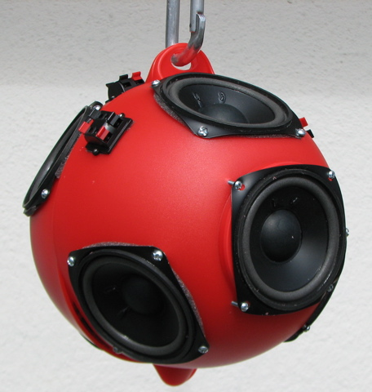
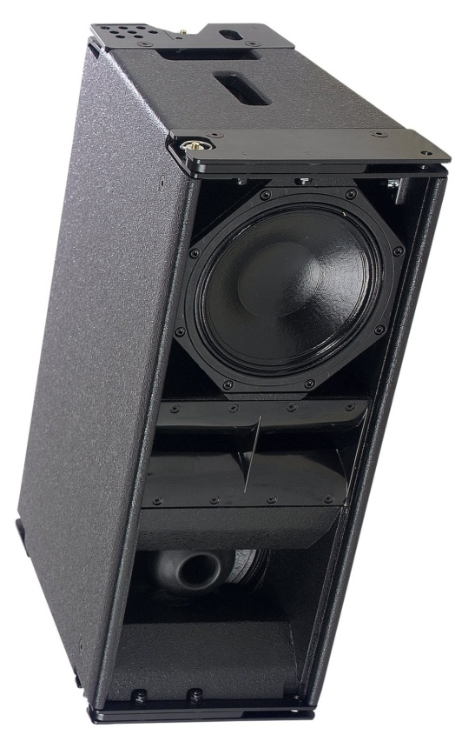

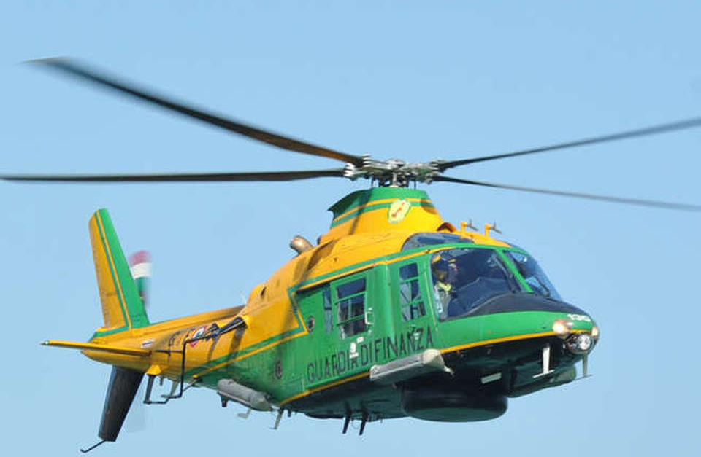
How to excite: acoustic tools
continuous loud broadband noise
short impulsive noise
Copter not easily and not always available, however (they decide …)
impulsive loud broadband noise
Very Low Frequency noise

Slide 6
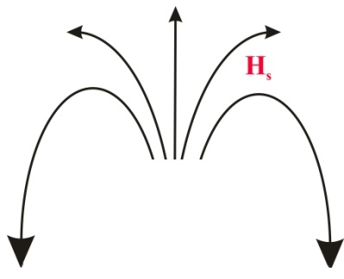
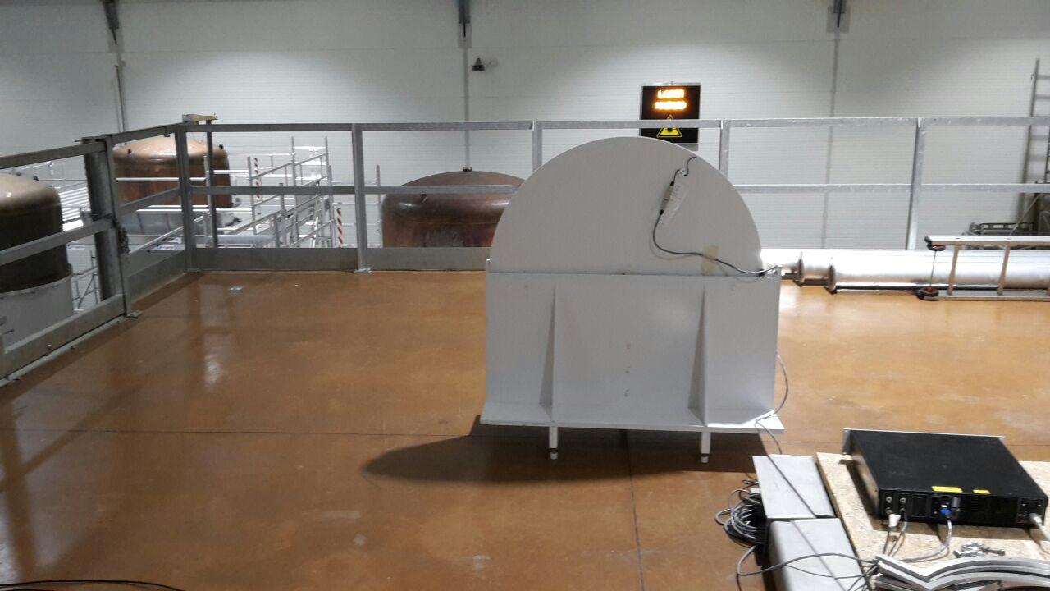
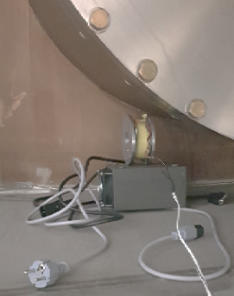
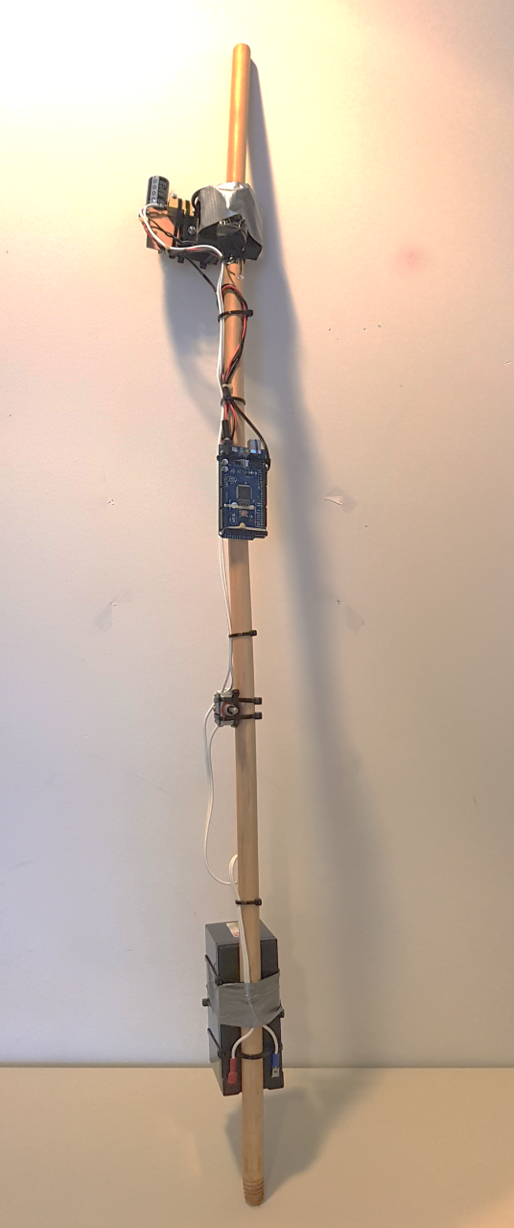
How to excite: magnetic tools
emitter
Little (portable) Coil …
clock
switch
(not_so_much) Big Coil …
… driven by a power amplifier
… idem
battery
Self-powered Magic Wand
(square wave, 55Hz circa)

Slide 7
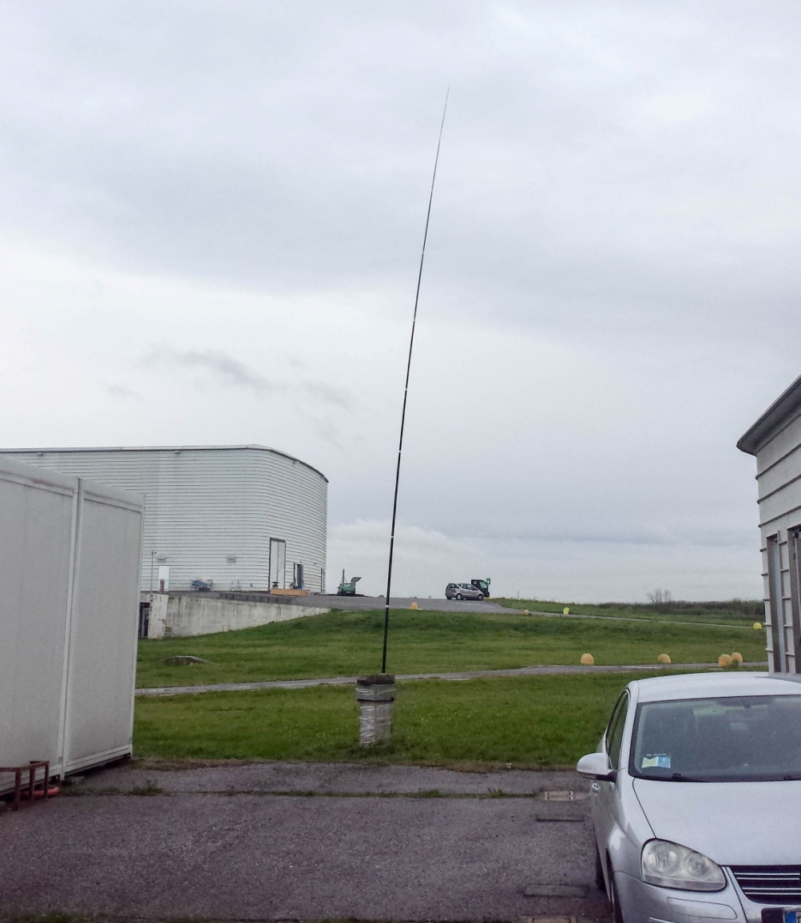
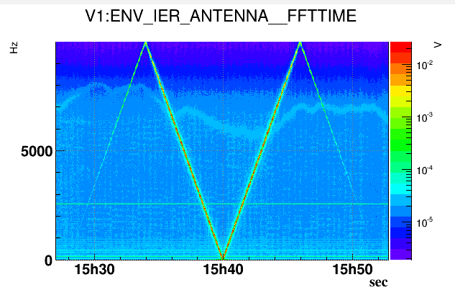
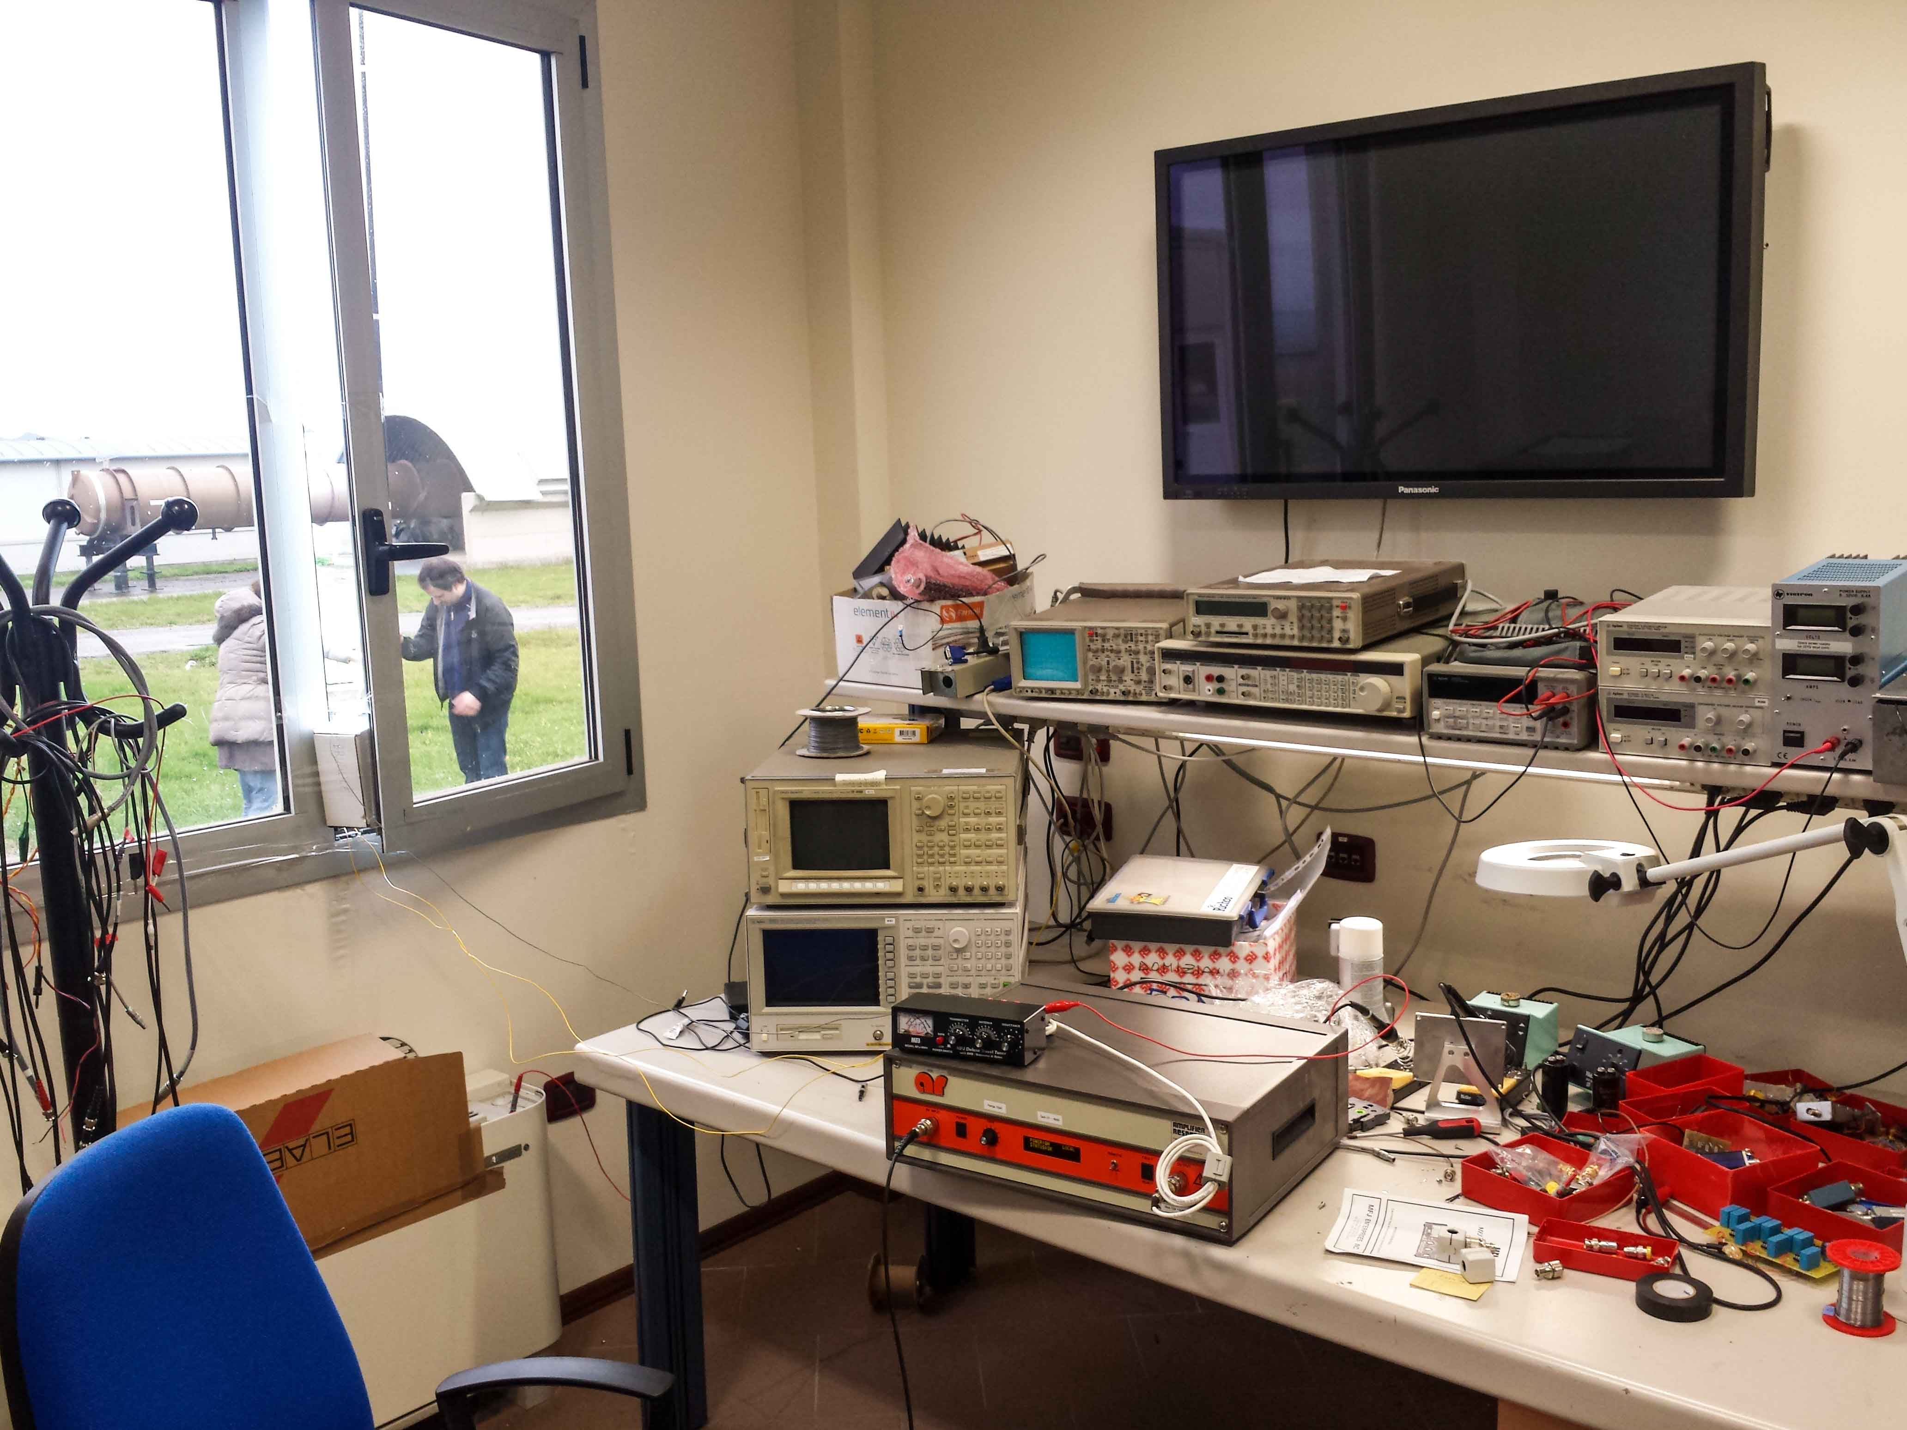
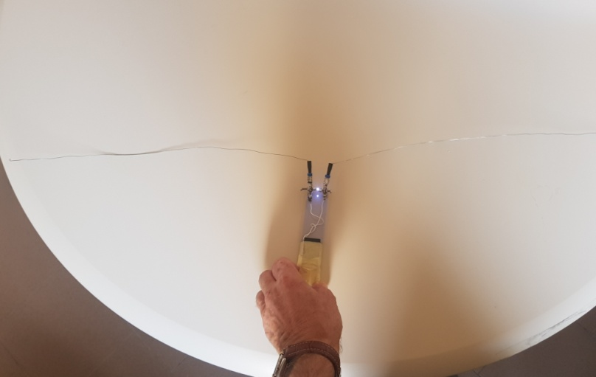
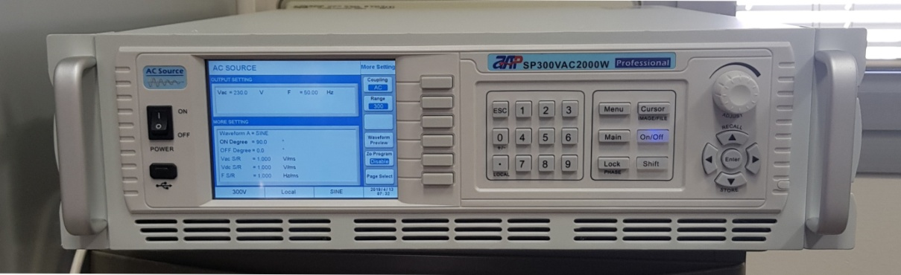
How to excite: ElectroMagnetic (RF) and other tools
Vertical antenna
Connected to an RF power amplifier (max 100W) via an antenna coupler
Mains power generator (0 to 300Vac rms, 10 to 1200Hz, 2kVA)
“Marconi style” spark generator

Slide 8

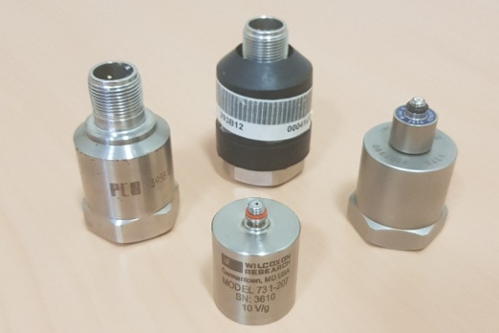
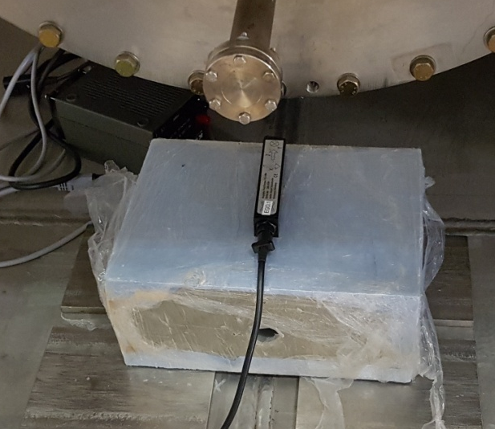
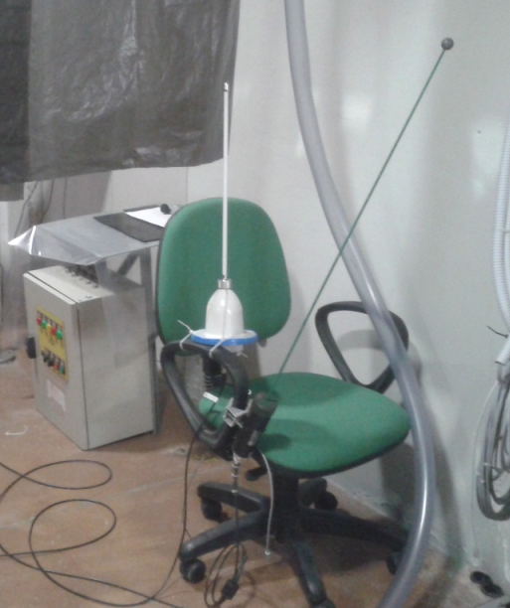
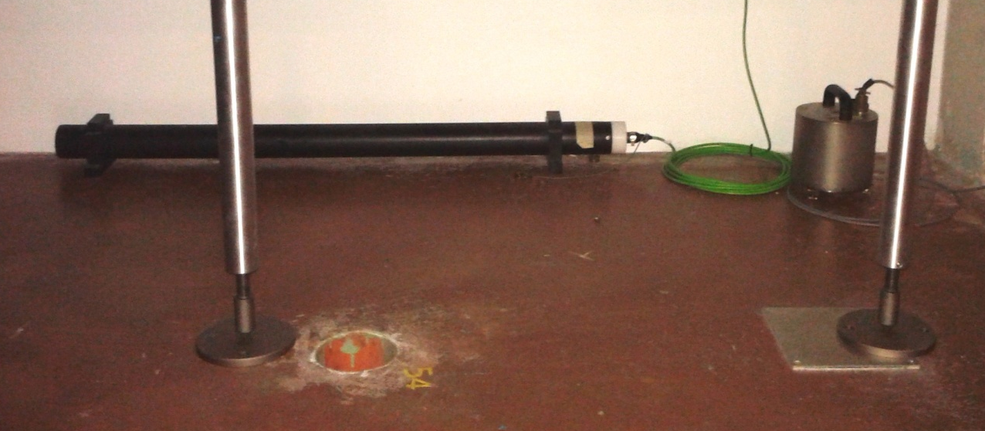
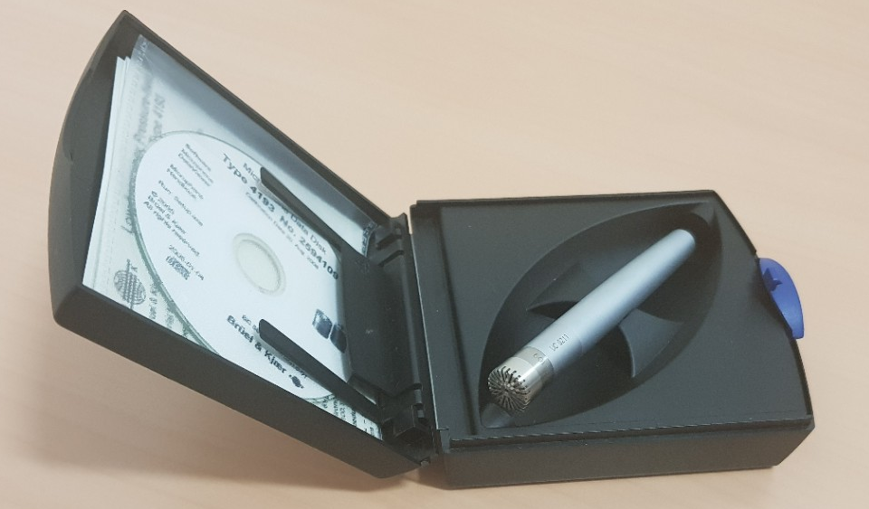
How to READ: sensors (just a remind)
RF receiving antennas
Triaxial accelerometer
Monoaxial accelerometers
Triaxial (portable) magnetometer probe
Monoaxial (very sensitive) magnetometer
Triaxial (very sensitive) velocimeter
Broadband Microphone
And many others “non visible” tools (e.g. Voltage and Current sensors on UPS and IPS, Ground Voltage drop sensors …)

Slide 9
How to use the tools
Rule #1: do not overexcite
Rule #2: choose the right type of signal to be generated
Rule #3: use the right tool (and if you have not, use your fantasy)
…
Rule^{(n)}: do not overexcite!

Slide 10
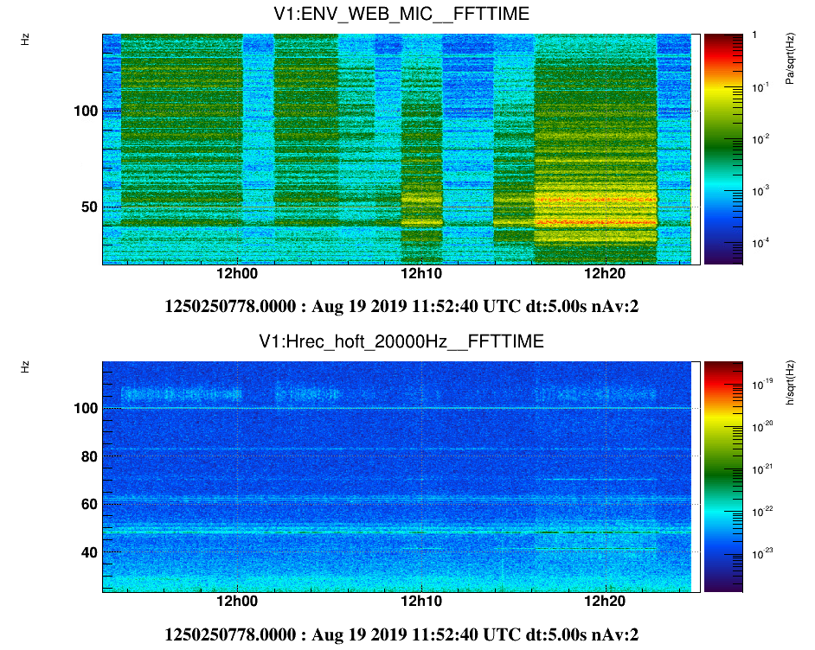
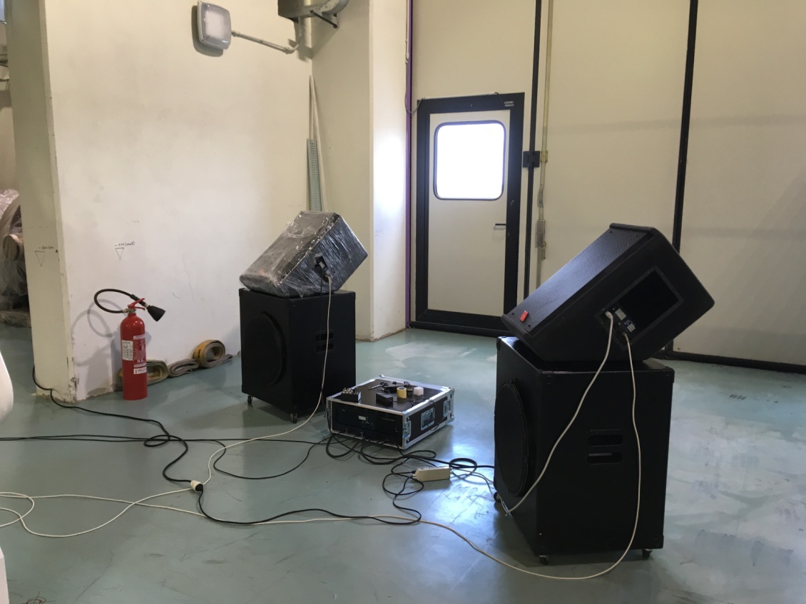
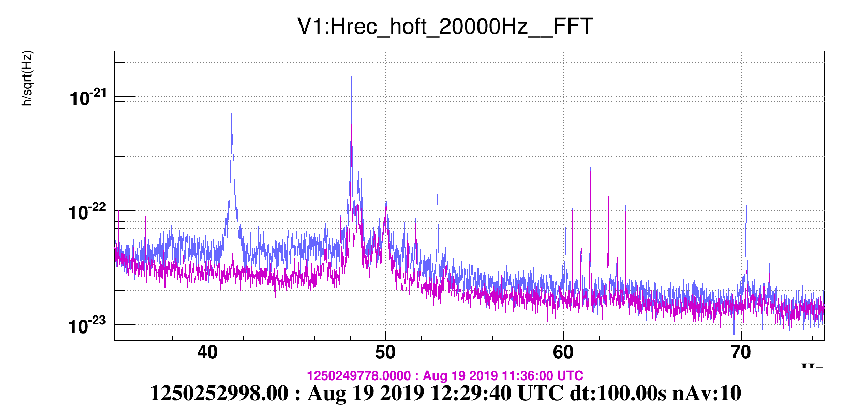
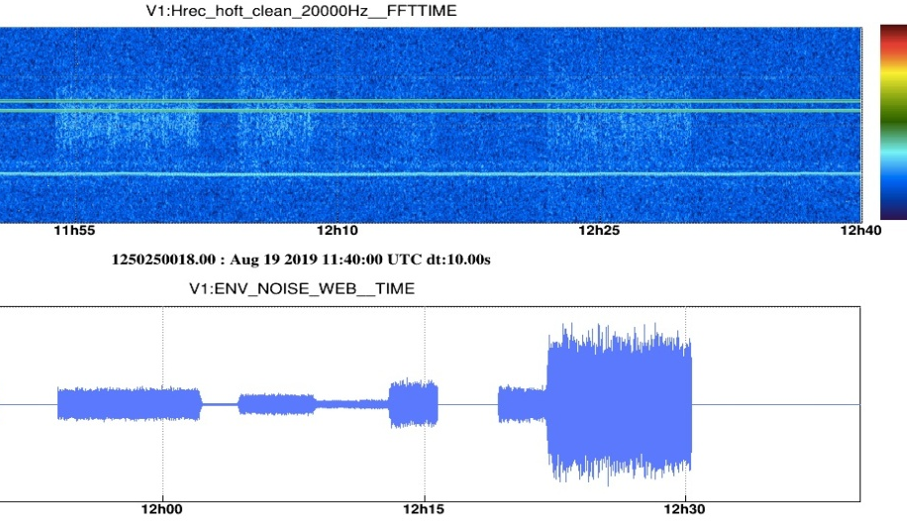
West End Building acoustic injection
(see elog 46708)
Let’s see some examples
Self-amplified broadband loudspeakers
“colored” noise (= bandpass filtered white noise) generated with different levels/frequencies
Subwoofer
Subwoofer
Subwoofers power amplifier
Analysis in progress (planned in October commissioning stop)
Broad excitation spotted some problems in Hrec
(41.5 Hz and others)

Slide 11
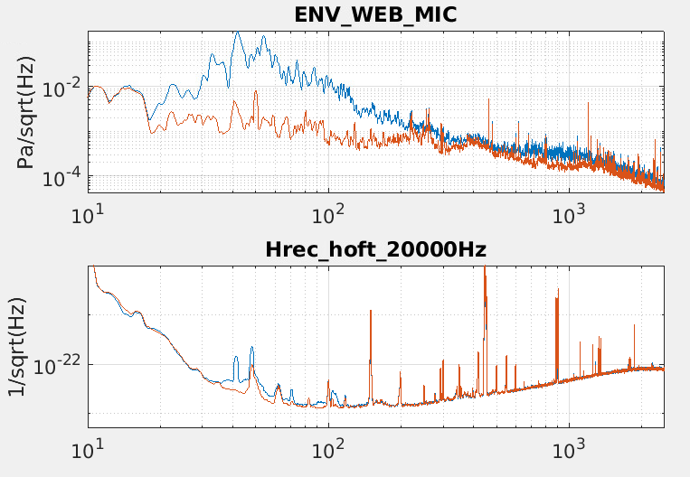
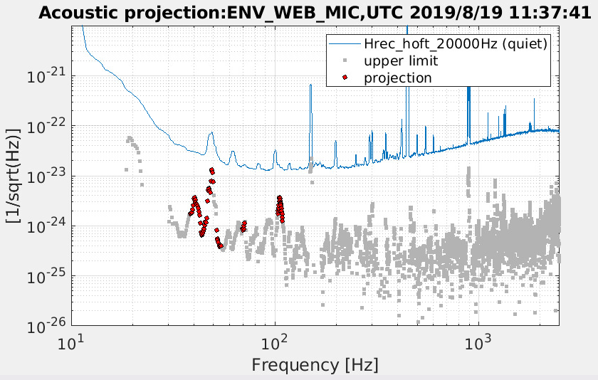
Let’s see some examples
Acoustic noise projection
How generated acoustic noise is seen in the sensor (microphone) and in Hrec
How the “quiet” acoustic noise is projected in Hrec (RED dots = coherence)

Slide 12
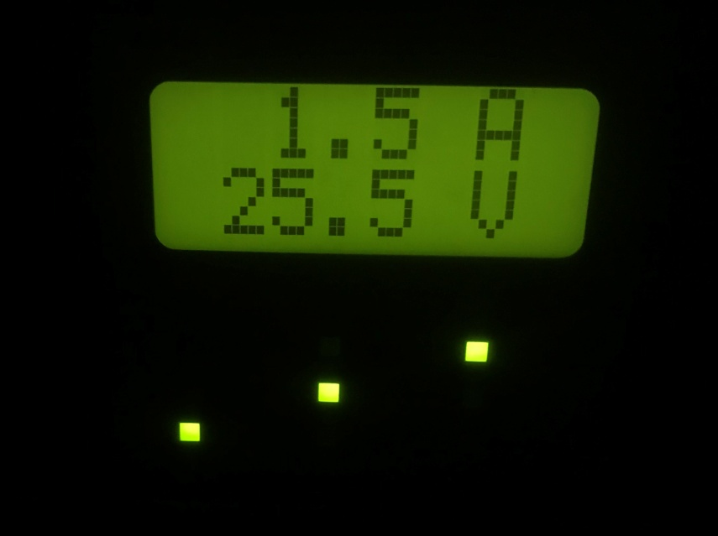
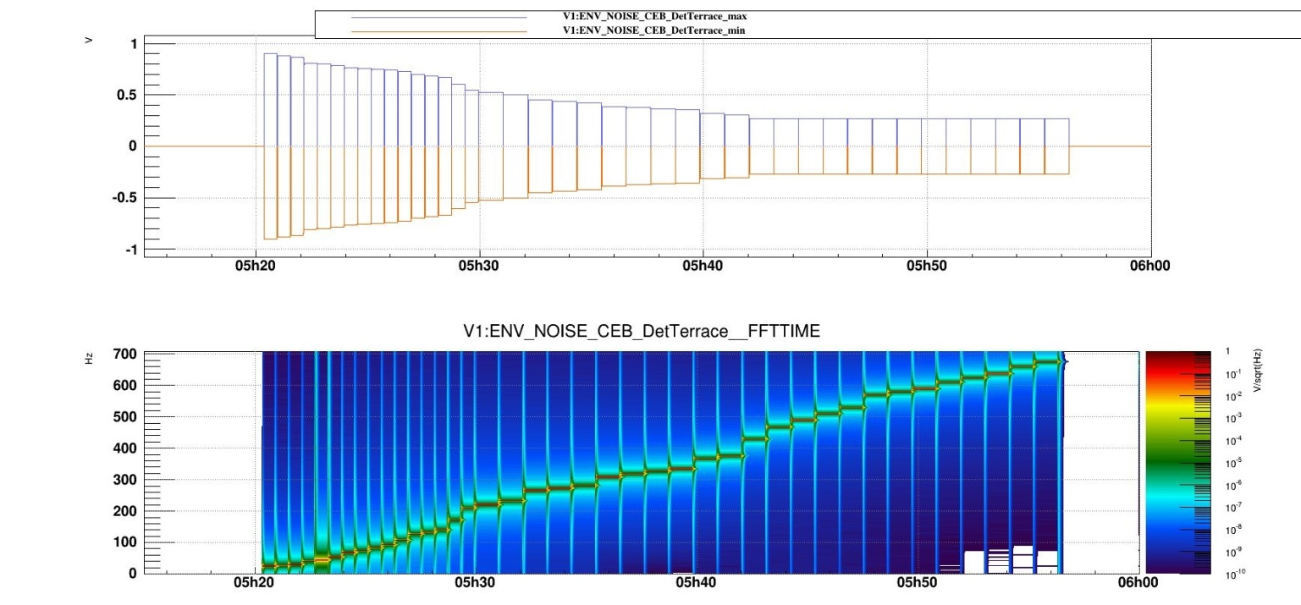
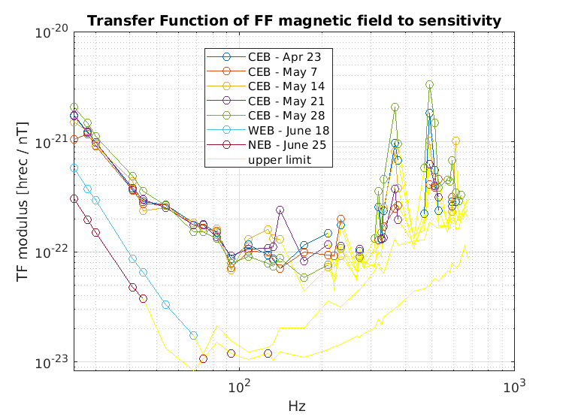
Buildings Magnetic injections
(see elog 46207)
Let’s see some examples
Signal generated (sine, different levels and frequencies)
Typical power amplifier working point
An unexpected rise is visible in all Central Building Transfer Functions (while no problems are visible in Terminal buildings)

Slide 13
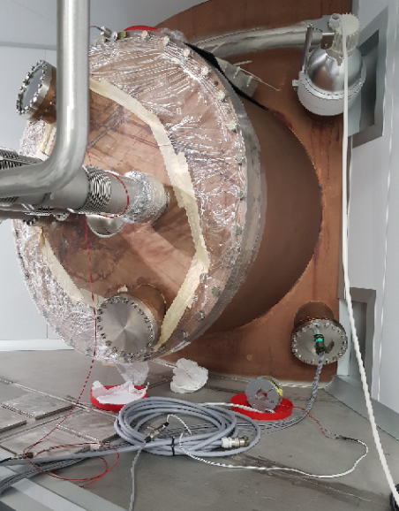
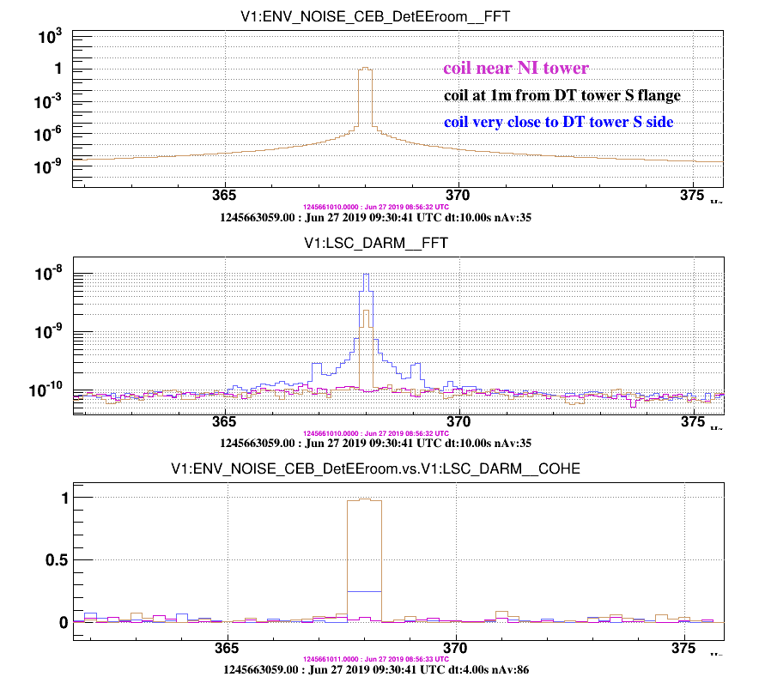
Buildings Magnetic injections
(see elog 46207)
Let’s see some examples
Suspecting some localized coupling, we changed from Far Field to Near Field injections trying to find the weak point
Little Coil, driven by the usual Power Amplifier, and placed near the DET tower
Generated a single line (a sine) at high frequency (368Hz)
Indeed we found an increase in coupling when working around the DET tower.
Analysis still in progress, we suspect a coupling with cables or electronics (if not directly with the magnets of the suspended bench)

Slide 14
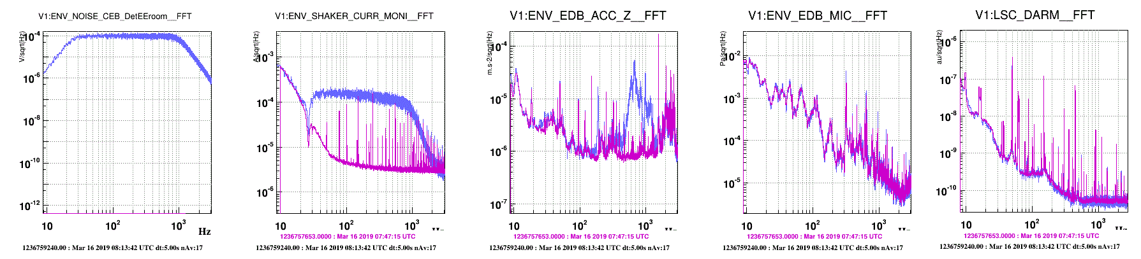
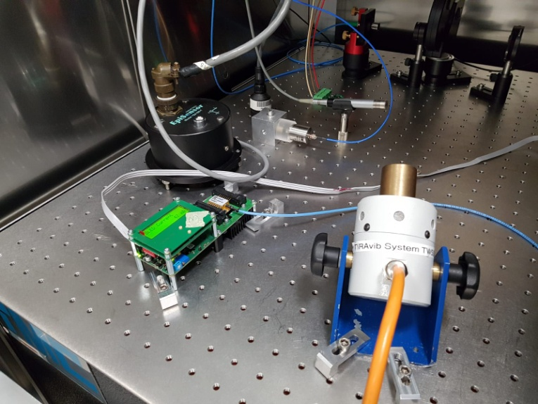
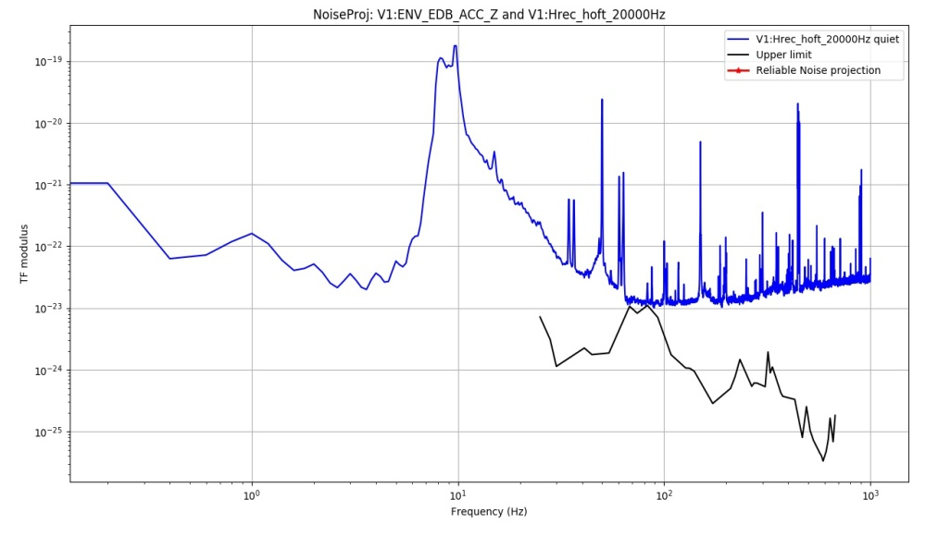
Optical benches Seismic injections
(see elog 45279)
Let’s see some examples
“colored” noise generated and sent to the shaker via a power amplifier
EDB excited at 189Hz
(bench resonant mode?)
and mainly above 500Hz
No acoustic emission (good!)
No visible effect in DARM (good!)
One triaxial accelerometer
+ two monoaxial acc. on EDB
Little shaker
Signal and Coherence near zero in DARM, only upper limit projection is possible
(no “RED dots”)

Slide 15
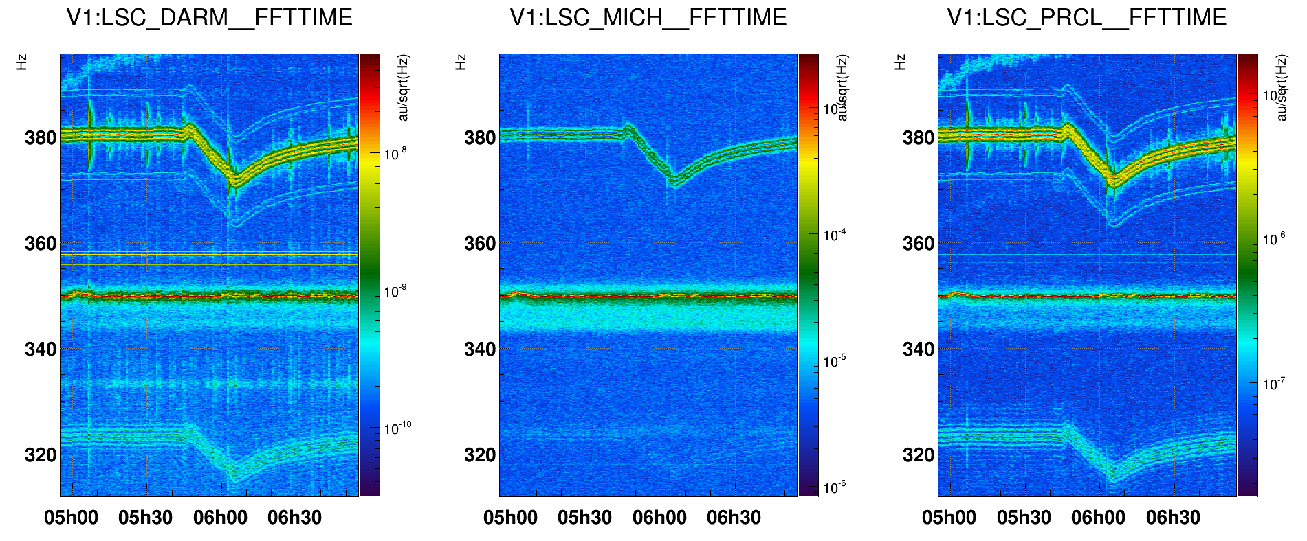
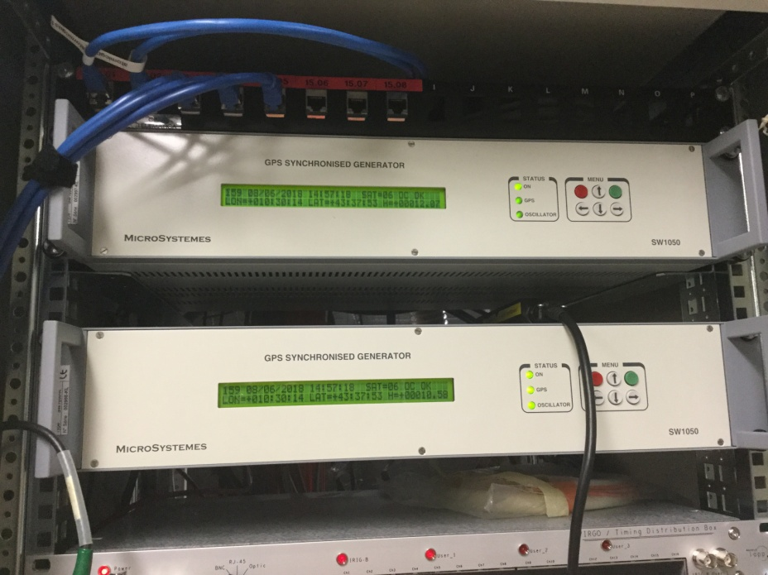
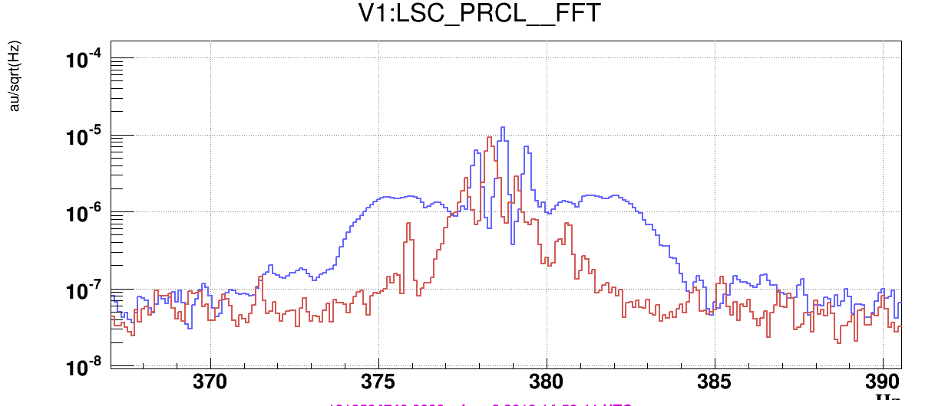
GPS receiver Tapping injections
(see elog 45279)
Let’s see some examples
We had an annoying forest of lines in many signals (DARM, PRCL, MICH …); some evidence of frequency change following the DAQ_room temperature:
Gently tapping on one of the two GPS receiver created an increase in amplitude and width of the lines.
The receiver was faulty, and promptly changed with a spare one

Slide 16
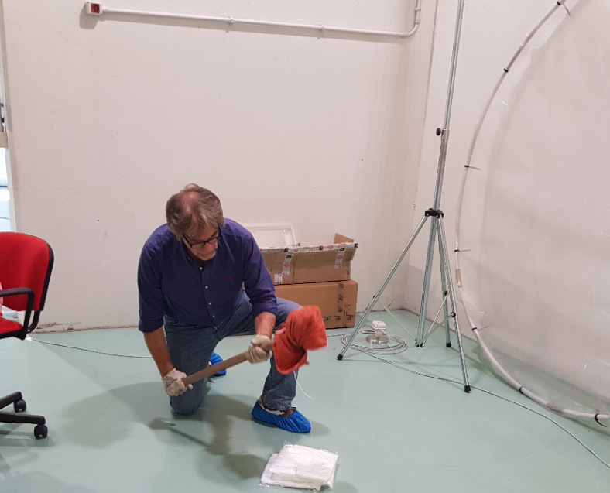
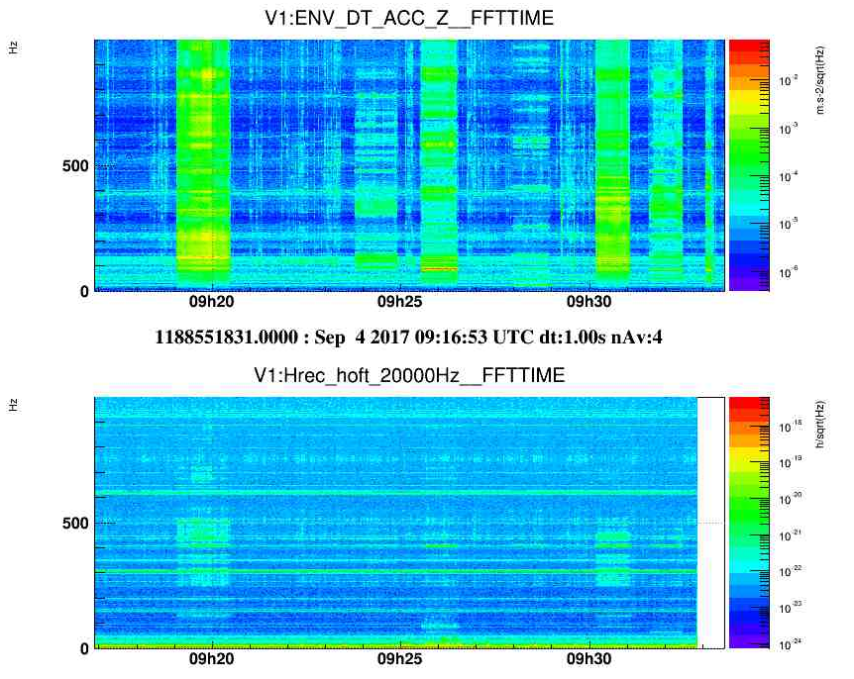
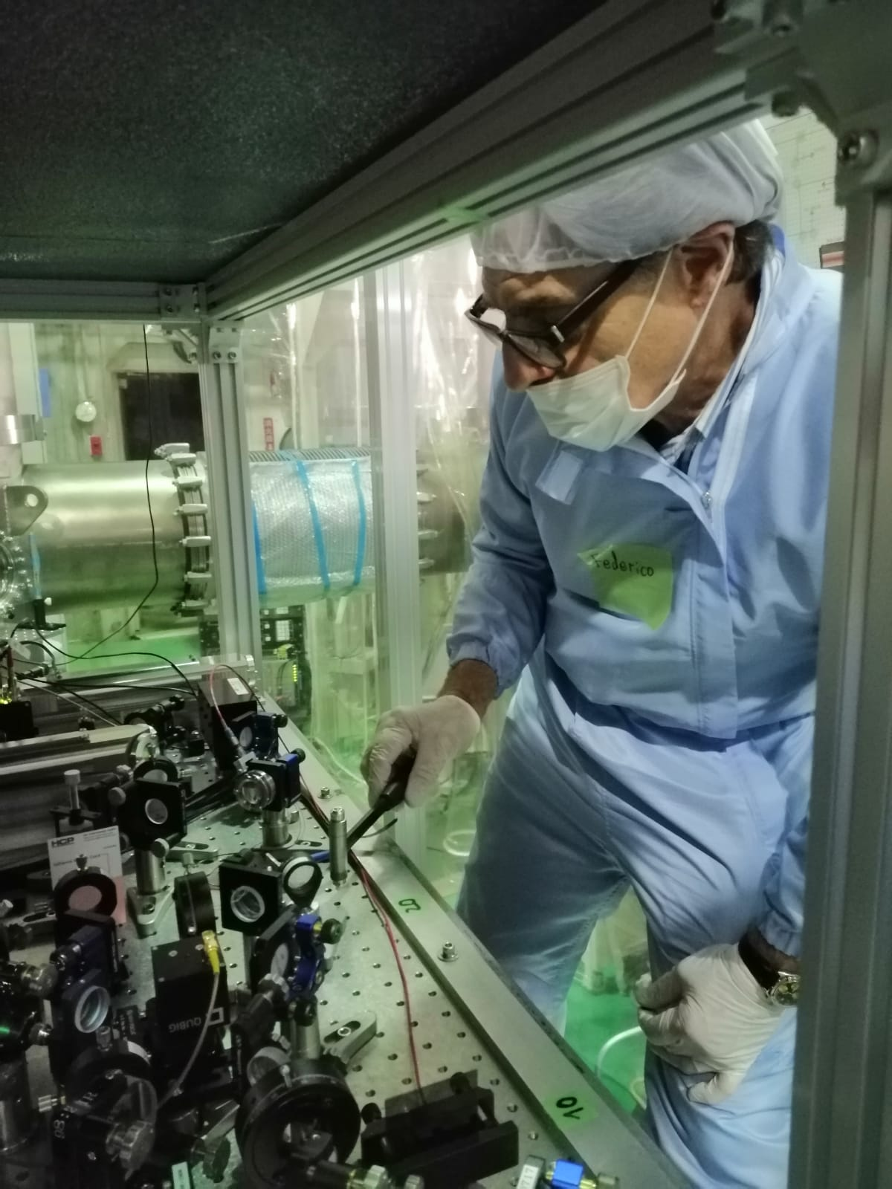
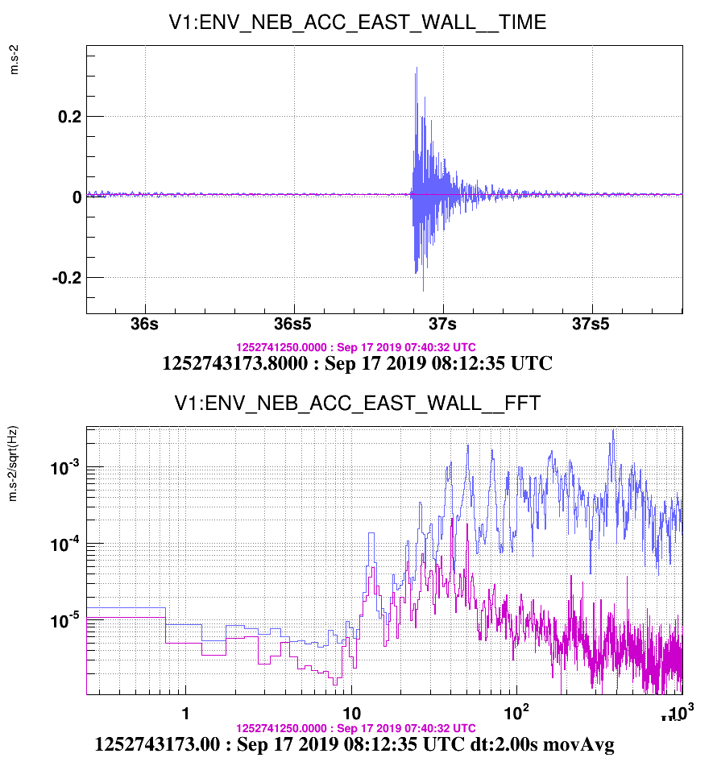
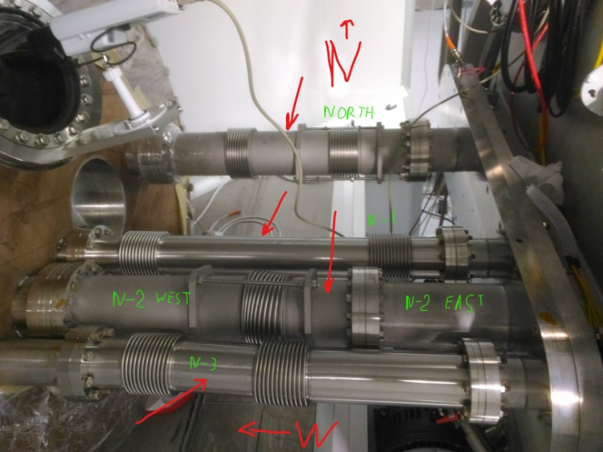
Use of hammers
(see elog 46948)
Let’s see some examples
Little hammer useful for excitation of (e.g.) optics, pipes …
Big hammer useful for buildings’ eigenmodes study

Slide 17
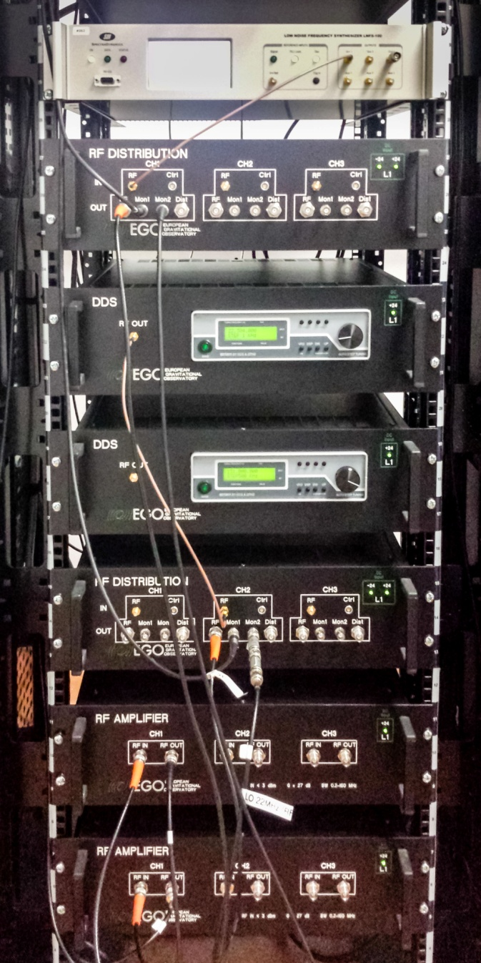
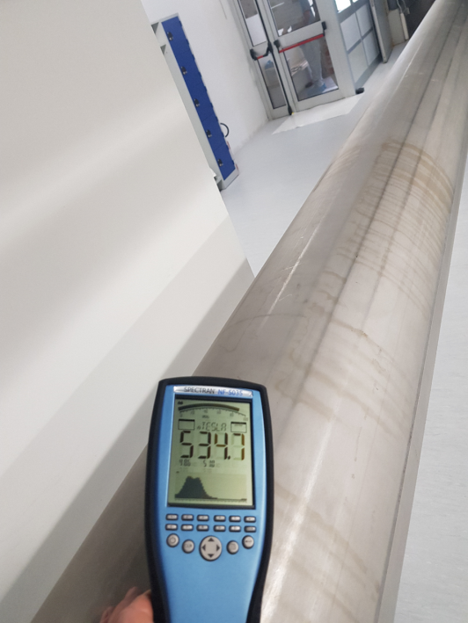
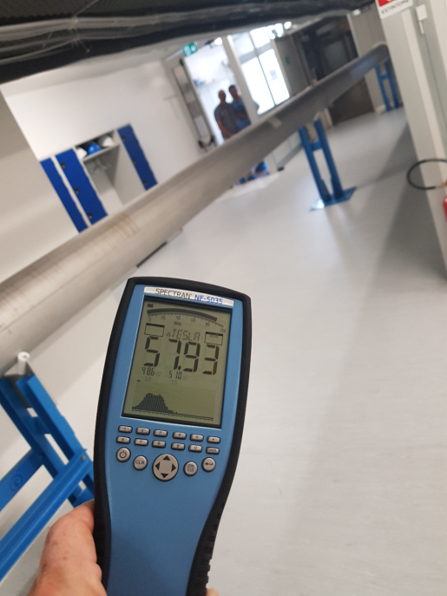
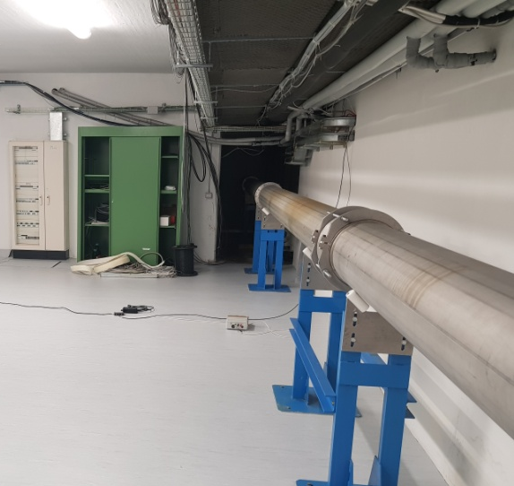
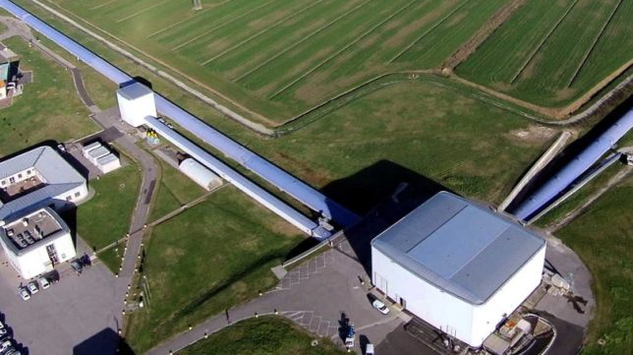
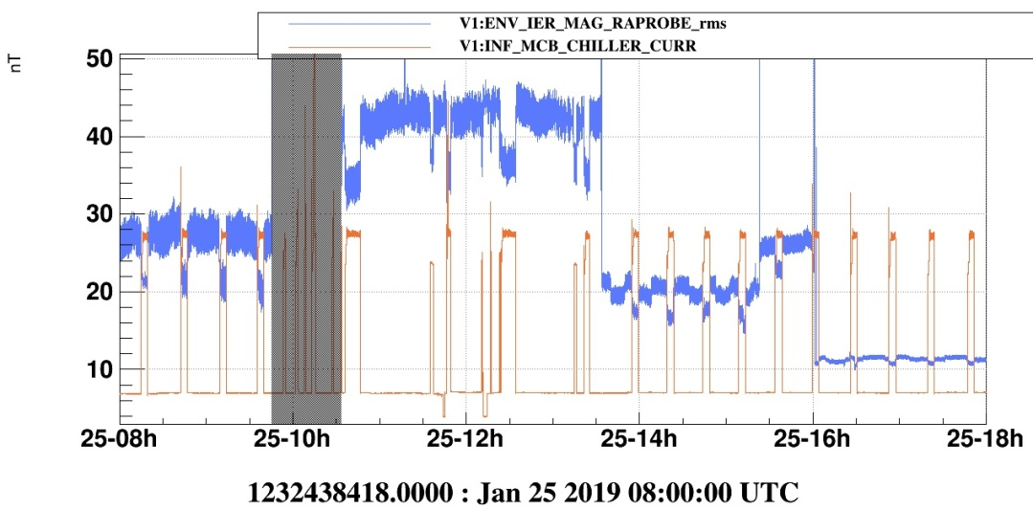

Find a source
(see elog 44540)
The art of sniffing
The story: a little magnetic probe, placed over a INJ electronic chassis, detected the working cycle of a far far HVAC (Heating, Ventilation and Air Conditioning) machine (MCB, 150 meters apart)
Over the tube:
>500nT @ 50Hz
Far from the tube:
57nT @ 50Hz
Moving the probe all around, we found the most of the correlation when near the Mode Cleaner vacuum tube
(it was few meters apart, on the other side of the wall)
Suspect of ground parasitic current flowing into the tube; galvanic insulation planned on the next commissioning period

Slide 18

Close to the goal
Take a break; and have a (virtual) cup of coffee ☺
(We are close to the goal)

Slide 19


Synchronous signals to be generated
For some tools it is possible (mandatory in some case!) to use a Virgo coherent generated signal. This is done using some dedicated DACs:
Physical DAC location
Matrix enabling the DAC output and the kind of signal
The kind of signal (a sine, a ramp, a noise, a comb …) is written in a page reachable and modifiable following these instructions:

Slide 20

Synchronous signals to be generated

Slide 21

Synchronous signals to be generated

Slide 22

Synchronous signals to be generated

Slide 23

Synchronous signals to be generated

Slide 24

Synchronous signals to be generated

Slide 25



Configuring the file (and some example)
1) Choose the kind of signal and enable the DAC output in the Matrix
(example: noise colored generated in WEB (West End Building)
2) Locate the filter characteristics (example: noise from 10 to 990Hz)
3) Locate the amplitude command (example: amplitude 1mV rms)

Slide 26



Save the file…
… then reload it (and remember: when you press the “Reload config” button, then you really unleash hell)

Slide 27
Some caveat
Do not do it alone the first time (I mean: without a senior ENV trainer with you): the risk is to overexcite the tool you are using (e.g. the shaker: it could bang to the endtravel, damaging the internal supports)
- it happens, it happens, believe me … -
As written at the beginning: always start with a very low level, then increase step by step. Too much noise is often puzzling (and could propagate in other physical areas where you do not want to excite)
When you generate acoustic noise, remember that you can’t confine it: you are exciting a whole room/building
The kind of signal to generate depend by many variables: if you do not know where to look for the response of the system, start with broadband colored noise (but is not very efficient); if instead you want to use all the energy to increase the signal-to-noise ratio, use a single line, or a comb of lines, or a stepped sweep line
You will find some non linear systems: you put a line, and you’ll see sidebands around it in the ITF signals; or you increase a level, and you’ll see an abnormal response of the ITF. That deserves a special analysis, see Irene’s slides
Too many hints to give … come and play with us!

Slide 28

END of part 2
"Leave the beaten path and dive into the woods. You are certain to find something interesting."
Thank you for your kind attention

