Slide 1


ENV training
Part III
Data analysis techniques
Irene Fiori on behalf of the Commissioning team
VIR-0948A-19
Virgo training sessions
September 26 2019

Slide 2
Outline of Part III
Inspection of Time-Frequency plots
Correlations
  On/off lines
  Moving lines
  Brute force approach
Coherence (BruCo)
Line DB and NoeMi Line finder
Scattered light hunting
  Spectral features (How to recognize you are dealing with S.L)
  Investigation techniques

Slide 3
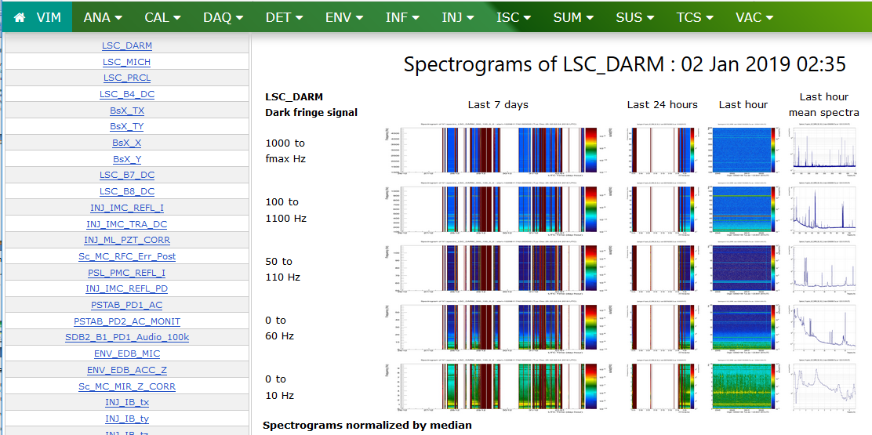
Inspection of Time-Frequency images
The VIM (see Nicolas Arnaud’s talk)

Slide 4
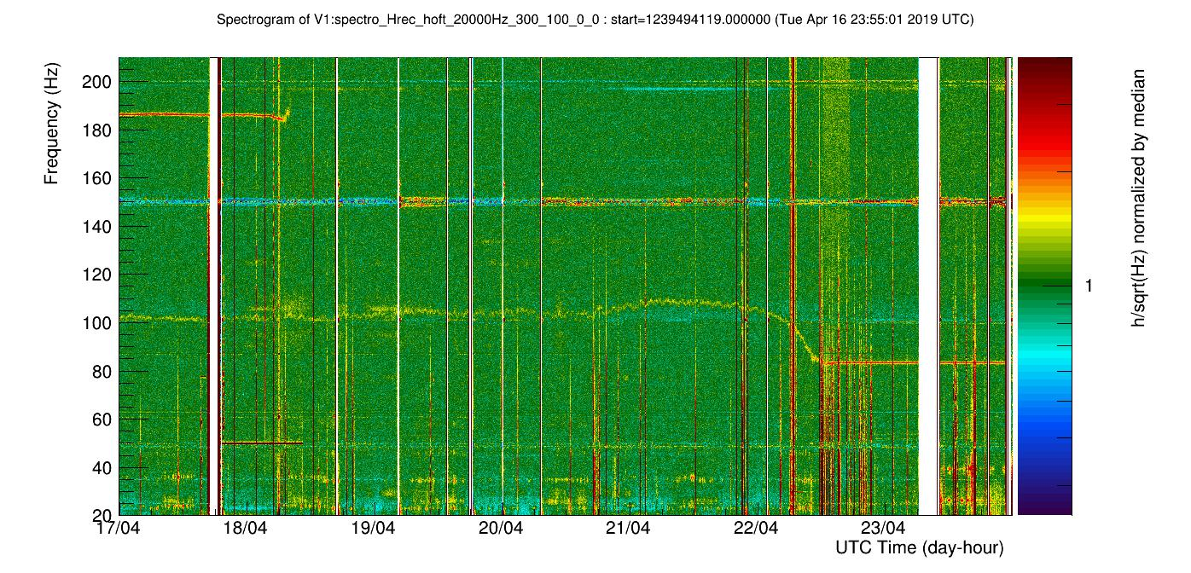
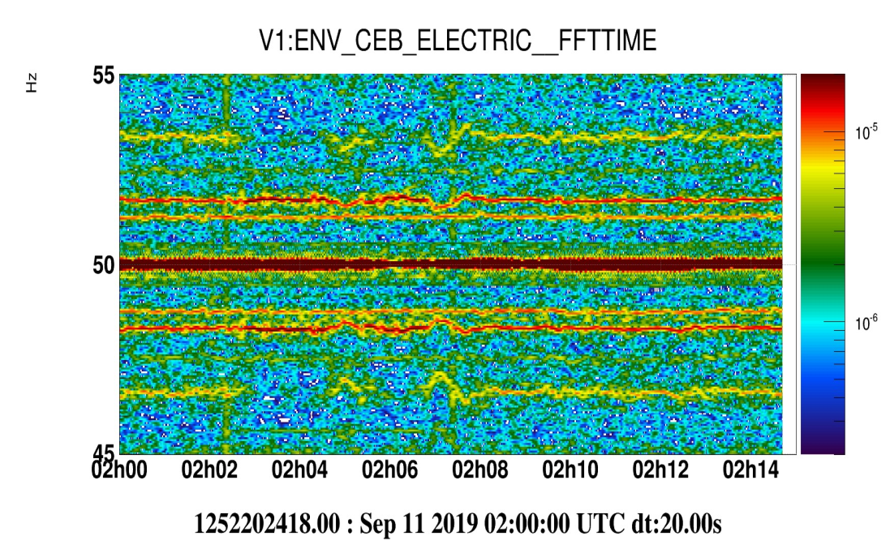
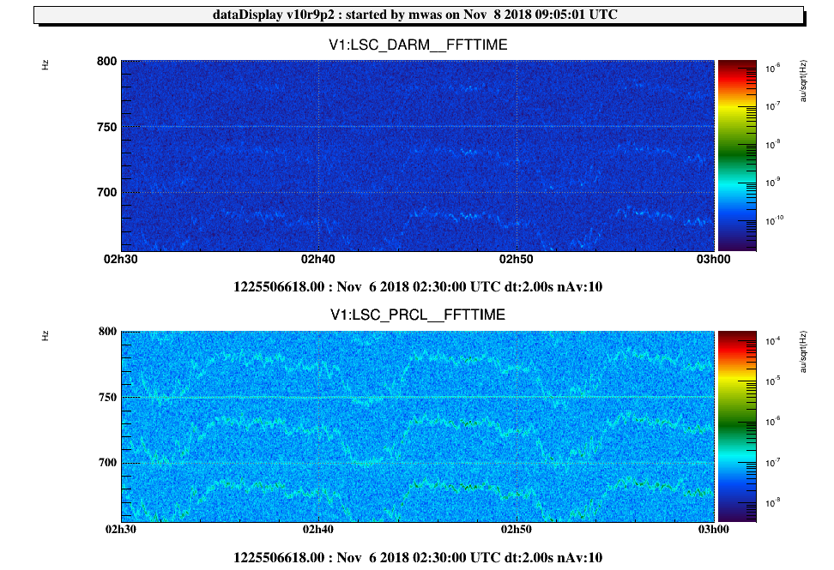
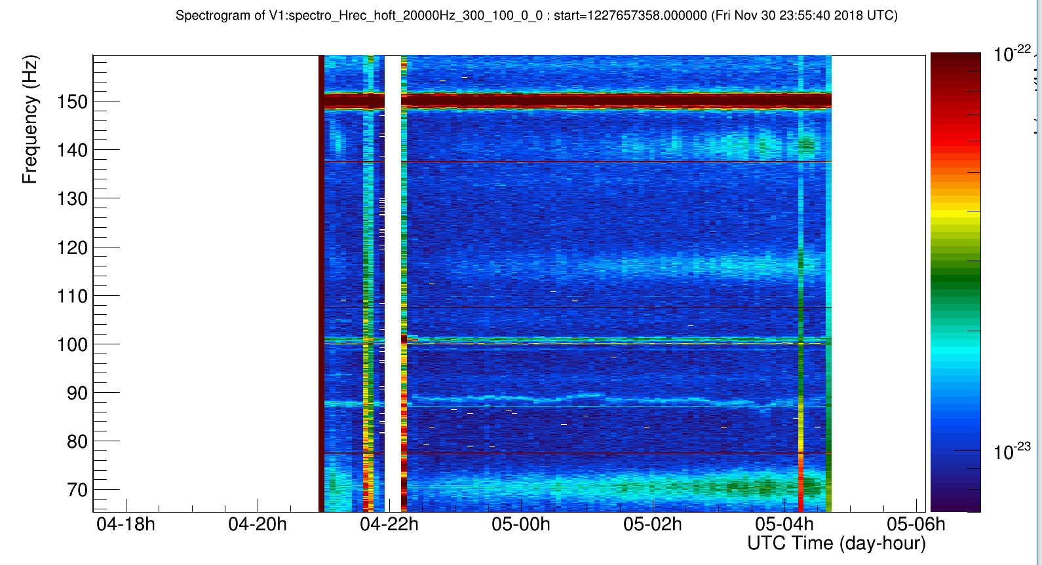
Inspection of Time-Frequency images
Look for:
  Lines or bumps that
  Start/stop/move
  Periodic patterns
  Combs (equally spaced lines)
  Sidebands

Slide 5
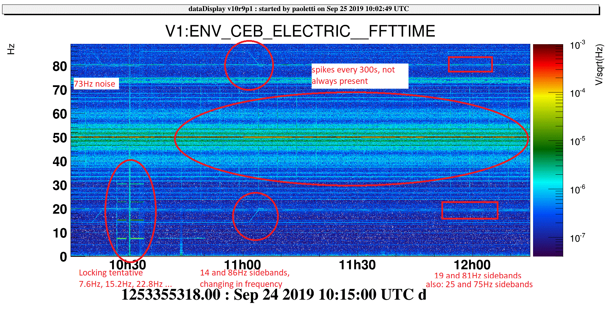

Slide 6
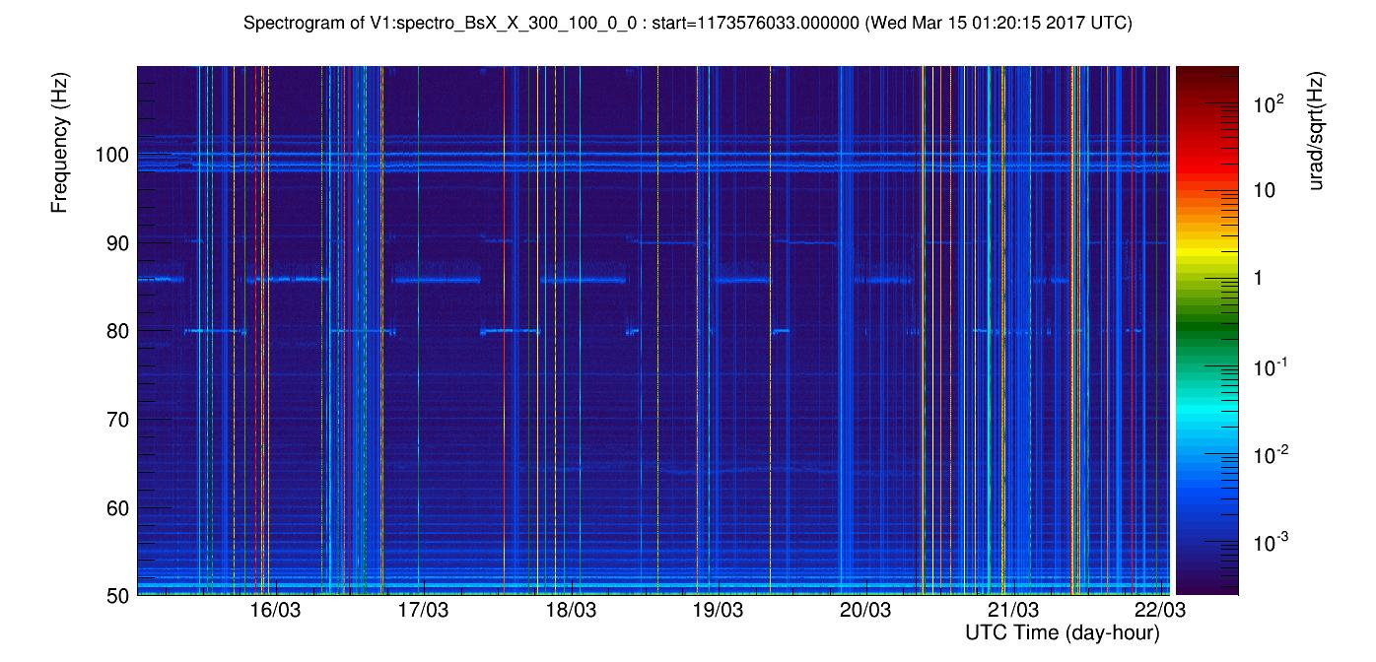
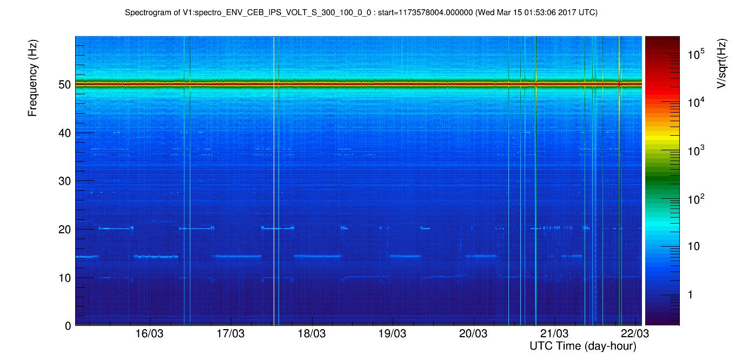
Inspection of Time-Frequency images
Browse through VIM spectrogram and Look for correlated patterns
Where:
  Hrec and DARM
  LSC_PRCL/MICH → orthogonal dofs
  SNEB_B7/SWEB_B8/SPRB_B4 power of peak-off beams
  SSFS_Err → frequency noise
  BsX_* → input beam jitter
  ENV_*SEIS, *MAG, *MIC, *UPS, *IPS → source is in the environment
  …. all VIM channels are interesting, have been selected on purpose.
BsX
CEB_IPS
elog 37121
Did you know?
You can reproduce all VIM spectra and zoom/play as you like
https://logbook.virgo-gw.eu/virgo/?r=38996
USEFUL to inspect LONG time stretches

Slide 7
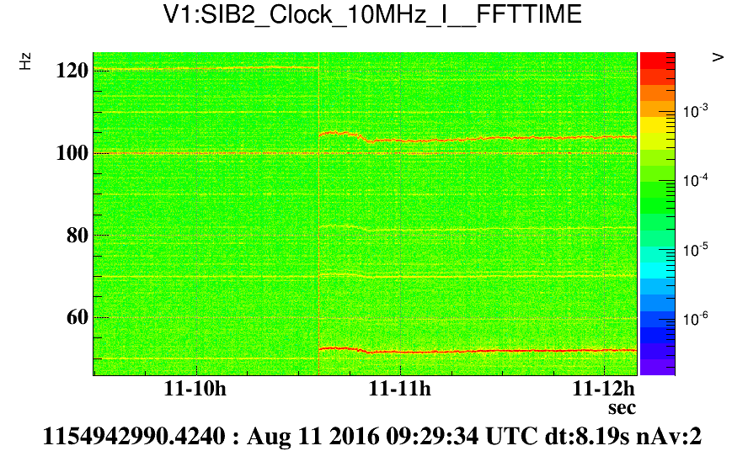
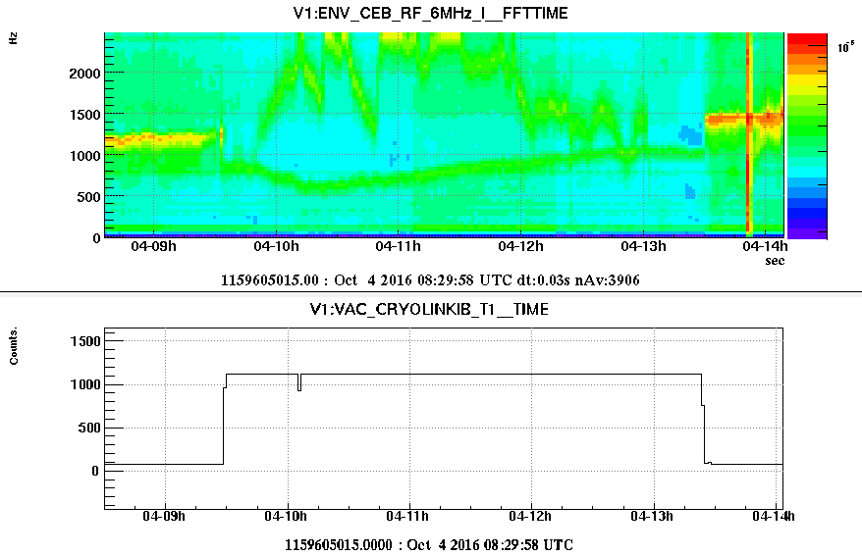
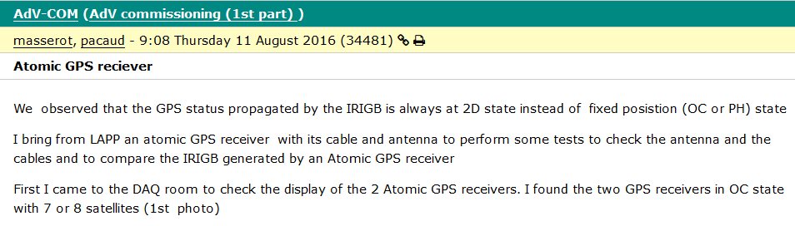
Correlate on/off lines
Often NEW NOISE appear during MAINTENANCES
Always suspect of “transparent activities” ☺☺☺
On/off lines usually means some device turned on/off …
Asked VACUUM guys if they did something…. “well… maybe we switched off one PLC driver”. YES!
RF noise at 1200Hz around 6MHz
Atomic GPS receiver board was swapped

Slide 8
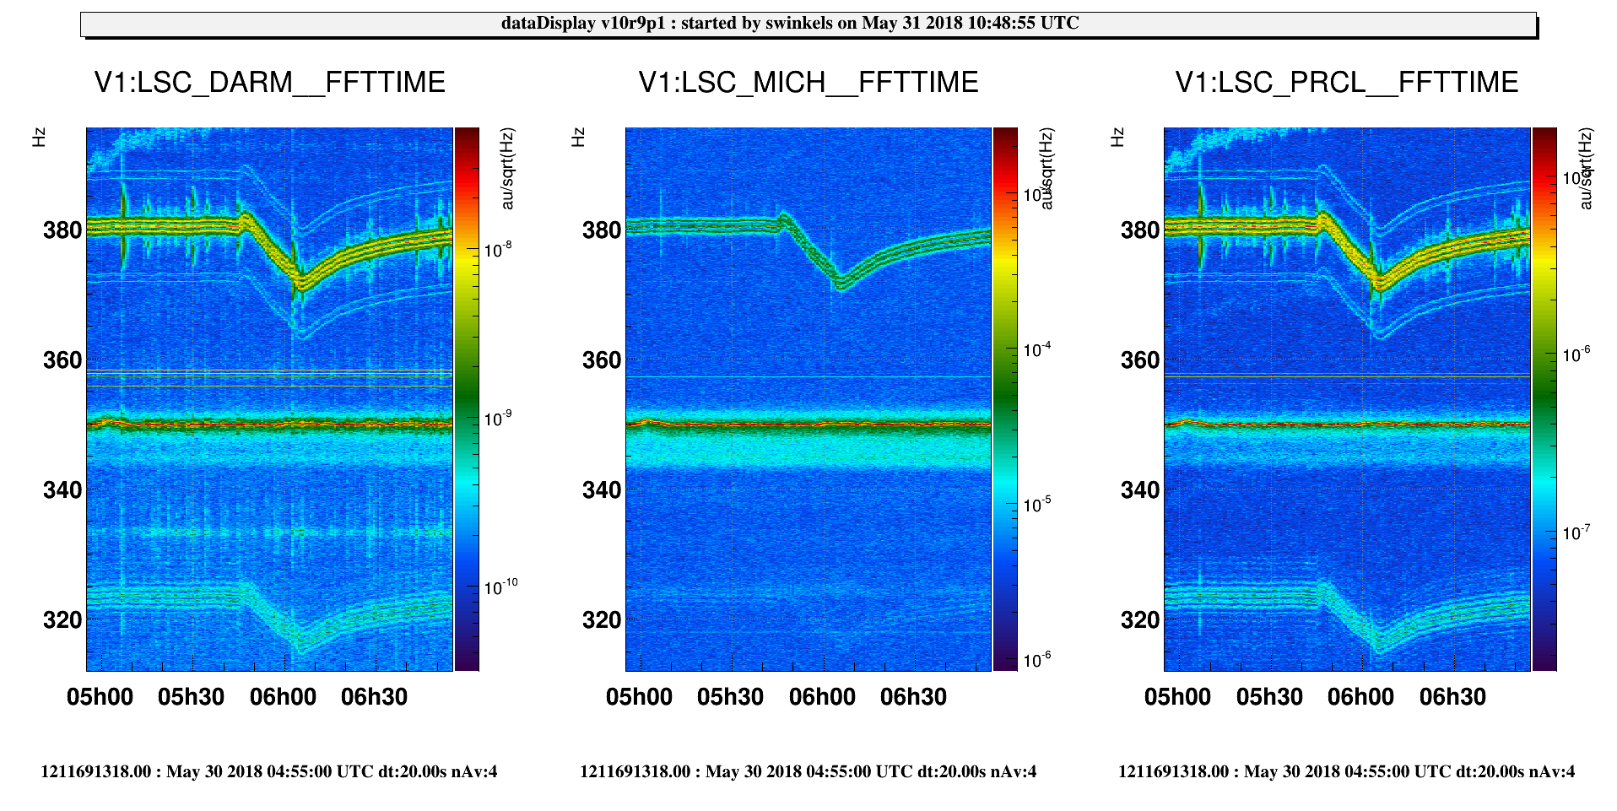
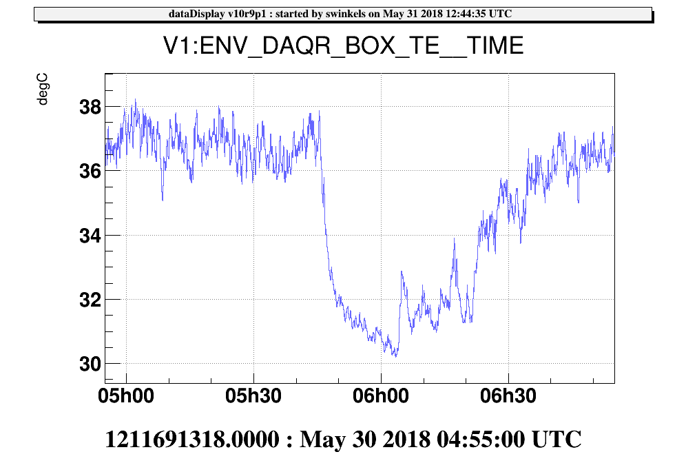
Elog 41624 “Forest of lines moving yesterday morning” (B.Swinkels)
In case of Moving lines TEMPERATURE probes are the first to be looked at
because:
  Many noisy devices have temperature driven cycles (i.e. AirConditioners)
  Noise disturbances (EM) produced by electronic devices are typically very sensitive to temperature.
Temperature of DAQ
room

Slide 9
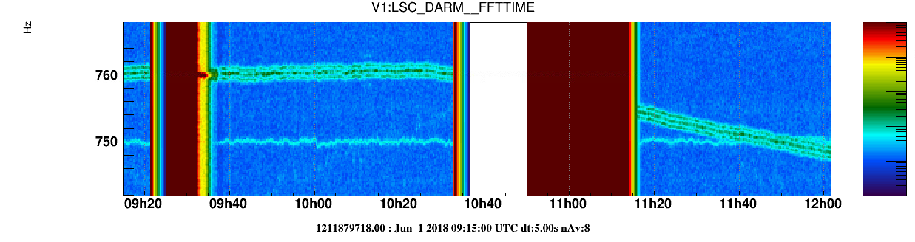
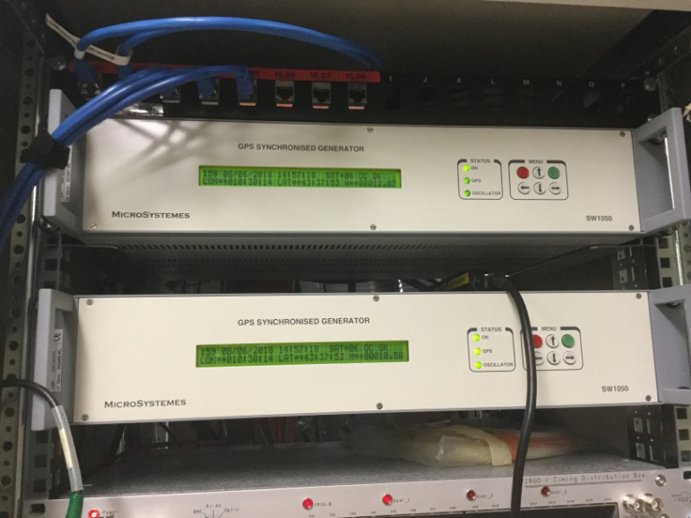
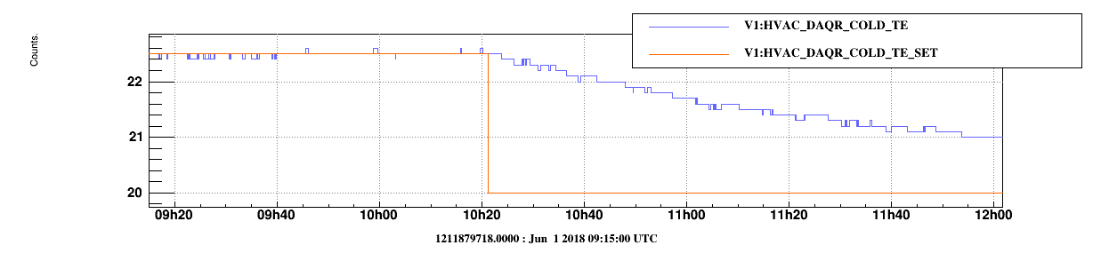
… follow up: source identified
Changed on purpose DAQ room temperature by switching off air conditioner
Magnetic sniffing and Tapping on Electronic boards
Tapping on only this chassis at ~4 Hz generates ~4 Hz sidebands on many of the frequencies that responded to the previous temperature test
GPS synchronized 10 MHz timing generator

Slide 10
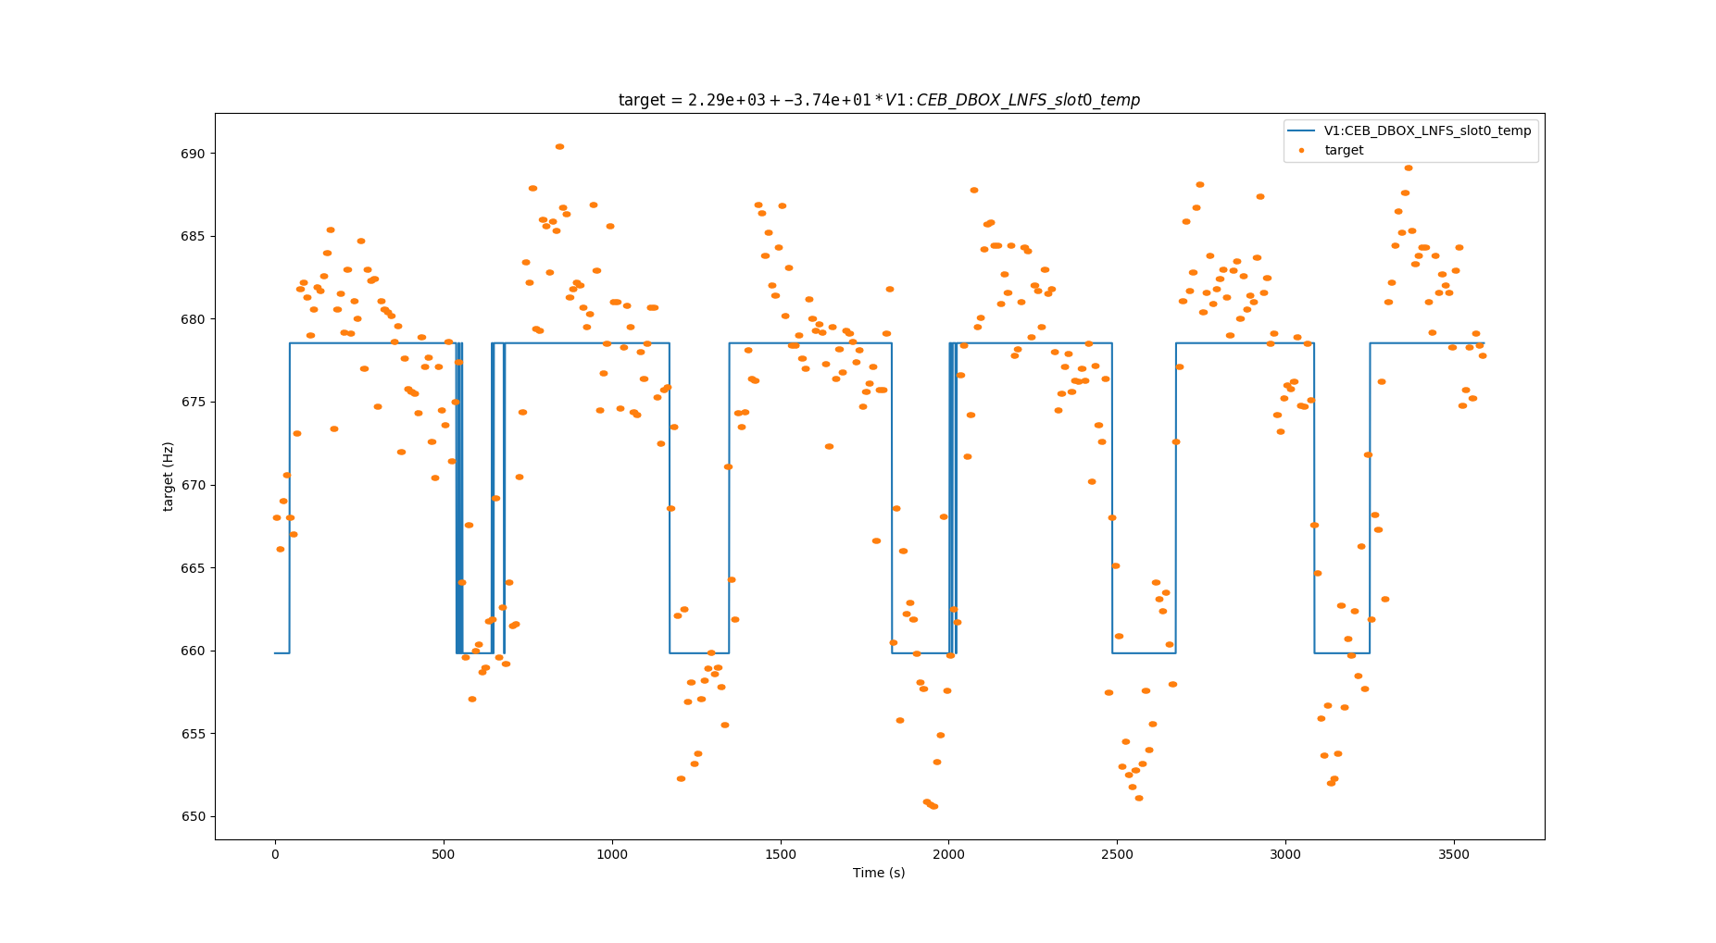
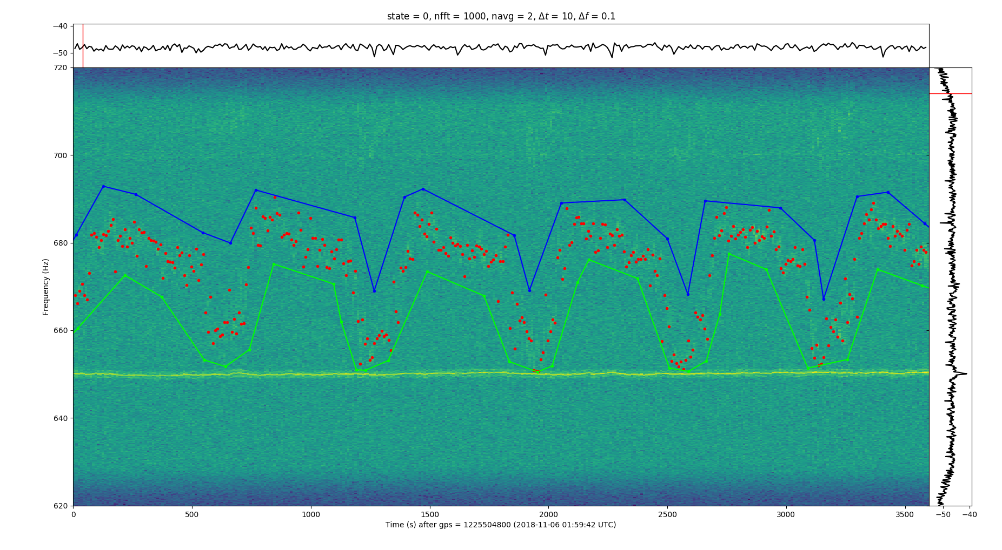
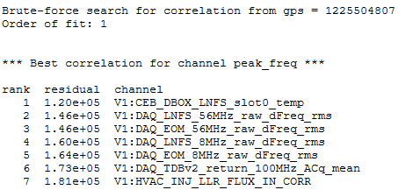
… but “brute force” works better
“brute force” approach = search noise correlation in ALL slow channels (i.e. O(10000 channels)!)
NonNA (Non-linear Noise Analysis) by Francesco di Renzo, VIR-0406A-18
BUFFALO - Brute-force Utilities For Finding Annoying Lines and Others by Bas Swinkels, VIR-0420A-18
Example of Hrec line moving btw 650Hz and 700Hz. Correlated to Temperature of the electronics which demodulates photodiodes signals

Slide 11
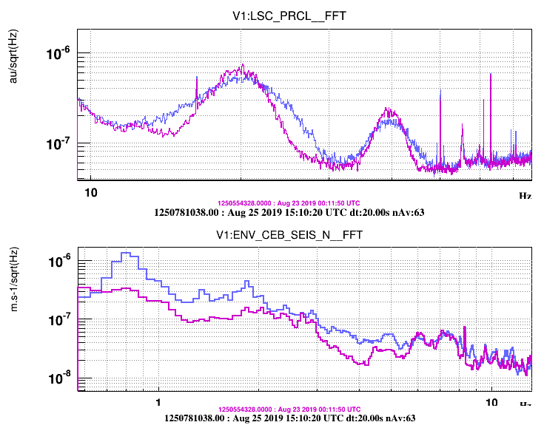
Do yourself…. correlations
Maddalena’s, 46852 “PRCL noise between 5Hz to 50Hz correlates with low frequency seismic noise”

Slide 12
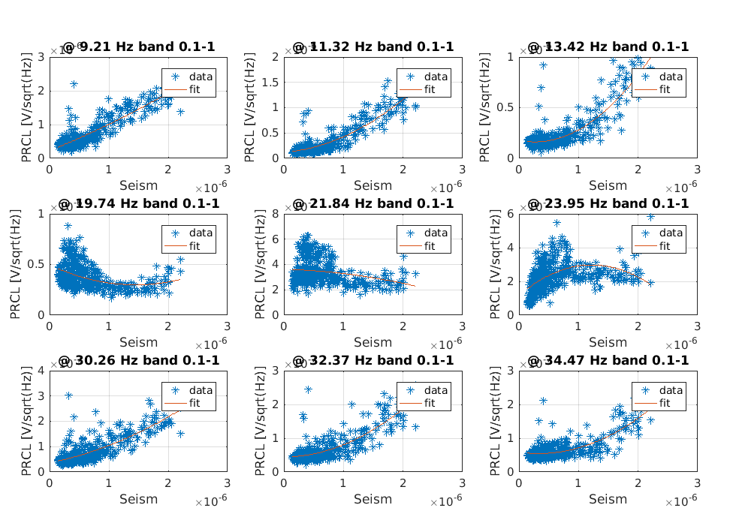
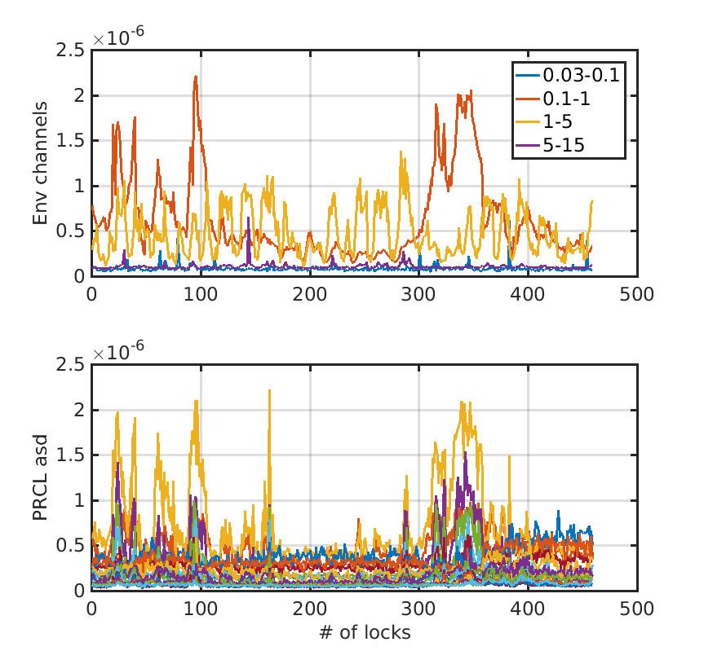
Do yourself…. correlations
Maddalena’s, 46852 “PRCL noise between 5Hz to 50Hz correlated with low frequency seismic noise”
SEISM band rms
PRCL asd amplitude
Several scripts exist, either in MATLAB or Python
…. ask commissioners ☺

Slide 13
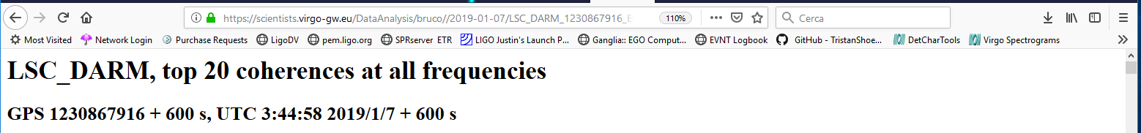
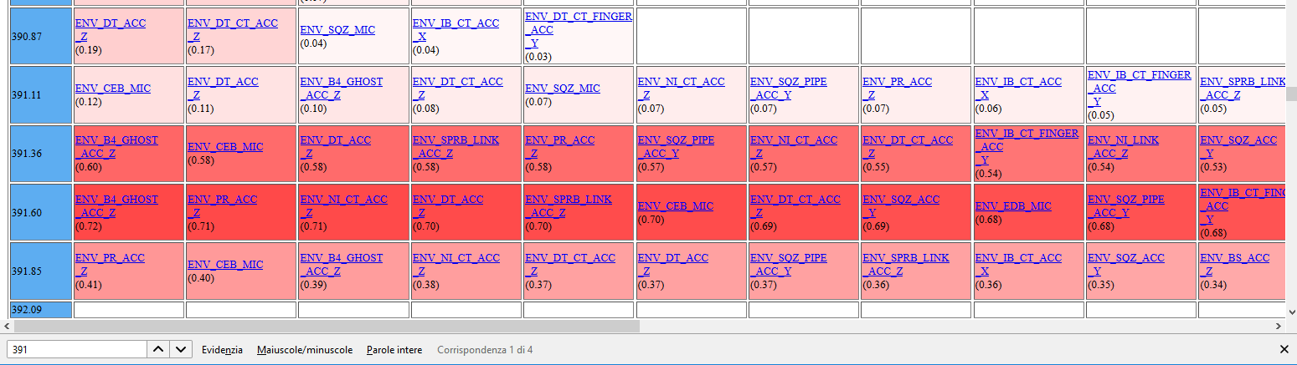
BruCo: Brute force Coherence
BruCo – computes and ranks coherence between Hrec and all AUXILIARY channels
(G.Vajente, https://dcc.ligo.org/LIGO-G1500230)
BruCo VIM plots: daily and ARCHIVE https://vim-online.virgo-gw.eu/?config=28

Slide 14
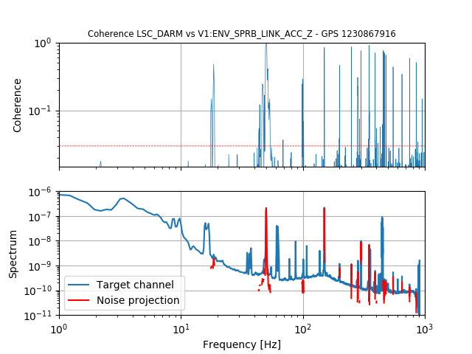
BruCo plot
COHERENCE
Dotted line:
Level of coherence
of pair of random signals
Blue: LSC_DARM
Red: Projected coherence
LSC_DARM*COHERENCE

Slide 15
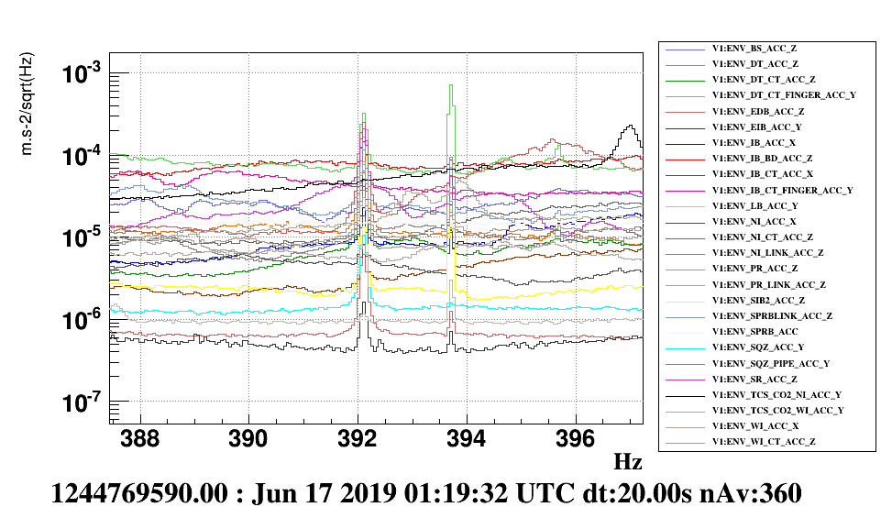
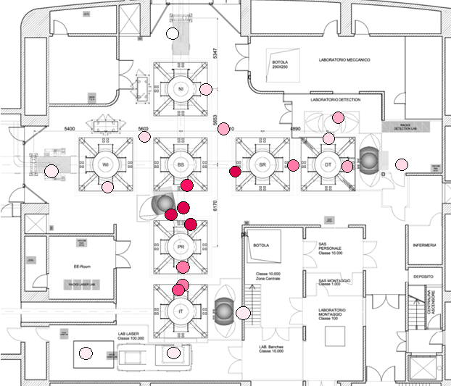
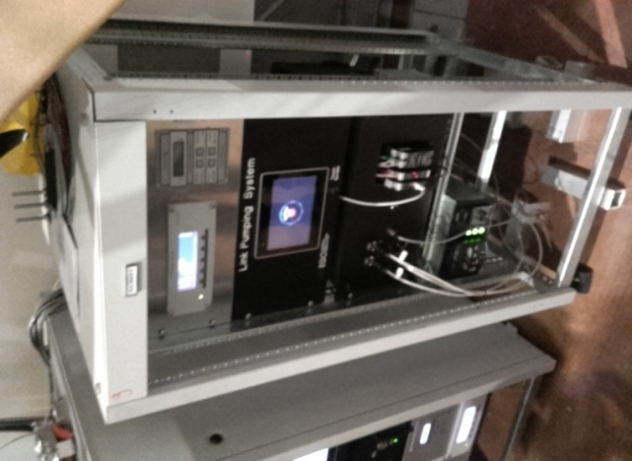
… follow up: locate the noise source
Comparing the peak’s amplitude in all ENV accelerometers in CEB (26) helps locating the source
Example: 391Hz spectral line in all CEB accelerometers
… done by hand ☺
Nice to have utomated tool to do this

Slide 16
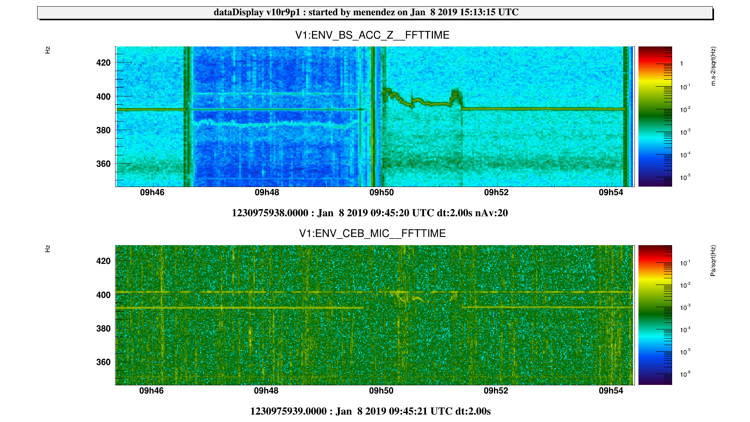

Sniffing ….
Located the source of 391Hz line - Noisy cooling fan of turbo pump driver
Test accelerometer attached to chassis (double-side tape, always at hand ☺) → coherent line
Used some paper to temporarily block the air outlet so to perturb the fan speed
Noisy fan because of ageing has been replaced and added vibration dampers
(VACUUM team - O3)

Slide 17
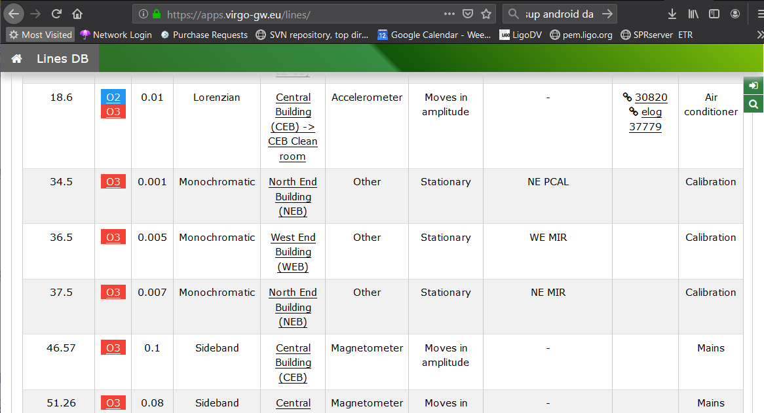
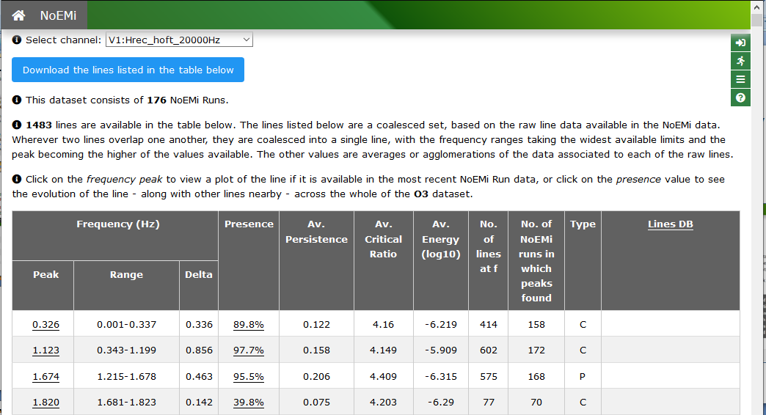
Lines
Lines DB : archive of identified LINES https://apps.virgo-gw.eu/lines (by Gary Hemming). In charge: Neha Singh nsingh@astrouw.edu.pl
NoEMi V2.0 - LINES FINDER https://apps.virgo-gw.eu/noemi/?c=1. Ornella.Juliana.Piccinni@roma1.infn.it , gary.hemming@ego-gw.it

Slide 18
Scattered light
A few slides tutorial:
What is it
How to recognize it … from spectral features (!)
Investigation techniques to locate the scatterer

Slide 19
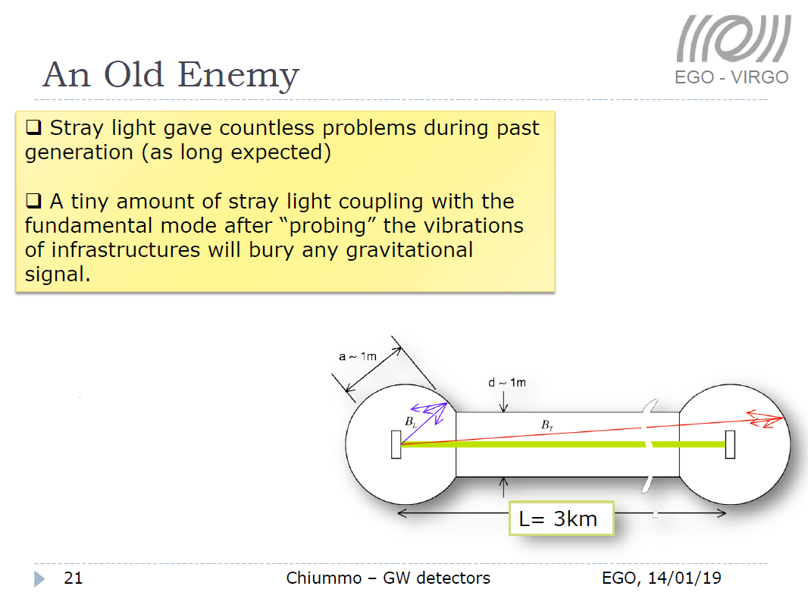
Credits: Antonino Chiummo
VIR-0013A-19

Slide 20
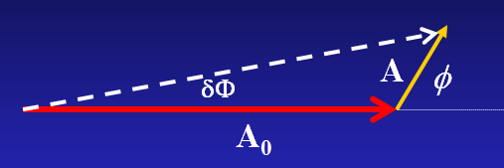



Scattered light, some formulas
From: S.Braccini – VIR-0277A-09
Reference: Vinet J-Y, Brisson V and Braccini S 1996
Scattered light noise in gravitational wave interferometric
detectors: Coherent effects, PRD 54,2 1276
x(t)
“ITF”
Scatterer = some surface ground connected
in view of ITF beam (typical: optics on not suspended bench, vacuum chamber…)
Seismically excited: displacement x(t)
x₀ + x(t)
“G”
A change of x(t) of λ/2 means a change of optical path length of λ and a full rotation of the stray light vector
Frequency of noise = rate of rotation:
x : λ/2 = φ : 2π
φ = 4π x / λ
NON LINEAR !
Expect non linear effects
(up-conversions) if
dφ/dt
= 2 (dx/dt) / λ
2π
Frequency of the induced noise is proportional to the absolute value of scatterer velocity
>>

Slide 21
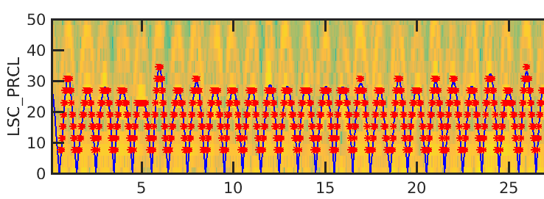
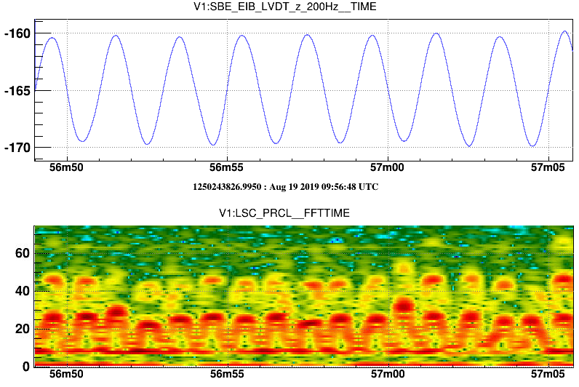
Scattered light – ARCHES
Derivative of bench displacement
Example: shaking EIB with 0.5Hz sinus (46720)
Blue line is
.
Bench displacement in microns:
NOTE that:
Height of arches is proportional to scatterer velocity
(i.e. if f_{max} = 20Hz → V_{max}= 20*λ/2 = 10 λ = 10μm, a LOT!!)
Spacing of arches = half of scatterer period or 1/(2*f_{scatterer})
Second order of arches: scattered beam does double bounce

Slide 22
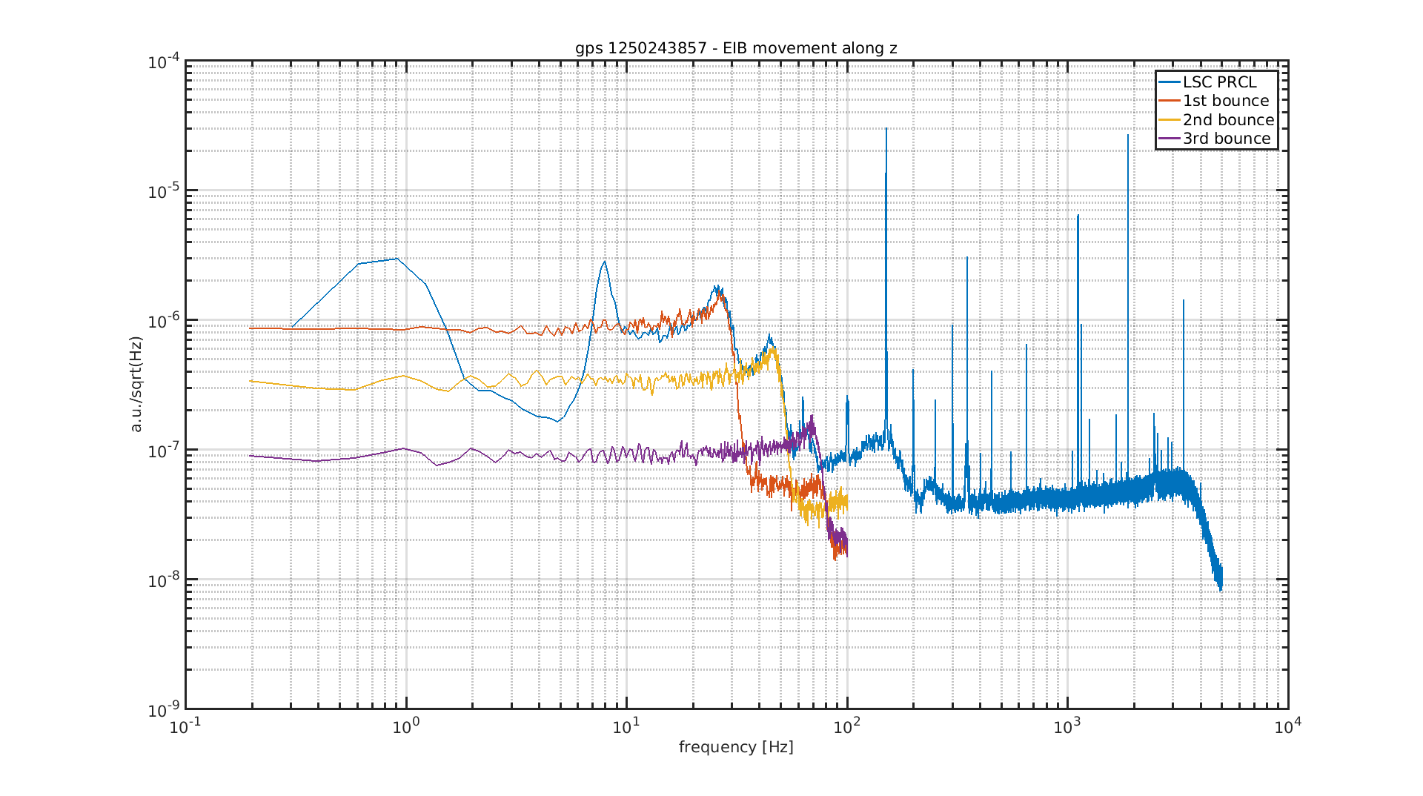
Scattered light – SHOULDERS
Is just another way to look at the arches….
.
Averaged FFT
NOTE that:
Height of shoulder is proportional to “G”,
i.e. amount of scattered light which is coupling to ITF
Fitting the shoulders → measure G

Slide 23

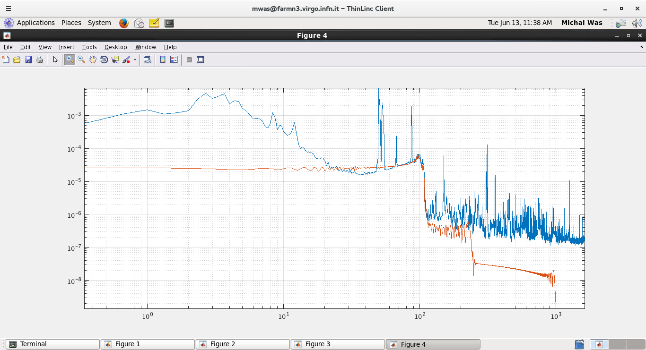
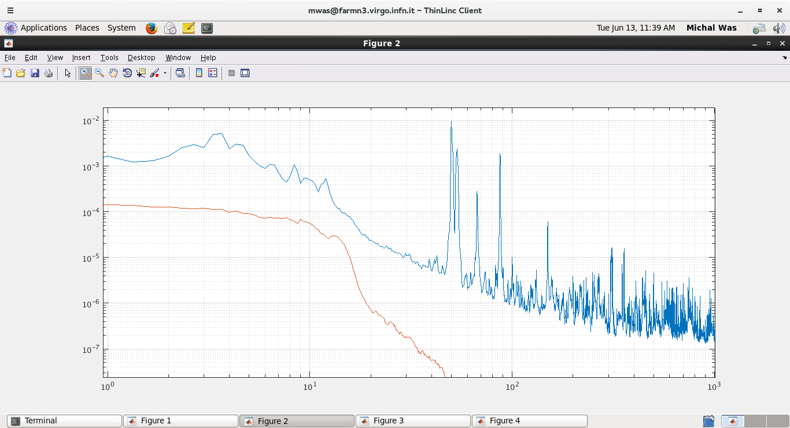
Measure and project
This technique is used to measure and monitor the
Amount of scattered light from benches
See Michal Was’s Noise Budget training session
Apply a known (some microm) motion x(t)
to the bench (use voice coil actuators)
Do fit of the shoulder to extract “G”
Use this G and x(t) in quiet condition
to evaluate the “expected contribution”
Of scattered light from that bench

Slide 24
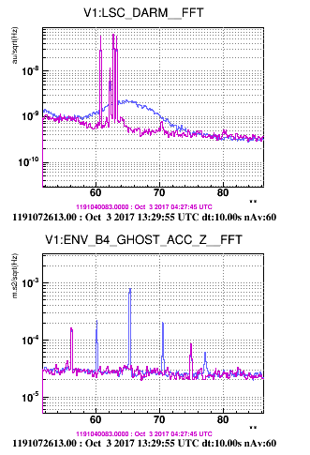
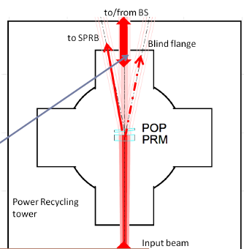
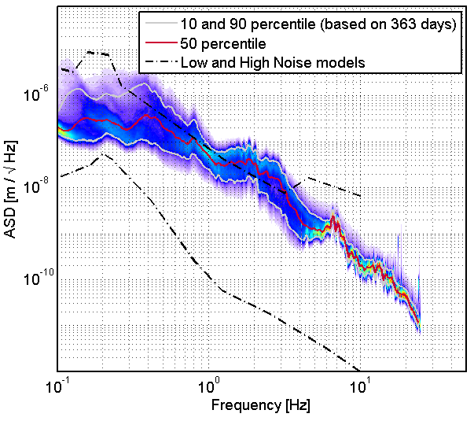
Scattered light - BUMPS
Mono-chromatic vibration due to a fan or resonant mode of a mount or bench
(typically in the 10Hz to 100Hz range) is seen as a BUMP in Hrec (!)
Case of light scattered from PR chamber blind flange:
Flange had vibration at 65Hz of ≈ 10^-9m
Small… BUT flange overall displacement was actually of O(microns) because of low frequency microseism
Accelerometer attached to the flange
See Antonino Chiummo
VIR-0013A-19

Slide 25
One last feature:
when microseism increases bumps get shorter and fatter
Try yourself:
all these features can be easily reproduced with a simple simulation, feeding one realistic x(t) in the formula

Slide 26
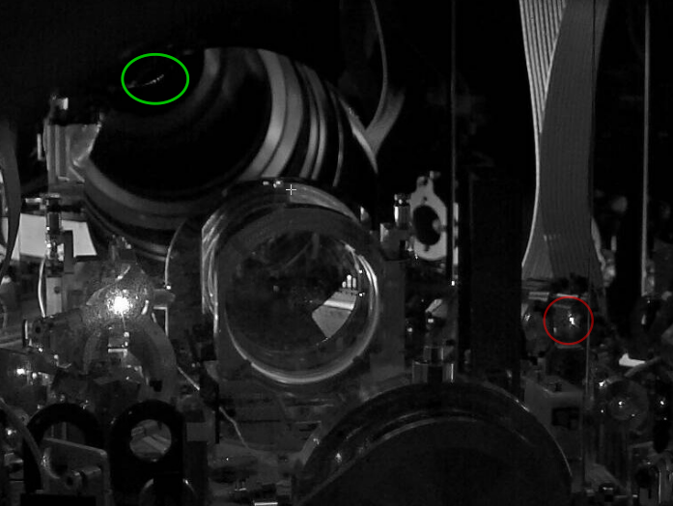
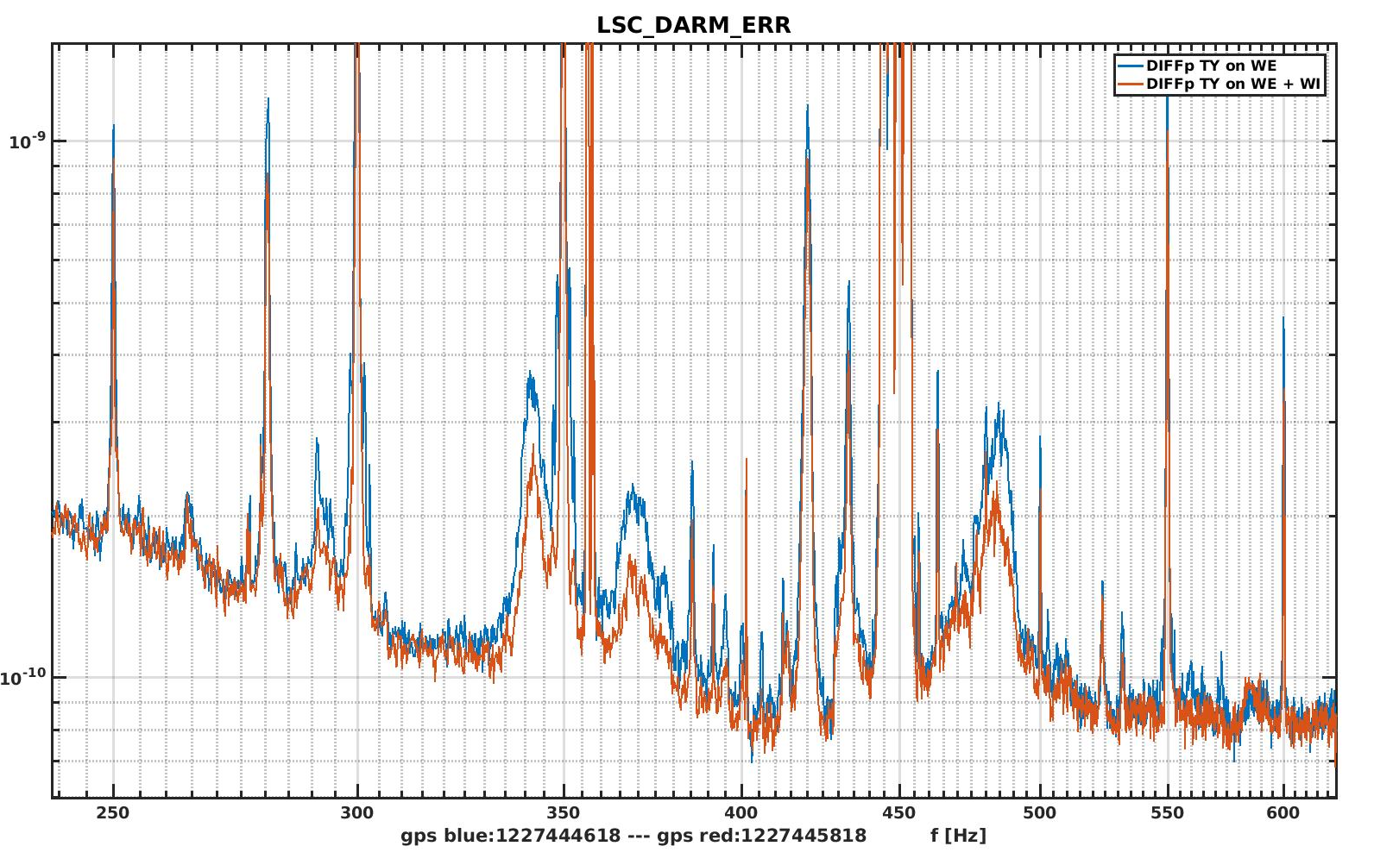
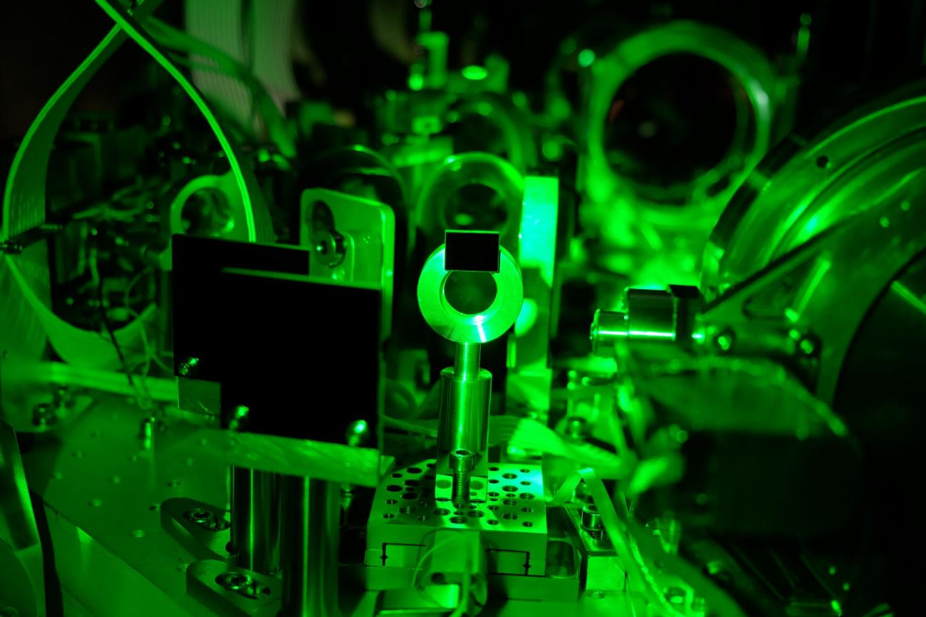
Scattered light hunting techniques
SDB1 – DET team
Inspect optical bench with infrared camera or IR cards to locate stray light beams
Tap the optics → DARM noise “explodes” when touching the critical one
MITIGATIONS:
add beam dumps/black glass to absorb scattered beams
Better align the beam on the bench, improve ITF global alignment:

Slide 27
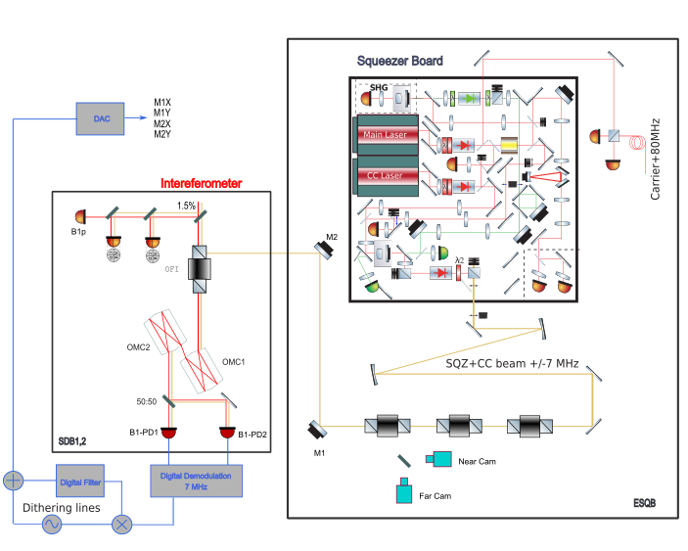
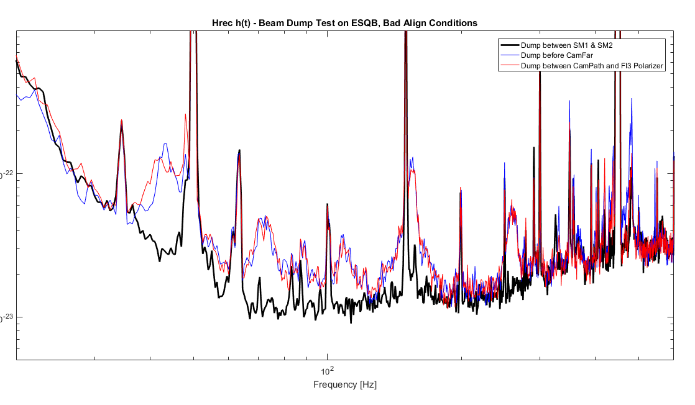
Elog 45006: ESQZB - Beam Dump Test and IR Viewer/Card Inspection (S.Chua et al)
Scattered light hunting techniques
3. Block the beam on bench following backwards the beam path and see when noise disappears
Critical scattering
mitigated: improved alignment of SQZ injection, reduced OFI reflected power

Slide 28
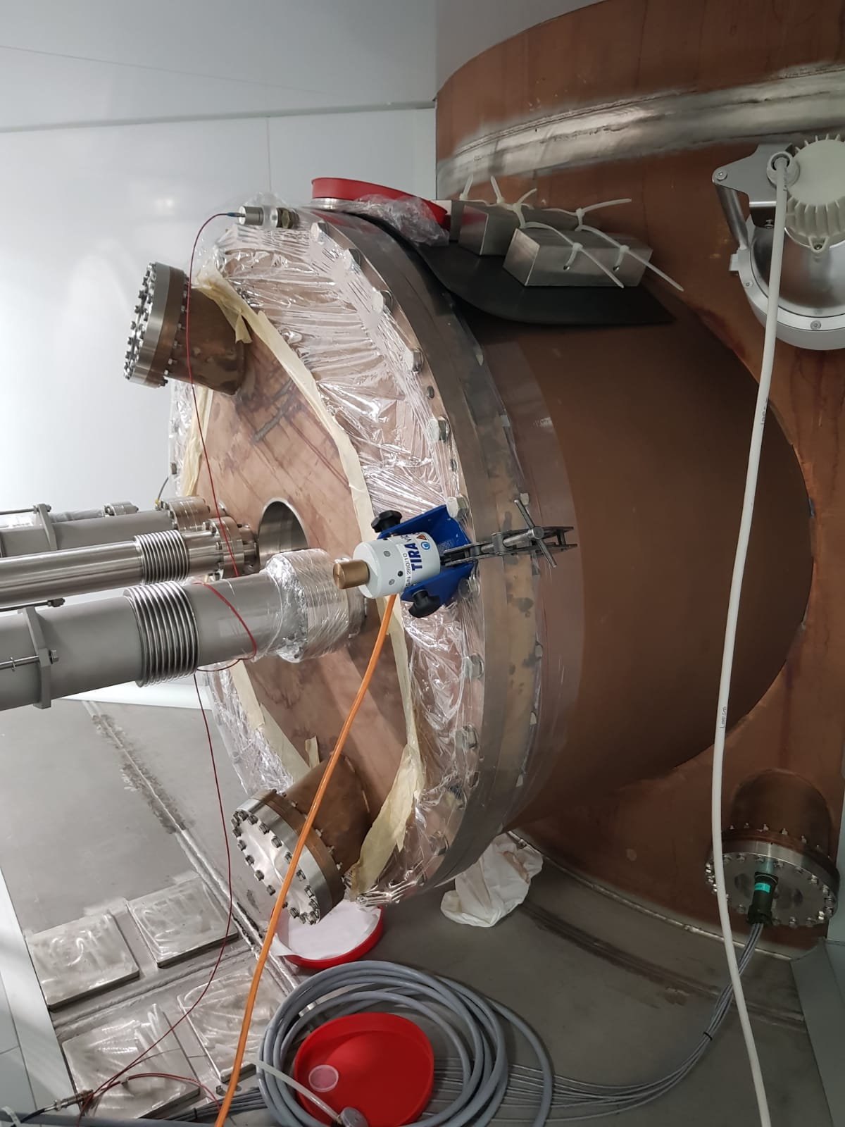
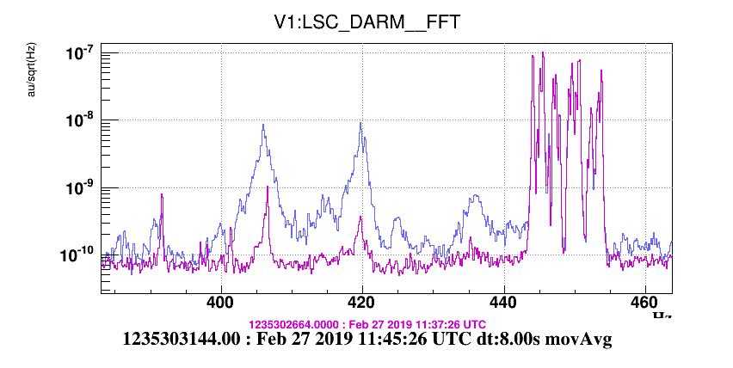
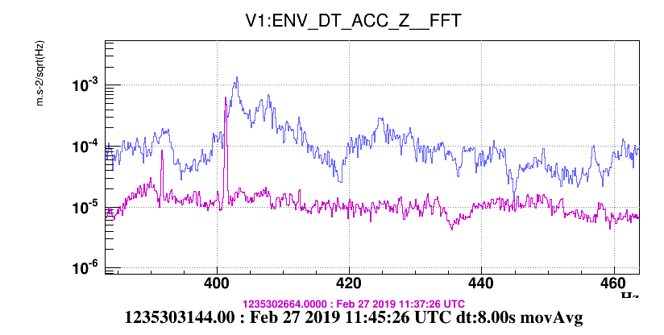
Scattered light hunting techniques
SDB1 chamber
4. Shake or TAP (gently!) and see if some existing structures in Hrec grow….
(see Federico’s talk – ENV training Part 2)
White noise injected with shaker on SDB1 chamber wall
Cause is: light scattered off SDB1 onto chamber walls
Disadvantage: shaker injection is not localized, sometimes we prefer using instrumented hammer or “tapping”
Hrec
ACCELEROMETER

Slide 29
Concluding …
Noise Hunter skills:
  Curiosity
  Perseverance
  Dedication
  …
  Curiosity!

Slide 30
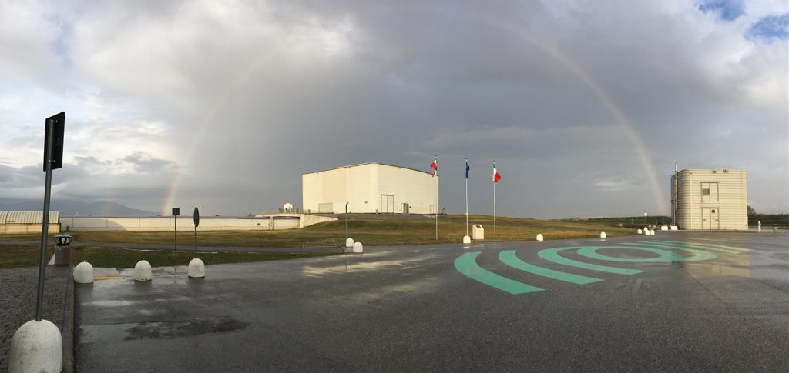
END
Thank you for your kind attention!

