Slide 1
ENV training Outline
Introduction – Environmental noise hunting, WHAT IS IT?
Part I – Sensors and channels (Irene)
Part II – Experimental techniques (Federico)
Part III – Data analysis techniques (Irene)

Slide 2


ENV training session
Part I
Sensors and Channels
Irene Fiori on behalf of the ENV team
VIR-0947A-19
Virgo training sessions
September 26 2019

Slide 3
Outline of Part I
Introduction: what is ENV noise disturbing Virgo?
Environmental sensors
  Type
  Location
  What they measure
Channels
  Names
  Where to find the data

Slide 4
Introduction
Environmental noise hunting, WHAT IS IT?

Slide 5

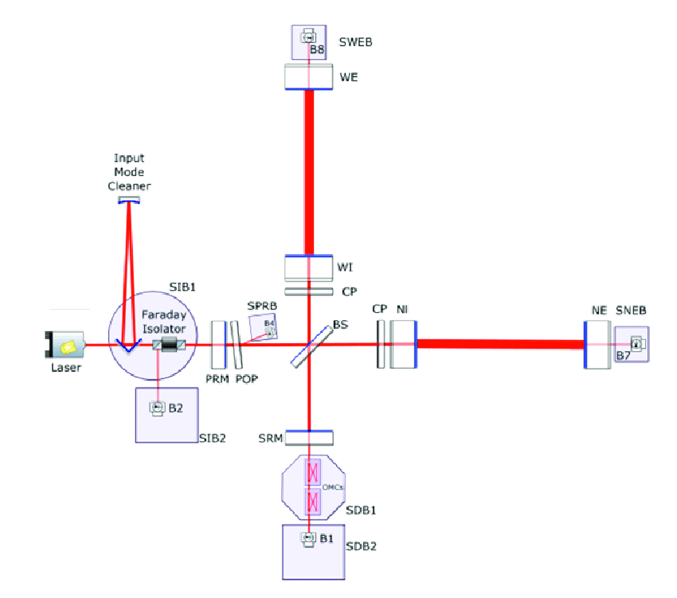
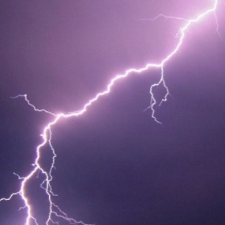
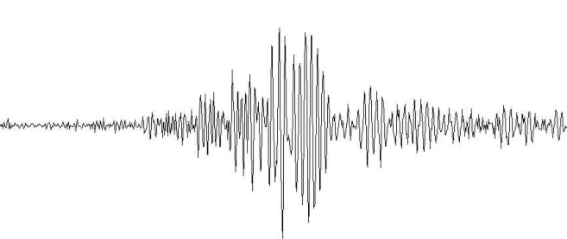
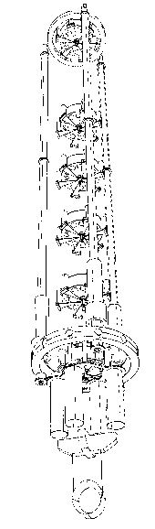
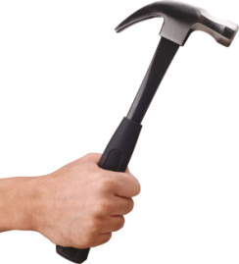
Environmental influences on GW interferometer
Electro Magnetic fields
Radio waves
(6MHz, 8MHz, 56MHz)
Act on mirror MAGNETS
RF modulated laser beam
used for angular and longitudinal controls
Slow ground motion
Seism & Sounds
Excite vibrations of vacuum pipes and tanks, optics on in air benches
Imprint phase noise on spurious scattered light beams
Excite mechanical modes of mirrors and optical benches suspensions

Slide 6
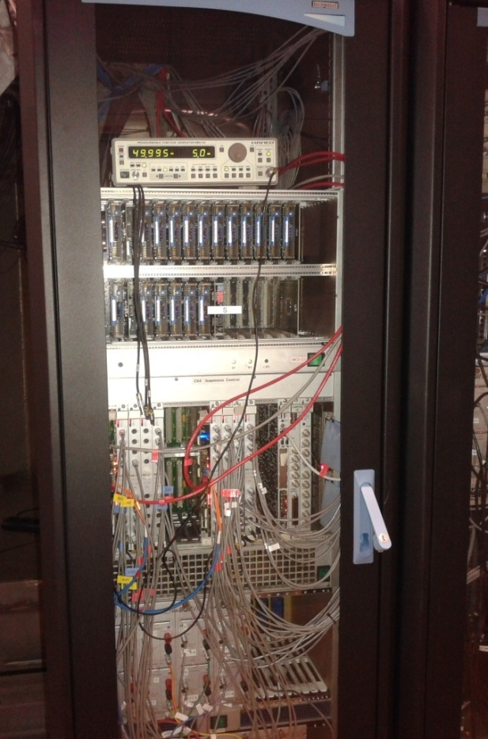
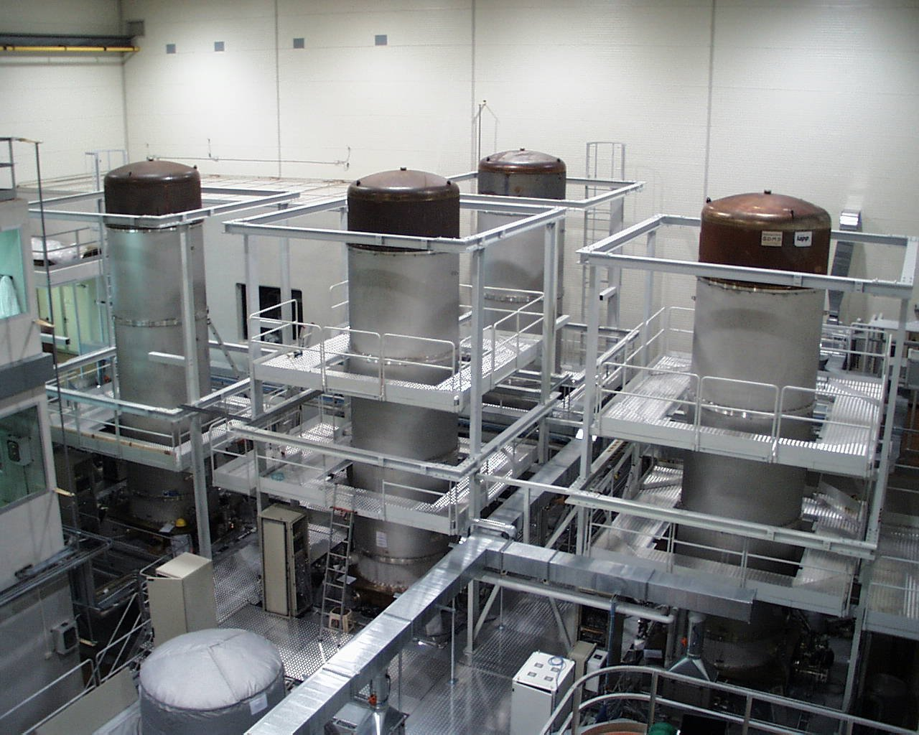
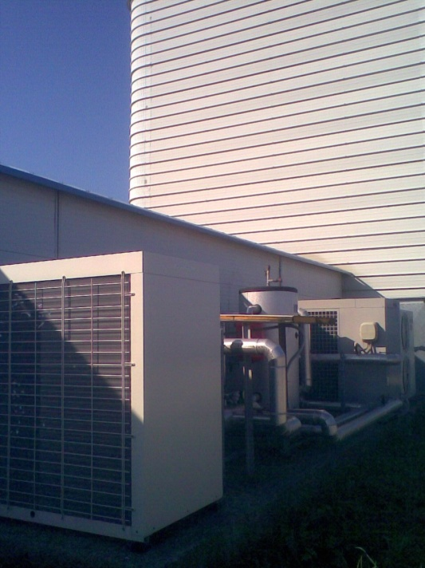
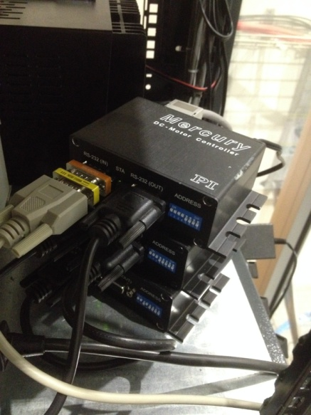
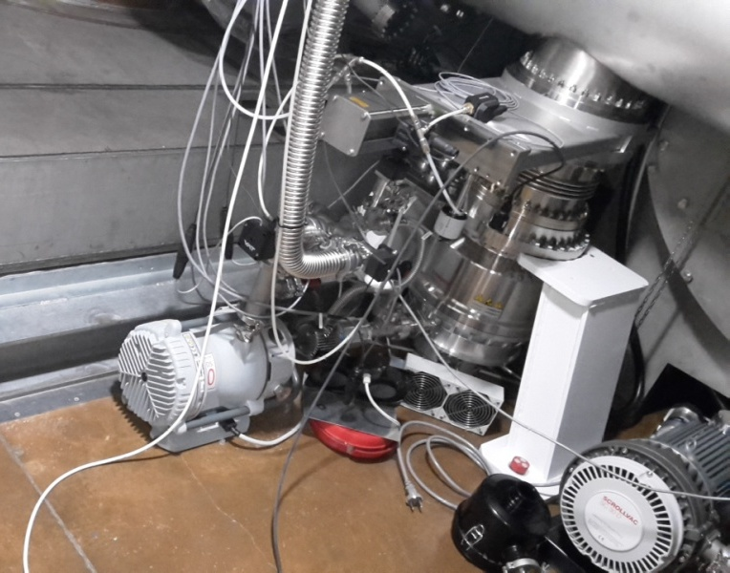
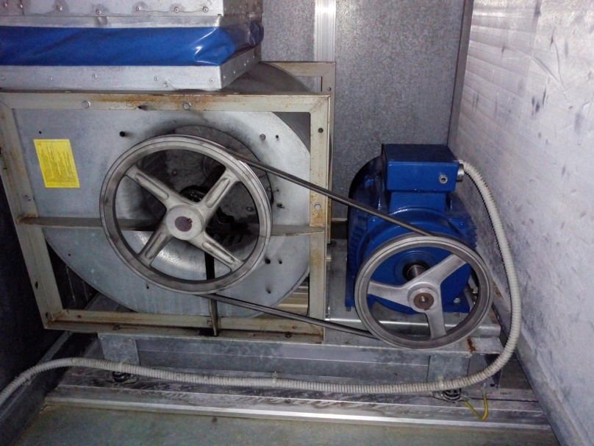
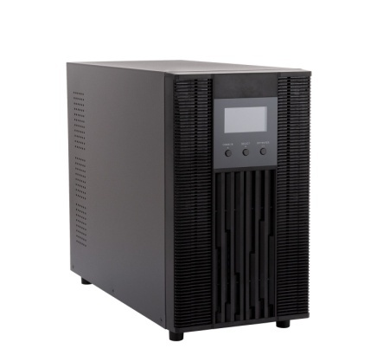
Self-inflicted noise
Electronic devices,
cooling fans
Chillers
Vacuum pumps
Electrical system, cables
Illumination, Uninterruptible Power Supply
Air ventilation

Slide 7
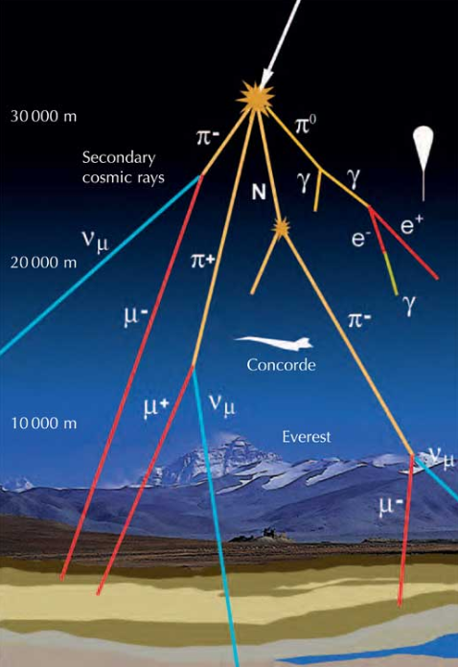
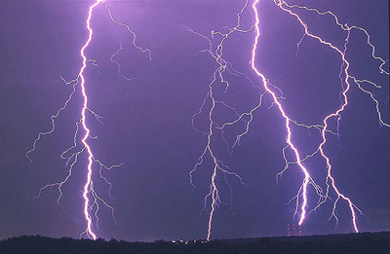
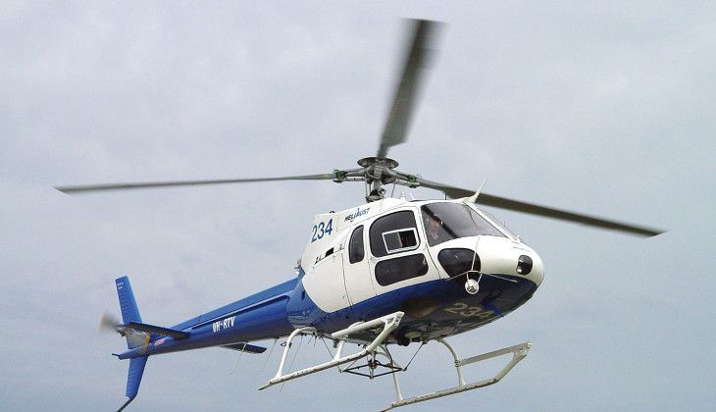
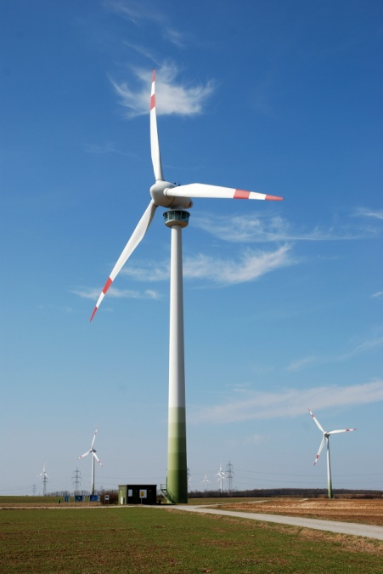
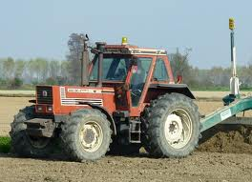
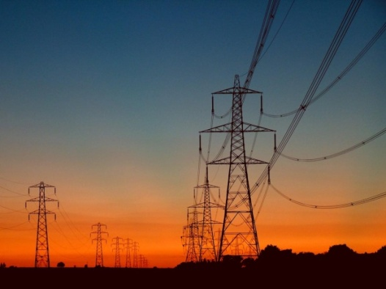
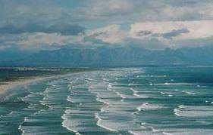
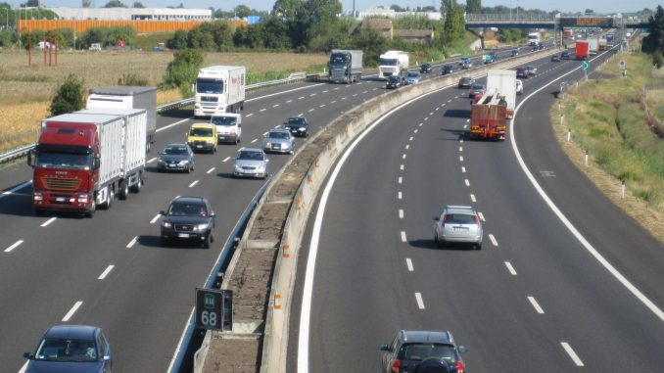

Distant but loud ….
7

Slide 8
Part I
Sensors and channels

Slide 9
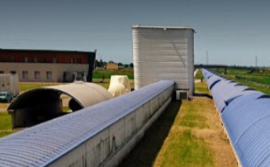
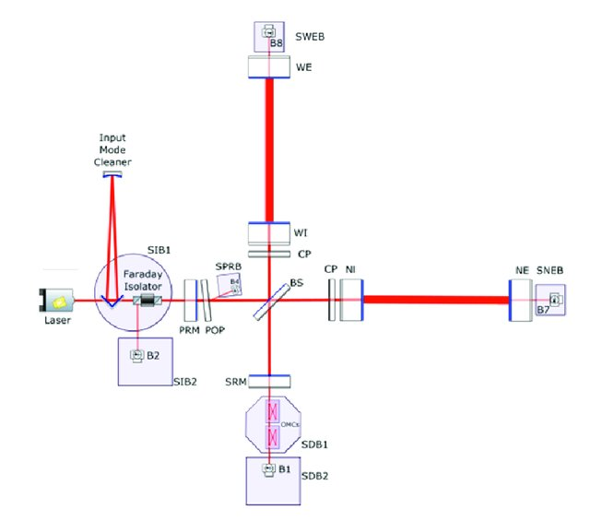
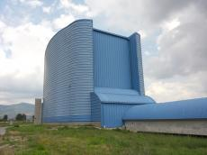
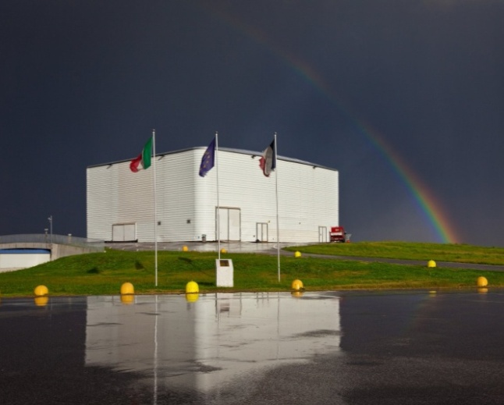
MCB
WEST arm
3km
NEB (WEB)
NORTH arm
3km
CEB

Slide 10
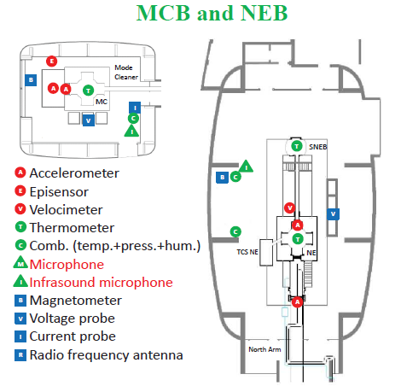
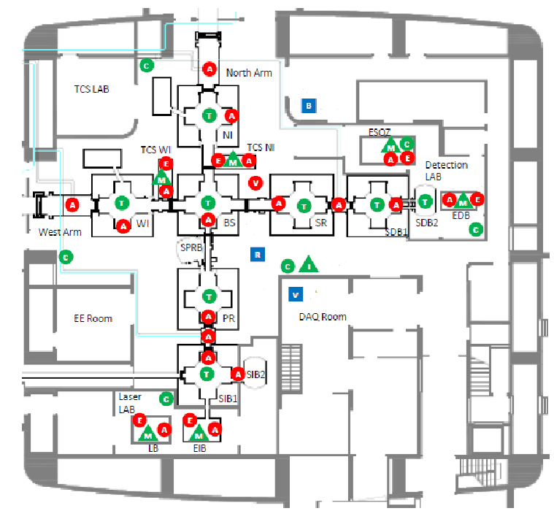
ENV probes
CEB
MCB and NEB (WEB)

Slide 11

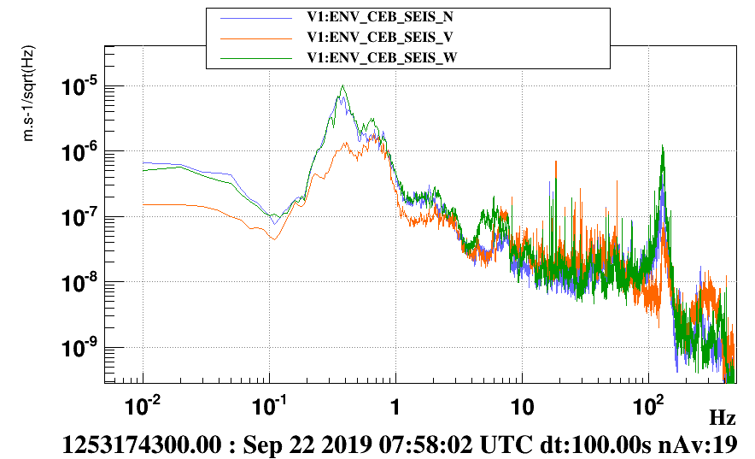
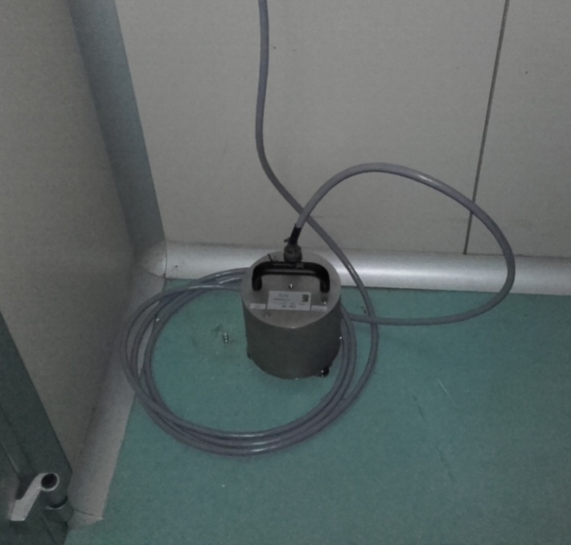
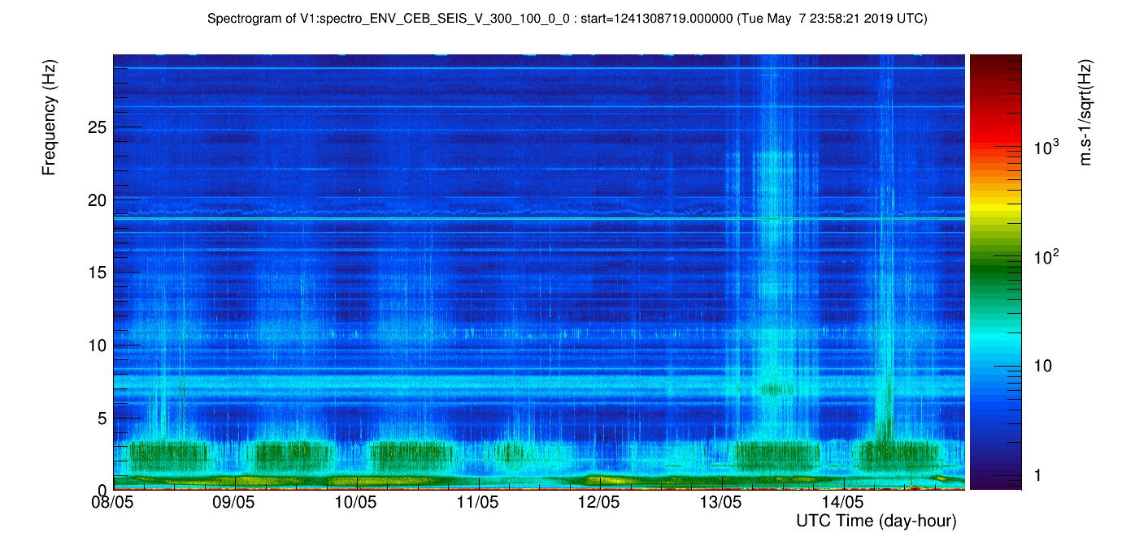
Building monitors
Also _NEB, _WEB, _MCB
SOIL VIBRATIONS
Site infrastructure
WIND
SEA
ANTHROPIC
Microphone
Infra sound
0.1 – 10kHz
GURALP velocimeter
0.1Hz to 100Hz

Slide 12
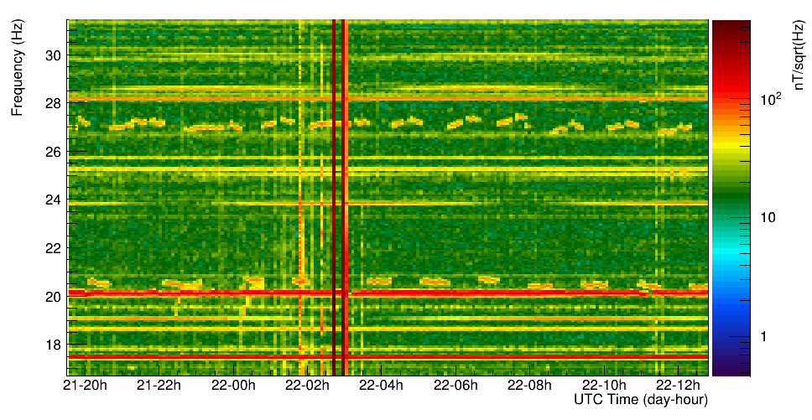
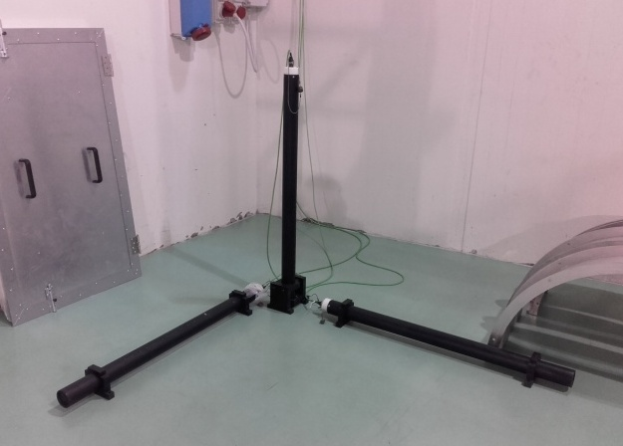

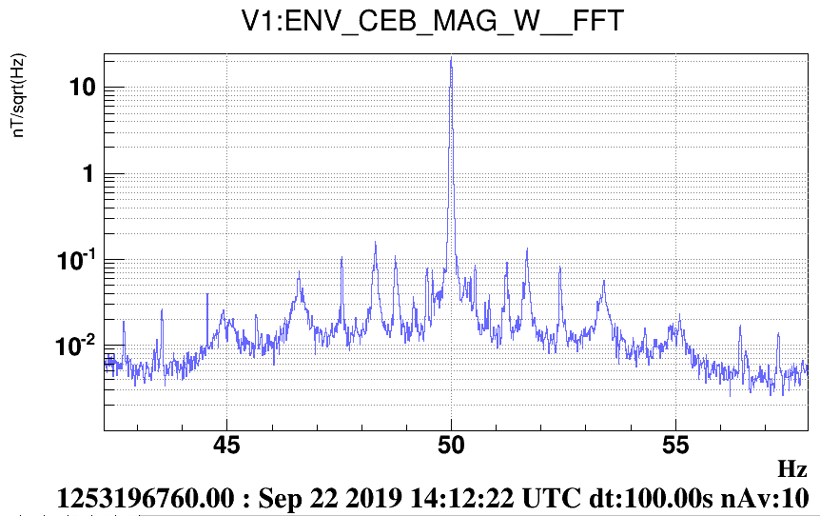
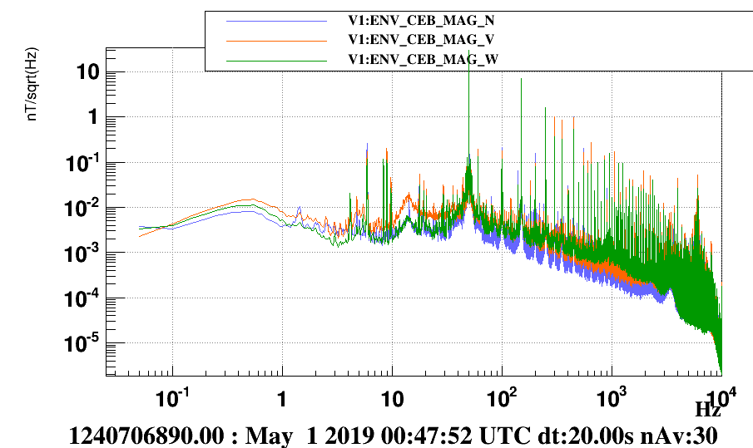
Building monitors
MAGNETOMETERS
Magnetometers
0.1-10kHz
_NEB, _WEB, _MCB
SIDEBANDS

Slide 13
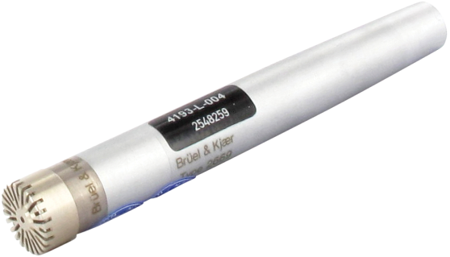
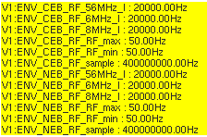
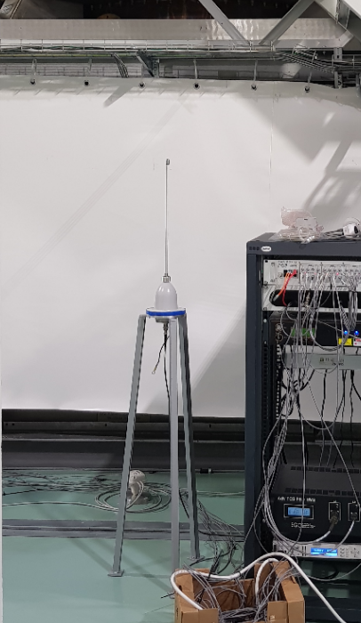

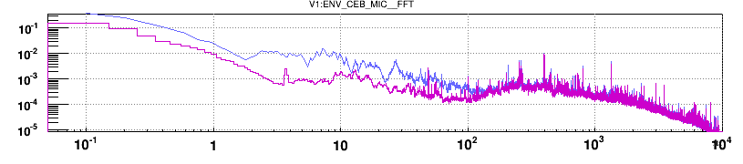
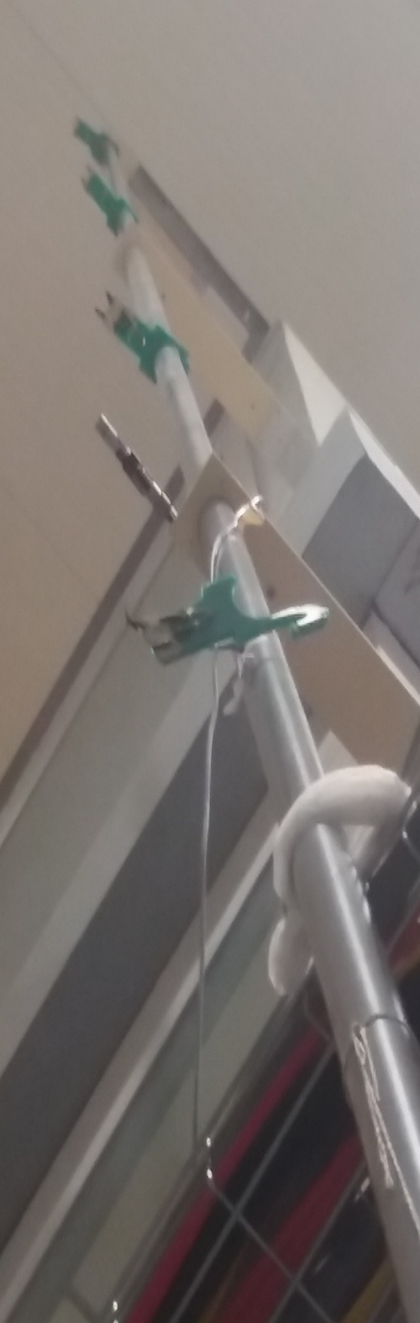
Building monitors
Temperature probes
Microphone
Infra sound
0.1 – 10kHz
Microphone
Mostly RACKS cooling fans
Air conditioners OFF
Temperature
1Hz sampling
RF antenna:
signal is demodulated around Virgo’s
Laser modulation frequencies: 6MHz, 8MHz, 56MHz
20kHz sampling

Slide 14
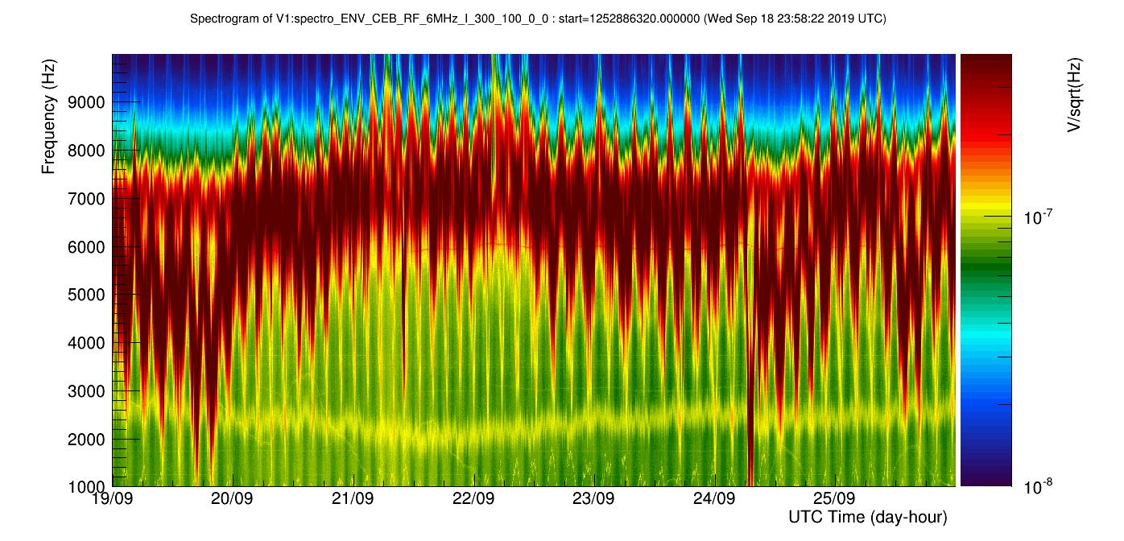

Slide 15
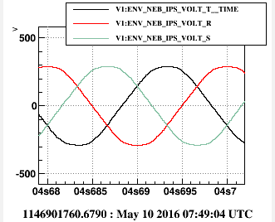
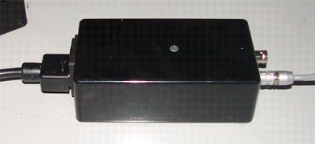
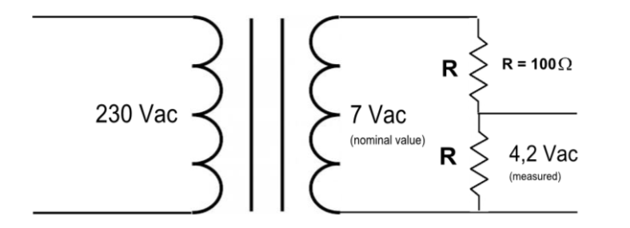
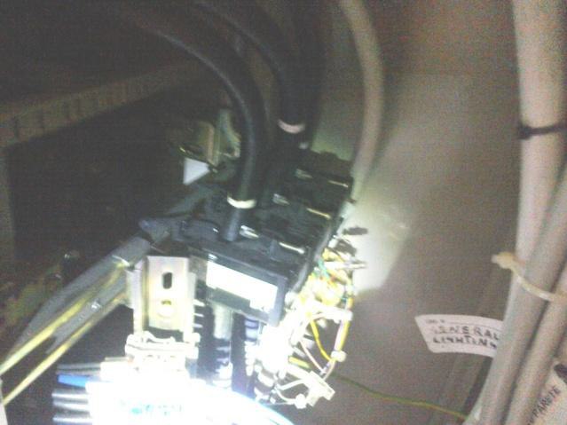
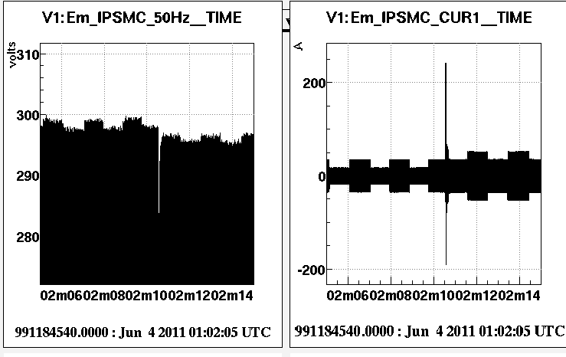
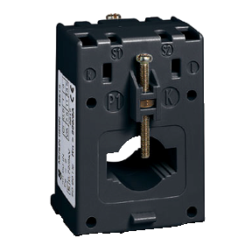
Building monitors
3 PHASES of MAINS
Voltage monitors
Current monitors

Slide 16
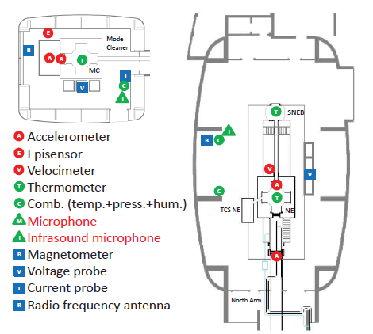
ENV probes
SUSPENDED IN_VACUUM
BENCH
Acoustically isolated area
IN-AIR
BENCH
CEB
MCB and NEB (WEB)
= Electronic racks
v
suspended to GAS filter

Slide 17
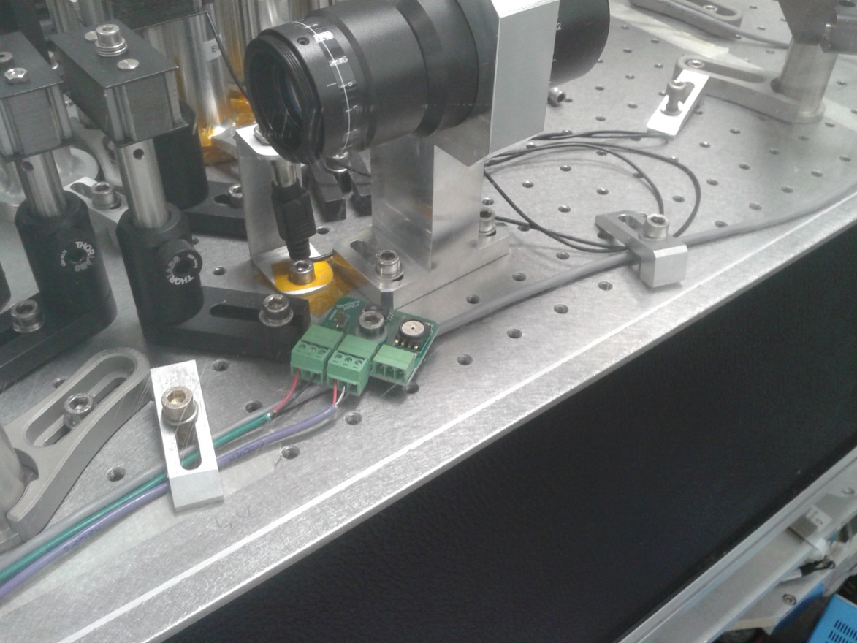

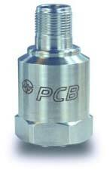
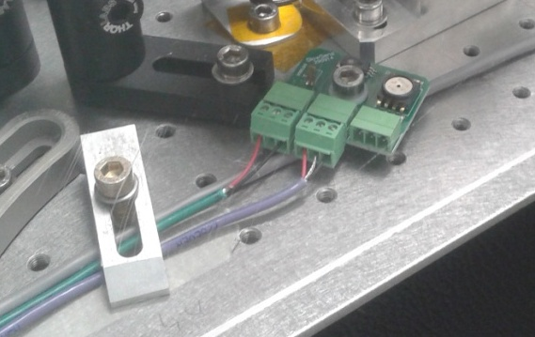
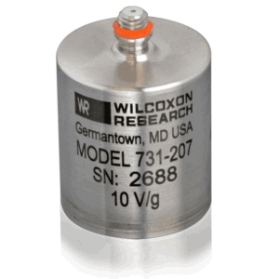


Monitor of in-air benches
Also:
LB,EIB,SQZ,TCS_CO2_NI
TCS_CO2_WI, EMCB
1 Microphone
1 Accelerometer (high frequency)
1 Tri-axial accelerometer (low frequency)
1 Temperature +Humidity sensor attached to bench
1 Temperature + Humidity + Pressure in the Clean Room
1Hz-500Hz
10Hz-2kHz
Peaks 10-40Hz are bench modes

Slide 18

ENV probes
Vacuum chambers
Cryogenic vacuum traps
View-ports
CEB
MCB and NEB (WEB)

Slide 19





Monitor of critical spots
Possible sources of back-scattering:
Optical windows
Beam dumps
Cryogenic traps
TOT of 36 accelerometers
outer tank
inner tank

Slide 20




AUXILIARY slow monitors
Monitors of infrastructure 1 Hz sampling
(V1:INF_* V1:HVAC_* V1:VAC_*)
Air&Water Temperature&Pressure
Power consumption of big switching loads (chillers, heaters)
Illumination (*LUX*)
Air conditioners Hot&Cold loops
Vacuum valves, LN2 levels, residual gas pressure, …

Slide 21






External monitors
Weather station and Lightning detector
External magnetometers

Slide 22

External monitors

Slide 23



Environmental probes DOCUMENTATION
MAPS:
  HARDWARE inventory MAP http://slwebtest.virgo.infn.it/ifoapp/
  • ENV_maps_24_07_2018.pdf (with location of FAST and SLOW probes)
  • Map_ENV_sensors_cirone.pdf (with location of FAST probes, and associated NAMES)
  INF sensors interactive MAP https://scientists.virgo-gw.eu/IMMS/
SENSORS specs:
  https://scientists.virgo-gw.eu/EnvMon/sensorDocs.htm
FAST sensors with Channel names
(pdf file)
HARDWARE inventory
(active directory account)
IFN sensors interactive map

Slide 24
Channel name conventions
V1:ENV_LOCATION(_SUBLOCATION)_SENSOR(_DIRECTION)
CEB = Central Building
(NEB,WEB,MCB)
LLR = Laser Lab Room
….
BS = Beam Splitter
….
EIB = External Injection Bench
….
CT = CryoTrap
CHILLER
HEATER
LINK = link pipe
….
SEIS
ACC
MAG
MIC
VOLT
CURR
TE
HU
PRES
RF
….
Z is along beam
Orthogonal triplets:
X,Y,Z → Z is along beam direction, Y is vertical
N,W,V → N= along N arm, W=W arm, V= vertical
For a more complete description
CHANNEL DATABASE
http://slwebtest.virgo.infn.it/ifoapp/
Channel naming conventions
VIR-0223B-14
https://tds.virgo-gw.eu/ql/?c=10250

Slide 25



DATA streams: OFFLINE
“RAW”:
  All channels with full sampling (1Hz, 1kHz,…. 20kHz,….)
  File list /virgoData/ffl/raw.ffl (to load in dataDisplay, or your own Matlab or Python script )
  (updated every 5-10minutes)
“TREND”:
  Only channels sampled at 1Hz or less
  min, max, mean, rms of each raw channel (computed over 1s)
  File list /virgoData/ffl/trend.ffl (updated every 30minutes)
  BRMS channels: RMS computed over given band, DQ_BRMSMon*, Hrec, several ENV channels
Quick look over long time stretches
Very useful to look for time evolution of noise
and correlate with slow trends

Slide 26


DATA streams: ONLINE
Use dataDisplay as an Oscilloscope …

Slide 27

END of part I
Pictures (hall, benches)

