Slide 1
SRC alignment,
High Order Modes and Contrast Defect:
“The dark side of the fringe”
Raffaele Flaminio
CNRS/LAPP Annecy

Slide 2
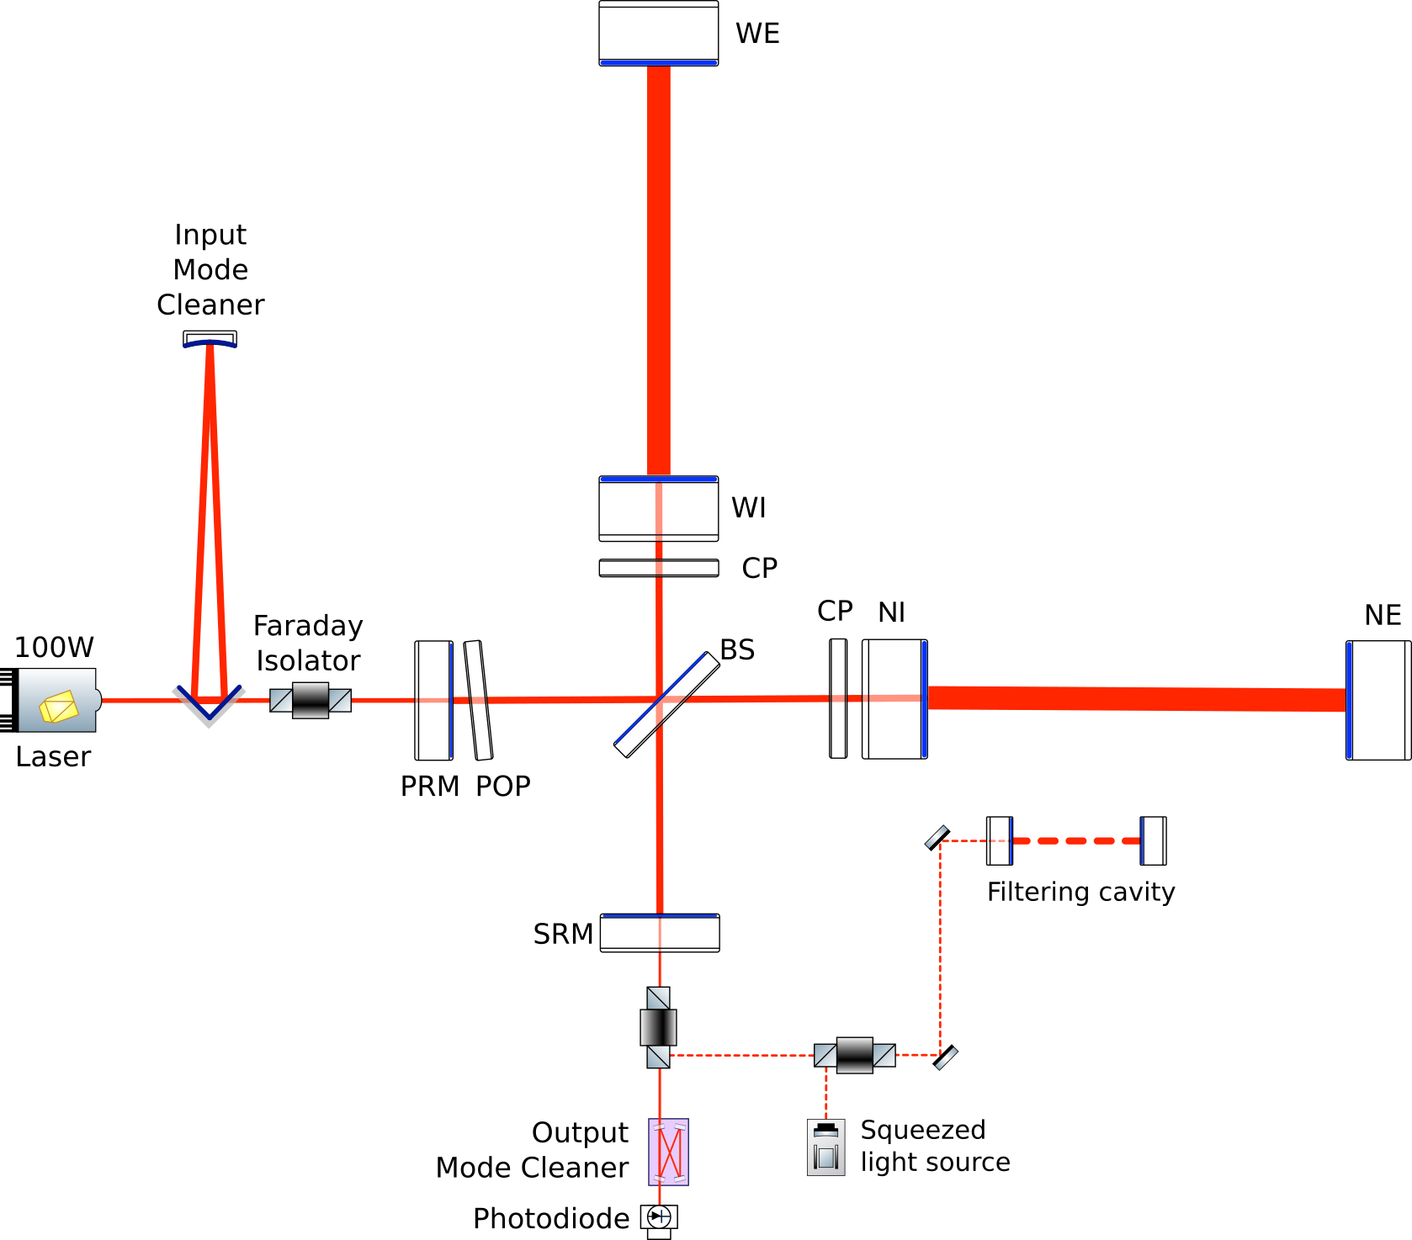






Contrast defect vs SRC alignment
Signal recycling cavity tuning
  Resonant sideband extraction
HOM resonance conditions
  HOM not resonant in FP
  same for all modes (SRC cavity degeneracy)
  HOM are close to resonance in SRC cavity
SR mirror aligned when power on the dark fringe is maximum
$$φ_{c}^{00}+φ_{SRC}=(2n+1)π$$
$$φ_{c}$$
$$φ_{c}^{mn} \sim φ_{c}^{00}+π$$
$$φ_{SRC}$$
$$φ_{SRC}$$
$$φ_{c}^{mn}+φ_{SRC} \sim 2nπ$$

Slide 3
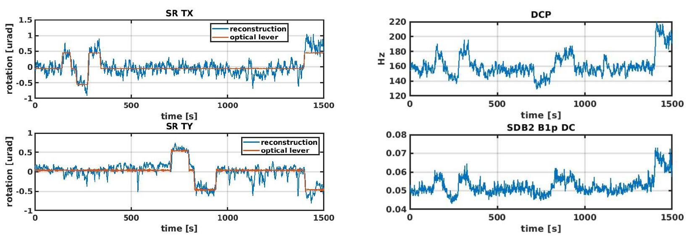
SRC pole vs SRC alignment
Better SRC alignment
 
Higher SRC pole More power on dark fringe
(DCP) (SDB2_B1p_DC)
P. Ruggi

Slide 4
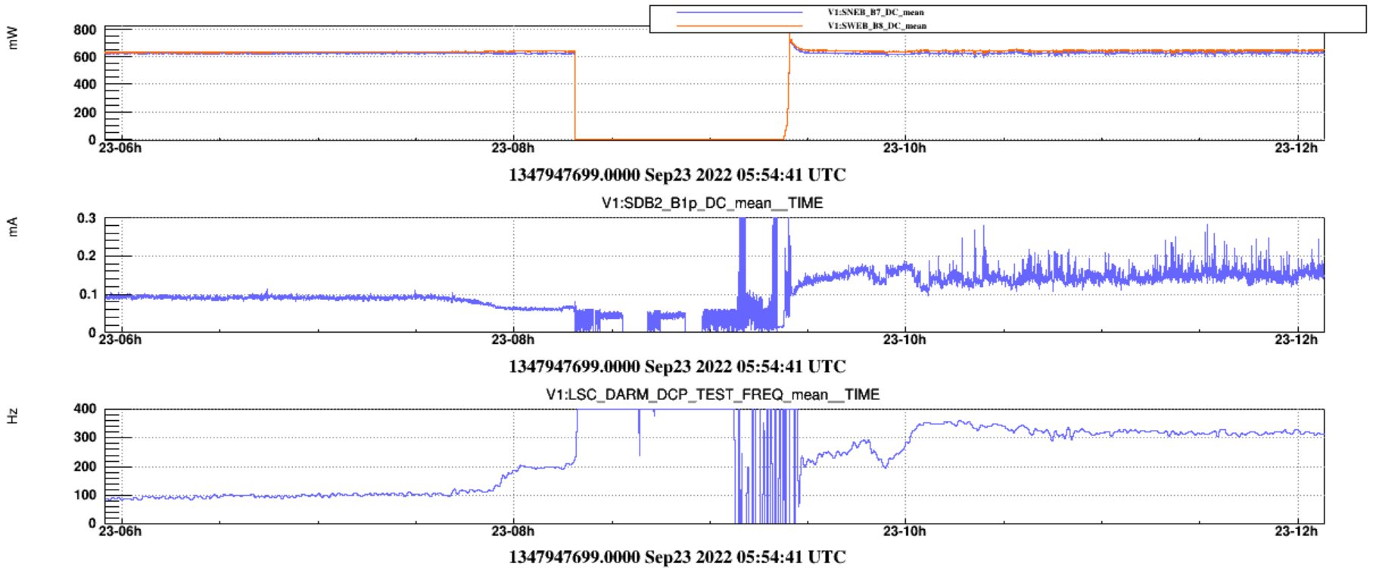
Dark fringe vs SRC alignment
Better SRC alignment
 
Higher SRC pole More power on dark fringe
 
More fluctuations of power on dark fringe

Slide 5

Summary & Open questions
SRC alignment ⇒ Higher cavity pole
  Understood (obvious, resonant sideband extraction)
SRC alignment ⇒ Large power on dark fringe
  Understood (less obvious, resonant HOM extraction)
SRC alignment ⇒ Larger power fluctuations on dark fringe
  Why?
    Stronger dependencies on locking & alignment accuracy?
      Related to optical spring?
      Need to increase loops gain? If yes, which one?
    Spurious beam? Right at the place of maximum cavity pole??

Slide 6
Procedure for SR cavity tuning
Pre-alignment (as usual)
Goto CARM 0
Keep all AA loops closed (DIFF+, COMM+, PR, IB, BS) with no offset
Adjust SRM alignment to maximize ITF bandwidth
  Don’t look at dark fringe
Adjust SRC cavity length to minimize optical spring and maximize ITF bandwidth
  Tune SRCL offset
$$φ_{c}$$
🙈
$$φ_{SRC}$$

Slide 7
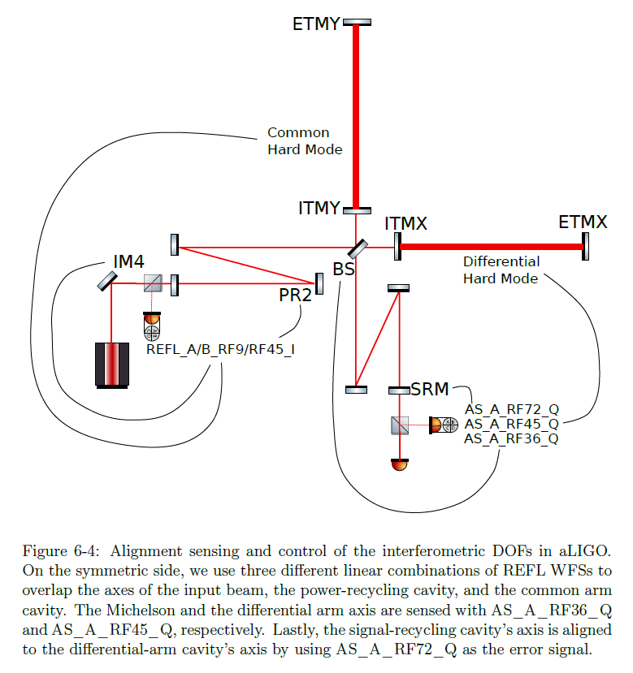
Interferometer automatic alignment
Need to run all the 6 interferometric degrees of freedom of automatic alignment
  COMM+ (Common Hard Mode) ✓
  PR ✓
  Input beam ✓
  DIFF+ (Differential Hard Mode) ✓
  BS ✓
  SR
See LIGO scheme
  Pointing degrees of freedom not included here

