Slide 1

Training Session
EGO Projects EASYREDMINE
Christian.olivetto@ego-gw.it

Slide 2
EASYREDMINE USER’S TYPE
EASYREDMINE is a online complete project management tool with:
  Schedule management
  Budget management
  Documents management
  Ressource management
  Lots of others plugin availables

Slide 3




EASYREDMINE USER’S TYPE
      In EASYREDMINE tool there are 4 user’stype with different rights associated
C-Level Role: Institution management (CNRS/INFN/NIEKHEF/EGO FIR)
Reader only with global dashboard graphics and indicators
Project Management Role: Project leader with all rights for global projet and all
Subprojects, administration rights.
Group Manager Role: Management of subprojet with tasks, users, budget
management.
Executive Role: Team member, read rights for all information but no modification
available.

Slide 4
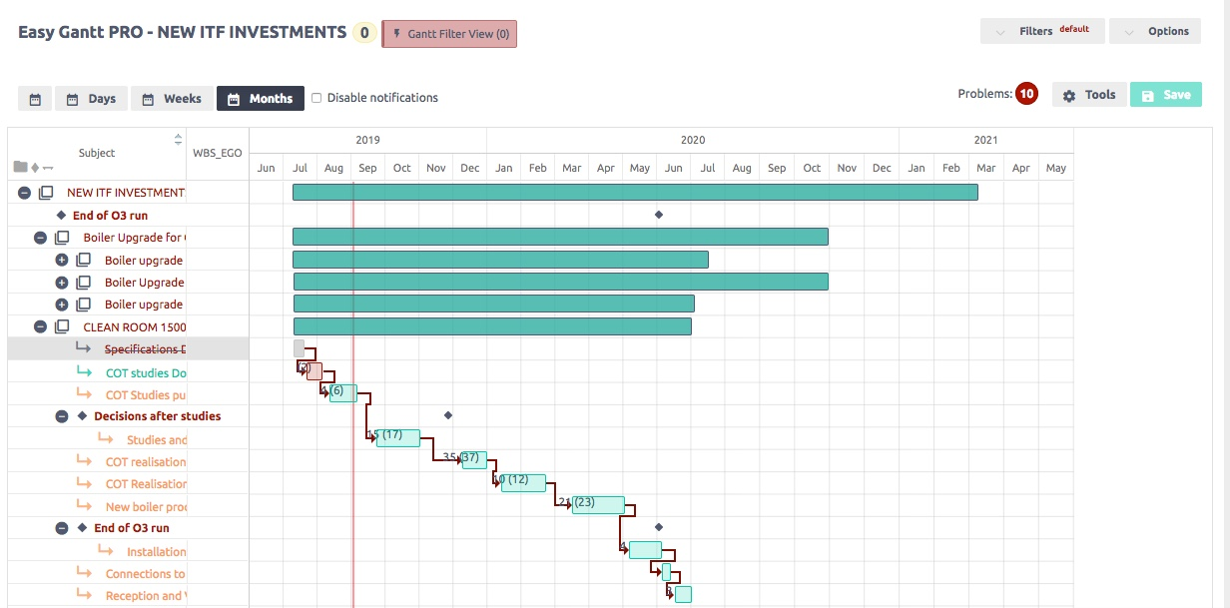
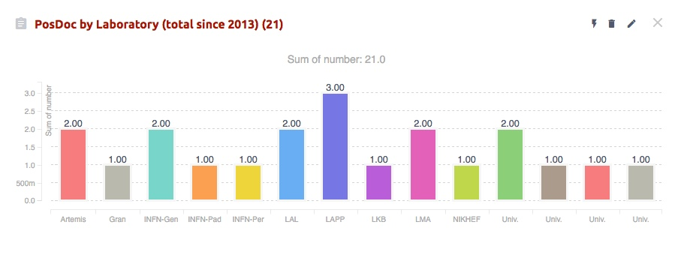
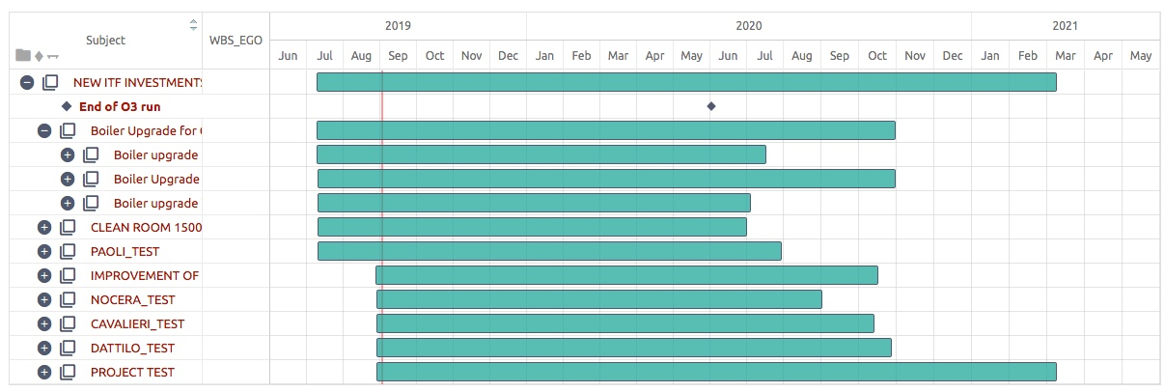
EASYREDMINE USER’S TYPE
      EASYREDMINE allow to consolidate global project with all subprojects managed by each project manager
C-Level Role =
CNRS/INFN/NIEKHEF/…
Project Management =
Global project
Group Manager =
Subproject Manager
Global project view with all subprojects
Admin rights
READ ONLY all graphics, indicators, budget
And schedule of global EGO’s Projects
Team member

Slide 5
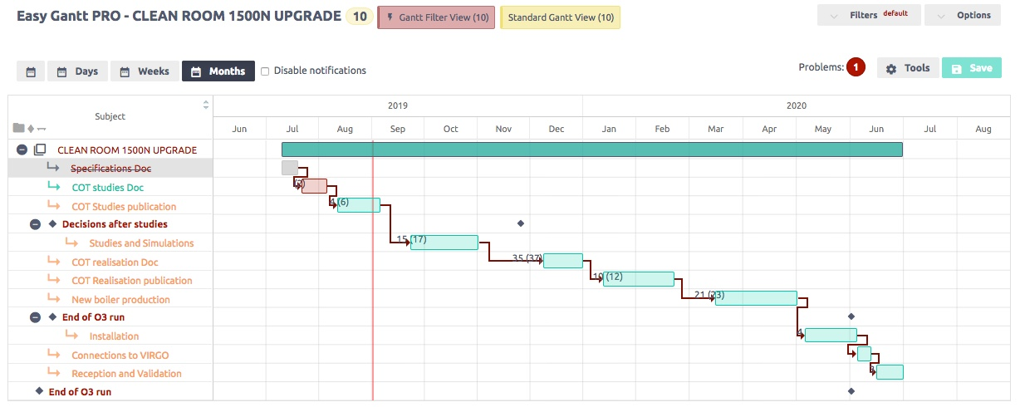
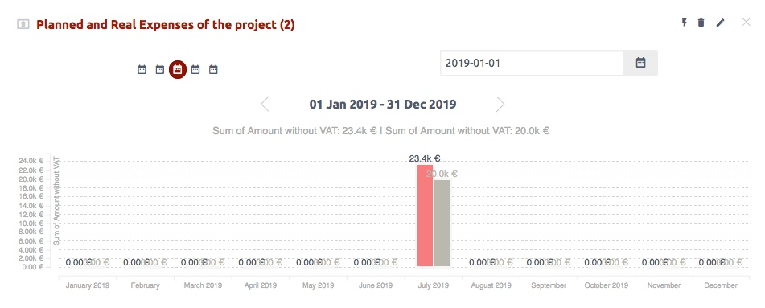
EASYREDMINE USER’S TYPE
      EASYREDMINE allow to consolidate global project with all subprojects managed by each project manager
C-Level Role =
CNRS/INFN/NIEKHEF/…
Project Management =
Global project
Group Manager =
Subproject Manager
Subproject Manager: write/delete all tasks,
Subproject millestones, links, ressources,
Budget management
Team member

Slide 6
EASYREDMINE USER’S TYPE
      EASYREDMINE allow to consolidate global project with all subprojects managed by each project manager
C-Level Role =
CNRS/INFN/NIEKHEF/…
Project Management =
Global project
Group Manager =
Subproject Manager
Team Member: read only all tasks,
Subproject millestones, links, ressources,
Budget
Team member

Slide 7
EASYREDMINE TRAINING SESSION
LINKS AND TUTORIALS
IN THIS TRAINING SESSION WEE’LL BE ABLE TO:
  Connect to Easyredmine: change password, configure your profil
    https://ego-gw.easyredmine.com/login?
    Tutorial Video #1
  Define rights for each project’s member
    Tutorial Video #2
  Overview of Project’s informations and graphics
    Tutorial Video #3
  Creation of tasks
    Tutorial Video #4
  Task budget
    Tutorial Video #5

