Slide 1
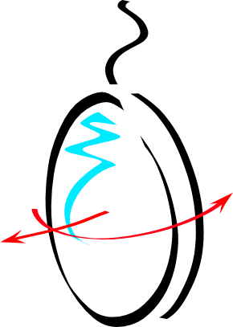



The Advanced Virgo Interferometer Sensing And Control For The O3 Scientific Run
Maddalena Mantovani
For the Virgo Collaboration
VIR-0736A-19

Slide 2
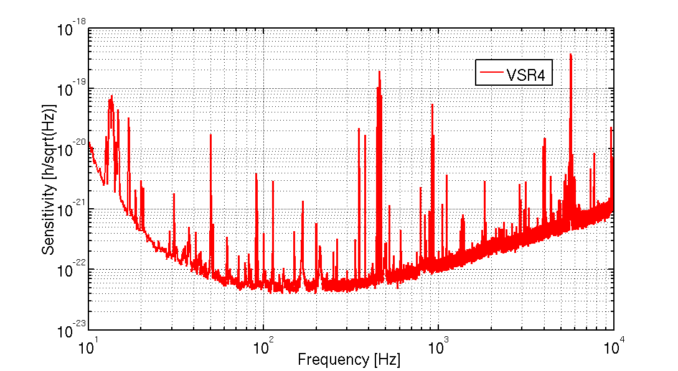
Introduction
1st generation of GW detectors have proven working principle of the GW detectors, but unfortunately the sensitivity was too low to be able to detect a GW signal.
The target of the 2nd generation was to improve the sensitivity by a factor 10!
Thermal noise
(suspensions and coating)
Need of reducing the
fundamental noises
Quantum noise
Best sensitivity of Virgo (2011)
Maddalena Mantovani
2

Slide 3
Introduction
Several changes have been performed, but most of them had a direct impact on the complexity of the ISC subsystem commissioning
Reducing the Quantum noise:
increase the Arm finesse
  Dynamical effects in the cavity locking signals
  Radiation pressure effects
increase the input power
  Larger thermal effects
  Radiation pressure effects
inject squeezed light
Reducing the Thermal noise:
Increase the mirror masses
Increase the beam size on the mirrors
  This led to have a marginally stable recycling cavity (space constrain)
- Monolithic suspensions
Maddalena Mantovani

Slide 4
Introduction
Several changes have been performed, but most of them had a direct impact on the complexity of the ISC subsystem commissioning
Reducing the Quantum noise:
increase the Arm finesse
  Dynamical effects in the cavity locking signals
  Radiation pressure effects
increase the input power
  Larger thermal effects
  Radiation pressure effects
inject squeezed light
Reducing the Thermal noise:
Increase the mirror masses
Increase the beam size on the mirrors
  This led to have a marginally stable recycling cavity (space constrain)
- Monolithic suspensions
Maddalena Mantovani

Slide 5
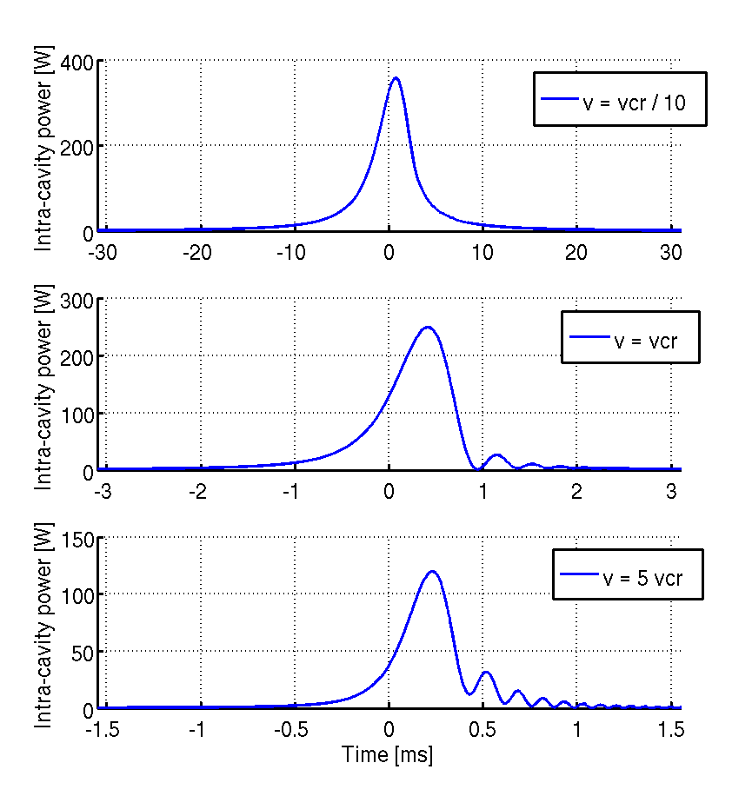
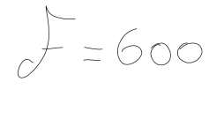

Guided lock – improved algo
The standard Guided lock technique measure the cavity speed as:
Thanks to this technique, the cavity velocity is measured at one peak and it is slowed down at the following peak.
An alternative and more efficient algorithm has been implemented for Advanced Virgo
[*] K. Izumi et al “Guided lock of a suspended optical cavity enhanced by a higher-order extrapolation”, Appl. Opt. 56 (19) (2017)
Corr. fact.
Cal. fact.
Ringing
Maddalena Mantovani

Slide 6
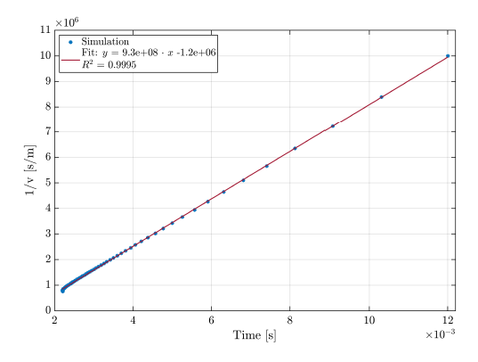
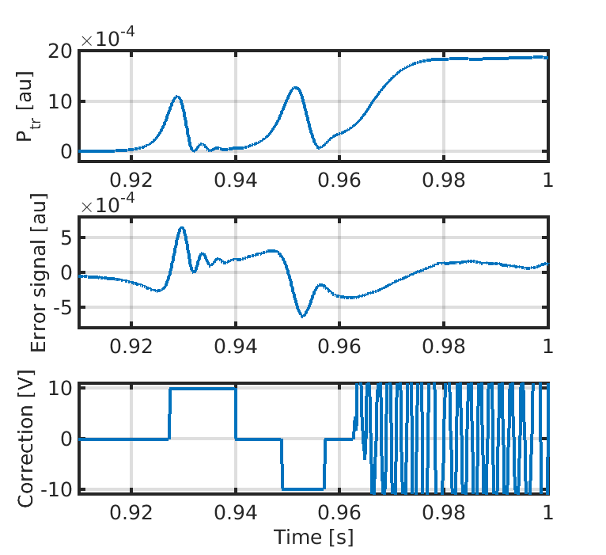
Guided lock – improved algo
The idea is to measure the raising time between the 10% and the 40% of the maximum power which has a linear dependency with the cavity speed.
The main advantages are:
No need of calibration and correction factors
The impulse can be sent while the cavity is passing trough the resonance
Maddalena Mantovani

Slide 7
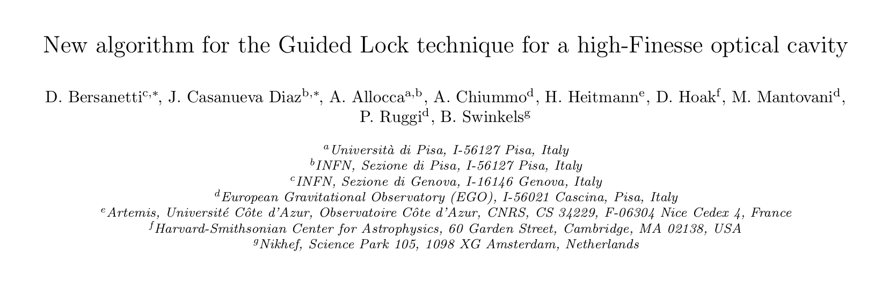
Guided lock – improved algo
The idea is to measure the raising time between the 10% and the 40% of the maximum power which has a linear dependency with the cavity speed.
The main advantages are:
No need of calibration and correction factors
The impulse can be sent while the cavity is passing trough the resonance
To be submitted to Astr. Phy.
Maddalena Mantovani

Slide 8
Introduction
Several changes have been performed, but most of them had a direct impact on the complexity of the ISC subsystem commissioning
Reducing the Quantum noise:
increase the Arm finesse
  Dynamical effects in the cavity locking signals
  Radiation pressure effects
increase the input power
  Larger thermal effects
  Radiation pressure effects
inject squeezed light
Reducing the Thermal noise:
Increase the mirror masses
Increase the beam size on the mirrors
  This led to have a marginally stable recycling cavity (space constrain)
- Monolithic suspensions
Maddalena Mantovani

Slide 9
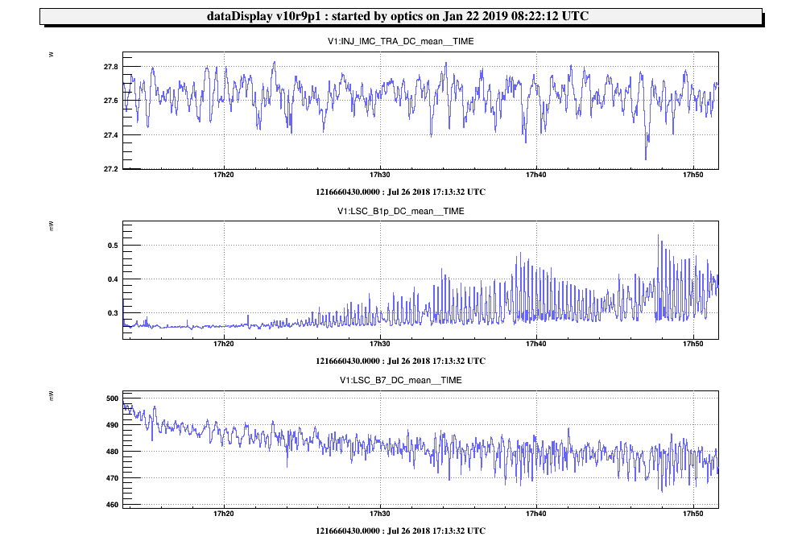
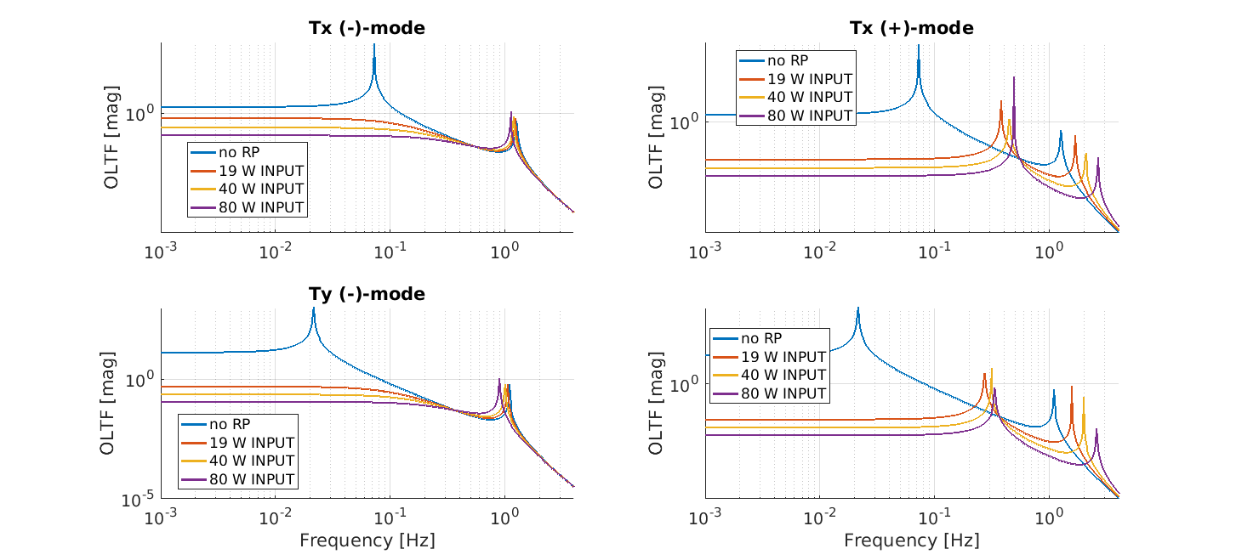
Radiation pressure effects
During the trial of running the ITF @ 25W we experience the radiation pressure effects on the angular direction.
After this the OLTF of the opto-mechanical system (in presence of radiation pressure has been modeled with OCTOPUS [*])
Input Power
[*] L. Trozzo “Low Frequency Optimization and Performance of Advanced Virgo Seismic Isolation System” Phd Thesis
Dark Fringe
Unstable pole
Cavity Power
P. Ruggi
Maddalena Mantovani

Slide 10
Introduction
Several changes have been performed, but most of them had a direct impact on the complexity of the ISC subsystem commissioning
Reducing the Quantum noise:
increase the Arm finesse
  Dynamical effects in the cavity locking signals
  Radiation pressure effects
increase the input power
  Larger thermal effects
  Radiation pressure effects
inject squeezed light
Reducing the Thermal noise:
Increase the mirror masses
Increase the beam size on the mirrors
  This led to have a marginally stable recycling cavity (space constrain)
- Monolithic suspensions
Maddalena Mantovani

Slide 11
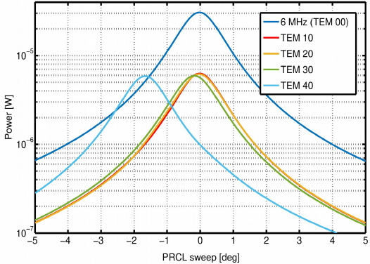
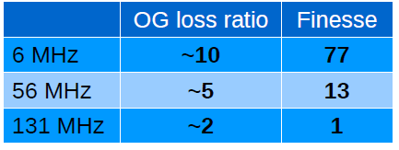
Marginally Stable cavity
The most challenging peculiarity of the Advanced Virgo ITF is given by the low stability of the recycling cavity.
This choice is a consequence of the need of increasing the beam size on the input mirrors and space constrains
The solution is to use high modulation frequency (lower finesse) to be more robust against aberration, but still a marginally stable cavity is strongly affected by defects...
Intracavity power
J. Casanueva
1-g₁g₂ ~1.9e-5
Maddalena Mantovani

Slide 12
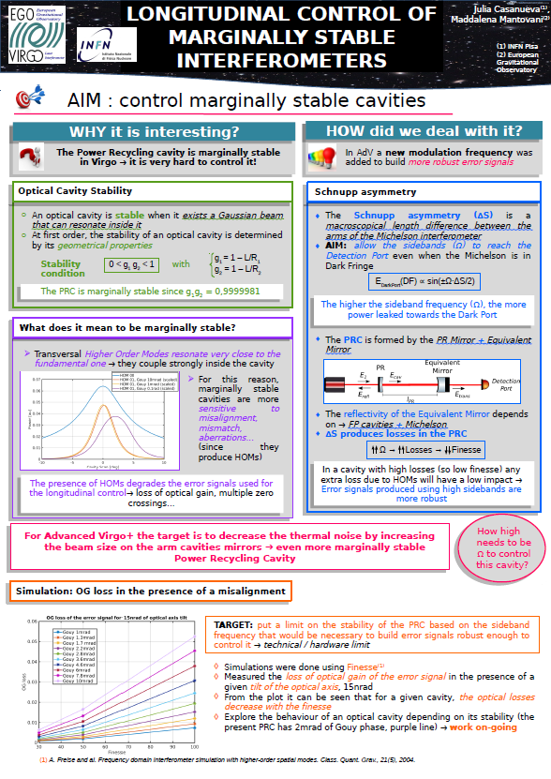
Marginally Stable cavity
The most challenging peculiarity of the Advanced Virgo ITF is given by the low stability of the recycling cavity.
This choice is a consequence of the need of increasing the beam size on the input mirrors and space constrains
The solution is to use high modulation frequency (lower finesse) to be more robust against aberration, but still a marginally stable cavity is strongly affected by defects...
See J. Casanueva Poster
Intracavity power
J. Casanueva
1-g₁g₂ ~1.9e-5
Maddalena Mantovani

Slide 13
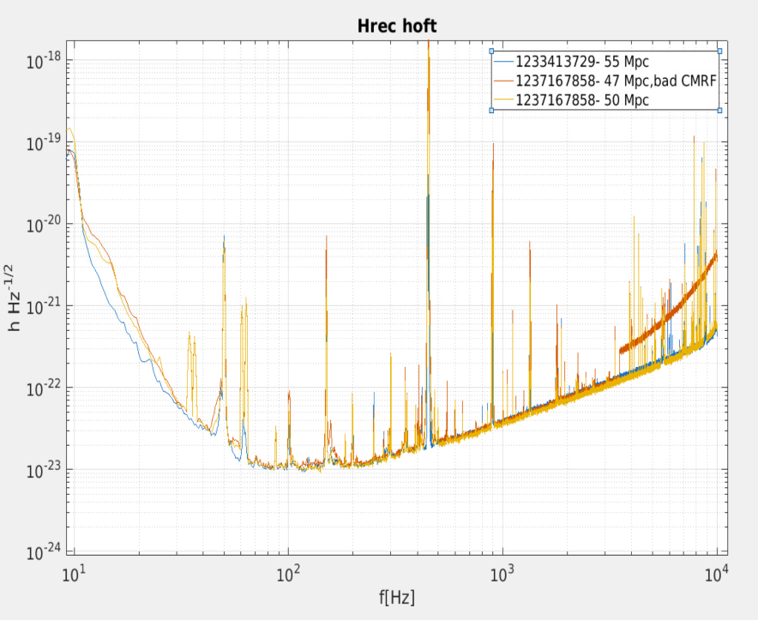
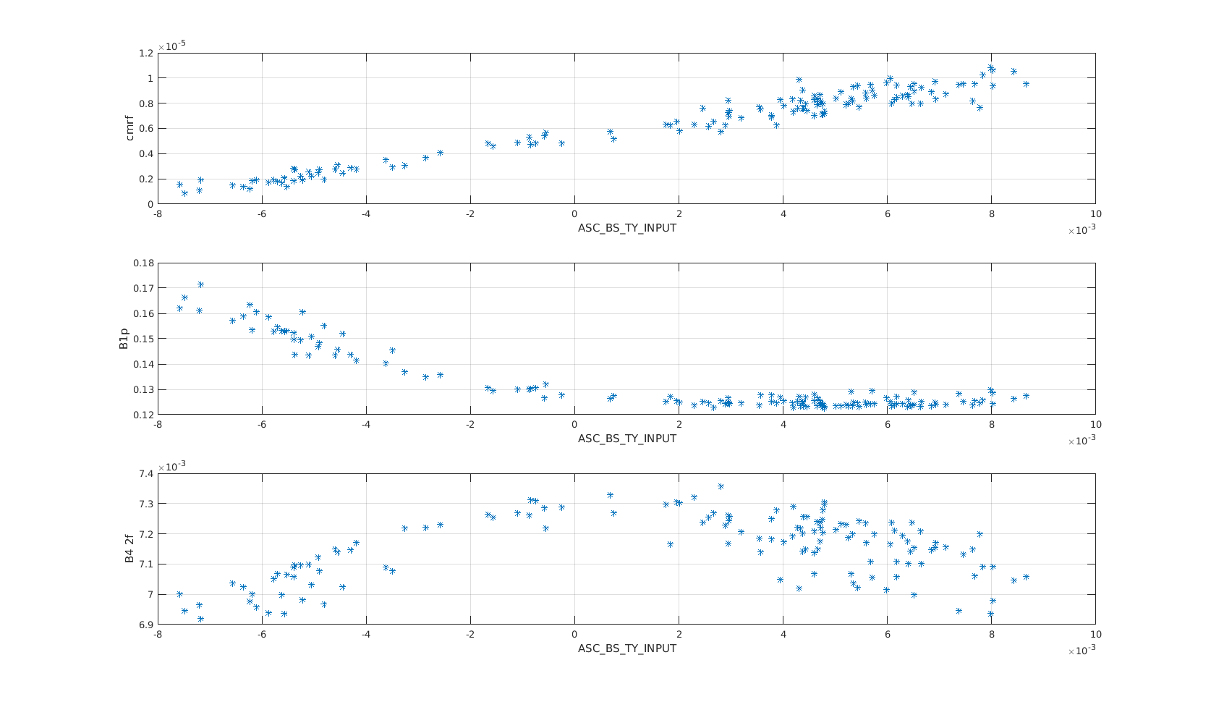
Marginally stable cavity vs Thermal aberrations
If the TCS (Thermal Compensation System) is not properly compensating the thermal aberrations, the ISC subsystem is strongly affected (especially alignment) having the ITF working point not reliable anymore (offsets on the error signals).
Dark Fringe <0.12mW Sidebands ~0.008mW
CMRF ~1-2°-9 @ 1111Hz
Good WP
CMRF
Not good CMRF (7e-6)
Good CMRF (1e-6)
Not stable locking position (too misaligned)
Aligned position
Bad CMRF
B1p DC
I. Nardecchia
B4 112MHz
The BS angular control can not be engaged anymore
BS yaw
Maddalena Mantovani

Slide 14
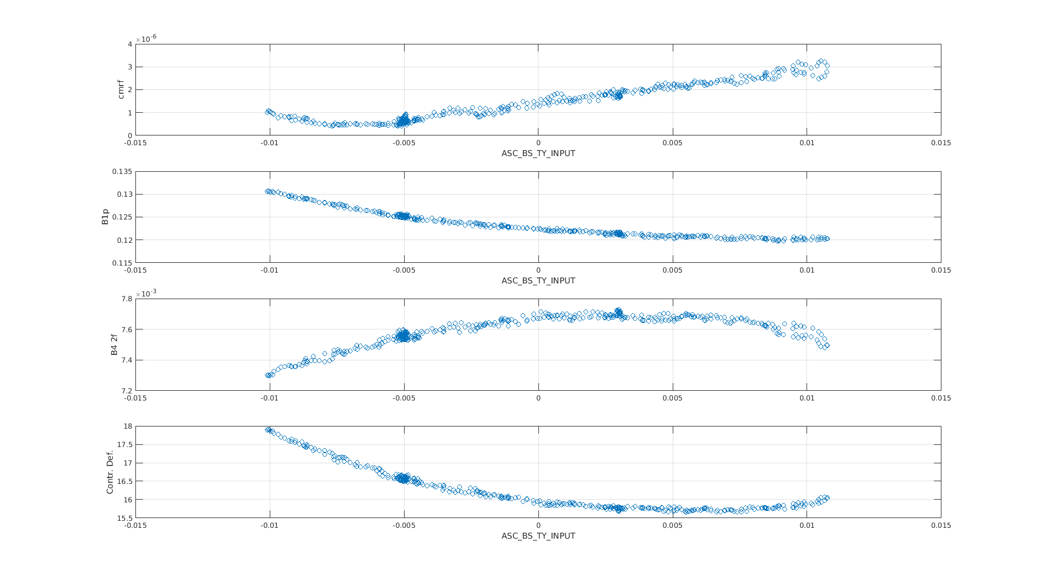
Marginally stable cavity vs Thermal aberrations
If the TCS (Thermal Compensation System) is not properly compensating the thermal aberration, the ISC subsystem is strongly affected (especially alignment) having the ITF working point not reliable anymore (offsets on the error signals).
Dark Fringe <0.12mW Sidebands ~0.008mW
CMRF ~1-2°-9 @ 1111Hz
Good WP
Optimal CMRF (0.7e-6)
CMRF
Still good CMRF (1.5e-6)
B1p DC
Bad CMRF
B4 112MHz
I. Nardecchia
Aligned position
CD
A stable working point can be reached
BS yaw
Maddalena Mantovani

Slide 15
More ISC features to improve the noise
Maddalena Mantovani

Slide 16
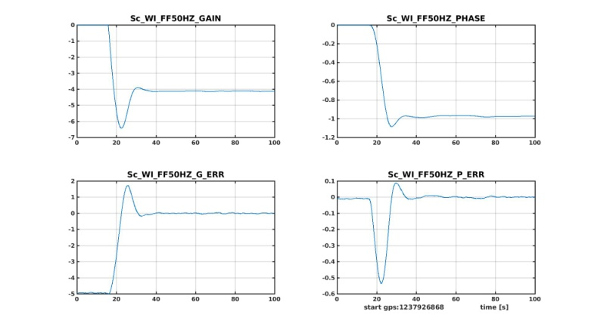
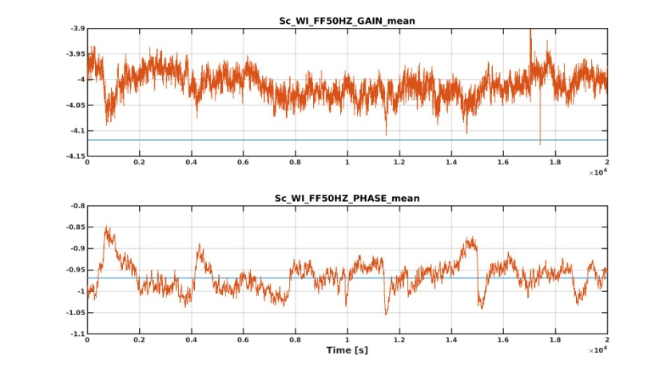
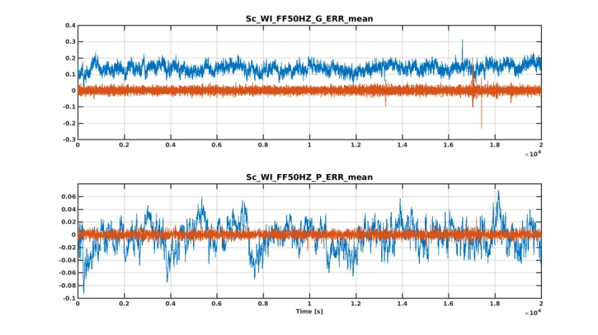
50Hz Feed-Forward optimized
Parameter loops convergence
The 50Hz line reduction is done with an evolved technique:
The 50Hz line is measured using and electrical probe and it is multiplied for a gain G and de-phased for a phase φ, and sent to the WI mirror actuators.
The 50Hz line reduction can be optimally reduced if the parameters G and φ are obtained with a feed-back loop
Step response
Blue : fixed parameters for G and φ
Red : optimal parameters for G and φ (obtained using a feed-back loop)
P. Ruggi
Maddalena Mantovani

Slide 17
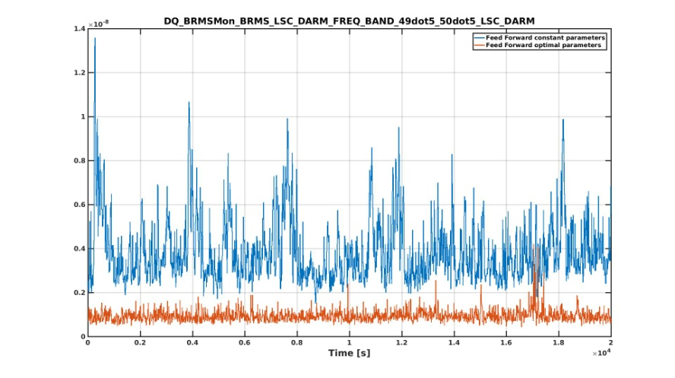
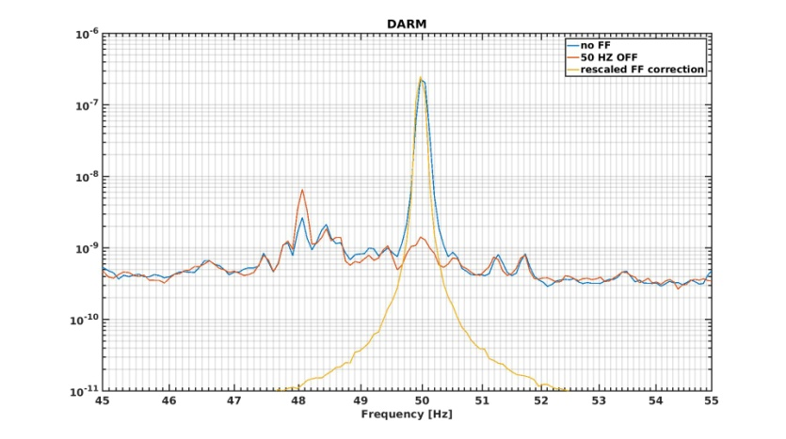
50Hz Feed-Forward optimized
The 50Hz line reduction is done with an evolved technique:
The 50Hz line is measured using and electrical probe and it is multiplied for a gain G and de-phased for a phase φ, and sent to the WI mirror actuators.
The 50Hz line reduction can be optimally reduced if the parameters G and φ are obtained with a feed-back loop
Blue : fixed parameters for G and φ
Red : optimal parameters for G and φ (obtained using a feed-back loop)
Maddalena Mantovani

Slide 18


PRCL->DARM subtraction (β)
The standard PRCL noise reduction (β)
TF_{DARM->AP}
Optical system
β
TF_{PRCL->DARM}
This is essentially the Common Mode Reduction Factor (CMRF)
The CMRF how much the ITF can reduce the common noise in the asymmetric port, this ability can be easily spoiled by asymmetries, defects, misalignment, ...
TF_{PRCL->SP}
The standard noise substraction is not efficient and reilable
M. Was, M. Mantovani, J. Casanueva, D. Bersanetti, A. Masserot
Maddalena Mantovani

Slide 19
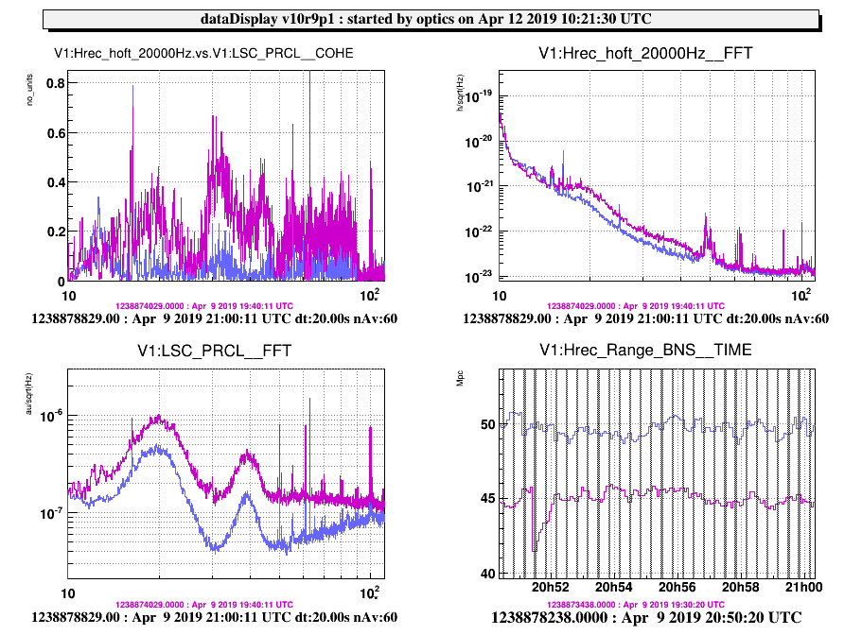
PRCL->SSFS subtraction
The PRCL loop is now subtracted to the SSFS (Second Stage of Frequency Stabilization) instead of the DARM loop.
Removing PRCL from SSFS is more direct and removes the noise on the correct signal
M. Was, M. Mantovani, J. Casanueva, D. Bersanetti, A. Masserot
Maddalena Mantovani

Slide 20
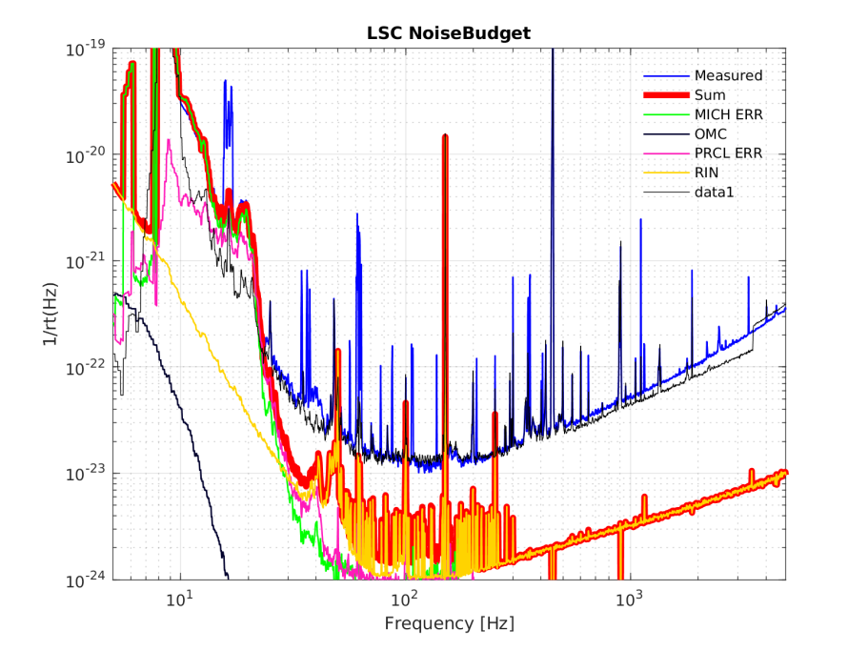
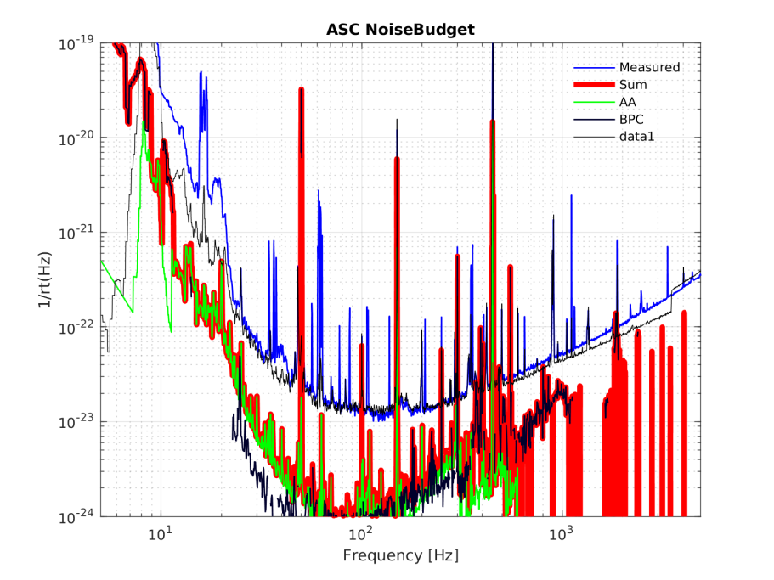
ISC reliability and sensitivity
Longitudinal noise budget
Angular noise budget
Limiting below 20Hz
Not limiting yet, but close
Maddalena Mantovani

Slide 21
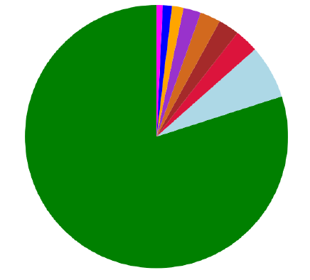
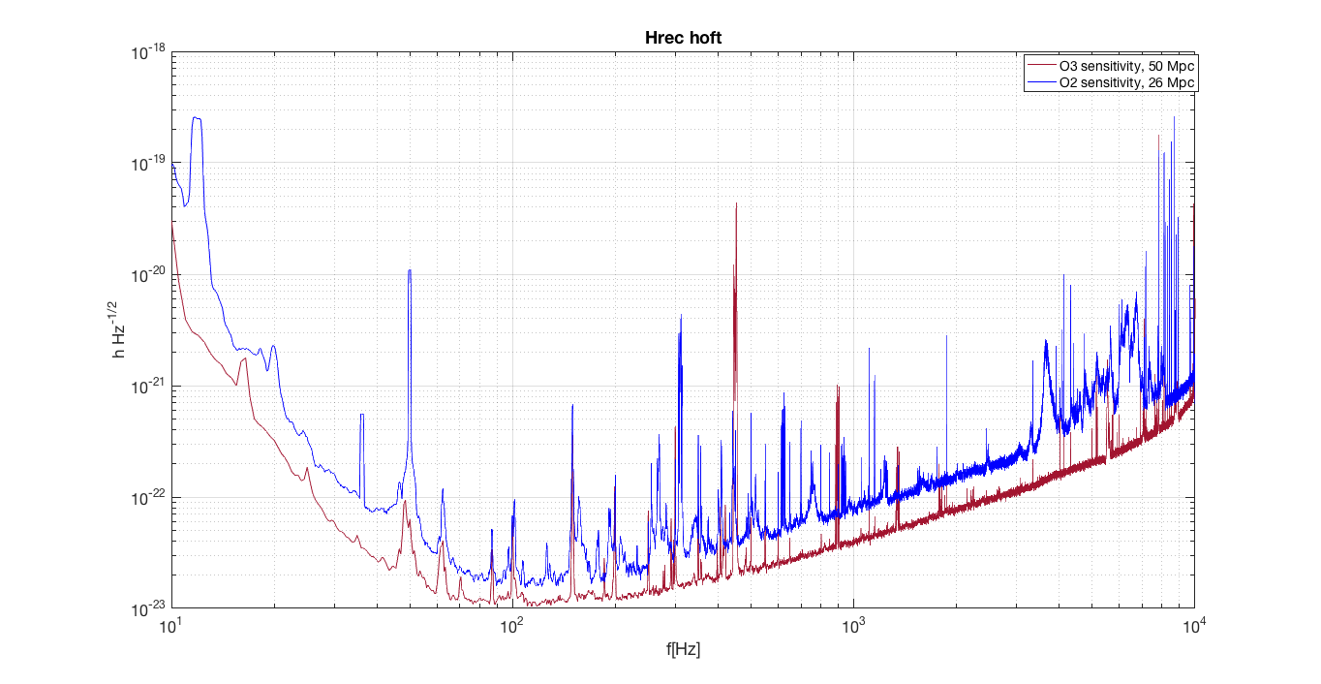
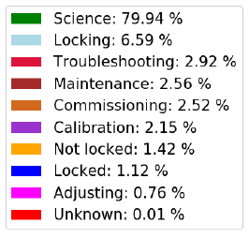
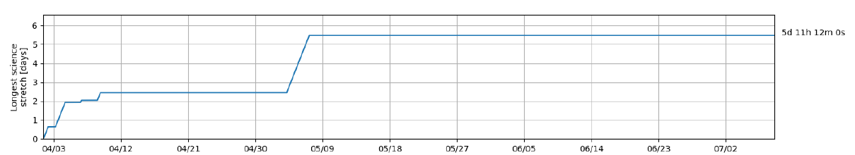
ISC reliability and sensitivity
I. Nardecchia
See N. Arnaud’s talk
Maddalena Mantovani

Slide 22
Conclusion & next steps
The ISC subsystem is strongly affected by the ITF behavior, especially in case of Marginally Stable recycling cavity, thus strong efforts have been employed to ensure the ITF reliability.
The tuning of the ITF working point has to be carried out together with the compensation of the thermal effects.
The system turned out to be robust and well behaving
Maddalena Mantovani

Slide 23
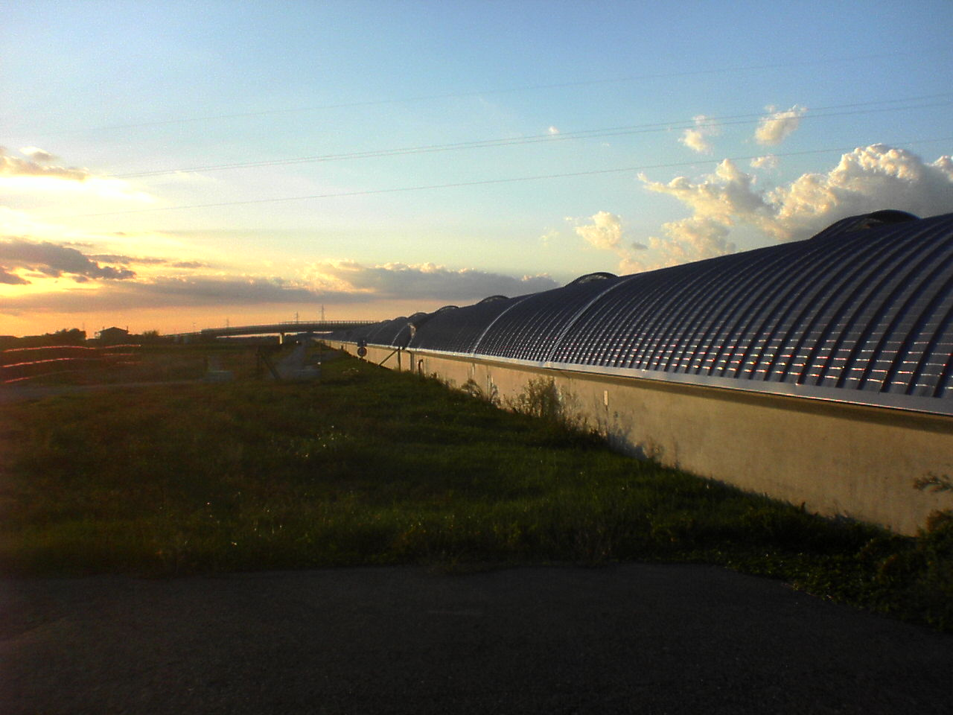
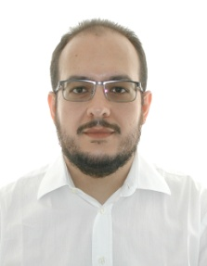


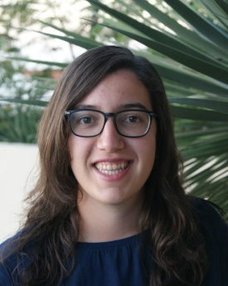

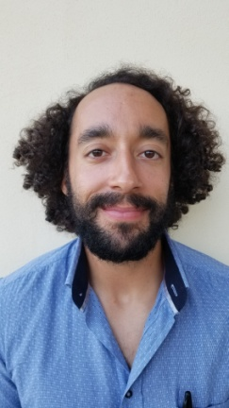
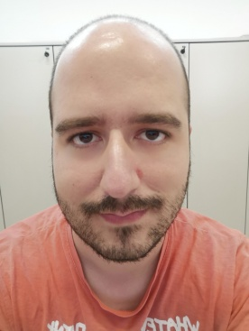

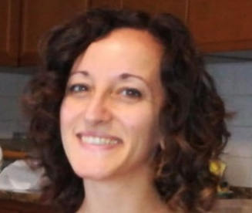
ISC team
D.Bersanetti
M. Mantovani
M. Boldrini
J. Casanueva
P. Ruggi
J. Brooks
M. Valentini
M. Vardaro
A. Allocca

Slide 24
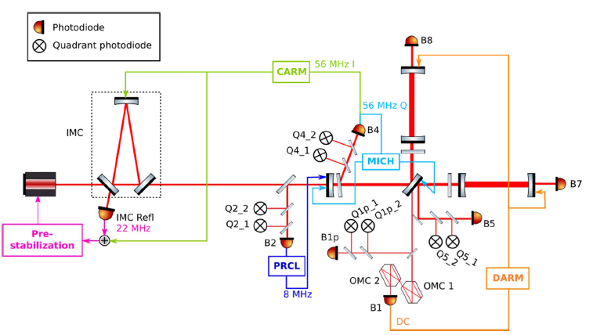
LSC control scheme

Slide 25
Introduction
Several changes have been performed, but most of them had a direct impact on the complexity of the ISC subsystem commissioning
Reducing the Quantum noise:
increase the Arm finesse
  Dynamical effects in the cavity locking signals
  Radiation pressure effects
increase the input power
  Larger thermal effects
  Radiation pressure effects
  Larger scattered light
Inject squeezed light
Reducing the Thermal noise:
Increase the mirror masses
Increase the beam size on the mirrors
  This led to have a marginally stable recycling cavity (space constrain)
- Monolithic suspensions
Maddalena Mantovani

Slide 26
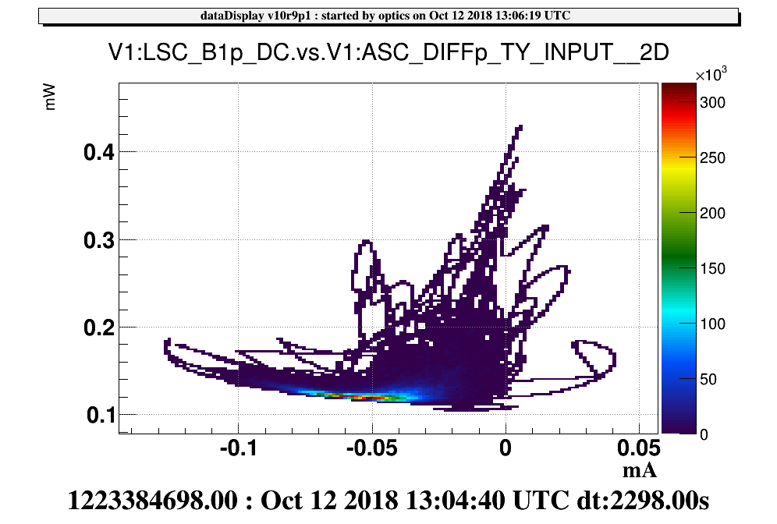
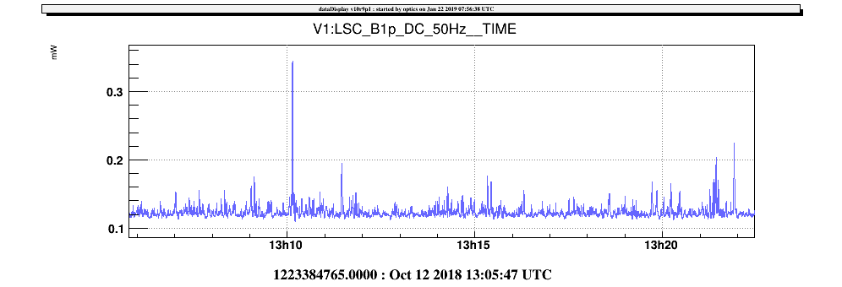
DIFF(+) yaw error signal vs Suspended detection bench alignment
The DIFFp TY error signal was asymmetric and was not possible to run @ the correct working point (the minimum of B1p DC). The behavior pointed towards scattered light issues on the SDB1 bench.
Optimal wp
This mis-behavior could be cured by tuning the angular position of the SDB1 bench to minimize the scattering on the dark fringe path (clipping, etc...)
Maddalena Mantovani

Slide 27
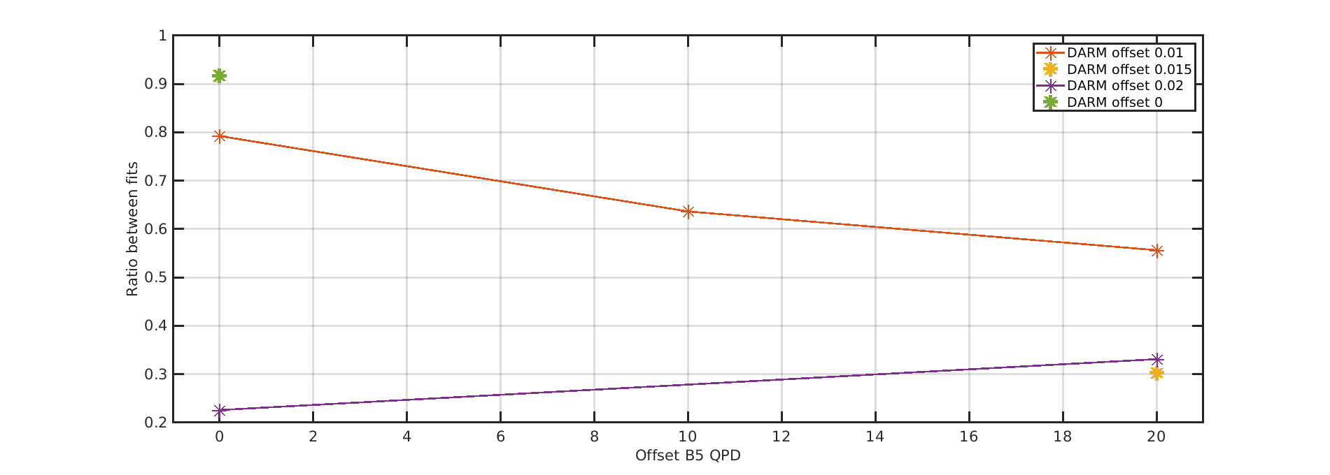
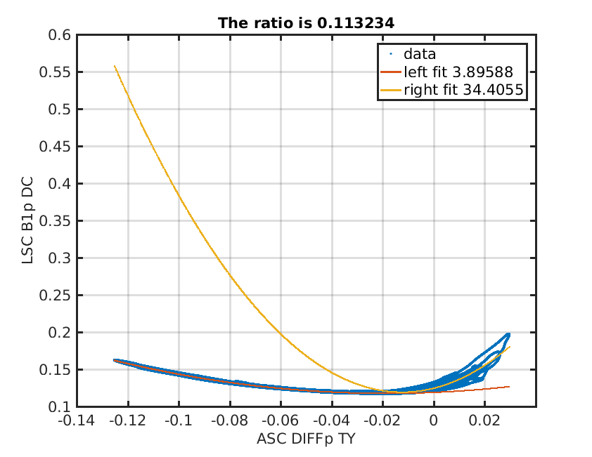
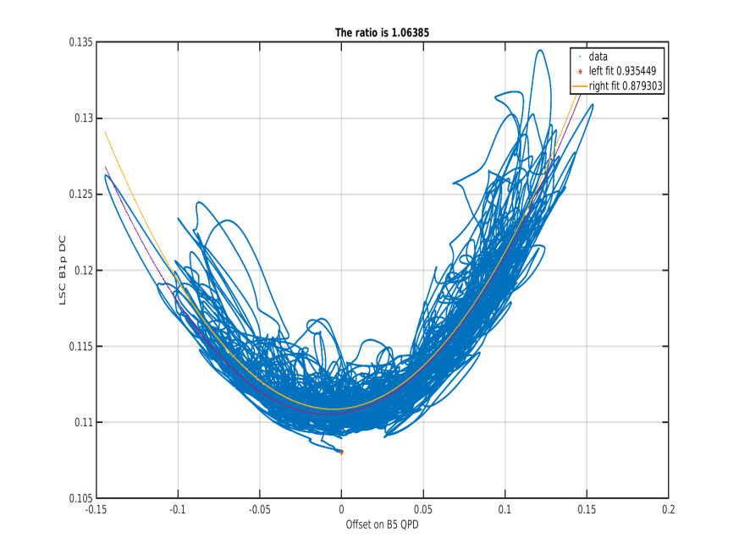
DIFF(+) yaw error signal vs Suspended detection bench alignment
Mantovani, Casanueva, Tacca, Gouaty, Bonnand
The symmetry of the parabola has been evaluated as a function of the SDB1 alignment and the symmetry and good behavior have been recovered.
AFTER ratio = 1.06
BEFORE ratio = 0.11
Maddalena Mantovani

