Slide 1
First test on final Monolithic suspension payload
E. Majorana

Slide 2
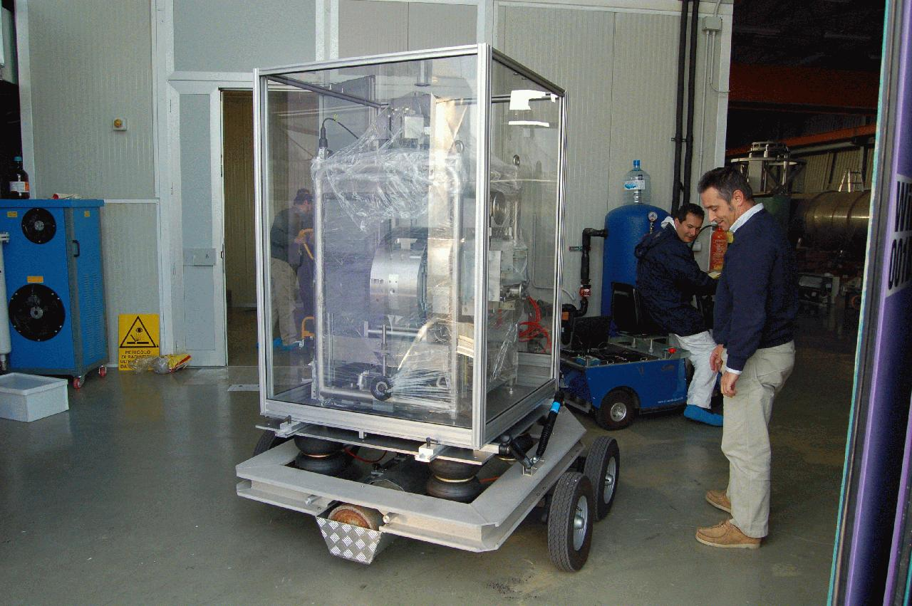
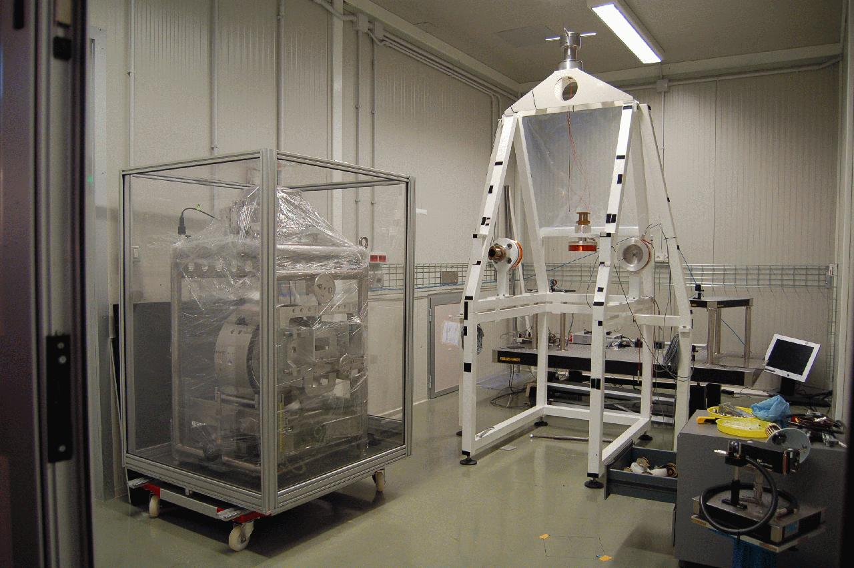
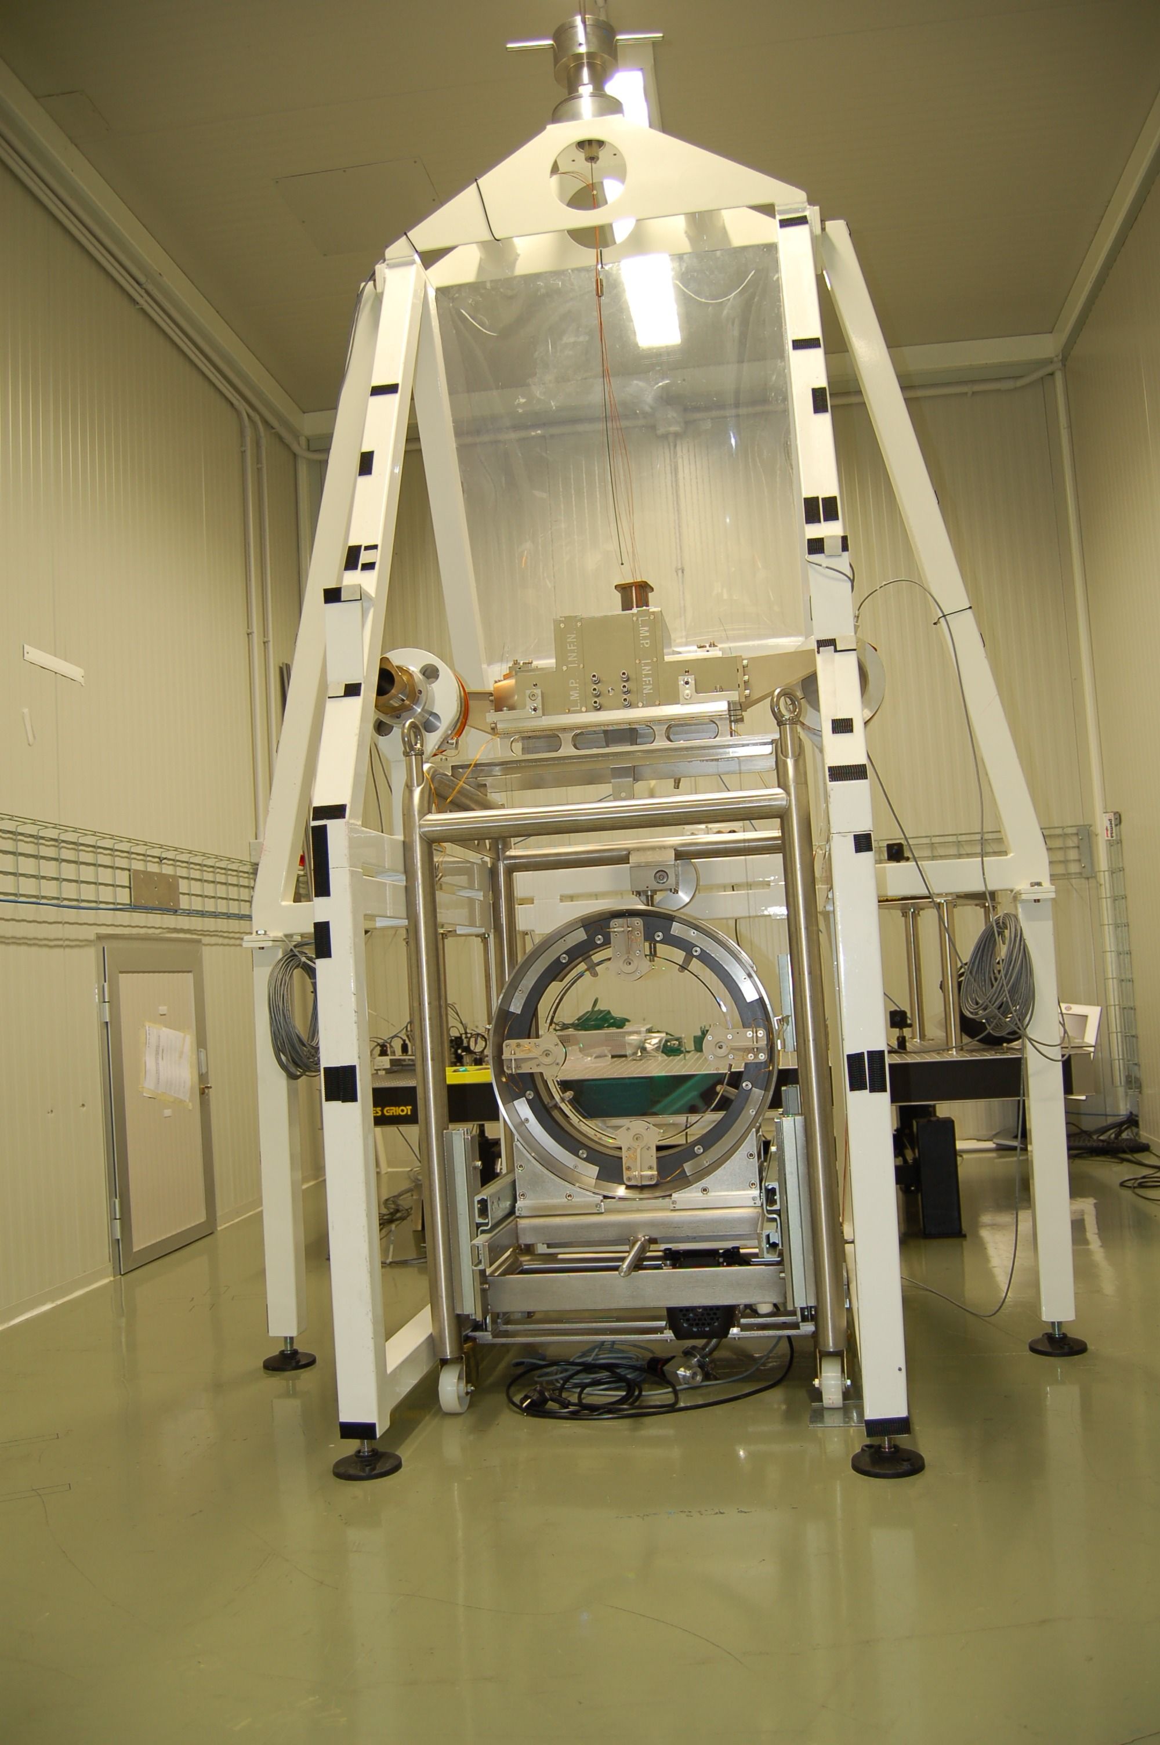
I) Payload Assembly
II) Transportation Test
III) Suspension in the test facility
Note: many infrastructure works done effectively and
well integrated with MS group needs

Slide 3
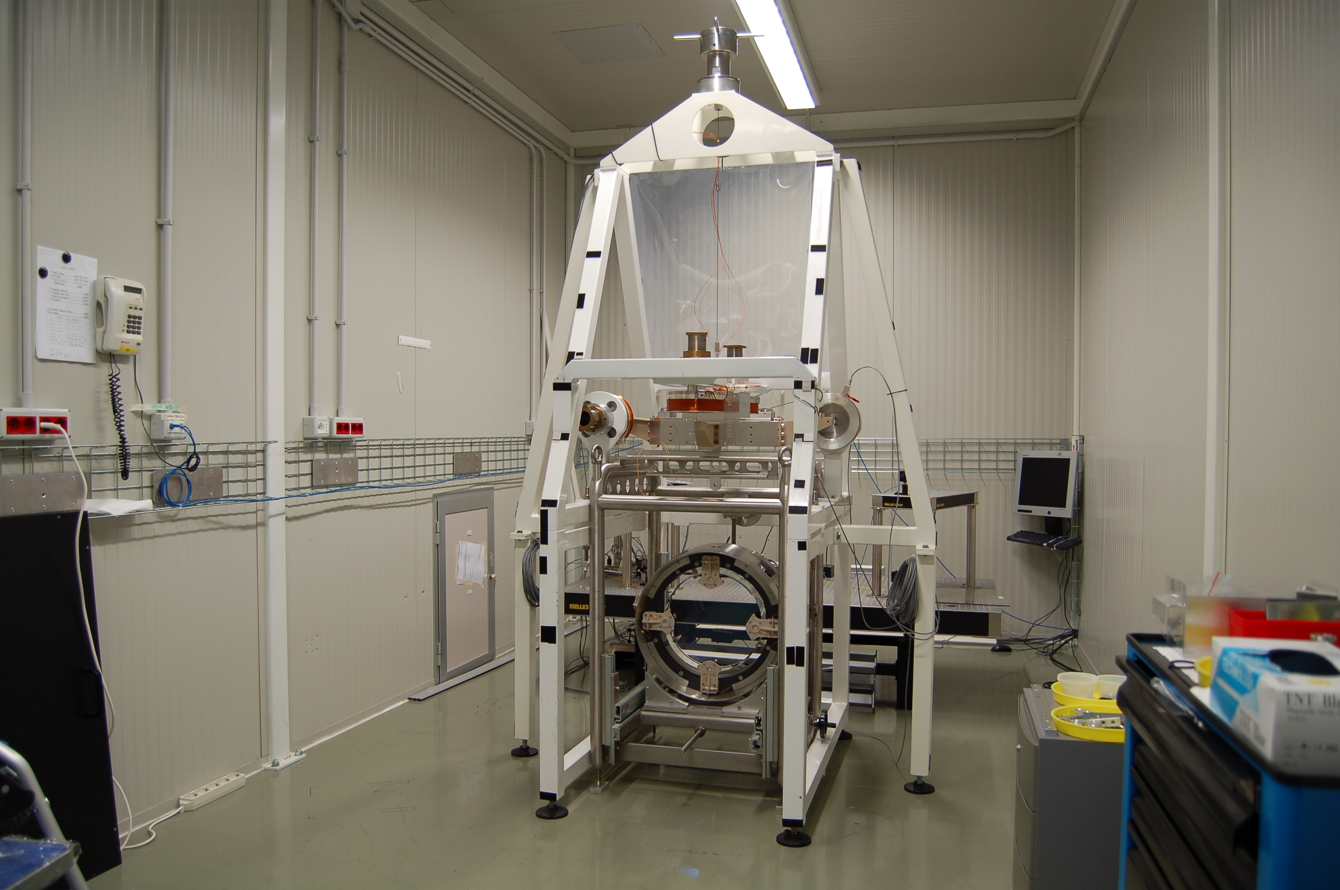
Thanks to the facility, fine payload balance can be studied carefully
That is crucial provided the new payload suspension configuration:
marionette barycentre close to suspension wire bending point

Slide 4
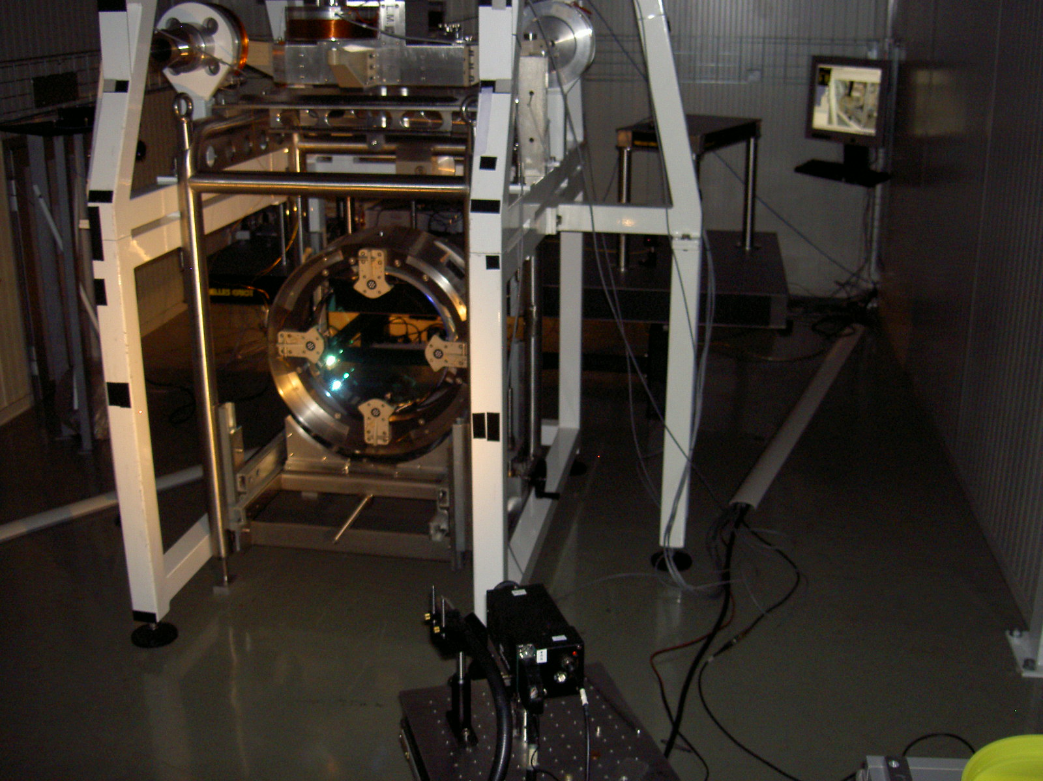
Installation complete and balance re-tuned
Balance accuracy critically dependent of the vertical suspension point of the marionette

Slide 5
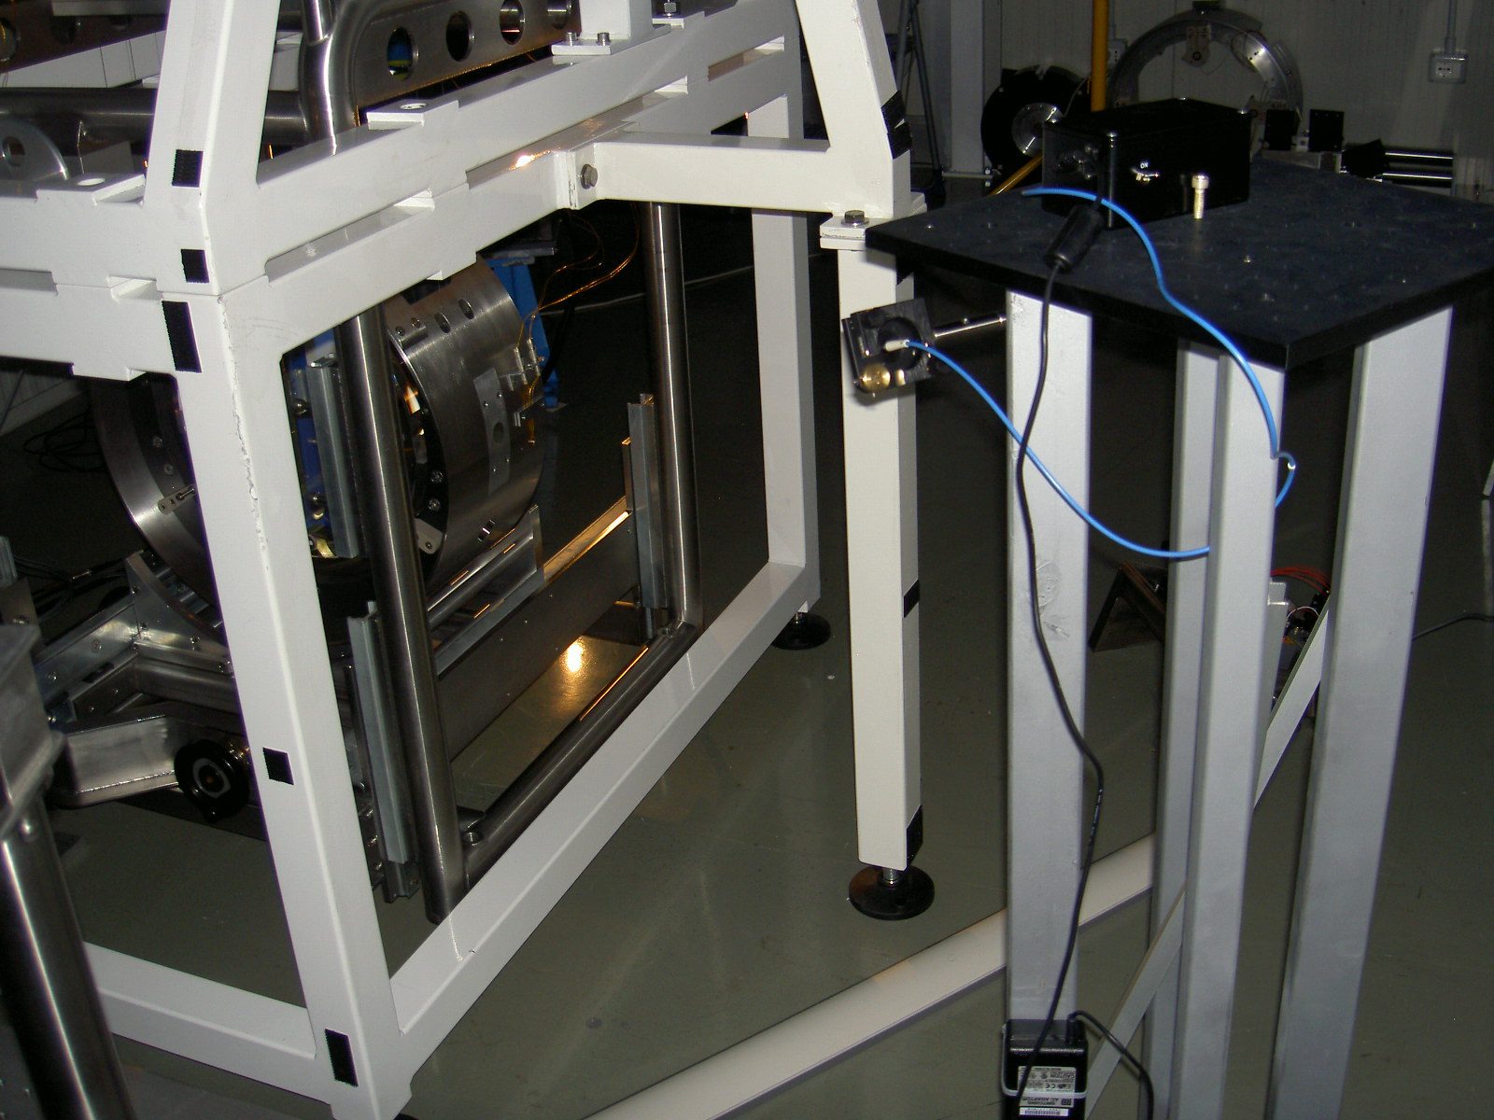
X (transversal oscillation)- readout prototype working (RM position)
No test of x-damping done yet, local conditions relatively poor

Slide 6
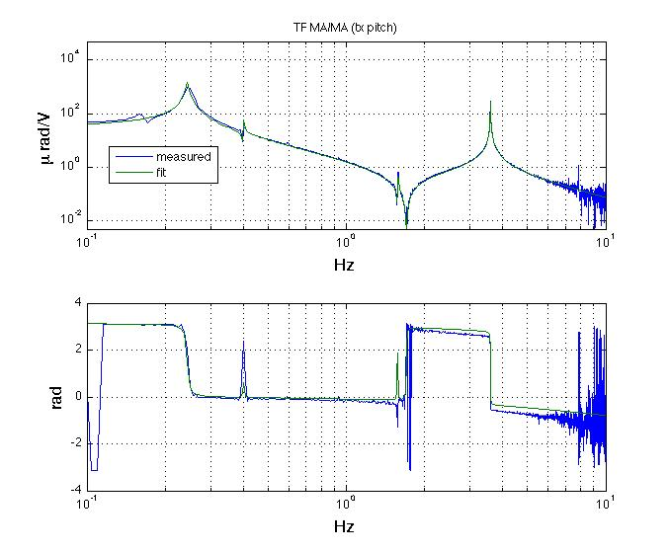
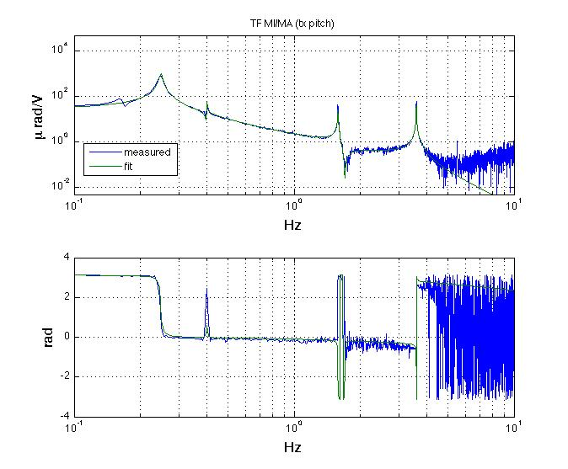
Pitch TF (tx)
tx Ma/Ma DC=35 urad/V
Type f (hz),Q
P 0.244,45
Z 0.399,200
P 0.402,200
Z 1.569,200
P 1.581,200
Z 1.703,200
P 3.595,500P 10
tx Mi/Ma
Type f (hz),Q
P 0.248,45
Z 0.399,200
P 0.402,200
Z 1.703,200
P 1.581,200
P 3.595 400
P 10

Slide 7
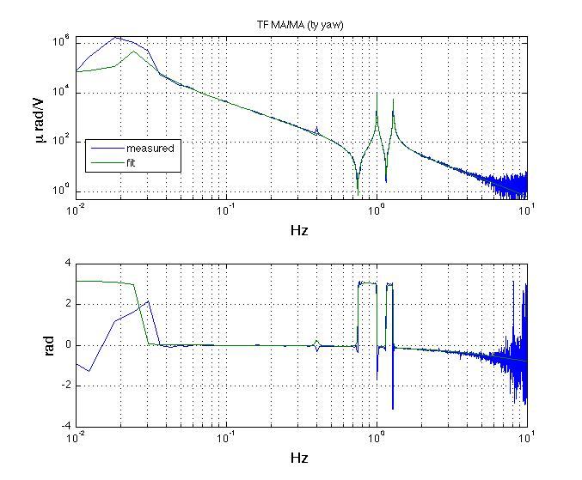

Yaw TF (ty)
ty Ma/Ma DC=60000 urad/V
Type f (hz),Q
P 0.023 ,45
Z 0.399,20
P 0.402,20
Z 0.7505,200
P 1.007,500
Z 1.16,200
P 1.294,300
P 10
ty Mi/Ma
Type f (hz),Q
P 0.026,45
Z 0.399,20
P 0.402,20
Z 0.7505,200
P 1.007,500
P 1.294,300
P 10

Slide 8
Measurements in progress...
According to the design the suspension point can be adjusted and fixed during the
assembly procedure by 10 mm
But it should be frozen rapidly in order to fix the length of marionette suspension wire
(presently we are working with the suspension point 7mm below the wire bending-point)
Hence the actual margin of adjustment is tiny
Anomalous coupling tx => ty and tx=>tz
hardware mistake/mistuning OR poor mechanical accuracy in marionette actuator setup ?
Within one week the problem must be addressed (Huet/Ruggi already at work)
The most pessimistic solution: rising-up the suspension point
The most optimistic finding: actuator setup easily retuned
(coil/magnet pairs alignment and centering)

