Slide 1

Virgo/EGO Outreach
11/2011

Slide 2
Outreach Group
Carlo Bradaschia
Elena Cuoco
Giuseppe Di Biase
Severine Perus
Gabriele Vajente
(Federico Ferrini)

Slide 3
Site Visits
As usual since several years, every Saturday (Tuesday) morning 20-50 visitors
Guides:
Barsuglia, Boschi, Bradaschia, Calloni, Carbognani, Cella, Chiummo, Colacino, Cuoco, Dattilo, Ferrante, Frasconi, Mantovani, Paoletti, Passaquieti, Passuello, Perus, Ricci, Swinkels, Tonelli, Vajente

Slide 4
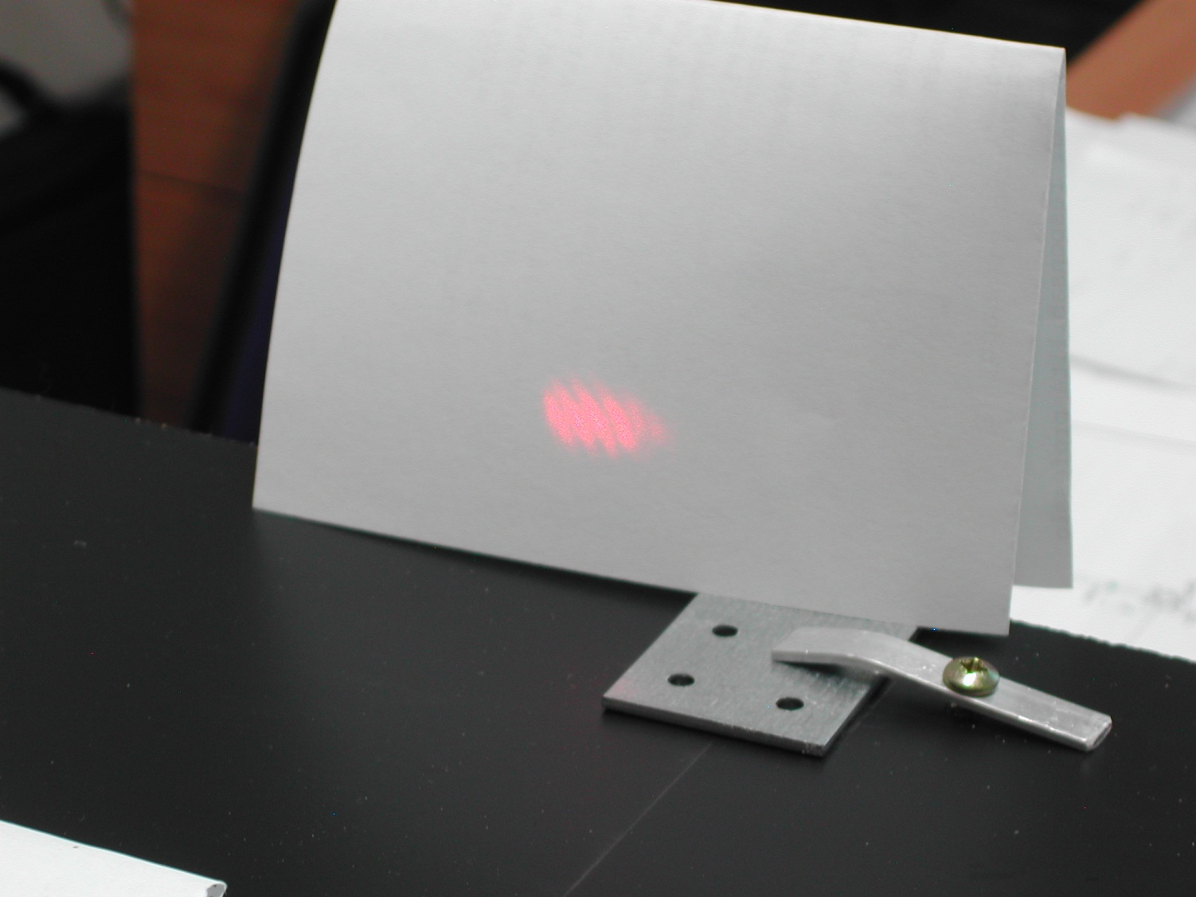
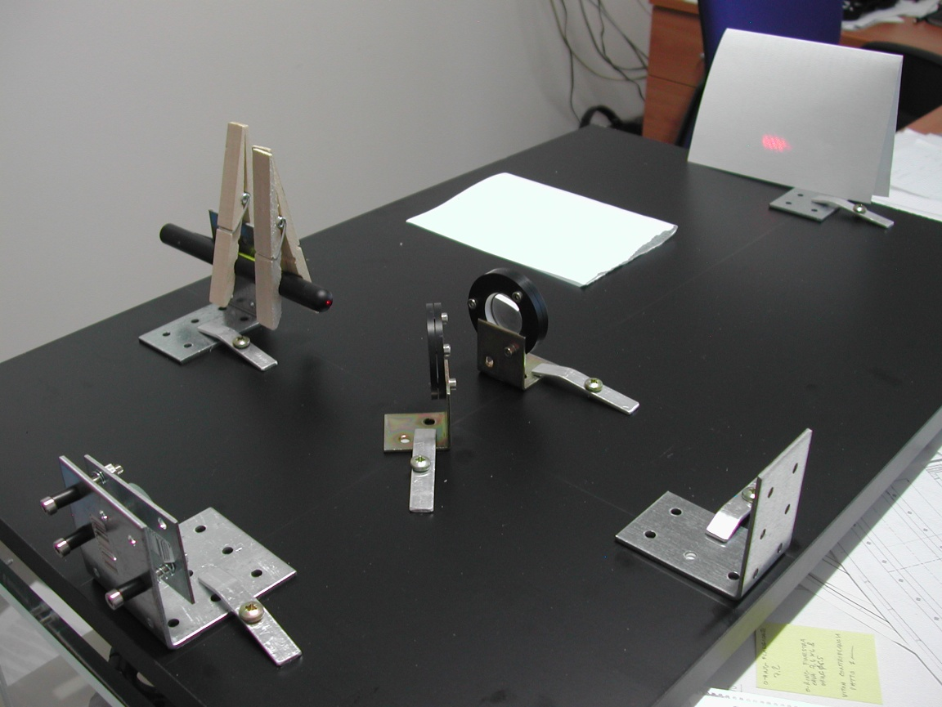
TV
We (Gabriele Vajente and C. B.) have been invited to talk about Virgo and to perform the assembly of a 100 € interferometer at GEOMagazine, a popular afternoon science show of the national TV chain RAI3.
It has been successfully recorded on October 28.
The 13 minutes video will be broadcasted next Tuesday.

Slide 5



European Researchers’ Night
23 (and 24) September2011
EGO/Virgo answered successfully the European call as partners of
obtaining a modest share of budget: 2000€
…….and a lot of visitors > 750
www.frascatiscienza.it

Slide 6
Night 2011 program (23 and 24 September)
To See
Virgo
Tunnel
Control Room (taking data)
Interferometer (working model)
Superattenuator 1987
A real Payload
200 vistors
To Do
Virgo
Build your interferometer
Science
Meet the scientists (Science Cafe)
Astronomy
Observe the sky with the astronomers
150 visitors
Theatre
Big Bang monologue by Lucilla Giagnoni
Discussion on
Science, art, philosophy, religion
400 participants
In collaborazione con:
Comune di Cascina
Comune di Pisa
Astrofili Pisani Galileo Galilei
Regione Toscana
La Limonaia
INFN e Dipartimento di fisica
Fondazione CariPisa

Slide 7
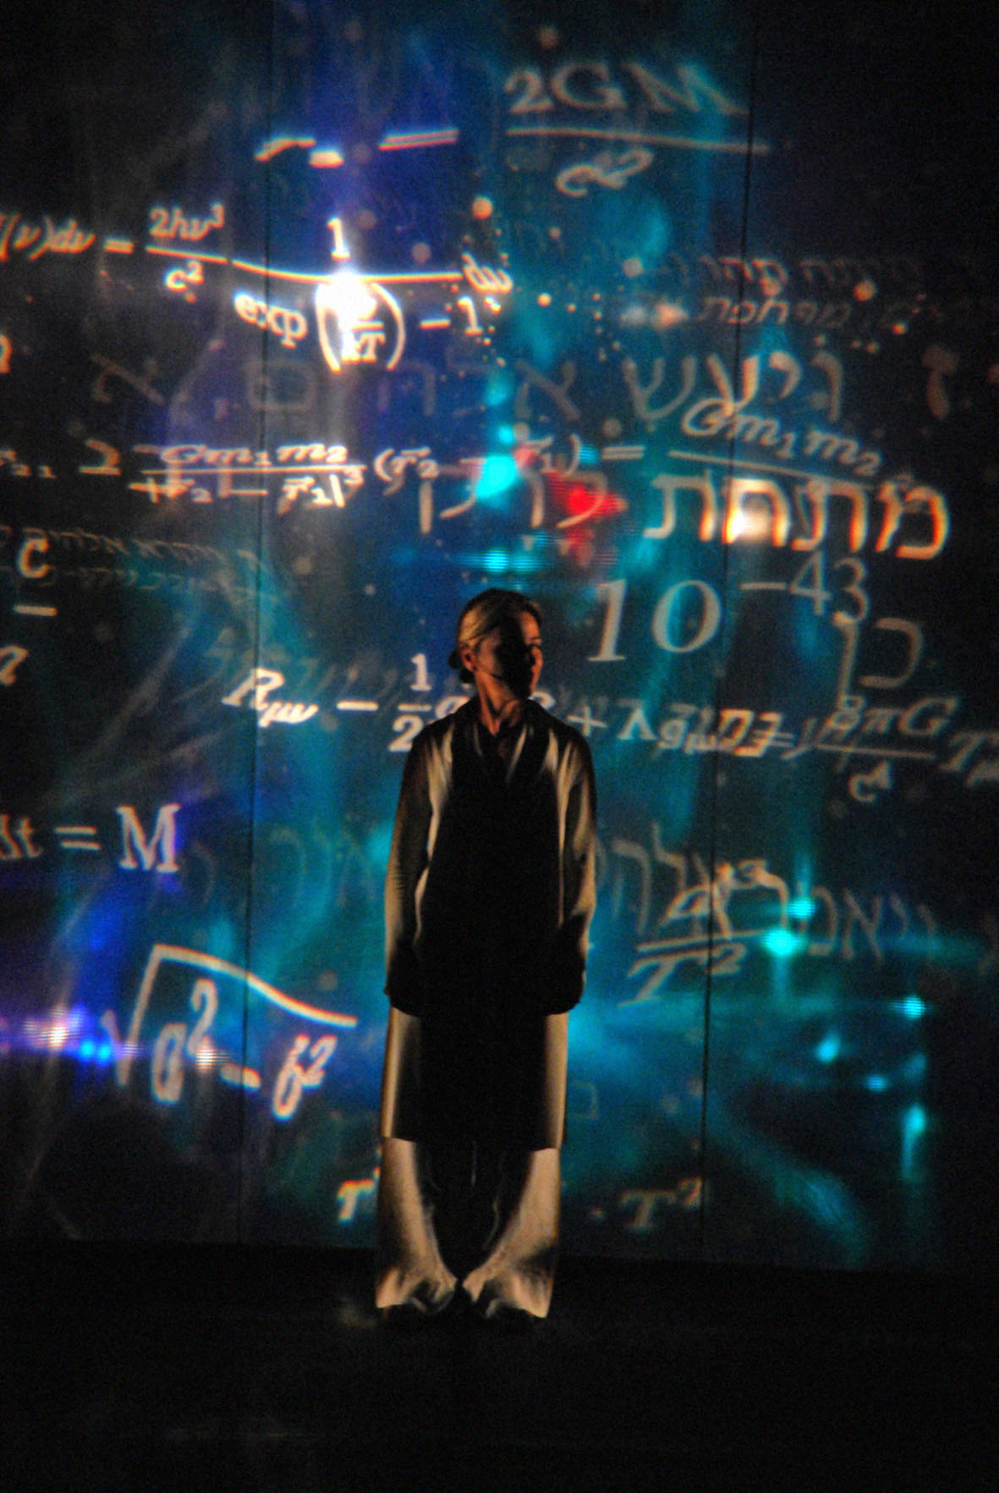
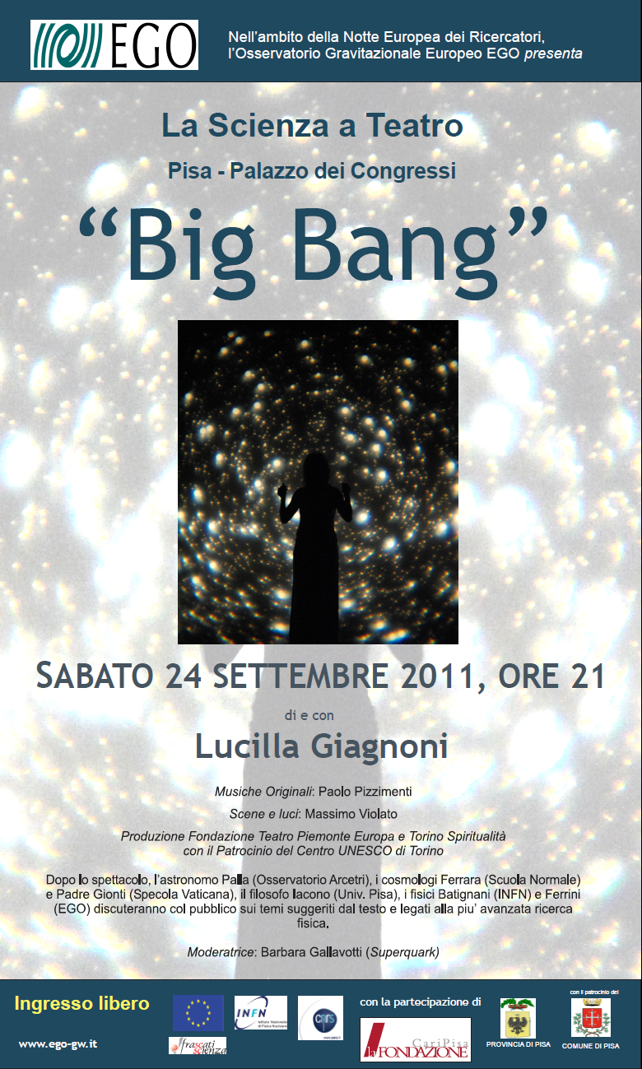

Slide 8
“Una Giornata da …… Ricercatore”
3rd November 2011
40 high school students from the surrounding Tuscany spent a full day at EGO.
Divided in four groups, guided by two tutors each, they performed in turn simple experiments on subjects related to Virgo:
Seismic and acoustic measurements
Signal analysis (time domain and frequency domain)
Comparison of a pendulum with an inverted pendulum
Air refraction index changing with pressure (counting fringe drifting in a small interferometer).
At the end the best teams (according to a quiz contest) have been rewarded with a Galileoscope, a working copy of Galileo’s “cannocchiale”
Tutors: G. Balestri, A. Basti, C.B., E. Cuoco, I. Fiori, F. Paoletti, M. Tacca
In the framework of the initiative “Pianeta Galileo” by Regione Toscana

Slide 9
European Researchers’ Night
28 (and 29) September2012
EGO/Virgo are considering the possibility to answer the European call together with the Arcetri observatory (dead line 10/01/12)

