Slide 1
Gravity field of subsurface mass changes in observation and simulation
VIRGO meeting 1 July, 2019,
European Gravitational Observatory, Cascina, Italy.
C. Braitenberg
University of Trieste
Co-authors to research:
Tommaso Pivetta¹ , Dora Francesca Barbolla², Ildiko’ Nagy¹, Barbara Grillo¹, Franci Gabrovšek³, Roberto Devoti⁴
1 Department of Mathematics and Geosciences, University of Trieste, Italy
2 Dipartimento di Scienze e Tecnologie Biologiche ed Ambientali, University of Salento, Lecce, Italy
3 Karst Research Institute, Research Centre of the Slovenian Academy of Sciences, Postojna, Slovenia
4 Centro Nazionale Terremoti, Istituto Nazionale di Geofisica e Vulcanologia, Roma, Italy.

Slide 2
Topics of talk
1) Introduction to the gravity field
2) Sources of gravity field changes
3) Transient deformation due to hydrologic effect: observation and model
4) Observed gravity changes in selected examples

Slide 3
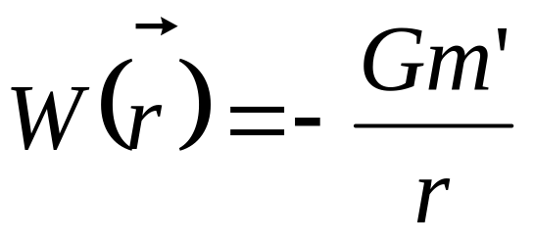
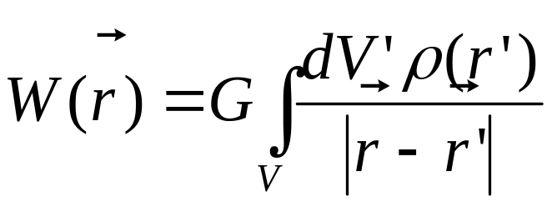
1) Introduction to the gravity field
Gravitational potential for a point mass:
Potential of extended body:
Change of potential: either through change of density distribution or change of the geometry.

Slide 4
Modeling the gravity changes
Gravity anomaly = Observed gravity - gravity of the earth ellipsoid
Local modeling exemplified with geometric bodies, as sphere, cylinder, prism, that describe the mass changes with respect to the starting situation.

Slide 5
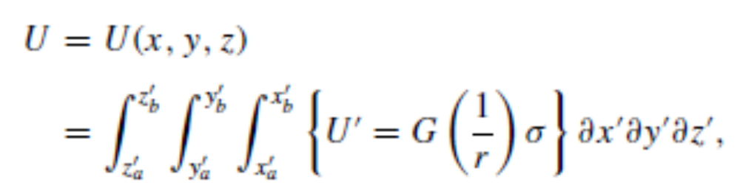
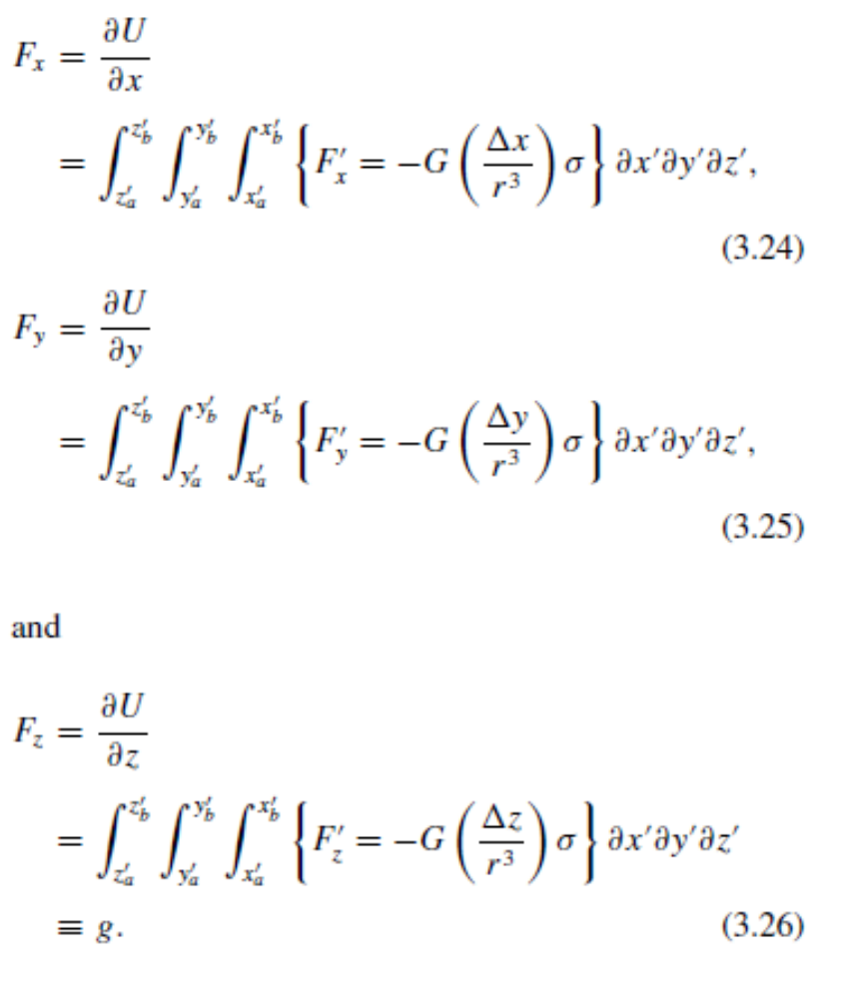
Gravity Potential effect of extended mass body
Gravity force of extended mass body:
Hinze, von Frese, Saad, 2013

Slide 6
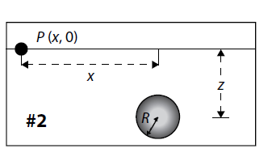
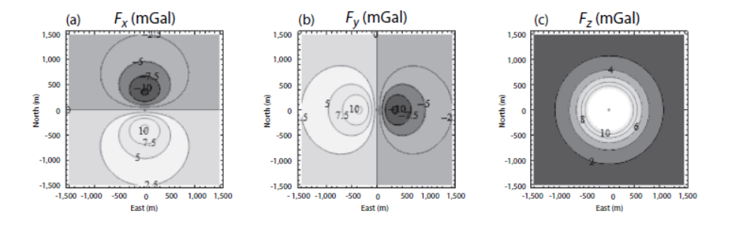
Force field components due to a buried sphere
Vertical section:
Map of field components:
Gravitational acceleration for a point mass with m=10¹² kg at depth z=500 m.
Corresponds for example to mass of radius r=440 m, density rho=2700 kg/m3
Hinze, von Frese, Saad, 2013

Slide 7
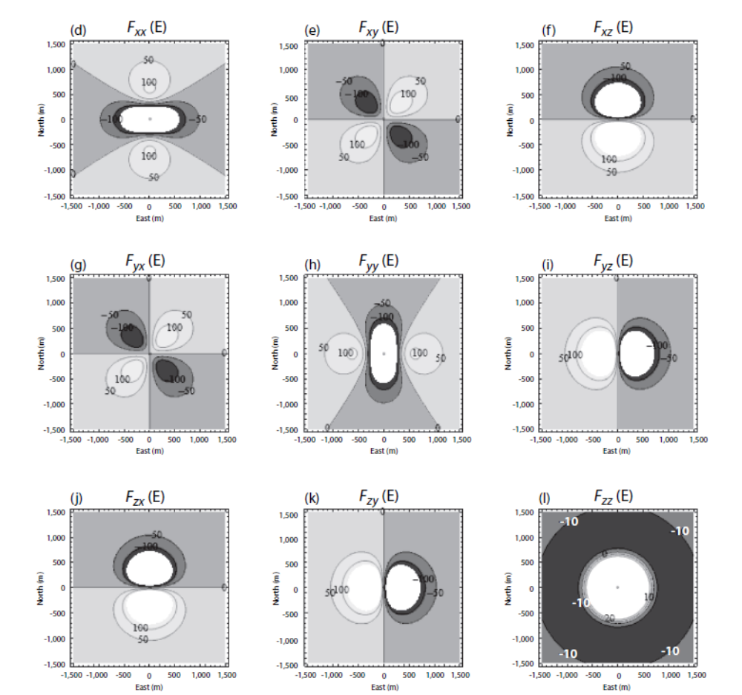
Gradient field components

Slide 8
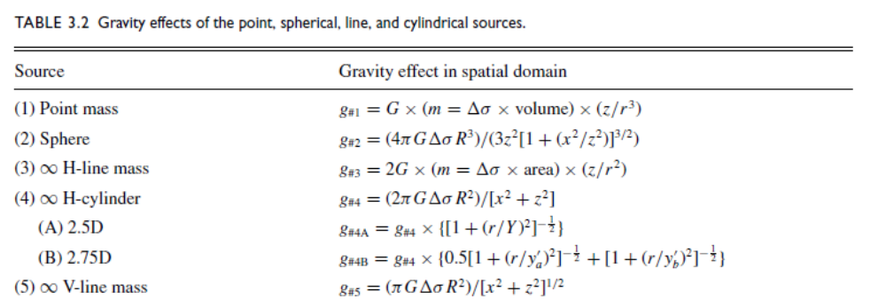
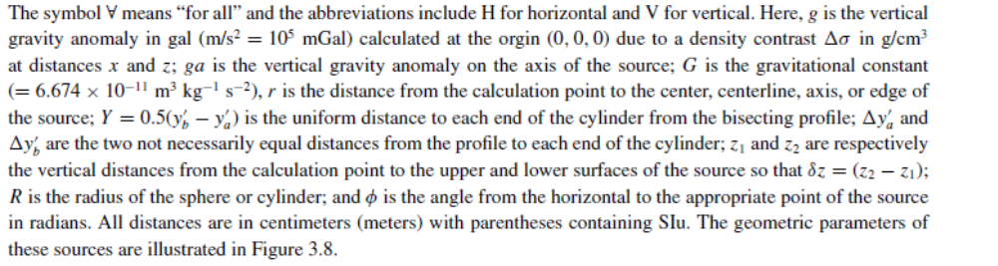
Integrated field for specific geometrical bodies

Slide 9
gravity meters- type of instruments
relative gravimeters: linear and astatized systems
- absolute gravimeters
gradiometers
continuous recording of gravity changes at a site

Slide 10
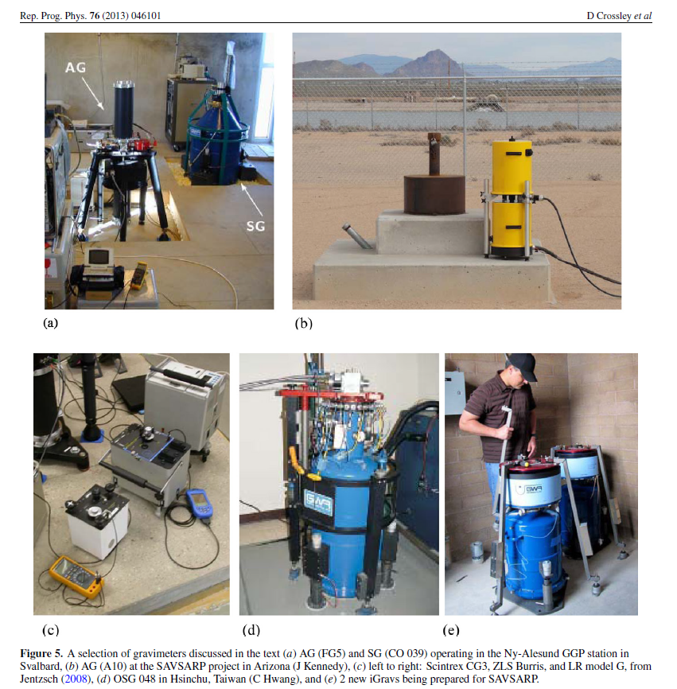
Spring- superconducting and absolute gravity meter

Slide 11
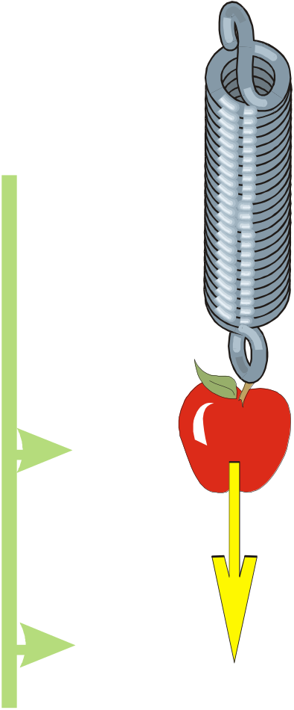
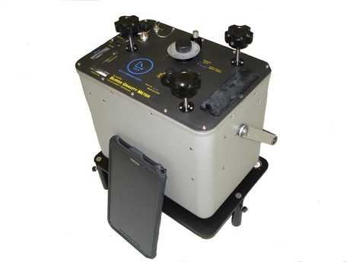
Relative gravimeters: linear and astatized systems
The principle of spring gravimeters:
ZLS-gravimeter (Burris gravimeter)
Resolution at 10⁻⁹ g level (= 1 microGal = 10 nm/s2)

Slide 12
Pendulum type instruments
Increase sensitivity by introducing a rotational system. Consider torques.
Astatization: make system so it is near to stable in any position.
Variation of gravity torque should be very similar to torque exerted by spring in function of the rotation of beam.

Slide 13
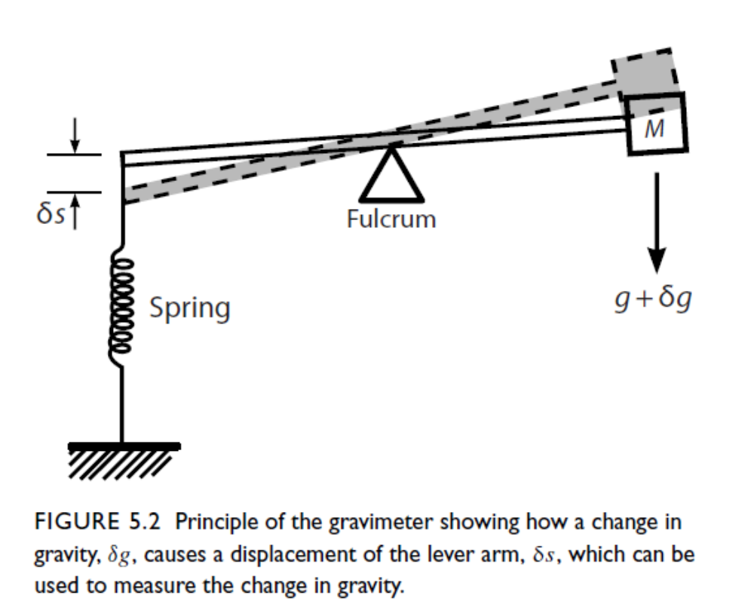
Principle of the astatization: counterbalance of the mass to increase sensitivity of the construction.

Slide 14
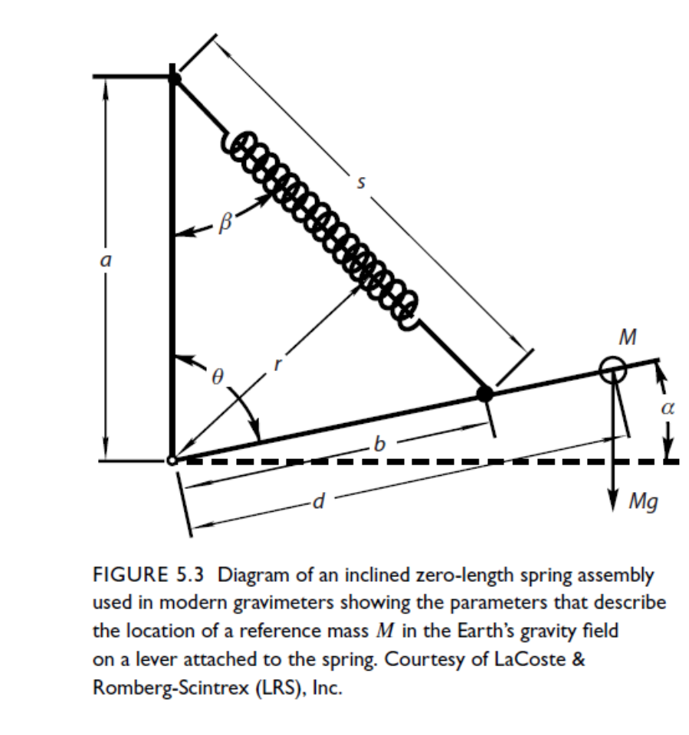
Astatized system. Consider the torque of the spring and of the gravity force of the mass that acts on the beam of length d on which the mass is fixed.
The spring is a special zero-length spring.
Torque due to the Spring, where the
positive torque indicates clockwise
rotation of the beam.
$$T_{f}=−D\left(s−s_{0}\right)r$$
D= elastic constant of spring.
Zero length spring:
$$T_{f}=−Dsr$$
Torque of gravity:
$$T_{g}=Mgd cosα$$
At equilibrium: T_{g}+T_{f}=0

Slide 15

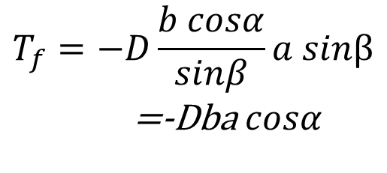
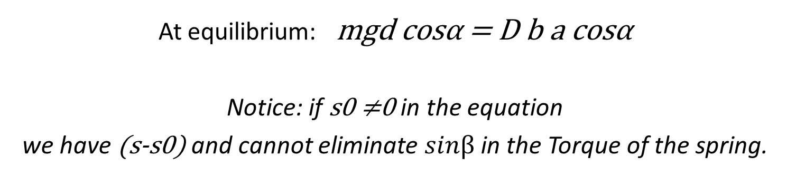

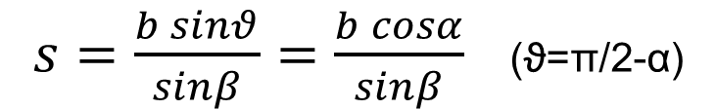

Apply the law of sines to the triangle of sides a,s,b:
$s=\frac{b sinθ}{sinβ}=\frac{b cosα}{sinβ}$ (ϑ=π/2-α)
$$r=a sinβ$$
$$T_{f}=−D\frac{b cosα}{sinβ}a sinβ$$
=-Dba $cosα$
Torque of gravity:
$$T_{g}=Mgd cosα$$
At equilibrium: mgd cosα = D b a cosα
Notice: if s0 ≠0 in the equation
we have (s-s0) and cannot eliminate $sinβ$ in the Torque of the spring.
$$T_{f}=−D\left(s−s_{0}\right)r$$

Slide 16
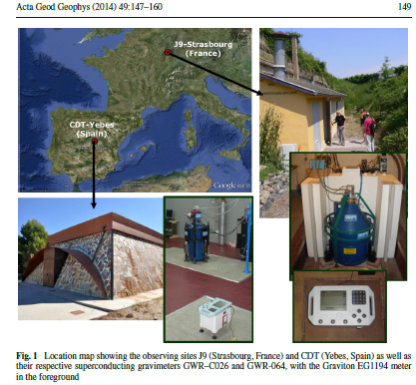
Superconducting gravimeter
Usually laboratory instrument
Resolution and drift shows best performance.
Resolution at 10⁻¹⁰ g level.
(Arnoso et al., 2014)

Slide 17
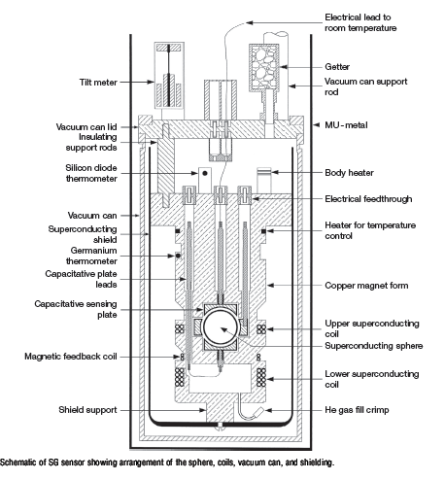
Superconducting gravimeter principle
Three major superconducting elements are the levitated mass (sphere), the field coils, and the magnetic shield.
The levitation force is produced by the interaction between the magnetic field from the coils and the currents induced on the surface of the superconducting sphere.
The use of two coils allows the operator to independently adjust both the levitation force and the magnetic gradient. The upward levitation force is mainly produced by the lower coil. Its current can be precisely adjusted to balance the time-average downward force of gravity on the sphere at the center of the displacement transducer. The upper coil is used to adjust the magnetic force gradient (‘spring constant’), which can be made very weak. As a result, a very small change in gravity (acceleration) gives a large displacement of the test mass, generating an instrument of very high sensitivity.
Superconducting Gravimetry 65
Treatise on Geophysics, 2nd edition, (2015), vol. 3, pp. 59-115

Slide 18
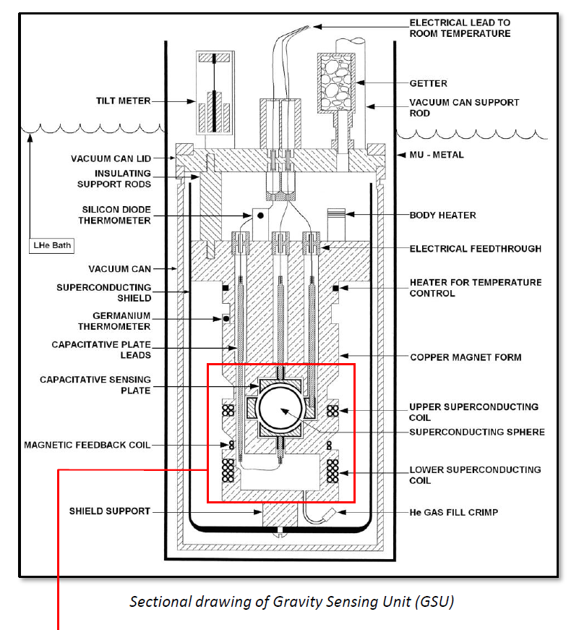

Slide 19
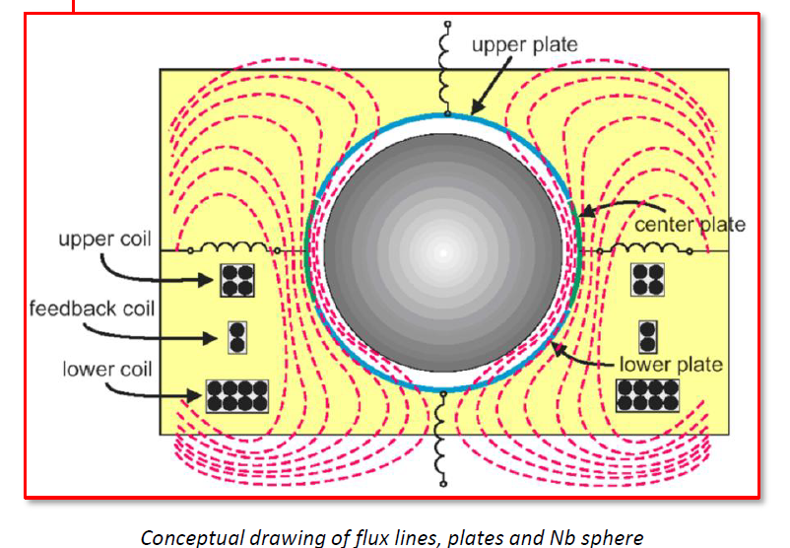
Magnetic levitation

Slide 20
Absolute gravimeters
(1) pendulums of different designs
- so-called Sterneck-pendulum for ‘field measurements’;
- reversion pendulum for operation in a laboratory under stable cond.
→ Today: no use anymore
(2) free-fall gravimeters
A mass is dropped in an evacuated tube and the time and distances
are measured.
- rise-and-fall principle
- free-fall principle (most important: JILA absolute gravimeter by Faller et al., 1983, and Niebauer et al., 1986)
special features:
- very short height difference of less than ½ meter
- ellimination of seismicity by using a long-period seismometer as support (super-spring)
- accuracy is now better than 50 nms⁻²
- a transportable ‘field version’ is now available.

Slide 21
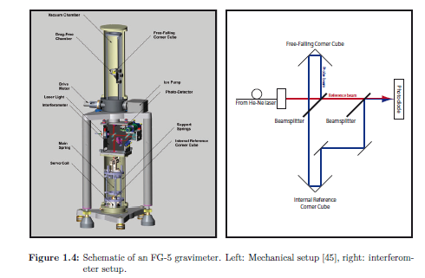
JILA FG-5 absolute gravimeter
Accuracy goes down to ± 2 µGal.
From Torge (1989)

Slide 22
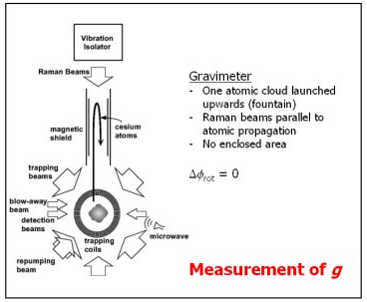
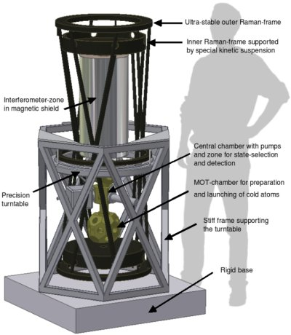
Atom interferometric gravimeter
Targeted accuracy: 10⁻⁹ g
https://www.physik.hu-berlin.de/

Slide 23
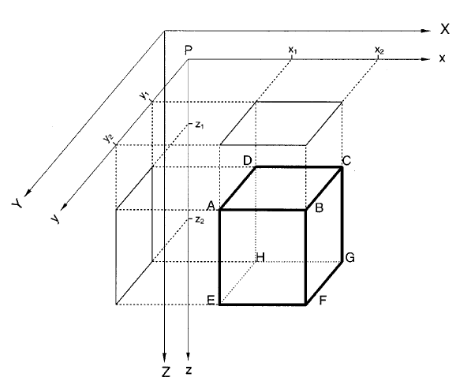
Gravity forward modeling with a discretization in prisms.
- Prism defined by vertices
- Any geometry of masses approximated by prisms
Gravity effect of prisms is calculated analytically.
Nagy et al., 2000

Slide 24
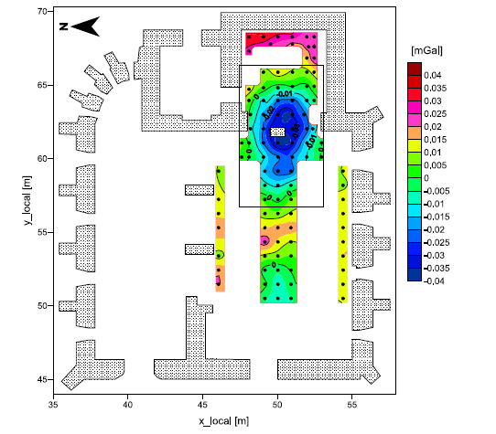
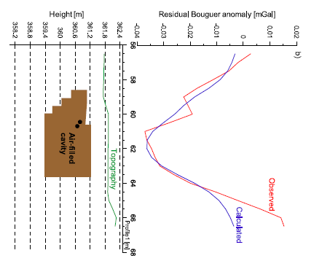
Application of gravity in archeology. Find the underground void below a building.
Panisova e Pasteka, 2009

Slide 25
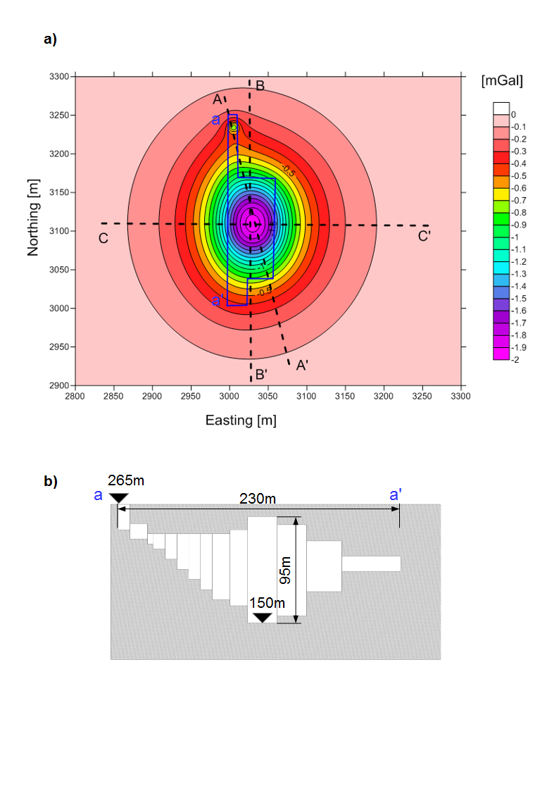
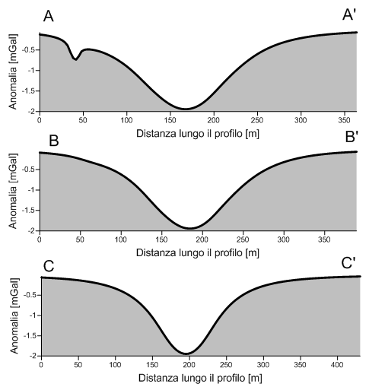
Sensitivity analysis for natural caves
Gravity effect of cave- simulation
2680 kg/m³
Pivetta & Braitenberg, Geophysics 2015
Braitenberg et al., PAGEOPH, 2016

Slide 26
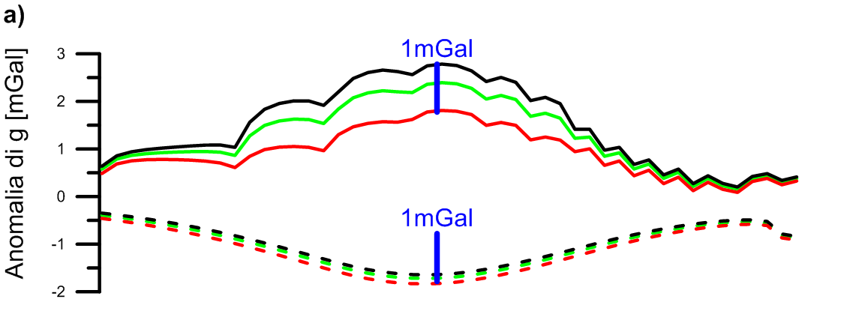
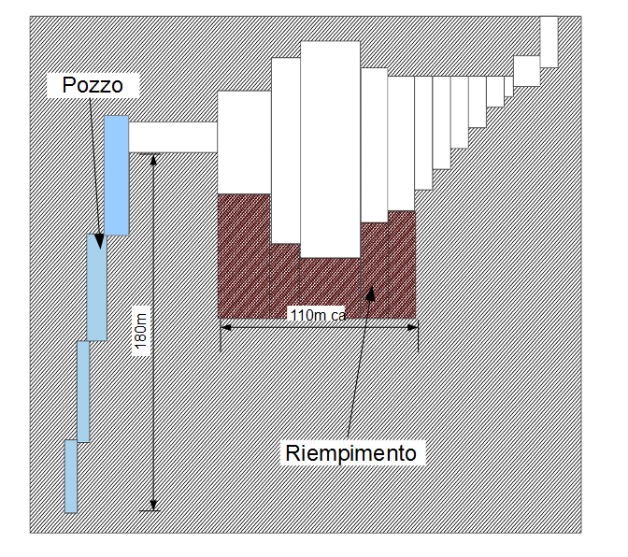
Simulated signal for a cave close to Trieste (Grotta Gigante)
= cave signal
= cave signal+infill (density 2200kg/m³)
= cave signal+infill (density 1700kg/m³)
Broken line= outer measurement
Continuous line= internal measurement
= measurement stations
Pivetta & Braitenberg, Geophysics 2015
Braitenberg et al., PAGEOPH, 2016

Slide 27
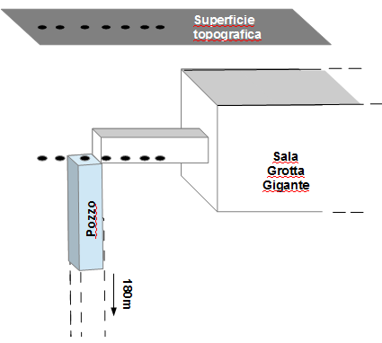
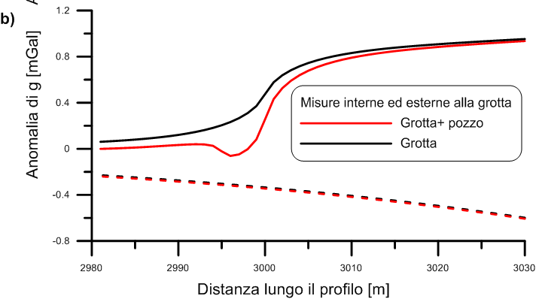
Synthetic models results of well
  Effect of internal well
Broken line= outer measurement
Continuous line= internal measurement

Slide 28
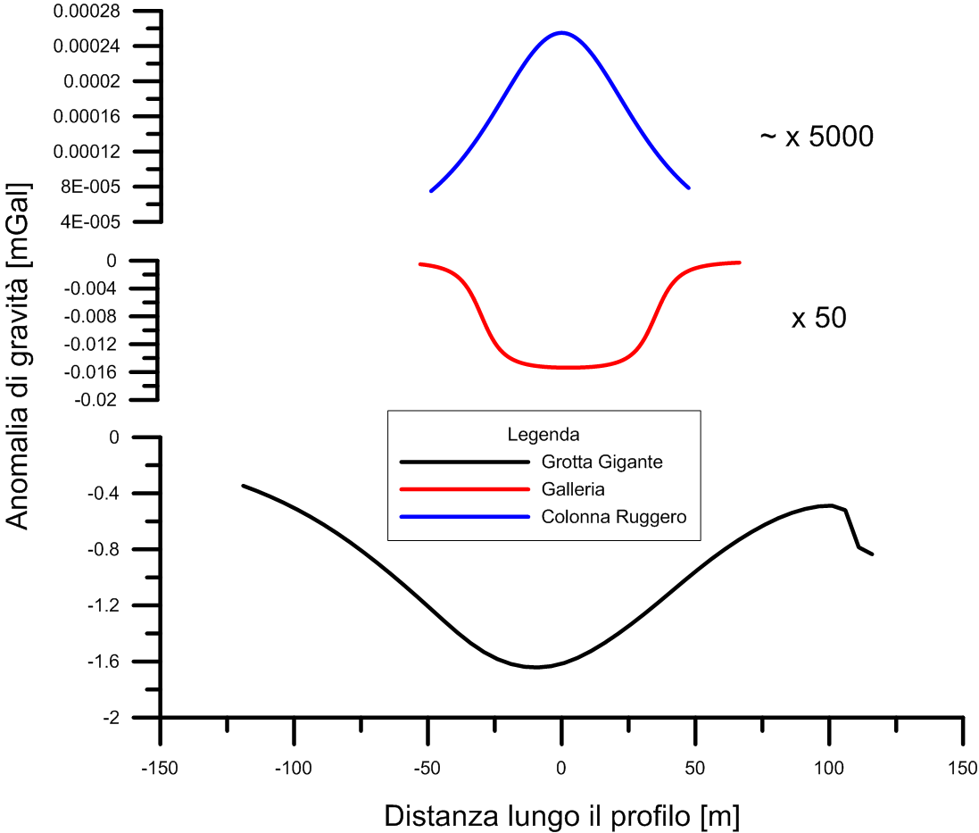
More synthetic models related to the cave
Stalagmite Ruggero
Gallery, 10m deep, 65m long, section 4m²
cave

Slide 29
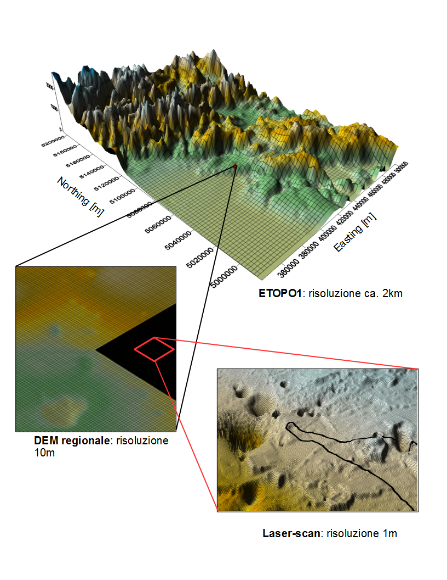
Forward model of effect of topography
Observations are corrected for effect of topography → Bouguer anomaly is obtained
More coarse resolution of digital terrain models used at increasing distance. (Laser-scan, Regional DEM, ETOPO1)

Slide 30
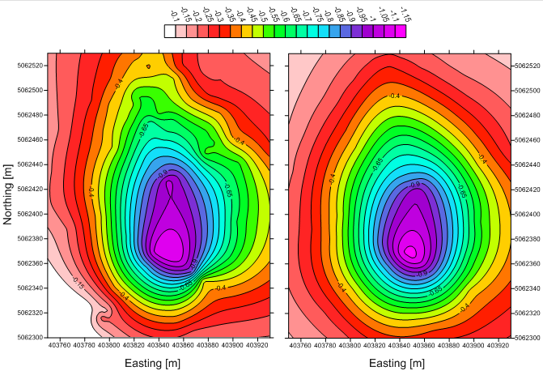
Model of gravity field generated by cave compared to observation
Observation Campaign 2013
[mGal]
Observed
Modelled

Slide 31
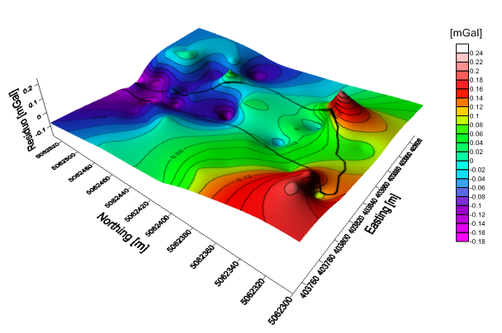
Excellent agreement between observed and modelled field
RESIDUAL

Slide 32
2 Sources of gravity field changes
Deformation of the Earth: change of earth’s shape. Causes are external loading (atmospheric pressure, hydrologic load, snow load), internal pressure
Mass redistributions as due to hydrology, snow, ocean
Deformation due to earthquake movement, and volcanism
Mountain uplift; basin subsidence through compaction or fluid extraction
Possible mass changes in the deep earth.

Slide 33
Summary of contributions to gravity observations
g(obs) = g(disturbances – instrument and site origin) +
g(tides – solid Earth, ocean) +
g(atmosphere – nominal admittance correction) +
g(polar motion – annual and Chandler) +
g(drift – instrument) +
g(hydro – rainfall, soil moisture, groundwater, surface water, ice) +
g(other – ocean currents, tectonics, slow earthquakes, GIA, .......)

Slide 34
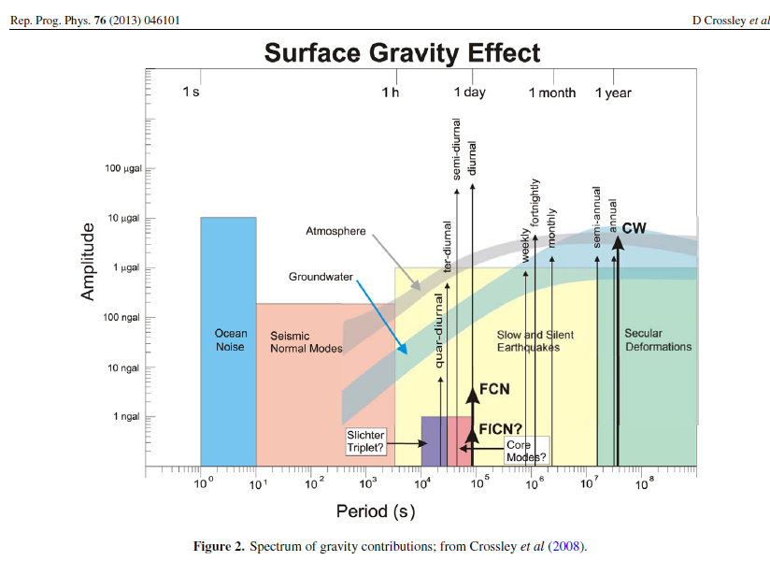
Amplitude-Frequency of gravity field: measurements of gravity are static or the time-variable field is observed.
FCN= free Core Nutation
FiCN: Free inner Core Nutation
Non alignment of the rotation axis of core and mantle
CW: Chandler Wobble. 435 day movement of earth rotation axis about figure axis

Slide 35
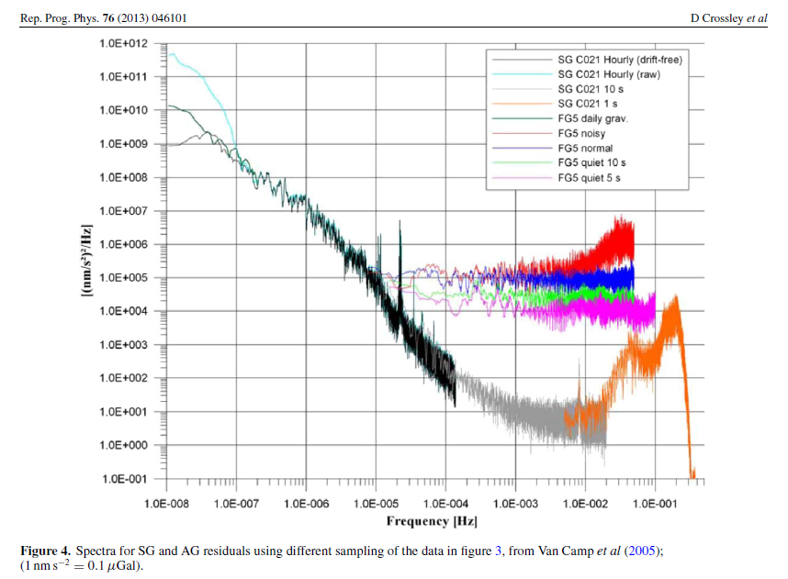
The relative gravimeters achieve higher accuracy than absolute measurements. In figure: SG: superconducting gravimeter. AG: absolute free fall gravimeter

Slide 36
Gravity change calculation
Define the mass change in terms of density and geometry.
Approximate through a series of small mass units, like small prisms
Density of prisms = new density – old density

Slide 37
3 Transient deformation due to hydrologic effect: observation and model
Proof of overpressure in Hydrologic channels
Elastic model of pressurized channel
Uplift and tilting of pressurized channel in Tilt and GPS of Trieste Karst
Response of mudfilled channels- Observations from Genziana station, Cansiglio Karst

Slide 38
1 Overpressure in Hydrologic channels
We start with introducing some general properties of the hydrologic system in a karst unit. The results are from the well studied Classical Karst which is divided between Italy and Slovenia.

Slide 39
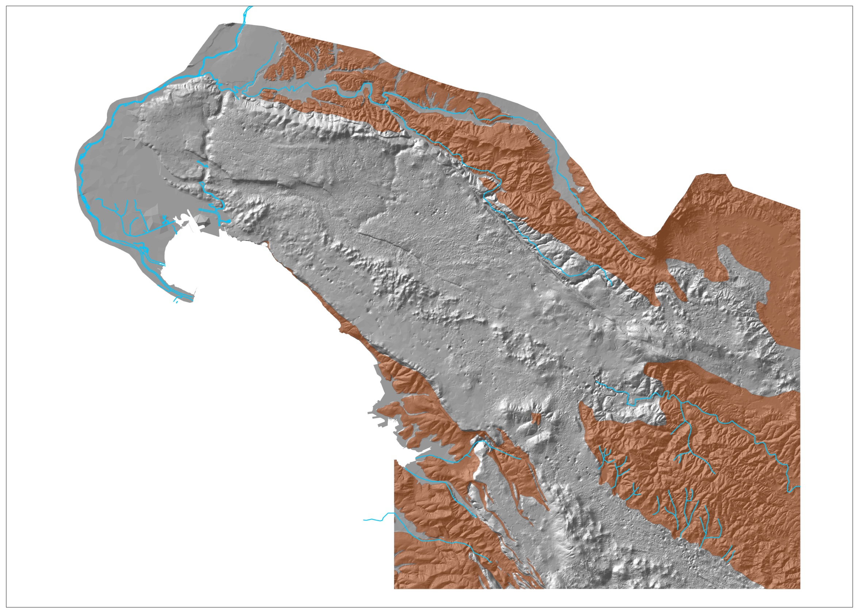
Isonzo and
Vipava rivers
10 m³/sec
WATER BALANCE OF CLASSICAL KARST
effective infiltration
21 m³/sec
Rasa torrent
0.5 m³/sec
Total discharge
35 m³/sec
SLOVENIA
The average evapotraspiration rate is from 450 to 750 mm.
Reka River
8 m³/sec
CLASSICAL KARST S.S.
basin = 660 km²
Classical karst s.l.
basin = 750 km²
rainfall: 1000 (cost) mm/year
1800 (continental) mm/year
Effective infiltration = 21 m³s⁻¹
Upper Reka River
basin = 440 km²
rainfall = 2000 – 2600 mm/year
discharge in flat land:
mean 8,26 m³s-1 (1961-90)
min 0,18 m³-1 (18.08.1988)
max 305 m³s-1 (16.05.1972)
ITALY

Slide 40
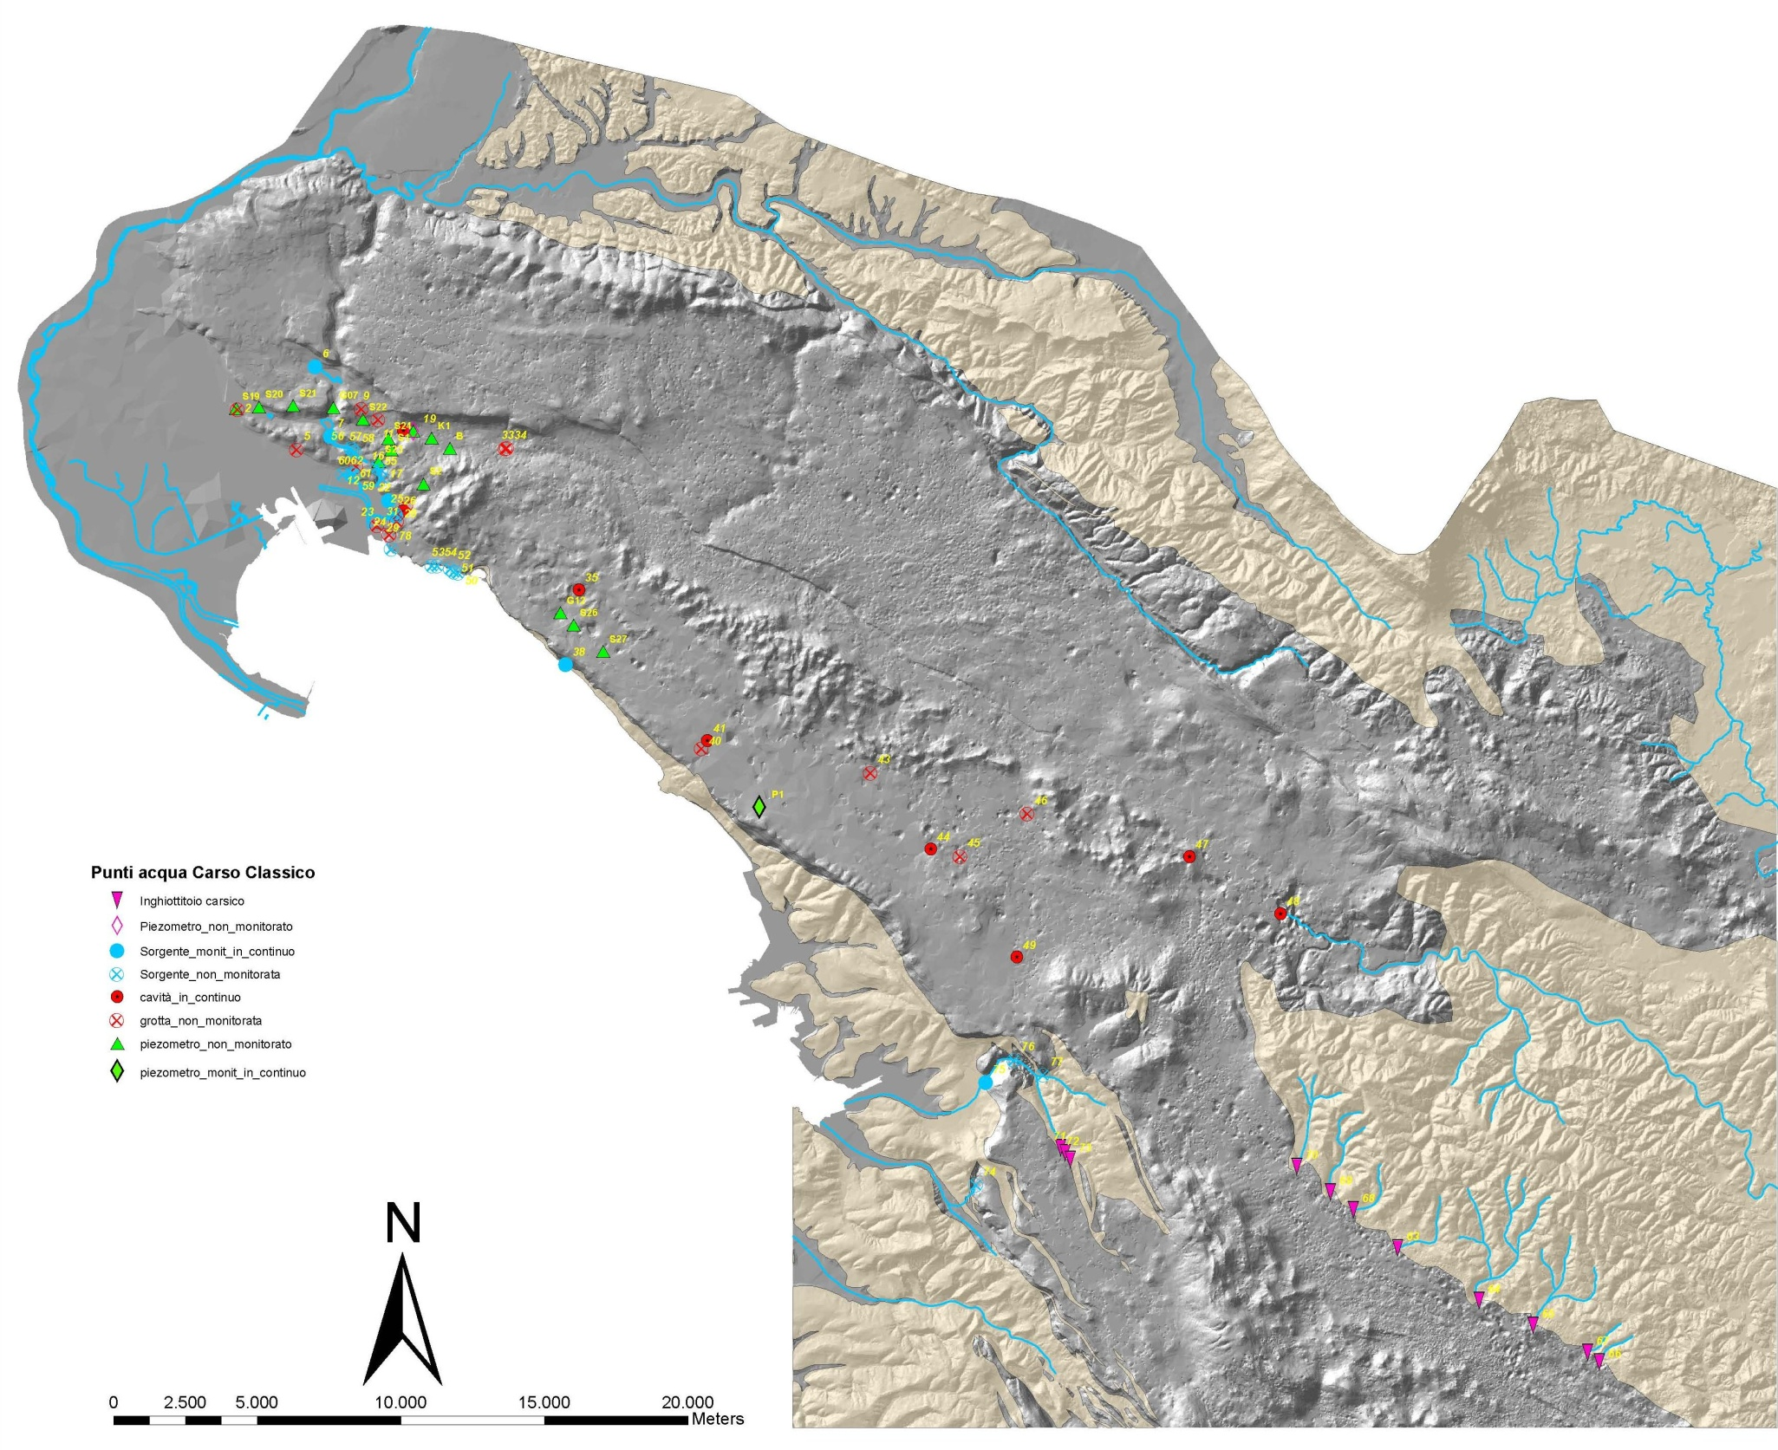
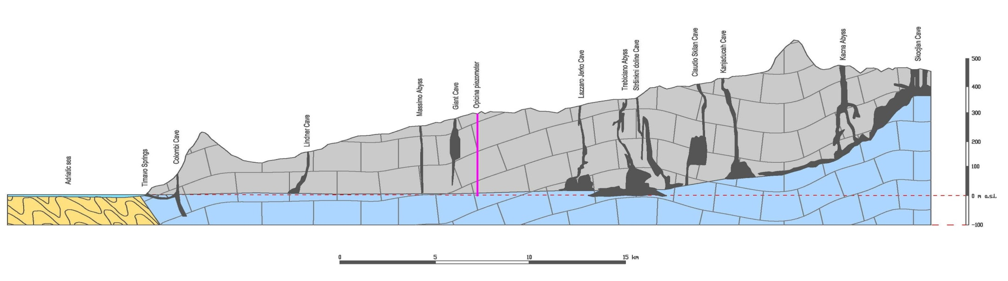
Monitoring Network Acquifer
F. Vipacco
F. Isonzo
Lago di Doberdò
Pozzo dei Colombi
Risorgive
del Timavo
Grotta Lindner
Sorgenti di
Aurisina
Abisso Massimo
Grotta Gigante
Grotta Lazzaro Jerko
Abisso di Trebiciano
Skocjanske Jame
F. Reka
(Timavo)
Antro di Bagnoli

Slide 41
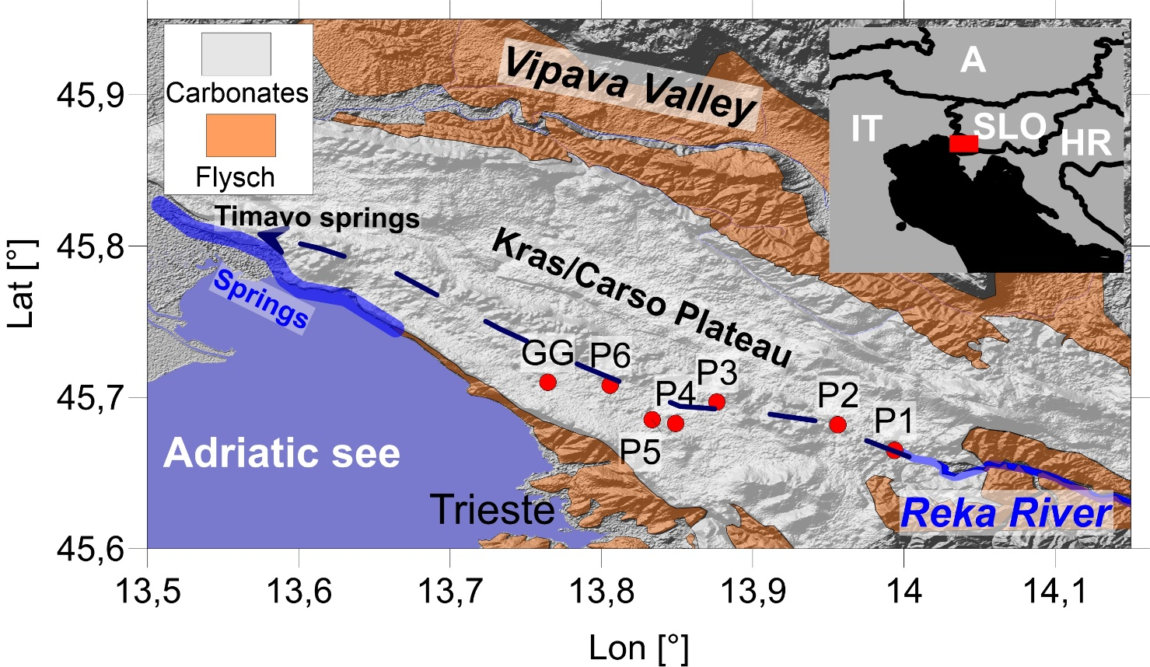
Location map of Carso/Karst, Italy, Slovenia, Skocjan caves, Reka river, Duino, Timavo springs, Adriatic-Carbonate platform, flysch
Braitenberg et al., Sci. Rep. 2019

Slide 42
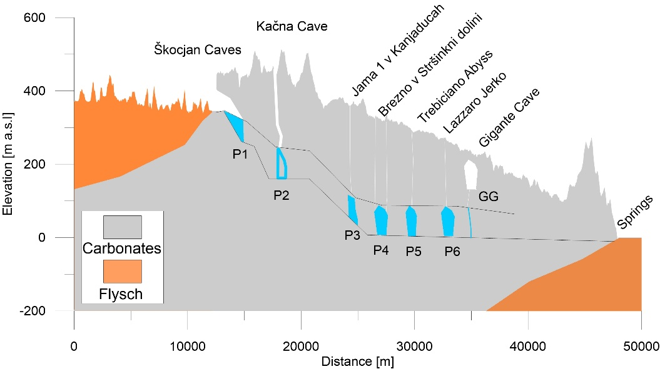
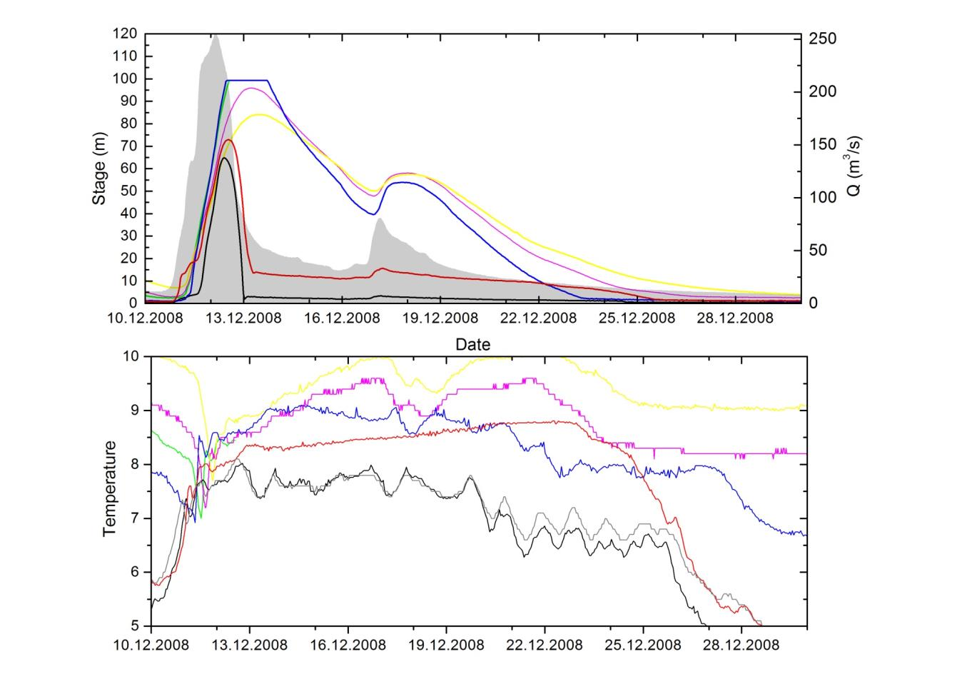
a
Proof of overpressure in channels: uprising of level is contemporaneous over a distance of 20km. Indication of pressure buildup. Rising water in vertical shafts is due to pressure increase in the channel-system- vertical shaft functions like a pressure gauge.
Our interest: estimate which are the consequences for the elastic deformation.
b
P1=black;
P2 red; P3 blue; P4 green; P5 purple; P6 yellow. Shaded grey area in stage plot and grey curve in temperature
plot are relative to Reka.

Slide 43
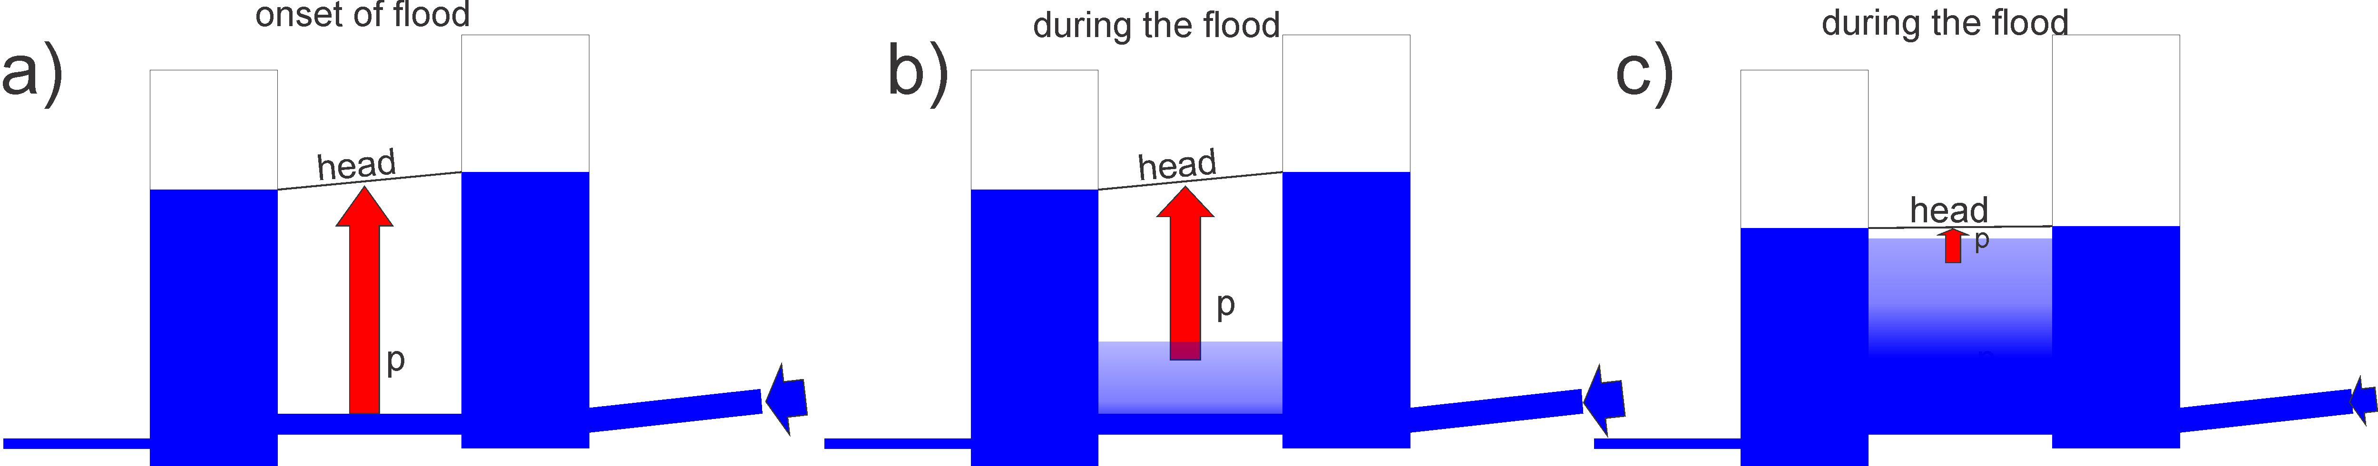
Hydrologic model for the evolution of the pressure along the channel system
Level increase in vertical shafts corresponds to pressure increase. 10 m equals 1 bar=10⁵ Pa=0.1 MPa
Diffusion of water into fractures and openings is a slower process than the pressure increase which is immediate.
Between shafts the level is lower than at shafts- the height in shafts does not repesent the maximum water level in the entire system. The diffusion into the system reduces the pressure
Braitenberg et al., SciRep 2019

Slide 44
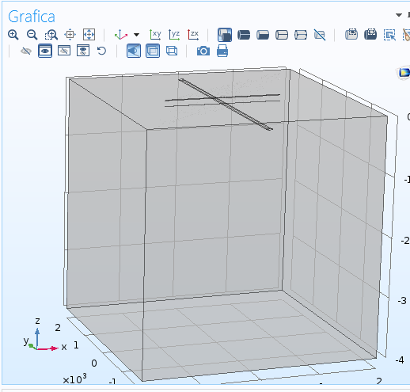
2 Elastic model of pressurized channel
Given the evidences of the overpressure in the Karst system, we model the deformation due to a pressurized channel in the subsurface. The FemLab numerical approach was used.
Model: linear channel buried in halfspace.
Top surface is free, displacements and tilt is calculated.
Braitenberg et al., SciRep 2019

Slide 45
Elastic model: elongated channel below surface which undergoes a pressurization.
Predicted movement of surface (units:m)
Horizontal Displacement
Uplift
Horizontal Displacement
The model predicts a vertical uplift and a horizontal displacement at the surface.
The uplift movement is up to 2.5 mm. Horizontal movement is smaller (0.9 mm).
The surface movement is reproduced by a channel 4 km long,
elliptical cross-section 60m wide, and 10m high, the center at 200m depth,
and dilating due to an internal pressure of 0.6 MPa.

Slide 46
Movement along a profile cutting the channel.
Vertical: maximum above channel
Horizontal: maximum at sides of channel
Tilt: also maximum at sides of channel.
The relative amplitude depends on the position of the stations relative to position of channel.

Slide 47
Dependence of the maximum movement on depth of channel
a
b
Tilt: more sensitive to depth of channel: decrease in signal is close to 1/10
Horizontal (u) and vertical ( w) movement less sensitive to depth of channel-
Consequence: Horizontal and vertical movement sense superposition of deep and superficial channels. Tilt is more sensitive to upper channels.

Slide 48
Vertical movement versus Tilt
c
d
Variable Channel depth
Variable Position Across Channel
100m
500m
c) Maximum uplift versus maximum tilt for varying channel depth. Channel depth varies between 100 m and 500 m.
(d) Uplift versus tilt for varying position across the channel; channel depth at 200 and
300 m.

Slide 49
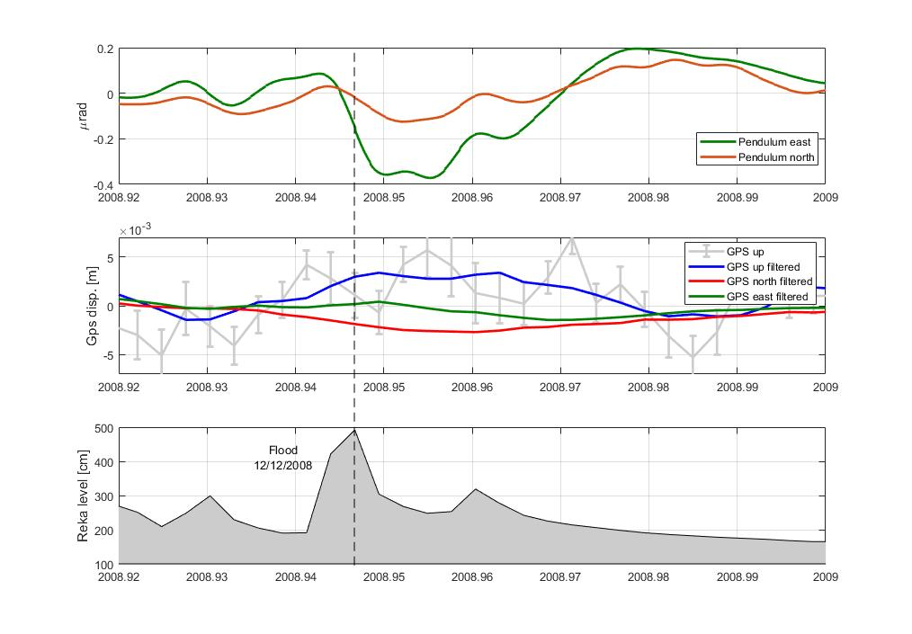
Observations at greater floods (12/12/2008)
Predicted uplift is observed. It is at the limit of resolution.

Slide 50
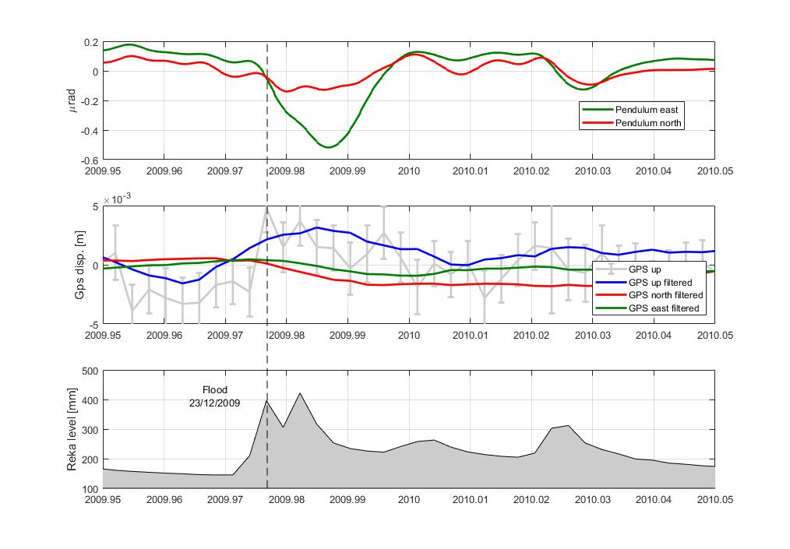
Observations at greater floods
(23/12/2009)

Slide 51
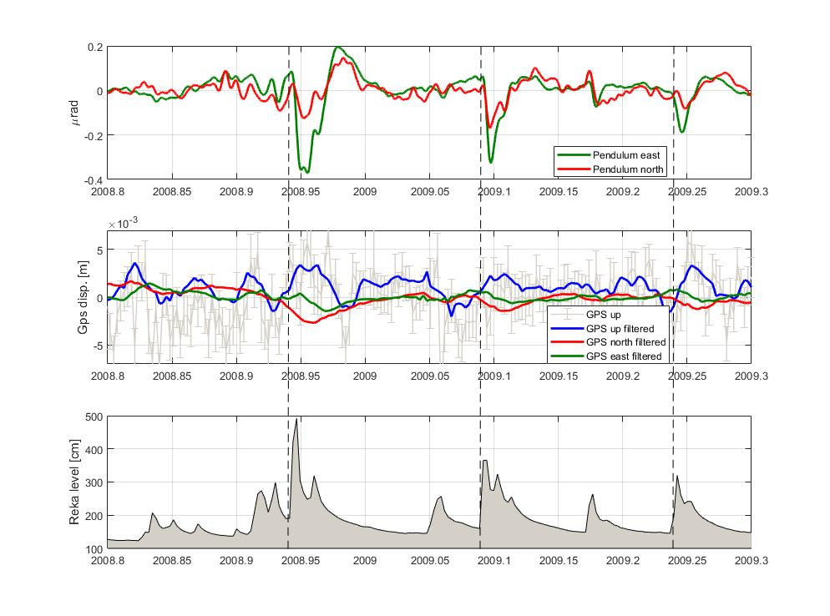


The selected floods in a greater time window
a
Flood 1
b
c
Flood2
Flood3

Slide 52

Relative position of tiltmeter and GPS with respect to channel defines amplitude of induced signal.

Slide 53
4 Expected and observed gravity changes in Karst
Modeling procedures:
Hydraulic model of the water level variations in the Skocjan caves and its time evolution
Discretization with prisms of the expected mass change and estimate of the gravity effect
Station Skocjan: PhD Thesis Tommaso Pivetta, ongoing research, presently at second year.

Slide 54


1) Škocjan cave gravity sensitivity analysis to hydrologic effects
  The Reka river sinks into Škocjan caves flows for over 3km into a wide underground canyon
  The Zaliti kanal represents the end of the caves and an hydraulic restriction
  During large flood events the water level in the Martelova Dvorana raises up to >50m!
  Simulated gravity changes for such events result in gravity anomalies > 20microGal
Pivetta T., PhD thesis.

Slide 55

Starting from cave plan view: discretization of cave with conduits
o1
800m
Cave is modelled with 4 conduits
The water is ‘injected’ in the node j1
The final node (o1) is the output
j4
400m
j3
800m
360m
j1
j2

Slide 56

Cross section of the channels
Martel hall

Slide 57
Flow input
2 flood events are analyzed- one in may 2005 (Qpeak=60m³/s) and the huge event of december 2008
We have at our disposal:
  the discharge values of the Reka river at Cerkvenikov mlin
  Water level variations in the Martel hall

Slide 58

Input data modeling: Water Level variations in the Martel hall
December 2008 event. In the Martel hall the level rose up to 60m!

Slide 59

Hydraulic modeling of the 2008 Event
Pivetta T., PhD thesis.

Slide 60

Observed vs. Modelled water level variation in the Martel cave
Modeled timeseries and observed water level in the Martel hall (at node j4).

Slide 61


Expected gravity signal depends on location of station- info center and directly above Martel Hall- huge event of 2008
8.5 microGal
20 microGal
Noise level: at 1 microGal

Slide 62

Gravimeter in Karst was installed in June 2018 – g-phone (LIAG)
Recorded time variations of g in the Karst area from 14/9/18 to
4/11/18. The periodic variations are due to tides

Slide 63


Analysis of observed gravity changes: first correction is for tidal signal
Tides: solid + ocean tides.
Amplitude: 0.3 mGal peak to peak.
Earth deforms under the tidal stress, so potential on rigid earth is modified by earth deformation.
SurfaceDisplacement vector:
Surface gravity potential:
h_{n}, k_{n}: Love numbers for spherical harmonic degree n
l_{n}: Shida number

Slide 64
Tidal gravity changes
SurfaceDisplacement vector:
Surface gravity potential:
h_{n}, k_{n}: Love numbers for spherical harmonic degree n
l_{n}: Shida number
δ_{n}: gravimetric delta factor.
W_{T}: tidal potential.
PREM earth layered model:
h₂ = 0.6032 k₂=0.2980 l₂=0.08399
δ₂ = 1.1562

Slide 65

Observed tidal gravity signals @ Škocjan
Hydrologically disturbed signal removed
Gravity timeseries contain several non hydrologic signals. The most important contributions:
Earth tides: different frequency bands involved amplitude >1000nm/s²
Atmospheric pressure variations: >100 nm/s²
Marine tides: depends on the location. For Trieste estimate of the maximum effect 100nm/s²
Non-Tidal marine signals: such as transients due to meteo (50 nm/s² ?)
Instrumental Drift
Thermo-elastic deformation
Pivetta T., PhD thesis.

Slide 66

Residuals: a closer look
The residuals show some periodic components: these components are due mainly due to unmodelled loading/newtonian effects of the oceans tides and the Adriatic sea. Marine tides could change amplitude and induce time shifts in the main Earth Tide constituents.
The global marine tidal models used for modelling and correcting these effects usually do not offer a sufficient resolution to take into account the response of marine tides to complex bathymetry and coastal morphologies typical of these areas.
For that reason an accurate physical model of Marine tides gravity effect for Trieste is challenging.
The best solution is perform a so called tidal analysis: the coefficients are directly estimated by fitting the observed time-series with the a theoretical model

Slide 67

Improvement of the residuals including a local tidal model
Standard deviations of the residuals:
Before 32.0nm/s²
With Local Model: 29.9nm/s²

Slide 68

Including atmospheric correction
Atmospheric corrected residuals:
  Admittance function for local part (derived from linear regression between gravity residuals and atmospheric pressure timeseries)
  4D physical model for the far-field component (ATMACS)
The estimated admittance is -3.3 +/-0.1 nm/s²/hPa which is in good agreement with the theoretical predictions
Slight improvement of the residuals RMS from 29.9nm/s² to 29.0nm/s²
Atmospheric effect= combination of attraction and loading
- 4 nm/s²/hPa is the attraction of the mass above the gravimeter
+1 nm/s²/hPa is the effect of loading and surface deformation
Scalar admittance generally is a good representation.

Slide 69

Check for other possible transients: global hydrology
Global hydrology contribution:
  Black circles: Correlation of some observed transients with global hydro models. Amplitude is very different (large observed w.r.t. predicted). Since Reka doesn’t show much discharge variations, this effect is due probably to very local water accumulation (few meters) around the station.
Orange: during strong flood events gravity change are sensitive to flood in Škocjan caves (300m away from the station)

Slide 70
Conclusions
Geodetic measurements sense a broad spectrum of phenomena, both in the changing gravity field and in strain or tilt measurements.
Modeling and transfer function calculation can greatly reduce the noise
We predict that the overpressure deforms the surface and is observable by geodetic methods
We are interested in cooperation in the analysis of high-precision interferometry

