Slide 1
Beams Centering Using Cameras
B. Mours
ISC meeting
November 9, 2011
VIR-0654A-11

Slide 2
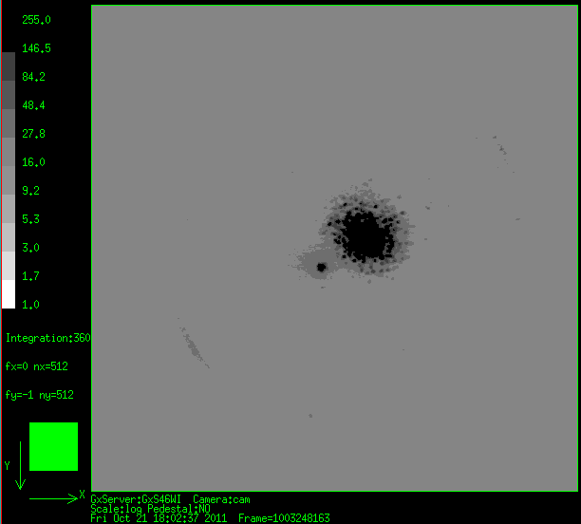
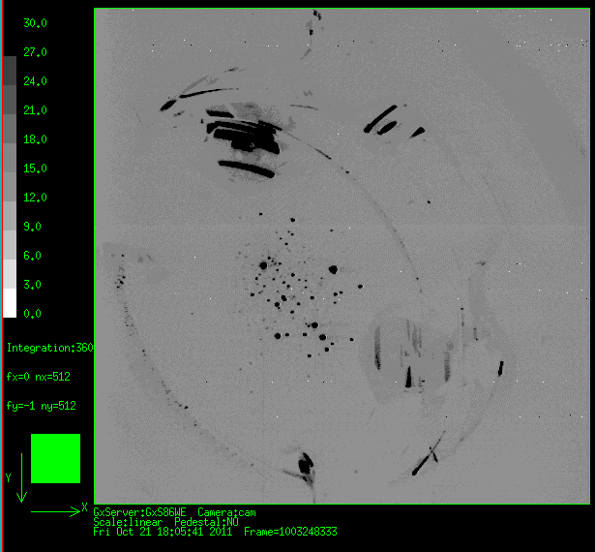
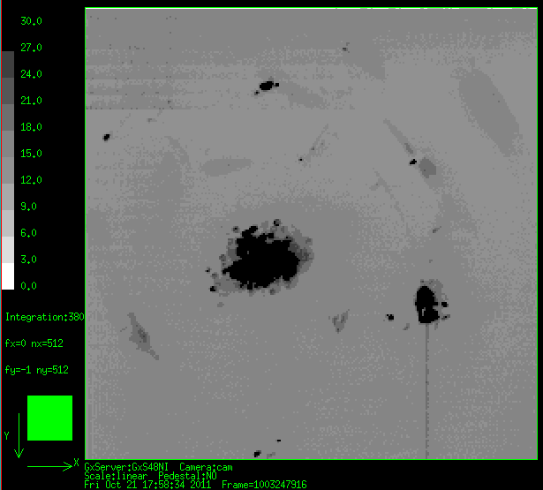
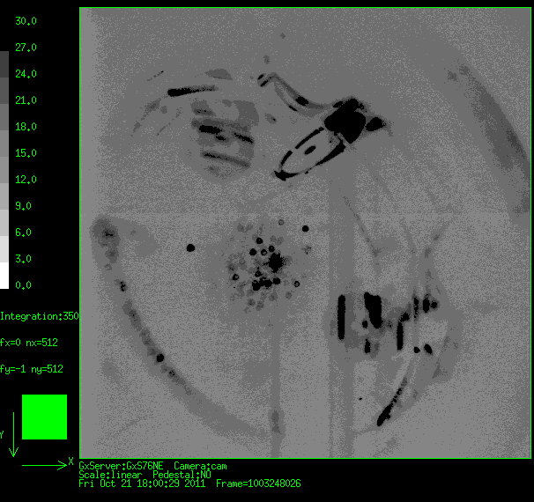
Beams are visible on the mirrors
Diffuse light make the beam spots visible when ITF locked
  Below are local control images
Could we use this to center the beam on the mirrors?
WI
WE
NE
NI

Slide 3
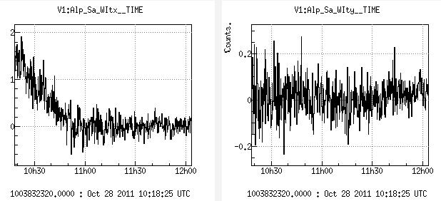
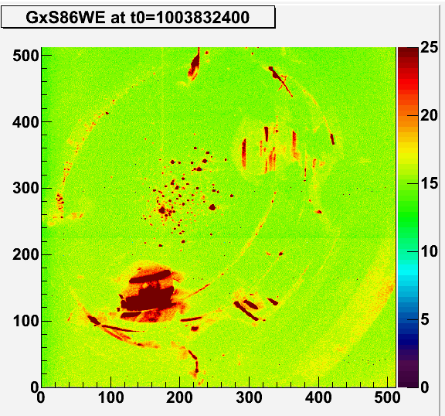
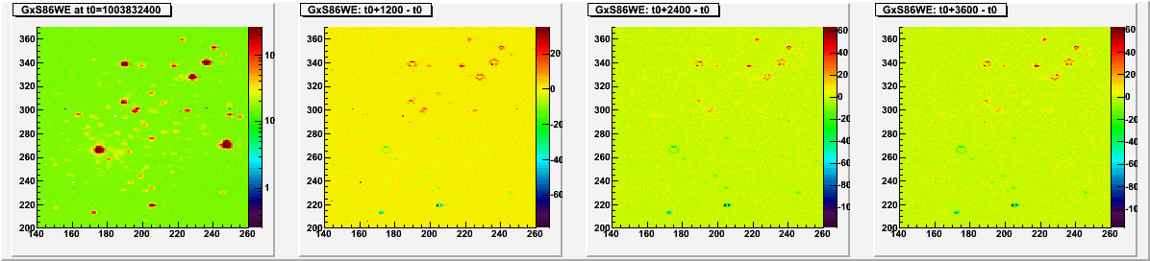
Beam centering with 6-8Hz lines
Case of a relock with off-centered beam
  Centering probed by 6 & 8Hz lines
Is this visible on the mirror itself?
  Look at images changes:
  - Top spots get brighter
  - Bottom spots get fainter

Slide 4
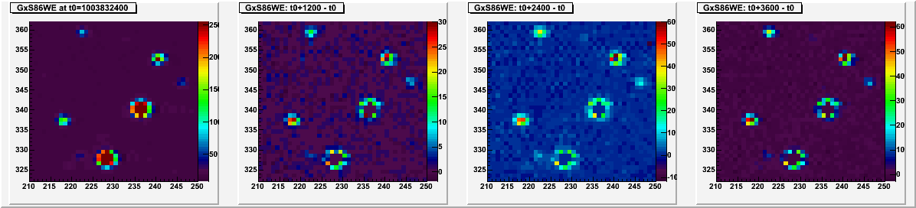
How to predict the beam offset
Select a diffusing spot → used as mirror reference position
  Should not be close to saturation
Monitor its power over time
Translate power variation to displacement
  Assuming a Gaussian beam
  dx= C.dP/P with C= w²/(4x) ~ 1cm for WE
Convert pixel to mm using the mirror size
  1pixel ~1.mm on the mirror
350mm

Slide 5
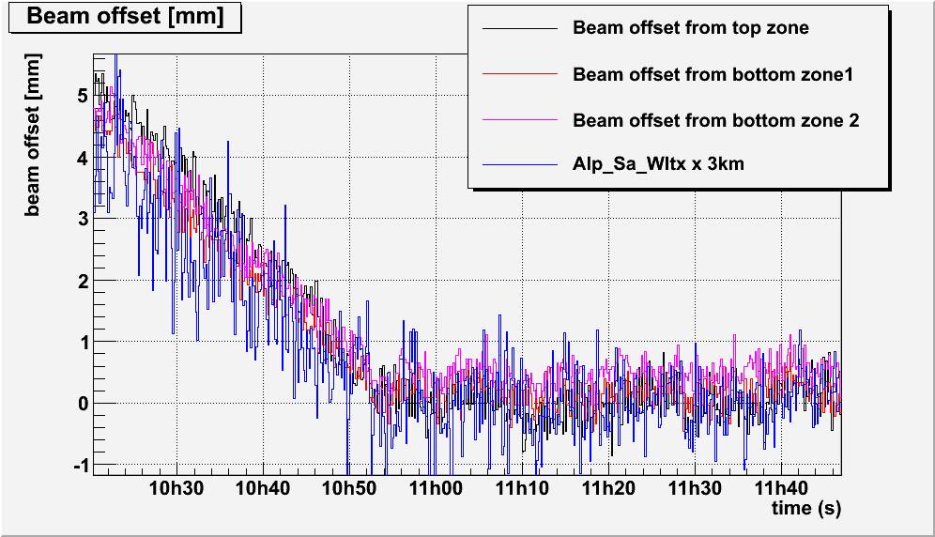
Result from images & lines analysis
Test with three diffusion points on WE
  Located at ~1 beam size
Fair agreement (rough calibration)
Dithering line signal seems more noisy than camera signals
  Images taken only at 0.1Hz

Slide 6
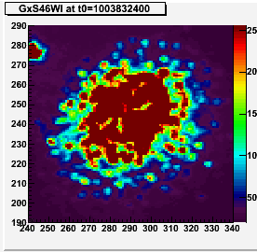
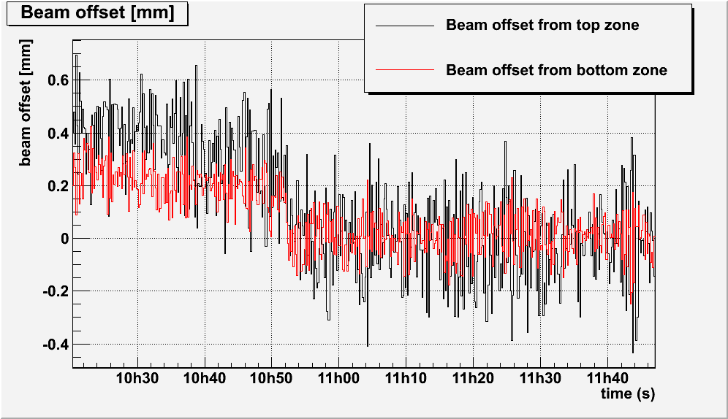
Same analysis on WI
Use two opposite diffusion points
  Located at ~1.2-1.5 waist
Beam more stable by a factor 10
Small jump observed by the two spots

Slide 7
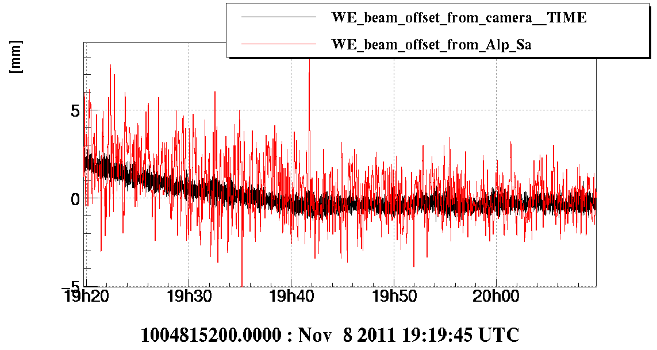
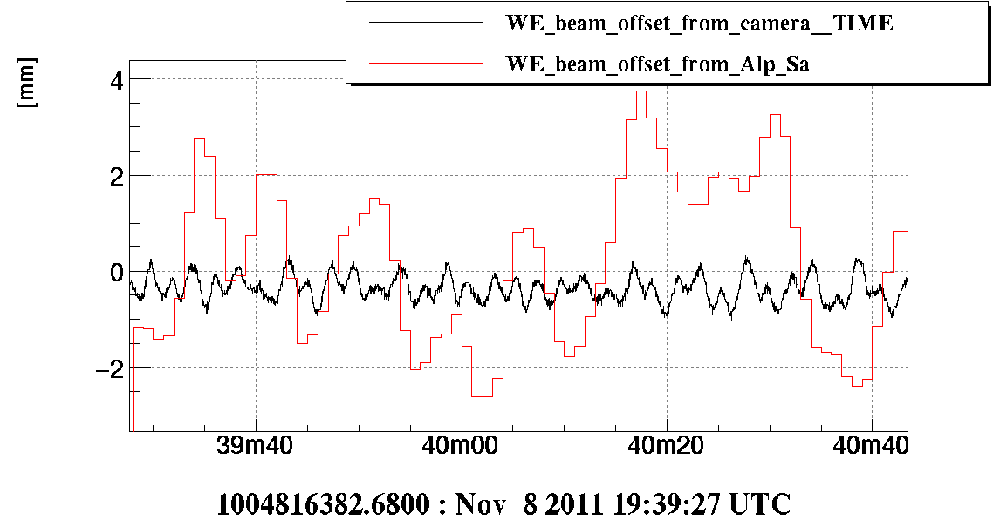
Faster signal
Monitor a diffusing spot with a local control GxServer
  Update Gx86WE configuration to acquire one more zone on Nov. 8 evening
  4x4 pixels; 50mm away from beam center→ dx = 12.5mm*dP/P
  Data recorded @ 50Hz; post-processing
Camera signal contains more information

Slide 8
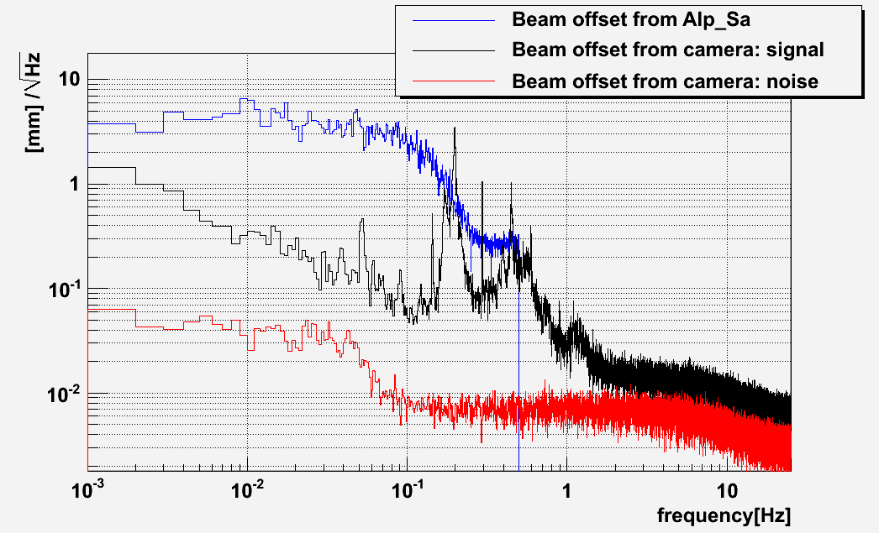
Noise floor
Noise floor @100mHz: 6µm/√Hz → 1nrad/√Hz
  Only one diffusing spot with an old camera; not the brightest spot
  → improvements are possible

Slide 9
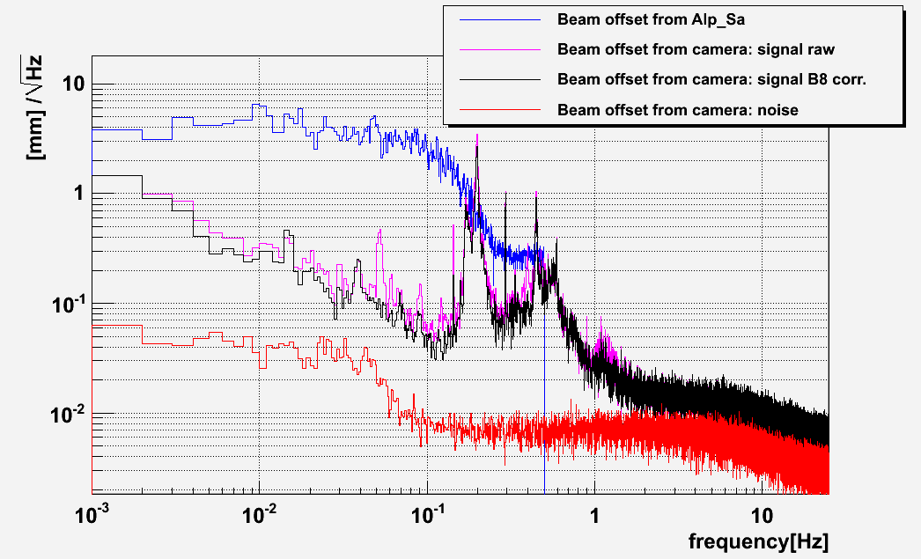
Coupling with cavity power
A single diffusing spot is sensitive to cavity power changes
  Renormalized using cavity power (B8)
  Using multiple diffusing spot should be a better option

Slide 10
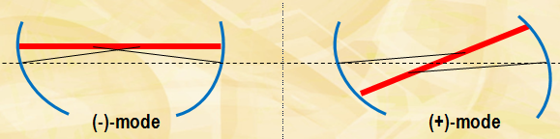
Conclusions
A camera viewing diffusion spots can track beam offsets
  Much more sensitive than line dithering: 1nrad/√Hz with a signal at 50Hz
Sensitivity can be improved for AdV:
  More spots, better mirrors but more light, new cameras, field of view tuning…
A new tool for cavity mirrors alignment
  Accuracy requirement (VIR-0523A-11):
    (-)-mode: 110nrad
    (+)-mode: 2nrad (different on beam offset?)
  A way to relax the RMS constrains for end bench displacement
  We could switch off alignment lines during science mode
    Lines still needed for absolute offset calibration from time to time
Need to add the appropriate viewports for AdV
  View the mirrors with a more direct angle?
  Pay attention to the baffles.
  2 cameras per mirror would be better

