Slide 1

Virgo summary report
& outreach update
Jean-Yves Vinet
(& Carlo Bradaschia)

Slide 2
Summary :
Perimeter of the Collaboration
Last phase of Virgo+
Advanced Virgo progress : questions & answers
EGO contribution
Relations with LSC/LIGO/GEO
Relations with other experiments

Slide 3
The Virgo
Collaboration
EGO
PADOVA/TRENTO
FIRENZE/URBINO
GENOVA
NAPOLI
PERUGIA
PISA
ROMA1
ROMA2
ESPCI
LAL
LAPP
LMA
ARTEMIS
LKB
APC
NIKHEF
POLGRAW
RMKI
104
66
22
9
9
~210

Slide 4
Fields of activity
Optics : 10 groups + EGO
Optical simulation : 3 groups + EGO
Mirrors : 1 group
TCS : 2 groups + EGO
Suspensions : 6 groups
Payloads : 4 groups
Vacuum : 5 groups EGO
Cryogenics : 3 Groups + EGO
Electronics &
Control : 6 groups + EGO

Slide 5
Data Analysis
Permanent sources : 4 groups
Bursts : 5 groups
Compact Binary Coalescences : 7 groups
Stochastic Background : 3 groups
MultiMessengers : 4 groups
Noise studies, DQ : 5 groups

Slide 6
Last phase of Virgo+
Commissionning, understanding the noise structure,
and science run VSR4 in common with GEO HF
Noise structure not fully understood : role of monolithic suspensions.
Tests in progress
Efficiency of the CHRoCC system for tuning focal lengths of mirrors
New control system allowing a reduction of the magnetic strengths of magnets
Sensitivity increased by a factor of 3 with respect to VSR2, duty cycle of ~80%
Injection system tested with the new dihedron produced for AdV
Noise hunting allowed to indentify and/or mitigate several sources : non-linear
couplings, scattered light
Some lines and corresponding harmonics pollute the sensitivity up to 100 Hz,
and remain to be understood.

Slide 7
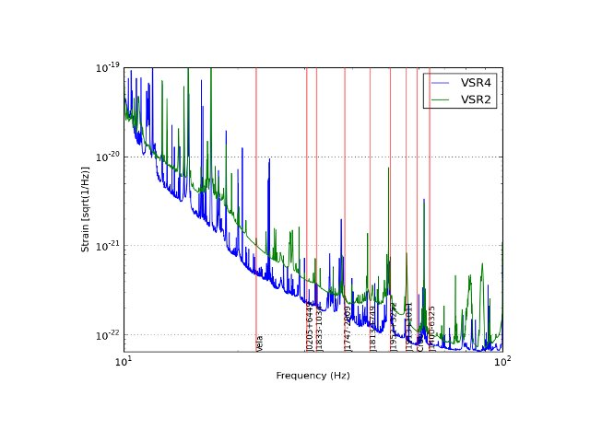
VSR2 vs VSR4
(VSR2 :
mid 2009→8 Jan 2010)

Slide 8
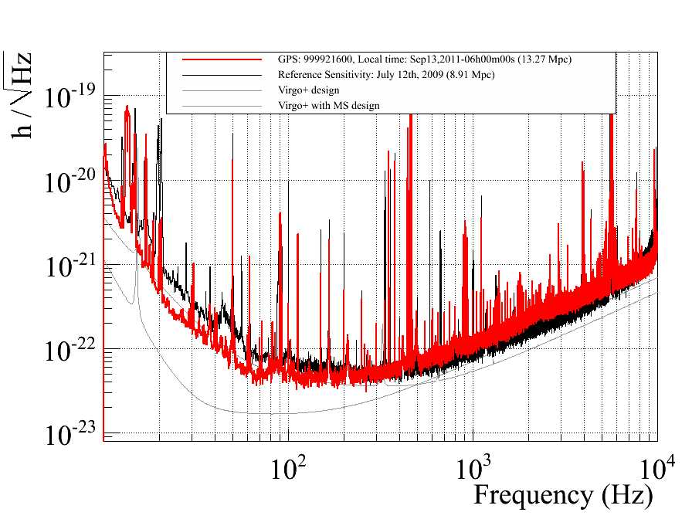
Global improvement of sensitivity

Slide 9
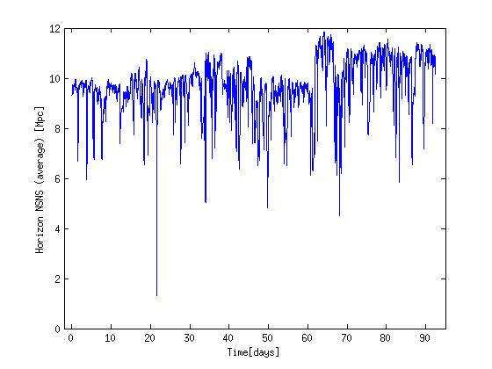
VSR4 : the astrophysical case
* By the end of VSR4 the horizon for CBnsC was ~11 Mpc
Distance at which an NS binary coalescence is
observed with a SNR of 8
Combining VSR2 & VSR4 data could improve by a factor of 1.6 the upper limit
on the amplitude of a signal at Crab pulsar frequency
Directed searches planned (known pulsars)
GRB searches in common with GEO : no detection

Slide 10
Advanced Virgo progress : questions & answers
Detailed planning to be worked out in the next months With WBS.
Start of AdV with the installation/commissioning of the EIB-SAS
(November→ begining February)
Optical layout adopted after several months of discussions, calculations and simulations
Intense simulation work : an effort in order to use documented codes in a systematic way needed,but specific developments made to cope with secondary beams, wedges,…
Wedges or not in the input test masses
Uniformity of mirrors coatings and transmittivity matching improved, ideas for producing symmetrical pairs

Slide 11
Promising results in thermal compensation systems : heating rings, scanning CO2 laser, double axicon.
Power laser : 100W rod fiber laser (EOLITE) being tested for reliability, beam jitter, power noise
Excess thermal noise in the monolithic suspensions observed in V+ : Q measurements planned and studies for modifying the payload
Watching the state-of-the-art in squeezing techniques
…Lack of manpower : EGO grants needed

Slide 12
Relations with LSC
1 – Common meeting
Sept. 24th → 29th
2 days of parallel sessions on DA (CW, Bursts, Stoch.,CBC)
Plenary sessions
  Status of current experiments
  Status of advanced projects
  DA recent results and specialized WG reports
  Detectors characterization
  R&D for Ad. Detectors
« open data policy » (plenary session + ad hoc committee)

Slide 13
Relations with LSC
2 – Bridges
Contributions to working groups :
M.-A.Bizouard (LAL): co-chair of the Data Analysis Council
G. Prodi (PADOVA-TRENTO) : co-chair of the « burst » group
F. Marion (LAPP) : co-chair of the « CBC » group
G. Cella (PISA) : co-chair of the « Stochastic Background » group
P. Astone (ROMA) : co-chair of the « CW »
D.Verkindt (LAPP) : Data Quality
E. Cuoco (EGO) : Noise Characterization
Physics
New :
We have appointed « liaisons » between corresponding subsystems :
Joint Run Committee co-chairs : N. Leroy (LAL) / F. Raab, P. Brady
Detector Characterization Committee : D. Verkindt / J. Smith
Calibration : Loic Rolland (LAPP) / X. Siemens
Joint Computing & Software WG co-chairs : M.-A. Bizouard / P. Brady
Instrument

Slide 14
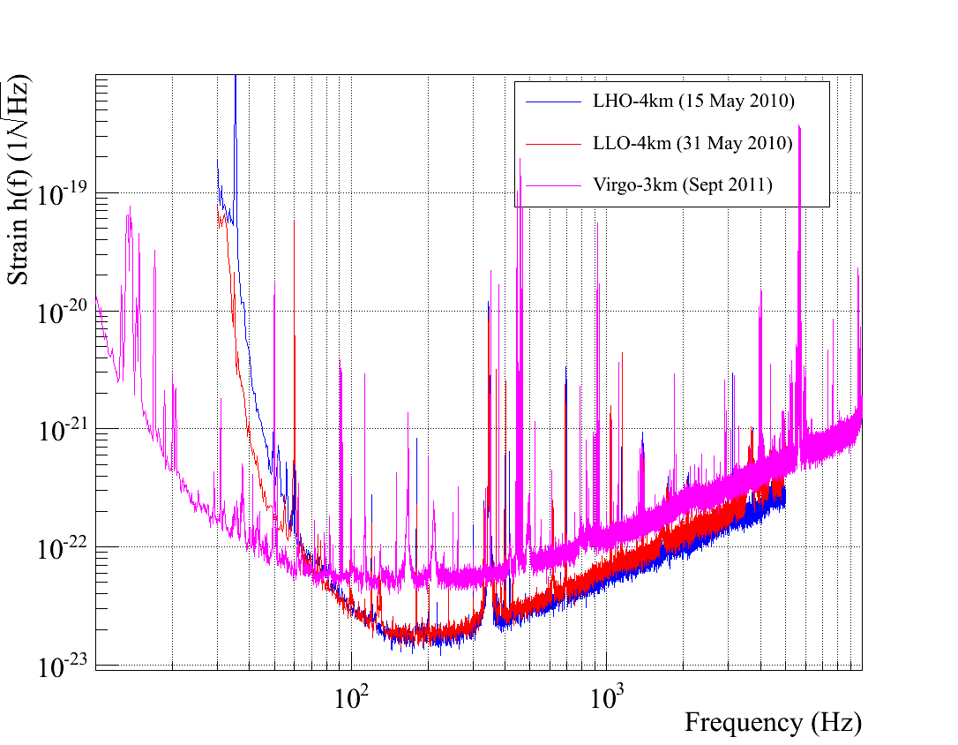

Slide 15
Relations with LSC
3 – The « big dog » affair
Detection of a transient event (CBC) on Sept. 16th (2010)
Localized in « canis major »
Estimation of parameters of the NS binary
Full program of DA completed
Writing of a paper
At the end : blind injection
- Excellent exercise of cooperative analysis
- The efficiency of blind injections is proved
Discussion with the LSC about the level of publicity
to be given to the paper → compromise found

Slide 16
Relations with LSC
4 – Public release of data
Two (extreme) approaches :
Release data as soon as the detectors are in science
mode, take benefit of the whole astro community,
improve the frequency of detections by receiving and
giving triggers, publish h(t) for transient events
2) Release data as late as possible, avoid misunderstanding
due to the complex noise structure of the instruments,
exchange data only with partners in MoU, delay the release of
data to the « frequent detections » era, and restrict the
type of public data (only triggers).
We (and firstly the EGO council) have to decide something
in between

Slide 17
Relations with other experiments
Common workshop with EGO-ICRR at Kashiwa (Oct. )
Status of Virgo and LCGT
R&D on suspensions, cryogenics, laser, coatings
Common workshop with Indigo at Pune (Nov.)

Slide 18
VESF
In the coming period in which detectors will be
mute, a DA school is less urgent.
Replace the February DA school by a school
on advanced detectors
Future of VESF’s grants will be more clear at the end of
the year, after decision of the Council

Slide 19
Participation to ET
Impressive international collaborative work
with the european GW community
Last local event :
Design Study presentation at EGO site
end May 2011

Slide 20
Outreach Group
Carlo Bradaschia
Elena Cuoco
Giuseppe Di Biase
Severine Perus
Gabriele Vajente
(Federico Ferrini)

Slide 21
Site Visits
As usual since several years, every Saturday (Tuesday) morning 20-50 visitors
Guides:
Barsuglia, Boschi, Bradaschia, Calloni, Carbognani, Cella, Chiummo, Colacino, Cuoco, Dattilo, Ferrante, Frasconi, Mantovani, Paoletti, Passaquieti, Passuello, Perus, Swinkels,Tonelli, Vajente

Slide 22
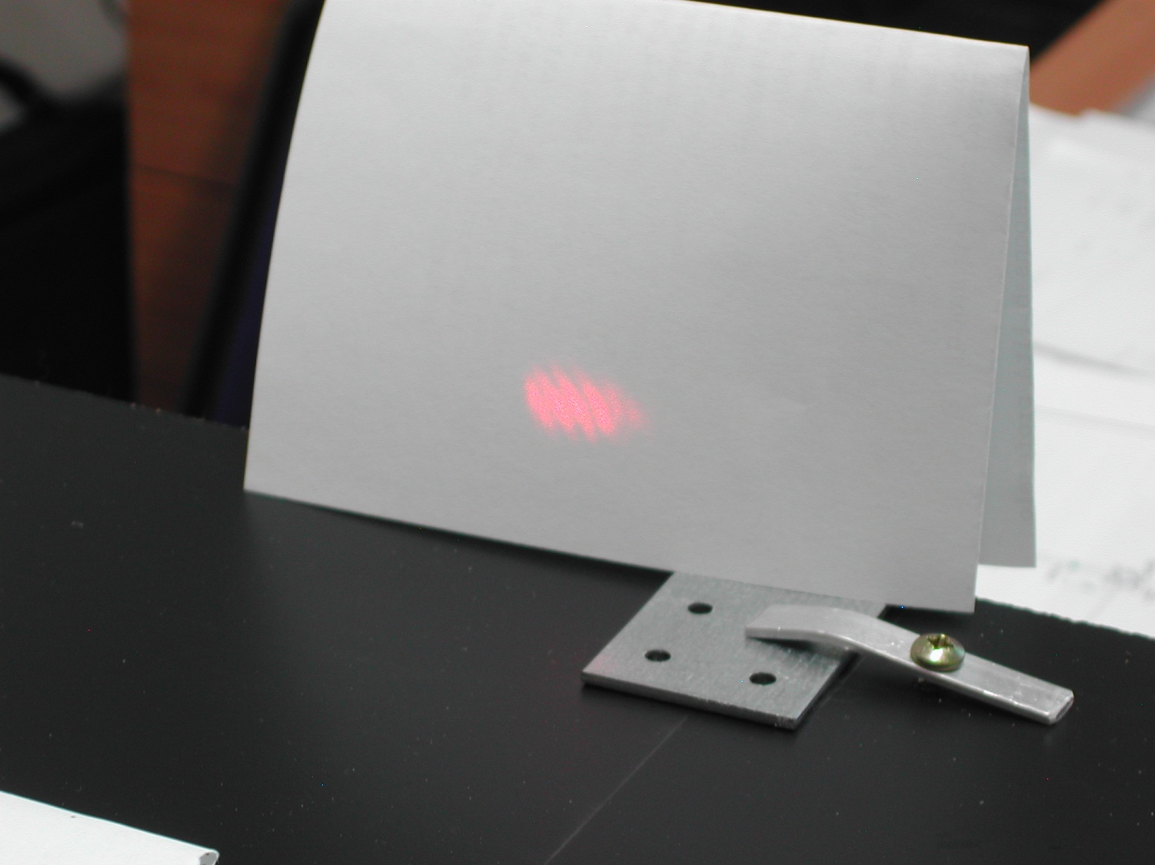
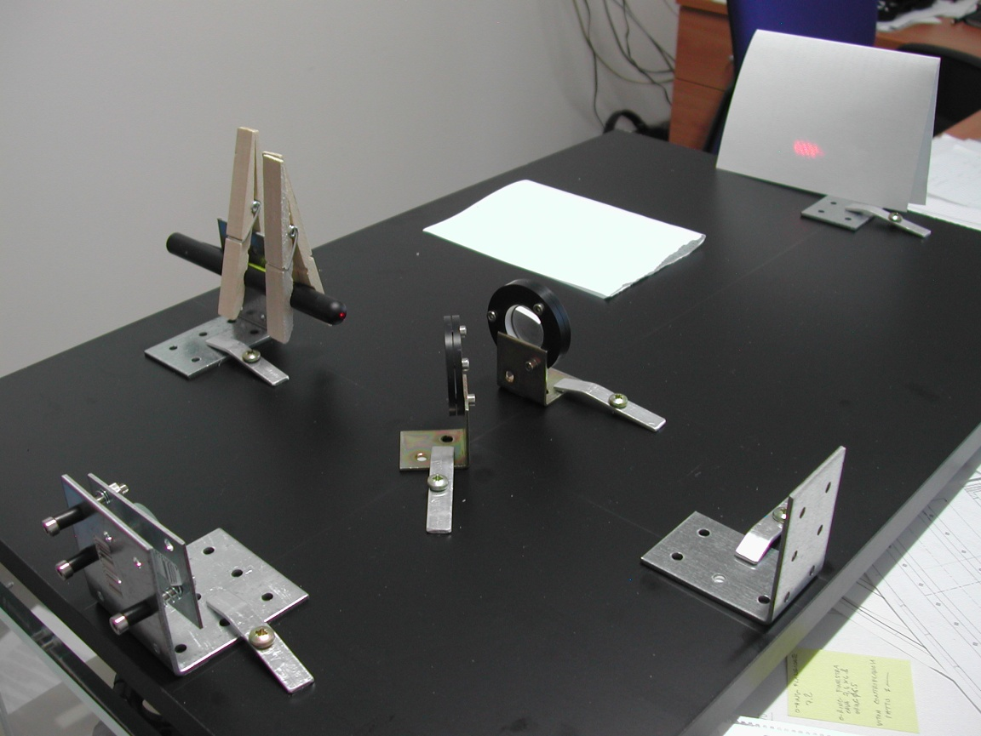
TV
G. Vajente and C. Bradaschia have been invited to talk about Virgo and to perform the assembly of a 100 € interferometer at GEOMagazine, a popular afternoon science show of the national TV chain RAI3.
It has been successfully recorded on October 28.
The 13 minutes video will be broadcasted in a few weeks.
STAC 11/11 Council
22

Slide 23



European Researcher’s Night
23 (and 24) September2011
EGO/Virgo answered successfully the European call as partners of
obtaining a modest share of budget: 2000€
…….and a lot of visitors > 750
www.frascatiscienza.it
STAC 11/11 Council
23

Slide 24
Night 2011 program (23 and 24 September)
To Do
Virgo
Build your interferometer
Science
Meet the scientists (Science Cafe)
Astronomy
Observe the sky with the astronomers
Play Galileo (Galileoscopes by Phys.Dept.)
150 visitors
Theatre
Big Bang monologue by Lucilla Giagnoni
Discussion on
Science, art, philosophy, religion
400 participants
To See
Virgo
Tunnel
Control Room (taking data)
Interferometer (working model)
Superattenuator 1987
A real Payload
200 vistors
In collaborazione con:
Comune di Cascina
Comune di Pisa
Astrofili Pisani Galileo Galilei
Regione Toscana
La Limonaia
INFN e Dipartimento di fisica
Fondazione CariPisa
STAC 11/11 Council
24

Slide 25
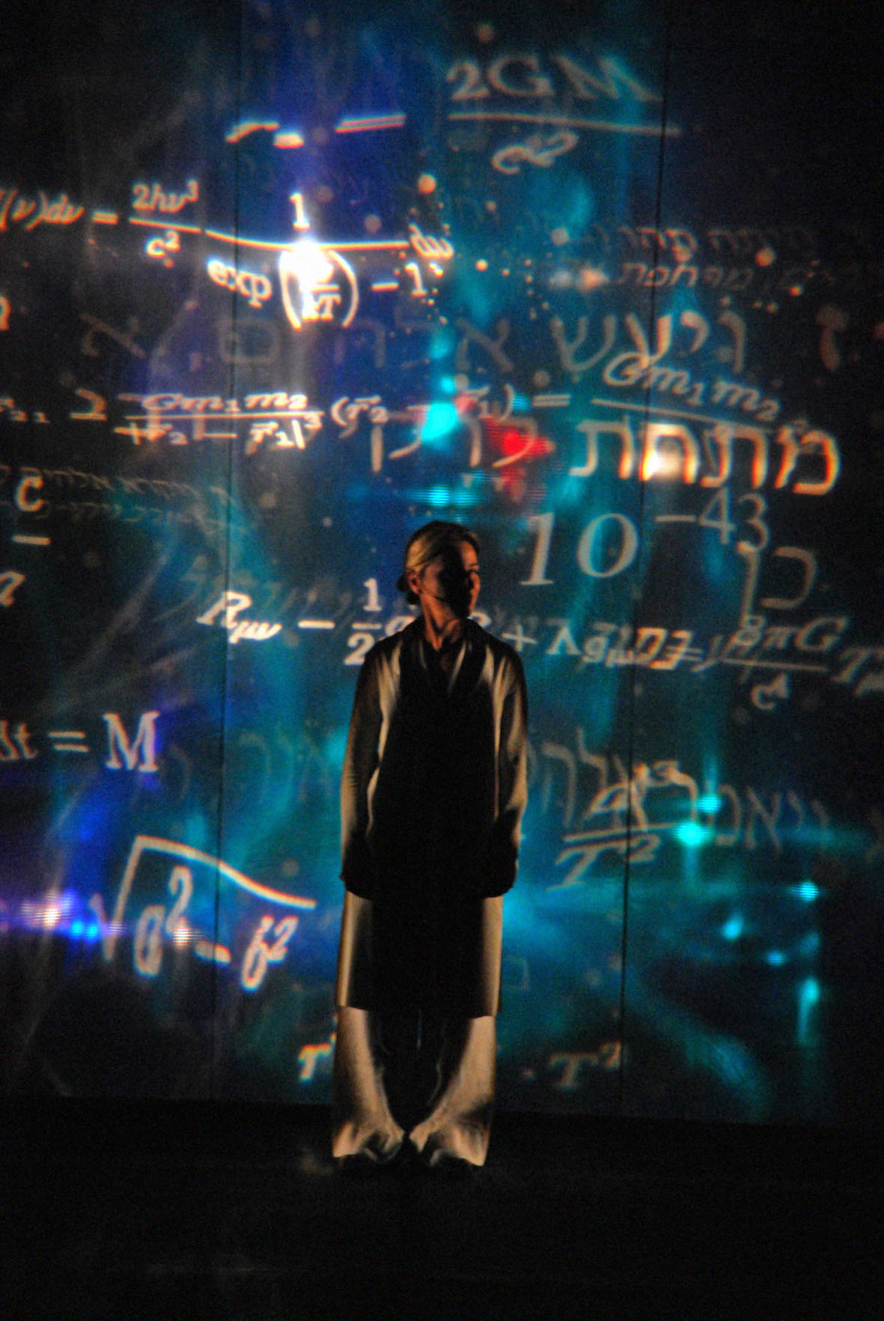
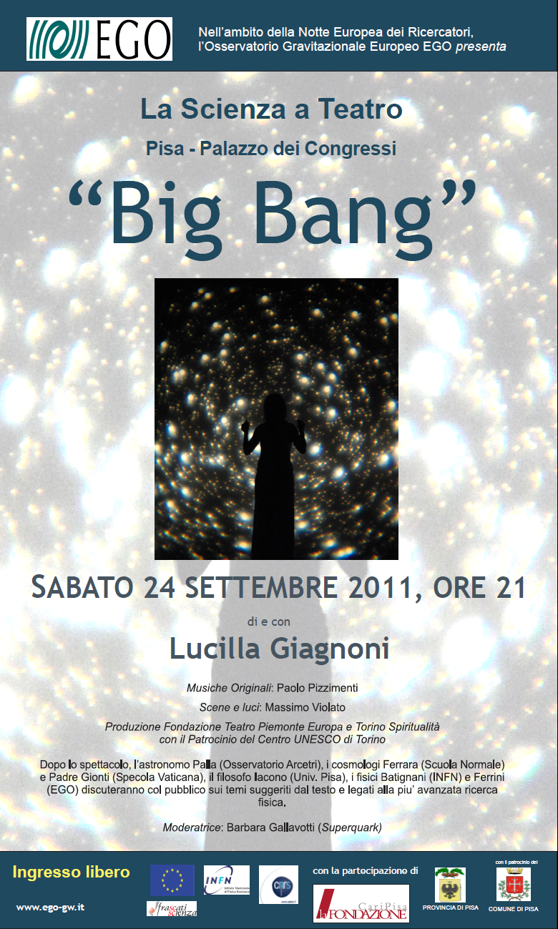
STAC 11/11 Council
25

Slide 26
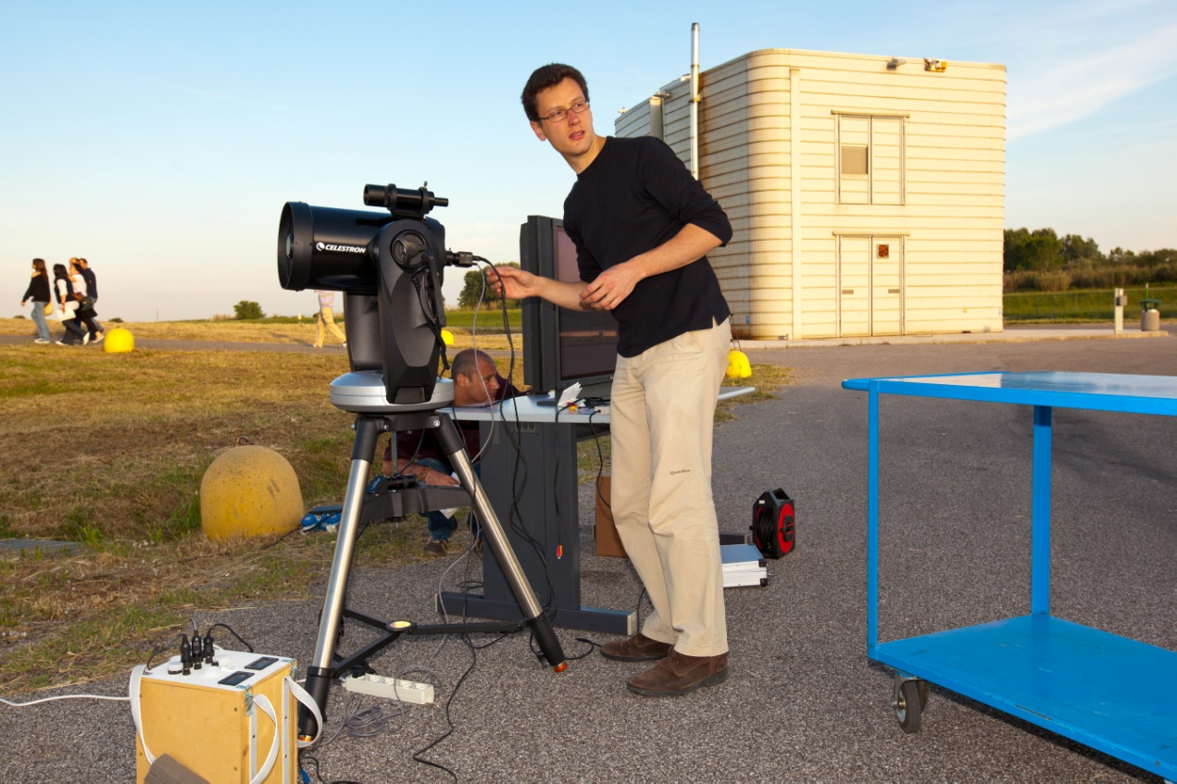
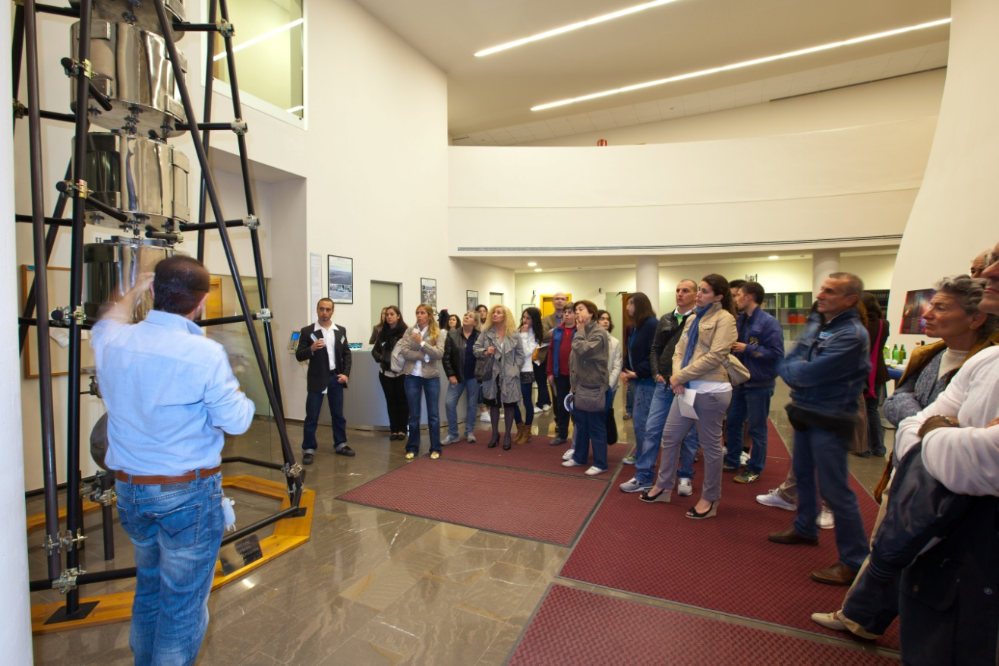
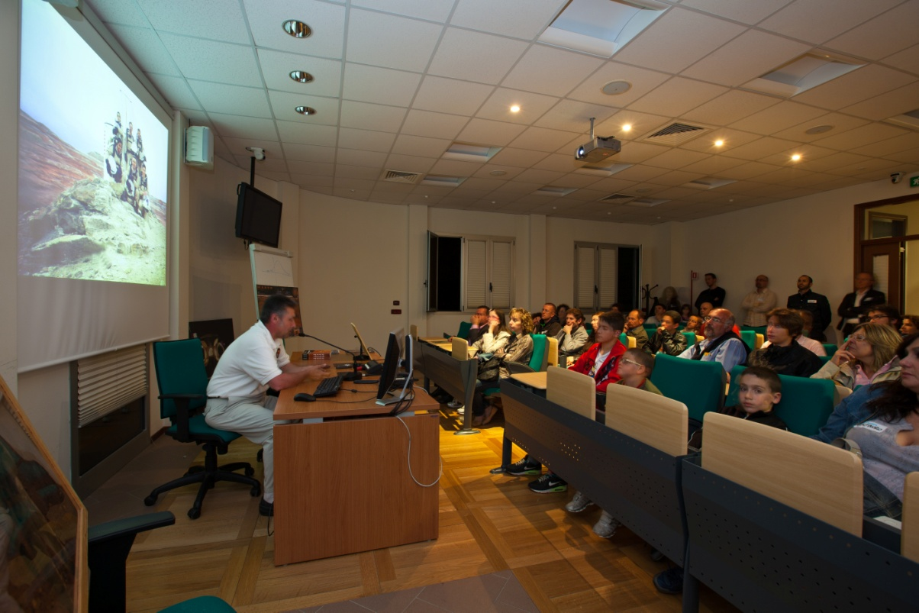
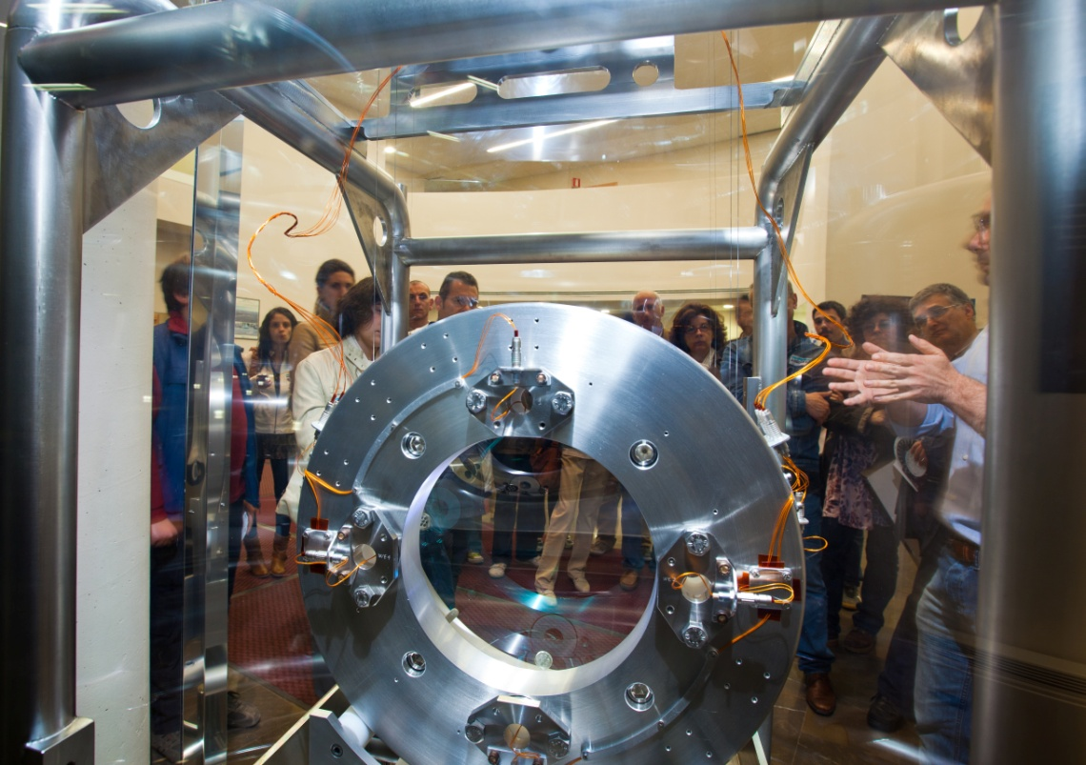
STAC 11/11 Council
26

Slide 27
“Una Giornata da …… Ricercatore”
(A Researcher Day)
3rd November 2011
40 high school students from the surrounding Tuscany spent a full day at EGO.
Divided in four groups, guided by two tutors each, they performed in turn simple experiments on subjects related to Virgo:
Seismic and acoustic measurements
Signal analysis (time domain and frequency domain)
Comparison of a pendulum with an inverted pendulum
Air refraction index changing with pressure (counting fringe drifting in a small interferometer).
At the end the best team (according to a quiz contest) has been rewarded with a Galileoscope, a working copy of Galileo’s “cannocchiale”
In the framework of the initiative “Pianeta Galileo” by Regione Toscana

