Slide 1
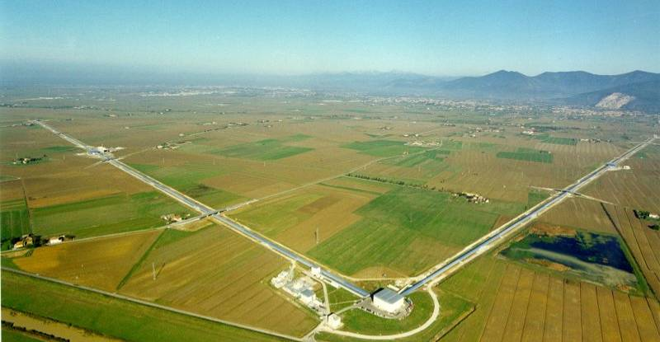
Virgo Open Data Plans
October 27, 2011
Benoit Mours (LAPP-Annecy)
On behalf of the Virgo Collaboration

Slide 2
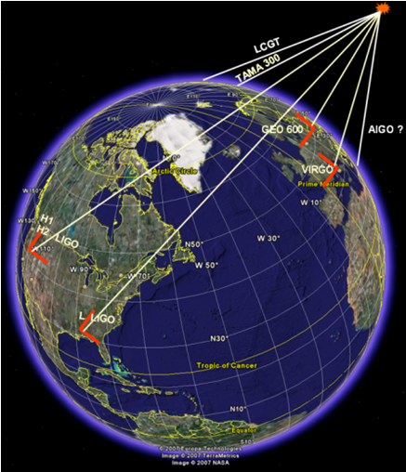
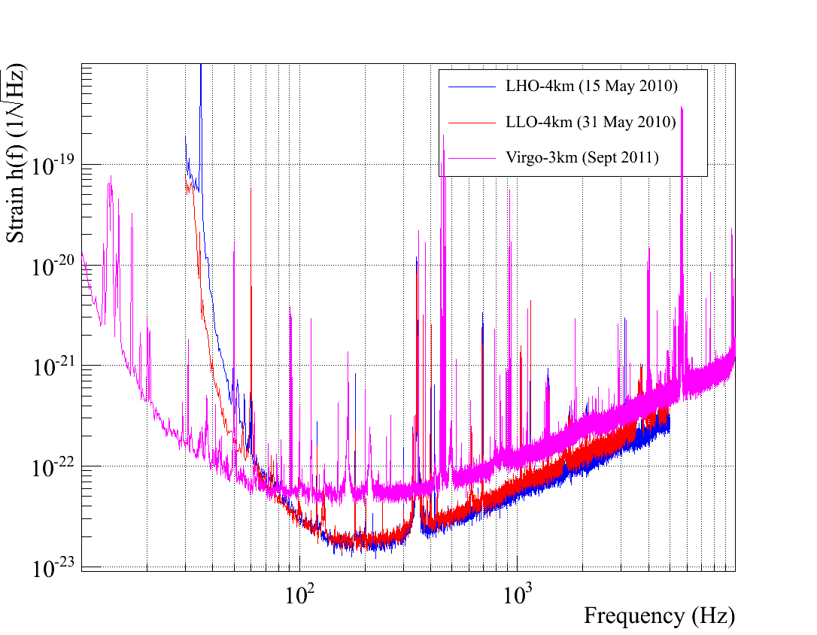
What is Virgo
3km long interferometer in Italy
  Collaboration from Dutch, French, Hungarian, Italian and Polish institutions
The “third leg” of the worldwide network of GW detectors
  Practice online alerts during S6/VSR3 run
Ongoing Advanced Virgo upgrade
  Schedule close to AdLIGO one

Slide 3
Open Data: General Guidelines
Extracting GW signals from instrumental noise is difficult
  Signal is weak and noise is as complex as the instrument
  Serious risks of misinterpretation, and waste of everyone resources
  Therefore Virgo plans to release only reliable information
    Release reliable triggers, and associated information
    No public release of sub-threshold triggers or h(t) when there are no triggers
Need a team of scientists with a wide range of expertise
  A deep understanding of the instrument is mandatory
  Look for as much talents as possible: the Virgo Collaboration is open
  Need to keep the interest of the Virgo scientists
    Their goal is not just to build an instrument but to use it: in house data analysis
Look for scientific partners for multimessenger astronomy
  How to be organized for the best scientific return?
    Example: how to ensure sky coverage of interesting triggers?

Slide 4
Policy before the first GW detection
The use of the full Virgo data remain limited to:
  The Virgo collaboration
  Other GW partners projects like LIGO
    Detailed MOU with joint data analysis and publications
Release GW alerts to interested non GW projects
  With explicit agreements which spell out
    The kind of triggers (mostly noise, possibly blind injections)
    The use of this information, including its dissemination
    The availability of the partners (like the number of pointing per month)
    Could it be used to optimize sky coverage?
Results (upper limits) are published as usual.
  Remark: unlike LIGO, no commitment of releasing the data in case of null results of significant externally triggered searches for which Virgo could have made detection.

Slide 5
The first detection of GW
For the discovery of transient GW source(s), make public
  The parameters of the observed event(s)
  Short data segment to illustrate the finding
    To let other scientists test different waveform models.
For the discovery of CW source, make public:
  The parameters of the source, and the appropriate spectra.
This release of information will continue for the events observed after the first detection(s), once validated.

Slide 6
Once GW events are “frequent”
Start when we can claim online reliable GW events
  Require some experience, not possible for the first triggers
  Require enough rate for statistical studies
  “frequent” is expected to mean a few confirmed GW events per month.
Public alerts for triggers likely to be GW signal,
  typically above a given threshold in significance.
Keep sub-threshold triggers for interested partners
  Offer the possibilities of specific joint studies.
Virgo could consider releasing h(t) for old data taking runs,
  Once the corresponding data analysis projects have been concluded.
  The usefulness of such a data release will have to be check
  The impact on the collaboration resources will also have to be validated.
  Limited to good quality data segments and useful frequency bands.
Do not foresee the full raw data release

Slide 7
A few comments
This is the current Virgo policy.
  Lot of unknown in the future
We have to learn together how to best use GW and astronomers resources
Be patient: The first detection may take a while
  Reaching the design sensitivity is a long process
  There is some uncertainty on the predicted even rates
But tomorrow is a better day:
  The instruments are going to improve, even after the first years
  We will eventually find GW sources and start GW astronomy.

