Slide 1
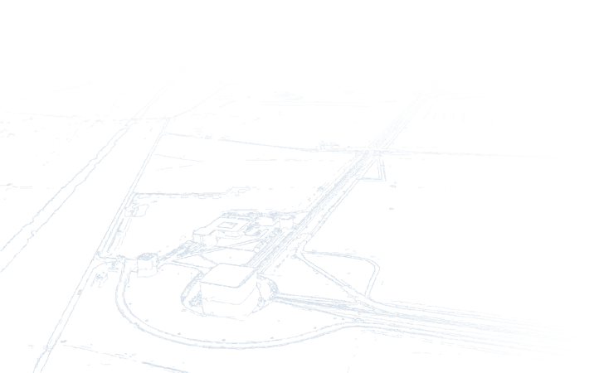

AdVirgo computing resources
allocation at Cascina
EGO IT – S. Cortese , G. Di Biase: Virgo meeting 10-12-2014

Slide 2
New computing nodes: physical platforms
biprocessors: 2 x Intel E5650v2 8-cores 2.6GHz, 128GB RAM, 4x10G eth
  22.37 HS06 per physical core
  21.5 Linpack Gflops and 5 FFTE Gflops per physical core
4-processors: 4xIntel E5640v2 10-cores 2.2GHz, 256GB RAM 8x10G eth
  18.47 HS06 per physical core
  Linpack/FFTE Gflops not measured
( RAM speed 1866MHz for both)
For comparison: 1 physical core of the current computing farm (olnode33-97) Opteron 275 2.2GHz is rated 7HS06

Slide 3
New computing nodes: tests
Benchmarks used:
  RAMspeed SMP3.5 , COPY subtest : array copy in RAM by concurrent processes via SYSV ipc communication in shared memory (note: to fill the number of cores in the 80 cores case two instances have been used)
  mfbench : original benchmark written by Leone Bosi (once at the Perugia group) for the selection of the old computing farm.
  It performs template matched filtering in RAM using FFTW (N=2^20) and SYSV ipc communication up to 4 processes (note: to fill the number of cores multi single-process instances have been used)
Comparisons:
  bi-processors vs quadri-processors on bare metal
  Virtual machines versus bare metal on both physical platforms
  Different kind of virtualization settings (not reported here)

Slide 4
New computing nodes: test results
 | bipro-BM-32-lcpu | bipro-2VM-16+16-lcpu | quadpro-BM 80-lcpu | quadpro-5VM-5x16-lcpu |  | virtualization overhead |  | Speedup bipro –BM vs quadpro –BM |  | bipro 2.6Gz vs quadpro 2.4GHz
 |  |  |  |  |  | bipro: VM vs BM | quadpro: VM vs BM |  | per GHz
RAMspeed (GB/s per lcpu) | 1.7 | 1.7 | 1.4 | 0.2 |  | -0.26% | -87.96% | 27.02% | 7.48% | 16.44%
mfbench (disjoint jobs) - GFLOP/lcpu | 1.4 | 1.4 | 1.2 | 0.5 |  | 4.52% | -53.12% | 17.31% | -0.74% | 7.54%
Performance of 16 –lcpu VM on bipro equal or better than the bare-metal quadripro
Performance of the biprocessor in bare metal better than the quadriprocessor with maximum clock of 2.4GHz (not measured)
Performance of VM at full load generally worsens increasing the number of concurrent VMs on the same host but it is optimal for the case of 2 VM on a single biprocessor
NOTE: this scaled comparison is meaningful provided that the application can be disaggregated on multiple computing nodes eventually by exchanging data , otherwise the choice is forced to the platform with the maximum number of cores

Slide 5
New computing nodes: considerations
biprocessor vs quadriprocessor:
  The extra-cost of the quadriprocessor core is form 20% (2.2GHz clock) to 40% (2.4GHz) higher than the biprocessor one (2.6GHz clock)
  if there are no compelling reasons in favour of the quadriprocessor , the standard physical platform for AdVirgo application should be made of bi-processors both in the bare-metal and in the virtual case
virtualization vs bare-metal:
Virtualization has many advantages:
  hw-independent -> the VM can survive untouched and exploit many hw upgrades
  physical location independent -> moving for maint/reorg can be done on-line
  crash recovery -> the VM can restart automatically in case of crash
  resource optimization -> changing RAM / lcpus requires only a reboot, multiple VMs can exploit fully the hw if they are not all at full load (which is the normal case)
  prompt provisioning -> needs can be satisfied more easily

Slide 6
New computing nodes: considerations on VM vs BM
overhead:
  It is not guaranteed that the overhead is negligible for every application
  But , given the advantages, the target of virtualization is that it is possible to find a virtualized configuration with the needed performances , even at the cost of a 10% overhead respect to bare-metal
  We did not find significant overhead in the network throughput: switching to the latest XenServer Citrix hypervisor lets a VM to achieve 10Gbit/s wire speed
  In case of extreme network latency requirements, the overhead could be overcome by pinning resources (NICs, CPUs …)
Proposal for computing resources allocation:
  Take VM as the default and distribute applications in VM pools (i.e olservers or olnodes) in order of continuity/latency requirements
  Monitor applications performance
  Tune the VM/hypervisor setup in case of need (pool migration / ad hoc configuration)
  Switch to BM if unavoidable

Slide 7
Logical cores allocations: initial=370 , maximum=600
subsystem | AdVirgo tasks (in rough order of latency/continuity demands) | pool | number of logical cores (~10HS06) in initial setup | hardware possibilities seen by OS (logical cores and memory) | notes
Operation Alignment Locking Suspension Control Injection DAQ Data Quality Low latency on-line processingData Quality Noise Monitoring Detector characterization | Cm framework daemons (Db, Cm ns…) | olservers | 230 | 16 lcores 50-60GB RAM 8 lcores 8-16 GB RAM 2-4 lcores 4-8 GB RAM
 | DAQ, Alp
 | DAQ Frame builders: FbmAlp + FbmSt
 | h-reconstruction
 | DAQ frame builders: FbmTmp + Fbm50 - DQ BRMSMoniSM
 | DAQ compress + resize
 | ctrl
 | Control
 | VPM
 | Telescreen
 | online DQ, Omicron
 | MBTA
 | low latency data transfer
 | Noise Monitoring (SpectroMoni)
 | Detector Monitoring (Monis)
 | Suspensions + VSU |  |  |  | already running on VM
 | lsc-gw (MBTAalert) |  |  |  | already running on VM
 | MonitoringWeb (Spectrograms)
 | DQ reprocessing,vdqsegdb exchange with Ligo
 | BacNet server (Eurotherm) |  |  |  | already running on VM
 | Tangodb / Vacuum |  |  |  | already running on VM
 | Slow control/DAQ IMMS |  |  |  | already running on VM
 | CAM Applications |  |  |  | already running on VM
Noise monitoring In-time analysis IT Infrastructure | NOEMI | olnodes | 110 |  | already running on VM
 | WDF |  |  |  | already running on VM
 | Coherence |  |  |  | already running on VM
 | Silente/Regression/NonStatMoni
 | Omicron
 | bulk data transfer (datagw, dataldr) |  |  |  | already running on VM
 | …
Data Analysis/ general | … |  | 30
TOTAL |  |  | 370

Slide 8
Final notes
The choice is dynamic, hardware and network capacity is the same for all pool, but:
Considerations of homogeneity or decoupling at OS or application level between different areas (for example ITF control and on-line data analysis) still hold and are independent from the underlying virtualization
=> different OS releases can coexist even more than now in the same pool but this impacts on manageability and on the software baseline

