Slide 1


SAT Electronics
ADC-DAC Performances
M. Bitossi
V. Boschi, C. Carissimi, A. Gennai, C. Magazzu, D. Passuello
Cascina , October 28th 2014
Alberto Gennai (INFN Pisa)

Slide 2
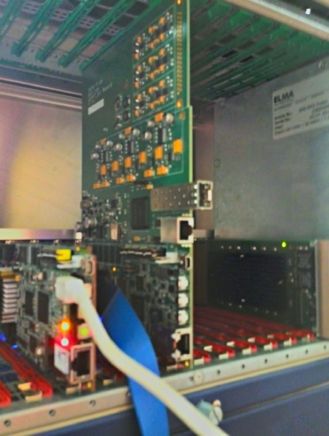
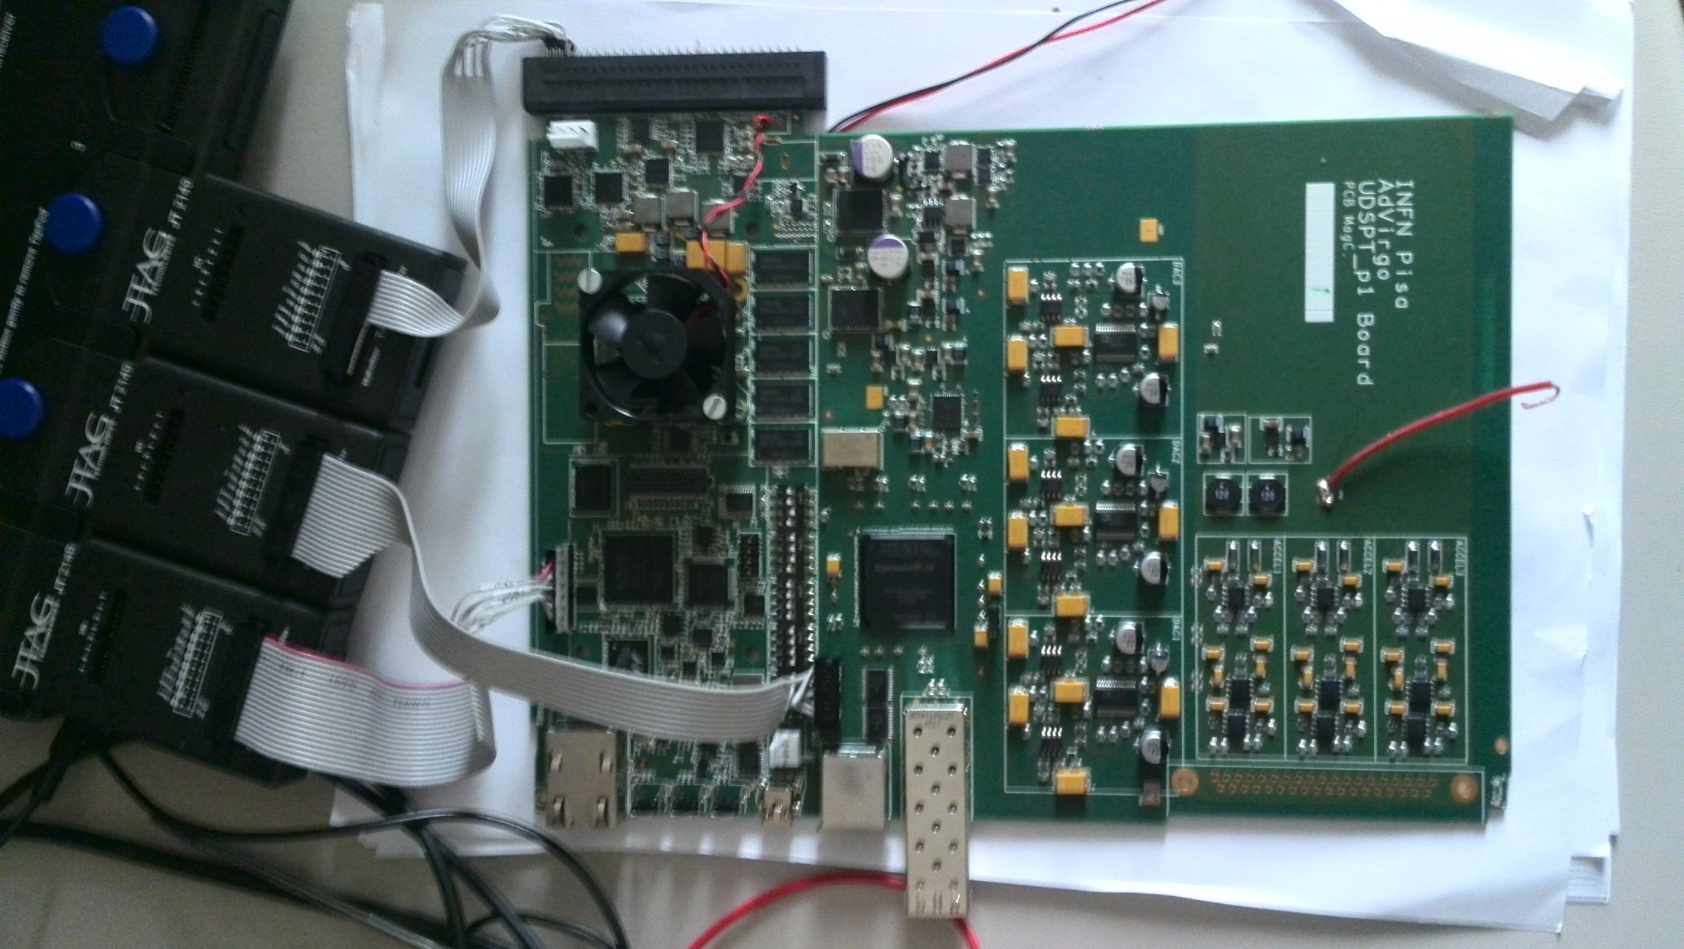
Board Testing

Slide 3
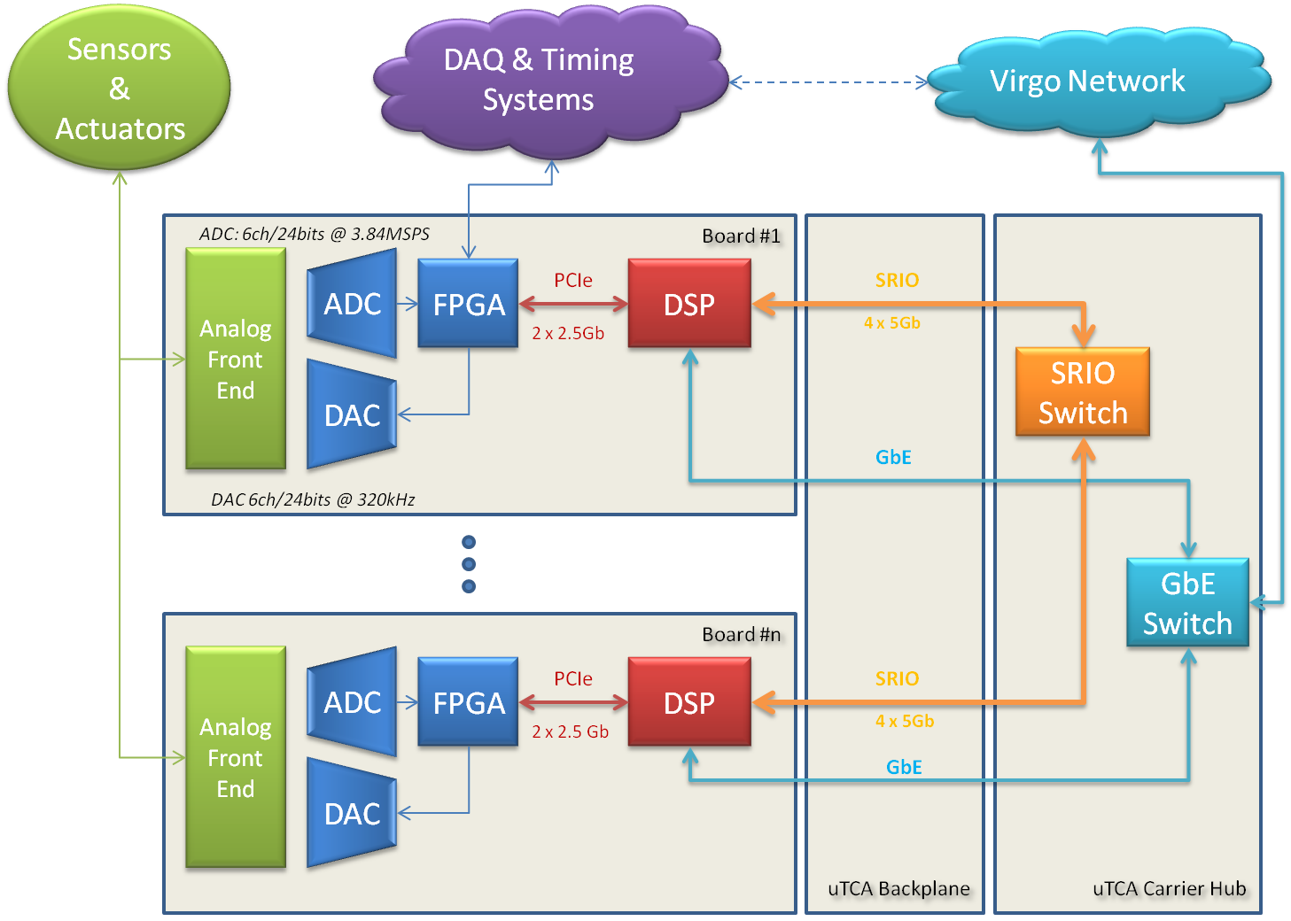
Board Block Diagram

Slide 4

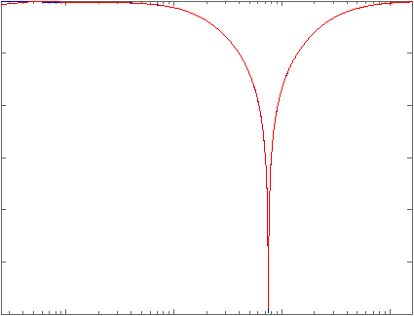
DAC Noise and Distortion Measurement Setup
DAC
Analog Front End
FFT Analyzer
Analog notch filter
DSP

Slide 5
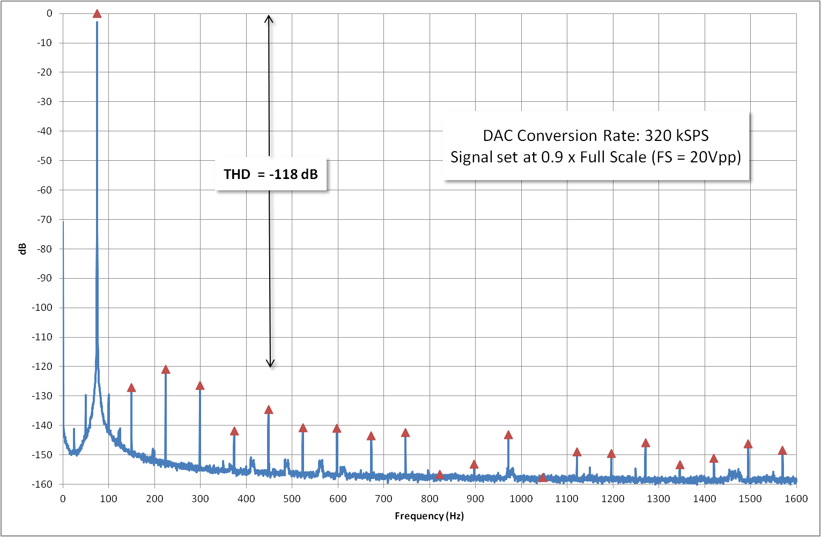
DAC Total Harmonic Distortion
74.75 Hz

Slide 6
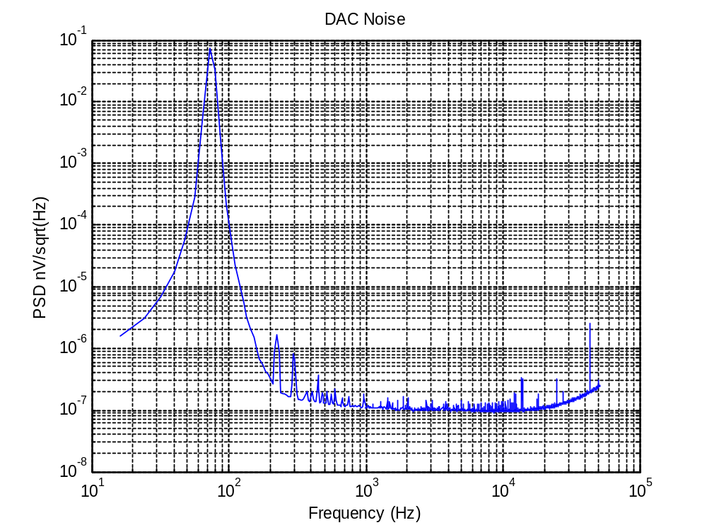
DAC Noise 1/2
ADC Conversion Rate: 320 kSPS
Signal set at 0.9 x Full Scale (FS = 20Vpp)
100nV/sqrt(Hz)

Slide 7
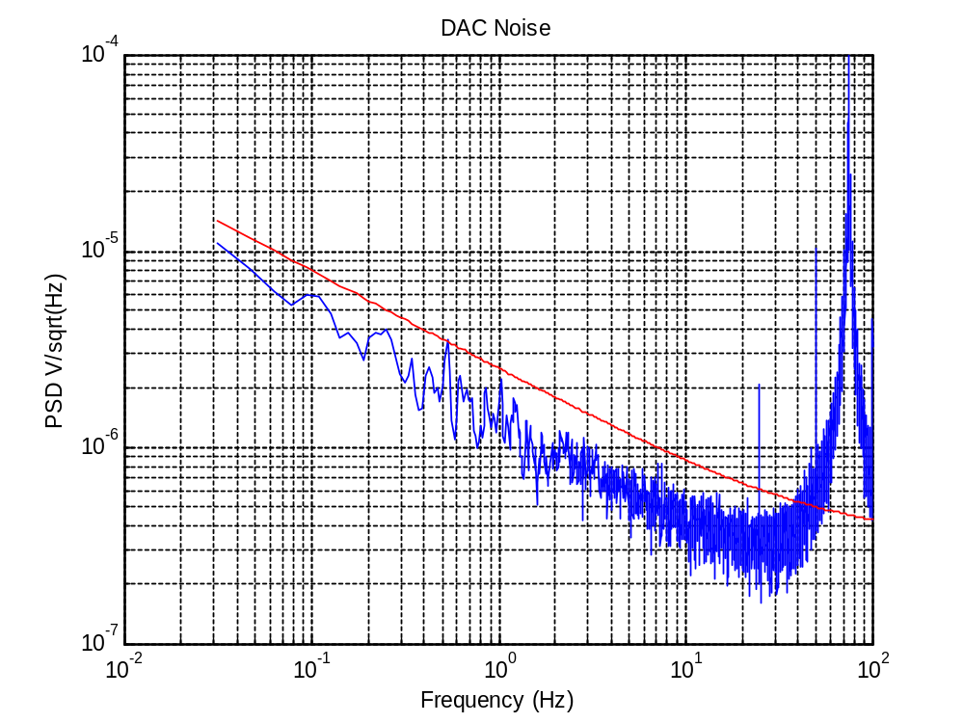
DAC Noise 2/2 (Low Frequency)
ADC Conversion Rate: 320 kSPS
Signal set at 0.9 x Full Scale (FS = 20Vpp)
1uV/sqrt(Hz)
Virgo/Virgo+ DAC Noise

Slide 8
ADC Noise and Distortion Measurement Setup
1. DAC #1 generates a sine wave
2. DSP reads ADC, apply a digital notch filter and amplifies by a factor 1000 before sending output to DAC #2
DAC#1
Analog Front End
ADC
Analog Front End
DSP
DAC#2
Analog Front End
FFT Analyzer

Slide 9
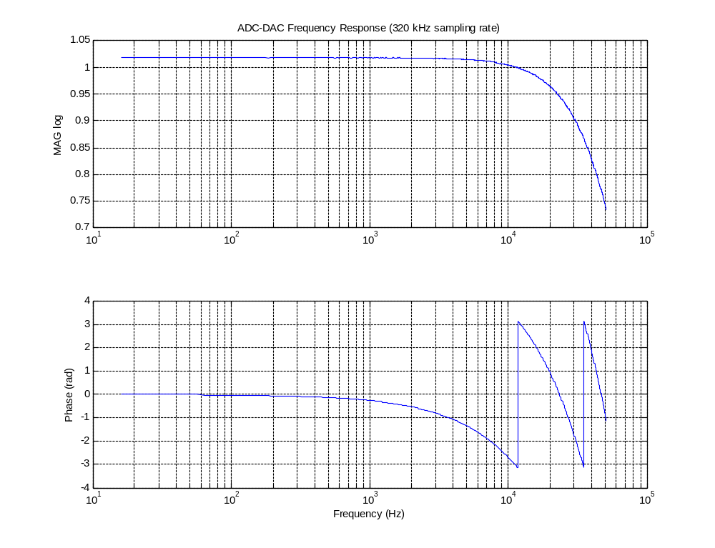
ADC-DSP-DAC Frequency Response
Group delay ~ 42 usec (~650 usec in Virgo+)
24 kHz

Slide 10
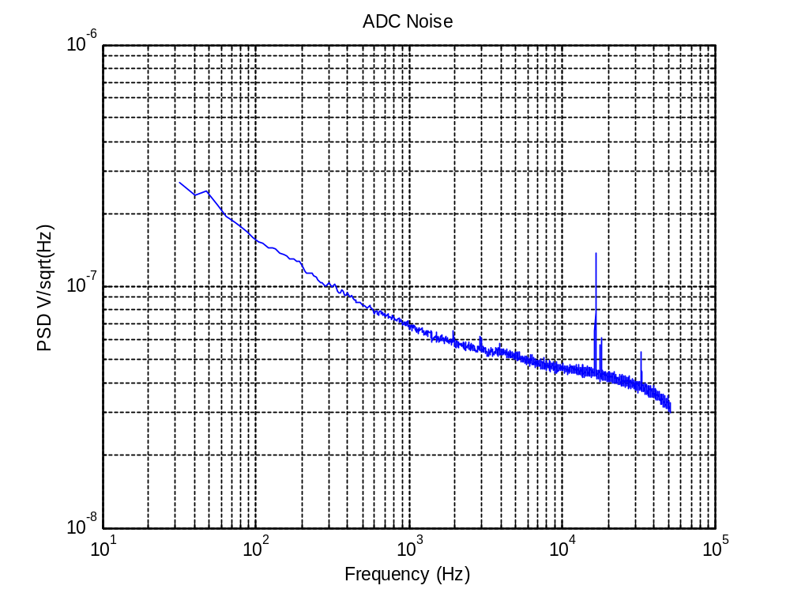
ADC Noise 1/2 (High Frequency)
ADC Conversion Rate: 3.84 MSPS
12 x decimation → 320 kSPS
0 Vdc output (FS = 10Vpp)
100nV/sqrt(Hz)
70nV/sqrt(Hz)

Slide 11
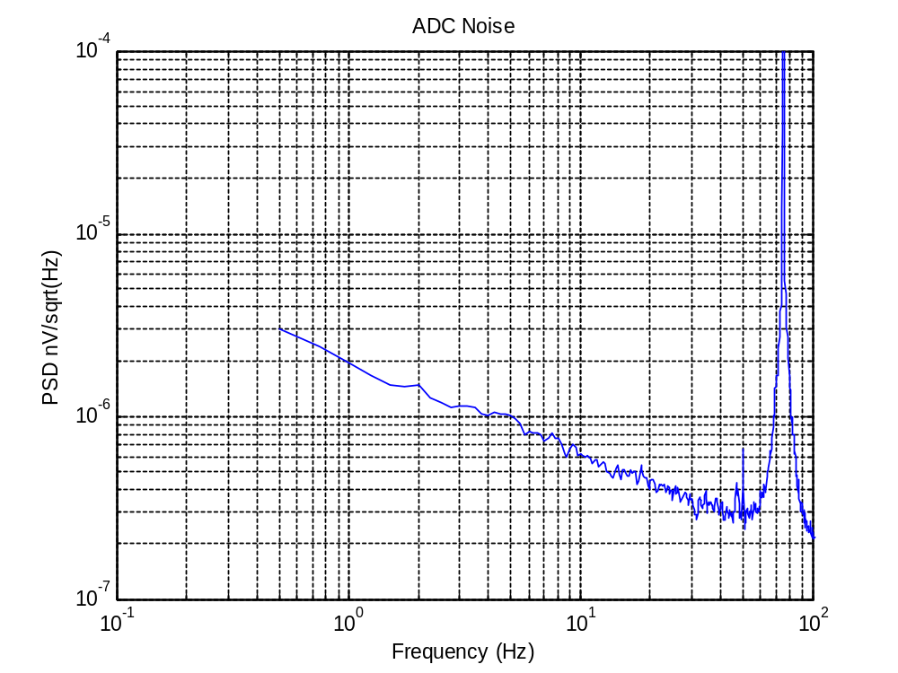
ADC Noise 2/2 (Low Frequency)
ADC Conversion Rate: 3.84 MSPS
12 x decimation → 320 kSPS
Signal set at 0.8 x Full Scale (FS = 10Vpp)
2uV/sqrt(Hz)

Slide 12
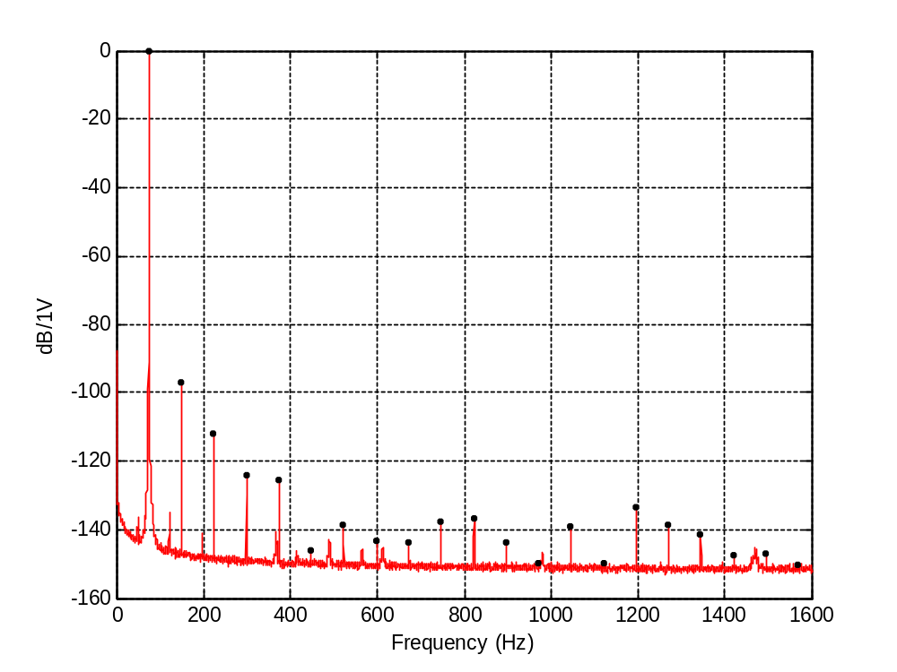
ADC THD
74.75 Hz
ADC Conversion Rate: 3.84 MSPS
12 x decimation → 320 kSPS
Signal set at 0.8 x Full Scale (FS = 10Vpp)
THD = -96.8 dB

