Slide 1
On-site works coordination

Slide 2
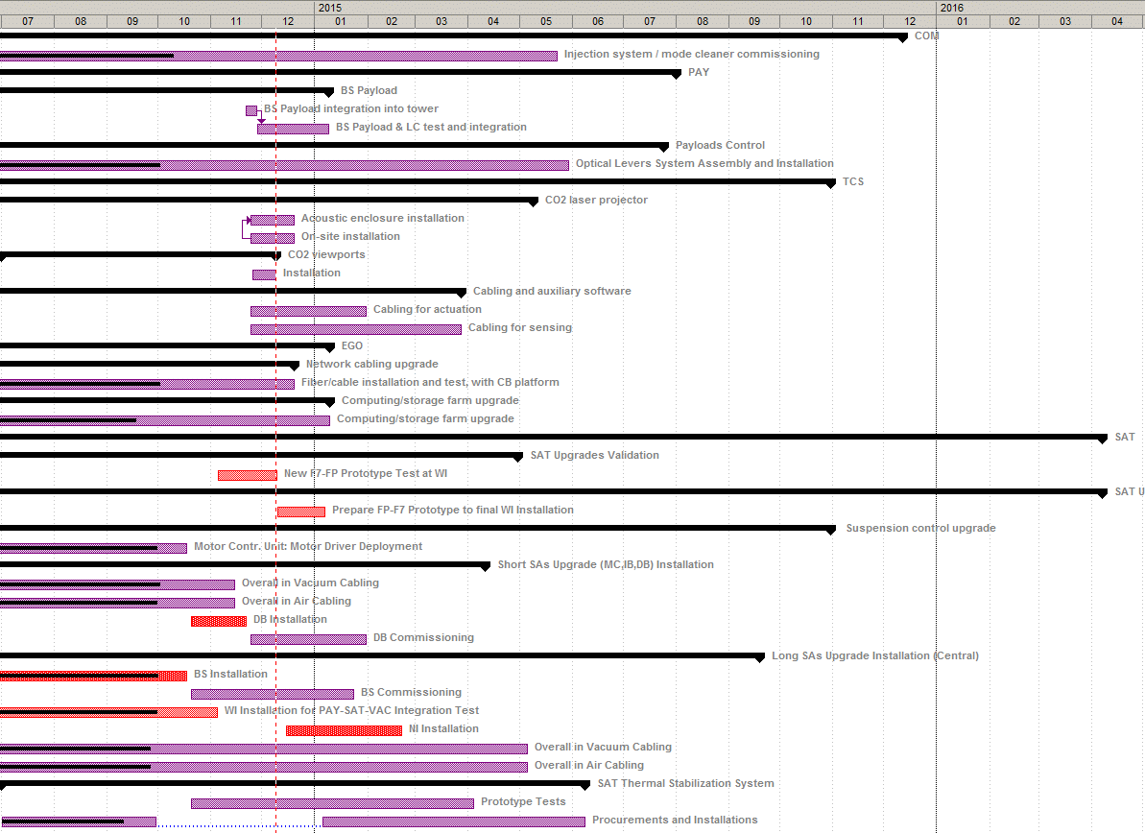
Works going on in this period
COM
PAY
TCS
SAT

Slide 3
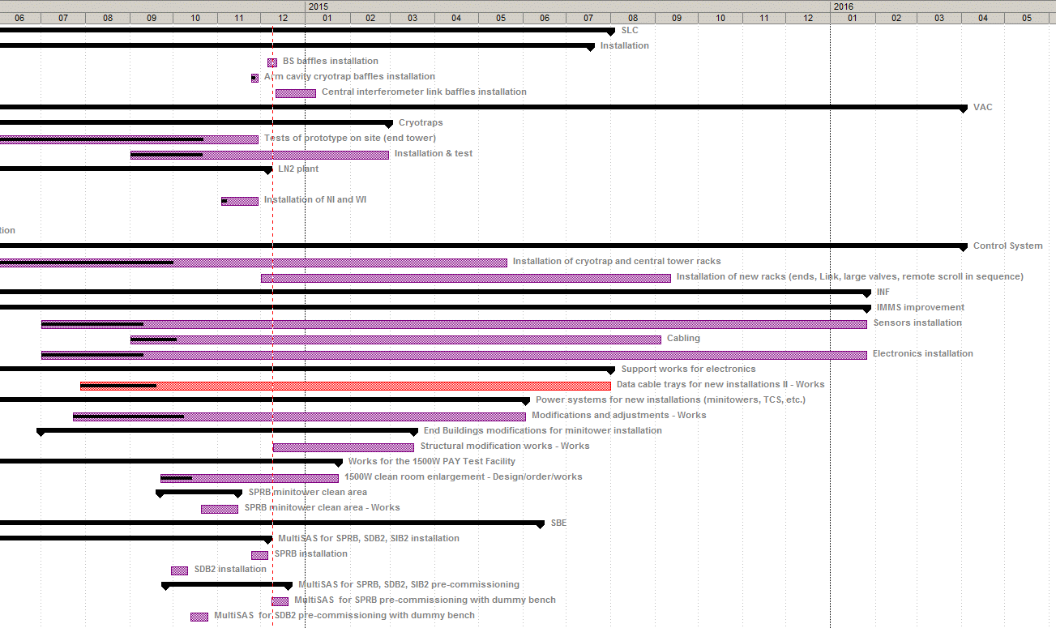
Works going on in this period
SLC
VAC
INF
SBE

Slide 4
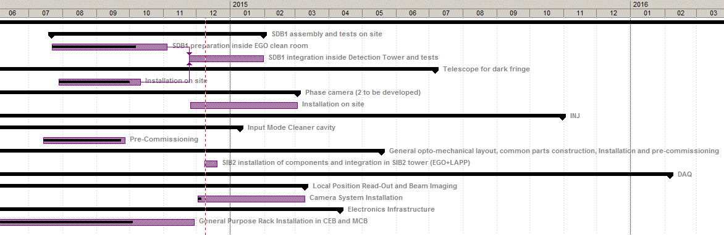
Works going on in this period
DET
INJ
DAQ
Extract from AdV global planning
works scheduled for being active in this period
Other works (EGO maintenance works, ... ) not included

Slide 5
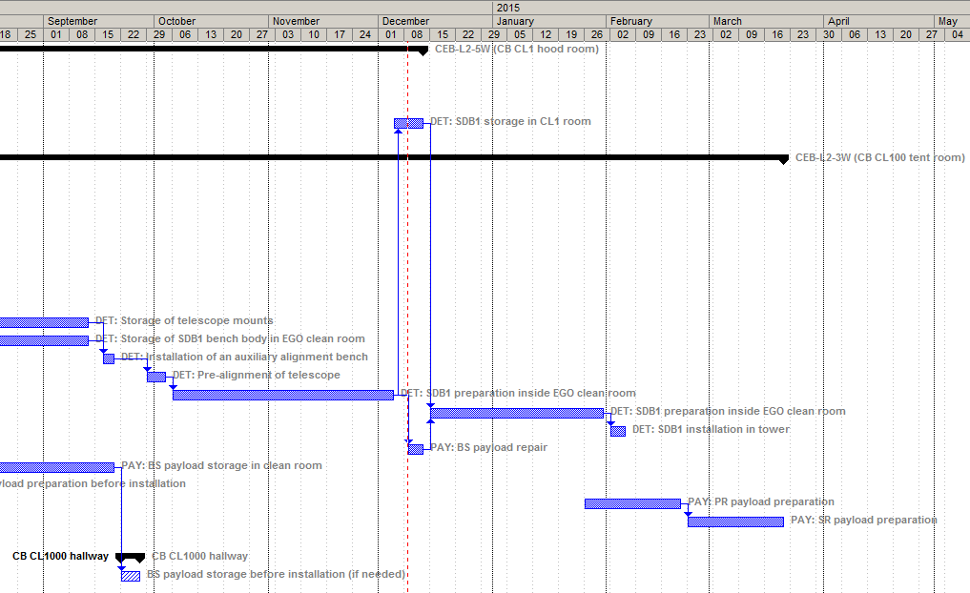
Clean room use
See AdV web site
Class 1 clean room
Class 100 clean room
SDB1 preparation
Payload preparation
Clean room hall

Slide 6
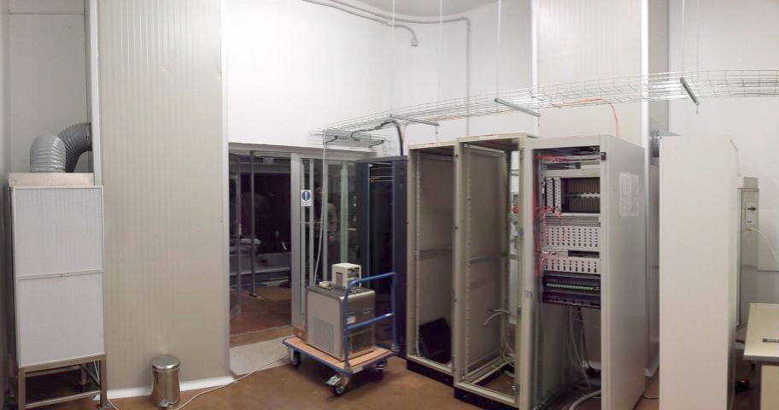
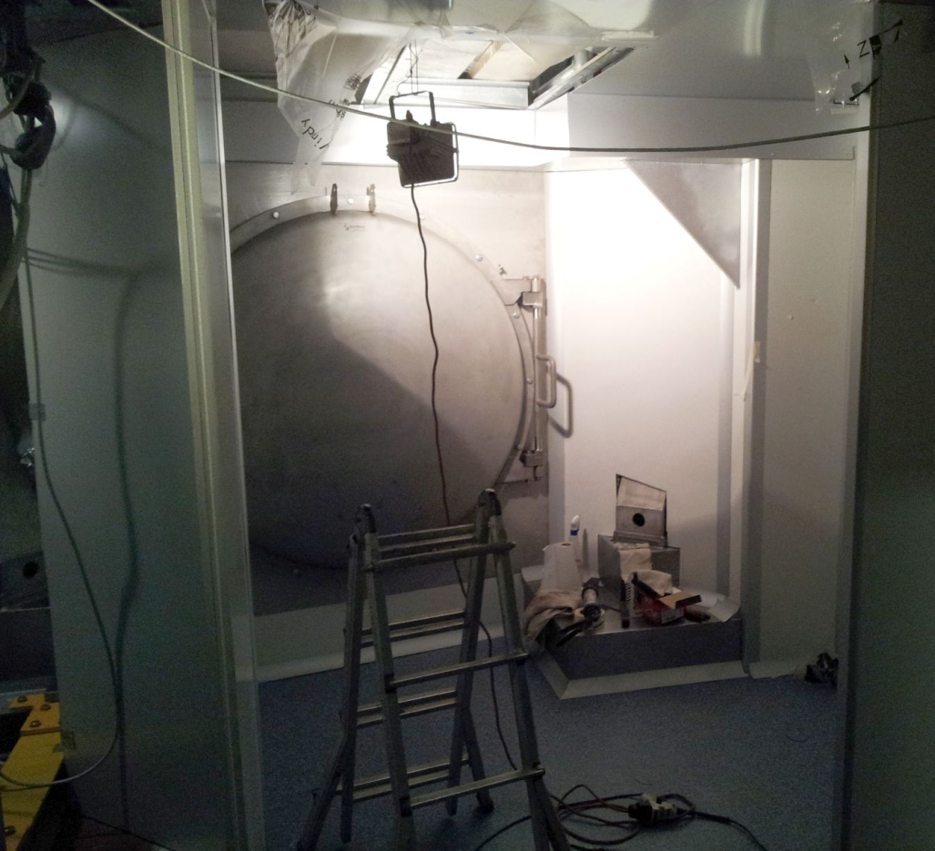
New clean areas
TCS room
Finished, being equipped
SPRB area
Being finished

Slide 7
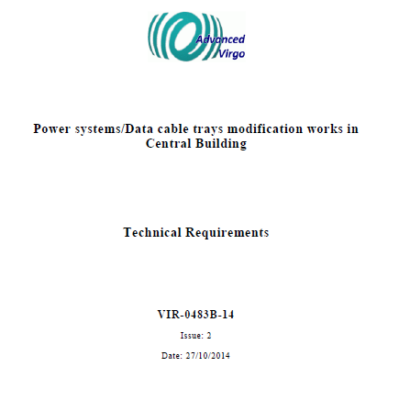
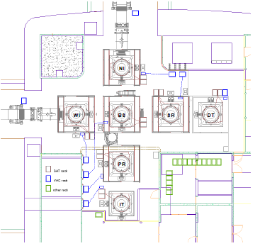
Power systems/Data cable trays in CB
A document (VIR-0483B-14) has been provided describing, at general level, the modification/adjustment works still needed to finalize the electrical power/signal connections for the equipments located in Central Buildings. Those works should soon start.

Slide 8
Power systems/Data cable trays in CB
Actions dedicated to Magnetic Noise Mitigation
In order to mitigate magnetic noise that could impact the Detector sensitivity the following actions will be implemented:
The mains cables currently lying in the cable trenches on the Concrete floor will be removed
the cables routed through the double wall (intercapedine) of the building
Twisted mains wires will be used to connect electrical loads under and over the
For what concern the Central Building UPS possible upgrades. the actions to be implemented will be agreed after a dedicated survey on IPS vs UPS balance among different Adv subsystems plus additional tests and dedicated meetings.

Slide 9
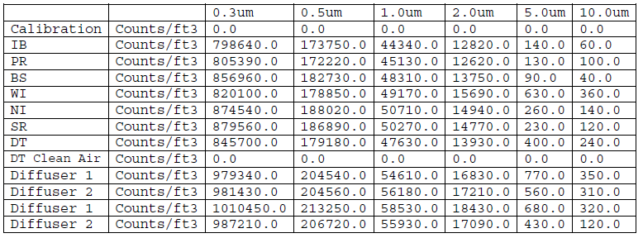
Cleanliness Control
A quick set of comparative air cleanliness measurements have been performed in Central Building. We have measured the air cleanliness near each tower and made a set of measurements just at the output of the 2 easily reachable air diffusers on the highest terrace.
This measurements confirm others made in the past. At the moment the quality of air, at the level of the platform, is identical (or even slightly better) than the one coming out from the air diffusers. This push for improving, via the insertion of filters, the air coming out from the diffusers as precursor of any other dust mitigation action in CB.

Slide 10
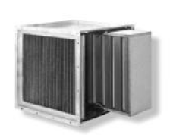
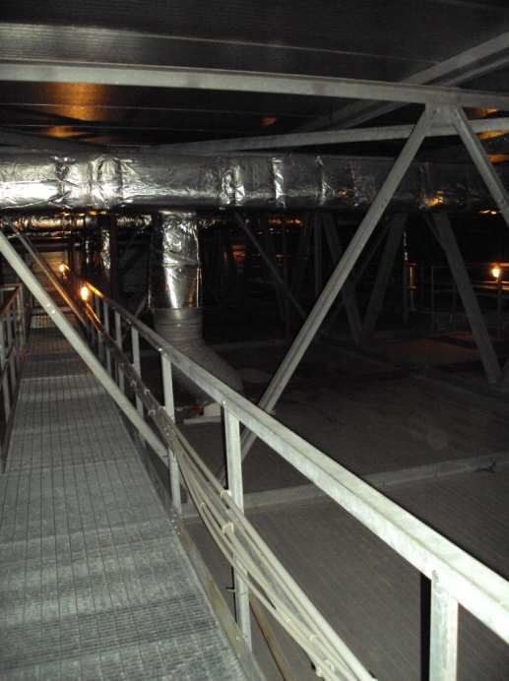
Cleanliness Control
Central building roof
Air conditioning ducts
Insert clean air filters in all air conditioning outlets
Change request VIR-0512A-14
(See INF talk)

Slide 11
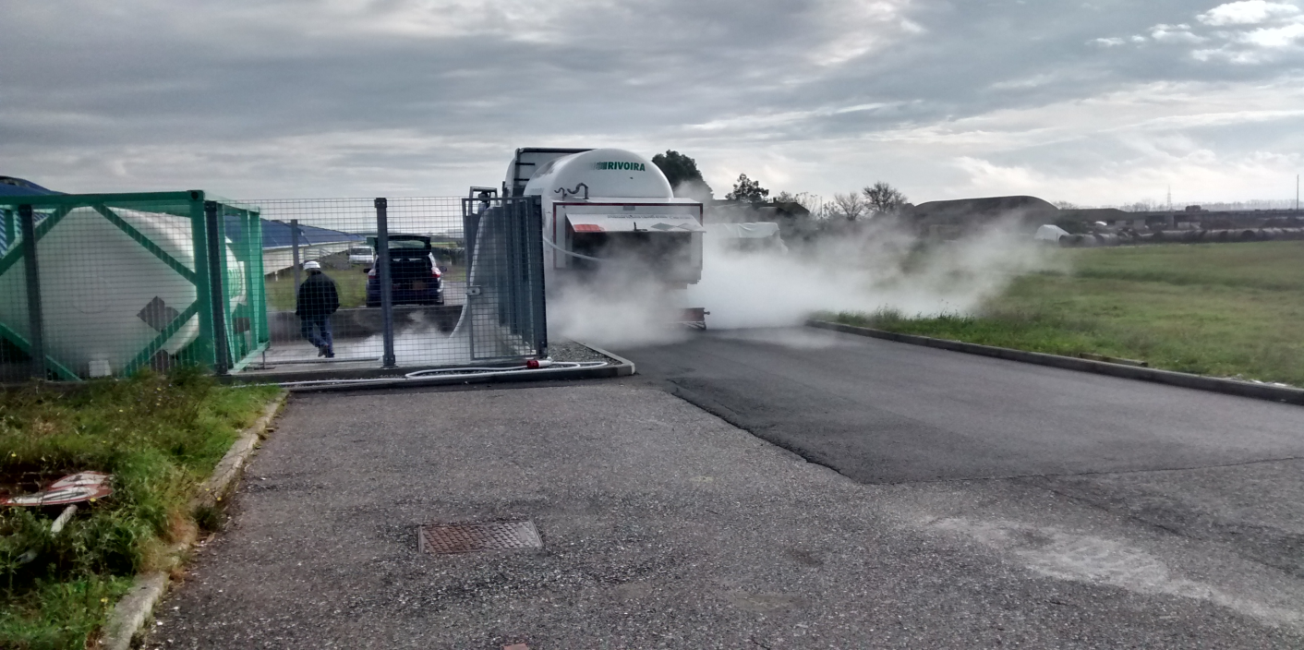
Safety precautions for cryogenic tests at WE
From this week the first cryotest of the WE cryotrap will start and last until Dec 23. During this testing, for safety reasons linked to cryogenic hazard:
The access to the clean rooms under the tower will be blocked
Everybody is requested to inform beforehand about needs of work interventions on the building in order to assess any safety issue and organize for an accompanying person acquainted with the defined emergency procedures.

Slide 12
End of Year Computing/DAQ Shutdown
At the end of December the major upgrade of the onsite machines will happen with the convergence to SL6 64 bit.
The corresponding Computing/DAQ shutdown is foreseen from Dec 23 to Jan 9.
The detector subsystems (mainly INJ) shutdown will start on Dec 22.
Jan 7-9 will be fully dedicated to DAQ restart

Slide 13
End

