Slide 1
IMC cavity length noise
Jean-francois Hayau, Francois Bondu

Slide 2
Introduction
Different IMC length noise requirement has been done:
  In VIR-0425B-10 : Fisrt IMC length noise requirement gave by considering transfer function of IMC motion to h and the advanced virgo sensitivity ( MSRC configuration).
  In VIR-0501A-10 : SSFS loop is considered ( MSRC configuration).
  In VIR-0517B-10 : Requirement on IMC RMS residual motion is added ( MSRC configuration).
New specification: saturation of electronic gain is taken into account for NDRC configuration.

Slide 3
Outline
Simulation
result

Slide 4
Simulation
0ptickle model (NDRC) : Parameters defined in VIR-0541A-10
Simulation realized for various loss asymmetries ( -80ppm to 80 ppm with a step of 20 ppm) and finesse asymmetries ( -1% to 1% with a step of 0.5%):
  hardest case is taken between the different simulations at each frequency.
Precision:
  Ideal SSFS Gain:
  Electronic gain condition : C_{SSFS} < 30000 (saturation) => Gives real G_{SSFS}
  IMC length noise requirement x_{IMC} given thanks to frequency noise requirement ν_{spec}:

Slide 5
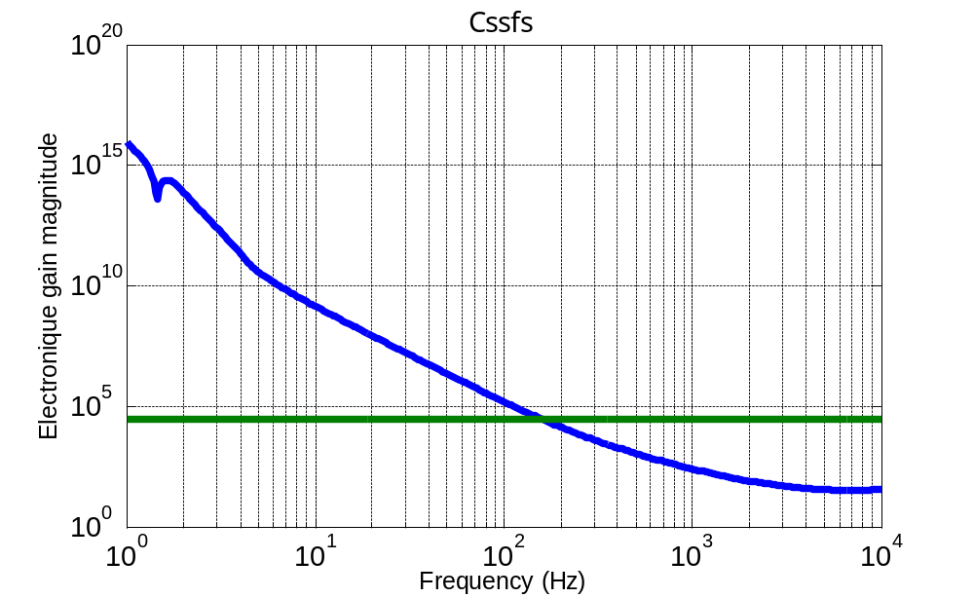

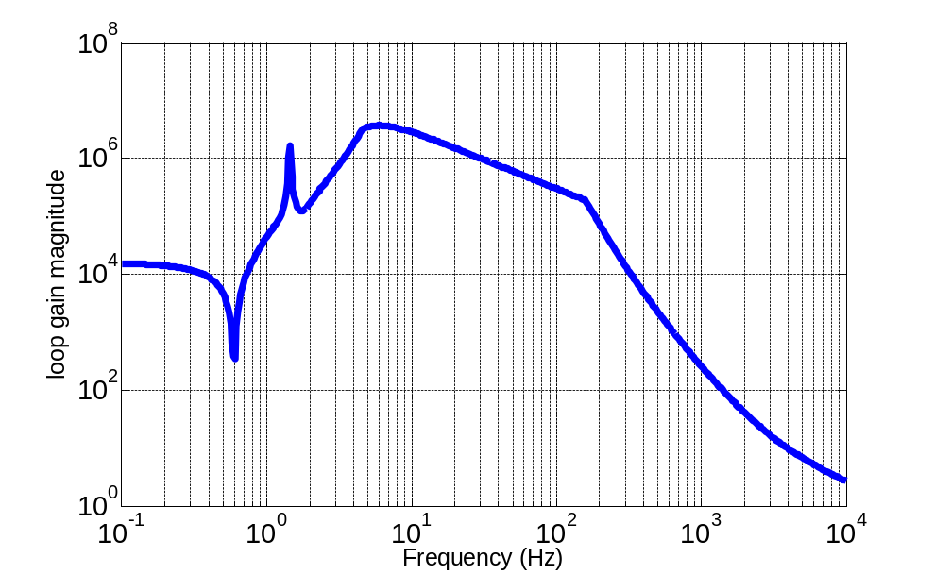
Result
Condition on electronic SSFS gain:
Real GSSFS:
30000
Reduction at low frequencies due to radiation pressure effect

Slide 6
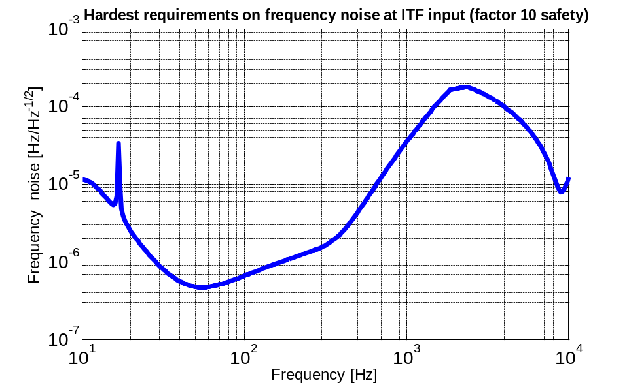
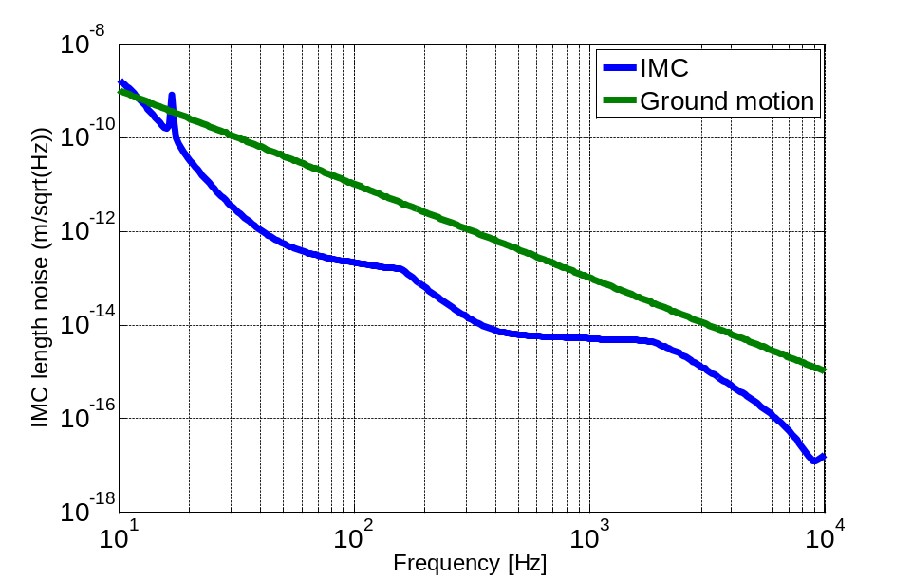

Result
Frequency noise requirement:
IMC length noise requirement:

Slide 7
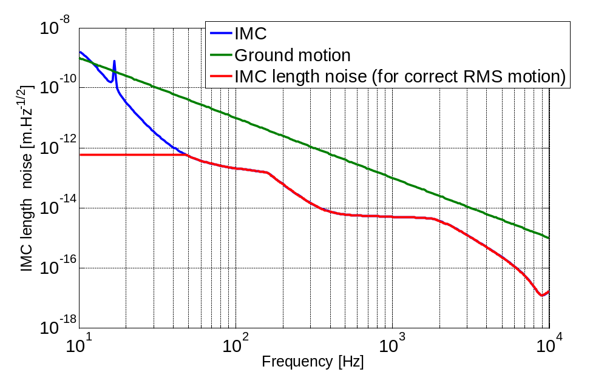
Result
Condition on IMC RMS motion:
  RMS motion on IMC length noise requirement:
  => IMC length noise requirement reduced at low frequencies to have a correct RMS motion

