Slide 1

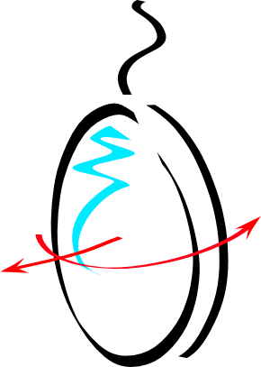
Q&A from STAC phaseII
M. Mantovani for the ISC team
VIR-0549A-22

Slide 2
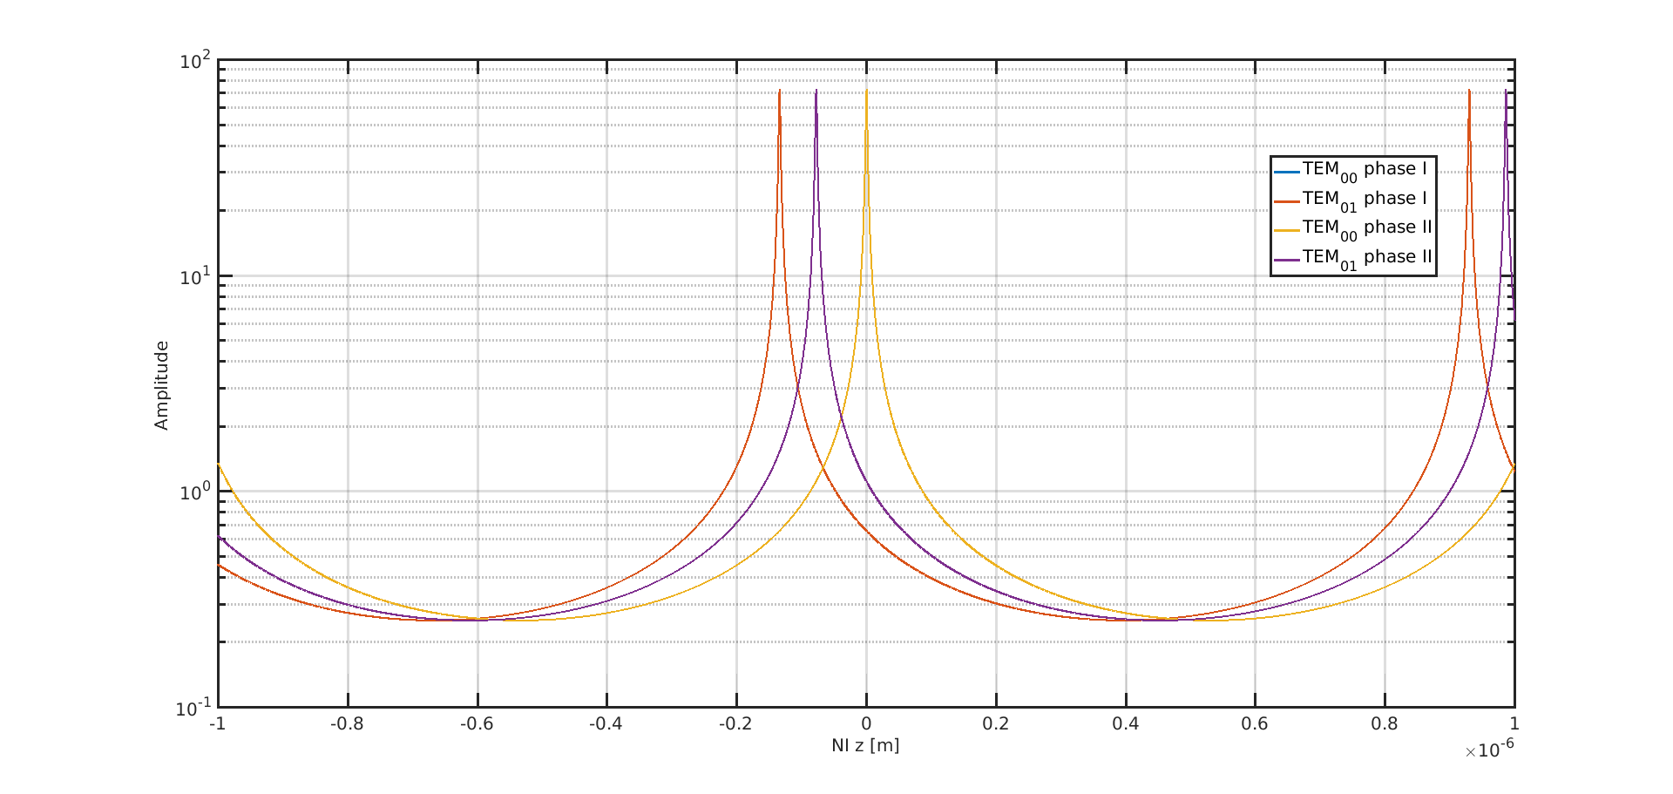
Q&A
One (enduring) question from me: are the marginally stable in/out cavities going to in any way be problematic with the new g-factor? Intuition would say no for the cavities themselves, since they are already g=.99 or something. But some combined effect of the arm+in/out ? degradation of the alignment signals? greater sensitivity to recycling mirror motions in the arms?
The filtering of the TEM01 mode will be a factor 1.7 worse in amplitude in phase II with respect to phase I (VIR-1210A-19), which leads to a more stringent control accuracy on the arm cavity angualr control which is not dramatic (a factor ~2).
Parameters | Advanced Virgo + phase I | Advanced Virgo + phase II
RoC End Mirror [m] | 1420 | 1067
RoC Input Mirror [m] | 1683 | 1969
Cavity g-factor | 0.87 | 0.95
Factor 1.7 of difference in recycling

Slide 3
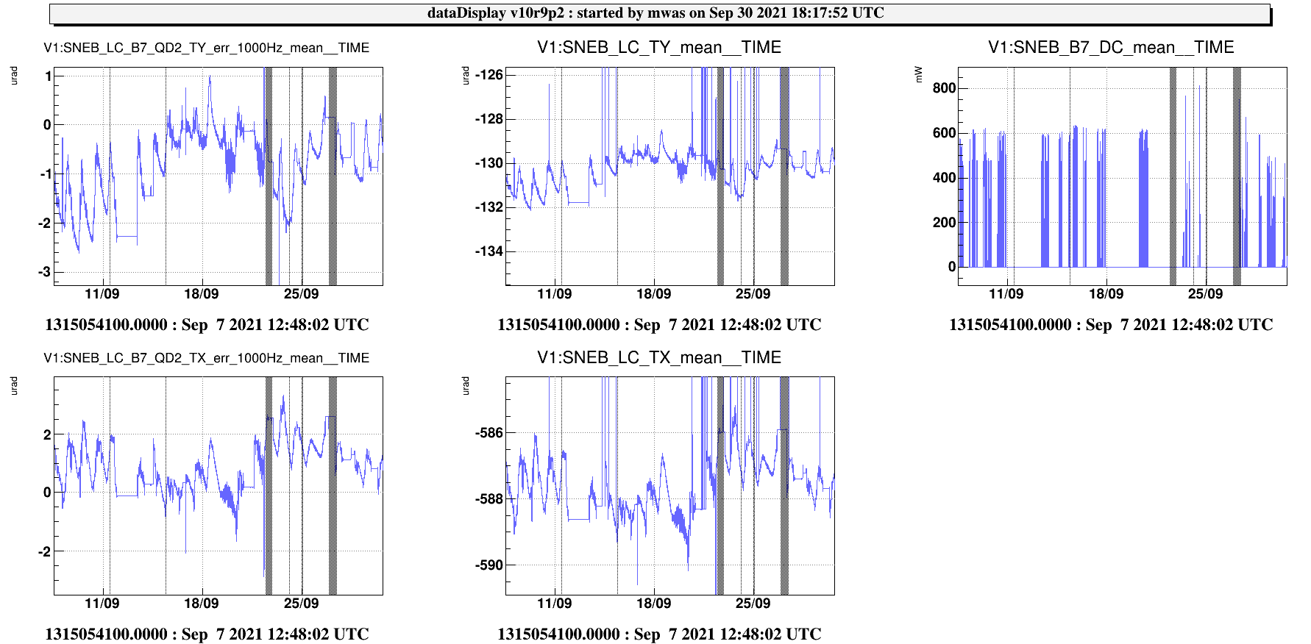
Q&A
According to VIR-1054A-21, the required accuracy for a beam shift in order to have a power loss lower than 1% , for Advanced Virgo+ phase II is 0.06 mm. — is this a feasible level of stability? What motion is seen now, and what is the tolerance now?
This level of stability is feasible, what is has been measured is approximately 0.01 mm. This value has been evaluated by using the corrections needed to control the benches in transmission to the cavities to be aligned with the arm cavity beam (see log-entries https://logbook.virgo-gw.eu/virgo/?r=54161, https://logbook.virgo-gw.eu/virgo/?r=53335).
The End bench tilt of 1urad corresponds to 4um of beam shift (first log-entry). It has been monitored for about 1month and the maximum bench tilt was 3urad leading a maximum of beam shift of 12um (second log-entry).

Slide 4
Q&A
A series of simulations will be performed in order to address all the three deliverables, i.e.:
Locking acquisition design
Steady state locking scheme design
Automatic Alignment scheme design — are those already done or to be done? presumably a preliminary study has shown feasibility. The tenses here and in the later Alignment section move around between ‘will be done’ and ‘was done’.
This will be better clarified.
SRCL offset are often put in place to mitigate the optical spring in the arm cavities. This can make the phase noise requirement much more stringent at a level 1e-7 rad/rtHz at 56MHz. — how is this looking now?
The plan is to not use a SRCL offset to mitigate the optical spring. The simulations performed for phase I to understand the origin of the strong optical spring measured during the Phase I commissioning, point toward the PRC mismatch (with respect to the SRC). The optical spring should be mitigated by matching the two recycling cavities. Moreover the SRCL offset is not presently used to lower the optical spring to make the lock to survive, because a strong modification on the DARM control allows to lock also with very high level of optical spring.

Slide 5
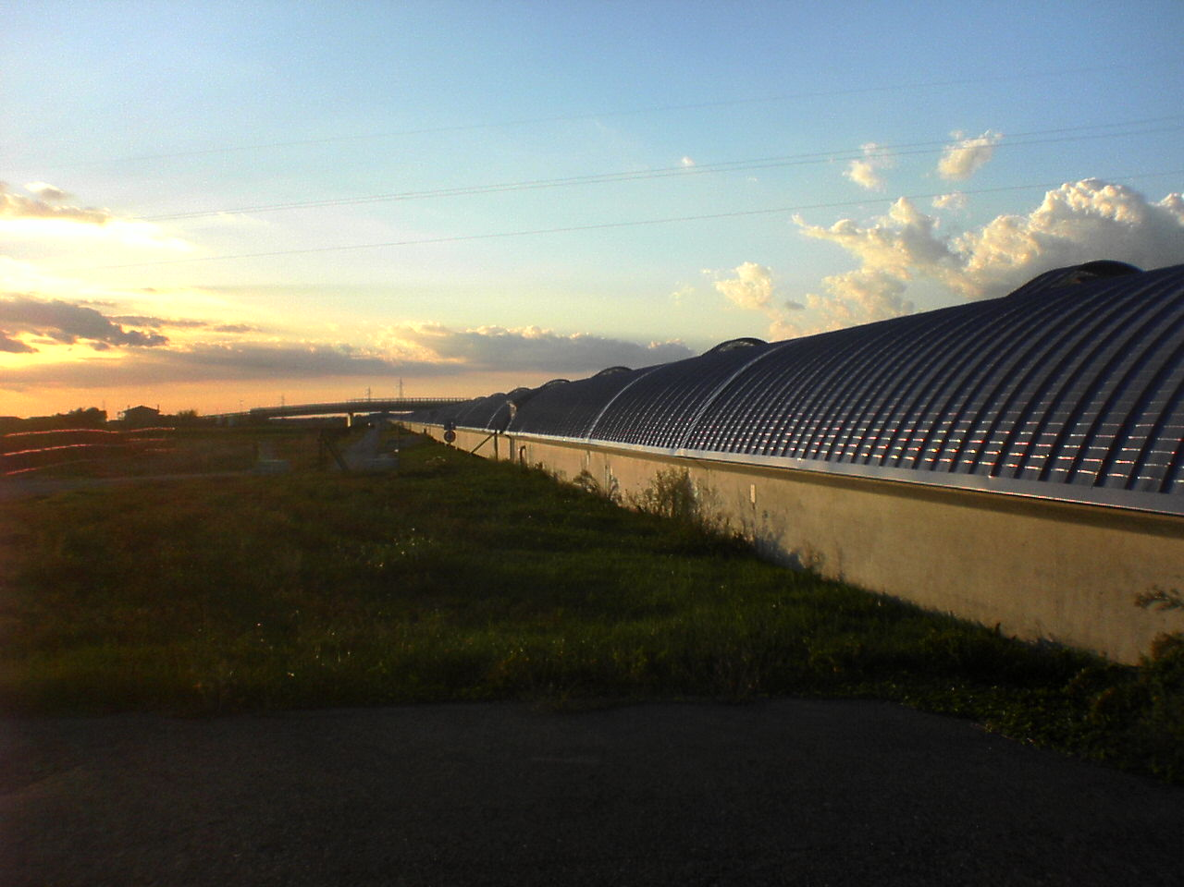
The end...

