Slide 1
ACTUATION FORCE ON THE CP
Matteo Lorenzini for TCS team

Slide 2
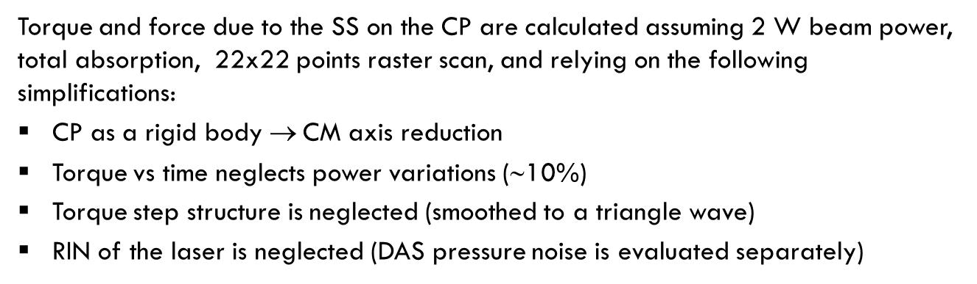
COMPUTATION OF TORQUE AND FORCE
Torque and force due to the SS on the CP are calculated assuming 2 W beam power, total absorption, 22x22 points raster scan, and relying on the following simplifications:
CP as a rigid body $$CM axis reduction
Torque vs time neglects power variations (∼10%)
Torque step structure is neglected (smoothed to a triangle wave)
RIN of the laser is neglected (DAS pressure noise is evaluated separately)
The torque and force time dependence is related to the choice of the following parameters of the scan:
Power (2 W)
Pattern repetition period (1 s) (limited by GALVO performances or phase noise considerations)
Number of scan points (22x22) (related to the actuation area)
Scan geometry (raster scan)

Slide 3
COMPUTATION OF TORQUE AND FORCE
The raster scan ion the CP s characterized by the following parameters:
Side length of the scan pattern
Number of scan points
Laser beam spot size
NOTICE:
The torque is splitted in torque along x (horizontal) and along z (vertical).
Their curves vs time depend on the scan orientation: rotating the raster scan by 90°, the two components trade their places.
z
y
x

Slide 4
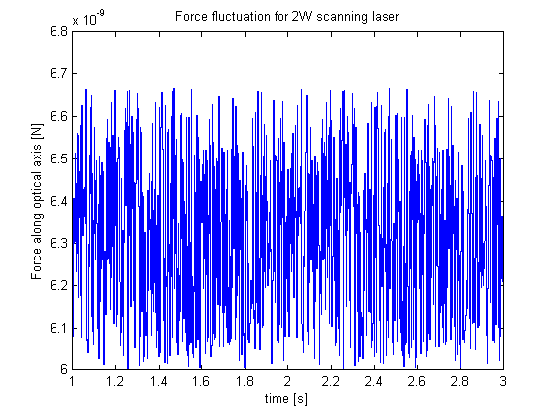
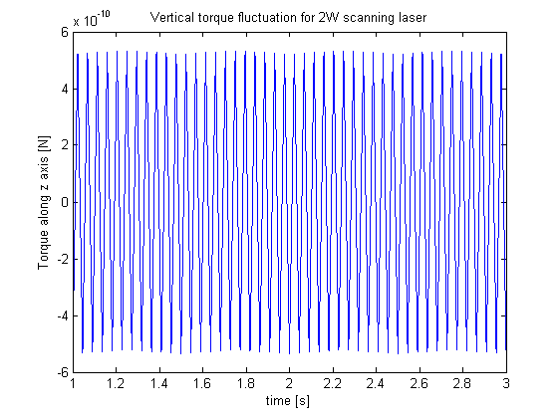
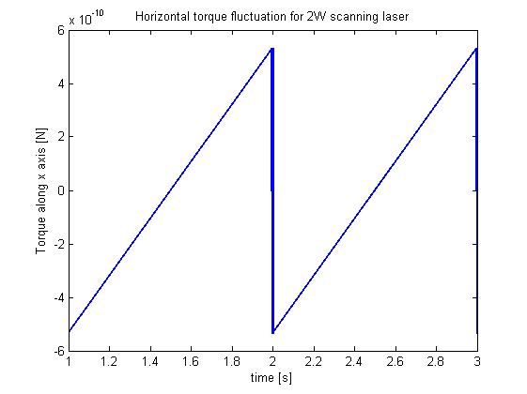
TORQUE AND FORCE vs TIME
FORCE
The force behavior is due to an (assumed) modulation of the intensity of 10% (as in the real SS)
TORQUES

Slide 5
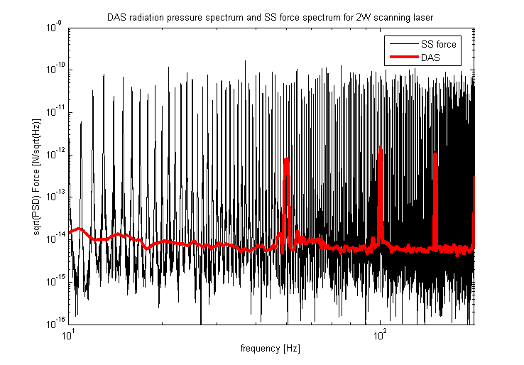
FORCE SPECTRUM

Slide 6
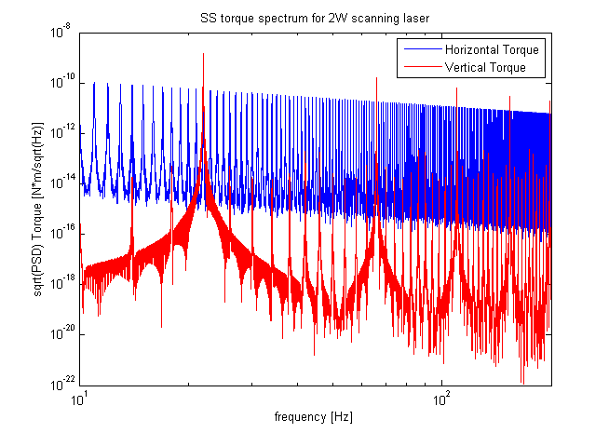
TORQUE SPECTRUM

Slide 7
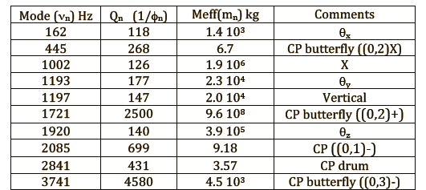
COMMENTS
VIR 0469A 13
CP resonances
Both the force and torque are computed for a rigid body: therefore, their application is straightforward only for those resonant modes of the CP that are due mainly to the suspension (e.g. θ_{x})
The other important information is the set of frequency peaks that can couple to the CP resonances
Coupling of the force with CP internal modes is not trivial!
Worst case: drum mode with F applied in the centre of the CP (?).
We can optimize the scan period to avoid worst coupling with CP internal modes

