Slide 1
Plan for the Environmental Monitoring Electronics
R. De Rosa
Virgo – Napoli
VIR-0534A-14

Slide 2
Outline
Slow Monitoring plan
  Central Building
  Mode Cleaner Building
Fast Monitoring plan
  Central Building
  Mode Cleaner Building
First installation details

Slide 3
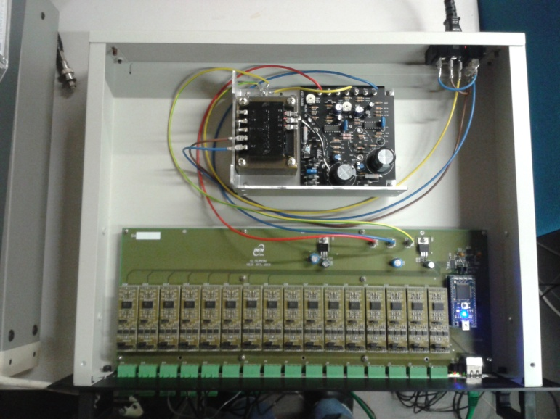
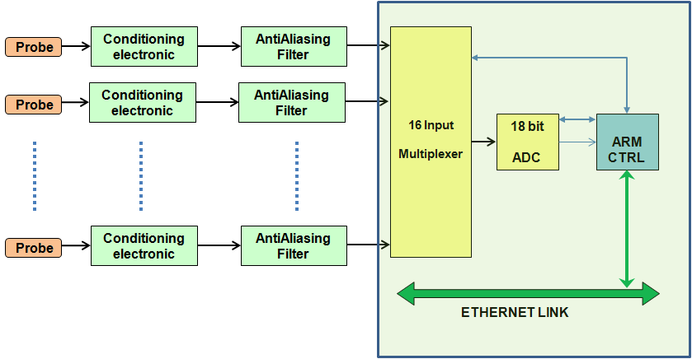
Slow Monitoring
Module Schematic
The slow monitoring module is composed by a mother board that manages the data acquisition and the communication with the server, and several mezzanines that manage the probes (temperature, humidity or generic voltage signal, SE or DIFF) and provide a first signal filtering (Anti Alias).

Slide 4
Slow Monitoring
Installation plan
Central Building:
  Experimental hall:
    3 modules: S-wall, W-wall, N-wall.
    The probes, along the pipes, and the cabling are already installed.
    Location: walls, 1 ethernet link required for each module;
  EE room:
    2 modules for the probes in the INJ-LAB: LB, EIB, SIB2 (Temperature, pressure and humidity);
    Probes already installed on LB, other probes available;
    Location: DAQ -EM rack (4U), 2 ethernet link required;

Slide 5
Slow Monitoring
Installation plan
Central Building:
  DET LAB:
    1 module for the probes in DET-LAB: EDB, SDB2;
    Probes available: to be installed;
    Location: DAQ-EM rack (2U), 1 ethernet link required;
  TCS room:
    1 module for probes on TCS-NI and TCS-WI (bench temperature, laser temperature, pressure, humidity);
    Probes available: to be installed;
    Location: DAQ-EM rack (2U), 1 ethernet link required;

Slide 6
Slow Monitoring
Installation plan
Central Building:
  Platform:
    10 modules, one for each tower for the temperature probes inside the towers and temperature on the local control benches.
    Probes already installed (not in SR);
    Location: Tower rack ? Better elsewhere ? 1 ethernet link required for each module;
  Suspended Power Recycling Bench:
    1 module for temperature monitoring on the bench;
    Probes available: to be installed;
    Location: SPRB rack ? In any case it will be installed later.

Slide 7
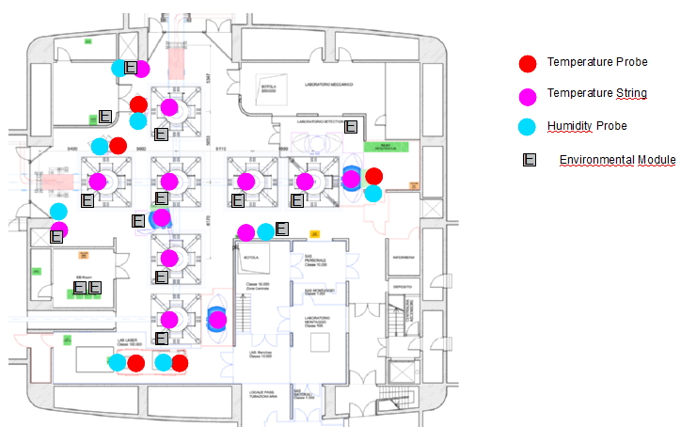
Slow Monitoring
Probes and Modules Location

Slide 8
Slow Monitoring
Installation plan
Mode Cleaner Building:
  Hall
    1 module for the probes along the pipe;
    Probes already installed (temperatures);
    Location: E-wall; 1 ethernet link required;
  Platform
    1 module for temperature monitoring inside the tower;
    Probes already installed, cabling to do;
    Location: Platform or DAQ-rack;

Slide 9
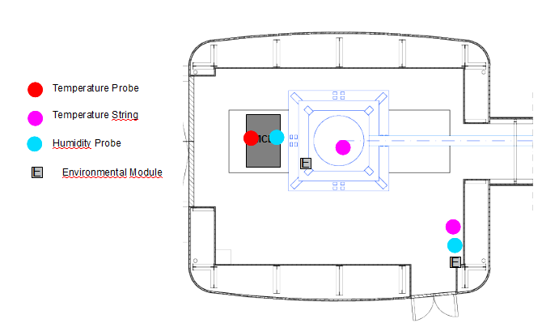
Slow Monitoring
Probes and Modules Location

Slide 10
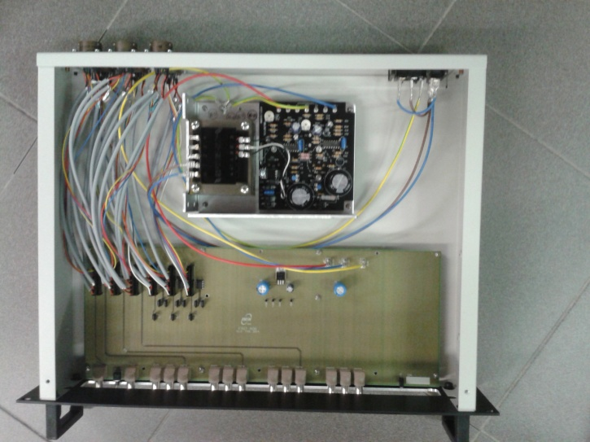
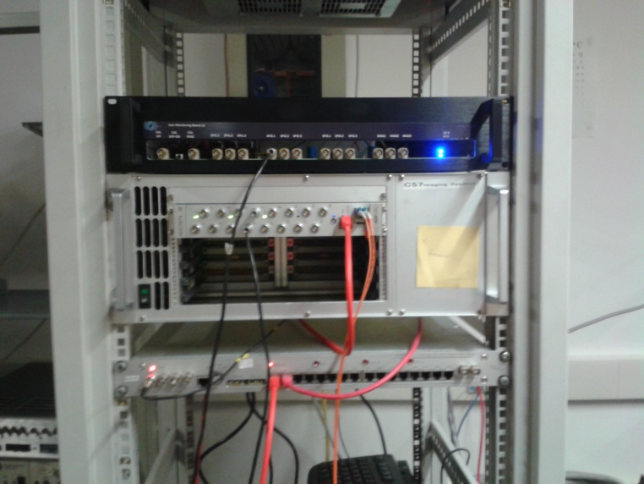
Fast Monitoring
Board schematics
Commercial conditioning amplifiers for:
  Microphone, PZT accelerometer (Nexus or 483C05);
Fast Monitoring Board (Home made) for:
  Episensors, Seismometers and Magnetometers;
Internal view of Fast Monitoring Board
Fast Board during the test with LAPP DAQ

Slide 11
Fast Monitoring
Installation plan
Central Building:
  EE room:
    1 Fast Board for episensors on: EIB (3), LB (3) and SIB2 (1);
    1 Nexus for microphones and PZT accelerometers on EIB and LB;
    1 483C05 for PZT accelerometers on WI, BS and SPRB.
    Total of 15 ADC channels required;
  TCS room
    1 Fast Board for episensors on: TCS-NI (3), TCS-WI (3) and SPRB (1).
    1 Nexus for for microphones and PZT accelerometers on TCS-NI and TCS-WI;
    Total of 11 ADC channels required;

Slide 12
Fast Monitoring
Installation plan
Central Building:
  DET lab:
    1 Fast Board for episensors on: EDB (3) and SDB2 (1), seismometer in central area (3), magnetometer in central area (3);
    1 Nexus for microphone on EDB and PZT accelerometers on EDB and SDB2;
    1 483C05 for PZT accelerometers on NI, DT and SR.
    Total of 16 ADC channels required;
  DAQ room:
    1 Nexus for PZT accelerometers on: IB, PR, SIB2 and microphone for central area;
    Total of 4 ADC required;

Slide 13
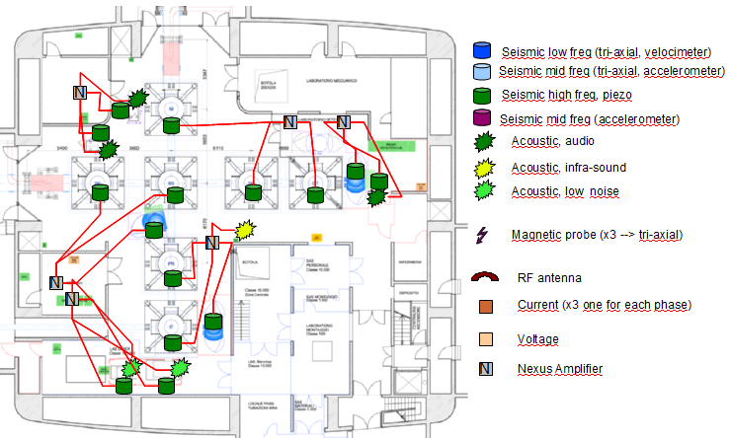
Fast Monitoring
Probes and Boards Location

Slide 14
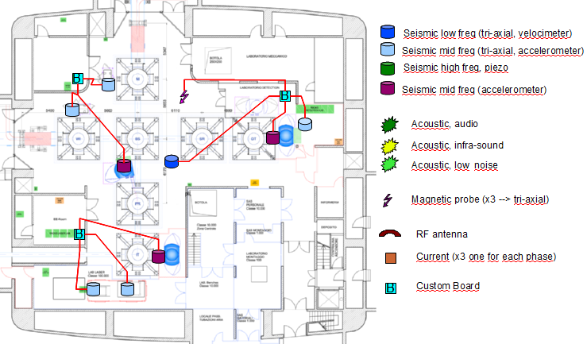
Fast Monitoring
Probes and Boards Location

Slide 15
Fast Monitoring
Installation plan
Mode Cleaner Building:
  Hall:
    1 Fast Board for episensor on MCB (3), seismometer in central area (3), magnetometer in central area (3);
    1 Nexus for microphone and PZT accelerometers on MCB and PZT accelerometer on MC tower;
    Total of 12 ADC channels required;

Slide 16
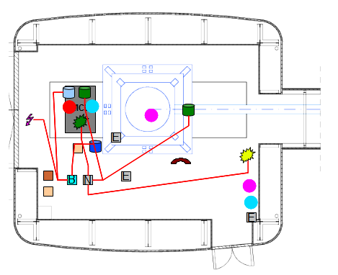
Fast Monitoring
Probes and Boards Location

Slide 17
First Installation
Plan
For next week we plan to install:
  Fast monitoring boards in CEB and MC;
  Slow Monitoring Boards in EE room, DET lab, TCS room, Hall in CEB and MC, at least two towers in the central area;
  Cabling of existing slow probes;
  Cabling of selected fast probes, mainly in the central area if possible;

