Slide 1
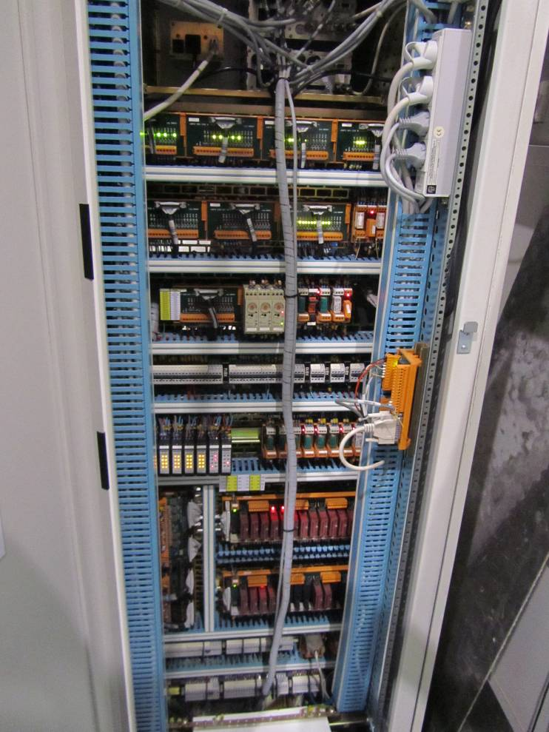
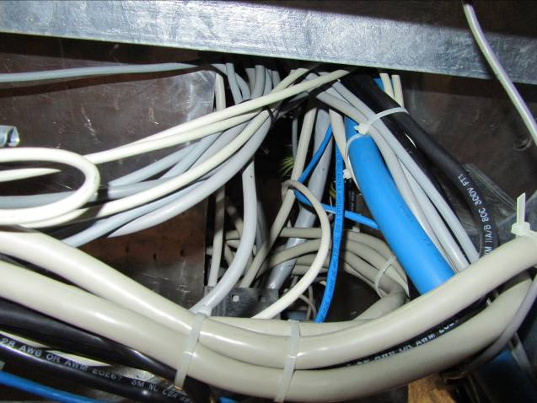
Inputs from VAC to DAQ about cabling and racks
Some features of existing cables
We think it is not necessary to remove the cables for racks upgrade or towers displacement
Most of the cables from controllers to devices are provided by the vacuum companies
Current lengths cannot allow significant displacements of racks
Cables removal could be tricky
Cabling one UHV tower is one week of work for 2 persons

Slide 2
Vacuum racks for Advanced Virgo
all UHV racks will be modified but will be very similar to present ones (addition of ion pump and turbo in some cases)
all tubes racks will have to be replaced (PLC cannot fit inside existing crates)
New racks :
  4 racks for cryopumps
  1 rack for scroll pumping
  2 racks for 300m tube stations
  5 racks for minitowers (included in UHV racks ?)
All racks located close to vacuum devices, none in DAQ room. Exact location of new racks to be defined.

Slide 3
Some planning information (preliminary)
Mid 2013:
  first cryotrap
  minitowers
2014: other cryotraps
Fall 2014:
  scroll pumps
  UHV towers
For towers, first evacuations during installation could be done with old version of the racks. New racks should be in place before the start of AdV commissioning.
Upgrades of tube racks could be done one by one in parallel with commissioning.
Other about the interface VAC / DAQ: Data from vacuum will be sent to DAQ (as at present). It would be useful to have ‘data recording’ during the vacuum equipment commissioning (from 2013).

