Slide 1
Environmental noise activity summary, preparing for AdV
Irene Fiori, Paolo Ruggi, Bas Swinkels
Daniel Vander-Hyde (stage student, Fullerton U.)
A.Magazzù (technical support)
F.Paoletti (technical consultant)
Virgo collaboration meeting, DA session, Cascina, 18 Nov 2013

Slide 2
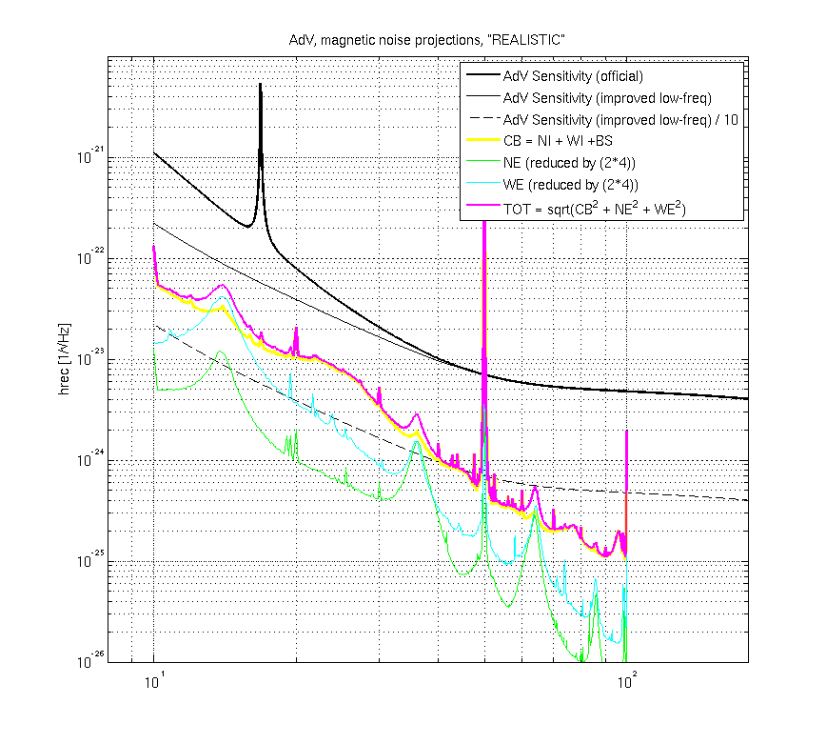
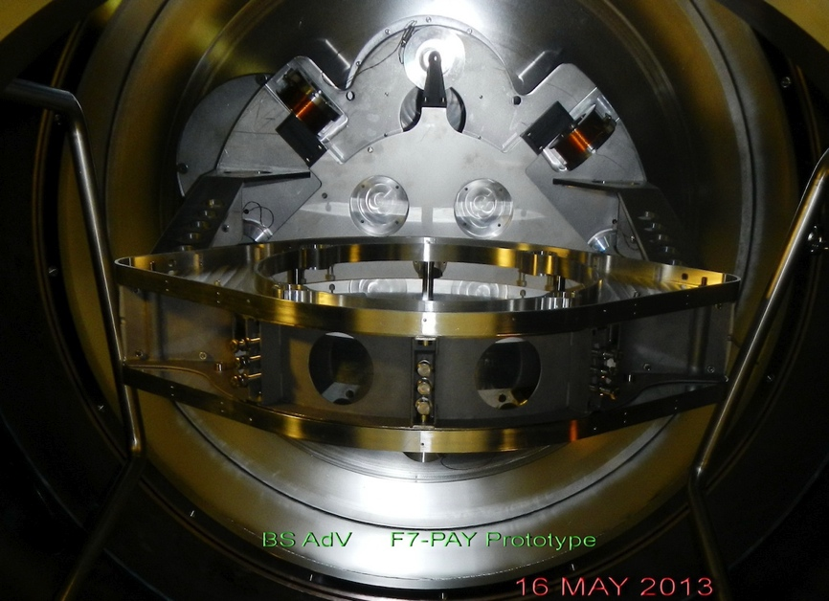
Noise models
Magnetic noise projection (MAN.06.06-t):
added to M.Punturo AdV sensitivity noise budget. It is preliminary, based on simple scaling of V+ measurements. It is missing the modelling of magnetic field distortion close to mirror magnets caused for ex. by Eddy currents in the new cage (therein assumed to be simply “not worst” than in V+ payload).
→ improve projection realiability using payload EM simulation by INFN-Genova (S.Farinon, M.Neri, A.Chincarini). First check accuracy by comparing simulated and measured B field distorsion by a simple object (aluminum disc). Work starting soon.

Slide 3
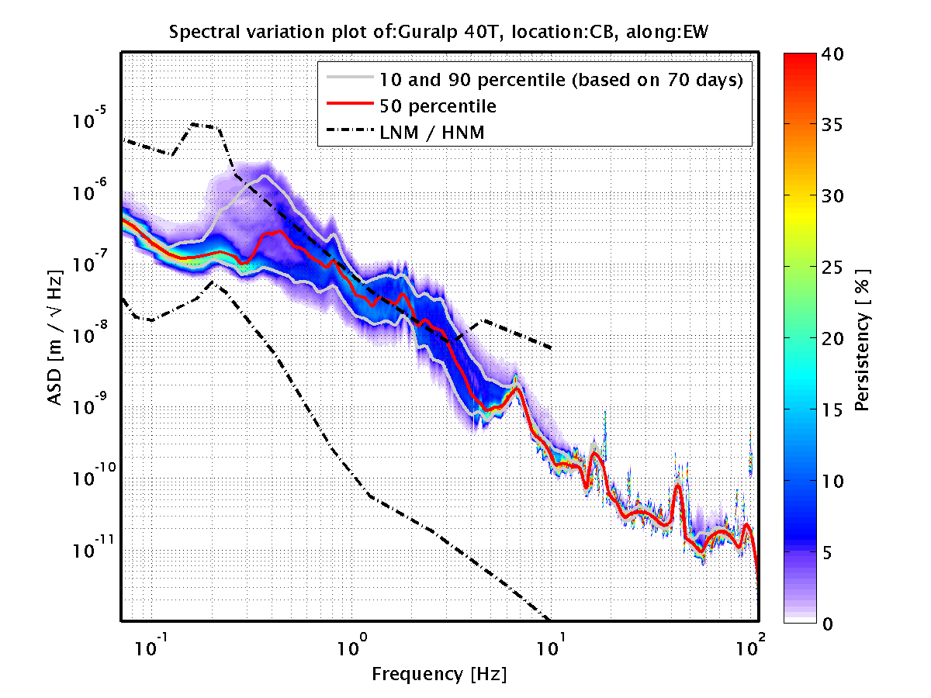
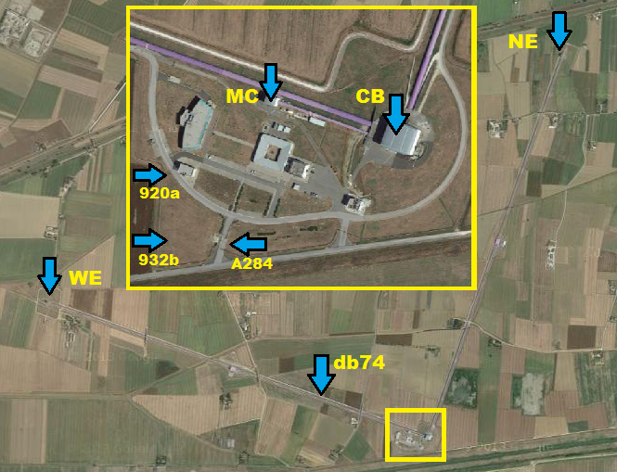
Noise models
Seismic noise model of Virgo site (MAN.06.06-t) :
needed by M.Punturo for projecting Newtonian and Diffused Light noises in AdV sensitivity budget.
Model is based upon statistical analysis of seismic data collected at various locations: “towers’ floor” and “external” soil. Web page collecting results: https://wwwcascina.virgo.infn.it/EnvMon/SeismStatGraphs.html

Slide 4
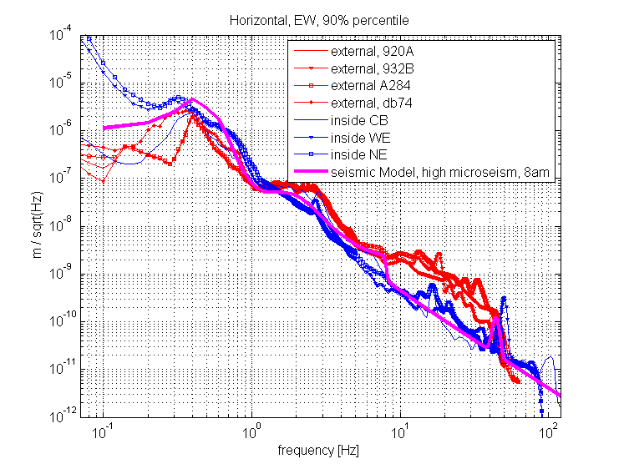
Preliminary
(more tomorrow in Michele’s talk)
Comparison of 90 PL horizontal displacement spectra, of inside and outside loactions.
Tower’s floor moves significantly less than external surface soil, above 10Hz or so.

Slide 5
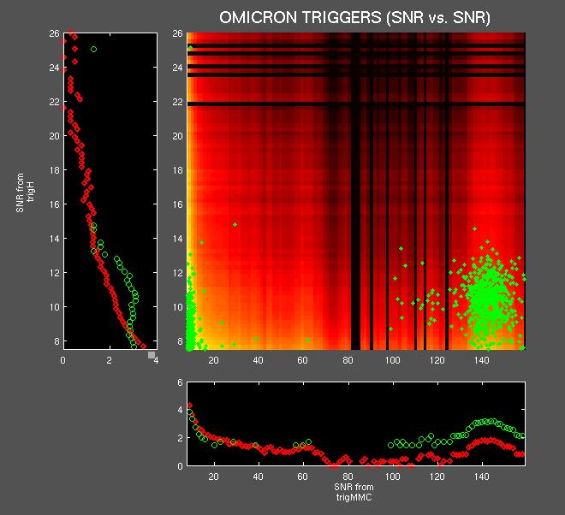
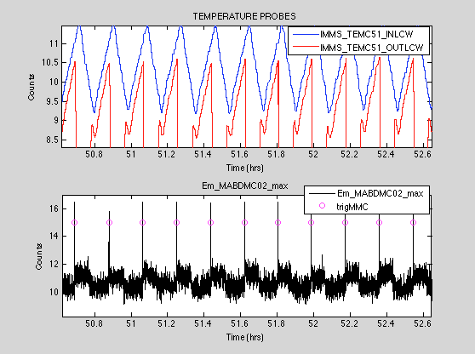
Noise sources
Analysis of magnetic noise transients in VSR4 data: (Daniel V. in VIR-0348A-13)
statistically significant clusters of coincident Omicron triggers between “hrec” and auxiliary channels (presently, Magnetometers, Voltage and Current probes). Clustered triggers are then used in follow-up analysis (presently, Time correlation with IMMS infrastructure monitoring signals ) helping to identifiy sources.
→ Found families of magnetic glitches in hrec associated to aircon water chillers switch-on: MC chiller (already suspected) but also NE and WE chillers.
→ Slow rate (<1/600s), efficent veto by Magnetometers and (new) current probes.

Slide 6
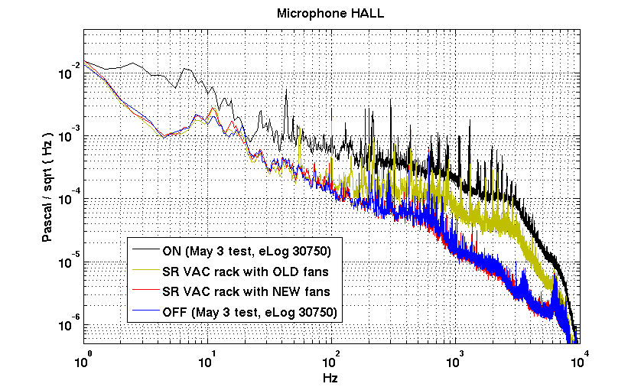
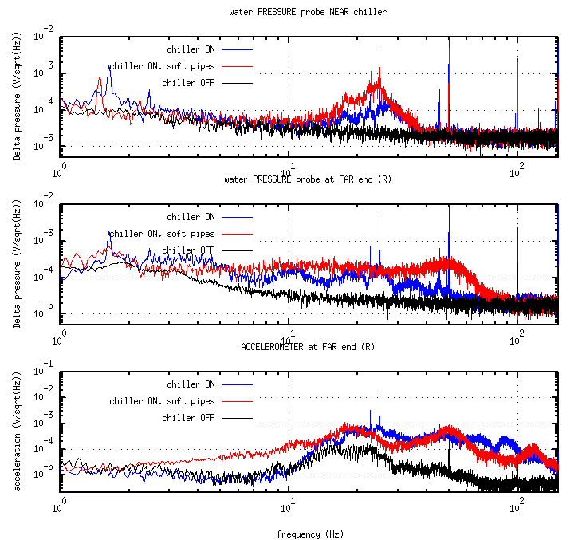
Noise mitigation
New, more silent fans adopted in VAC racks, preliminary tests eLog 30775. WBS VAC.05
TCS water chiller vibration (“Vela killer”) travels in water pipes as water pressure noise. Use of softer rubber pipes dumps noise significantly (eLog 30983, V.Dattilo, M.Ciardelli). Also, adopt small heat-exchangers (E.Genin for INJ). To be tested soon.
ACCELEROMETER at pipe FAR END

Slide 7
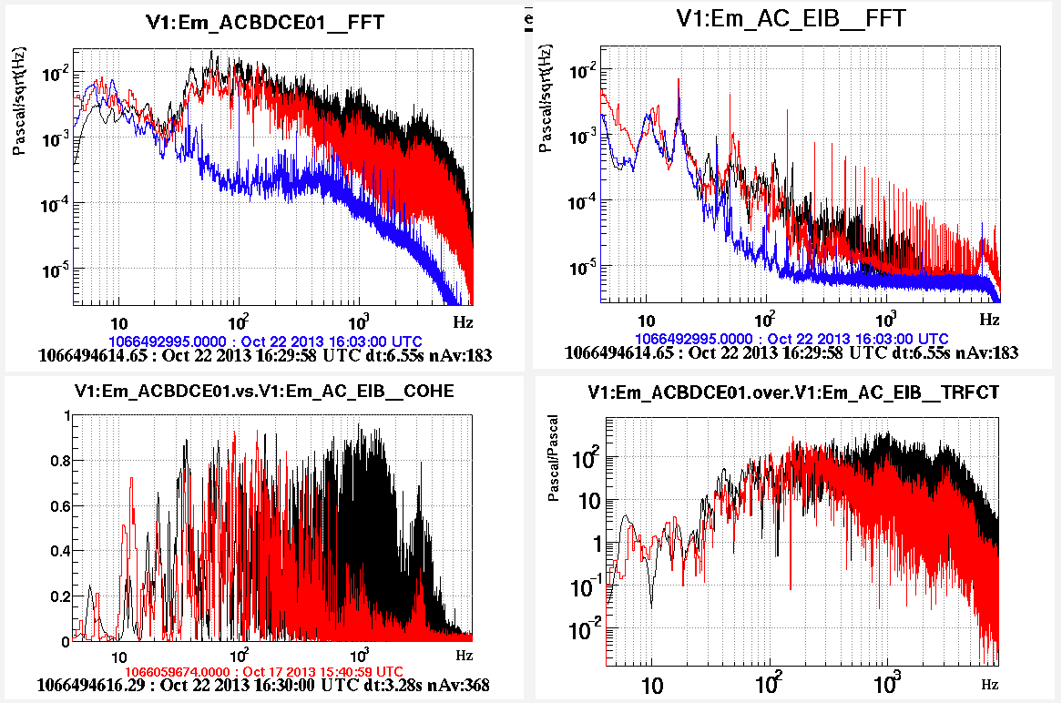
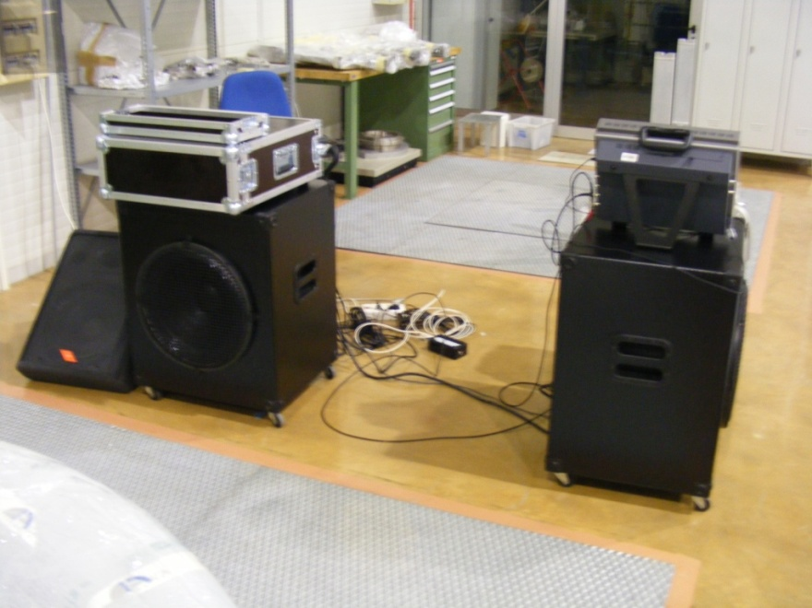
Noise mitigation
New INJ and DET clean rooms, completed. Preliminarly measured acoustic isolation: looks good and compliant with our requests, see eLog 31094. More tomorrow, in Andrea Paoli’s talk.
Check compliance of acoustic emissions of new air conditioners (to do).
WBS codes INF.09.09-t, INF.10.09-t.

Slide 8
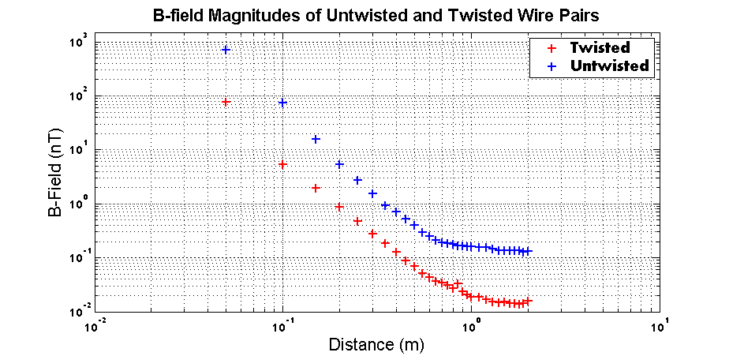
New power distribution of CB design in progress. We gave indications for reducing magnetic noise radiated by power lines close to sensitive locations (NI, WI, BS mirrors): i.e. optimize cables path, adopt twisted-pair power cables, VIR-0338B-13.
Test bench of magnetic of magnetic field decay with distance from single phase plus neutral power cable: standard (blue) and twisted (red), by D.VanderHyde, VIR-0349A-13.
Noise mitigation

Slide 9
Noise characterization
Magnetic emissions of new AC-DC converter for VAC racks . New design adopting toroidal transformers: prototype tested (eLog 30903);
Magnetic emissions of new PLC for VAC control (preliminary). Comb of lines at polling rate, but seems safe (eLog 30942). WBS code VAC.14
Modal analysis of PSL Baffles, just started on prototype (M.Mantovani, VIR-0445A-13). WBS SLC.05.07-t
Modal analysis of SIB periscope mount (VIR-0317A-13) WBS INJ.05.04
Mechanical modes of new Cryotraps and mini traps (...soon) WBS VAC.16

Slide 10
New sensors and tools:
Fixed sensors (INFN Napoli)
.... what’s new with respect to Virgo:
  Monitor Vibration of optical links (windows, with single axis Episensors);
  Cryotraps accelerometers (purchased by INFN Genova, G.Gemme);
  Accelerometers on baffles (UHV compatible, custom design in progress, Napoli);
  Seismometers (Guralp 40-T) monitoring tower’s ground, one per building;
  Current monitors (VIR-0232A-13)
Documented in VIR-0427A-12 (R.DeRosa, Virgo note to be released)
Sensors dedicated to noise hunting/characterization (EGO budget):
  Low frequency loudspekers (purchased),
  Water pressure sensors (purchased),
  Accelerometers for modal analysis (purchased),
  Current probe (ordered),
  RF receiver (soon),
  Field seismometers with datalogger (2014 and 2015)
  Outdoor microphone (2016)
  Outdoor magnetometer (?)
  External camera for tracking flying objects(?)
  ...

