Slide 1


5W fibered electro-optic phase modulator
November, 17th 2015, EGO
Virgo Week
Matthieu Gosselin
GraWIToN
GW Initial Training Network

Slide 2
Summary
GraWIToN project
Phd overview
First developments and results
GraWIToN
GW Initial Training Network

Slide 3
Summary
GraWIToN project
Phd overview
First developments and results
GraWIToN
GW Initial Training Network

Slide 4
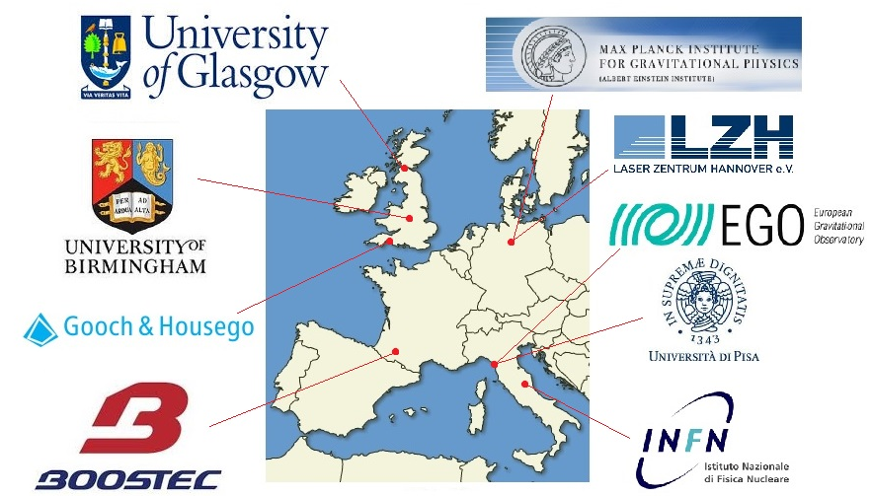
GraWIToN Training Project
14 PhD students in public and private institutions
Funded by European Commission under FP7-Marie Curie Actions
  High power optical components
  Materials (Silicon Carbide, Adhesive-Free Bond...)
  Computer simulations
  Data Analysis
GraWIToN
GW Initial Training Network

Slide 5
GraWIToN in the Virgo Collaboration
Data Analysis
Gang Wang, INFN (Pisa), Multi Band Template Analysis, multimessenger (regular basis)
Shubhanshu Tiwari, INFN (Trento), cWB : Bursts Analysis (regular basis)
Simulation
Jose M. González Castro, University of Pisa, Computer intensive simulation of optical systems and components (regular basis)
Daniel Töyrä, University of Birmingham, Computational modeling of advanced laser-interferometric gravitational wave detectors (2 months in 2016)
New technologies
Rudy Nahed, Boostec Tarbes, Silicon carbide for stray light control (June 15, Oct 15, 2016)
Marina Trad Nery, AEI Hannover, Power stabilization at and below the shot noise limit (Oct 15, 2016)
Omar De Varona, LZH Hannover, Dynamics of high power fibre amplifiers (2016)
GraWIToN
GW Initial Training Network

Slide 6
Summary
GraWIToN project
Phd overview
First developments and results
GraWIToN
GW Initial Training Network

Slide 7
Details on my Phd position
Input optics components for the upgrade of the 2nd and 3rd generations of gravitational waves detector
    1st year : fibered Electro-Optic Modulator for ≤10W
  2nd year : fibered Electro-Optic Modulator for ≥ 100W
  3rd year : fibered Faraday isolator for ≥ 100W
November 2014 - November 2017
Gain experience with EOM before working on Faraday Isolator
Increasing power step by step
GraWIToN
GW Initial Training Network

Slide 8
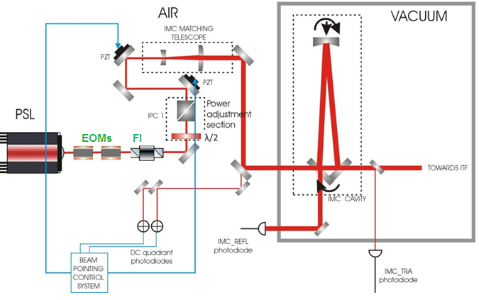
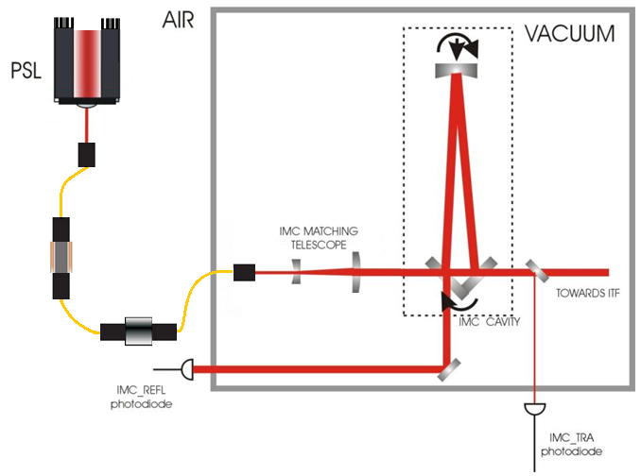
Injection into vacuum with a fiber
Fibered the transmissions before Mode cleaner
Reduction of the noises
Ease the transmission on the in-vacuum bench
Fibered EOM
Fibered FI
and Power Control
GraWIToN
GW Initial Training Network
Possible futur design

Slide 9
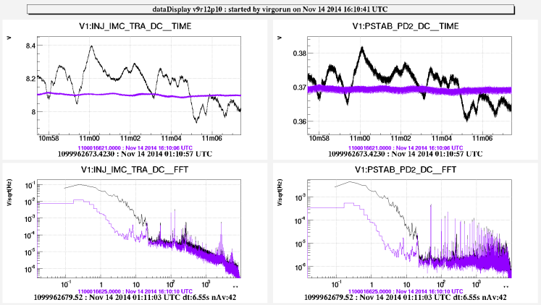
Fibering expectations
Noises due to the free space propagation
Already improved by covering the beam path
Could be improved by fibering everything
Better control on the propagation
No alignment issues, beam jitter
Fiber can be directly brought inside the tower
Fibering will induced other noises that have to be characterized
Phase noise induced by the fiber can be canceled with a retroaction loop on the EOM or other “phase” actuators
Noises, free space to vacuum injection
GraWIToN
GW Initial Training Network

Slide 10
Trainings and Experiences
GraWIToN school : Useful lectures on high power optical components
Good overview of all the fields of GW detection
Meet many actors of the project
EGO optics group (Eric Genin, Gabriel Pillant) : experience in high power electro-optics components
LZH (3 month secondment) : Abilities in high power injection into fibers, Use of a single frequency high power laser inducing non linear effects
Boostec (1 month secondment) : use of silicon carbide as beam dumps in our application
GraWIToN
GW Initial Training Network

Slide 11
Summary
GraWIToN project
Phd overview
First developments and results
GraWIToN
GW Initial Training Network

Slide 12
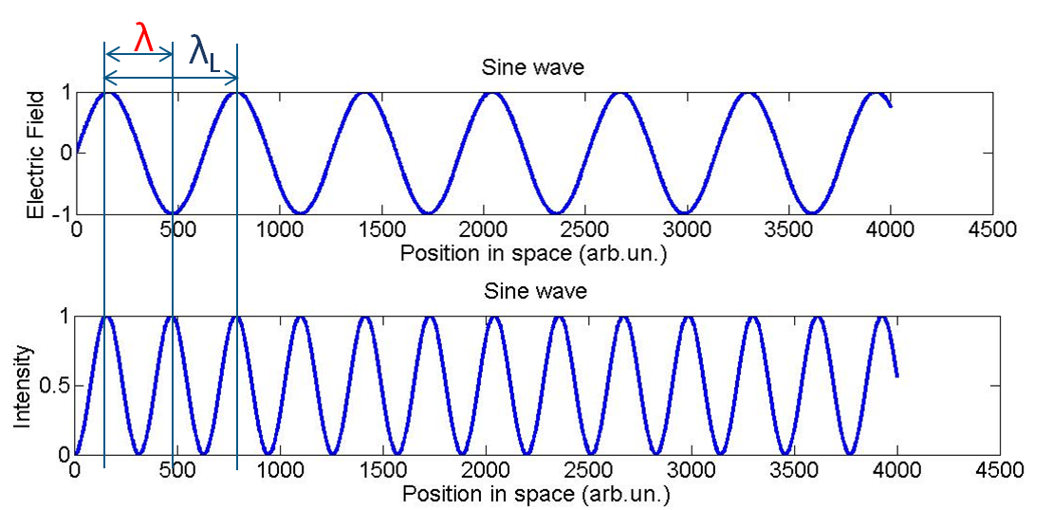
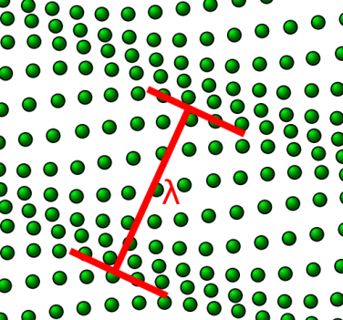
Non linear effects
Raman, Four waves mixing, Brillouin…
Field of a single frequency laser
Intensity of the light
Electrostriction , Bragg Mirror
Incident light is back reflected
Increase with
Power
Length
Narrowband
GraWIToN
GW Initial Training Network

Slide 13

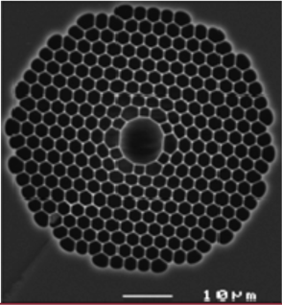
Brillouin effect into fibers
200W CW single frequency in a 15μm silica core
Few centimeters of propagation
Behavior for microstructured fiber not well defined by the theory
It has been used for powers to up 30W in the AEI at Hannover
5 meters no brillouin effect
LMA-PM-15
Upcoming tests on new fibers
LMA-PM with larger core : 25μm , 30μm
Hollow core fibers : propagation into air
Power densities divided by 4
No non-linear effects anymore
GraWIToN
GW Initial Training Network
Compromise between beam quality and propagation

Slide 14
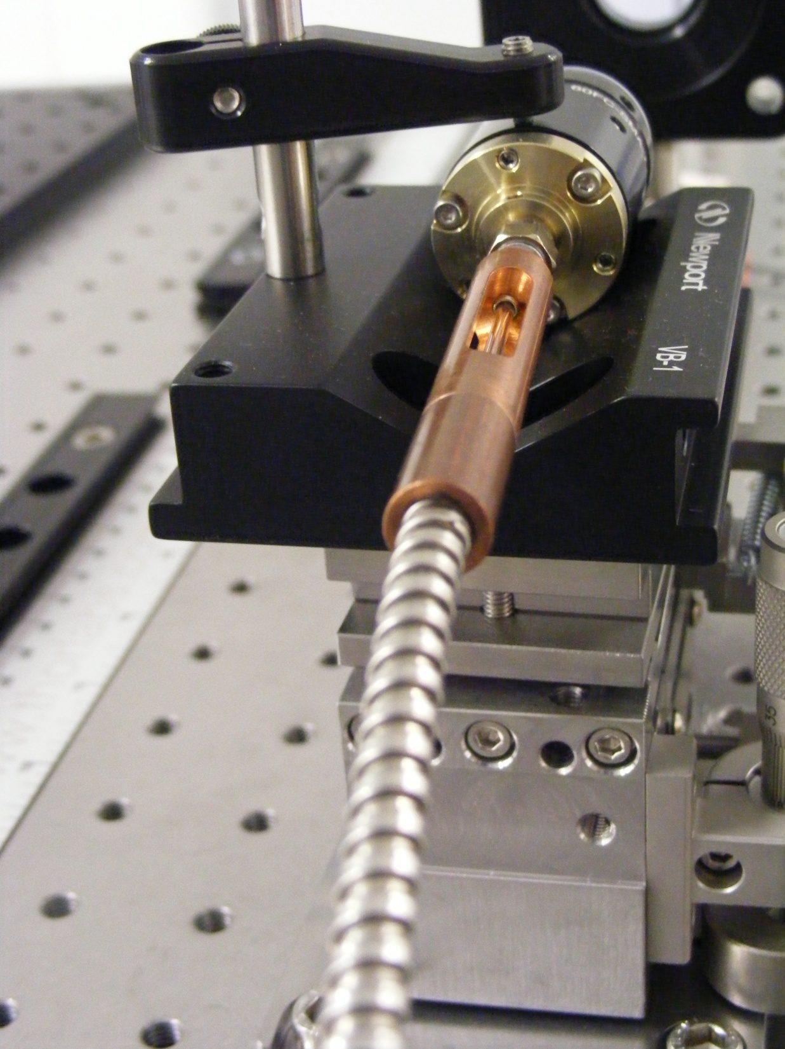
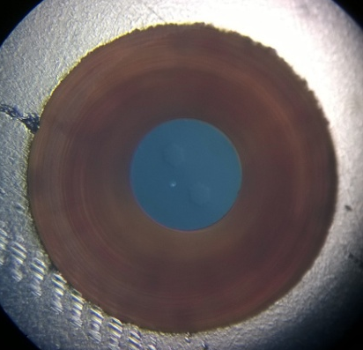


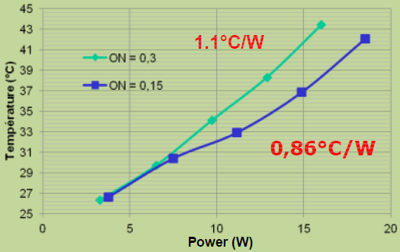
Injection into fibers-Connectors
Losses
Noises…
ALphanov
New generation of connectors
Laser micromachined
Higher power tolerance
10W misaligned
end facet
melted
Strip out the mismatched light
Current connectors
High power SMA-905
Temperature elevation ~7°C/W
GraWIToN
GW Initial Training Network

Slide 15
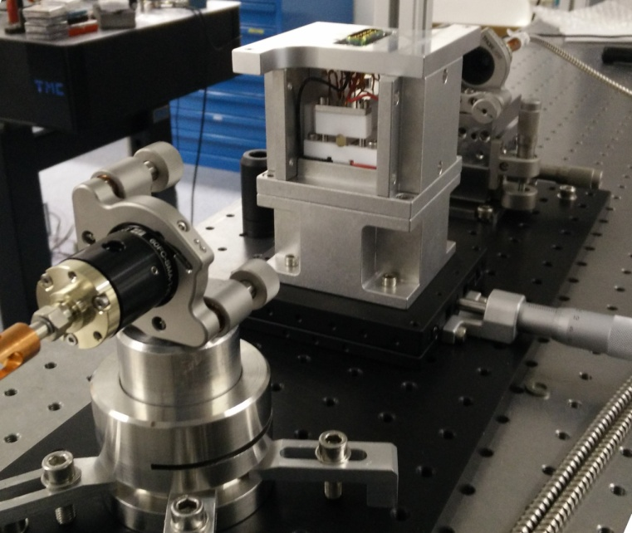
EOM set-up
coupling
Plastic box
High power Laser
EOM
Breadboard
Plastic box to confine the component as much as possible from outside perturbations
Free space injection
Or
Fibered laser
Breadboard to be easily move from a place to another, from a laser to another, keeping the alignment
GraWIToN
GW Initial Training Network

Slide 16
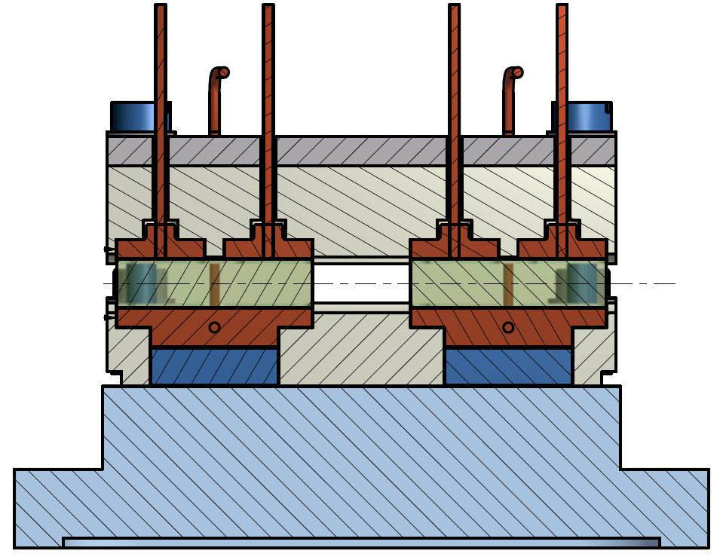
Electro-optic modulator
Design with the mechanics and electronics department of EGO
Electrodes
Crystals
Peltier
Control the temperature with peltier modules to reduce the noises (in particular RAM)
5W electro-optic modulator with 4 modulation frequencies
GraWIToN
GW Initial Training Network

Slide 17
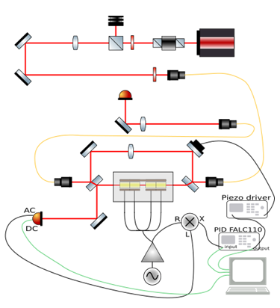
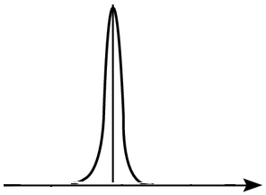
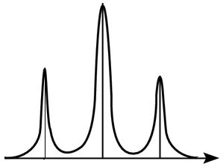
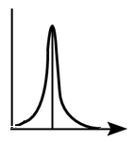
Characterization Set-up
Injection part
87% coupling through the all fibered EOM
Mach-Zehnder interferometer
Beating between the incident light and the modulated light
ω₀
ω₀-ω_{m}
ω₀+ω_{m}
ω_{m}
Electronics layer
Mixing with the reference signal
Study the characteristics of the sidebands
17

Slide 18
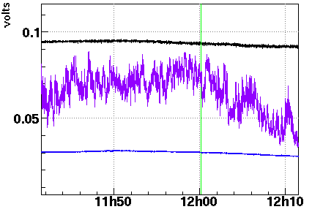
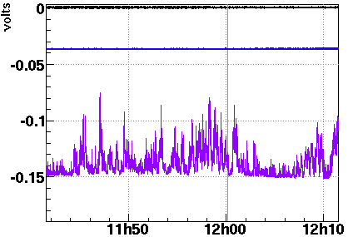
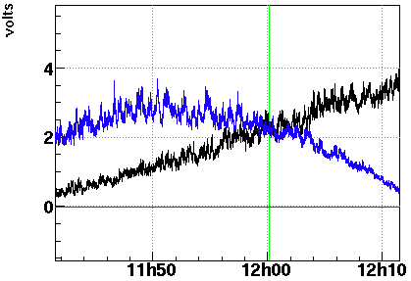
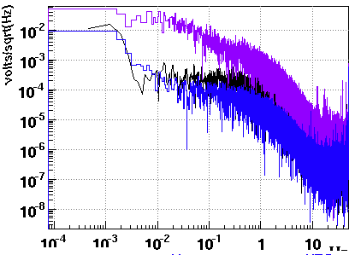
Lock Mach-Zender
Output power
Error Signal
Apply correction
Bright fringe
Slow shift of the arms
Dark fringe
Lock of the Mach-Zehnder interferometer in order to cancel its phase noise
Upcoming measurements : full characterization
Residual Amplitude Modulation
EOM phase noise
Vπ, modulation depth
GraWIToN
GW Initial Training Network
18

Slide 19
Conclusion
Functional 5W electro-optic modulator under characterization
Further developments
Increase the power : up to 200W at EGO
New fibers for higher power : larger core, hollow core
in order to avoid non linear effects
Control of the characteristics with feedback loops
Up to 200W single frequency in Hannover (early 2016)
GraWIToN
GW Initial Training Network
19

Slide 20
Thank you for your attention
Matthieu Gosselin, gosselin@ego-gw.it
GraWIToN
GW Initial Training Network

