Slide 1


Burst search using a coherent algorithm applied with a network of detectors
M. Drago, AEI Hannover

Slide 2

Burst Search
Bursts are waves of short duration: less than 1 s
  Time of arrival is not (always) predictable
  Waveform is not modeled enough and
  there is a great variety of possibility
  We must be ready to the unexpected!!!
Necessity of a general method to give a reliable confidence of a possible candidate:
  Characterize detector noise: background study
  Establish detection efficiency of an algorithm on test waveform (software injections)
  Maximize detection efficiency and glitches rejection

Slide 3
Network of detectors
The use of more detectors helps to give a more reliability on detection
Data from different detectors can be combined in different way:
  Incoherent pipelines: each detector has its trigger list, time-frequency coincidences are made
  Coherent pipelines: data are combined as they belong to a single detector (likelihood)
  Semi-coherent: intermediate approach

Slide 4
Hypothesis test
 |  | Signal presence
 |  | Yes | No
Decision rule | Yes | True Alarm | False Alarm
 | No | False Dismissal | True Dismissal
At each time the signal could be present or not

Slide 5
Hypothesis test
 |  | Signal presence
 |  | Yes | No
Decision rule | Yes | True Alarm | False Alarm
 | No | False Dismissal | True Dismissal
At each time the signal could be present or not
At each time we can decide that the signal is present or not (decision rule)

Slide 6
Hypothesis test
 |  | Signal presence
 |  | Yes | No
Decision rule | Yes | True Alarm | False Alarm
 | No | False Dismissal | True Dismissal
At each time the signal could be present or not
At each time we can decide that the signal is present or not (decision rule)
4 situations: two right and other wrong

Slide 7
Hypothesis test
 |  | Signal presence
 |  | Yes | No
Decision rule | Yes | True Alarm | False Alarm
 | No | False Dismissal | True Dismissal
At each time the signal could be present or not
At each time we can decide that the signal is present or not (decision rule)
4 situations: two right and other wrong
Neyman-Pearson criterion: best decision rule gives greater True Alarm Rate at the same False Alarm Rate

Slide 8
Likelihood Analysis
Likelihood Ratio
Matched filter for bursts
  Noise model: Gaussian Noise
  Signal model:
Find best solution of h₊, h_{x} for maximum of L
Detector Noise Variance
Detector Response

Slide 9
Detector response and Antenna Patterns
Wave frame
Detector response in the TT gauge can be written as:
Where F₊ and F_{x} depend on the arms orientation respect to the wave propagation and the wave polarization
R_{z}(Ψ)
y
x
z
z
Θ
y
x
Φ

Slide 10
Coherent Waveburst (cWB)
Coherent Waveburst is an algorithm of Burst search developed at LSC
Interesting features:
  Excess power algorithm: minimal assumption on target signal
  Characterization of signal both in time and frequency (Wavelet)
  Coherent analysis (Likelihood approach)
  Reconstruction of waveforms and source coordinates
Waveburst is applied in two steps:
  Production: production events list
  Post production: candidate selection

Slide 11
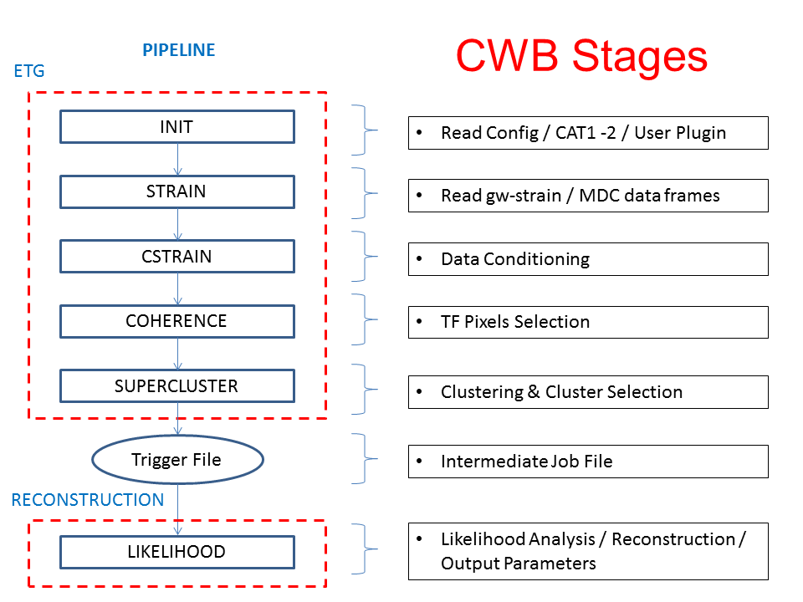
Flowchart

Slide 12
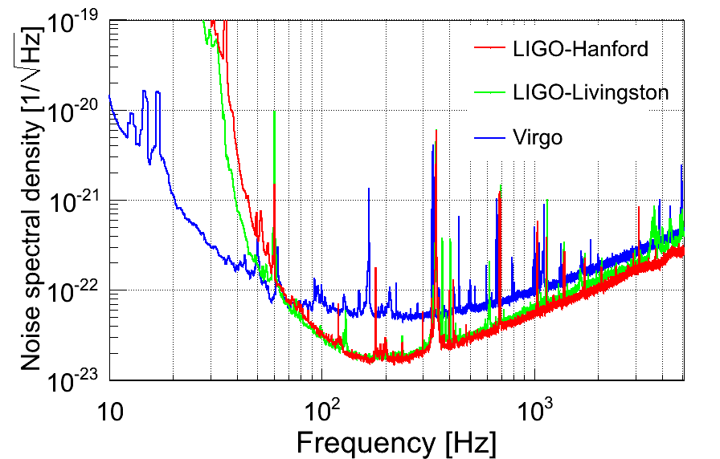
Data conditioning
Typical spectral feature for detector noise, one day of last joint run (2010)
Persistent lines
Not uniform in frequency
Excess power: put a threshold in energy
Persistent lines -> Linear Predictor Filter (Regression)
Non uniform noise in frequency -> Whitening

Slide 13
Time-Frequency Analysis
Need to identify the time of arrival with great precision
Need to identify frequency
How we can do it at the same time?
Time-Frequency analysis is a good solution
In the same time we obtain the frequencies and times of the signal

Slide 14
Wavelet Transform
Characterization of signal with use of template waveforms
  Ψ₀: mother wavelet
Natural basis of bursts
  low spectral leakage
  Good TF localization of transient

Slide 15

Wavelet Transform
Characterization of signal with use of template waveforms
  Ψ₀: mother wavelet
Natural basis of bursts
  low spectral leakage
  Good TF localization of transient
frequency
0
Decomposition level
time

Slide 16

Wavelet Transform
Characterization of signal with use of template waveforms
  Ψ₀: mother wavelet
Natural basis of bursts
  low spectral leakage
  Good TF localization of transient
frequency
0
1
Decomposition level
time

Slide 17

Wavelet Transform
Characterization of signal with use of template waveforms
  Ψ₀: mother wavelet
Natural basis of bursts
  low spectral leakage
  Good TF localization of transient
frequency
0
1
2
Decomposition level
time

Slide 18

Wavelet Transform
Characterization of signal with use of template waveforms
  Ψ₀: mother wavelet
Natural basis of bursts
  low spectral leakage
  Good TF localization of transient
frequency
0
1
2
3
Decomposition level
time

Slide 19

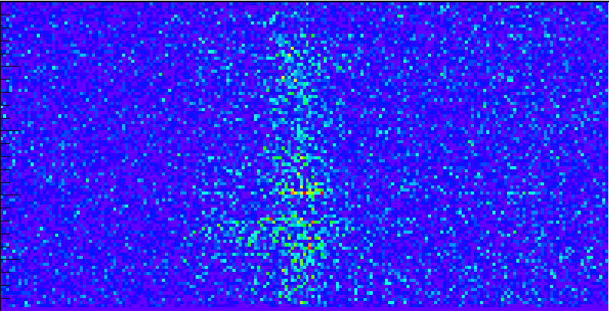
Wavelet Transform
Characterization of signal with use of template waveforms
  Ψ₀: mother wavelet
Natural basis of bursts
  low spectral leakage
  Good TF localization of transient
frequency
0
1
2
3
Decomposition level
4
time

Slide 20
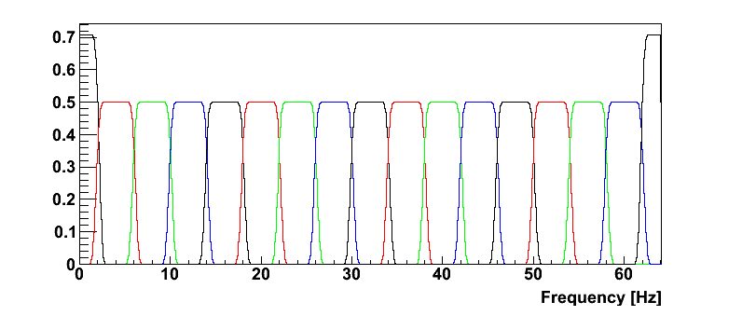
WDM
The wavelet function used by cWB is the
Wilson-Daubechier-Meyer (J.Phys.Conf.Ser. 363 (2012) 012032)
  Transform the data into two orthonormal bases which form a dual frame
    0° phase
    90° phase
  Uniform spectral leakage along all the frequencies

Slide 21
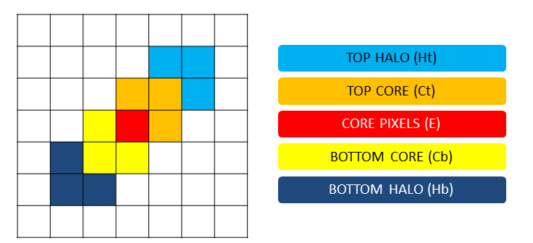
Pixel selection
A fraction of the most energetic pixel are considered: core pixels
For each core pixel cWB selects the neighbour in TF plane: halo
Core pixels are considered if the energy in the core and/or in the halo is above a certain threshold

Slide 22
Clustering
TF pixels are selected according to coherence between detectors
  Coherence verify if the energy of the pixels overcome a threshold
Coincident TF pixels from different detectors are combined to form a cluster
The cluster identify an event
Cluster for each TF map are combined to form a supercluster
Likelihood is calculated on the supercluster

Slide 23
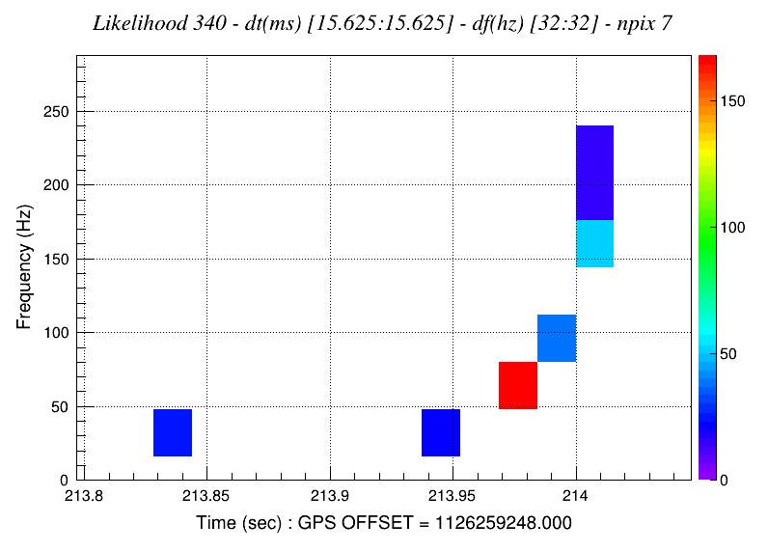
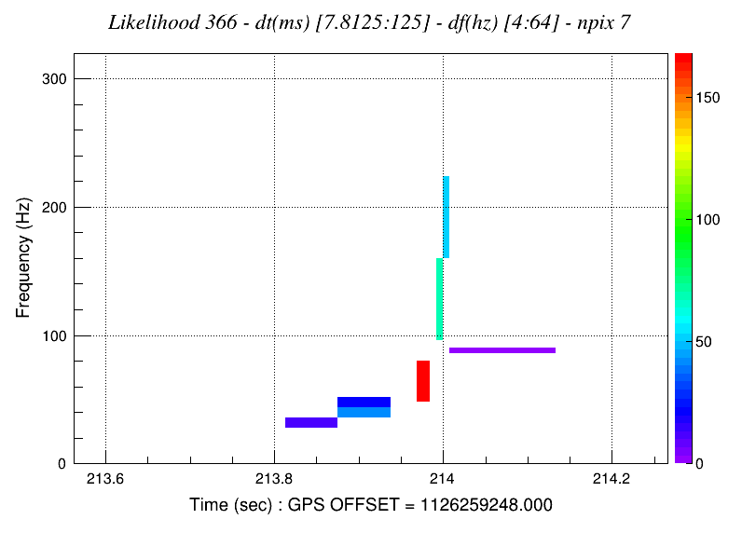
Principal Component Analysis
Using multiple TF trasform allows to find what is the optimal resolution for a given signal (Single-Resolution Analysis).
Signal could show variable behaviour along the TF plane (two compact object coalesce)
Multi-Resolution Analysis: include in the likelihood TF pixels with different resolution
Binary System with two Black Holes of 25 & 60 Solar Masses
SRA
MRA

Slide 24
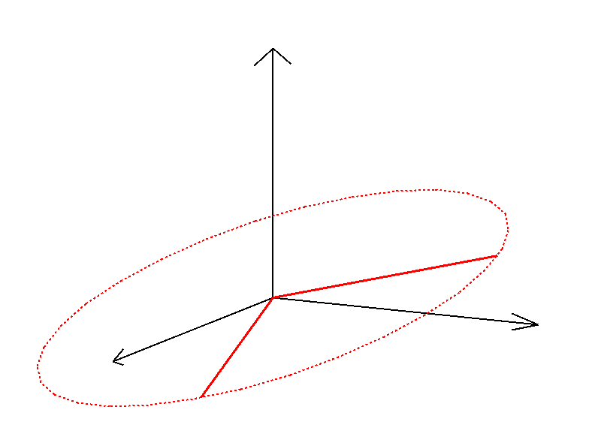
Dominant Polarization Frame
Defining a multi-dimensional space where axes are defined by detectors
Likelihood is invariant if we apply any rotation on the Wave Frame coordinate
  “Rotation” on the antenna pattern
The Dominant Polarization Frame is that angle which gives the following properties to the Antenna patterns
  Orthogonality
  F₊ is dominant
F_{x}’
F_{x}
F₊
F₊’

Slide 25
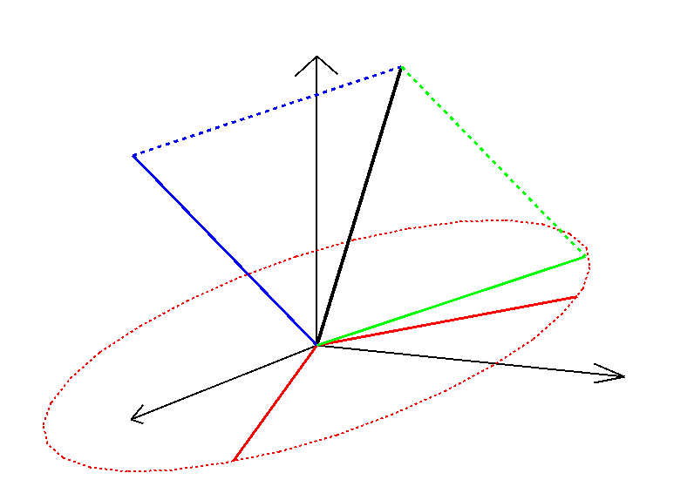
Maximum Likelihood
In the DPF, detector response corresponding to maximum likelihood is the projection of X vector on f’₊, f’_{x} plane
Null stream (N) described the noise after the likelihood subtraction
Noise could be also in the f’₊, f’_{x} plane: use of regulator
The likelihood projection on the axes is the contribution for each detector to the event energy, the rest is the coherent energy
X
DPF
N
u
F_{x}’
F₊’

Slide 26
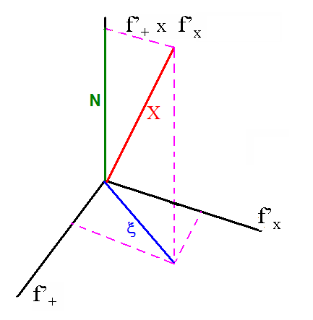
Two detector case
For two detector, maximum likelihood approach does not distinguish properly the data from the noise
  Only two dimension: projection remains the original data
Regulator approach: project the data on the F+ vector in the DPF
  Hard regulator
u_{Hard}
u_{Soft}

Slide 27
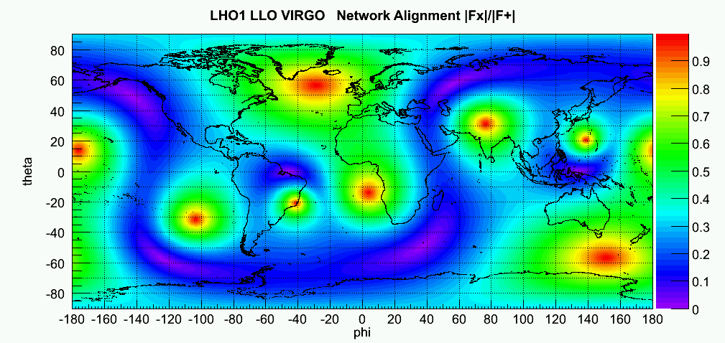
Regulators
Detectors are not equally sensitive over all the sky
Where a detector is blind, the network is lacking of detectors
  Applying regulator
Define a quantity over the sky which gives the value of involved detectors in the network for each sky position
L1H1V1 |f_{x}|/|f₊| in the DPF
  Apply Hard regulator for sky position that have N<=2
  Apply maximum likelihood (Soft regulator) for the rest
Soft
???
Hard
“Best” regulator depend on the sky position

Slide 28
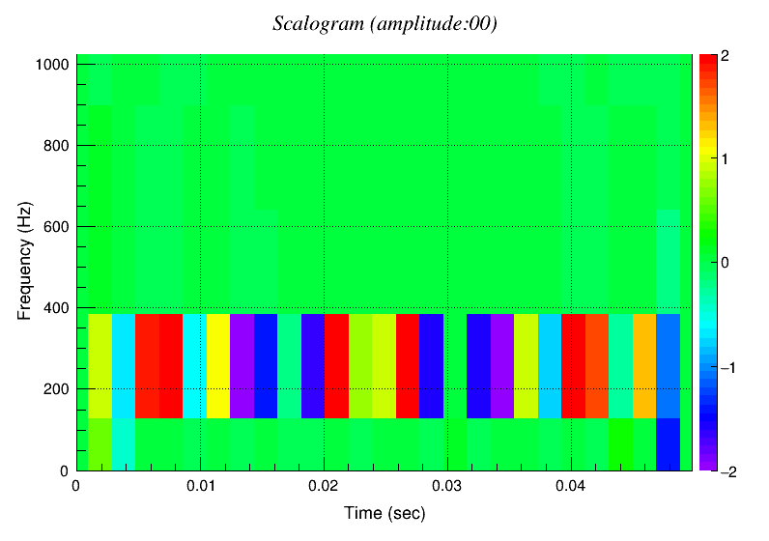
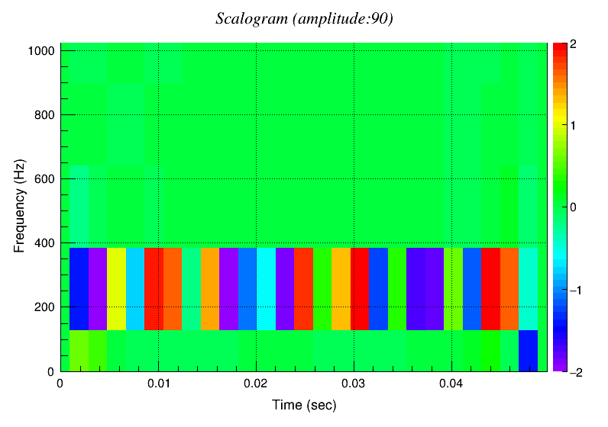
Dual stream analysis
Apply a phase shift of 90° to data
  Obtain an indipendent and complete characterization
Pixel selection: it is not assured that same pixels are above the threshold
  Considering two data stream: more complete description of the signal
Combine 0° likelihood and 90° likelihood
0° phase
90° phase
Sinusoide at 200 Hz

Slide 29
Dual Stream Phase Transform
Network Plane
For a polarized wave each time-frequency pixel can be parametrized as :
s = F_{+ *} q + e * F_{x *} Q 0º phase response
S = -F_{+ *} Q + e * F_{x *} q 90º phase response
s, S are the DSP components, e is the ellipticity
f_{x}
s
S
w⁺
w
W
w^{x}
The DSP Transform is defined as :
w = s * c _{dsp} + S * s_{dsp}
W = S * c_{dsp} - s * s_{dsp}
where
c_{dsp} = N*(f₊,s)/|f₊|² and s_{dsp} = N*(f₊,S)/|f₊|² (x,y) is the scalar product and N is the sin,cos normalization factor : N²= 1/(c²_{dsp} + s²_{dsp})
ψ
f₊
The angle ψ is defined by :
the DPF angle d
the polarization angle p
the ellipticity e : |e|<=1
For a polarized wave e and p are fixed
but d can be different for each pixel because PSD change with frequency
This could produce a dispersion of the ψ angle
w,W define the DSP pattern and are expressed as:
w⁺ = f₊ * {(1+e²) + (1-e²) * cos[2 * (d-p)]} * N/2
w^{x} = -f_{x} * (e²-1) * sin[2 *(d-p)] * N/2
W = f_{x} * e * N
W is aligned with f_{x} , N = (q²+Q²) ^{1/2}

Slide 30
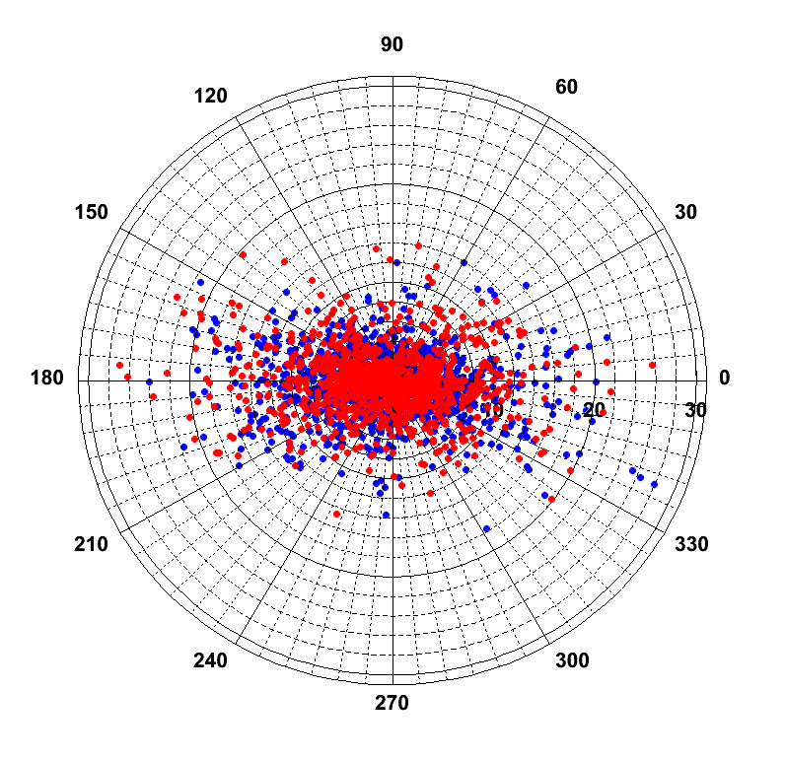
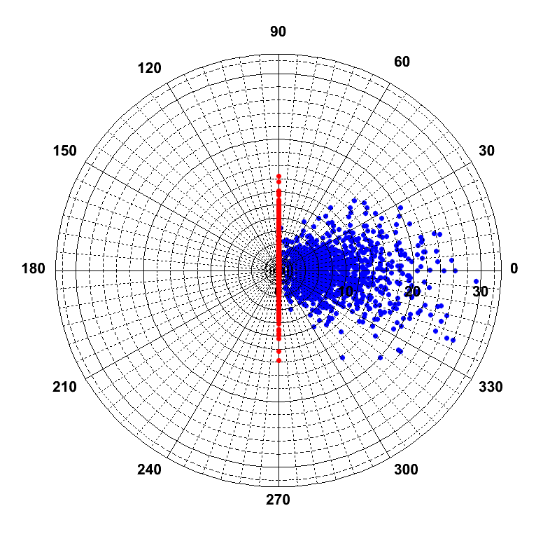
Simple example
Dual Stream Data
phase 0º : phase 90º
Dual Stream Phase (DSP) Transform
Network : ADV-LHV
Injection : WNB100_100_0d100 SNR=100
pixels are
randomly
distributed
No particular polarization, ellipticity of the pixels is random and no patterns are produced

Slide 31
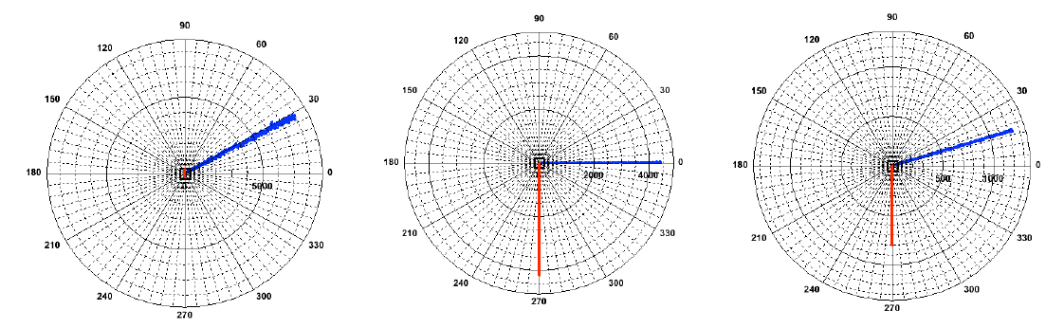
Polarization constraint
The use of dual stream allows to define a search focusing on the expected polarization of the signal
Applying the DSP transform, it is possible to characterize the likelihood of 0° and 90° according to the polarization pattern
Linear Circular Elliptical
More you introduce restrictions more the glitches rejection is efficient, but the waveform detection is improved only for restricted signals

Slide 32
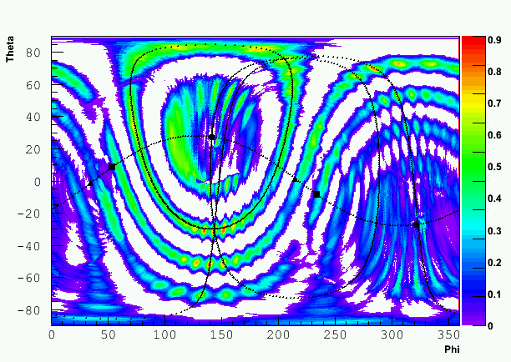
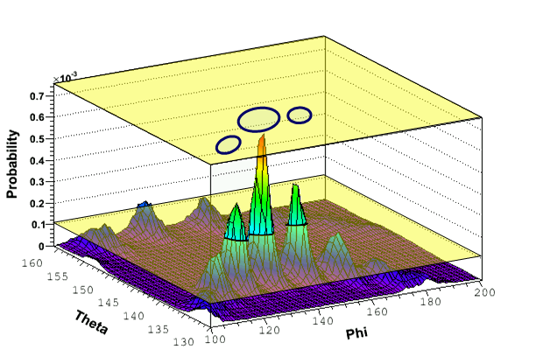
Coordinate reconstruction
Likelihood Sky Map shows how consistent are reconstructed waveforms and time delays as a function of Θ, Φ.
Maximum likelihood point to reconstructed direction
Θ
Φ
The angular difference between injected and reconstructed position gives an estimation of the reconstruction error
Error Angle: sum of sky pixel with likelihood greater than injected position
  Likelihood is used as a ranking parameter
  May be composed of disjoint areas in the sky
Error Angle

Slide 33
Direction Issues
Reconstruction of source direction is affected by many problems:
  Network Geometry
  Sky segmentation
  Antenna pattern

Slide 34
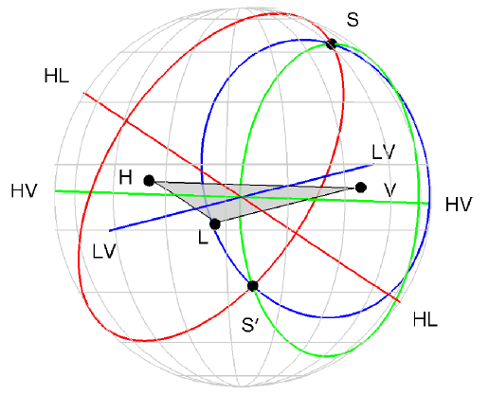
Direction Issues
Reconstruction of source direction is affected by many problems:
  Network Geometry
  Sky segmentation
  Antenna pattern
Time delays between three locations give an ambiguity of two possible locations
Can be resolved using antenna pattern informations

Slide 35
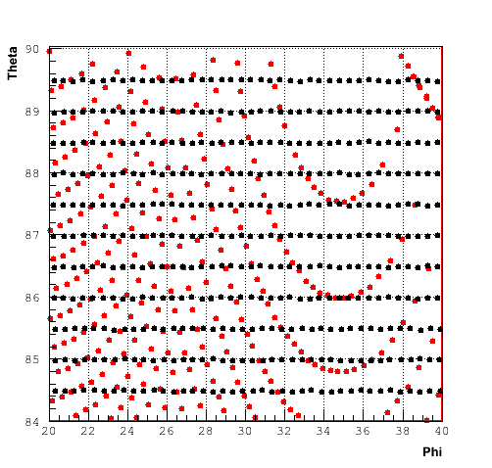
Direction Issues
Reconstruction of source direction is affected by many problems:
  Network Geometry
  Sky segmentation
  Antenna pattern
Time delays between three locations give an ambiguity of two possible locations
Can be resolved using antenna pattern informations
The discretization is sfavoureable for some zones in the sky

Slide 36
Direction Issues
Reconstruction of source direction is affected by many problems:
  Network Geometry
  Sky segmentation
  Antenna pattern
Time delays between three locations give an ambiguity of two possible locations
Can be resolved using antenna pattern informations
|f_{x}|/|f₊| in the DPF
The discretization is sfavoureable for some zones in the sky
Where detector is blind is not possible to see

Slide 37
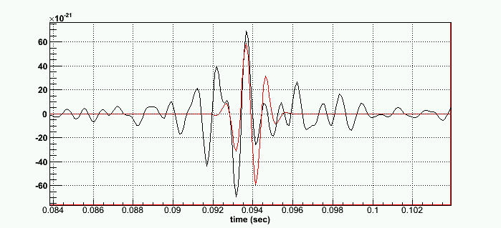
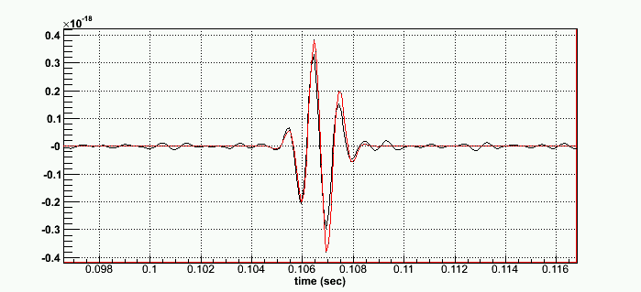
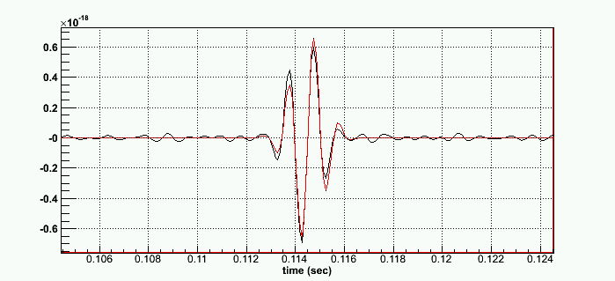
Waveform reconstruction
SG2226Q9 injection
The detector response vector in the DPF frame gives our solution
From this solution we can recover the original detector response of each detector
  We reconstruct the GW signal for each detector
Detector response can be confronted with source models for extraction of the source parameters
V1
L1
H1

Slide 38
Post Production Analysis
Necessity of a decision rule to identify a reconstructed event as a possible candidate
Event selection
  Effective correlated SNR: ρ > ρ_{th}
  This is the effective correlated SNR of the signal, averaged over all detectors. Used for the False Alarm Rate estimation
  Network correlation coefficient: cc > cc_{th}
  This is a correlation test based on the coherent (Ec) and null (Null) energies.

Slide 39
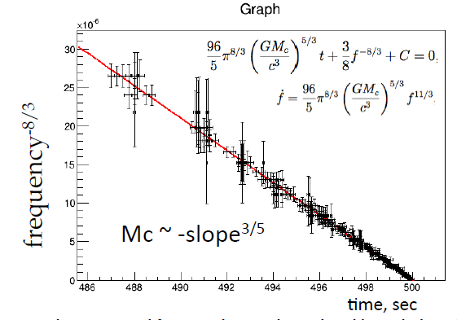
Signal classification
Chirp mass can be estimated from the TF data without detail knowdledge of the waveforms

Slide 40
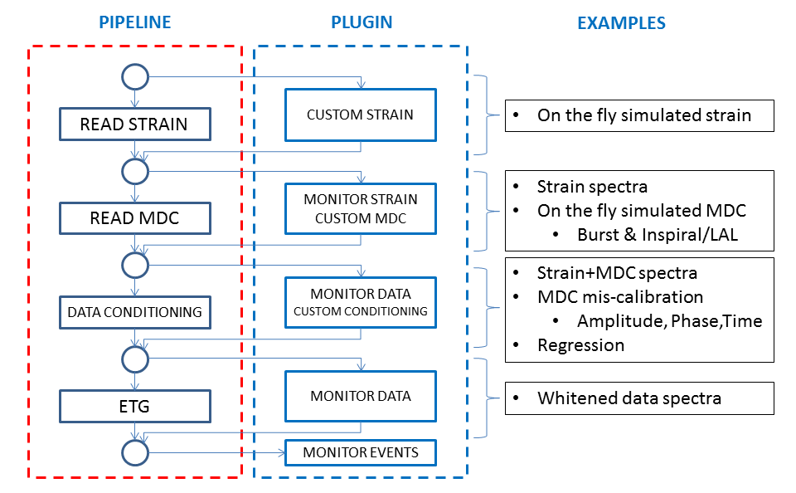
Plugin

Slide 41
Background
To characterize noise, we perform time shift between detectors
  Minimum shift greater than maximum delay between detector
  Triggers from shifted data cannot be due to GW
Time shift is applied circularly
  It can be applied to all detectors
  Each detector has its independent shift
  No losing time
t₀
t₀+t
t₀+T
t₀
t₀+T-t
t₀+T

Slide 42
Background (2)
Maximum shift allowed is equal to the segment length of analysis
It could be necessary to increase statistic
Super-lags: consider as “coincident” segment chunks that have a time shift greater than the segment lenght
In principle any time shift is possible.
[t₀,t₀+T]
[t₁,t₁+T]
[t₀,t₀+T]
[t₁,t₁+T]

Slide 43
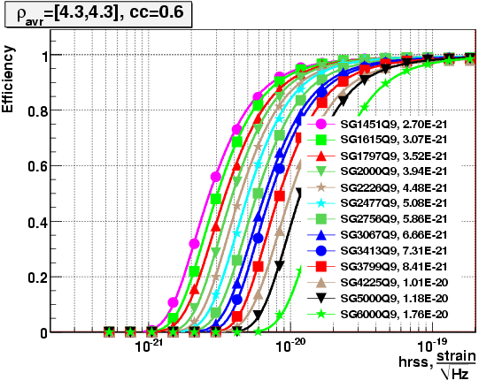
Injections engine
General idea: Calculate search sensitivity with efficiency curve injecting waveforms at different amplitude
cWB has various injecting structure:
  Discrete hrss values (SNR vary along the sky, according to antenna pattern)
  Discrete SNR values (hrss is adjusted along the sky, according to antenna pattern
  User-defined hrss distribution

Slide 44
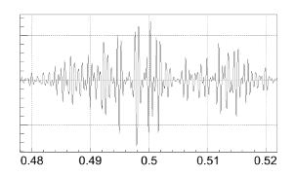
Signal classes
cWB internal engine:
  SineGaussian (SG)
  Gaussian (GA)
  White Noise Bursts (WNB)
  Ring Down (RD)
  Eccentric Binary Black Holes
LAL waveforms:
  Compact Binary Coalescence, with mass from NS-NS to BH-BH
User defined waveforms
  Giving h₊ and h_{x} to the pipeline
WNB

Slide 45
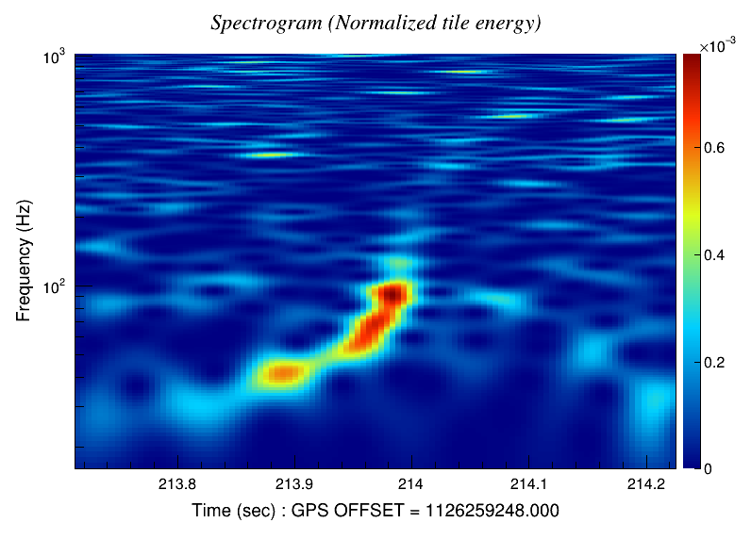
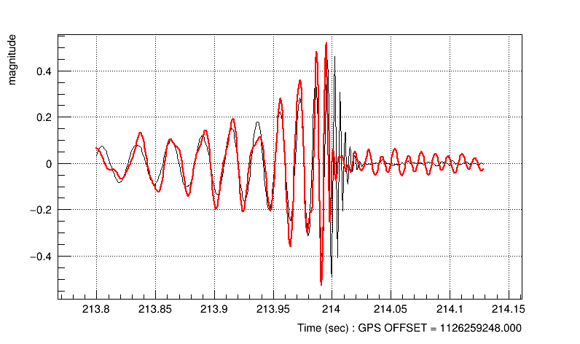
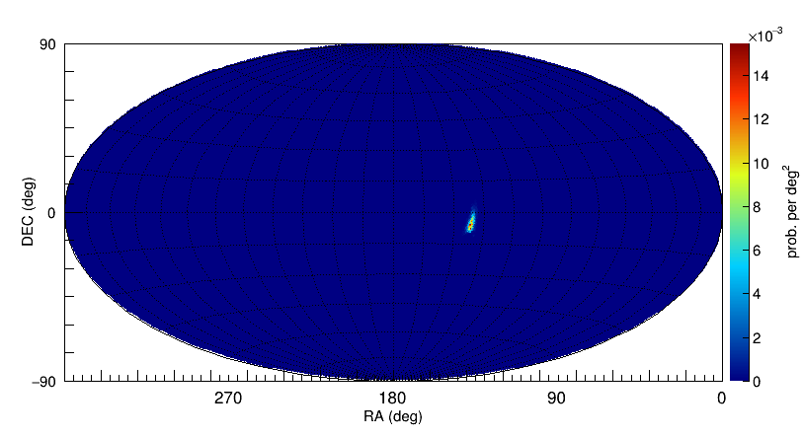
Coherent Event Display
CED is a detailed study of a particular event reporting more information than usual analysis
Spectrogram
Detector response
Sky statistics
And more…

Slide 46
Bibliography
Virtual box
cWB flowchart
  Regression: Paper (arXiv)
  Whitening
  TF map: Paper
  Clustering
  Dual stream and regulators
  Chirp mass: Paper (arXiv)
Background (superlags)
Injection engine
CED
Plugins

Slide 47
Exercise
Consider the example on the manual and repeat step by step, understanding the various stages and looking at the result

