Slide 1
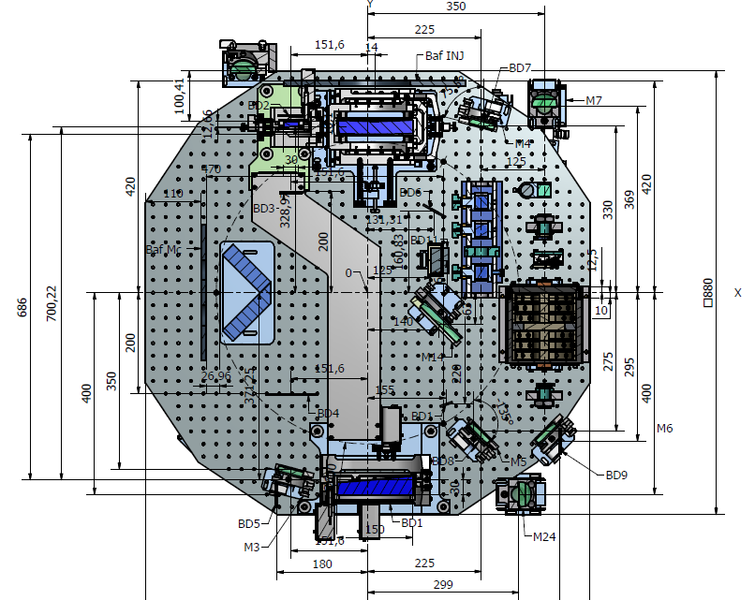
SIB 1 local control system: configuration 1
OL beam layout for LC susp-InjBench
EM111212
E. Genin 03/10/12
x
y
z
SLED
Mirror fixed on the bench
Video
camera
PSD1
PSD2
SLED
Should sense z, tx and ty
but a coupled d.o.f.
→ We are checking if there is enough space to install the new bench south
side of INJ tower.

Slide 2
SIB 1 local control system: configuration 1
Virgo-like configuration
PSD3
x
E. Genin 03/10/12
PSD4
y
z
SLED
Mirror fixed on the bench
Video
camera
PSD1
PSD2
Should sense z, tx and ty
but a coupled d.o.f.
→ a decision on the optical setup to use for AdV is expected to be taken soon (≈1 month).

Slide 3
SIB 1 local control system: configuration 3
SLED
PSD3
PSD4
OL2 (North): it senses x, tz
at marionette level .
Control uses marionette coils
x
y
z
SLED
CCD
Mirror fixed on the bench
PSD1
PSD2
OL1 (WEST): it senses z, tx and ty
but a coupled d.o.f.
SLED SOURCE: single source 2 mW, 670 nm,
splitted (Superlum pilot configuration ordered)

Slide 4
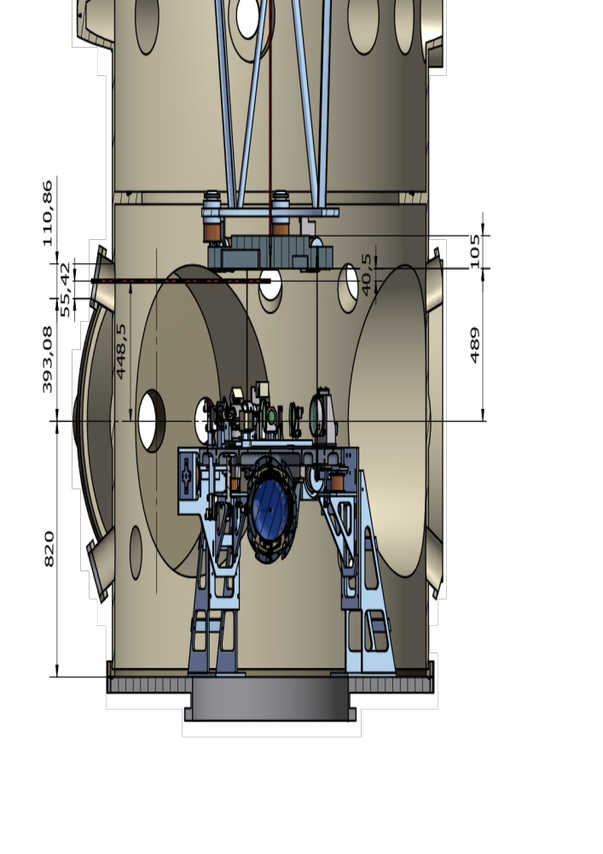
OL2 Heights
Center of OL mirror
40.5 mm below marionette bottom plane.
Coating plane on the vertical axis, 1 inch metal.
OK
Thanks, Tati

Slide 5
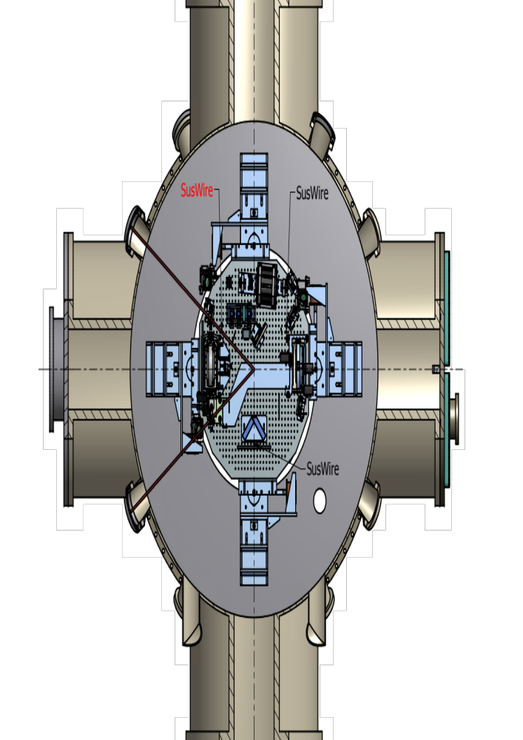
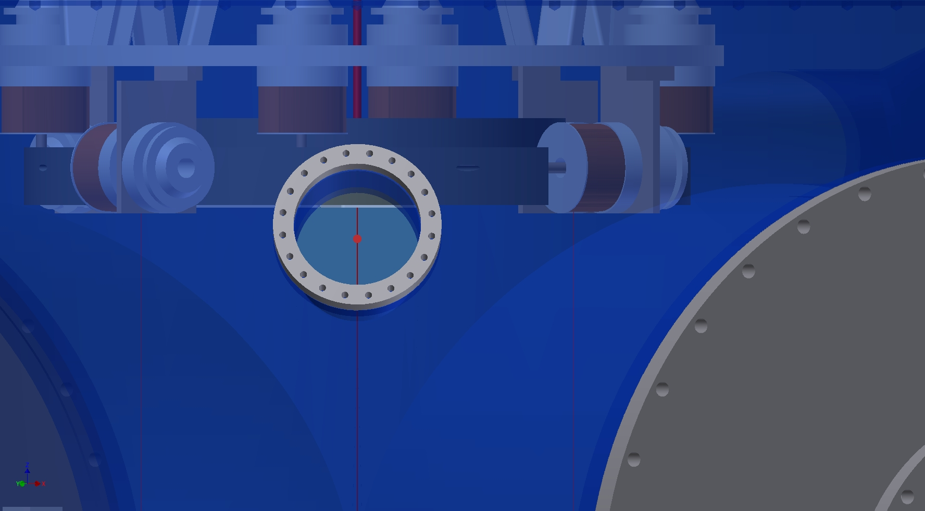
OL2 SUSP WIRE !
!
Thanks, Tati

Slide 6
Through WestNorthUp viewport

Slide 7
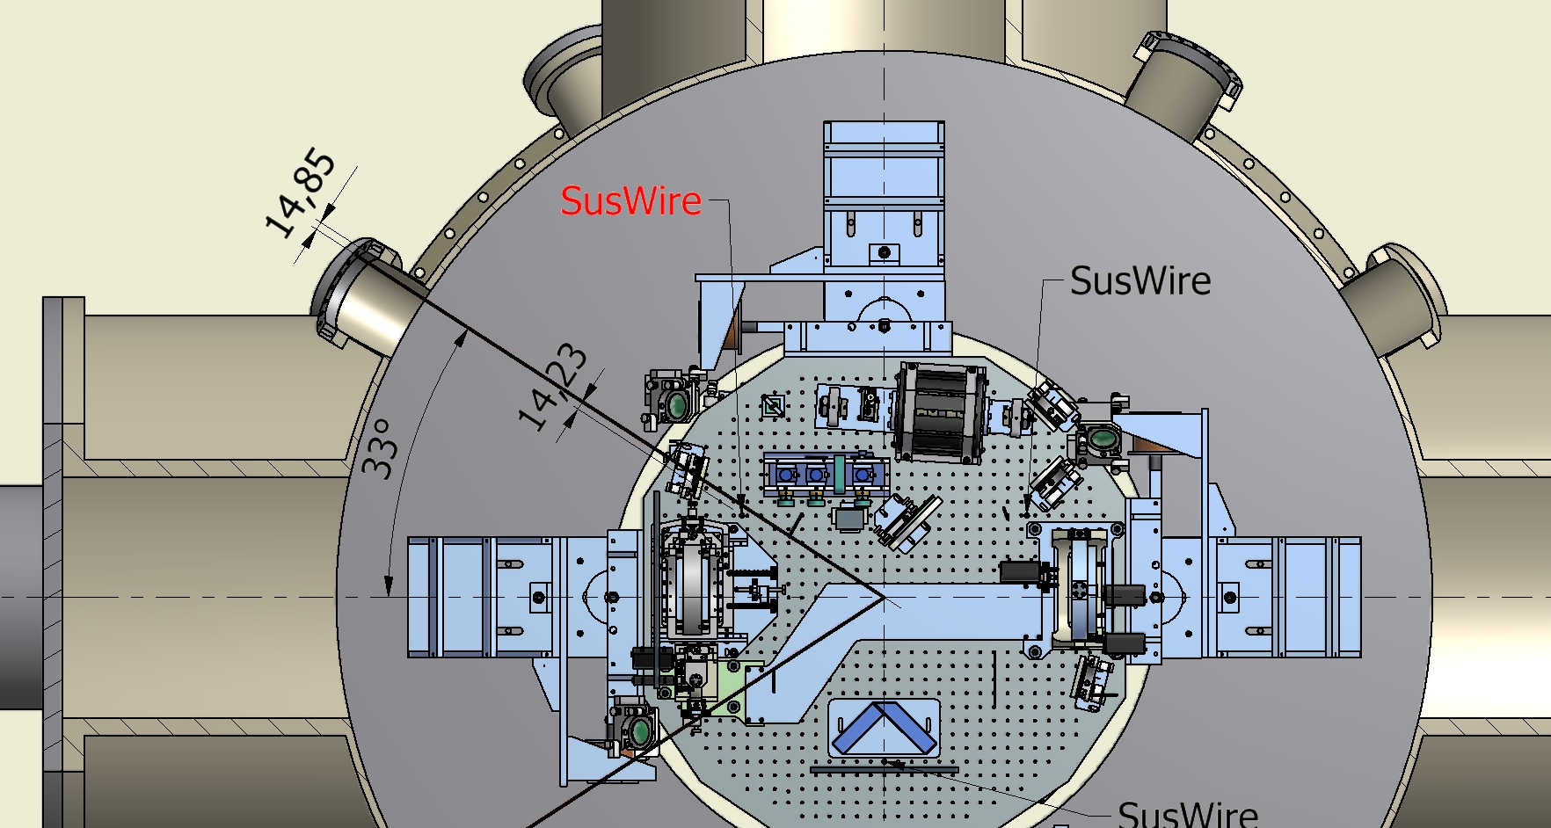
OL2 incident beam
OK
OK
Thanks, Tati
range ty CCW: 6 mrad clips on OL exit viewport (LC lens OK within mirror ty ±10 mrad)
range ty CW : 40 mrad clips on OL susp wire
Remind that ty is controlled by means of OL1, once controlled one can switch on tz,x,
few hundreds of μrad at most will be driven by tz.
=>OK

Slide 8
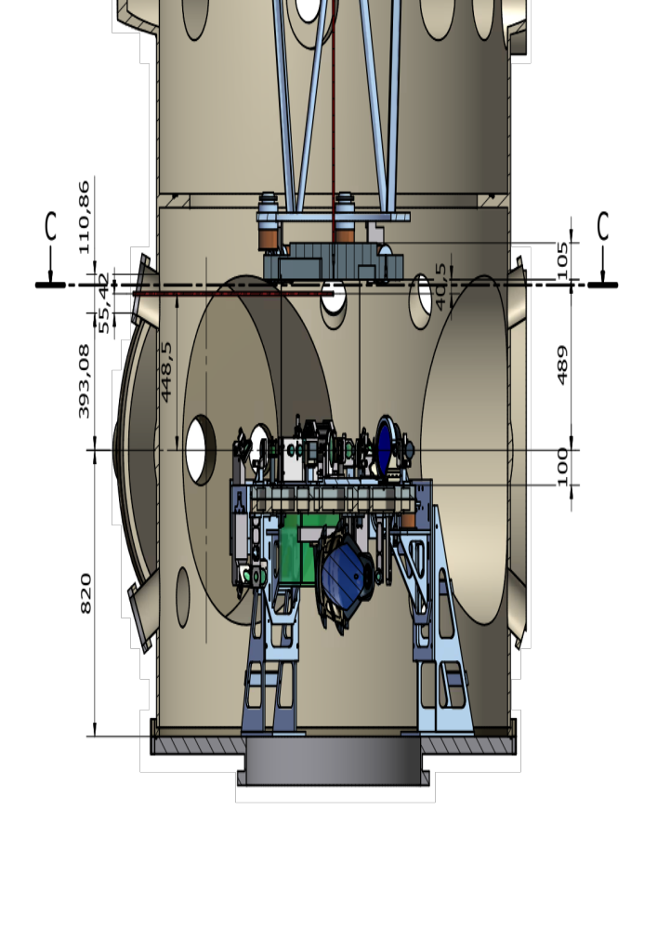
OL1 Heights

Slide 9
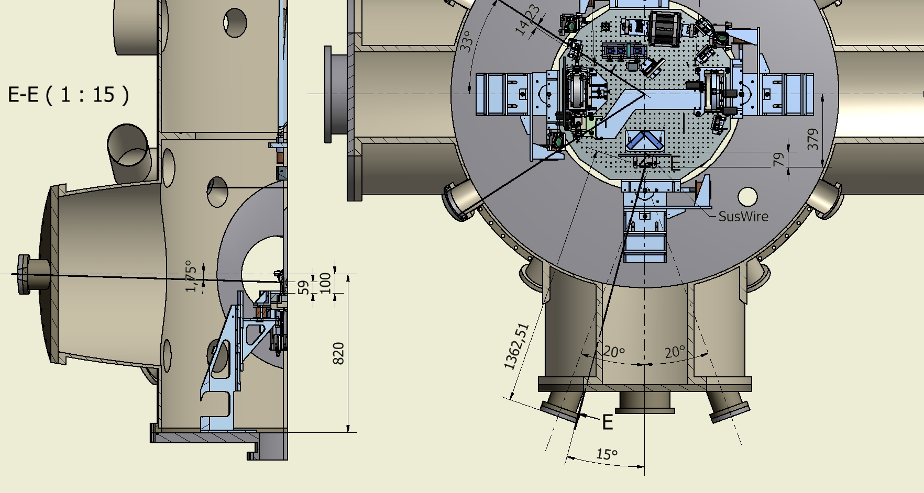
OL1 ~ 18 deg
ty range ± 10 mrad (LC lens)

