Slide 1
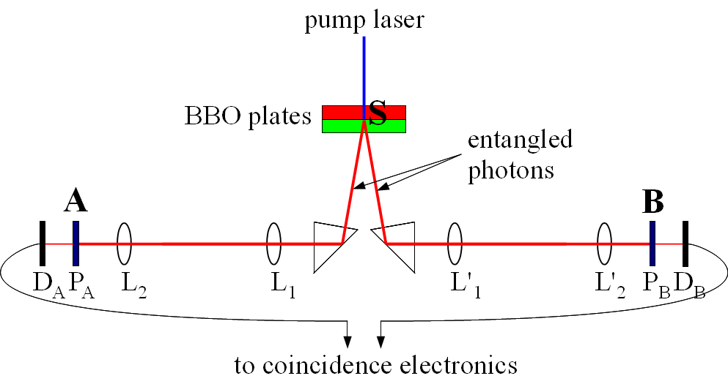
SUPERLUMINAL @ EGO
L₂, L₁,L'₁,L'₂ = plane-convex lenses, P_{A} and P_{B} = polarizers, D_{A} and D_{B} = photodetectors

Slide 2
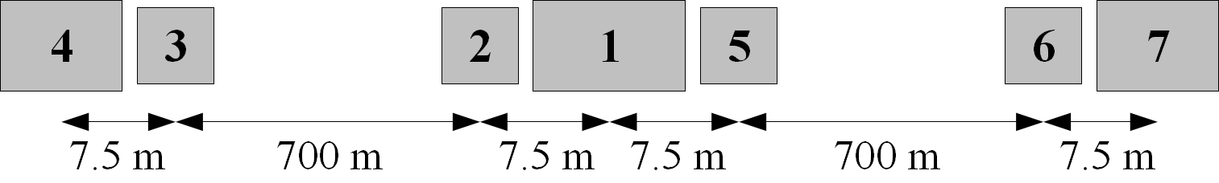
First Phase – Year 1 and 2
1 - central optical bench (1800x900 mm²) where entangled photons are produced
2,3,5,6 - optical benches (600 x 900 mm²) supporting optical lenses L₁, L₂, L'₁, L'₂ and similar lenses on the paths of the interferometer
4,7 - Optical benches(1200 x 750 mm²) for the detection of entangled photons

Slide 3
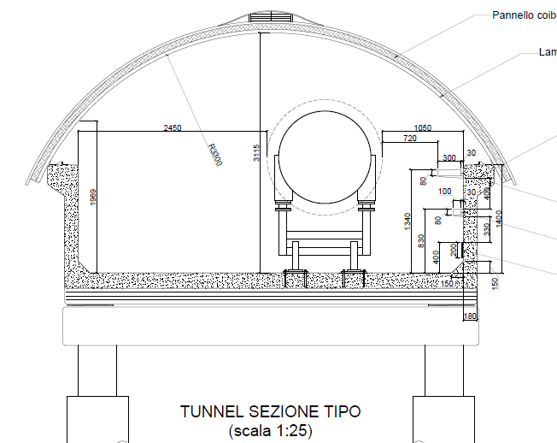
900 mm
1550 mm

Slide 4
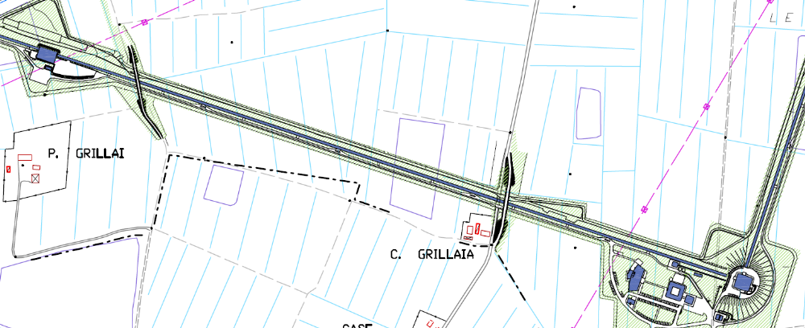
710 m
710 m

Slide 5
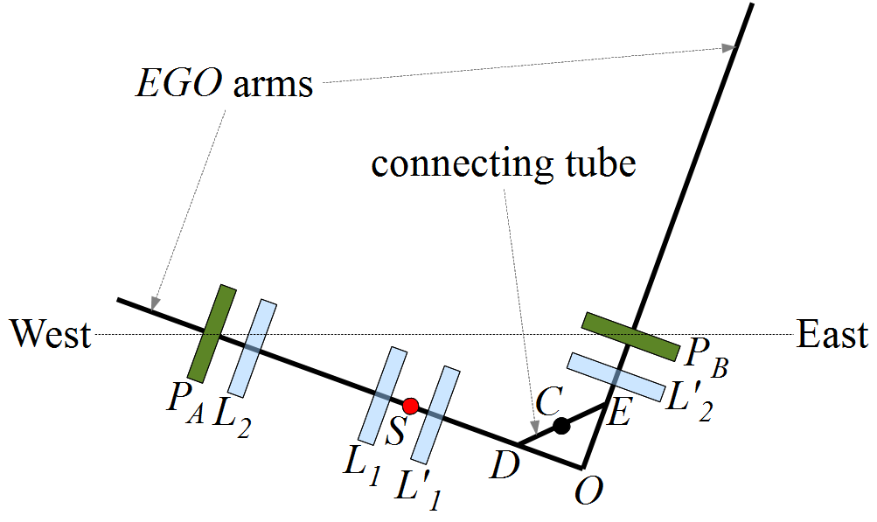
Second Phase – Year 3
S is the source of entangled photons. DE represents a connecting pipe between the arm tunnels of EGO. Two prisms are placed in D and E to deflect the entangled beams from the West to the North arm

Slide 7
