Slide 1
Baffle internal modes diagnostic
Maddalena Mantovani, Irene Fiori
For SLC team
With the contribution of A. Moggi and A. Magazzù

Slide 2
Introduction
The stray light noise will be a crucial issue in the Advanced Virgo commissioning
For this reason it would be important to have a database of the baffle internal modes resonance frequencies to:
Have a preliminary diagnostic on the baffle implementation (i.e. if the measured resonance frequencies will be strongly different from what is foreseen, or very different among baffles)
To speed up the ITF noise hunting phase.
This presentation describes the preliminary work to define a procedure to measure the baffle internal modes.

Slide 3
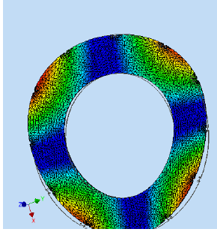
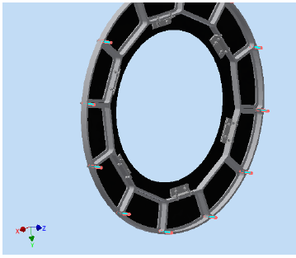
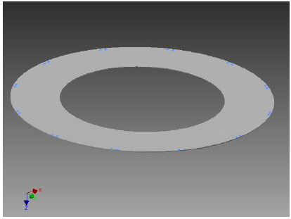
Mechanical simulations (A. Moggi)
Semi-free baffle
(the constrains are only on the edge)
1st mode frequency
80.37 Hz
Free baffle:
1st mode frequency
12.04 Hz
Final configuration baffle
(the constrains are on the edge and next to the inner aperture)
1st mode frequency
245.81 Hz

Slide 4
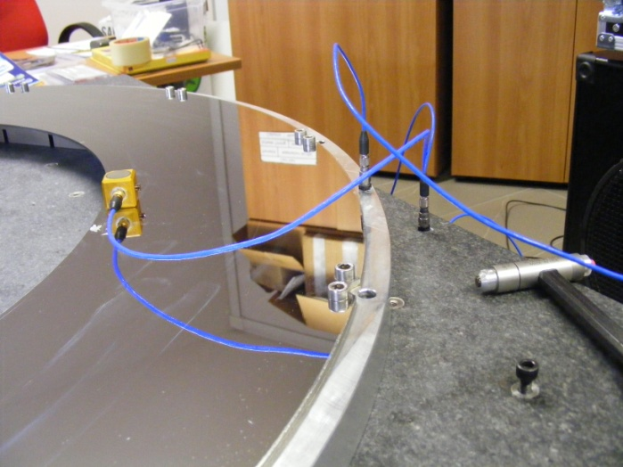
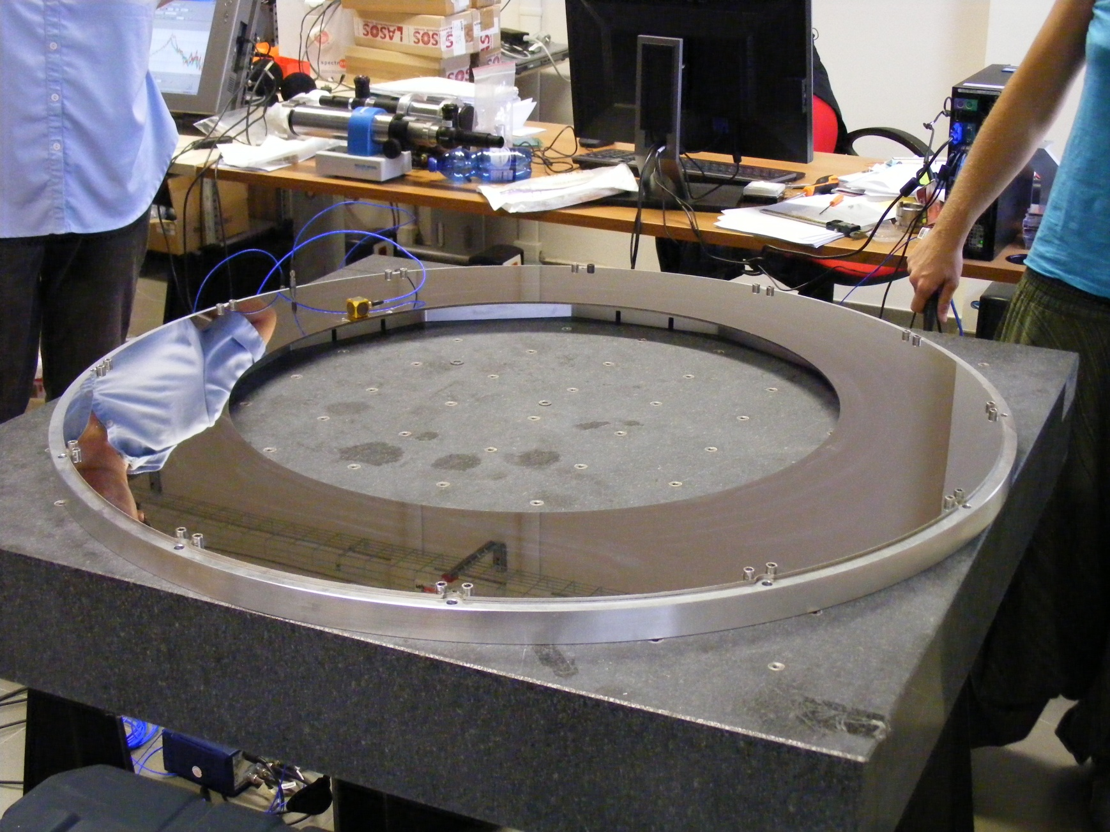
Preliminary Setup
Not clear if accelerometers can be used on site measurements (cleaning issues: accelerometers are attached with WAX)
.
Connected to the frame
Connected to the baffle
Connected to ground (i.e. our Granite Bench)
Listening to excited baffle sound with Microphones has been tried without success

Slide 5
Preliminary Setup
Not clear if accelerometers can be used on site measurements (cleaning issues: accelerometers are attached with WAX)
.
We expect to measure something slightly higher than 80.37Hz
since the baffle was connected to the frame just with screws along the edge (no inner screws) and leans on the frame
Connected to the frame
Connected to the baffle
Connected to ground (i.e. our Granite Bench)
Listening to excited baffle sound with Microphones has been tried without success

Slide 6
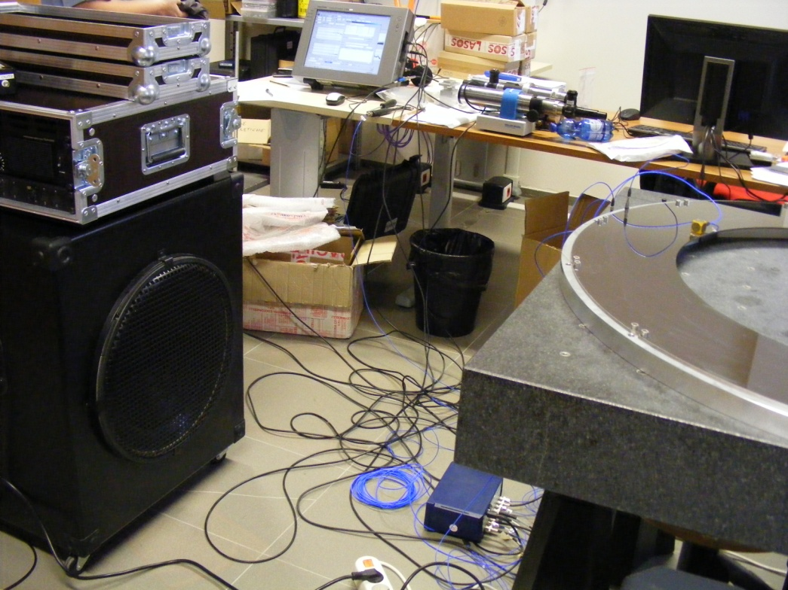
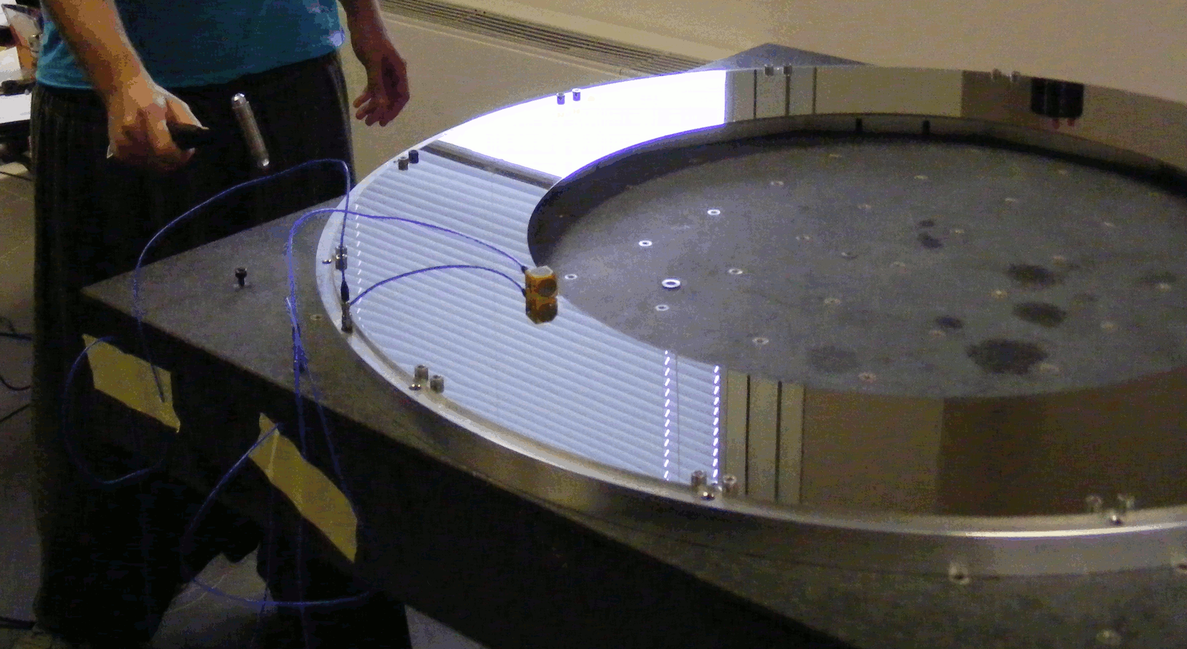
Excitation procedures
Two excitation procedures have been tried:
screws
sensor
Calibrated hammer
(single shots on bench)
Acoustic noise
(in the room)
At the moment Hammering seems to be the most promising
(Acoustic noise injections act on the baffle along different paths - through bench, frame
but also directly… which makes loosing coherence)

Slide 7
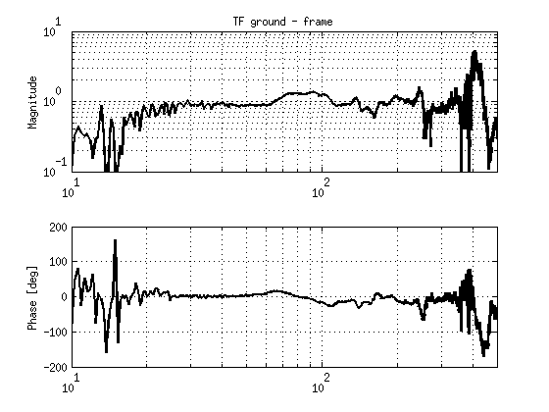
Measurements
Frequency [Hz]
The TF between the bench and the frame is ~1 thus the frame can be considered in this setup rigidly connected to the bench.

Slide 8
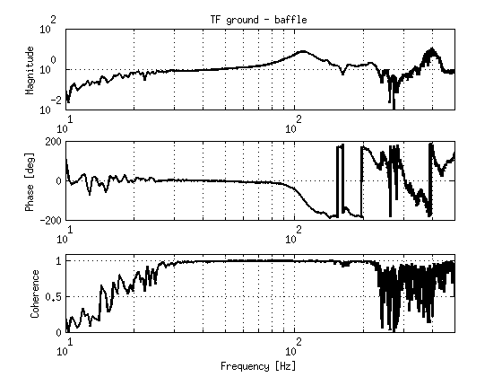
Measurements
TF between bench and baffle:
113Hz
Baffle resonance, in agreement with the mechanical simulations
n.b. very low Q factor Q
For stray light noise issue it is good to have low Q factor (!!)
… while for mode measuring an high Q factor would be preferable

Slide 9
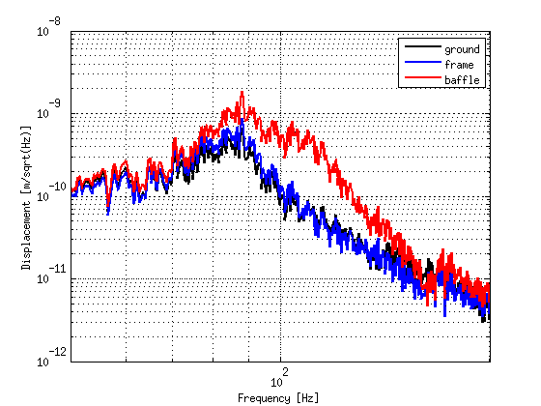
Measurements
Accelerometers spectrum:
Baffle resonance @ ~113Hz
Bench resonance @ ~90Hz

Slide 10
Open discussion
Some ideas and next steps:
Change the frame-ground connection (for instance putting spacers below the frame – under construction M.Bazzi) to evaluate the effect on the baffle mode frequency or Q.
Measure the resonance in several positions on the baffle.
Measure the baffle displacement with the fiber bundle (optical device by F.Frasconi)… advantage: would be contactless.
Try to measure higher frequency modes
…..
Please give us suggestions and ideas…

