Slide 1

Virgo/EGO Outreach
11/2012

Slide 2
Outreach Group
Carlo Bradaschia (Pisa)
Elena Cuoco (EGO)
Giuseppe Di Biase (EGO)
Severine Perus (EGO)
Gabriele Vajente (Pisa)
(Federico Ferrini)

Slide 3
Site Visits
Restarted, may be slower than usual, but we will see…
Guides:
some problem to find volunteers

Slide 4
“Una Giornata da …… Ricercatore”
3rd December 2012
40 high school students from the surrounding Tuscany spending a full day at EGO.
Divided in four groups, guided by two tutors each, to perform in turn simple experiments on subjects related to Virgo:
Seismic and acoustic measurements
Signal analysis (time domain and frequency domain)
Comparison of a pendulum with an inverted pendulum
Air refraction index changing with pressure (counting fringe drifting in a small interferometer).
At the end the best teams (according to a quiz contest) will be rewarded with a Galileoscope, a working copy of Galileo’s “cannocchiale”
Tutors: G. Balestri, A. Basti, C.B., E. Cuoco, I. Fiori, F. Paoletti, M. Tacca
In the framework of the initiative “Pianeta Galileo” by Regione Toscana

Slide 5



European Researchers’ Night
28 (and 29) September2012
EGO/Virgo answered successfully the European call as partners of
obtained budget share: 2000 €
www.frascatiscienza.it

Slide 6
Night 2012 program (28 and 29 September)
To See
Virgo
Tunnel
Control Room (taking data)
Interferometer (working model)
Superattenuator 1987
A real Payload
Free fall in vacuum
190 visitors
To Do
Virgo
Build your interferometer
2 x 8 students
Science
Meet the scientists (Science Cafe)
Astronomy
Observe the (virtual) sky
>100 happy guests, in spite of clouds
Theatre
“Die Physiker” by Friedrich Duerrenmatt
at teatro Politeama, Cascina
all 198 seats occupied
In collaborazione con:
Comune di Cascina
Comune di Pisa
Astrofili Pisani Galileo Galilei
Regione Toscana
La Limonaia
INFN e Dipartimento di fisica
Fondazione CariPisa

Slide 7
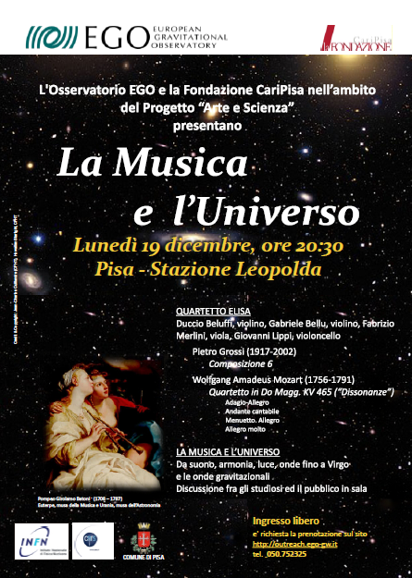
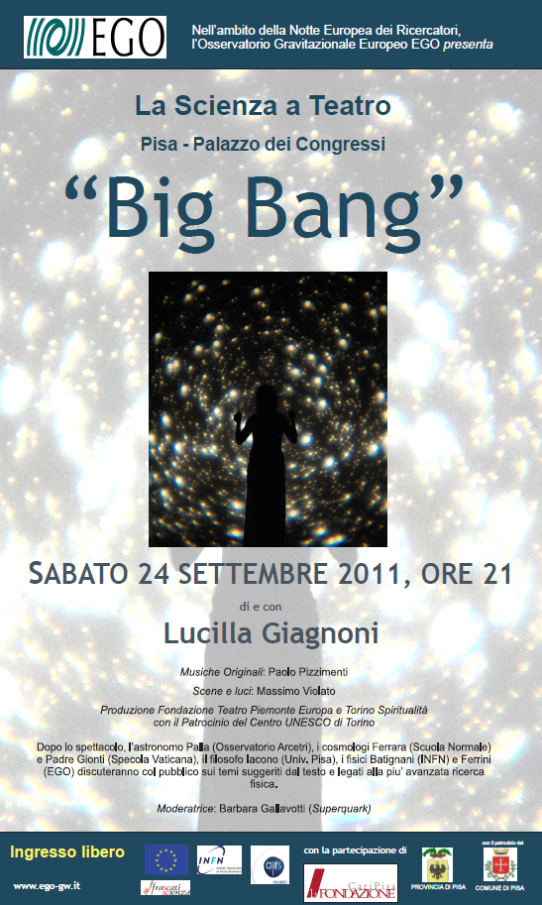
Arte e Scienza
(EGO & CariPisa)

Slide 8
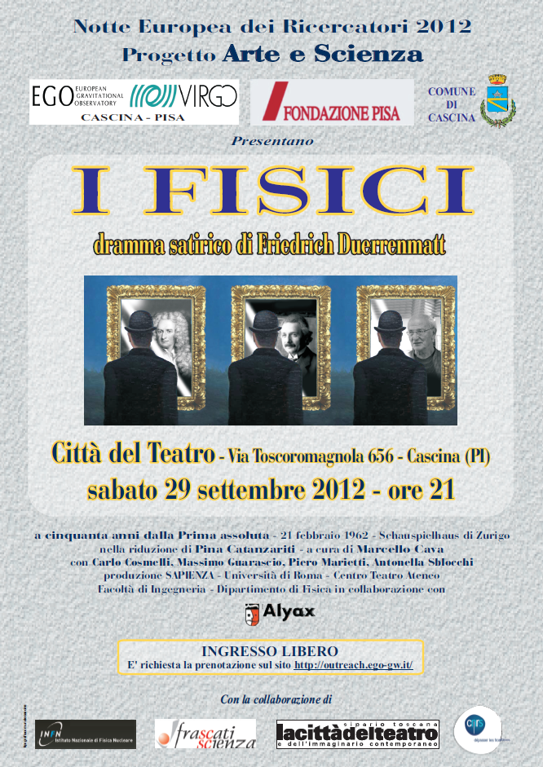
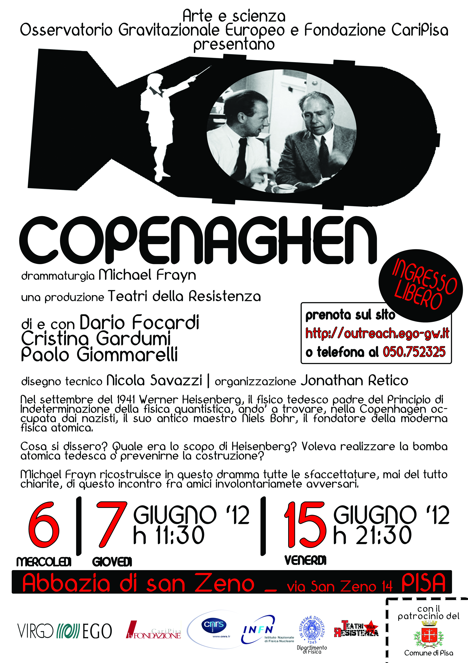
Arte e Scienza
(EGO & CariPisa)

Slide 9
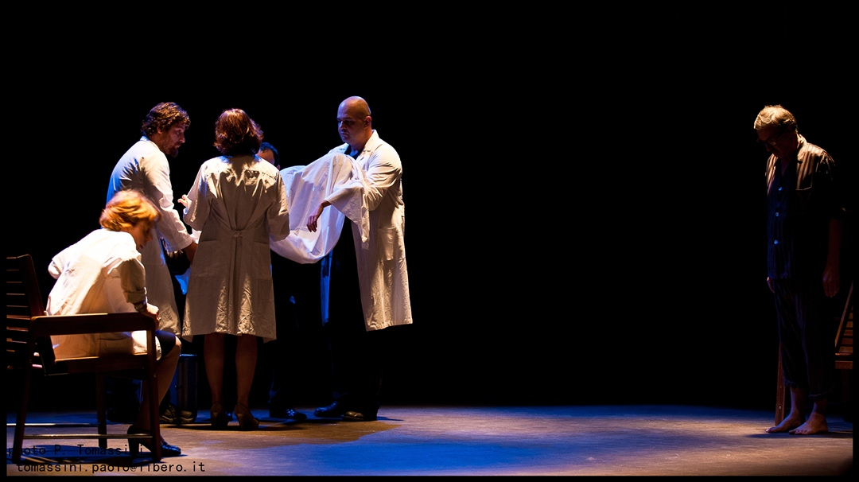
EGO actors: Nicola Menzione, Luca Paoli

Slide 10



Slide 11
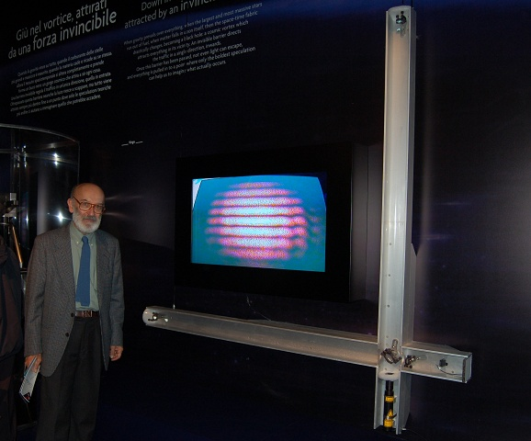
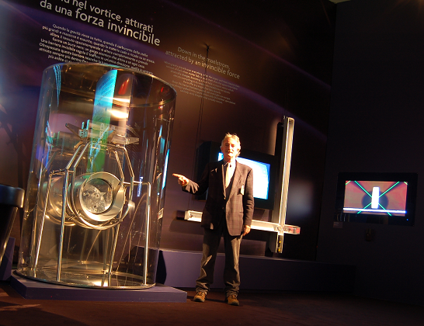
22,000 visitors

Slide 12
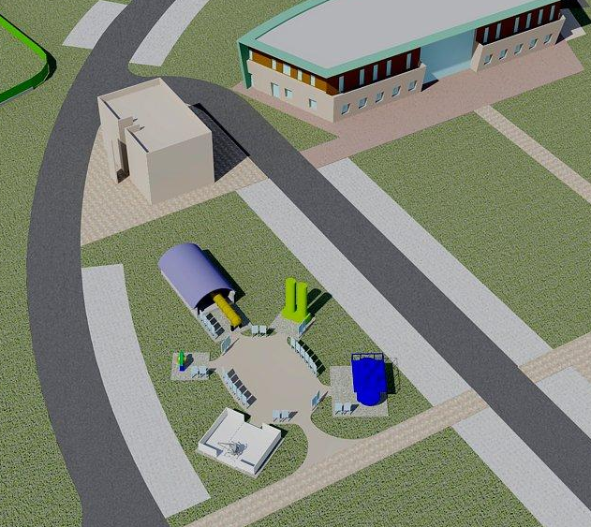
OPEN AIR MUSEUM
Near future if € from Comune di Cascina

Slide 13
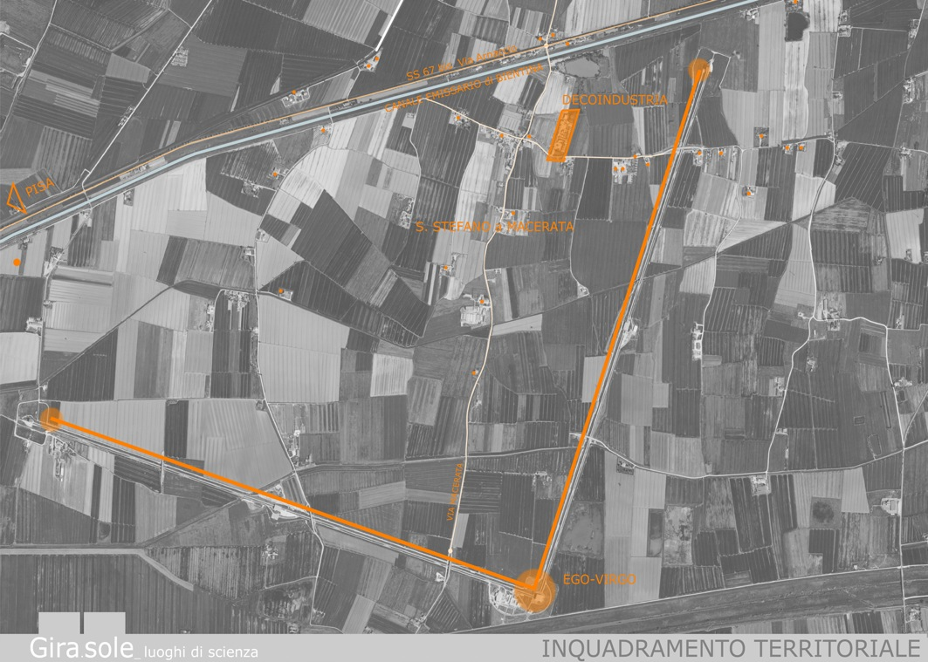
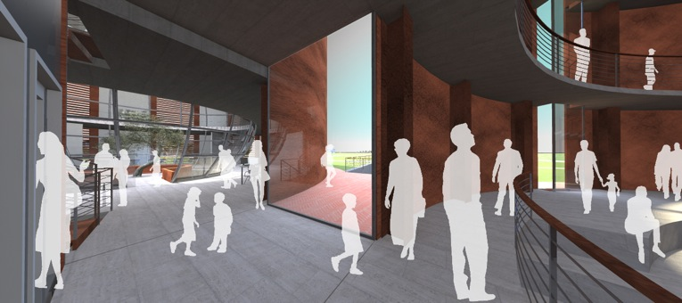
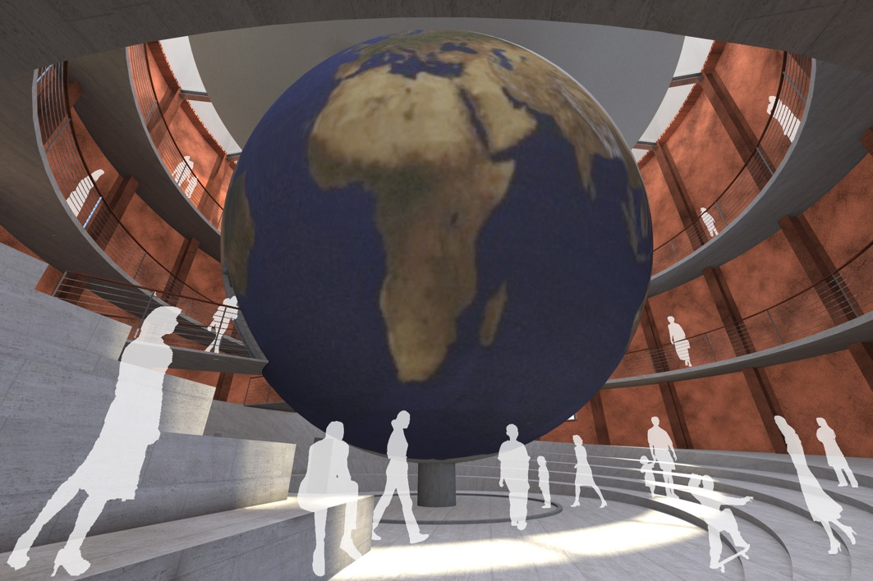
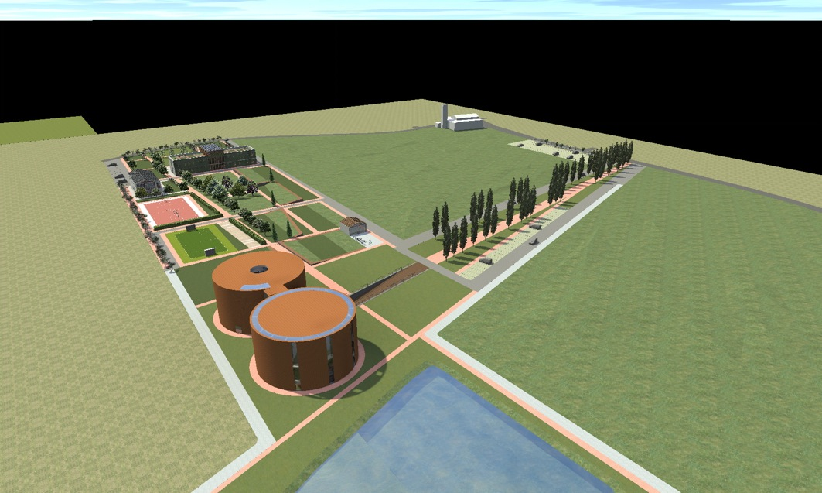
Far future if € from EU via Regione Toscana and Comune di Cascina

