Slide 1
Offline computing
Michele Punturo
INFN Perugia

Slide 2

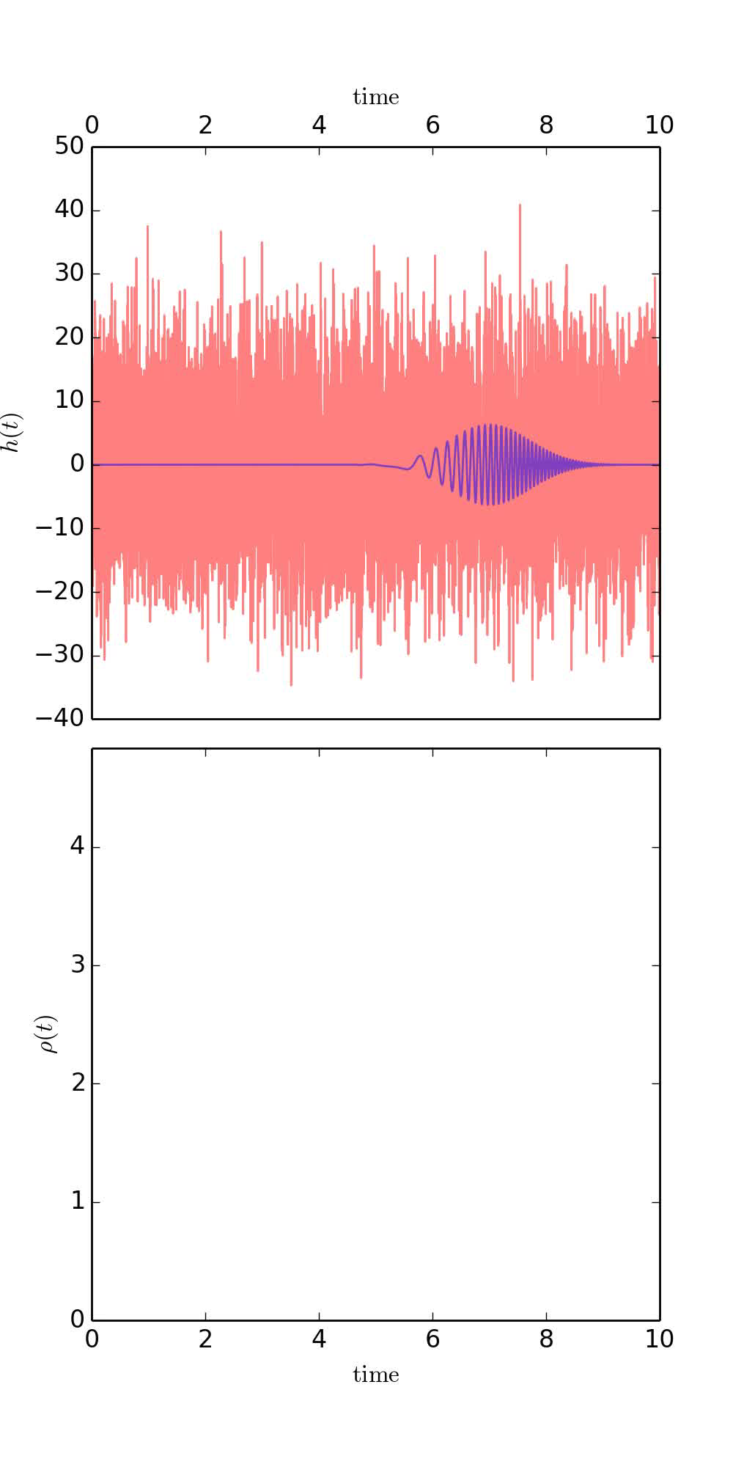
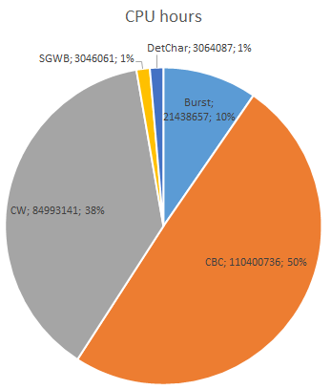
Size the problem
LIGO and Virgo are looking for several GW sources → several analysis
Each analysis can be investigated with different methods → several pipelines
Transients:
  Modelled search:
    Coalescing Compact Binary Systems (Neutron Star-NS, Black Hole-NS, BH-BH): Strong emitters, well modelled
  Unmodelled (bursts)
    Asymmetric Core Collapse Supernovae weak emitters, not well-modeled (‘bursts’), transient
    Cosmic strings, soft gamma repeaters, pulsar glitches
Continuous signals
  Stochastic search
    Cosmological stochastic background (residue of the Big Bang, cosmic GW background, long duration)
    Astrophysical stochastic background
  Continuous search
    Spinning neutron stars (known waveform, long/continuous duration)
223M CPU hours / year
Notes:
1 SU = 1 aLIGO Service Unit = 1 Intel Xeon E5-2670 2.6Ghz CPU core-hou

Slide 3
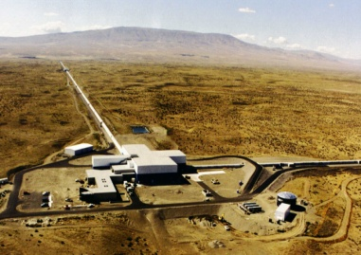


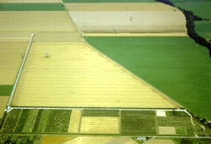

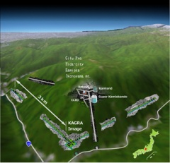
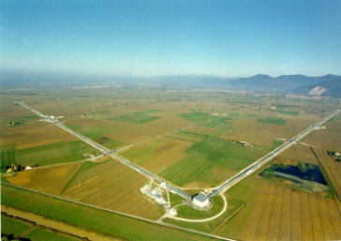


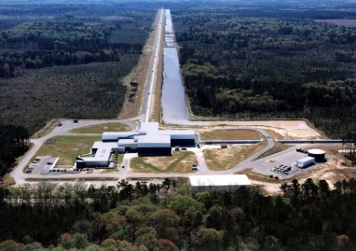

Network of GW detectors
~2019
aLIGO Hanford, 4 km
GEO, Hannover, 600 m
2015
2017
~2025
AdV, Cascina, 3 km
aLIGO Livingston, 4 km
It will operate as part of the LIGO Network and Collaboration
LIGO Scientific Collaboration:
1263 collaborators (including GEO)
20 countries
9 computing centres
~1.5 G$ of total investment
Virgo Collaboration:
343 collaborators
6 countries
5 computing centres
~0.42 G€ of total investment
KAGRA Collaboration:
260 collaborators
12 countries
5 computing centres
~16.4 G¥ of construction costs

Slide 4
Network of Computing Centres
LIGO Scientific Collaboration:
1263 collaborators (including GEO)
20 countries
9 computing centres
~1.5 G$ of total investment
Virgo Collaboration:
343 collaborators
6 countries
5 computing centres
~0.42 G€ of total investment
KAGRA Collaboration:
260 collaborators
12 countries
5 computing centres
~16.4 G¥ of construction costs

Slide 5
Network of Computing Centres
Sept 2016-Sept2017
Virgo ~6-8%
LIGO Scientific Collaboration:
1263 collaborators (including GEO)
20 countries
9 computing centres
~1.5 G$ of total investment
Virgo Collaboration:
343 collaborators
6 countries
5 computing centres
~0.42 G€ of total investment
KAGRA Collaboration:
260 collaborators
12 countries
5 computing centres
~16.4 G¥ of construction costs

Slide 6
Why so small Virgo contribution?
In effect, compared to the Astroparticle experiment sizes Virgo is not a small consumer (at CNAF)
Not enough resources:
  (Very) roughly <20% of the total LVC resources (in power)
But the major problem is the computing model:
  For the majority of the LVC common pipelines
    Condor clusters fully devoted to LIGO
    Pipelines looking for data and libraries in a local shared file system
    Pipelines could be intrinsically uncompliant with GRID
  Difficult to have them running at CNAF, CCIN2P3, Nikhef, ….

Slide 7
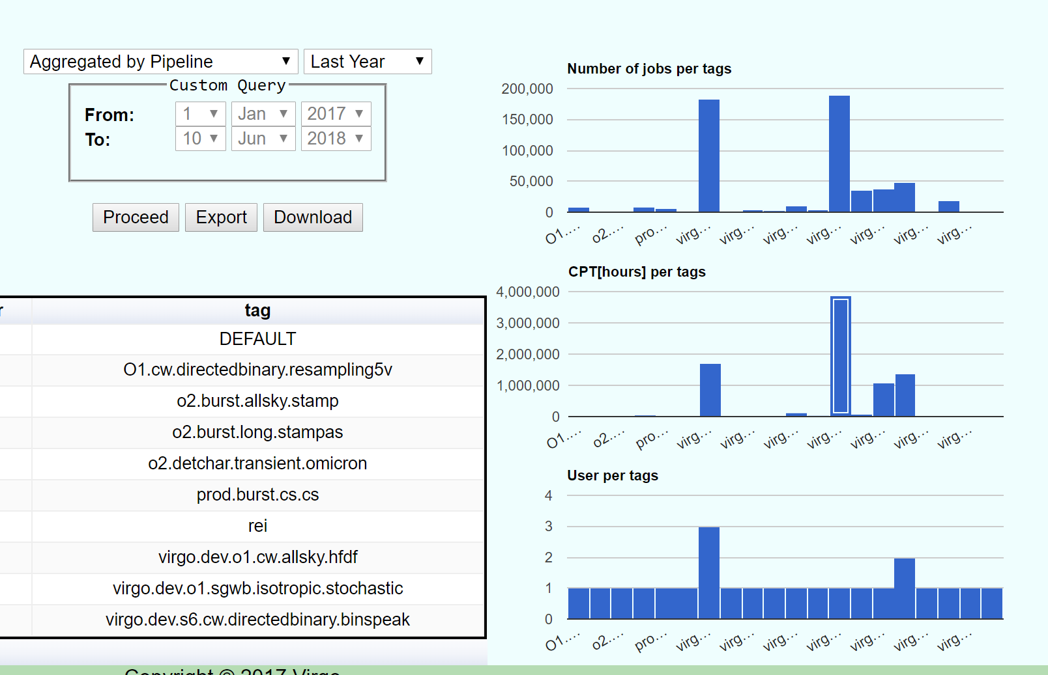
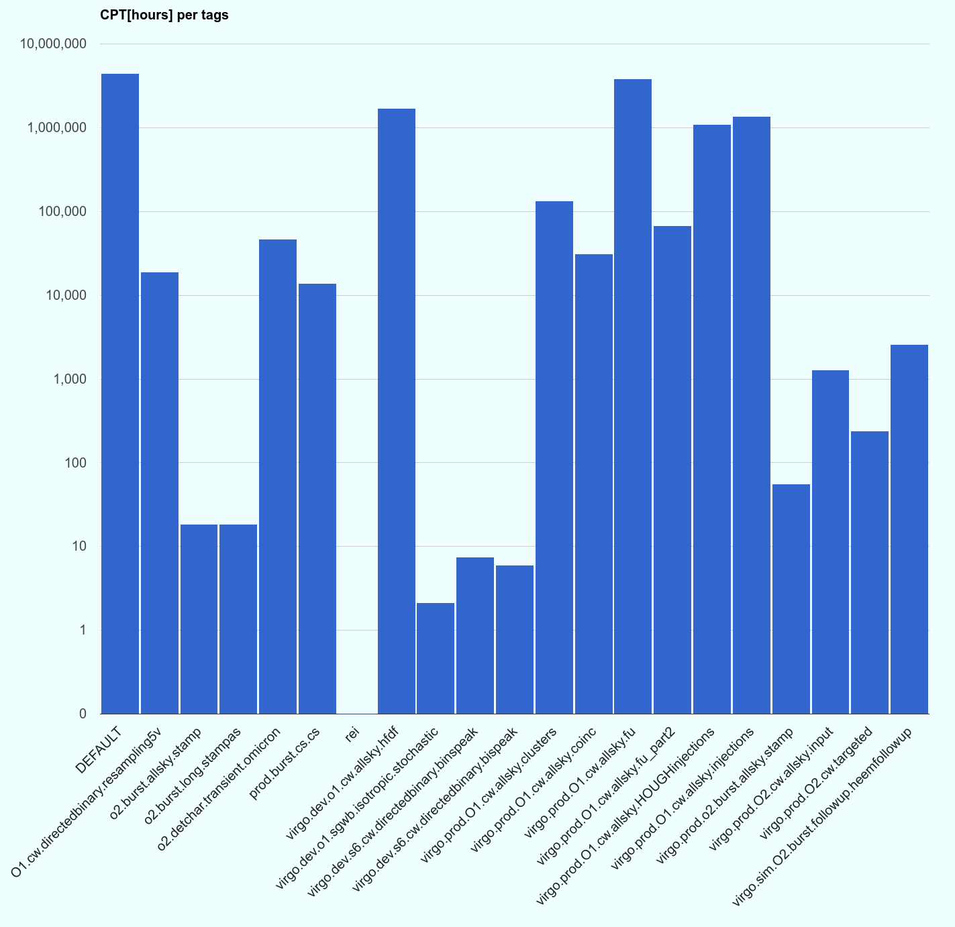
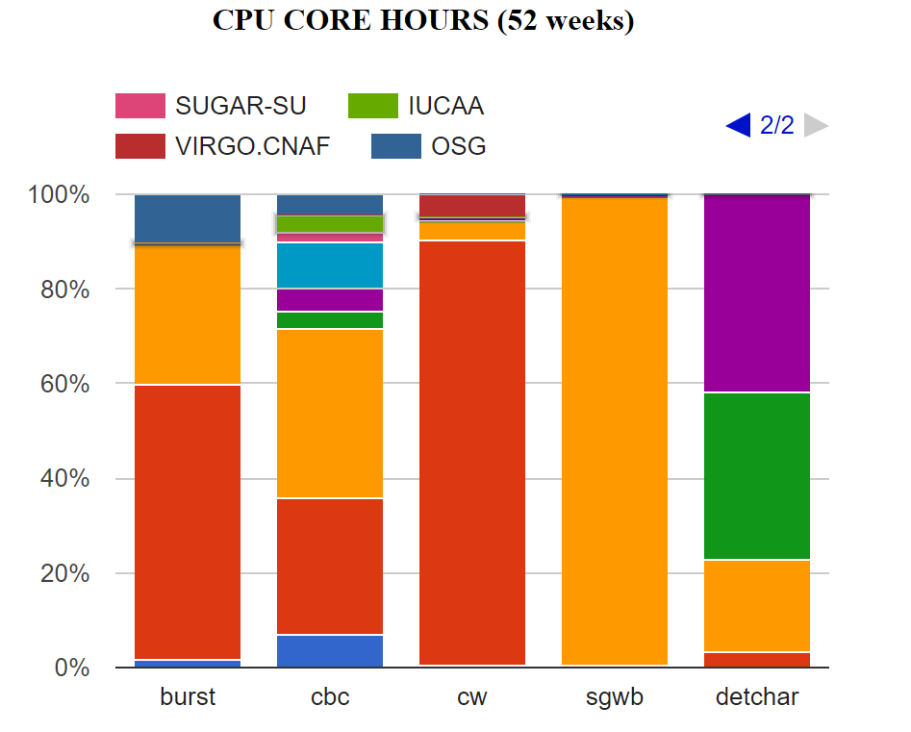
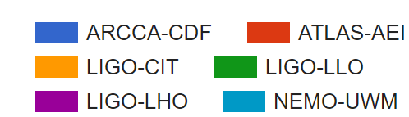
Computing load distribution
The use of the CNAF is almost mono-analysis
Diversification is give by OSG access
cw
cw
cw
cw
cw
cw
cw
cw
cw
cw
cw
cw

Slide 8
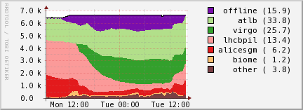
Running in Nikhef
CW analysis are also running in Nikhef CC by Roma people

Slide 9
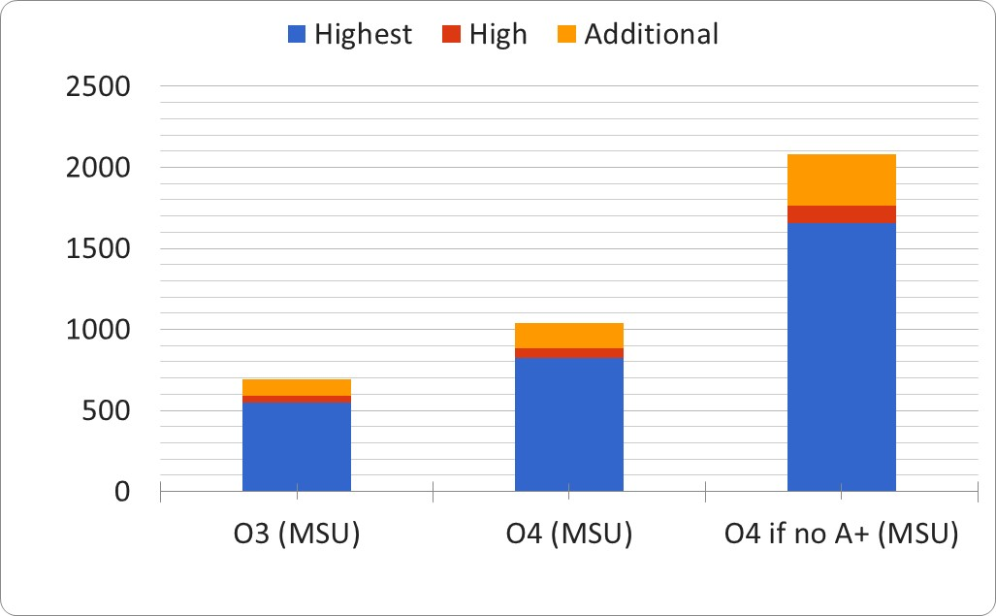
Future: Increase of CPU power needs
O3 run will start in February 2019 and will last for 1 year
We are signing a new agreement with LIGO that is forcing us to provide about 20-25% of the whole computing energy
3 detectors:
  Non linear increment for the coherent pipelines
    HL, HV, LV, HLV
4 detectors:
  At the end of O3, probably KAGRA will join the science run
Some of the pipelines will be tested (based) on GPUs

Slide 10
How to fill up the resources
Ok, let suppose to find the money to provide the 25% virgo quota
  Are we able to use it?
Within a parallel investigation made for INFN, I asked to (Italian) DA people to project their needs/intentions in the next years
With a series of caveat the projection is →
O4
O3

Slide 11
HPC resources
Numerical relativity is now a key element for the realisation of BNS templates
In Virgo there are important activities thanks to the groups in Torino and in Milano Bicocca
  They intensively uses the CINECA resources within the CSN4 framework and through some grant
    Being them “structurally” participating to the DA of LV we need to provide computing resources:
    Requests:
2018-2019:
------------------
2M GPU hours (e.g. on galileo @ cineca) [i]
6M CPU hours on Intel BDW/SKL (Marconi A1/A3 @ cineca) [ii]
50 Tb hard drive space [iii]
yrs 2020-2023:
----------------------
6M GPU hours per year [i]
6M GPU hours per year [ii]
150 Tb hard drive space [iii]

Slide 12
Issues and Actions
Summarizing:
  Just one “global LVC” pipeline (pyCBC) uses also GRID (OSG) as submission method
  Virgo computing facilities are used mainly by GRID “Virgo regional” pipelines, currently focused on CW
    A certain number of local submission are also present, mainly in CCIN2P3 and CNAF
Actions performed:
  Accounting
  Attempt to realise a “LIGO-like” environment at CNAF
  Local installation of Condor
  DIRAC

Slide 13
Accounting
LIGO developed its own accounting system based on condor info
We had to integrate the info about usage of Virgo CCs in to the LIGO accounting
Issues:
  Tags:
    Each job is labelled by a tag that identifies the pipeline
    The first issue has been to create and pass this information in Virgo CC submission system
  Username identification
  Daily update
We solved all the issues in CCIN2P3 and CNAF
  Tags issue still pending in Nikhef
Because of GDPR the info from Nikhef are now unavailable

Slide 14
Replicate LIGO environment at CCs
Test of realising a “LIGO-like” environment at CNAF
  failed and inefficient from the point of view of resource sharing within the CC
Currently we have a local installation of Condor at CNAF used as a wrapper for the local submission system
  It works at it could be used for example to run cWB at CNAF

Slide 15
Dirac
Both the workload management system and the Grid File Locator used by CW people has been dismissed by CNAF
  We were forced to investigate new solutions
At the CC meetings we have been suggested to use DIRAC
Dirac has been initially developed by LHCb and now used also by CTA, ILC, Belle2 and other experiments
It is a service supported by EGI (European Grid Infrastructure https://www.egi.eu/)
  https://confluence.egi.eu/display/EOSC/EOSC-hub+service+catalogue
Its development is supported by European Commission through the EOSC (European Open Science Cloud) initiatives
We had the enthusiastic support of EGI (providing competences and limited human resources) and the robust support of CNAF (installing servers, file catalogue, limited human resources) to the test activities of Cristiano Palomba (workload management) and Luca Rei (data management)
We are also organising a training project with EGI thanks to the support of EOSC-hub
  School at EGO in autumn

Slide 16
DIRAC: Lights
Preliminary tests on DIRAC workload management are quite positive:
  Capable to run test jobs on all the “Virgo” computing centres
  Possibility to access sites for opportunistic cycles
  Capable to access test files remotely
Preliminary tests on DIRAC file catalogues quite positive:
  It easily manages queries on the virgo files stored at CNAF
True access to Virgo raw data files still to be tested
  Is it working at CNAF? Is it working at CCIN2P3?
Data transfer to be tested but LHCb experiences of continuous DT using DIRAC has been reported to be positive

Slide 17
DIRAC: Shadows
The major “shadow” is the decision of LIGO to adopt Rucio for data management and maybe data transfer (abandoning LDR)
  We investigated Rucio in the past (before to start the DIRAC investigation) but:
    Experts (in INFN) told us to be too heavy for our purposes
    We haven’t an external support (like EGI offers for DIRAC)
    We are loosing the opportunity to unify in a single package all the major activities (DT, DM, WM)
      Rucio has not WM
  We inserted James Clark, the Rucio’s person in LIGO, in the Virgo-Dirac mailing list to follow our activities
  Obviously we can trash all the work done until now with DIRAC, restart with Rucio and find a WM system (still DIRAC?)
    Is it the right way to proceed in a human resource limited context like we are?

Slide 18
Containers
A possible medium term exit strategy is to use containers and virtualisation
LIGO is testing the use of Singularity and CVMFS
  We need to enter in this activity as soon as possible
Who?
  A post-doc for Virgo will be recruited soon by the INFN Torino unit by a group with large experience in containers and virtualisation

Slide 19
Historical Weaknesses
The main weaknesses of the Virgo computing are, since beginning:
  Resources (mainly human resources)
  Competences
  Organisation
Human resources:
  No additional human resources from the collaboration, although the precious continuous contribution of few Virgo/EGO collaborators: (EGO IT Dept, F. Carbognani, M.A. Bizouard, C. Lazzaro, C.Palomba, L. Rei)
Competences
    Improvement in the last months thanks to the external support of CNAF and EGI
    Training expected in the following months
    But the path is still long

Slide 20
Organisation
I have appointed as VDAS coordinator in emergency in Sept 2015
Since the beginning of my mandate, ended in Sept. 2017, I highlighted the need to improve the organisation of the VDAS (changing also the name!)
Recently I proposed a new structure of VDAS, dividing it in Working Packages and identifying the main projects
This organisation has been shown at the Virgo week in April and proposed to VSC
  Decision pending and a suggestion from this committee is more than welcome

Slide 21


«Local area»
Spokesperson / EGO Direcor
«Wide area»
DA coord
LIGO interface
Virgo Computing Coordination
Commissioning coordinator
Computing Centres
Local computing and storage infrastructure management & strategy
Low latency architecture
Analysis pipelines GRID compatibility
Sw management
Offline Computing Management
Networking infrastructure
Offline Computation needs evaluation
Local Computing Infrastructure
Online Computing subsystem
Dedicated hw management
Cyber-security
Data Management System
Local data allocation and management & strategy
Local services
( federated login, web servers ... )
Bulk Data Transfer

Slide 22
Reference persons at CCs
In addition, it is crucial to have a MEMBER OF THE VIRGO COLLABORATION, fully devoted to computing issues, physically or virtually located at each computing center, acting as reference persons
  Post-doc level
  He/she participates to the collaboration life (computing meetings, DA meetings, …), but he/she has the duty to solve (or to facilitate the solution) of all the issues related to the use of that CC by the collaboration

Slide 23
Cost model
In the current cost model EGO reimburses the costs at the French and Italian CCs, Nikhef and Polgrav are contributing in kind
This model balances the costs between Italy and France but it charges the largest fraction of costs on EGO shoulders
  To move the bill back on the funding agencies doesn’t work, because INFN will be by far the largest contributor without further balancing
We need to find a cost model that shares in a more clever way the costs for computing within Virgo:
  It should take in account the number of authors
  It should take in account the global investment in computing (DAQ, low latency analysis, storage, human resources)
  It should force the Virgo members to account their resources

Slide 24
Cost model
This is not a definitive proposal, but we need to open a discussion also in front of the EGO Council and the institutions
We have to define our standards:
  Needs and standard cost of the storage
  Needs and standard costs for CPU
  Accessibility requirements (LIGO compliant, Virgo compliant, …)
  Accountability requirements (resources need to be accountable)
  Human resource requirements (a collaboration member MUST be the interface)
  Compute a “Virgo standard cost” per author
Each institution in Virgo has to provide in kind and/or in money resources proportional to the number of authors according to the standard figures we defined
  Ghosts are expensive!
Over-contributions can be considered as a net contribution to the experiment by the institution; obviously we must take in account also the direct contribution to EGO

Slide 25
Thanks for your attention

