Slide 1
Introduction to Virgo computing framework and issues
Michele Punturo

Slide 2
(Personal) aim of the meeting
Computing has a growing relevance in GW experiments:
  Now we have real data
  Now we have real and astonishing events
  The event rate is beyond the expectations
Advanced Virgo has an historical gap wrt Advanced LIGO on data analysis and computing resources (and organisation)
  DA and computing weren’t included in the Virgo and Advanced Virgo projects
  DA and Computing aren’t in the current AdV+ update plan
My personal targets today are:
  Consolidate short term solutions (O3) exchanging know-how and expertise
  Discuss medium term solutions (O4) developing synergies with some of the participants to this meeting (CCs)
  Raise awareness of the funding agencies on the support needed by Virgo in terms of human resources, competences and hardware resources

Slide 3
Specific targets
You will see issues and difficulties on Online, Low Latency, Offline activities
We expect recommendation and suggestions on:
  Online and low latency activities
    Storage needs and urgency (an eventual green light is expected today)
    Data transfer solutions
    High Availability architecture for low latency analysis
  Offline
    Workload management solutions
    Data management solutions
    Computing power needs and solutions
  Organisation
    Human resources
    Organisation of the activities

Slide 4
Computing model: preamble
Virgo computing model cannot be an independent variable:
  It is constrained by the partnership (symbiosis?) with LIGO
    Our choices cannot be totally independent
    We are sharing online data with LIGO for a common and coherent “low latency” (detection) analysis
    We are sharing offline data with LIGO for a common and coherent “offline” analysis
    We share code, planning, activities, decisions, computing resources
  It is constrained by the “Virgo” ambient:
    Mainly HEP institutions or HEP funding agencies
    Computing resources available in large computing centres serving a long list of experiments
      Common solutions

Slide 5
Advanced Virgo
Advanced LIGO
EGO/Virgo Site
Temporary storage and DBs
h(t) data transfer
DAQ (50MB/s – 84MB/s full raw data)
Detector characterisation
Low latency analysis and detection
Reduced Data Set
(RDS) transfer
0.87MB/s
via LDR
LIGO
Virgo
Raw Data Transfer
45-50MB/s
Virgo
↔Via GridFTP
Via iROODS ↔
Nikhef
Offline DA
CCIN2P3
CC and Tier0-1
Offline Data Analysis
CNAF
CC and Tier0-1
Offline Data Analysis
SurfSARA
Offline DA
LIGO via LDR
PolGRID
Offline DA
GRID and
local access

Slide 6
Activities at the Virgo/EGO site
GW detectors are in a large fraction of their time in commissioning phase
  Innovative apparatuses that need fine tuning
  Physics: GW detectors are sensible to h(t)~1/r → a factor 2 gain in sensitivity is a factor 8 in detection rate
Hence, to facilitate and support commissioning is crucial also for the computing infrastructures:
  Local storage
    Commissioners need old data to compare detector performances
  Local computing
    Commissioners need interactive analysis tools to display, filter and handle data
  Local data management
    Special data need to be archived

Slide 7

Storage
Temporary storage and DBs
EGO/Virgo Site
DAQ (50MB/s – 84MB/s full raw data)
Detector characterisation
Low latency analysis and detection
Currently the storage capabilities at EGO are about 1PB
  50% devoted to home directories, archiving special data, output of the local “low latency analysis”
  50% devoted to the circular buffer that is used to store locally the raw data
  Less than 4 months of lifetime of the data before overwriting (at 50MB/s)
    Too short period for commissioning purposes
    Unable to keep O3 on disk
      Impossible, for example, to re-calibrate O3 data at the site
  This situation is due to a rapid evolution of the requirements scenario that is making obsolete the previous computing model specifications:
    Increase of the requests by DAQ; data writing rates:
      Nominal ~22MB/s
      O2: ~ 37MB/s
      Current: ~50MB/s
    Requests by commissioner to have data corresponding to “special periods” stored locally for commissioning and noise hunting purposes
    Requests by low-latency analysers to have disk space for outputs of their analysis

Slide 8
Storage
The shortage of disk space at the site is also raising the risk of loosing scientific data
Nota Bene:
  “If the incident at the CNAF had occurred during O3, Virgo would have lost science data”
This is related to the data transfer issues

Slide 9
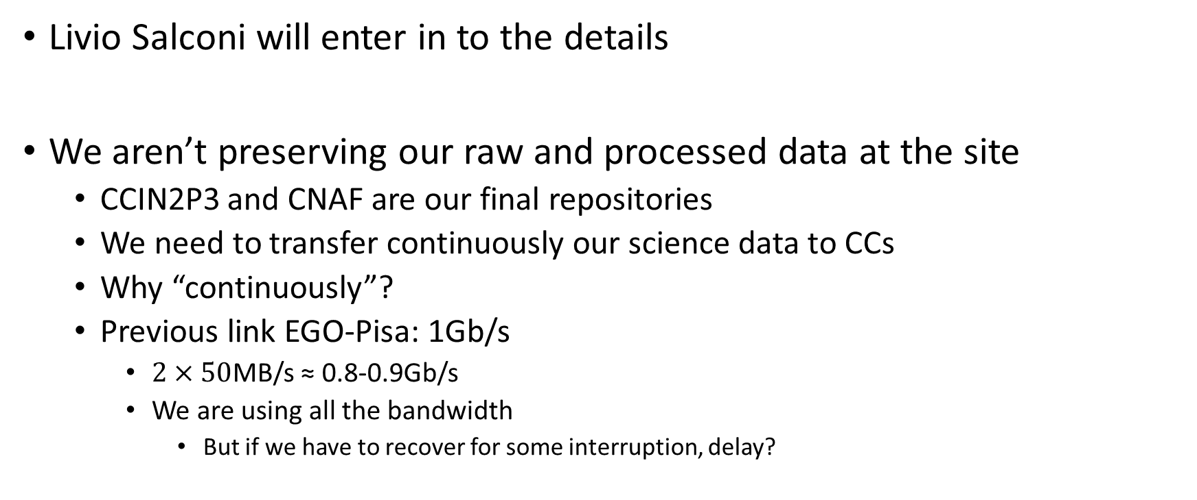
Data Transfer
Livio Salconi will enter in to the details
We aren’t preserving our raw and processed data at the site
  CCIN2P3 and CNAF are our final repositories
  We need to transfer continuously our science data to CCs
  Why “continuously”?
  Previous link EGO-Pisa: 1Gb/s
    $2×50$MB/s ≈ 0.8-0.9Gb/s
    We are using all the bandwidth
      But if we have to recover for some interruption, delay?

Slide 10
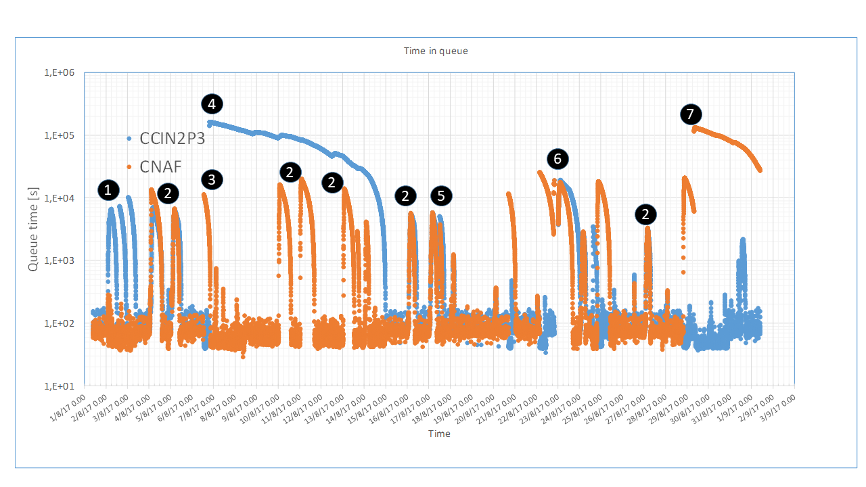
Raw Data Transfer: O2 experience
A sequences of internal and external issues affected the data transfer toward the CCs during O2

Slide 11
O2 issues highlighted by DT
Problem (1):
  iRODS hanging toward CCIN2P3
Problem (2):
  un-identified midnight slowing down
Problem (3):
  Grid certificate expiration
Problem (4):
  Saturation of the disk-to-tape transfer in CCIN2P3
Problem (7):
  Similar issue at CNAF
Problem (5):
  Freezing of the storage due to lack of disk space
Problem (6):
  Firewall freezing

Slide 12
Discussion with CCs
We had two meetings with CCs:
  16/01/2017: first meeting, presentation of the problems, discussions, hypothesis, some solution suggested on
    Data management (Keyword: Dirac)
    Workload management (Keyword: Dirac)
    Virgo software replica (Keyword: CernVMS)
    From CCs to Virgo: request of requirements
    From Virgo to CCs: request of common solutions
  07/05/2017: Second meeting
    Solution on Data Transfer discussed
    A possible common solution proposed by CCs

Slide 13
Risk reduction strategy toward O3
Increase availability and performances of the infrastructure
Solve radically the problem, support the commissioning
Bandwidth increase to 10Gb/s
  Link updated
High Availability Firewall has been installed
  See Stefano’s Talk
New Data Transfer Engine?
  Virgo request: use the same protocol for CNAF and CCIN2P3
  CCs answer: Webdav (see Livio’s talk)
Expand the local storage, devoted to the circular buffer
  Now: ~500TB
  Summer 2018: 500+1300 TB
  Summer 2019: 500+2000TB
Funds are available, the requests is pending since too long time
See Stefano’s Talk

Slide 14
Low latency Analysis architecture
Few words, Florent will talk later

Slide 15
Low Latency Analysis computing infrastructure 1/2
O2 highlighted some weakness in the Low Latency Analysis Architecture
  Virgo data weren’t transferred for online analysis around GW170817 event because of a failure in the chain
  A retrospective analysis has been made, an overview of the adopted architectures has been realised through the distribution and discussion at the VDAS of a form addressed to the Virgo low latency analysis pipelines managers
    Target: to provide (mainly to EGO IT department) a clearer vision of the critical processes in order either to allocate the available High Availability resources or to provide new resources
We depicted a scenario, identified few weakness, but the process is not concluded
Meanwhile, we have two actions:
  Robustness increase
  Computational power increase

Slide 16
Low Latency Analysis computing infrastructure 2/2
Robustness increase:
  New High Availability firewall
  Update of the DAQ servers, provided of standalone disk in order to disentangle them from NSF availability
  Online processes non more dependent on unrestricted shared accounts (unsecure and untraceable)
  Increase of the robustness of the central NFS file-server
Computational power Increase
  10 additional machines to MBTA
    Virtual machines
      successful test of performances
      Improvement in terms of management and availability
  6 additional machines to
    DetChar processes
    cWB online
      A part of cWB should be running online at the Virgo/EGO site in O3
  Machines installed in these days

Slide 17
Web Services and Federate login
Detector characterisation and low latency analysis are realised simultaneously in the LIGO and Virgo detectors
  Web-based resources are used to present results, status plots, info …
Documentation and archived files are shared using web based services
Currently we are accessing LIGO services using a ligo.org account
Virgo services are accessible through a EGO account
  Some of these services are behind a firewall that protects the network of the interferometer
This configuration caused several frictions with LIGO because:
  Their reluctance to use EGO account
  Unfriendliness of the Firewall access
Now LIGO is changing the way to access their resources
  LSC, Virgo and KAGRA people will access the services using their “home institute” account through a federate login method
  Virgo has to adopt a similar mechanism

Slide 18



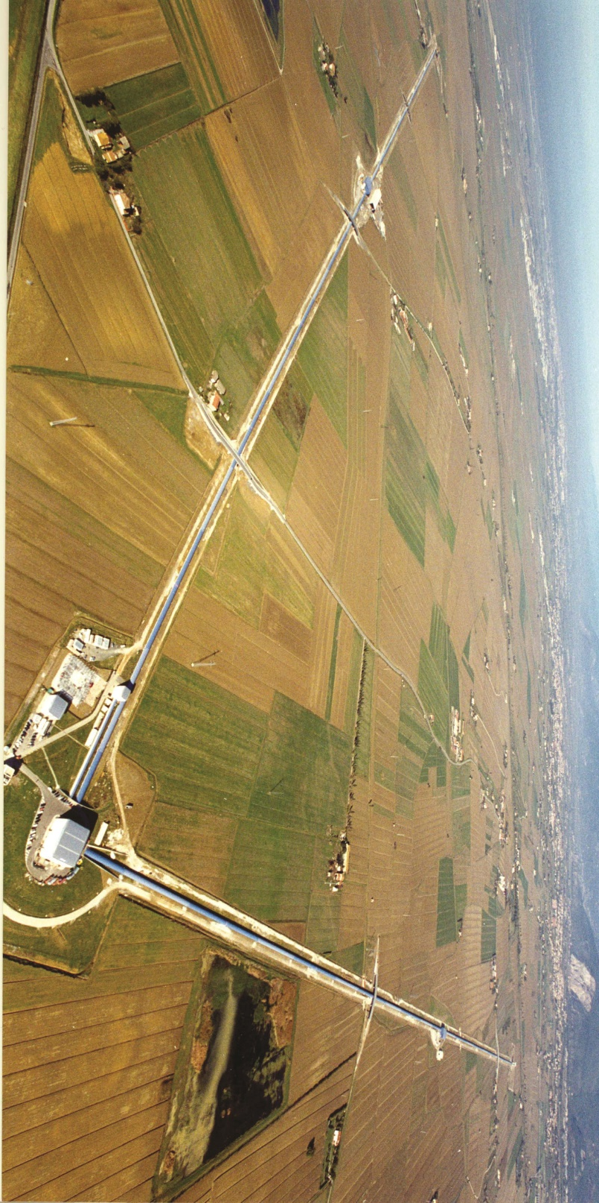

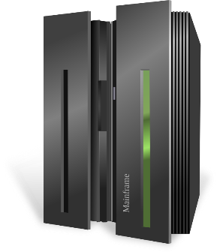

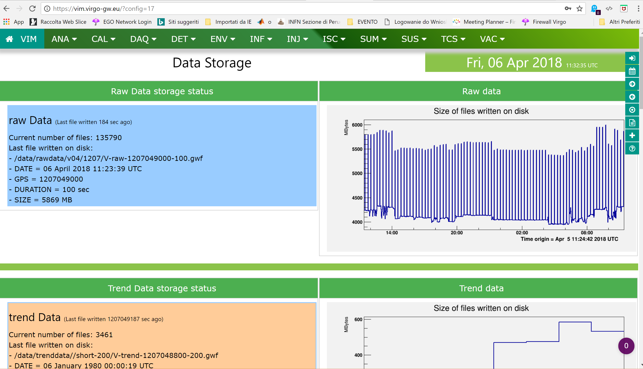

Scheme
AA COmanage IdMS
FIREWALL
TDS
AAI
LIGO lab and LSC universities offer access and services through EduGAIN
EGO federation
Idem
Interferometer:
(DAQ, Controls, Electronics, Monitoring, …)
WWW
EGO SP (IdP)
Renater
…
UV
Single sign on
Federate login access
VIM
SIR
VIM-replica
Surfnet
WIGNER
Poland: Pioneer?
EduID

Slide 19
Offline computing in the afternoon talk

