Slide 1
VIR-0443A-14
Some news about some monitoring tools
D. Verkindt
Virgo detchar meeting 26 sept 2014
Channel Database (for information)
Detector Monitoring System (for information)
dataDisplay (for discussion)
MonitoringWeb (for discussion)

Slide 2
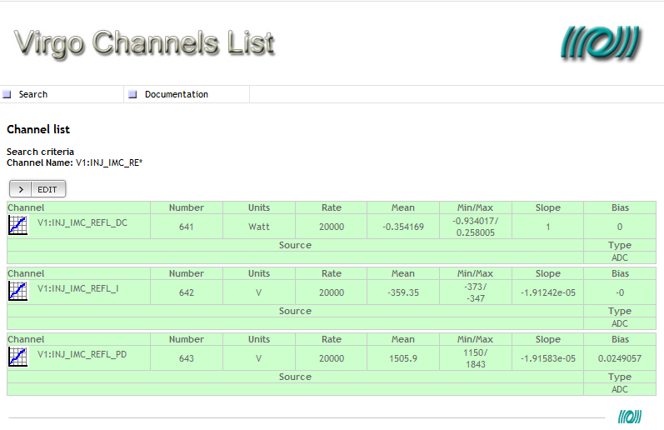
Channels Database
Current available channels : 1986

Slide 3
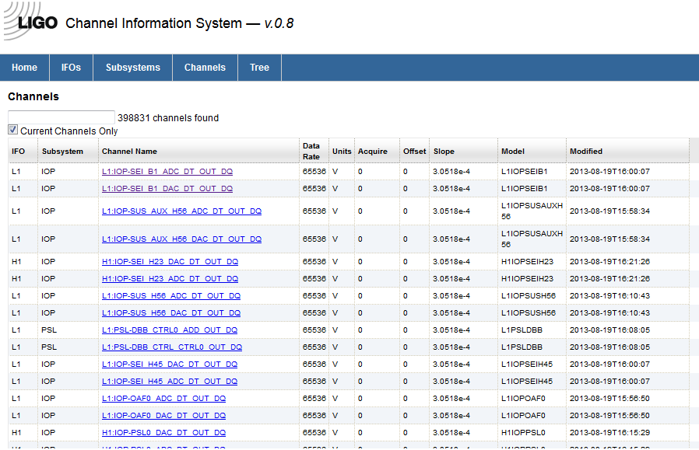
Channels Database

Slide 4
Channels Database
We start a new development
Keep in the requirements some of the previous structure and features
Have a look at the CIS developed in LIGO
Step 1: Write a document describing the database structure, the access tools, the links with hardware database, the organization of channels insertion (first draft already done)
Step 2: Do a pre-review of channel names and have a channels database ready
Step 3: Insert channels in the database
Step 4: Do a review of the channels inserted
Step 5: Have an automatic and periodic reading of raw data and trend data and insert automatically most of the information.
Timeline is: step 1 in october 2014, step 2,3,4,5 before february 2015
Gary’s priority until ER6 is DQSEGDB

Slide 5
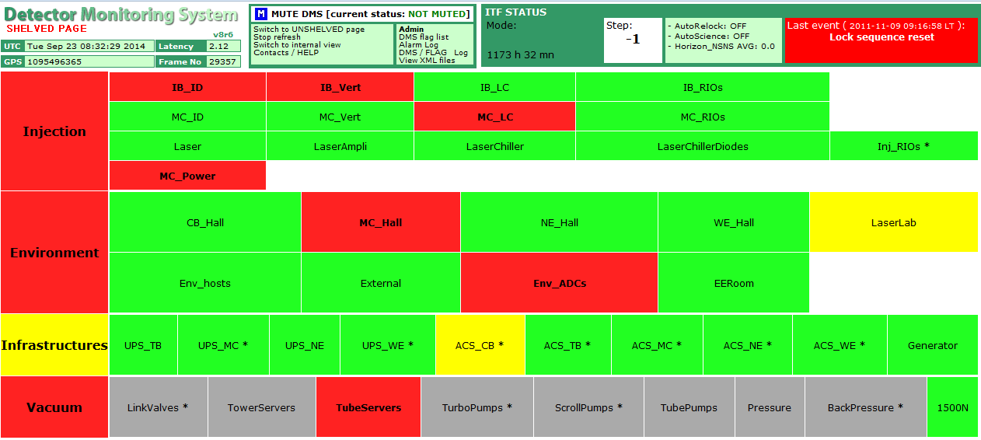
Detector Monitoring System (DMS)

Slide 6
Detector Monitoring System (DMS)
Current DMS is based on
  a set of Moni processes producing flags sent to trend data and to XML files (but flags contain information in their bits and are difficult to interpret for data analysis use)
  php scripts reading the XML files and producing the DMS web page with some interesting features like alarms and plots of recent data (but use its own database instead of using the frame formatted data)
A document will be written describing the XML format used by any process which wants to see its information included into the DMS web page
Moni processes will produce only 0/1 flags (no bits coding) to be used also by data analysis
Will include VirgoCAM information
VPM will provide a XML page containing the status of all the processes it monitors
We will investigate on the possibility to read trend data frames with php script.
Main workers: F. Berni and D. Verkindt
Discussions with: B. Swinkels and V. Dattilo
No timeline for now (level of priority of this work is yet TBD)

Slide 7
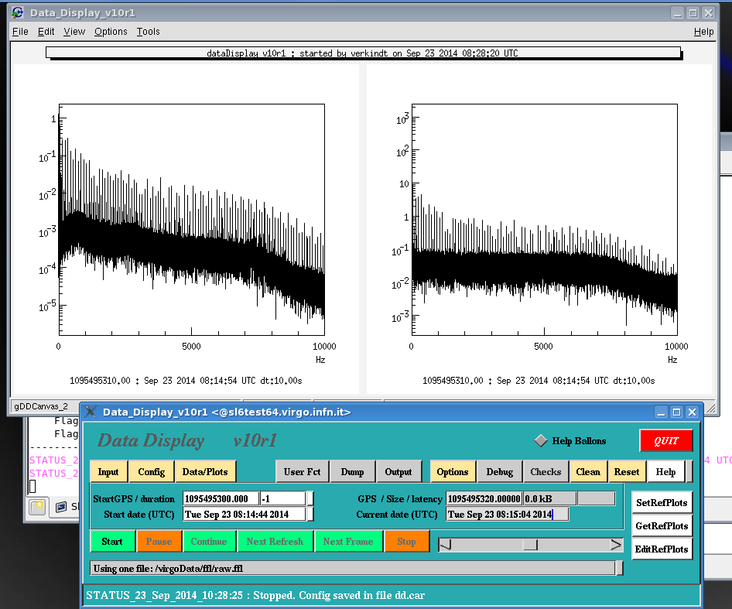
dataDisplay upgrade

Slide 8
dataDisplay upgrade
A new version (v10r1) that uses ROOT v5r34p5 is working under SL6 64 bits
This new version has for now only FFT plots
Several internal changes made (use of Xform, channels management, use of Frv, central engine no more based on Siesta and on frame format…)
For now, no beautiful text, no detection of missing channels, no operations on channels, no superposition of plots…
New features (like computing brms values or doing glitchgrams or getting information from channel DB) will be added only once old features are back.

Slide 9
dataDisplay upgrade
Remark1: previous version v9r12p13 using ROOT v5r34p5 compiles under SL6 and runs correctly when doing plot 1D, but crashes for plots FFT or TIME, when function Paint() is called. Origin of the problem not found.
Remark2: previous version v9r12p13 runs fine under SL6 when using ROOT v5r26p0
New version v10r1 and old version v9r12p13 to be tested with latest version of ROOT (v5r34p5 is quite old now) under SL6 and SL5. This may provide hints…
A review of dataDisplay current state and of the features requested will be welcome
Aim is to release Dy v10r1 within one month
(but not yet with all the features that were available in previous version)

Slide 10
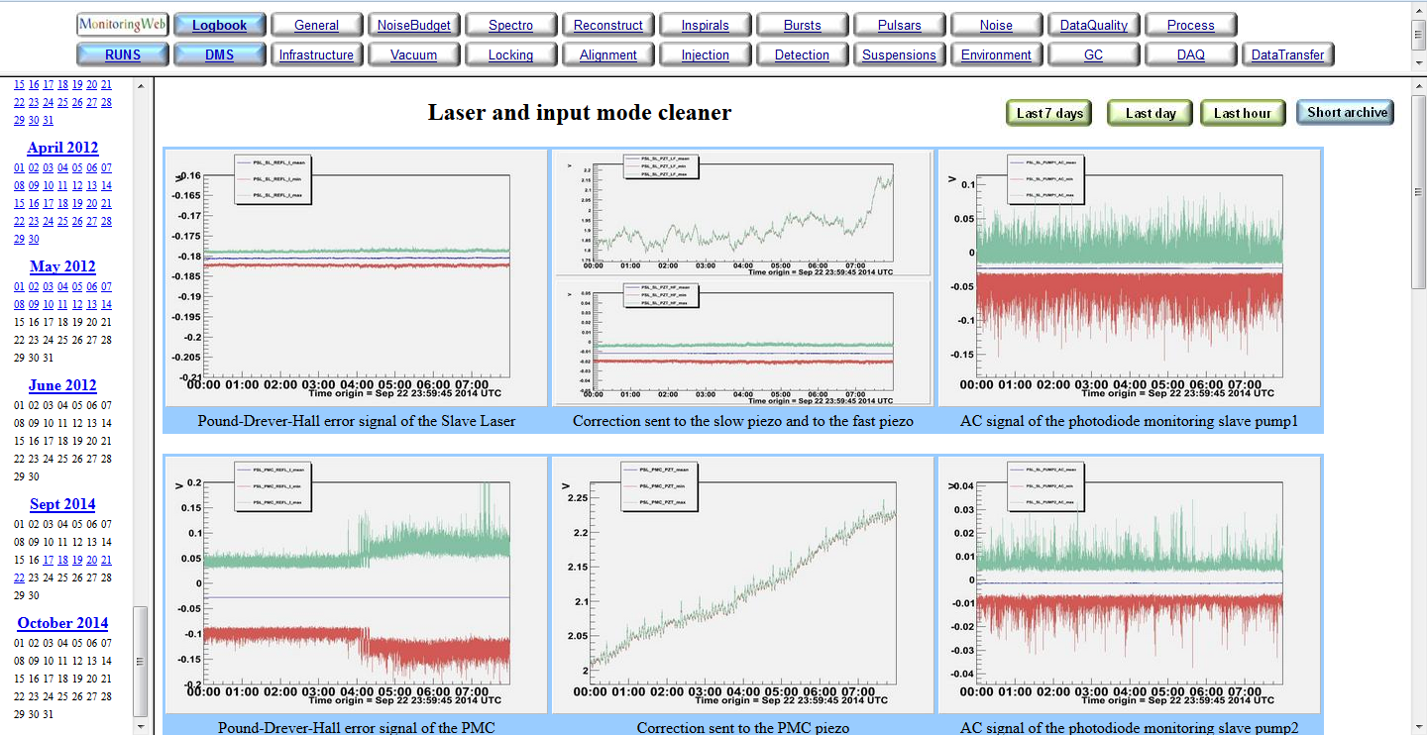
MonitoringWeb

Slide 11
MonitoringWeb main engine
Utils
Each subsystem directory contains
A bash script (injection.sh)
An html page (index_monitoring,html)
A plots directory (plots/)
A logfiles directory (logs/)
A calendar (calendar.html)
An archive directory (archive/)
General
Spectro
Injection
/opt/MonitoringWeb
Environment
archive/
2014/09/21
lasthour
lastday
Infrastructure
NoiseBudget
DAQ
Inspirals
Bursts
Etc…

Slide 12
MonitoringWeb main engine
Some of MonitoringWeb pages have specific features or plots or tables (no use of the trendcommon.C, specific organization of the archive…). This makes difficult any standardization of the MonitoringWeb pages
archive specific web pages, use of a config, auto rebuild of html web pages
Spectro
NoiseBudget
archive every 5 mn, specific ROOT macros
DQ
refresh every 4 mn, redo html web page
Inspirals
specific ROOT macros
Bursts
only update calendar, use Omicron web pages
Reconstruction
specific ROOT macros

Slide 13
MonitoringWeb main engine
archive_specific.sh
archive_day.sh
updater.sh
trendcommon.C
injection.sh
trendINJ_IMC.C
MdTrend
environment.sh
spectro.sh
spectro_auto.C
spectro-config.txt
spectrohtml.sh

Slide 14
MonitoringWeb
The MonitoringWeb engine has been restarted on Environment, Injection and Laser, Spectro
On short term: welcome any request of new channels and proposals of improvements
On short term: reduce the number of manual operations done each time a subsystem needs to be included or a new set of channels needs to be monitored
On a longer term: Keep the main engine (based on bash scripts and ROOT macros)
On a longer term: provide a better way to display the information on web pages
This includes new features like:
  Access to channels database information
  Navigation tools separated from plots web pages
  Possibility to look simultaneously to plots of different subsystems at a given time
  Possibility to look simultaneously to plots of different times for a given subsystem

Slide 15
MonitoringWeb
Work done with Gary Hemming
A first picture will be proposed by Gary in October
While developing the new display and its interface with the MonitoringWeb main engine: keep compatibility with plots and web pages archived up to now
Any development of this new display will be done after DQSEGDB, HW database and channels database completion.
Second step will be to include « On demand » plots based on tools like NMAPI.
TBD: updates and maintenance done by Didier and Gary, with requests of new plots or new features coming from subsystem managers
Or plots and web pages updates done by subsystem managers

Slide 16
Requirements to include a new monitor,
new plots or new channels in MonitoringWeb
Provide a code or a set of codes with the following requirements:
  Output plot or set of plots should be stored in files in jpg, png or gif format
  Output directory should be user defined
  Naming of output files should be user defined
  It can produce a html page (output directory and file name should be user defined)
  It can have some documentation in html or pdf
  It does not take more than 5 minutes to complete on an olnode (or a set of olnodes)
This code can be written in bash, C, C++ (compiled or ROOT macro), python, matlab… or a combination of those (for instance a bash script calling a python code and a ROOT macro)
This code will be either in virgoApp or put under virgorun account in the concerned MonitoringWeb subdirectory
You must then contact the MonitoringWeb responsible to include
  a call to this new code in the main bash script of MonitoringWeb/xxx
  a list of new channels to be monitored in the config of MonitoringWeb/xxx
If this implies the creation of a new MonitoringWeb subdirectory
  ask first to the MonitoringWeb responsible to prepare this new directory

Slide 17
Conclusions
Several tasks to be done in the coming months!
(dataDisplay, MonitoringWeb, DMS, channelsDB, DQSEGDB, HW database, online DQ…)
Regular update presentations on those works will be done in detchar meetings
Need clear statement about priorities and completion schedule
I plan also to work on data analysis and glitch investigations
(not just developing tools for commissioning and detchar)

