Slide 1
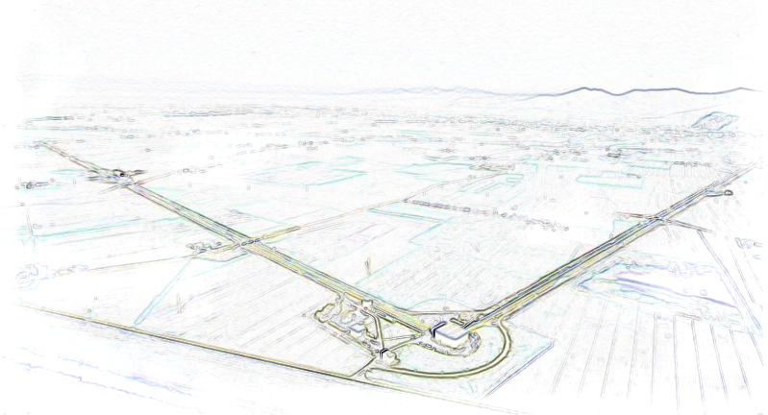
Magnetic Noise Mitigation: Possible Strategies
AdV DIM VIR-0441A-14

Slide 2
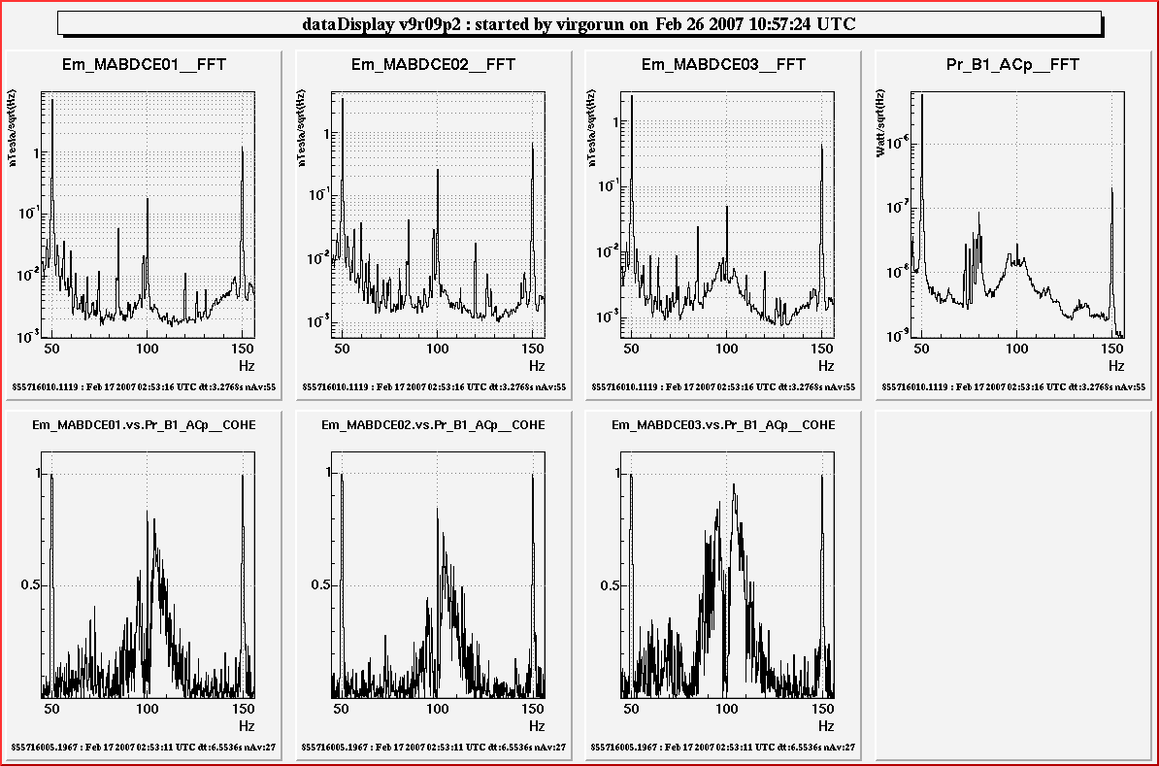
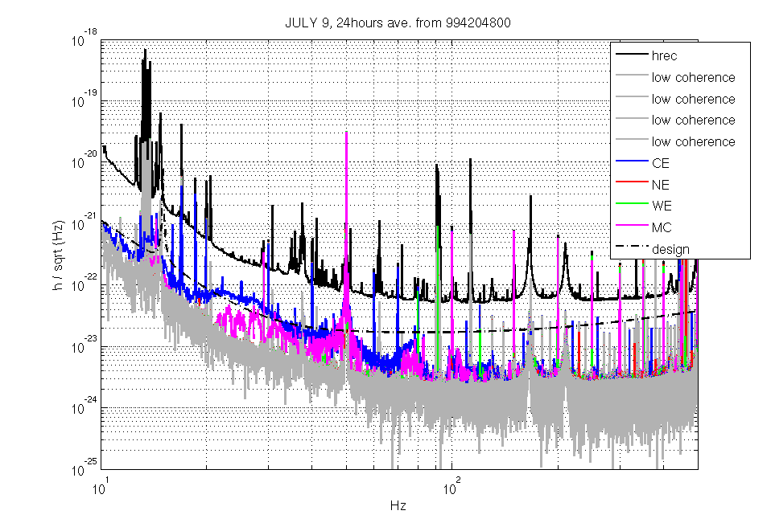
Magnetic coupling
Many magnetic effects in VIRGO literature:
{ext. fields → mirror → dark fringe}
(e.g. logbook 15367, 15506, 18384, 18484, 25247, 30247 and follow-up)

Slide 3
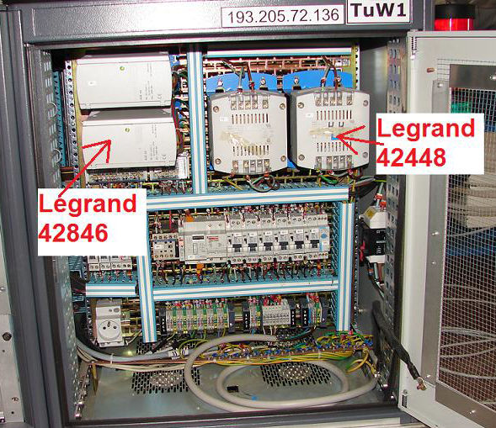
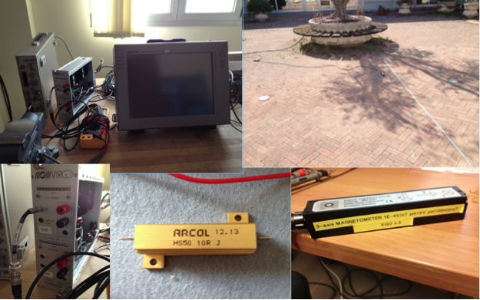
Magnetic concern
A lot of work done on magnetic source characterization
(e.g. UPS noise, vacuum racks noise, cables irradiation, logbook 25297, 25397, 30963, VIR-0289B-12, VIR-0349A-13, etc.)

Slide 4
Magnetic Noise mitigation: strategy
reduction of magnetic coupling in AdV
reduction of magnet magnetic momentum (~5 times smaller)
as in AdV TDR 10.1.1.2
reduction of ext. fields
focus on
requirements on actuation force (locking and calibration ask for ~mN up to 1kHz) and consequent compliance for driving electronics
possible roll-back to V+ magnets

Slide 5
Magnetic Coupling: ingredients
Sources Actuators Paths
typically only
one source:
Mains Supply
Non-zero area
of mains wires
Transformer
leakage
Cables
Transformers

Slide 6
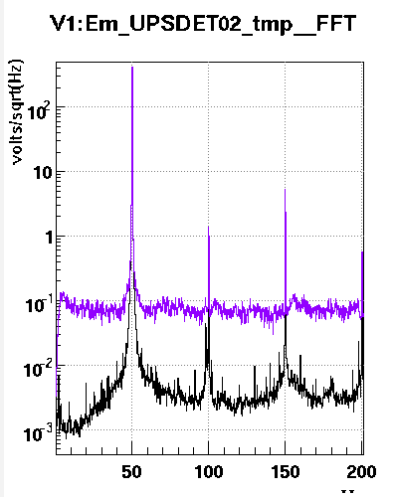
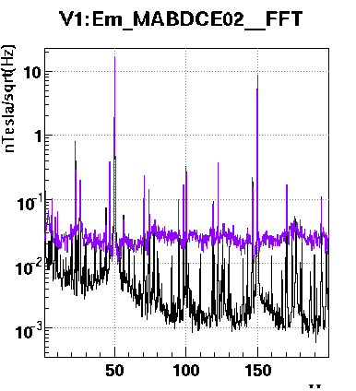
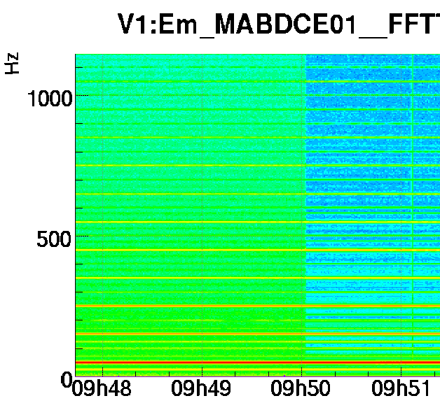
SOURCES: UPS vs IPS noise
Mains noise and magnetic noise in the CB (typical) during a UPS switch-off
voltage mag. field mag. field

Slide 7
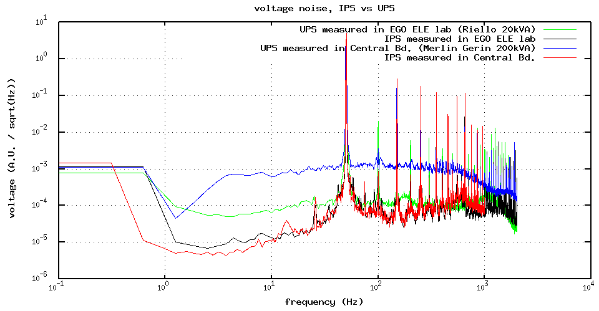
SOURCES: UPS noise
Not all UPS have the same noise:
blue is CB “big” (200kVA) UPS, green is little (20kVA) UPS, red & black is “ENEL” IPS line

Slide 8
SOURCES: CB UPS noise
We use two 200kVA UPS in Technical Building 1;
total power could be 400kVA, but they run in parallel, so we can supply always up to 200kVA
~30kVA for CB V+ experiment
… ~100kVA not used …
~70kVA for 2nd floor V+ computing farm

Slide 9
SOURCES: way to reduce UPS noise
We could “unplug” AdV from TB1 200kVA UPS, giving it all to computing farm;
we could then use one or more small UPS (~40kVA each one?) at the entrance of CB, having a factor 10 of noise reduction on UPS line (see slide 6)
pros:
less “magnetic” noise
better line regulation
improved “electrical quality”
no more harmonic correctors?
(TBC)
cons:
seismic and acoustic
noise evaluation
cost estimation
(~20kE each one?)

Slide 10
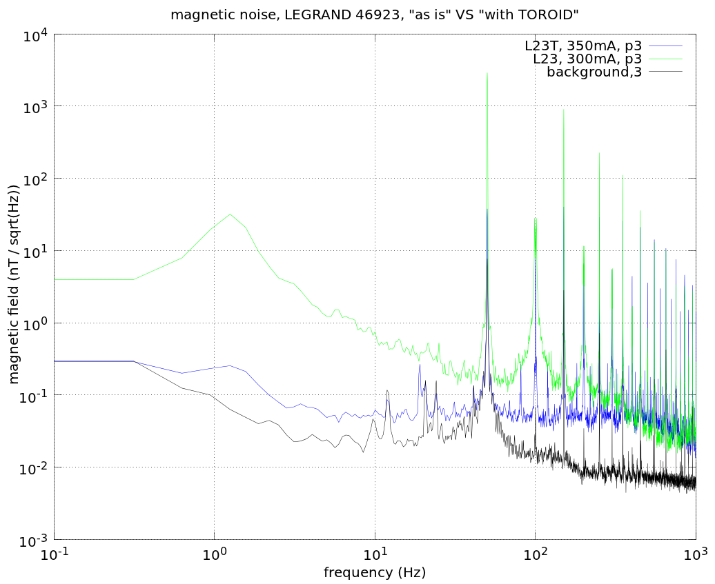
ACTUATORS: transformers
Reference document is VIR-0289B-12 (Measurement of magnetic stray fields of voltage converters of the Vacuum equipment)
Very simple rule:
use of toroidal transformers wherever possible (much smaller stray field)
Green: typical EI transformer
Blue: same power but toroidal
Black: power off (noise floor)

Slide 11
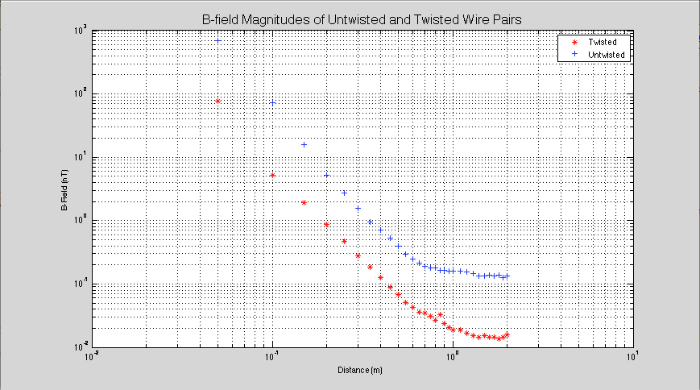
ACTUATORS: mains cabling (wires)
Reference document is VIR-0349A-13
(Testing the Magnetic Fields Produced From Twisted Wires)
Very simple rule:
use twisted mains wires wherever possible
(~10 times smaller stray field)
Blue: standard wire
Red: twisted wire

Slide 12
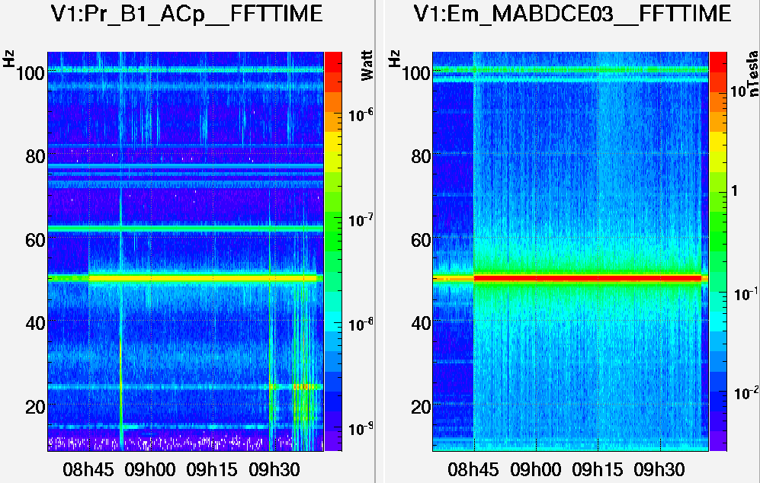
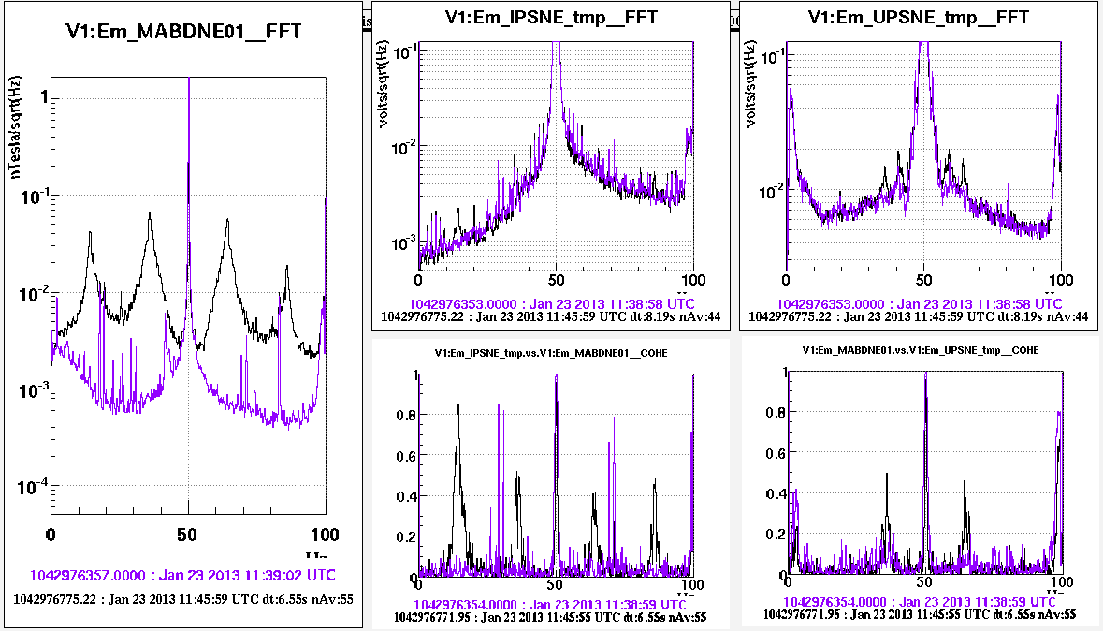
ACTUATORS: Some case studies
e-log 19751 “L-room lights”
When lights in the L-room were switched ON, the magnetic noise and the photodiode noise were increased
e-log 30963 “Magnetic noise from pumping stations along the tube”
Cables running along NE walls, powering pumping stations, were single wires creating loops with considerable section area

Slide 13
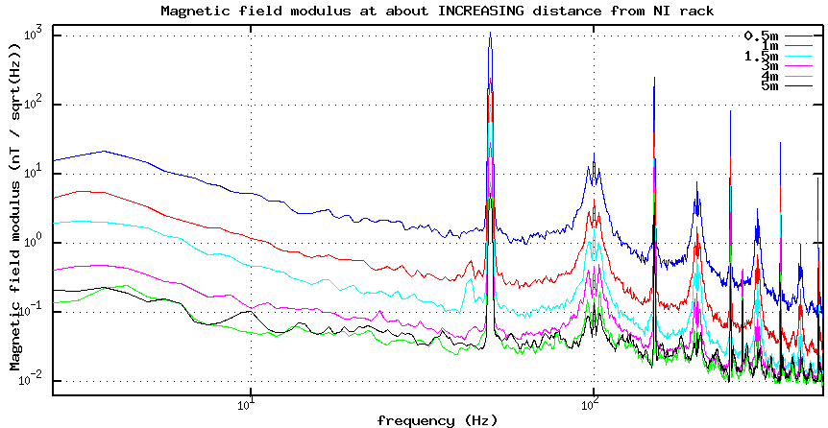
PATHS: distance culprit-victim
Reference document is (again) VIR-0289B-12
mag. field roughly decreases as the square of the distance from the source!
noise decrease is about a factor 100 as moving from 0.5m to 4m
(blue to green in Figure)

Slide 14
PATHS: distance culprit-victim
We must move away all possible noise “actuators” from mirror test masses nearby
some work has been done
(e.g. vacuum racks, see e-log 30903)
other has still to be decided/done
(e.g. mains cables in concrete cable trench under
mirrors, SAT mains cables, VAC mains cables, etc)
best approach solution: remote DC supply
(as in INJ)

Slide 15
----- aLigo ? -----
  No magnetic actuators at mirror test masses level
reduced risk of magnetic coupling with ext. sources
  No general UPS
UPS only for some critical systems (e.g. vacuum
safety controller, computer shutdown, etc.)
see LIGO-T1400508-v3

Slide 16
----- no UPS solution-----
Can we adopt the “no UPS” aLigo solution?
Select which system need to be protected by a little UPS system and which do not need to
pros:
even less “magnetic” noise
no extra cost
cons:
accept AdV out-of-service for (infrequent) power outage
example: aLigo last power outage was September, 17
https://alog.ligo-la.caltech.edu/aLOG/index.php?callRep=14651
Brief power outage
“The site suffered a brief power outage at 10:16am. It lasted for approximately 2-5 seconds. Recovery is underway.”

Slide 17
Conclusions
Three golden rules:
Increase distance (B~1/d^2)
Reduce sources
(B~1/10)
Reduce coupling
(B~1/10)

Slide 18
Conclusions
We still have to evaluate the “move cable far from mirrors” solution
(costs, time, feasibility)
We still have to check for twisted cables from standard suppliers (backup solution: ask for “ad-hoc” manufacturing), and plan to use them where forced to be close to sensitive points (mirrors)
We still have to evaluate the UPS (or no UPS at all!) alternative solutions (costs, time, feasibility, risks…)

Slide 19
Summary of useful references
Magnetic coupling has been studied in the past with many references:
VIR-0737B-09 (02/02/2011): Electronics for Advanced Virgo
VIR-0289B-12 (04/09/2012): Measurement of magnetic stray fields
VIR-0349A-13 (30/07/2013): Magnetic Fields From Twisted Wires
plus logbook entry 15367, 15506, 18384, 18484, 19751, 25247, 25297, 25397, 30247, 30963 and many others

