Slide 1
Advanced Virgo:
Status and Perspectives
A.Chiummo
on behalf of the VIRGO collaboration

Slide 2
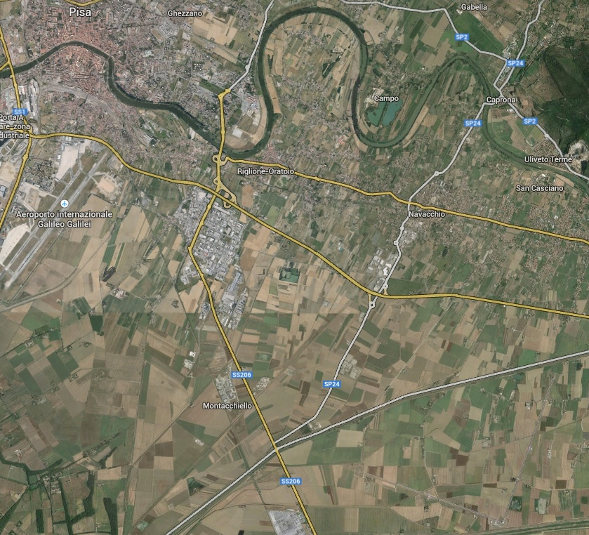
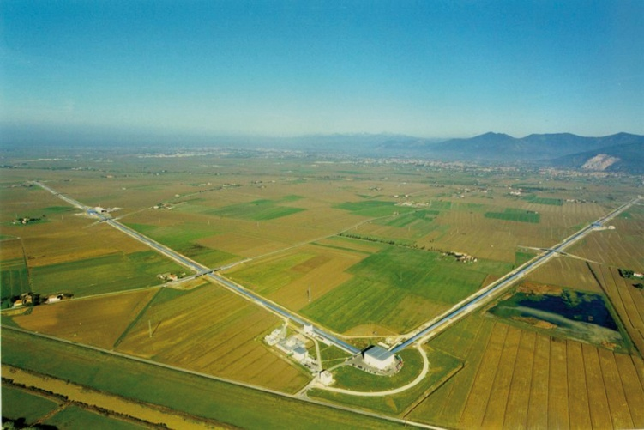


Advanced Virgo

Slide 3

Advanced Virgo
What’s that?

Slide 4





Advanced Virgo
In a nutshell:
5 European countries
19 labs, ~200 authors
Advanced Virgo (AdV): upgrade of the Virgo interferometric detector of gravitational waves
Participated by scientists from Italy and France (former founders of Virgo), The Netherlands, Poland and Hungary
Funding approved in Dec 2009
Construction in progress. End of installation: fall 2015
First science data in 2016
APC Paris
ARTEMIS Nice
EGO Cascina
INFN Firenze-Urbino
INFN Genova
INFN Napoli
INFN Perugia
INFN Pisa
INFN Roma La Sapienza
INFN Roma Tor Vergata
INFN Trento-Padova
LAL Orsay – ESPCI Paris
LAPP Annecy
LKB Paris
LMA Lyon
NIKHEF Amsterdam
POLGRAW(Poland)
RADBOUD Uni. Nijmegen
RMKI Budapest

Slide 5
What’s going on (and why)?
A quiet place?

Slide 6
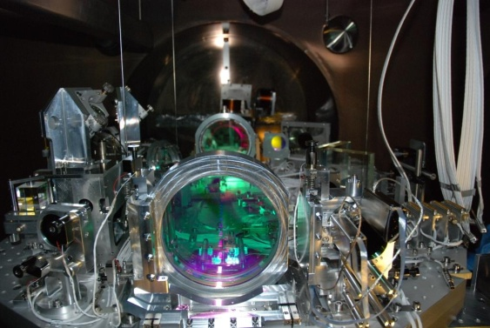
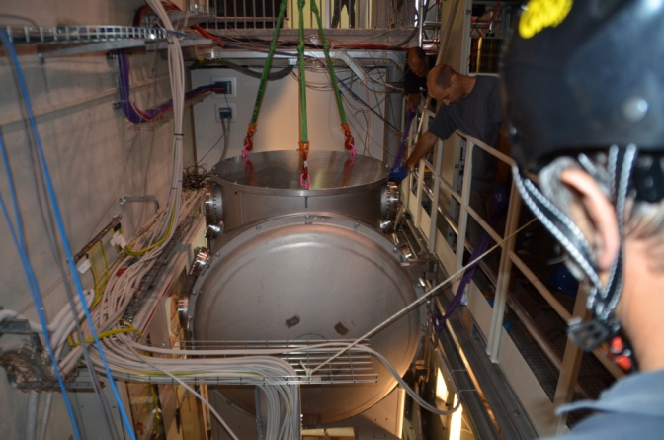
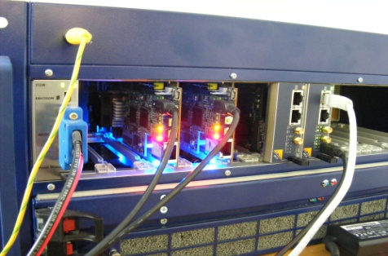
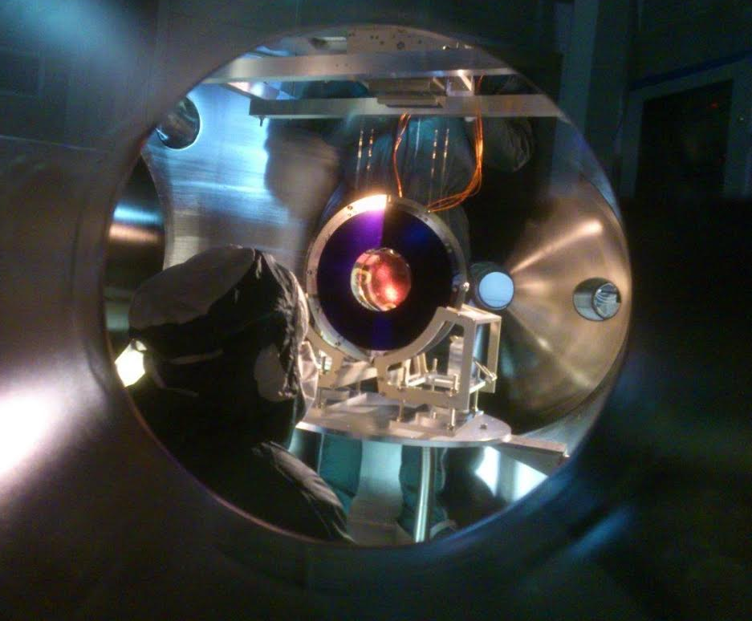
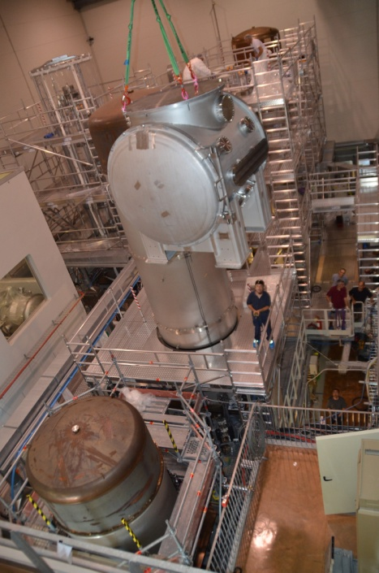
What’s going on (and why)?
Not really!

Slide 7
What’s going on (and why)?
What’s going on (and why)?
To answer the question, let’s come back to some one hundred years ago...

Slide 8
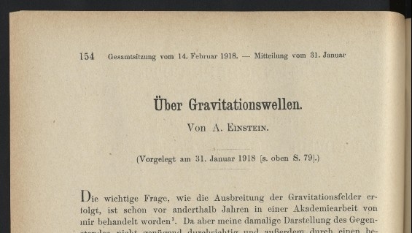
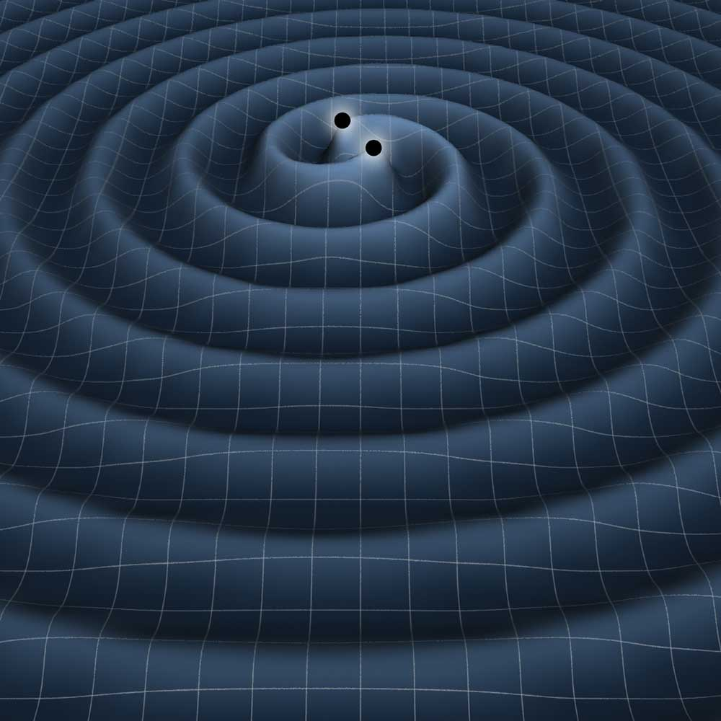
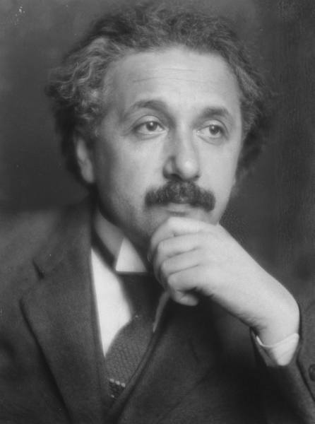
Gravitational Waves
... when Einstein firstly predicted the gravitational waves
Tiny interaction with matter:
Extremely difficult to detect
Ideal messengers from remote space-time regions
What are GWs?
a consequence of General Relativity
ripples in space-time due to cosmic cataclisms
quadrupolar distortions of distances between freely falling masses

Slide 9
Gravitational Waves
... when Einstein firstly predicted the gravitational waves
Tiny interaction with matter:
Extremely difficult to detect
Ideal messengers from remote space-time regions
What are GWs?
a consequence of General Relativity
ripples in space-time due to cosmic cataclisms
quadrupolar distortions of distances between freely falling masses
Does this radiation exist?

Slide 10
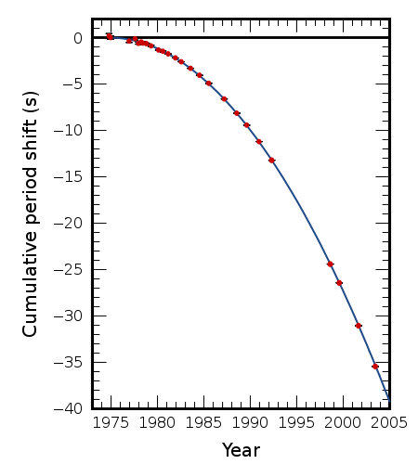
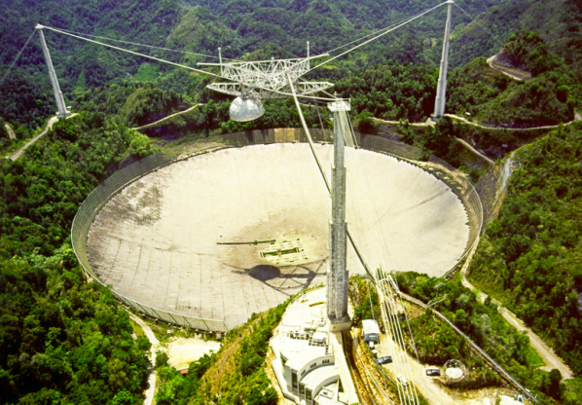
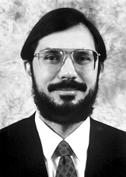
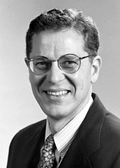
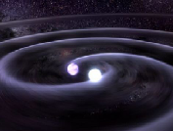
Gravitational Waves
Indeed...
Binary Pulsar 1913+16
GR prediction
The Nobel Prize in Physics 1993
Russell A. Hulse, Joseph H. Taylor Jr.
Ok, but how to directly detect it?
J. M. Weisberg, J. H. Taylor,
http://arxiv.org/abs/astro-ph/0407149

Slide 11
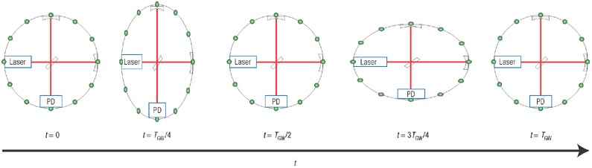
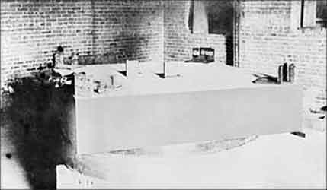
GW Detectors
Ok, but how to directly detect it?
David Reitze Nature Photonics 2, 582 - 585 (2008)
Michelson interferometer is a natural candidate
GW amplitude given by dimensionless strain h:
Long arms
Low noise

Slide 12
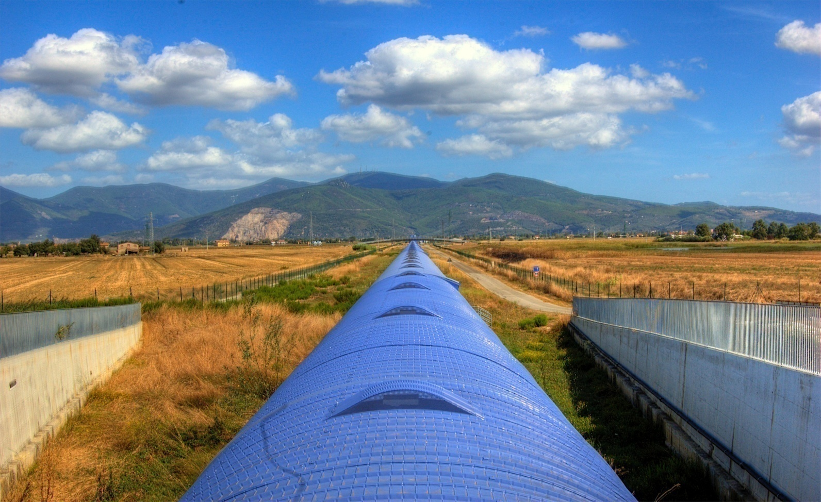
GW Detectors
Long arms
Low noise
Long arms: 3km (“easy”)
“only” the largest vacuum environment in Europe

Slide 13
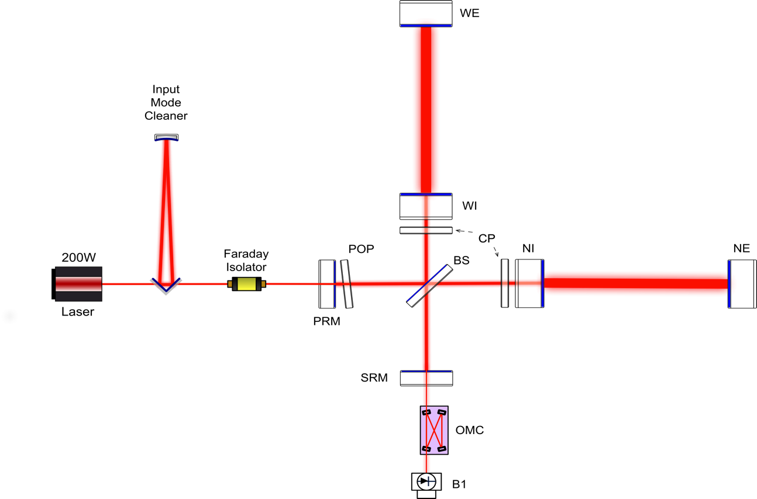
GW Detectors - Noise
Thermal noise
(coating + suspension)
Long arms
Low noise
Radiation pressure fluctuation
Residual gas (phase noise)
Stray-light
Residual laser noise
Seismic vibration
Newtonian noise
EM field quantum noise

Slide 14
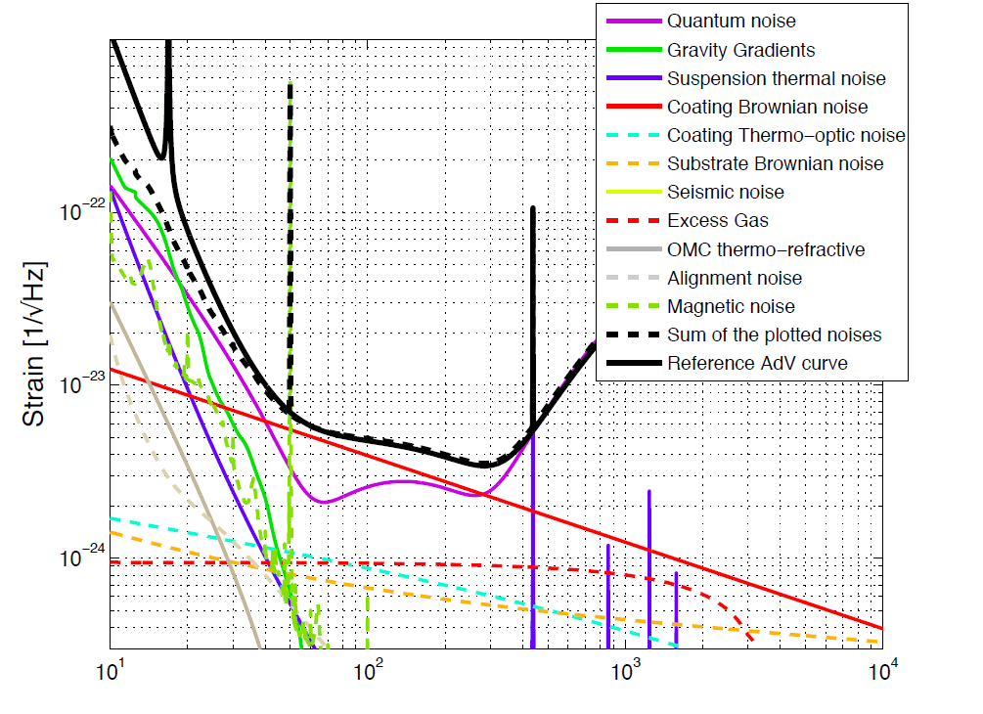
GW Detectors - Noise
Long arms
Low noise
Limiting noises:
Low-freq:
newtonian noise, seismic noise, residual technical noises
High-freq:
quantum shot-noise
Mid-freq:
thermal noise

Slide 15
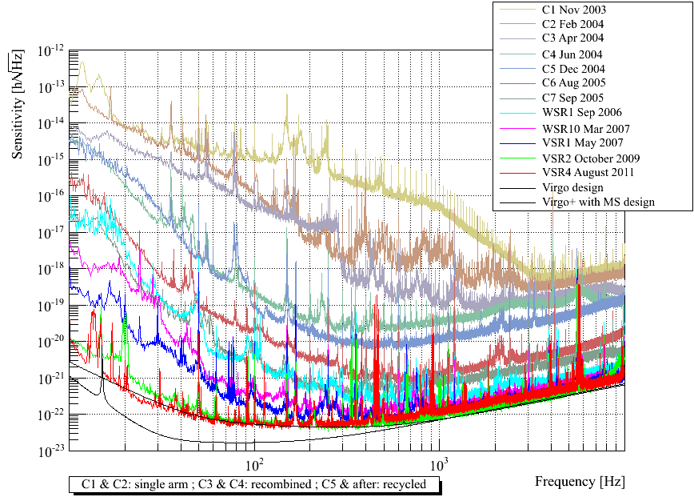
GW Detectors - Noise
Limiting noises:
Low-freq: seismic noise
Mid-freq: thermal noise
High-freq: laser shot-noise
It took 10 years of commissioning to get rid of excess “technical noises” with Virgo:
We learned a lot
But no detection yet!

Slide 16
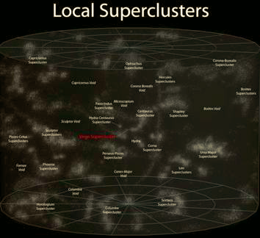
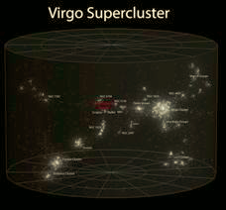
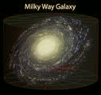
GW Detectors -Horizons
But no detection yet...
Design sensitivity for first generation implied a detection rate ~0.01 ev/yrs
1st gen GW detectors
Advanced GW detectors
Improved sensitivity is needed for GW astronomy
Explore a volume 1000x bigger → strain noise (h) 10x lower
We need to modify the hardware...

Slide 17
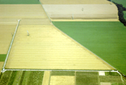
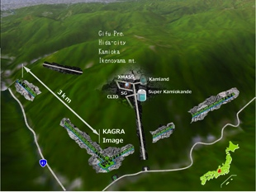
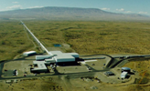
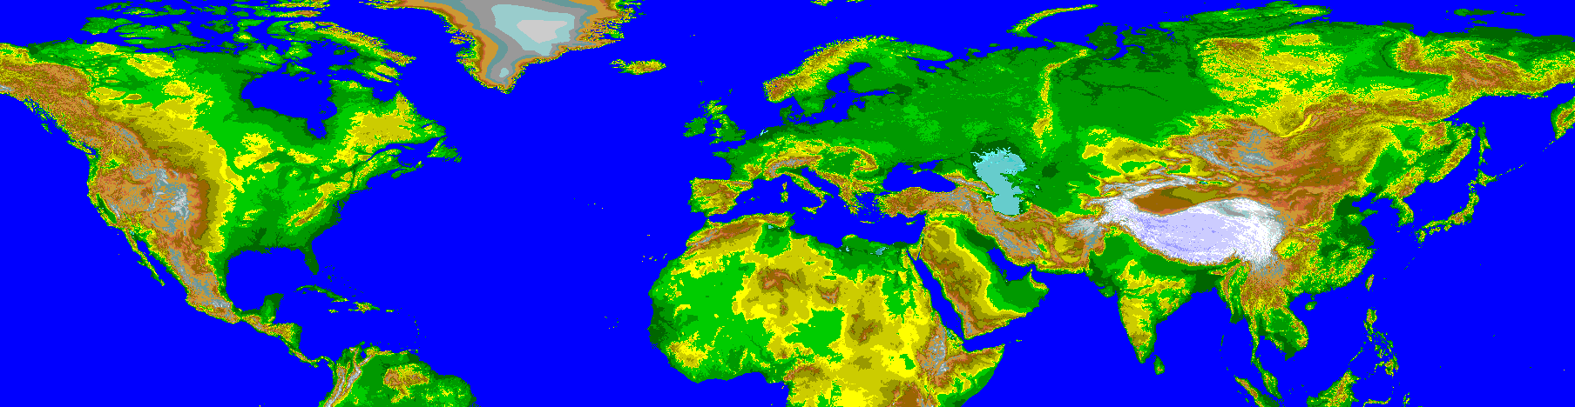
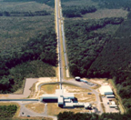
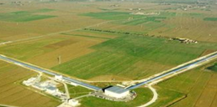

GW Detectors – The network
A world-wide effort...
aLIGO-WA
GEO-HF
KAGRA
aLIGO-LA
Advanced
VIRGO
aLIGO-India

Slide 18
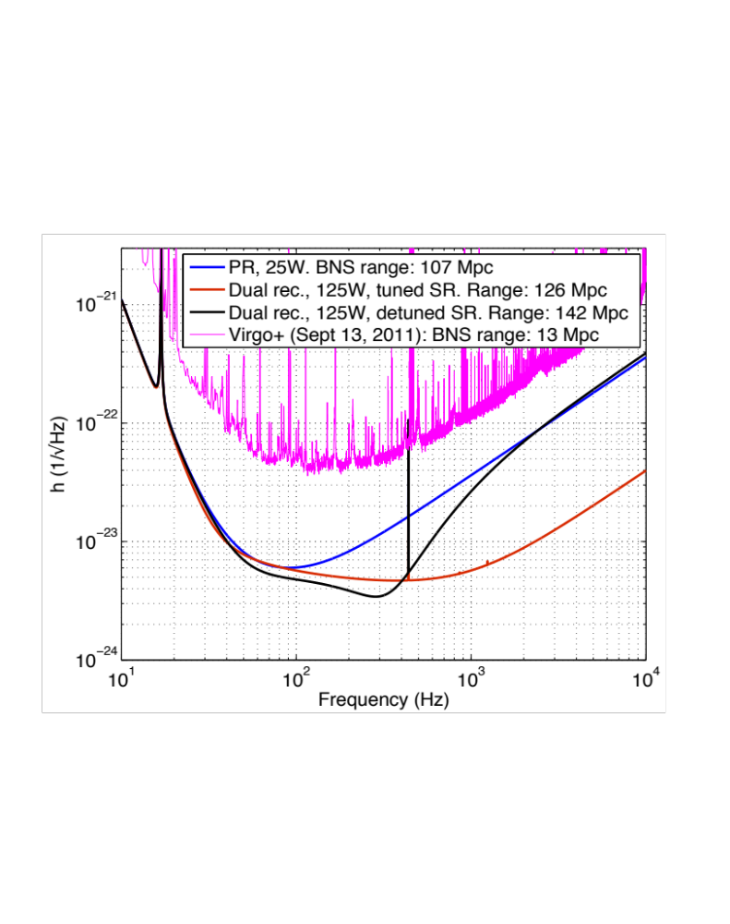
GW Detectors – Advanced Virgo
How do we fill the gap between Virgo and Advanced Virgo?
Virgo+
Early configuration
Late configurations
We need to modify the hardware...

Slide 19
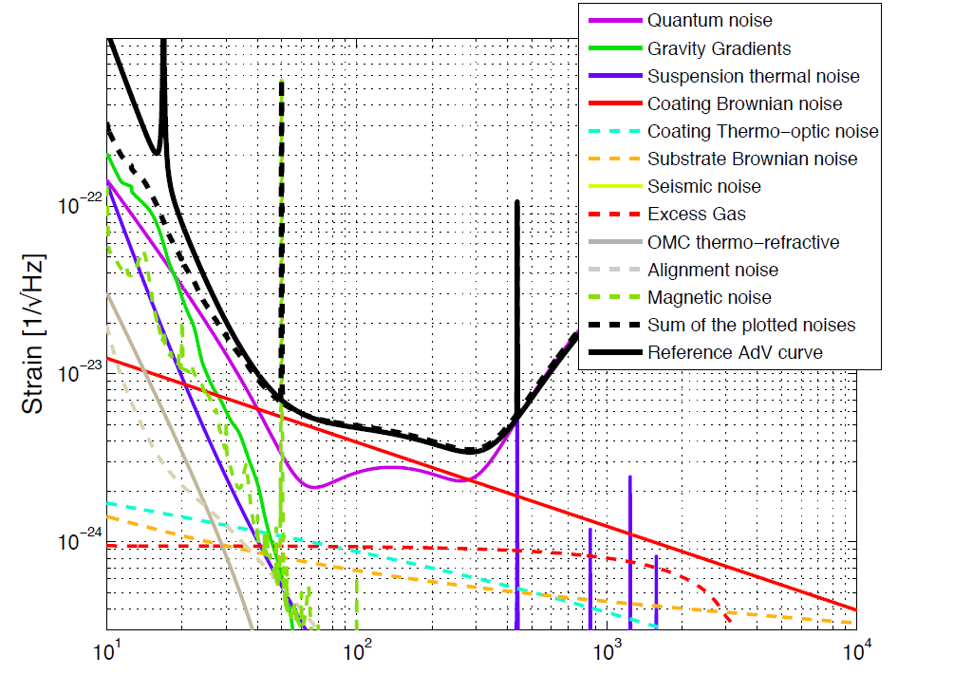
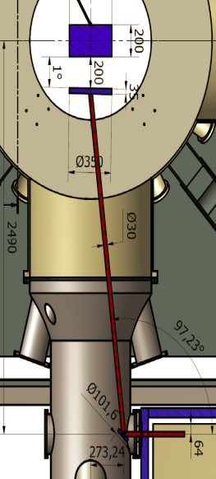
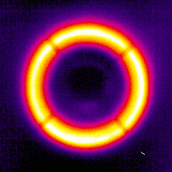
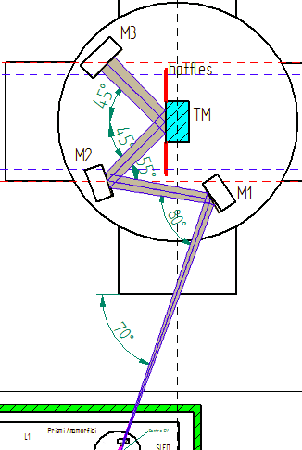
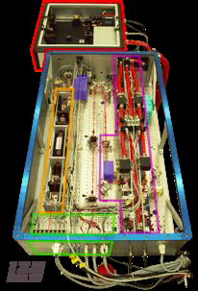
GW Detectors – Advanced Virgo
High frequency range:
  Dominated by laser shot noise.
  Improved by increasing the power:
  >100W input, ~1 MW in the cavities
Requires:
  New laser amplifiers (solid state, fiber)
  Heavy, low absorption optics (substrates, coatings)
  Sophisticated systems to correct for thermal aberrations

Slide 20
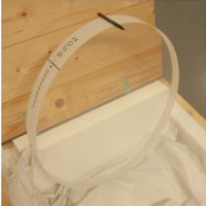
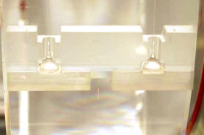
GW Detectors – Advanced Virgo
Mid frequency range:
  Dominated by thermal noise of mirror coatings and suspensions
Reduced by:
  Larger beam spot (sample larger mirror surface)
  Test masses suspended by fused silica fibers (low mechanical losses)
  Mirror coatings engineered for low losses

Slide 21
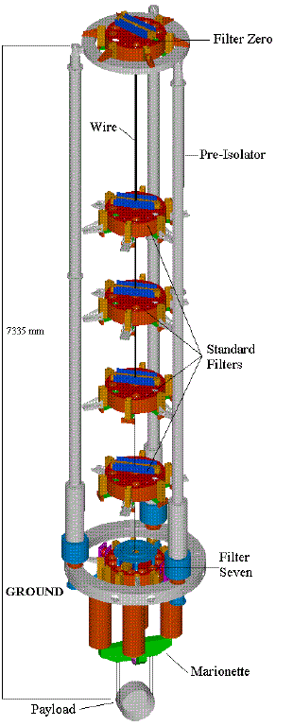
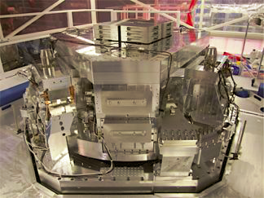
GW Detectors – Advanced Virgo
Low frequency range:
  Dominated by seismic noise
  Managed by suspending the mirrors from extreme vibration isolators
  Technical noises of different nature are the real challenge in this range
  Ultimate limit for ground-based detectors:
  gravity gradient noise
Virgo suspensions already compliant with AdV sensitivity (upgrade needed for new payloads)

Slide 22
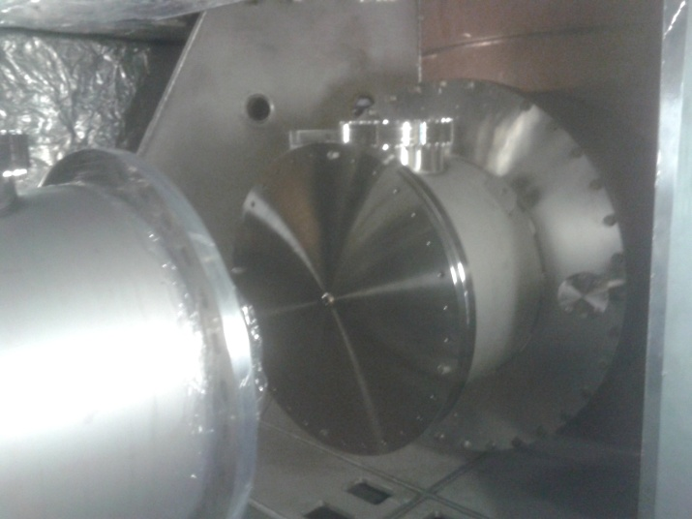
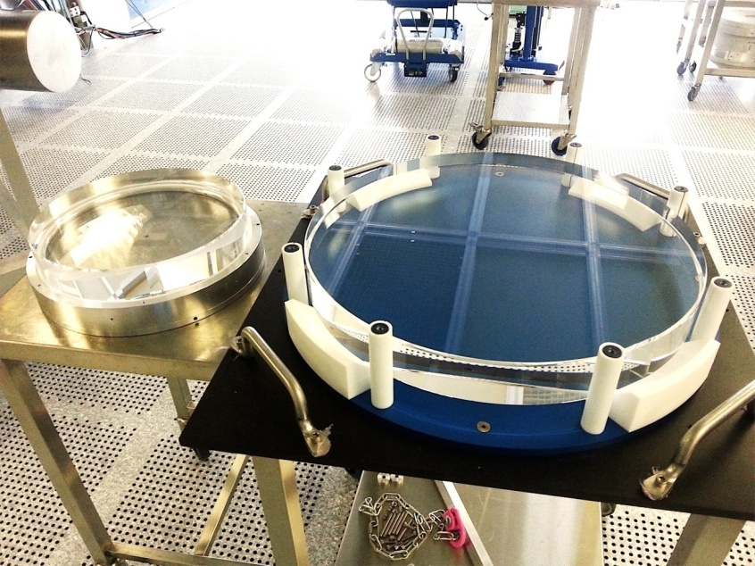
GW Detectors – Advanced Virgo
Impact of larger beam:
  required new vacuum links
  re-design of input benches, telescopes
  large BS (55cm)

Slide 23
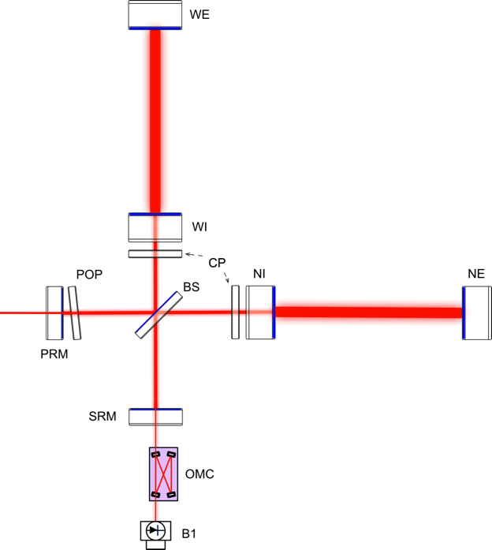
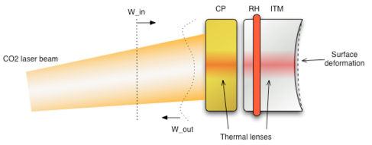
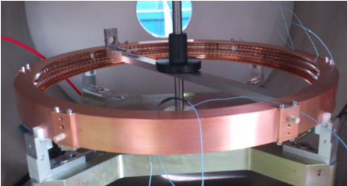
GW Detectors – Advanced Virgo
Impact of larger beam:
  Fit larger beam in the same topology as for Virgo → higher degeneracy in recycling cavities!
  Control sidebands high order modes are nearly resonant and very sensitive to thermal effects, substrate defects
Requires proper management of aberrations
  Optics quality
  Active aberrations control

Slide 24
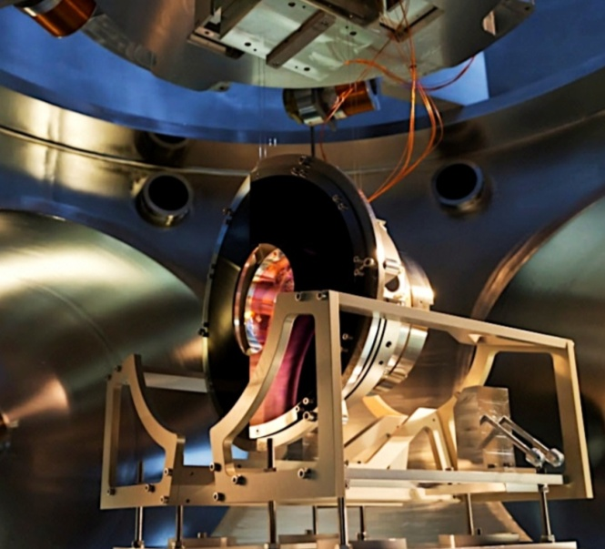
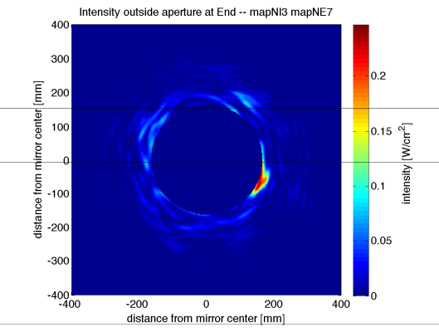
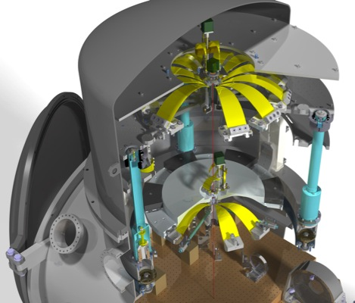
GW Detectors – Advanced Virgo
Stray-light mitigation:
  Learned form 1st generation: scattered light is one of the major risks towards the final sensitivity goal
  Large investment to mitigate it:
    Better optics quality
    Baffles to shield mirrors, pipes, vacuum chambers exposed to scattered light
    Photodiodes suspended in vacuum to isolate them from acoustic/seismic noise
    If required, control the position of the benches wrt the interferometer
    Significant simulation effort

Slide 25

From Virgo to Advanced Virgo
Where are we now?

Slide 26
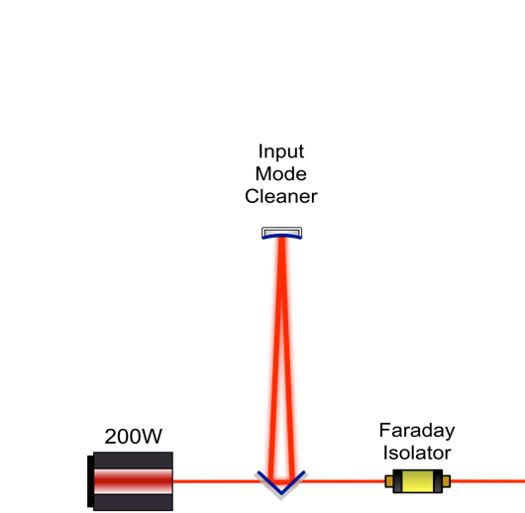
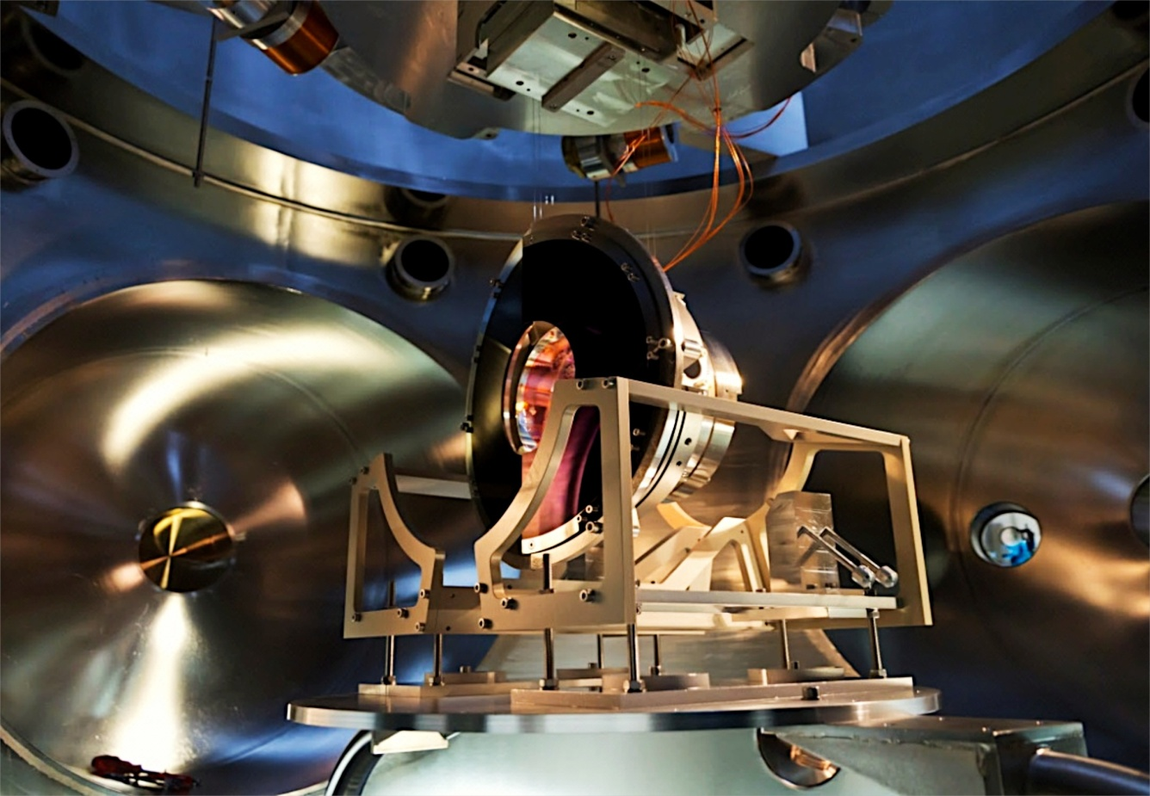

AdV - Current Status
Input mode cleaner locked on June 19, 2014
First top level milestone achieved on schedule.

Slide 27


AdV - Current Status
Most of the large optics polished
The surface figure of the polished test masses is better than specifications

Slide 28

AdV - Current Status
Most of the large optics polished
The surface figure of the polished test masses is better than specifications
IM02: Flatness: 0.17 nm rms on 150mm Ø
(spec.: 0.5 nm rms)
RoC: 1425 m (spec.: 1420 [-5,+15] m)

Slide 29


AdV - Current Status
Ongoing:
Superattenuators being upgraded to hold the new payloads
BS payload ready to be installed

Slide 30



AdV - Current Status
Ongoing:
Vacuum links upgrade
Installation of baffles for stray-light control
Installation of new, larger cryogenic traps
Installation of vacuum towers for suspended benches

Slide 31

AdV - Current Status
The integration of the sub-systems has been complex, but it is now well advanced

Slide 32



AdV – Project Current Status
First top-level milestone achieved on time, high commitment to meet the final goal on schedule
Work done and funds committed follow roughly the expected curve
Top level milestones
Work done
Money spent
End of installation by fall 2015
First observation run in 2016

Slide 33



AdV - 2016 challenge
The appointment we cannot miss

Slide 34

AdV – Sensitivity evolution
At the dawn of GW astronomy age...

Slide 35


~20km and 400yrs far...

Slide 36


Thank you
The European Gravitational Observatory is a consortium of:

