Slide 1
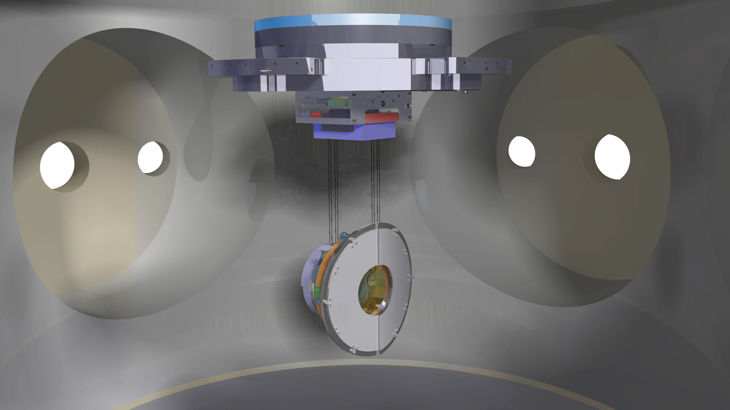
IMC Installation steps
Marco & Thomas
9 oktober 2013

Slide 2
Contents:
Pre-installation step 1 Positioning Gear Box
Pre-installation step 2 Positioning Mirror Vacuum clamp
Installation step 1 Positioning Mirror
Installation step 2 Wiring Mirror
Installation step 3 Positioning Reaction Mass
Installation step 4 Wiring Reaction Mass (RM)
Installation step 5 Transport to Tower
Installation step 6 Connection to Marionetta in Tower
Installation step 7 Mount Safety Stops and Baffles
Installation step 8 Remove Installation Frame from IMC
Installation complete

Slide 3
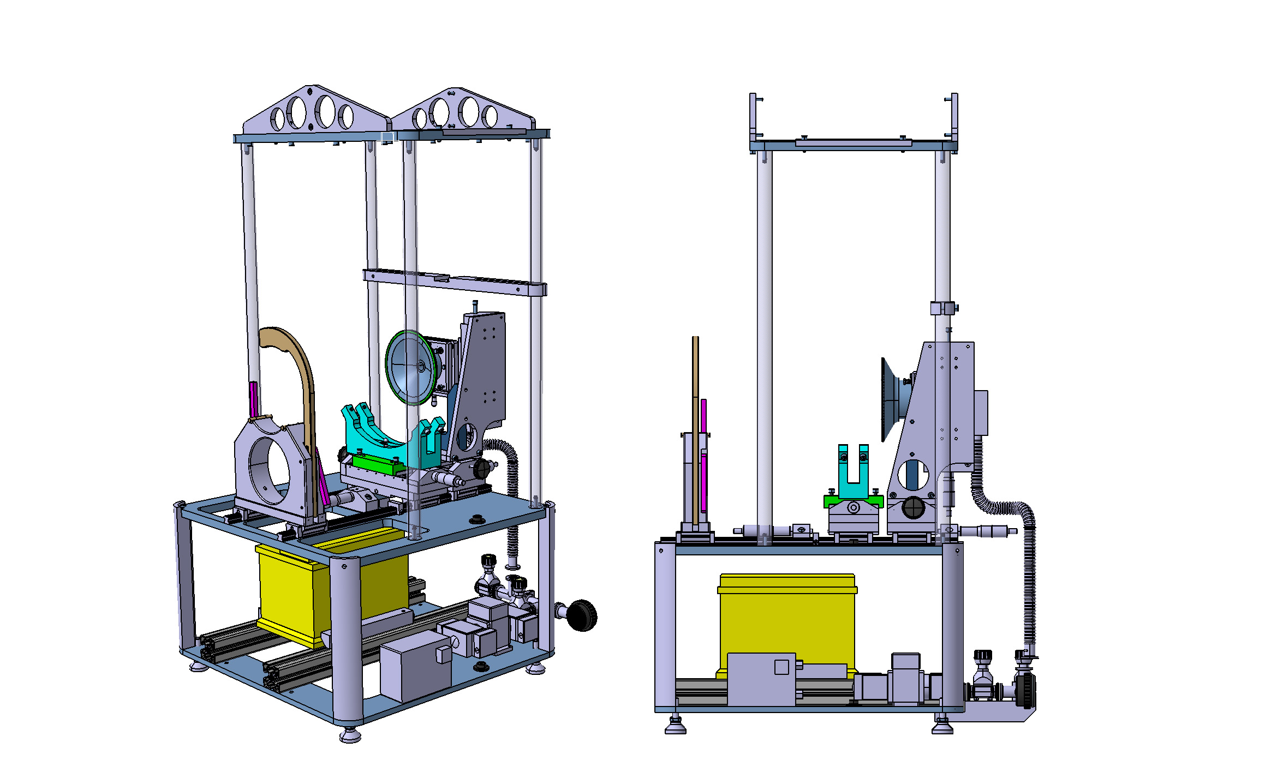
Nomenclatures
Mounting plate
Gear box
RM Support
Mirror
Vacuum Clamp
Mirror Support
Vacuum System
Translation rail
Battery for
Vacuum pump
Vacuum Pump
Switch Vacuum pump

Slide 4
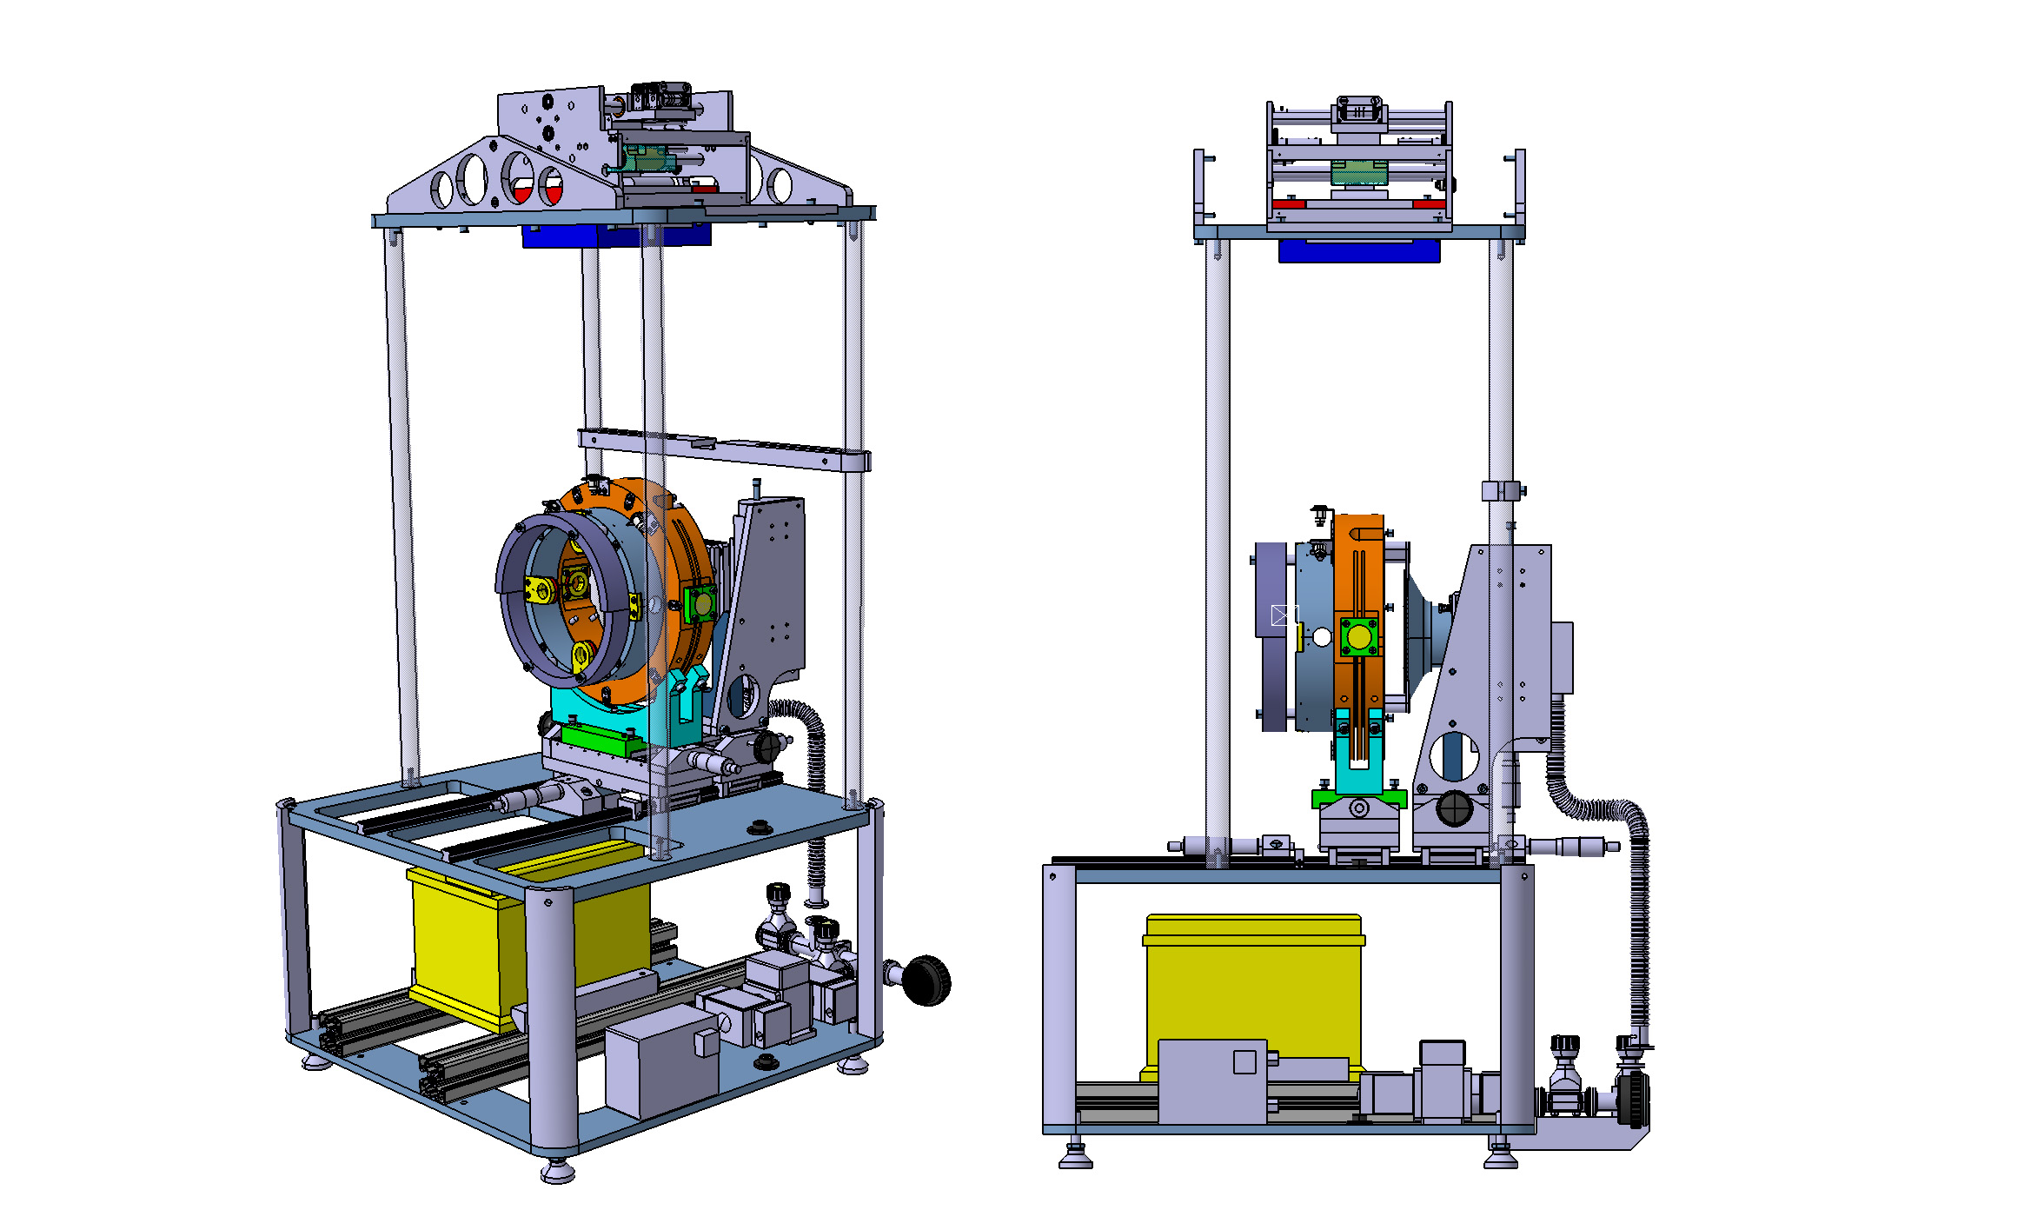
Pre-installation step 1
Positioning Gear Box
Actions:
Mount Gear box on top
Place RM support on rail
Mount RM on RM support
Check with 2 Plumb Lines paralism Gear Box with RM
Fix Gear Box with 4 bolts
Gear box
Plump Line

Slide 5
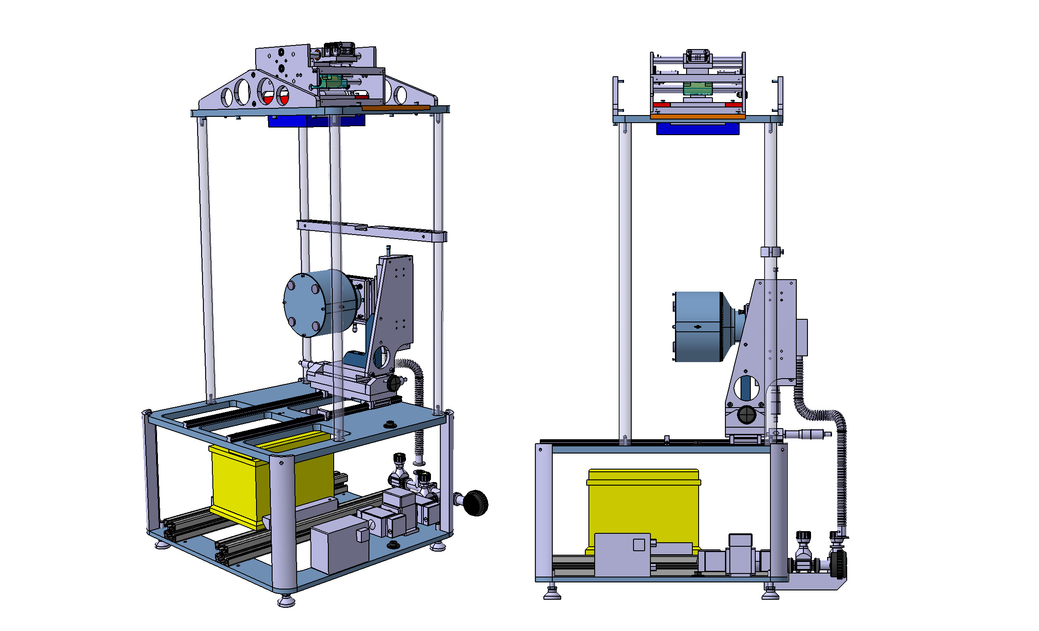
Pre-installation step 2
Positioning Mirror Vacuum clamp
Actions:
Check position Mirror Vacuum Clamp with the Dummy Mirror
Fix position Mirror Vacuum Clamp
Plump Line
Mirror
Vacuum clamp
Dummy Mirror

Slide 6
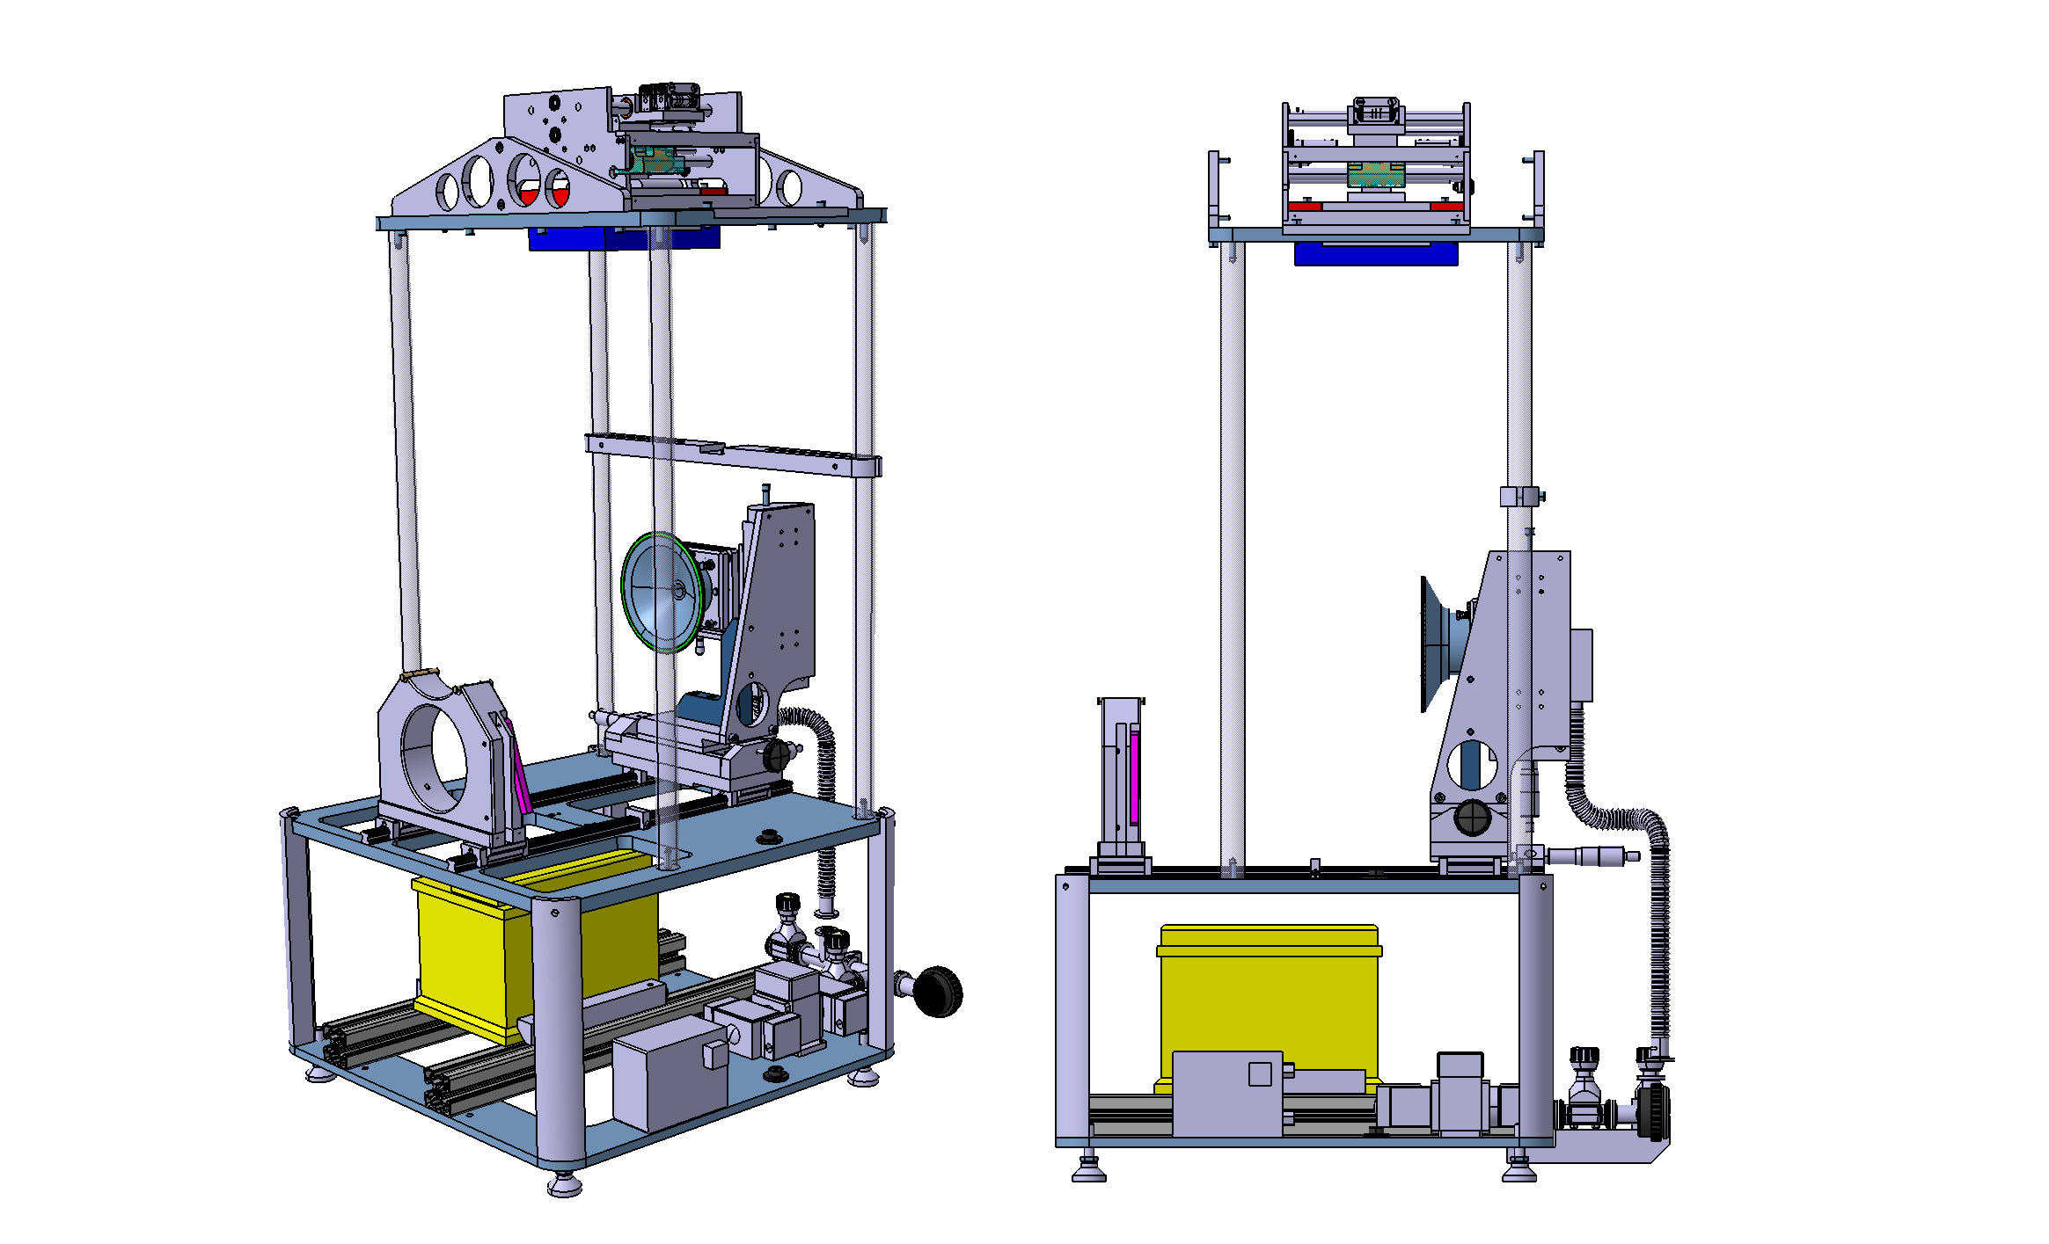
Installation step 1
Positioning Mirror
Actions:
a) Place Mirror Support on rail

Slide 7
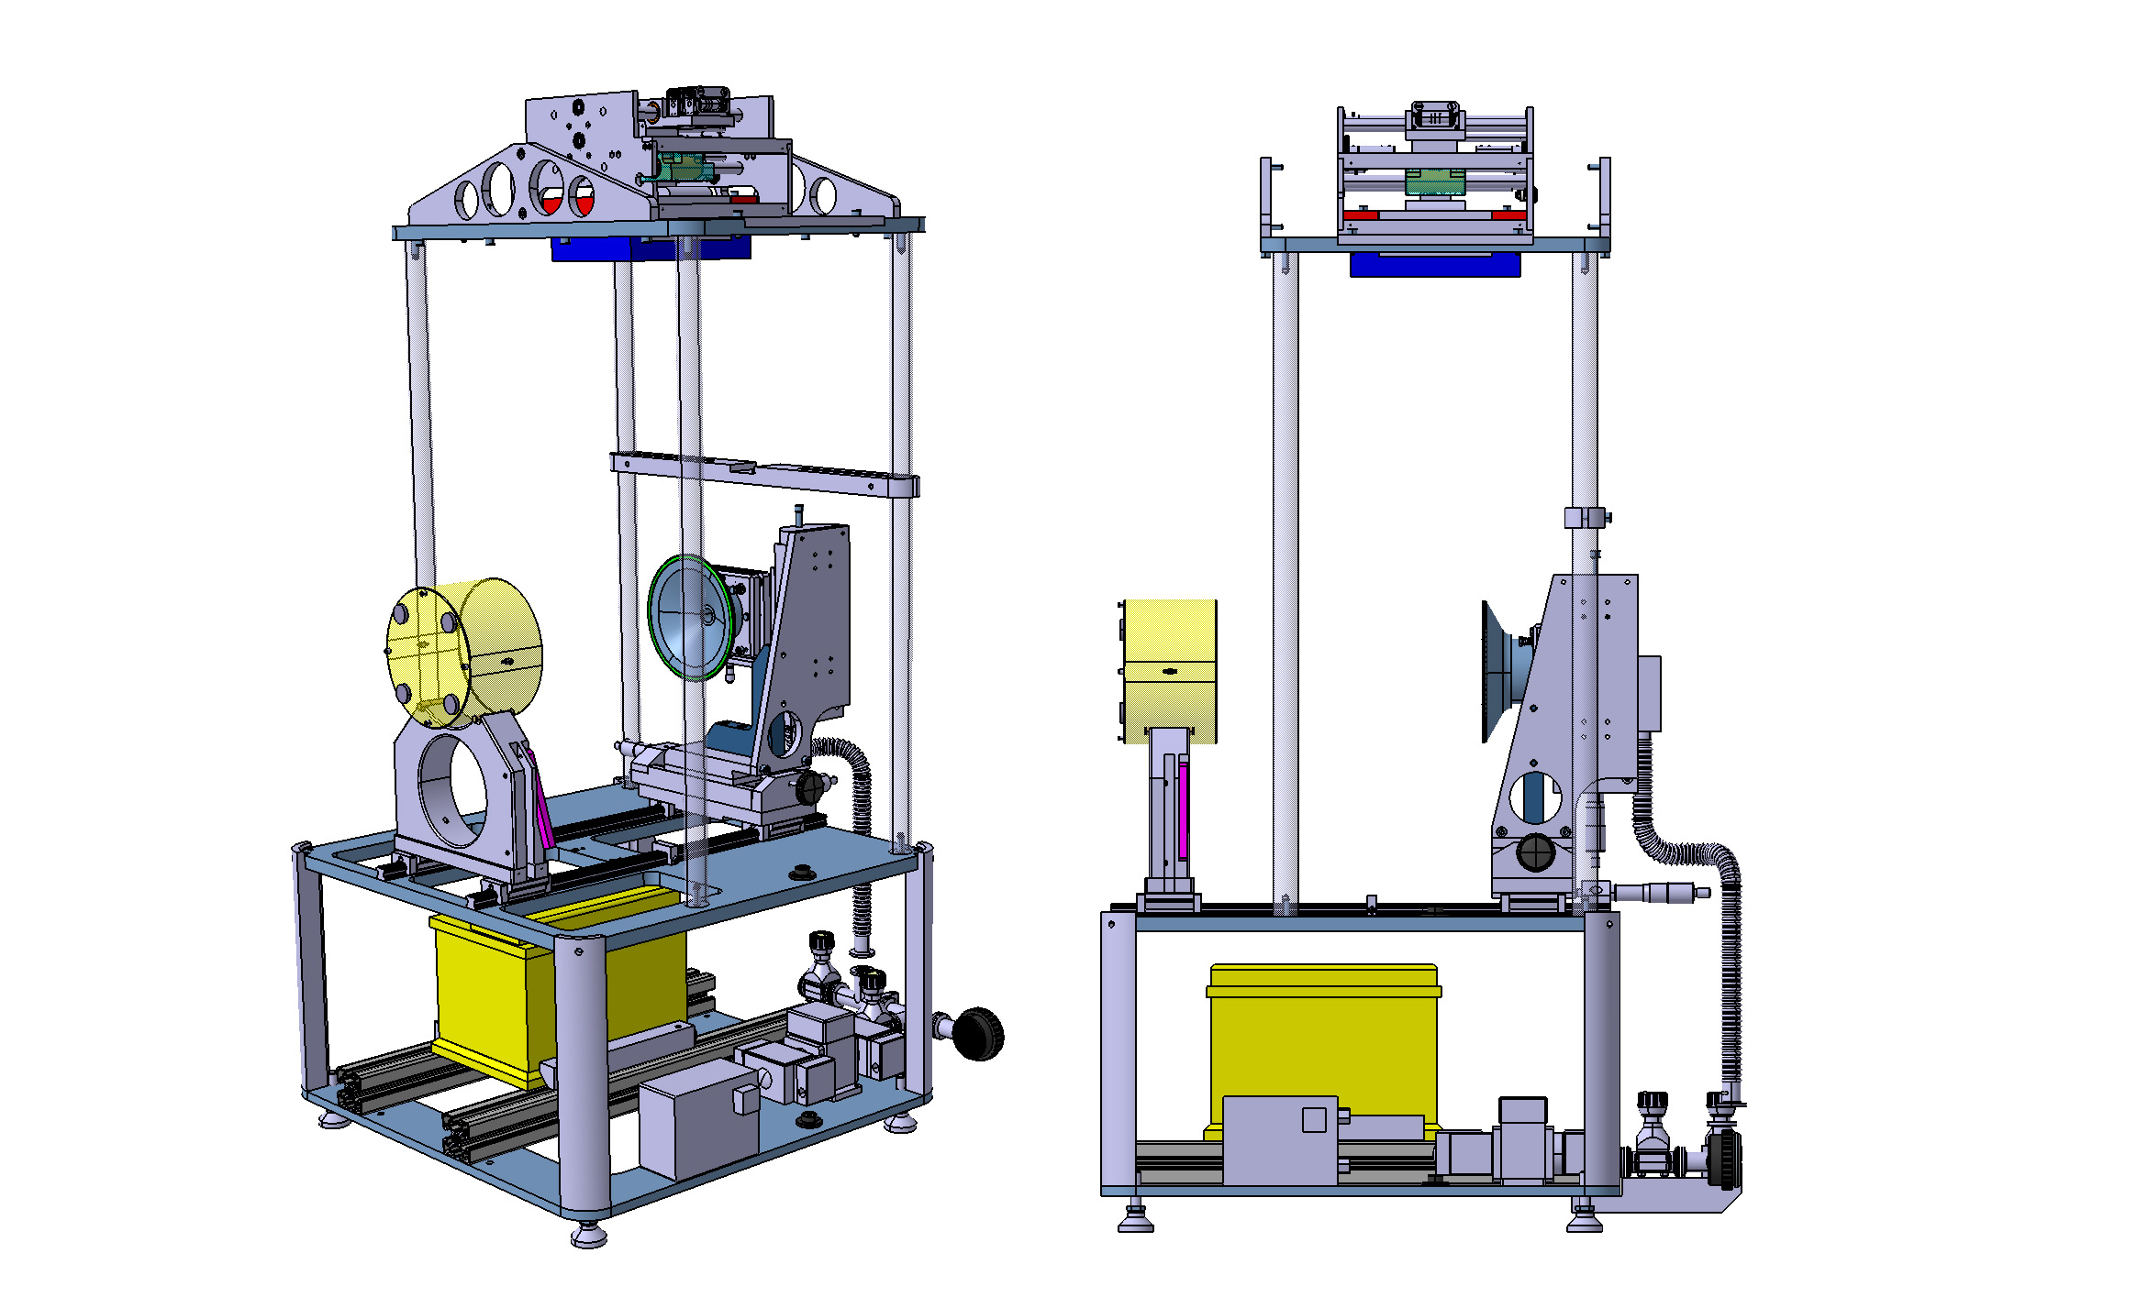
Installation step 1b
Positioning Mirror
Actions:
Place Mirror on Mirror Support

Slide 8
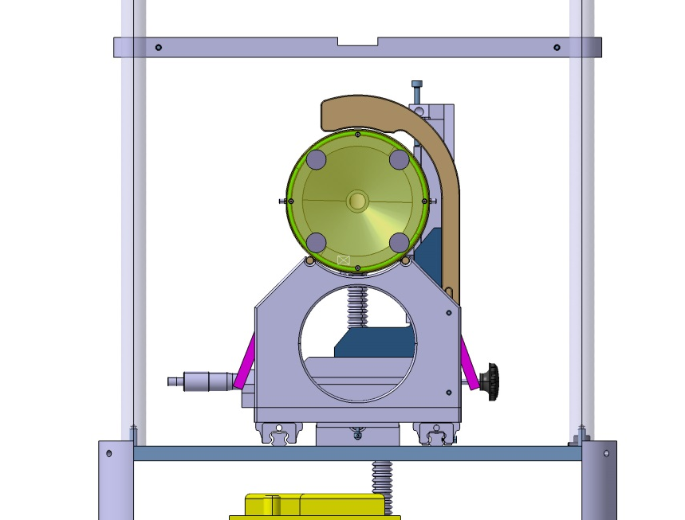
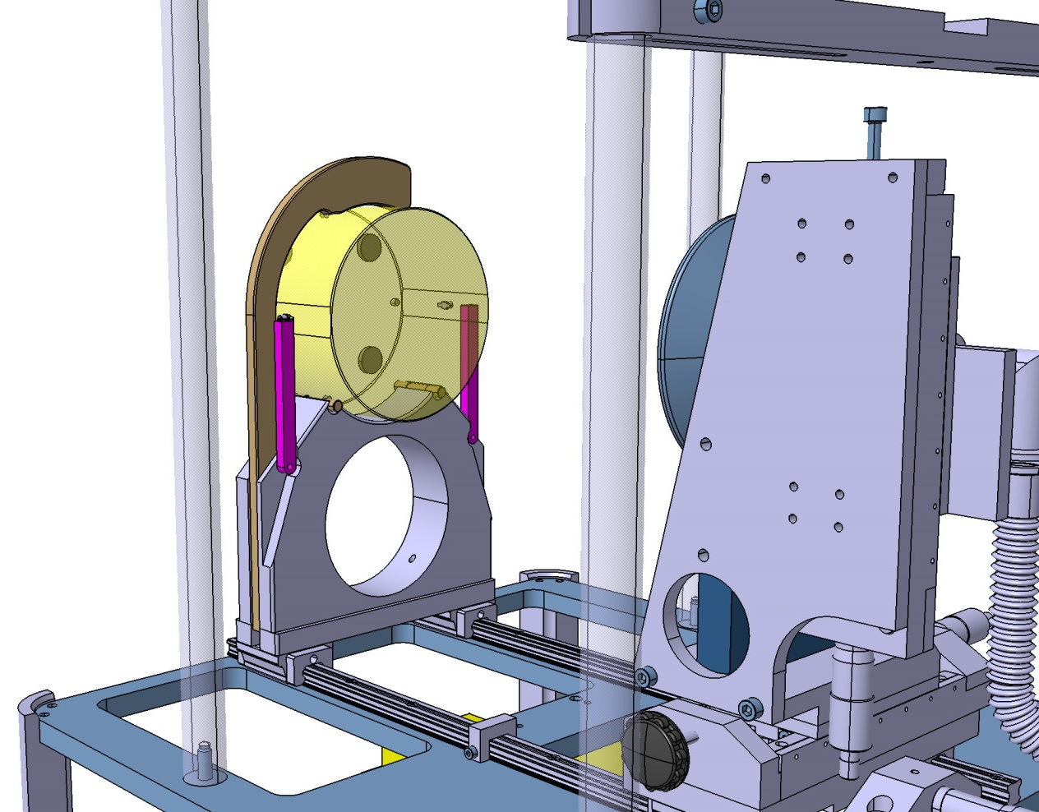
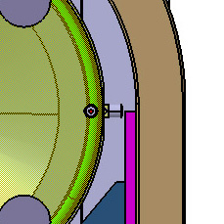
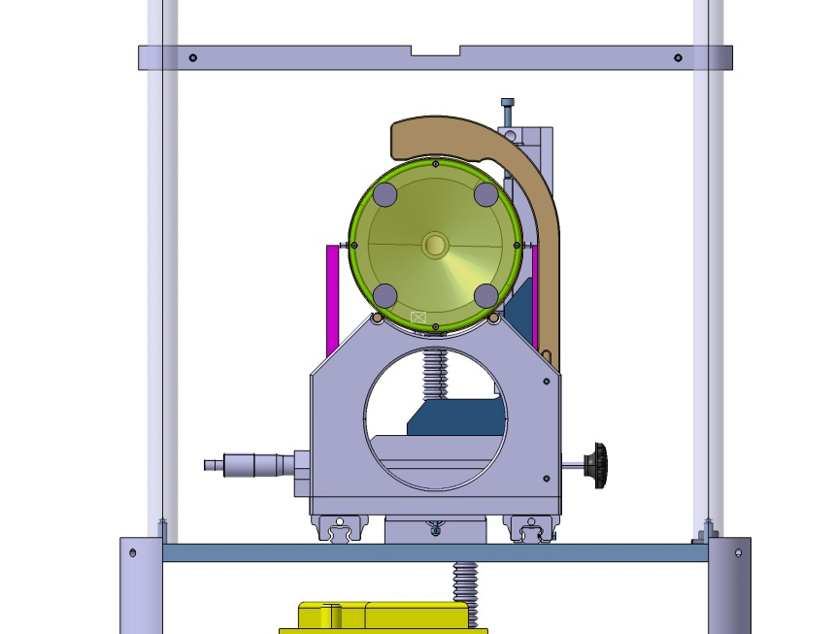
Installation step 1c
Top clamp
Positioning Mirror
Actions:
Place the Top clamp just above the Mirror
Check horizontal position Mirror with wire spaces/magnets and the two Horizontal strips (pink)
Horizontal strip

Slide 9
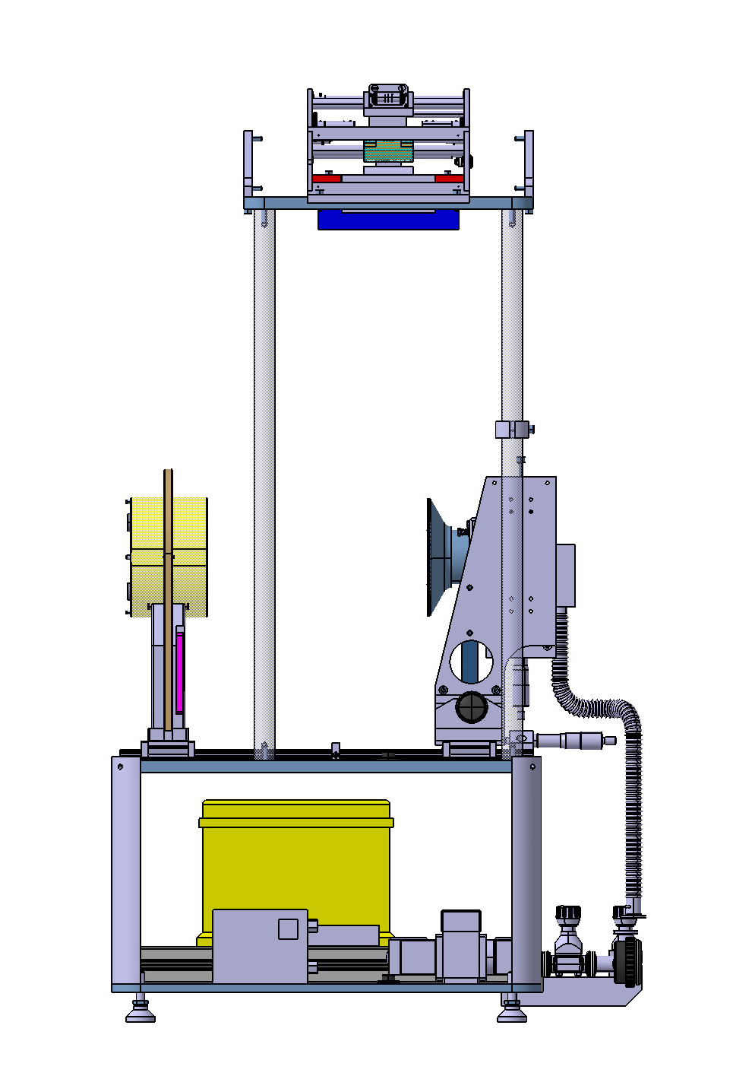
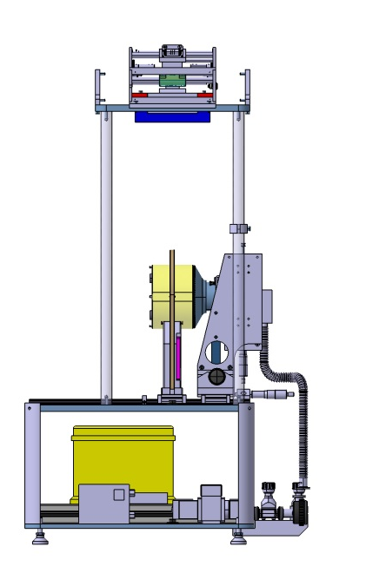
Installation step 1d
Positioning Mirror
Actions:
Place Klarez O-ring in Vacuum Clamp
Slide gently the Mirror with support close to the Vacuum clamp
Adjust the Vacuum clamp in the center and parallel to the surface of the Mirror
Start Vacuum pump
Slide gently the Mirror to the Vacuum clamp until the vacuum is closed (mirror touch the Kalrez O-ring)
Klarez O-ring
Vacuum clamp
Switch Vacuum Pump
Vacuum Pump

Slide 10
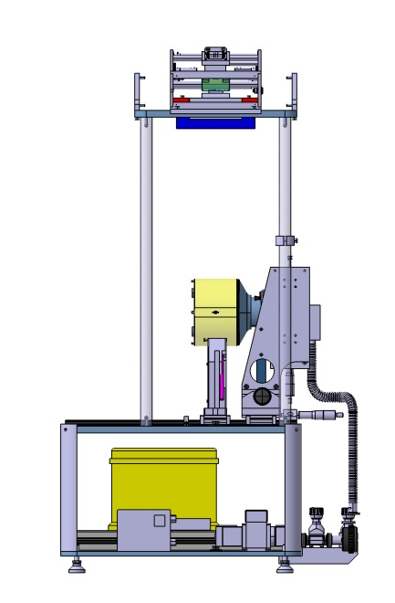
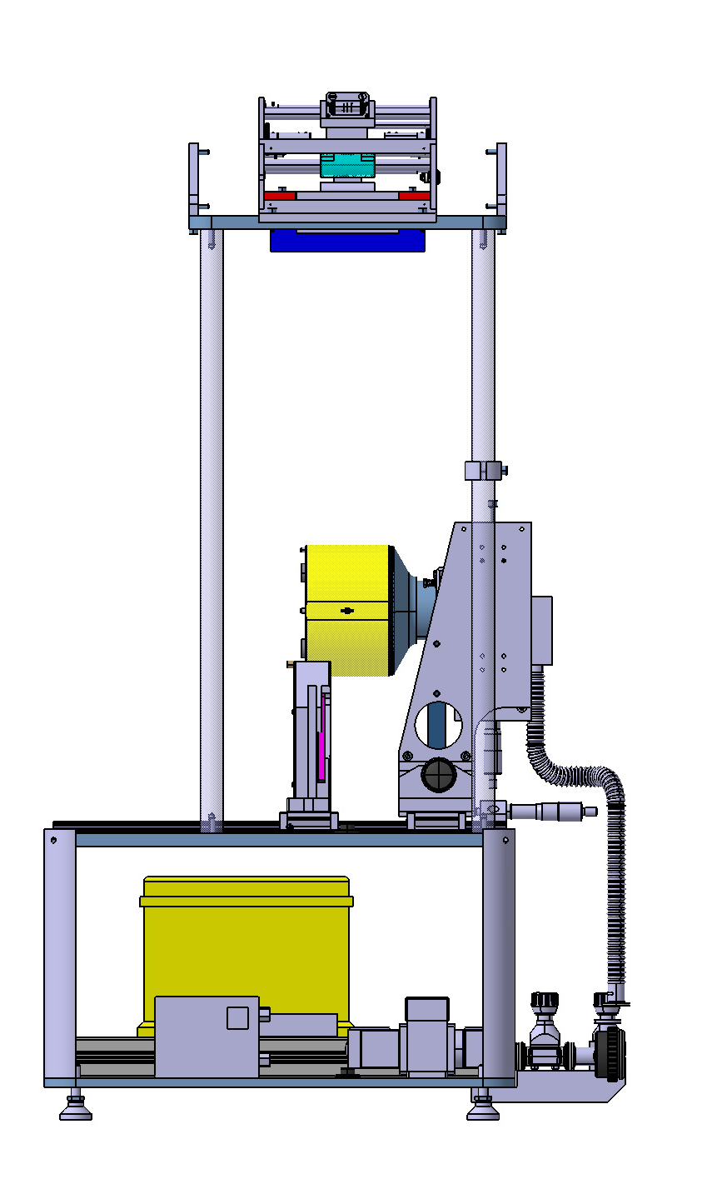
Installation step 1e
Positioning Mirror
Actions:
Move up the Vacuum clamp (with Mirror) by a known distance to get the Mirror Support free from the Mirror
Slide gently the Mirror clamp to the end of the Mirror.
Move down the Vacuum clamp.
Fix the Mirror Clamp on the rail
Now there is access for wiring and the Mirror is safe when the vacuum lost.

Slide 11
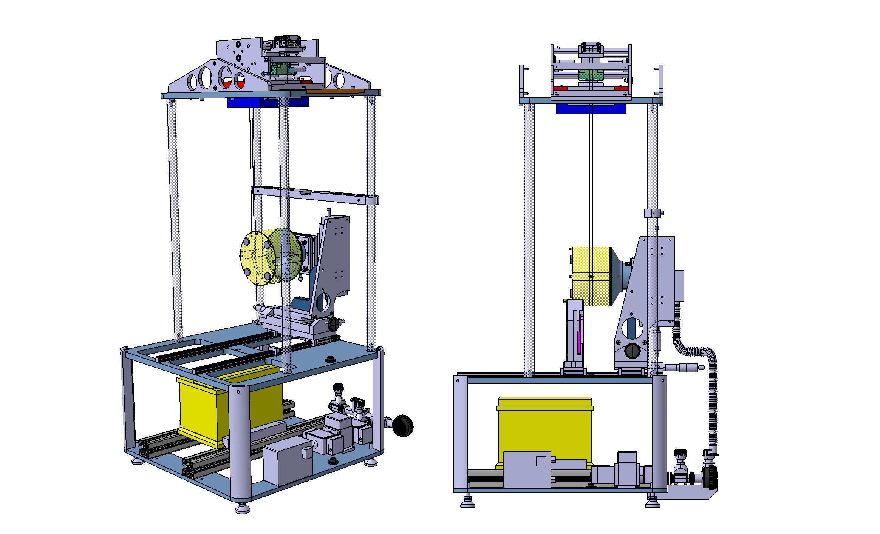
Installation step 2
Wiring Mirror
Actions:
Wire the Mirror with two CuBe Wires
Tension the two Wires in the Gear box. This tension will be adjust with a frequency probe used for the Multi-Payload Suspensions (not yet tested)
Two CuBe Wires

Slide 12
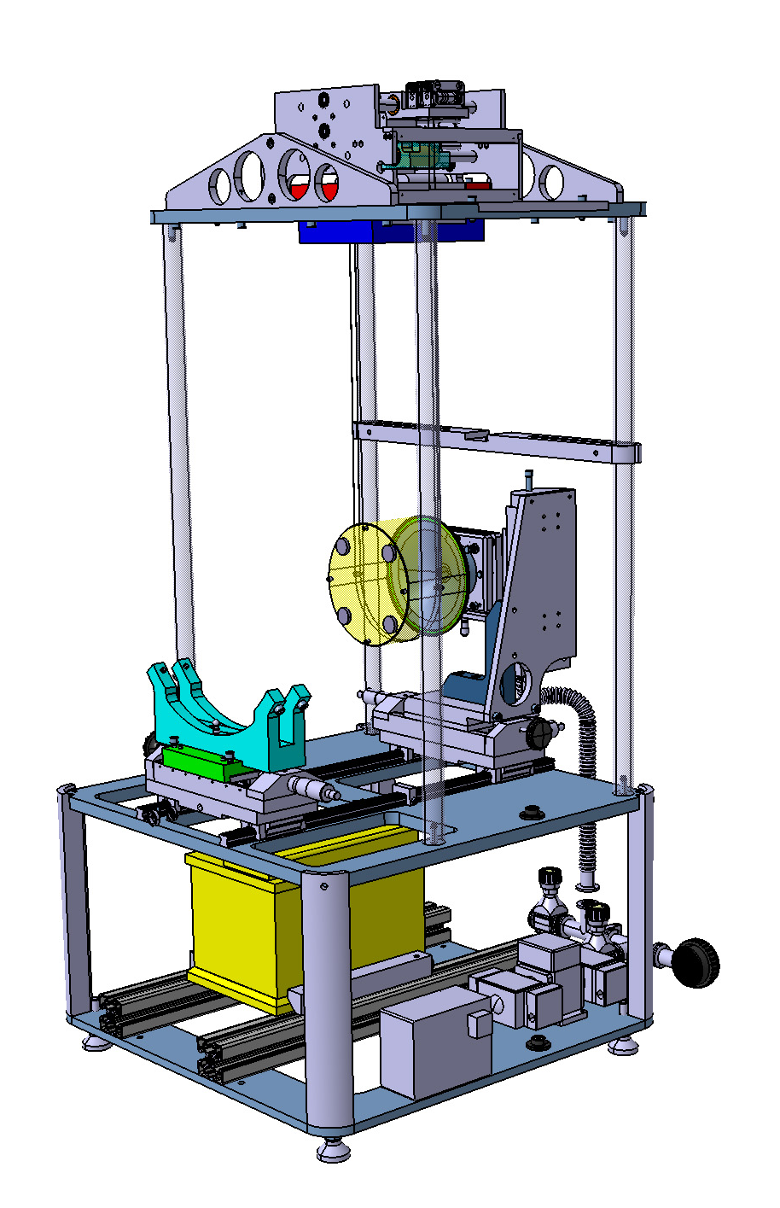
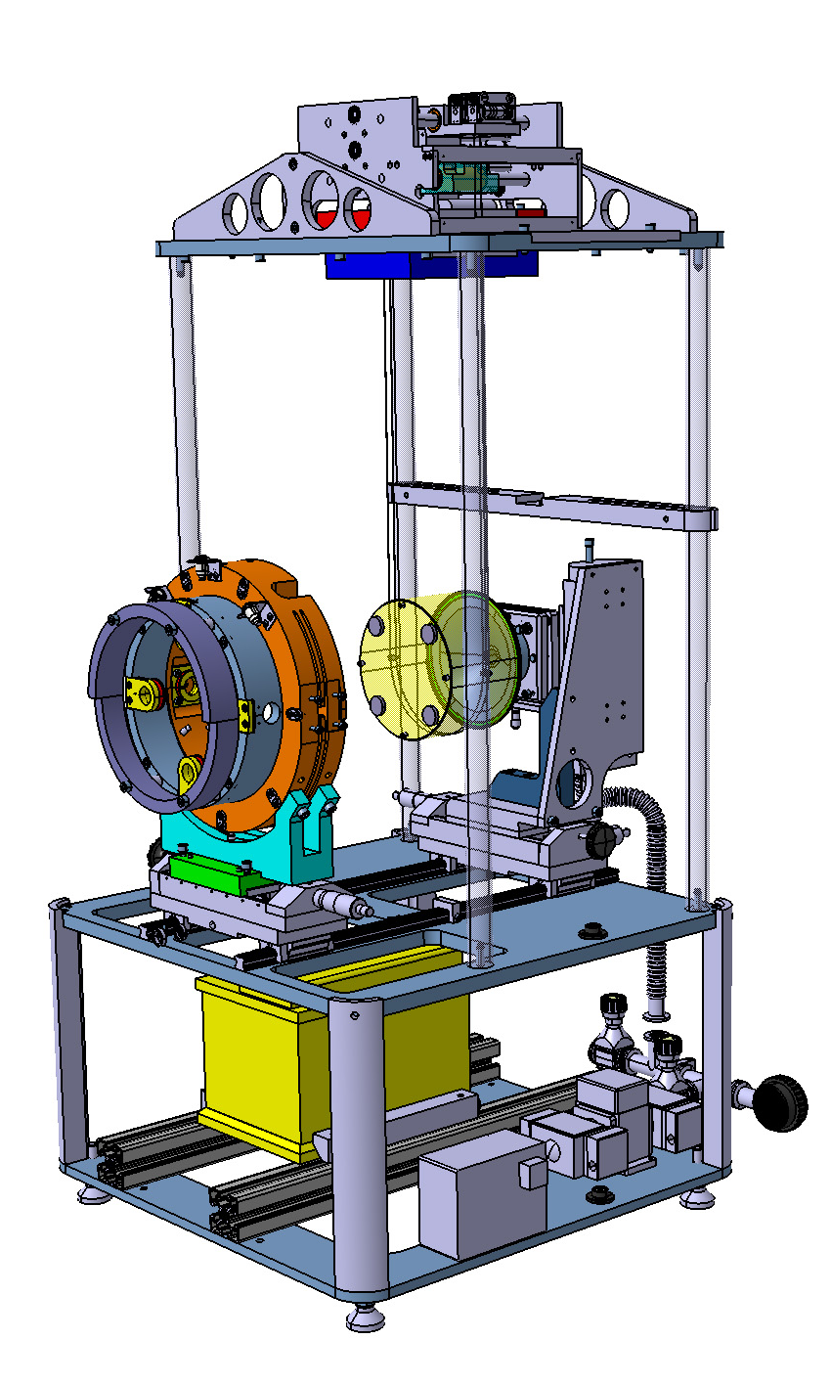
Installation step 3
Positioning Reaction Mass
Actions:
Place the RM support on the Translation rail
Place the RM in the RM Support, a dowel pin positioned and 4 bolts do the fixation
RM
RM Support
Dowel pin
Fixation Bolts

Slide 13

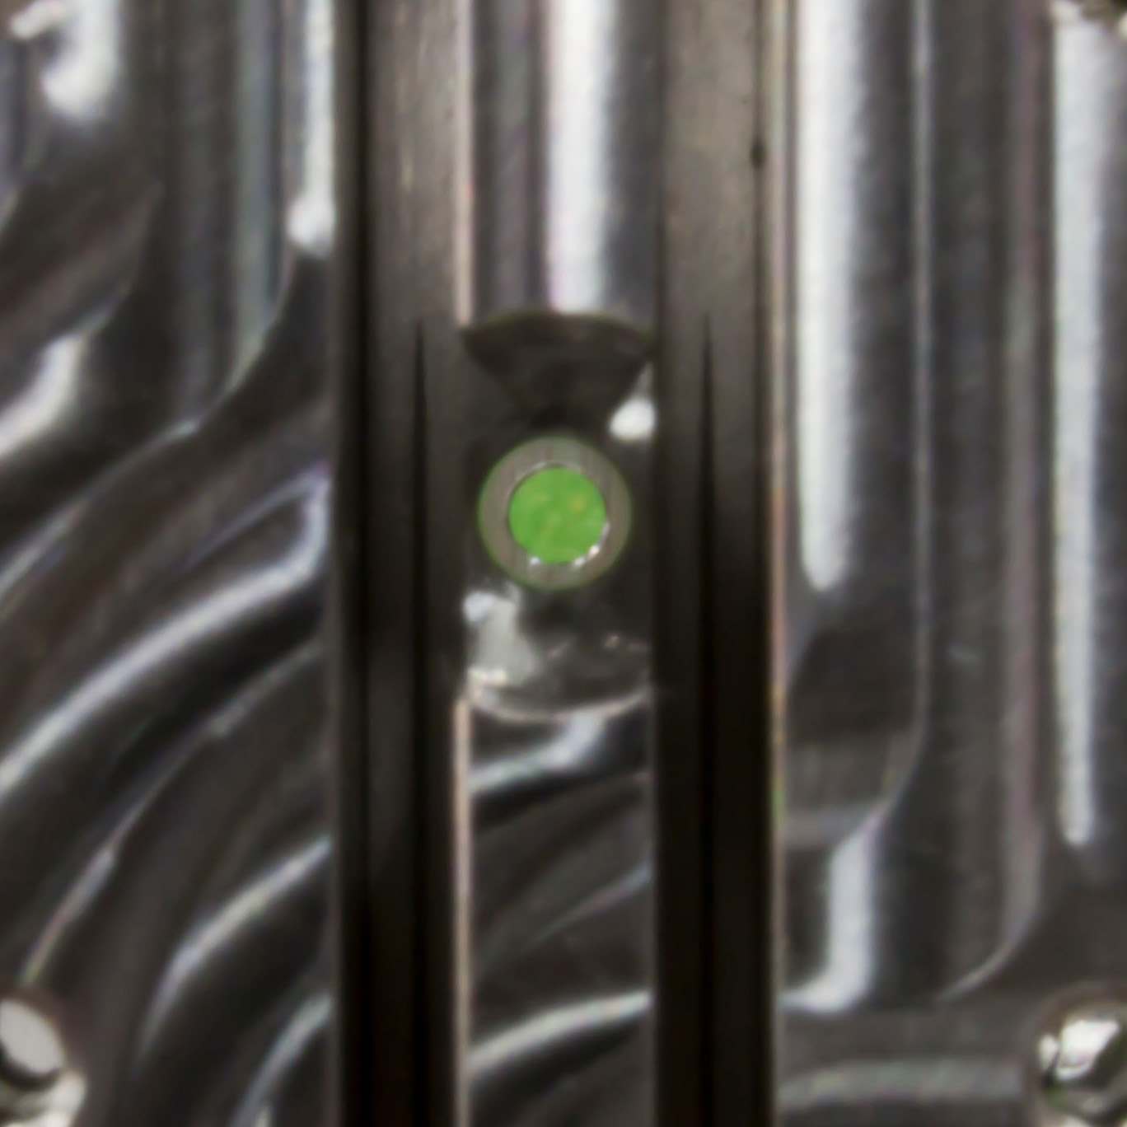
Installation step 3b
Positioning Reaction Mass
Actions:
Slide gently the Recoil with Support to the Mirror
Position is correct when the wirespacres are in the center of the holes through the RM (both sides)

Slide 14
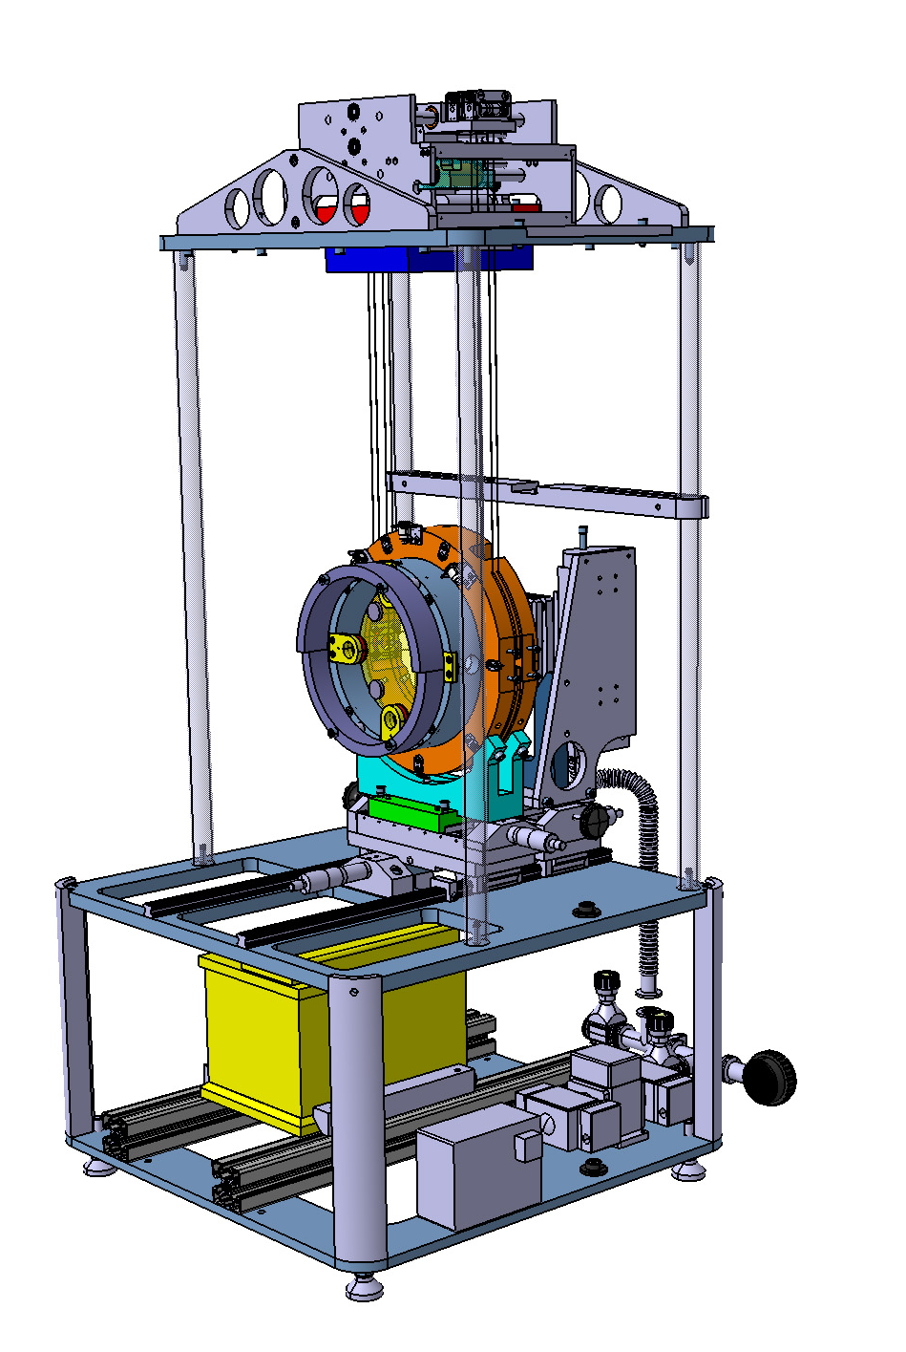
Installation step 4
Wiring Reaction Mass (RM)
Actions:
Wire the RM with two CuBe/C85 Wires
Tension the two Wires in the Gear box. This tension will be adjusted with a frequency probe used for the Multi-Payload Suspensions

Slide 15
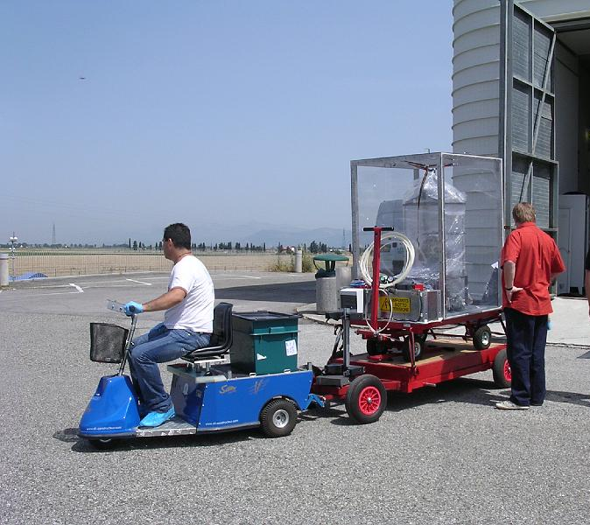
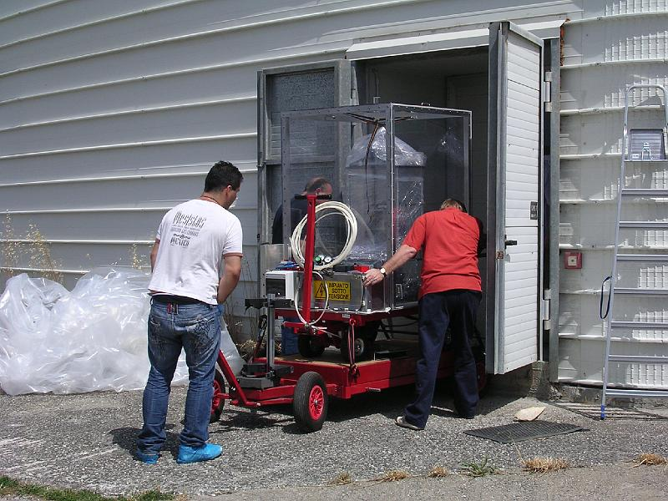
Installation step 5
Transport to Tower
Actions:
Secure the whole installation frame
Wrap the setup in plastic
.

Slide 16
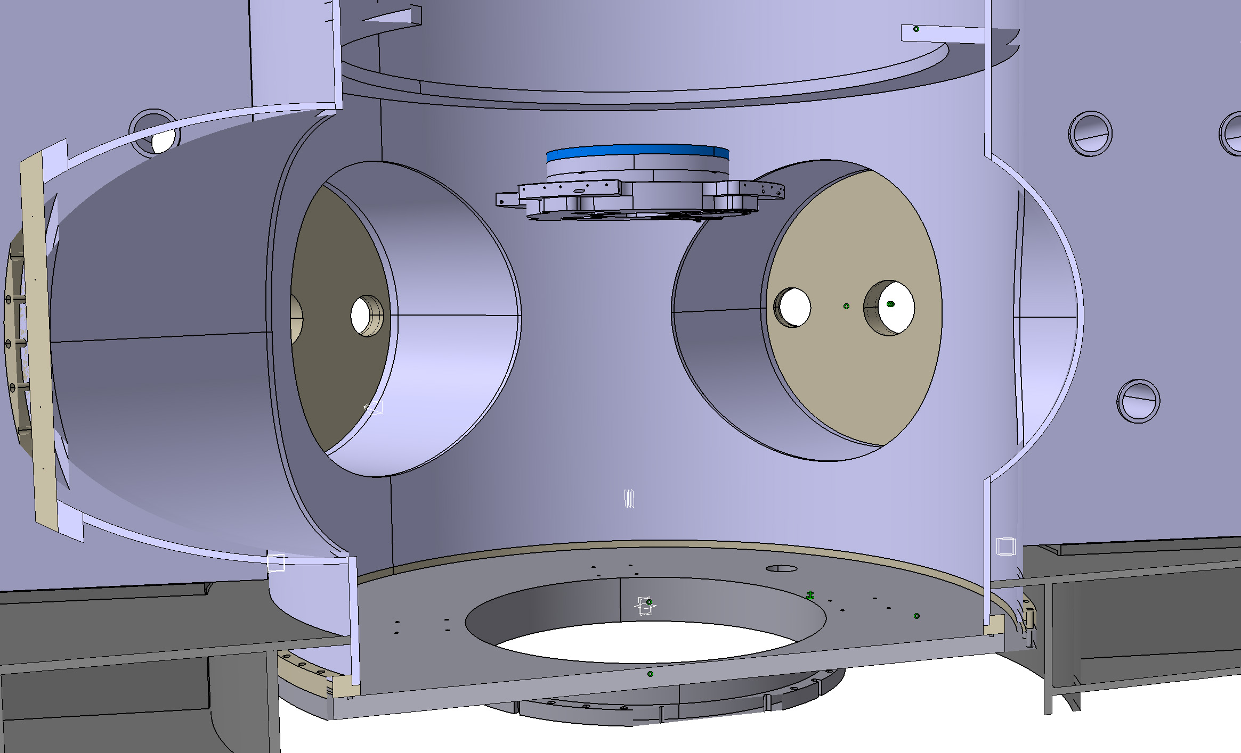
Installation step 6
Remark:
Marionetta is already installed
Connection to Marionetta in Tower
Marionetta

Slide 17
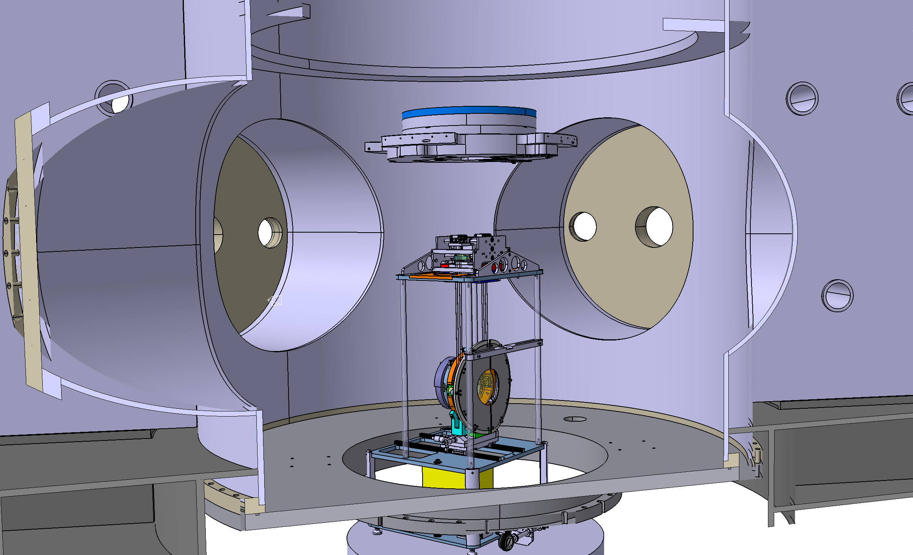
Installation step 6b
Actions:
IMC going up on Lift
Connection to Marionetta in Tower

Slide 18
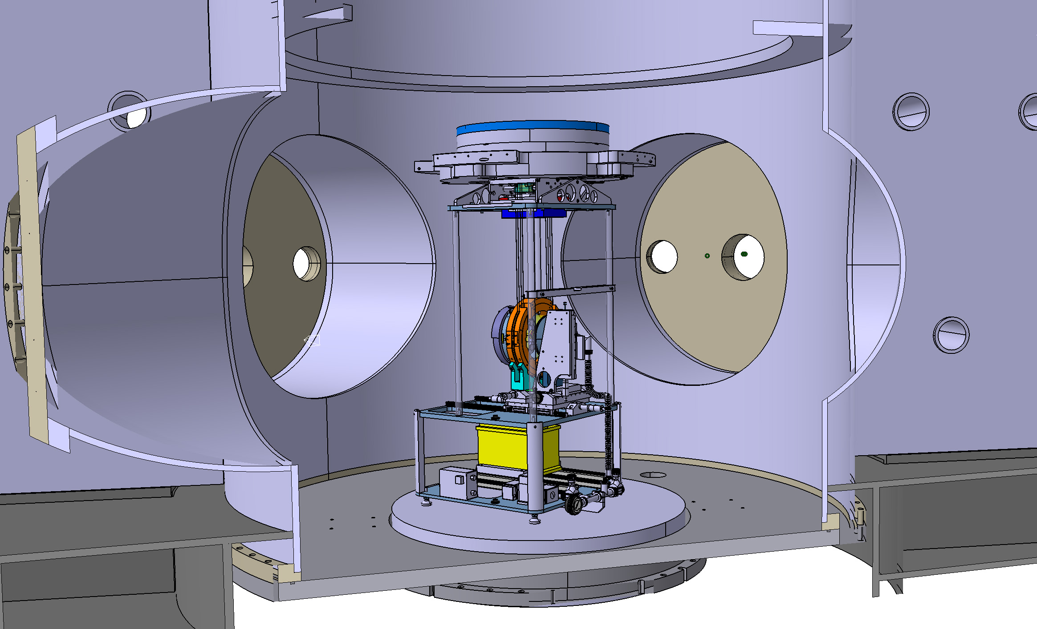
Installation step 6c
Actions:
Connect IMC Gear Box to Marionetta with 4 bolts
Connection to Marionetta in Tower
Note:
mirror and RM are suspended from wires, and are supported by supports
Bolt Connections

Slide 19
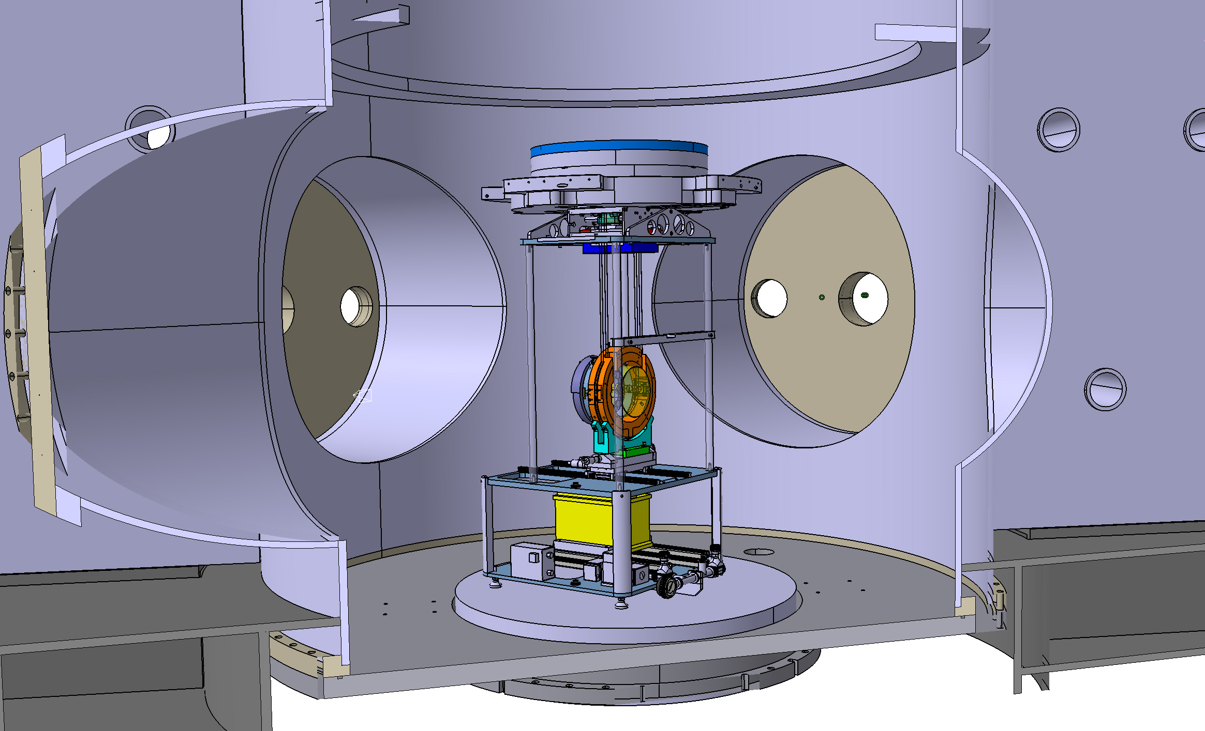
Installation step 7
Actions:
Remove Mirror Vacuum Clamp from the frame, to get access to front of RM.
Mount Safety Stops and Baffles
Note:
mirror is freely hanging,
RM is suspended from wires, and is supported by supports
remove Mirror Vacuum Clamp

Slide 20
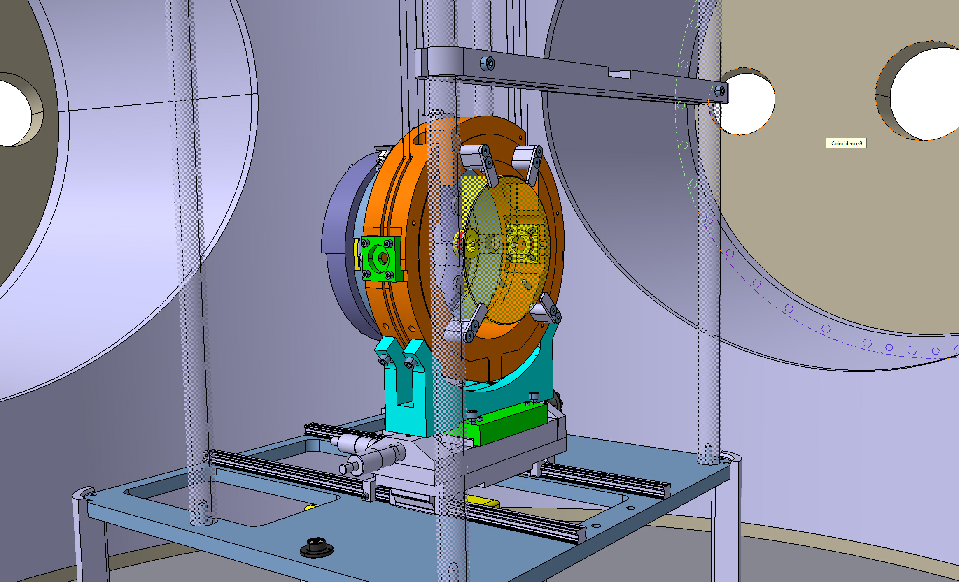
Installation step 7b
Actions:
Mount the 4 Safety Stops.
Mount Safety Stops and Baffles
Note:
mirror is freely hanging,
RM is suspended from wires, and is supported by supports
Safety Stop

Slide 21
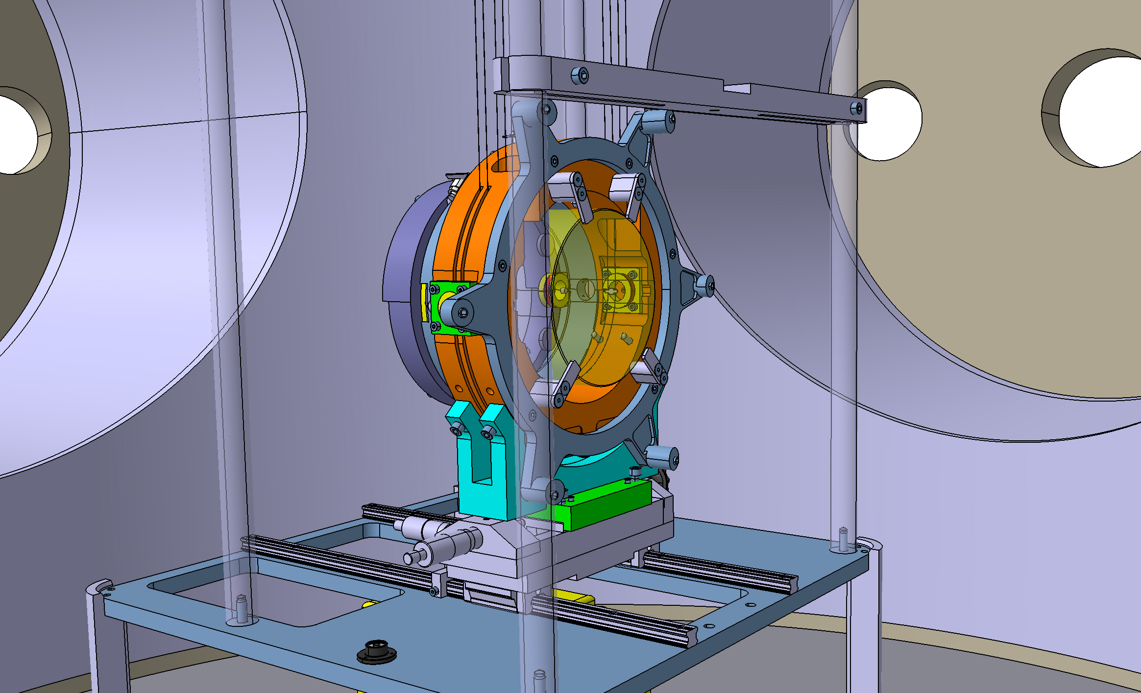
Installation step 7c
Actions:
Mount the Baffle Support Ring.
Mount Safety Stops and Baffles
Baffle Support Ring

Slide 22
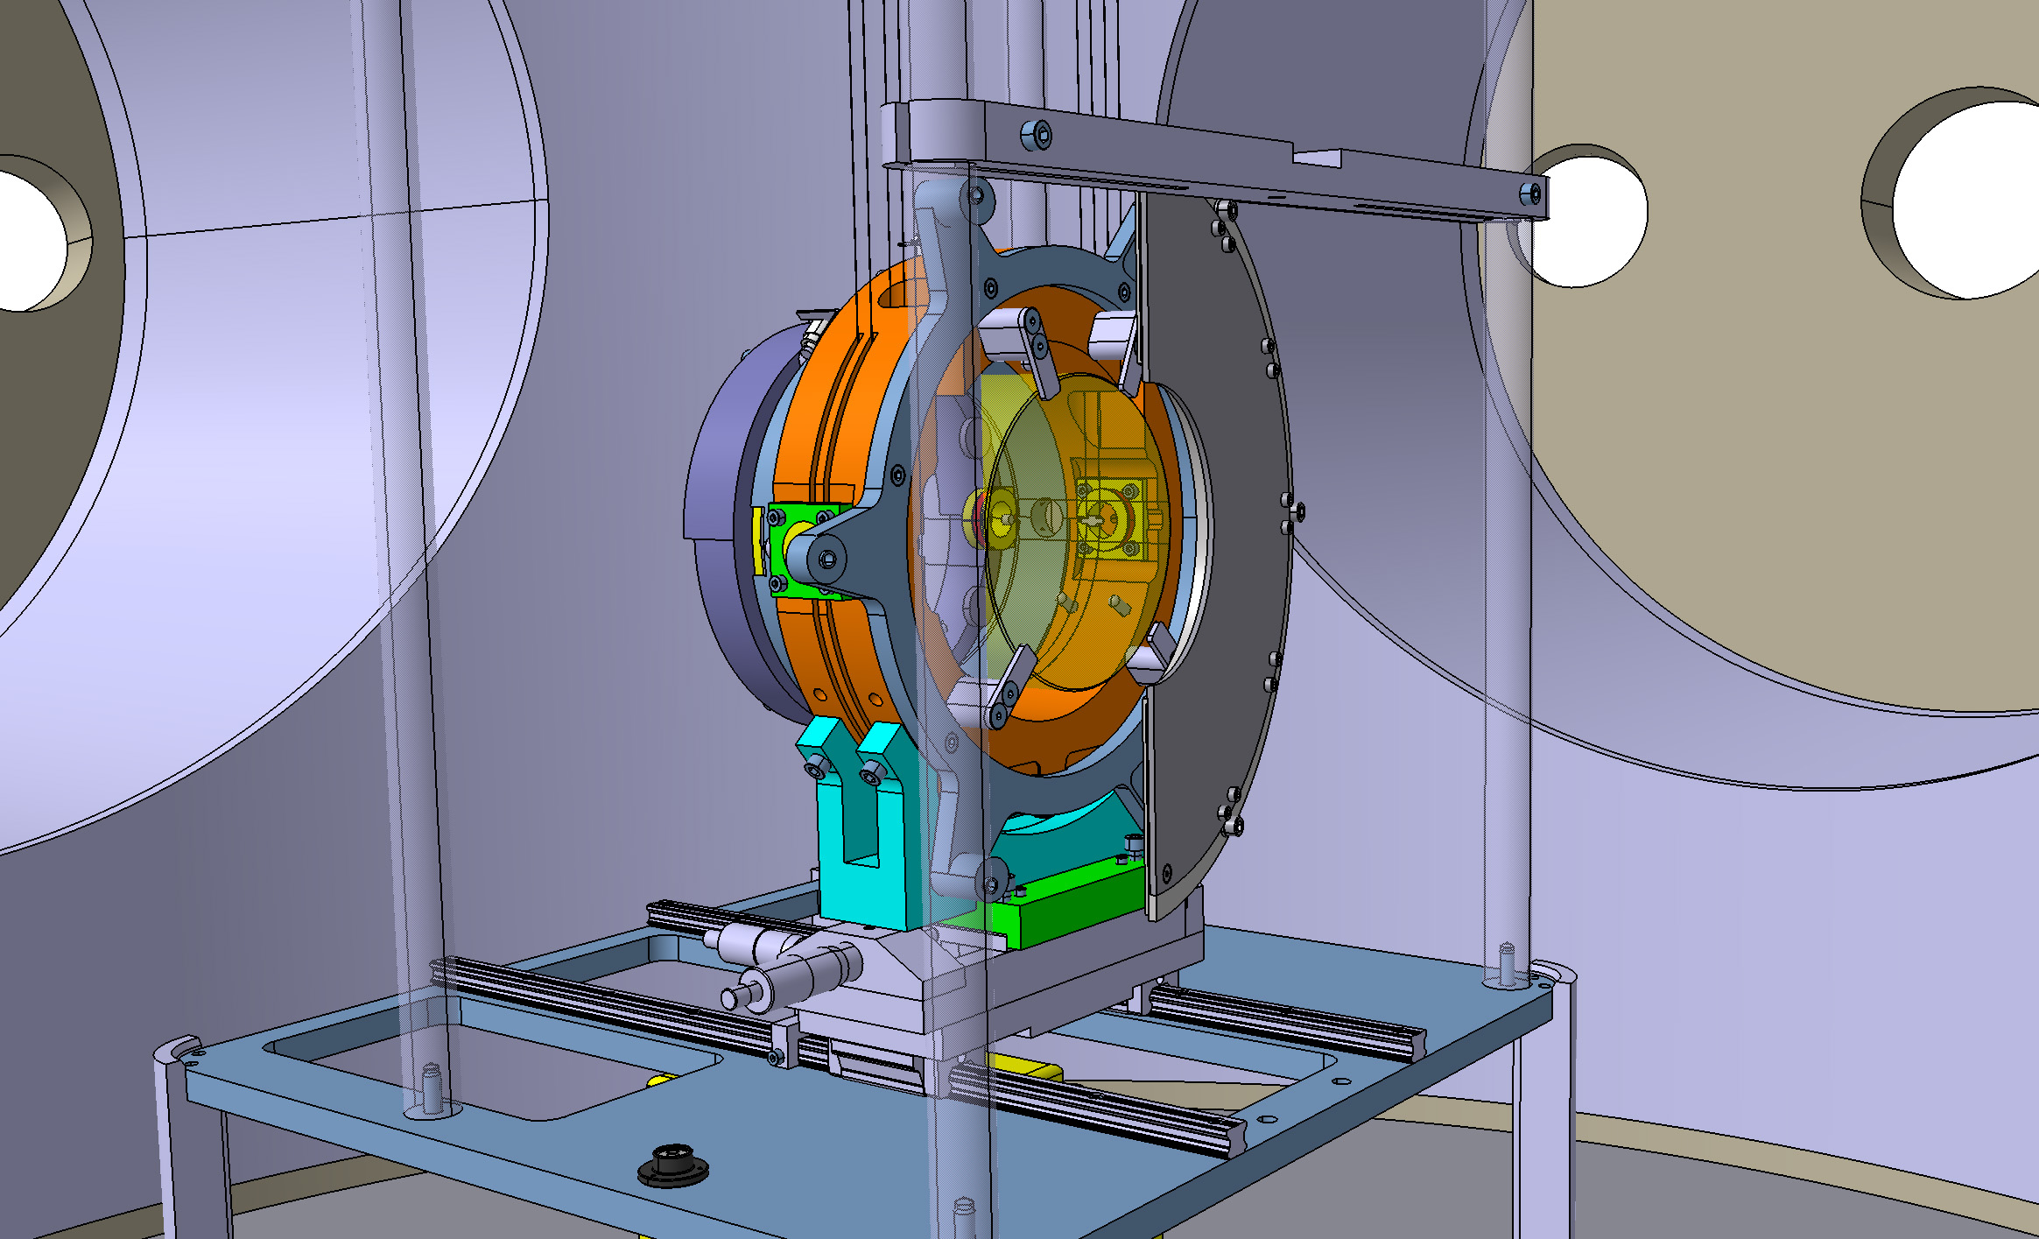
Installation step 7d
Actions:
Mount a Baffle.
Mount Safety Stops and Baffles
Baffle

Slide 23
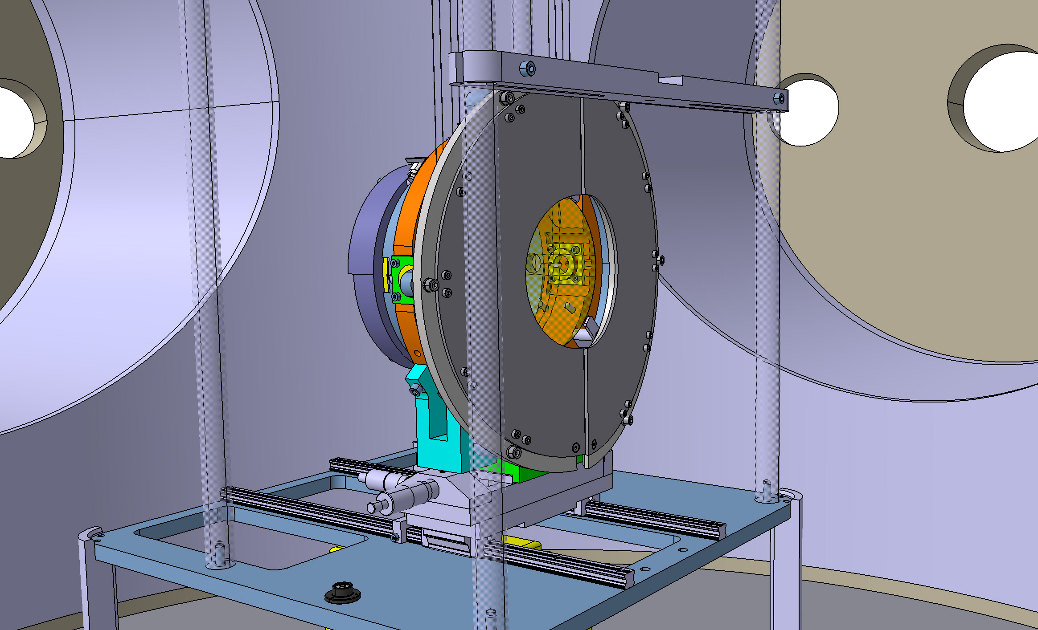
Installation step 7e
Actions:
Mount the last Baffle.
Mount Safety Stops and Baffles

Slide 24
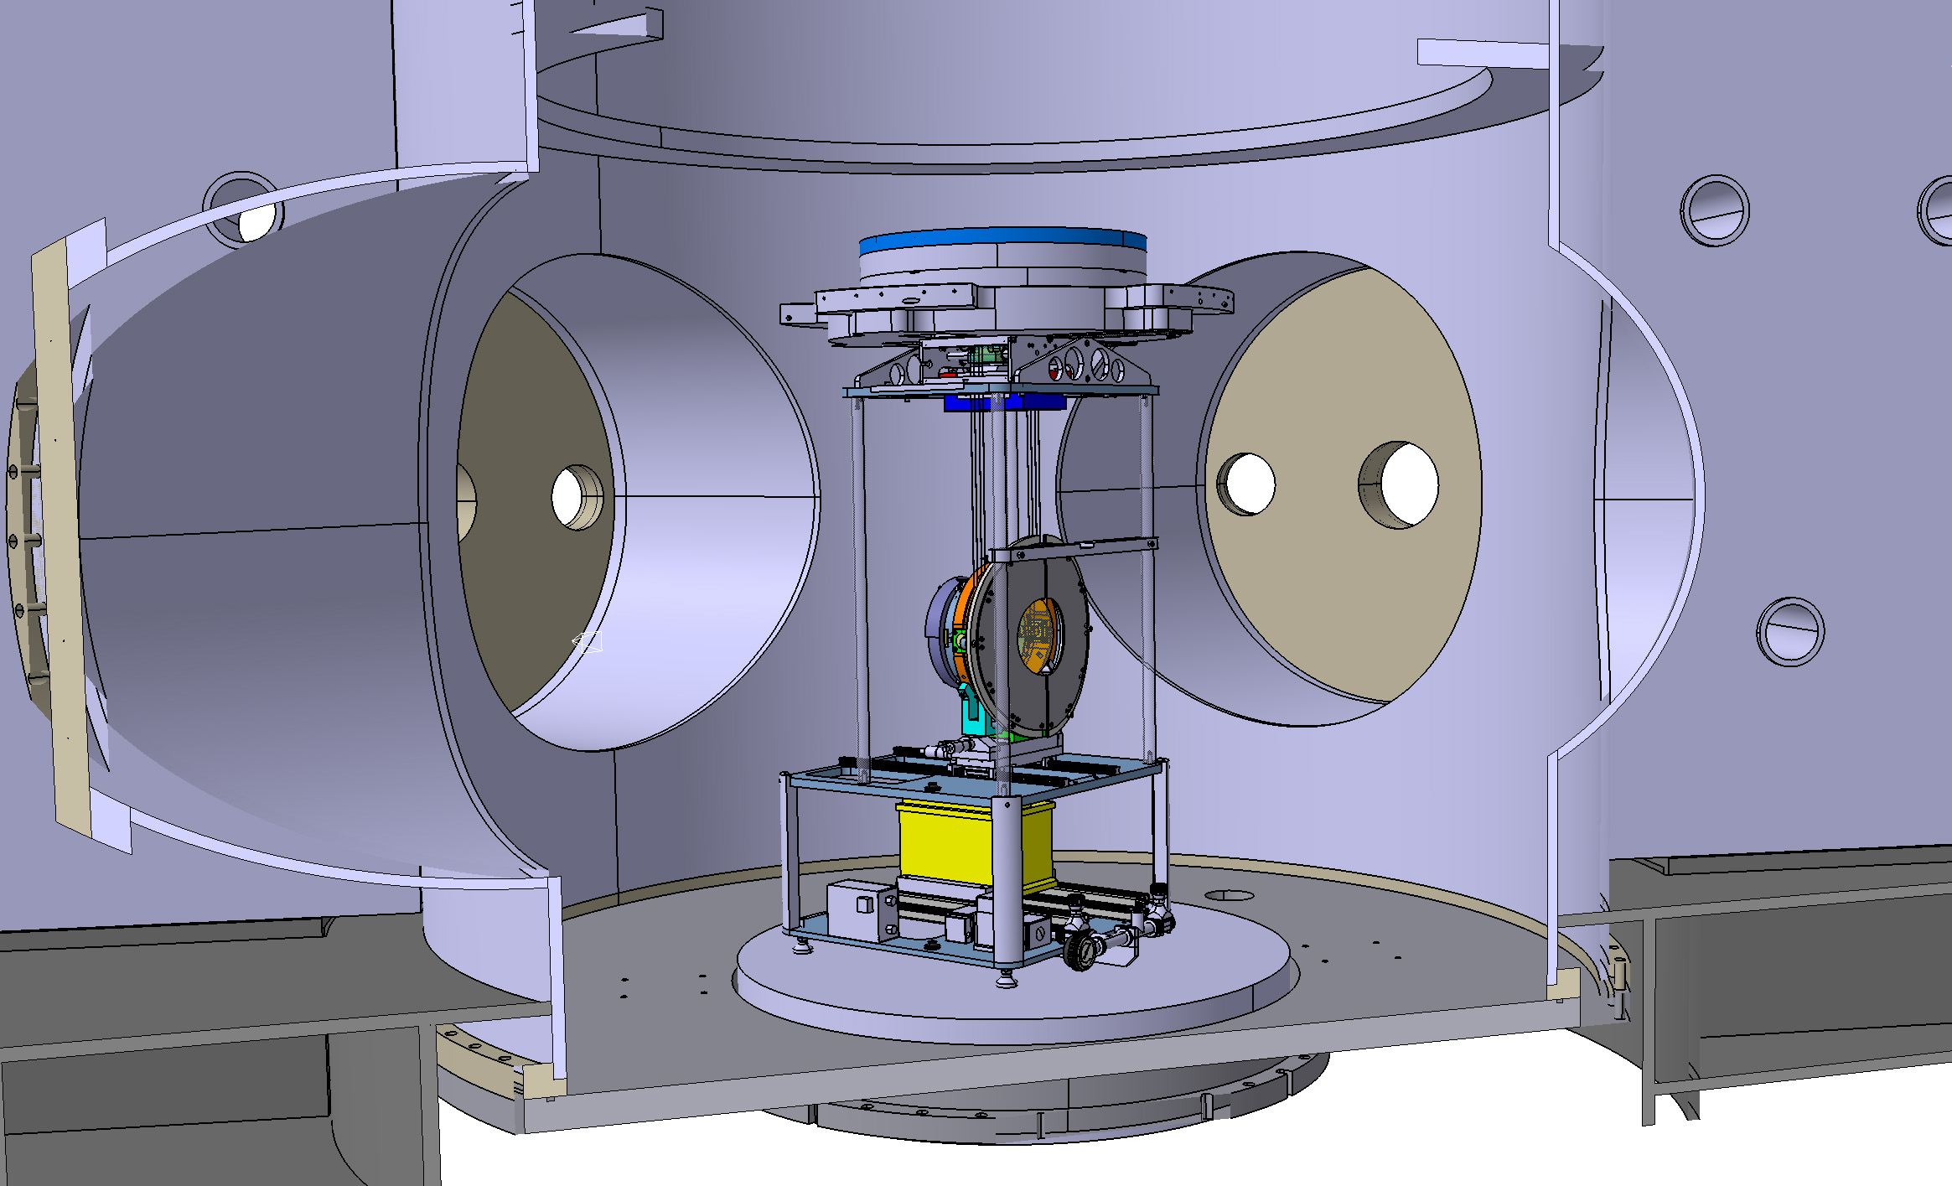
Installation step 7e
Mount Safety Stops and Baffles
Note:
mirror is freely hanging,
RM is suspended from wires, and is supported by supports

Slide 25
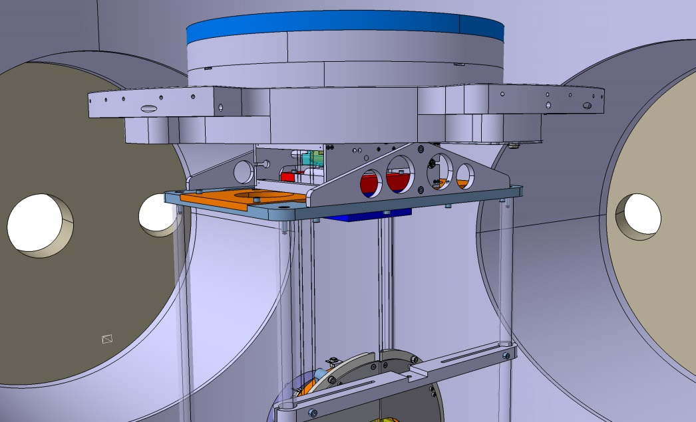
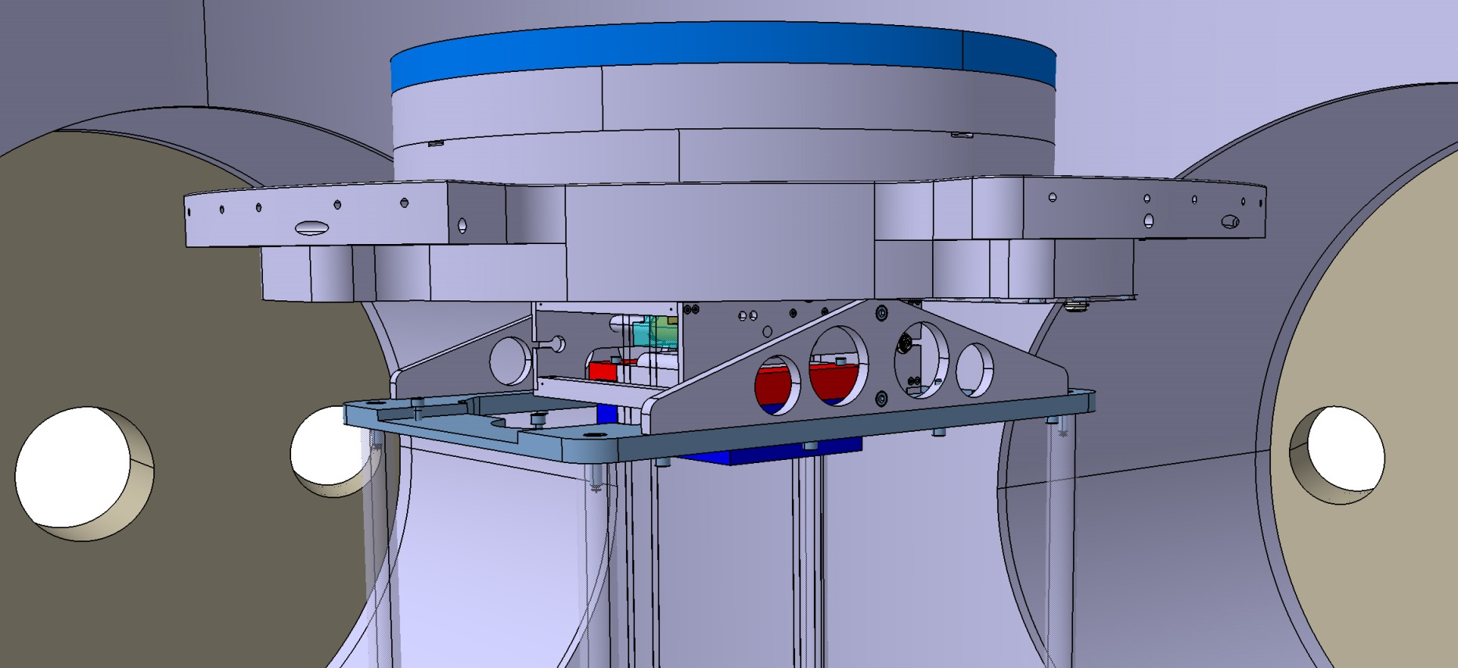
Installation step 8
Remove Installation Frame from IMC
Actions:
Disconnect the IMC from the Installation frame, by removing the two Gear box connection plates
Gear Box connection Plate

Slide 26
Installation step 8
Actions:
remove the four bolts between
RM support and RM.
Remove Installation Frame from IMC
Note:
mirror is freely hanging,
RM is suspended from wires only and not connected to support

Slide 27
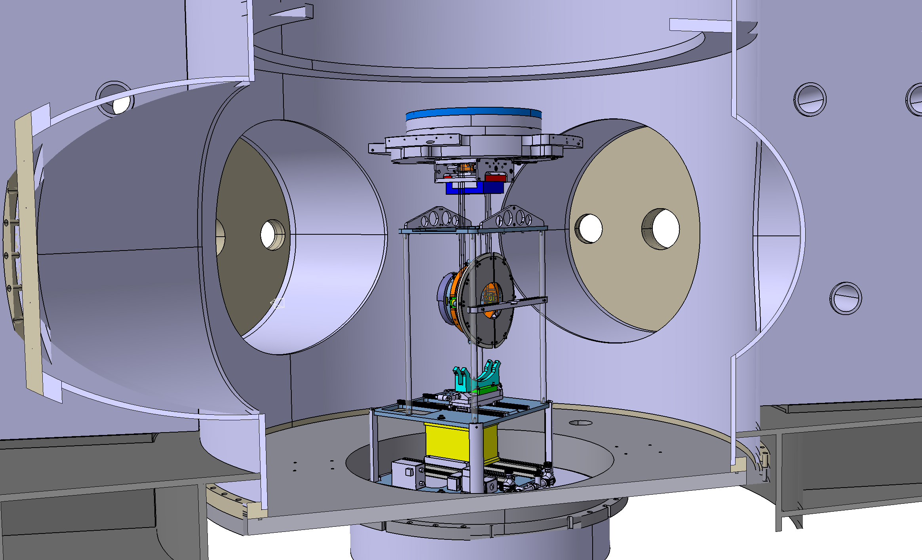
Installation step 8b
Actions:
Lower Lift
Remove Installation Frame from IMC

Slide 28
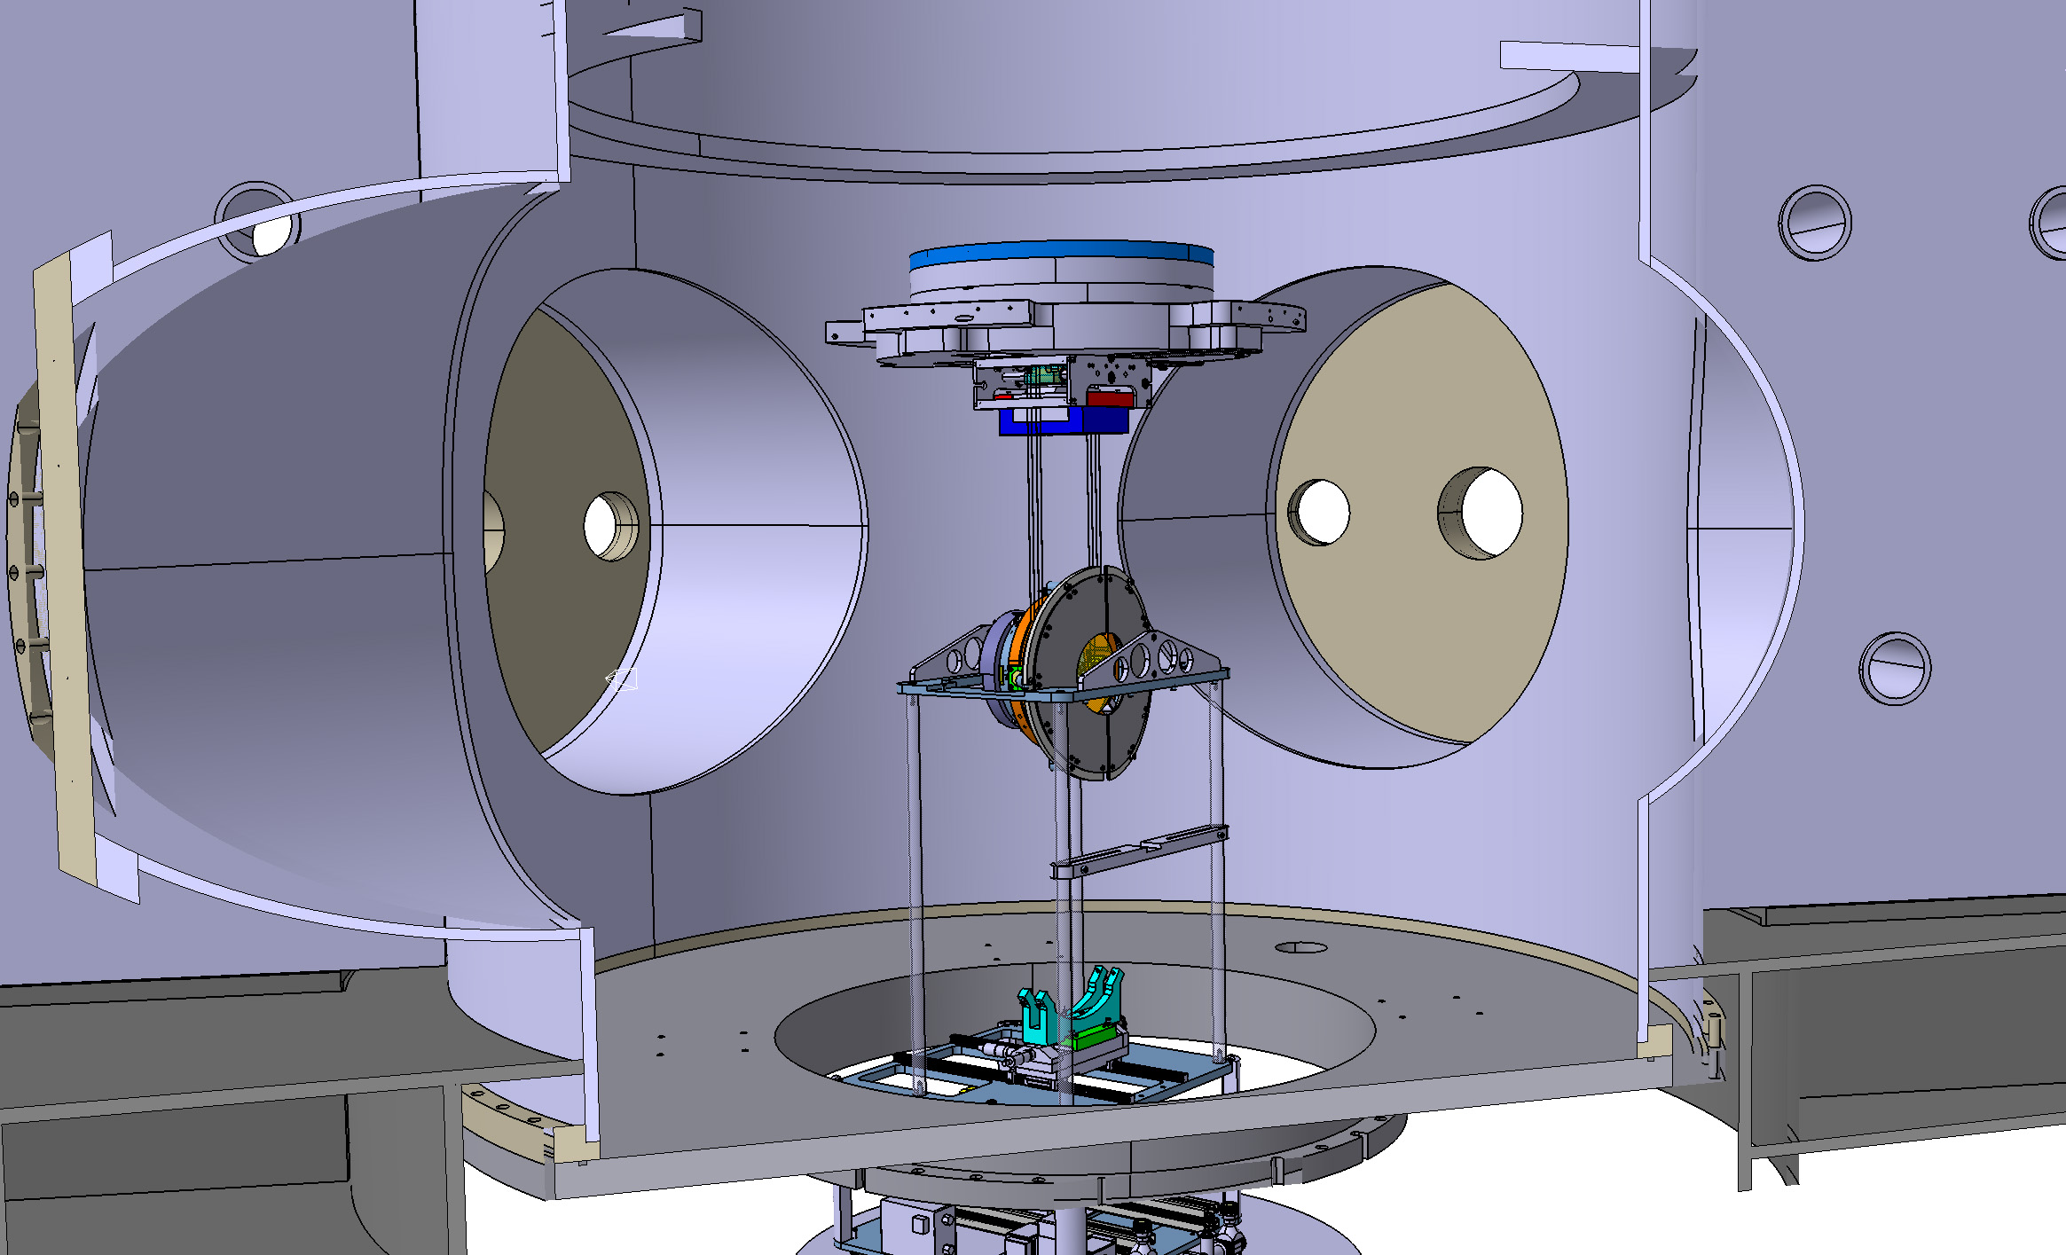
Installation step 8b
Remove Installation Frame from IMC

Slide 29
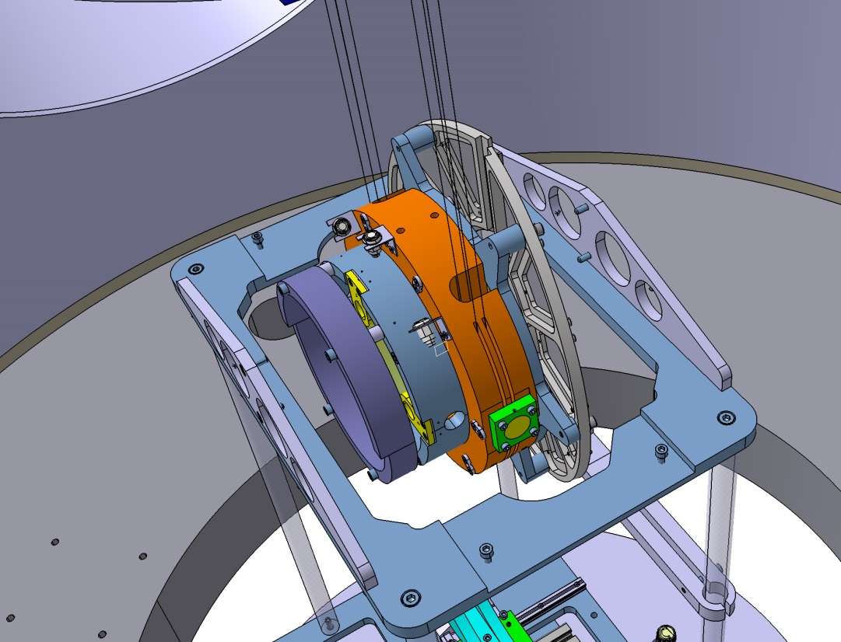
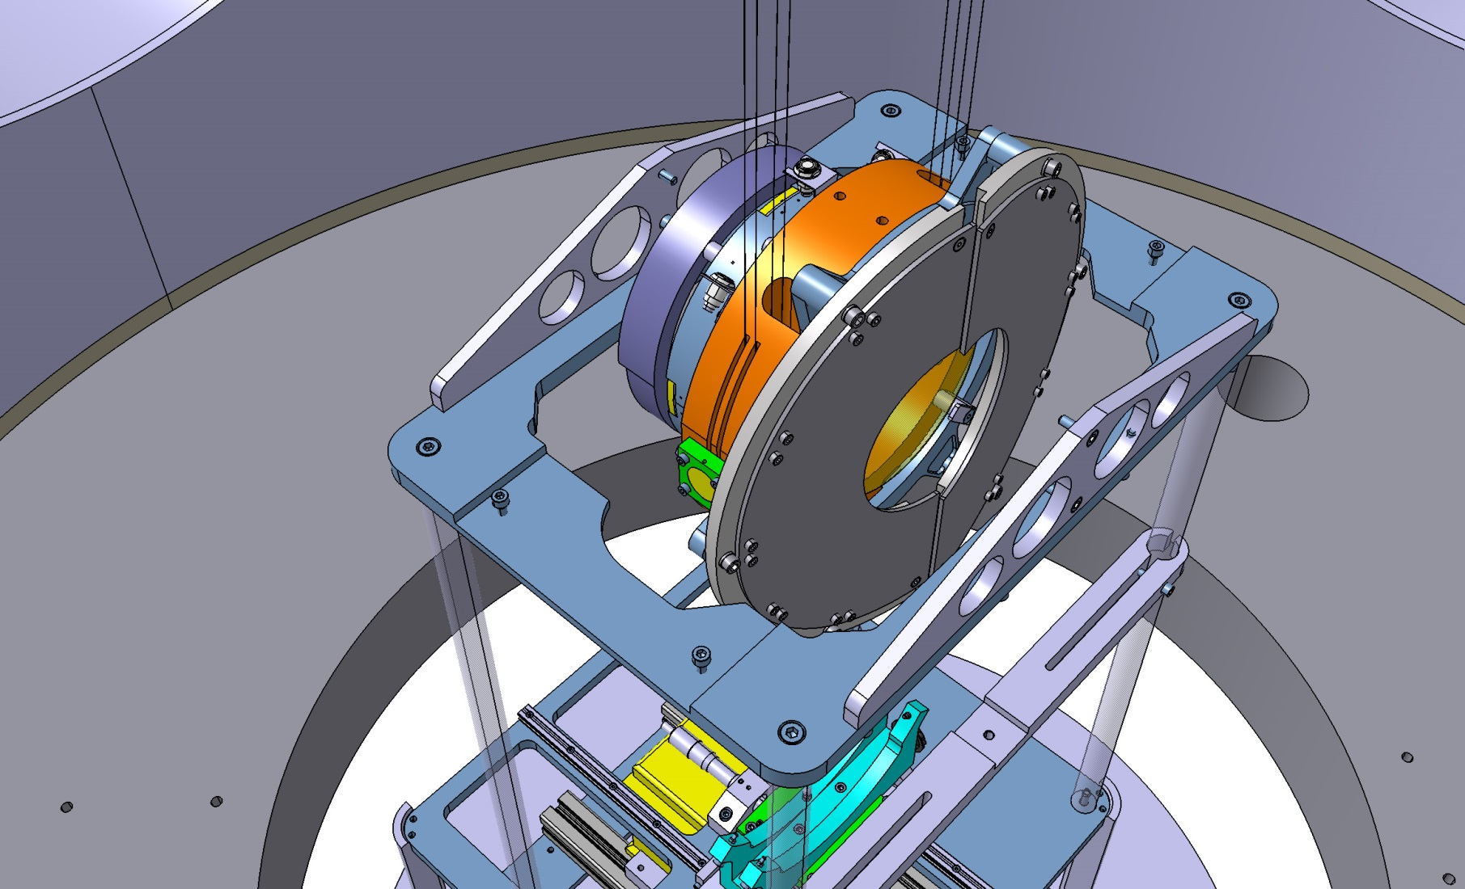
Installation step 8b
Remove Installation Frame from IMC

Slide 30
Installation complete

