Slide 1
AdVirgo specifications
Jean-francois Hayau, Francois Bondu
Virgo Week 19-21th july

Slide 2
Outline
Requirement on modulation index noise
Frequency noise requirement
IMC length noise requirement
Need of an etalon?

Slide 3
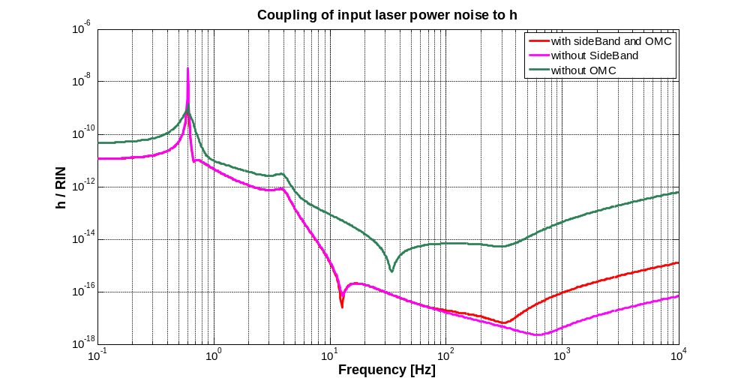
Intensity noise on sideband
0ptickle model : fMod1 = 6270339.2 Hz, fMod2 = 81515709.5 Hz, fMod3 = 8360585.6 Hz ; Lcav = 2999.9 m, Lprc = 11.953m, Delta = 0.037m, Lsrc= 11.033m, Lprbs = 5.980m.
Noise of sideband on dark fringe is reduced by the OMC
Without OMC intensity noise comes from sidebands ( mostly from f2)
Noise brings by sidebands
Noise brings by carrier
Factor 491

Slide 4
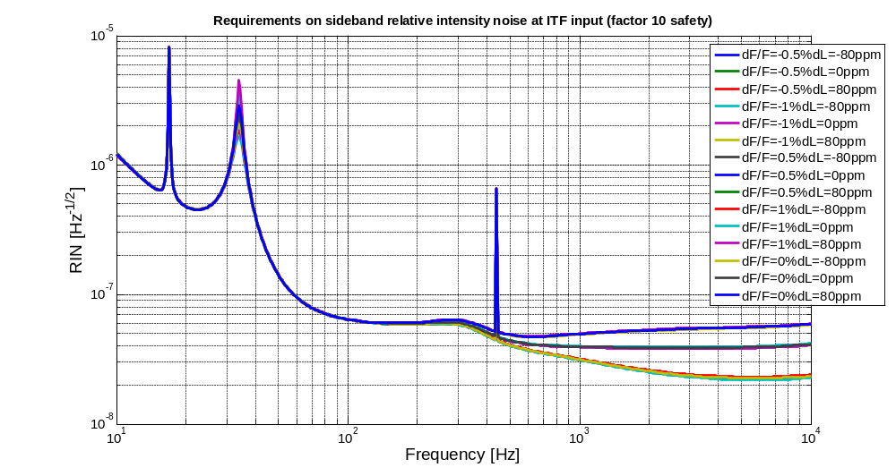
Noise on modulation index
Noise on modulation index = RIN on sideband.
RIN requirement on sideband realized for various loss asymmetries (from -80ppm to 80 ppm with a step of 20ppm) and finesse asymmetries ( from -1% to 1% with a step of 0.5%).

Slide 5
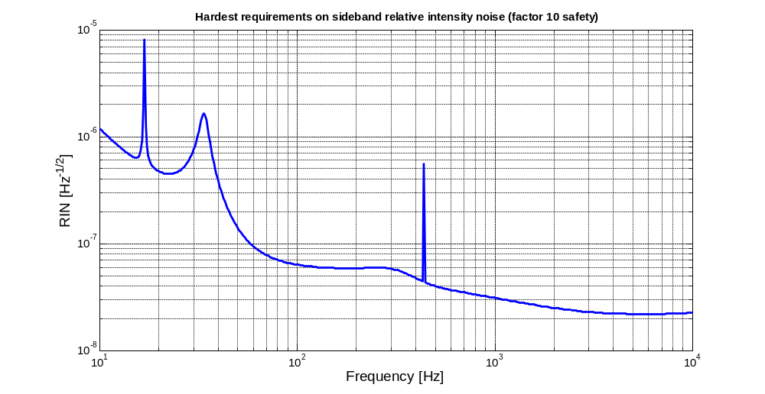
Modulation index noise
Lower RIN on sideband is taken between the different files at each frequency => Hardest RIN requirement.
Noise floor of 2.2 10⁻⁸ Hz^{-1/2}.
Result depends on f2 value.

Slide 6
Outline
Requirement on modulation index noise
Frequency noise requirement
IMC length noise requirement
Need of an etalon?

Slide 7
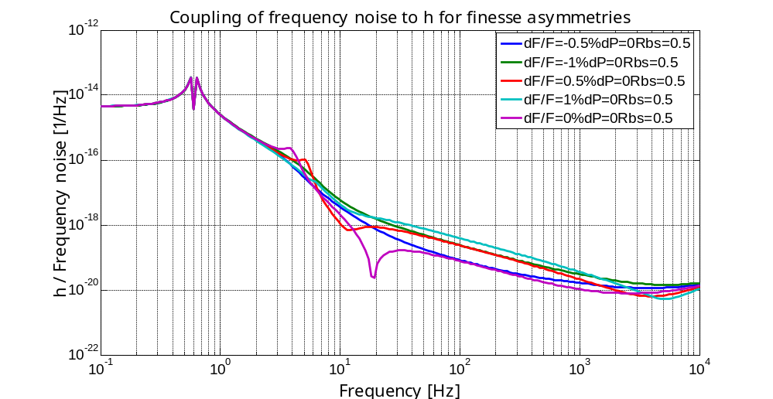
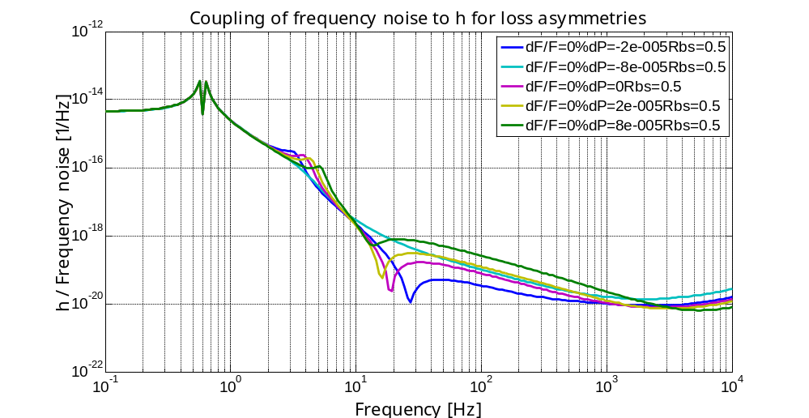
Frequency noise requirement
Frequency noise for various finesse asymmetries
Frequency noise for various loss asymmetries

Slide 8
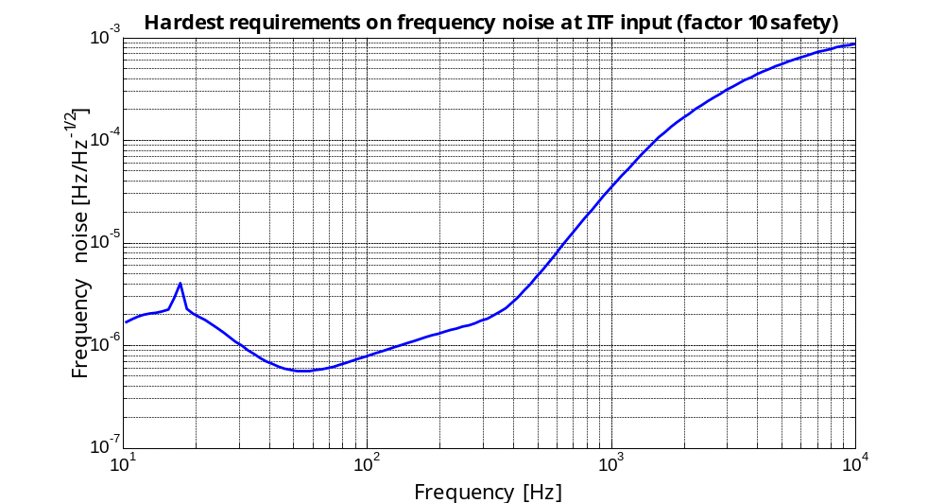
Frequency noise requirement
Frequency noise requirement realized for various loss asymmetries (from -80ppm to 80 ppm with a step of 20ppm) and finesse asymmetries ( from -1% to 1% with a step of 0.5%) : Lower frequency noise is taken between the different files at each frequency => Hardest frequency noise requirement .

Slide 9
Outline
Requirement on modulation index noise
Frequency noise requirement
IMC length noise requirement
Need of an etalon?

Slide 10
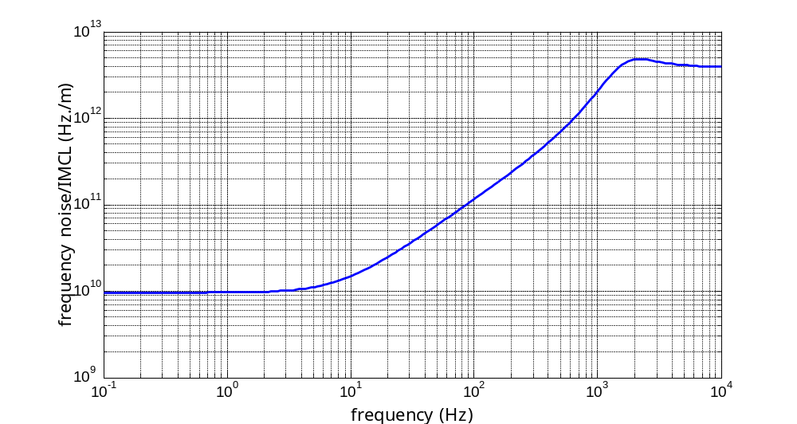
IMC length noise requirement
The length noise on the IMC is simulated by a small motion of the output mirror.
The motion of the IMC leads to frequency noise.

Slide 11
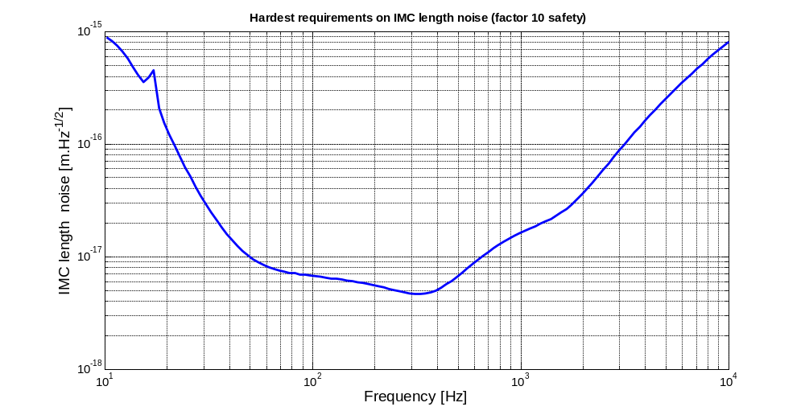
IMC length noise requirement
Hardest requirement on IMC length noise.

Slide 12
Outline
Requirement on modulation index noise
Frequency noise requirement
IMC length noise requirement
Need of an etalon?

Slide 13
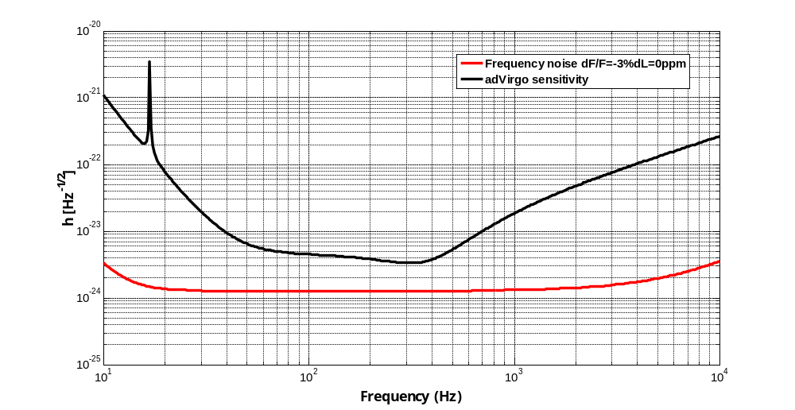
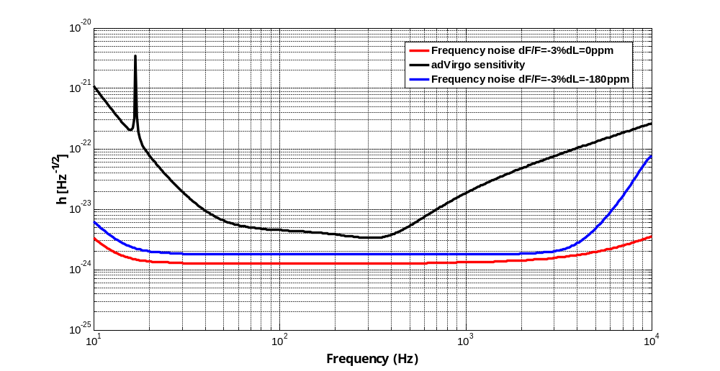
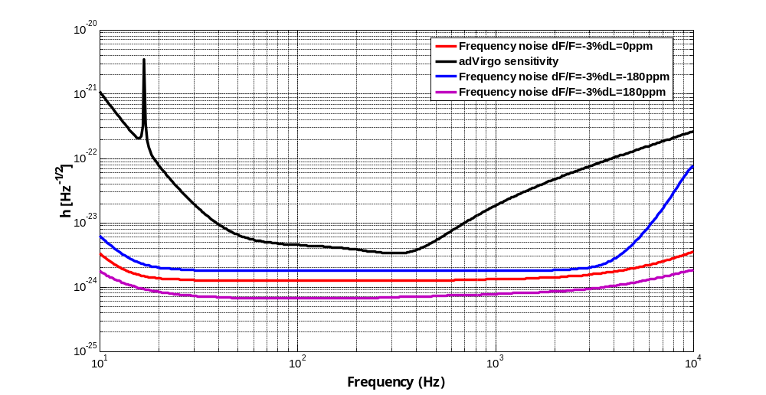
Frequency noise from shot noise
Shot noise from POBS (B5) is reintroduced as frequency noise by SSFS.
Frequency noise is coupled to h through arms asymmetries:
  Finesse asymmetry dF/F, loss asymmetry dL
  Various effect in function of arms asymmetries: need of an etalon?
Frequency noise induced by shot noise

Slide 14
Frequency noise from shot noise
Objective: Evaluate effect of various finesse and loss asymmetries on frequency noise from shot noise on dark fringe.
=> definition of a margin:
Frequency noise induced by shot noise on dark fringe
hsens
δν

Slide 15
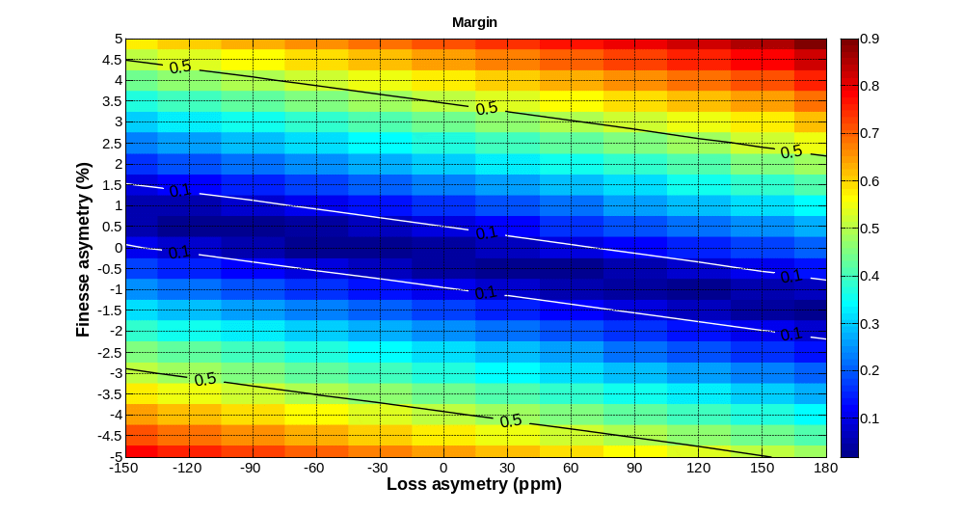
Margin
Margin lower than 1. Optimistic result (MSRC configuration).
Asymmetries can be compensated by each other.

Slide 16
Summary
Hardest RIN on sideband:
  Noise floor of 2.2 10⁻⁸ Hz^{-1/2}
  This requirement depends on OMC and f2.
Requirement on frequency noise and IMC:
  Hardest frequency noise :
  IMC length noise :
Frequency noise from shot noise :
  Effect of loss asymmetries can be compensated by an appropriate finesse asymmetry ( Possible use of an etalon).
Perspective: update result for new adVirgo configuration.

Slide 17
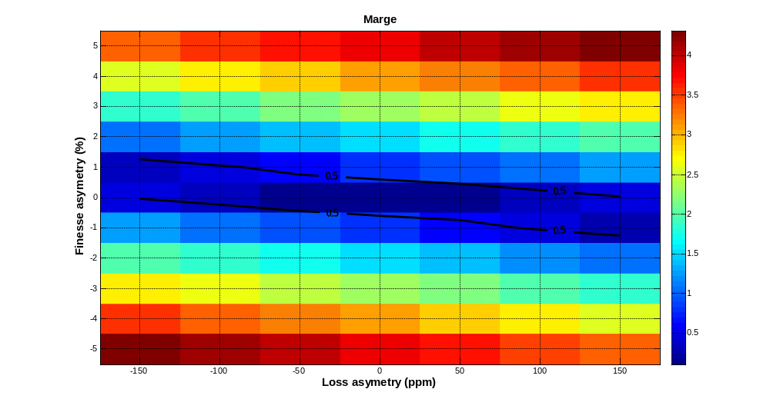
Margin for Virgo

