Slide 1
The bulk dataTransfer procedures
(Cascina, Oct 2015)
L. Salconi, A. Bozzi

Slide 2
Technical specs
A modular program (written in Python) that manages the file replica to the remote repositories (the datasender.py module):
  class based architecture, modular and expandable for future requirements;
  database with MySQL interface (with full stats for each file);
  logging system with support support for file, smtp, http;
  new command line interface with feedback support;
  thread based;
  run-time parameter controls (bandwidth limits, destination dirs, ecc..)‏;
  support for both data sender engines (GRID lcg tools and iRODS) via a wrapper classes with standard methods (sendFile, checkFile)‏;
  support for standard .ini sections oriented configuration files;
  management for 2 main data flows (rawdata and RDS) for each remote repository;
  socket interface with the DAQ data production flow;

Slide 3












Operational schema
new files
(from DAQ
or archive)‏
operator
(from CLI)‏
multimode log
thread socket server
LCG tools
(to Bologna)‏
MySQL
(db + queries)‏
iRODS
(to Lyon)‏

Slide 4
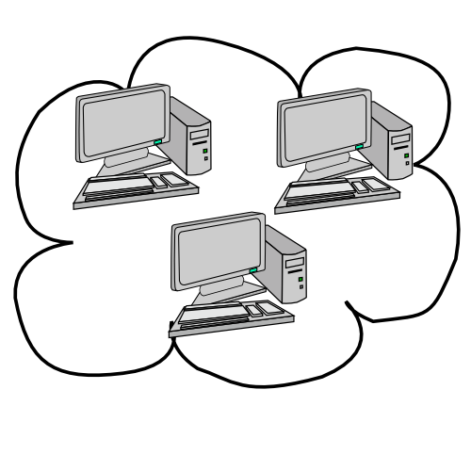




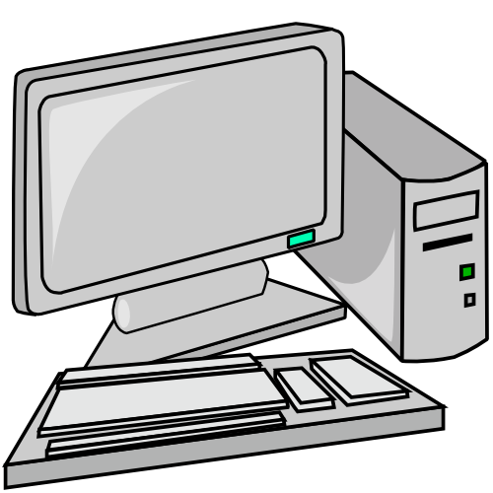



The “fake” ffl generation
local files
on disk
Lyon
Bologna
local ffl files
dataSender
informations
(log + ini)‏
new remote
ffl file
FrDump
and tools
datagw.virgo.infn.it

Slide 5
Achieved performance
Last spring we test deeply both engines (iRODS and LCG tools) with all parameter combination and with a bucket of rawdata files from the current production, we found the typical speed rate is:
  to Lyon: 42 MBytes/sec
  to Bologna: 65 MBytes/sec
  (we sent 959 rawdata files of about 1.25 GByte size each one, no errors were unmanaged by the software)

Slide 6
Tips, tricks and desiderata
Some tips, tricks and desiderata to improve the software:
  a permanent daemon module installed at CC’s: no more fake ffl, better control on file’s true final location, use of a true md5 or adler32 checksum code, ffl can be produced “on the fly” after a request;
  a recursive parser: the current architecture do not performs well on big subdirectory layout (like LIGO’s) and do not support recursive replication, this issue is closely related to the used engines;
  a local disk bucket at remote CC’s: this will avoid the coupling with the local engines. Any engine can be used for the transfer and, after the succesfully replica, the file can be moved and registered locally to final destination.
  a longer proxy certificate expire time: this will help with LCG tools and daily authentication;

