Slide 1
Dihedron
Status Report
18 July2011

Slide 2
Dihedron - Status
Substrates
2 substrates have been polished;
surfaces measured by TNO;

Slide 3
Short Mirror – Side A
low frequency
RMS: 0.17 nm
size: 4.5 x 3.5 mm²

Slide 4
Short Mirror – Side A
medium frequency
RMS: 0.16 nm
size: 315 x 236 μm²

Slide 5
Short Mirror – Side A
high frequency
RMS: 0.14 nm
size: 63 x 47 μm²

Slide 6
PSD – curves : Short Mirror – Side A
Raw results.

Slide 7
PSD – curves : Short Mirror – Side A
Raw results.
Note:
reasonable overlap;
spikes and “V” system immanent;
system response not yet corrected.

Slide 8
PSD – curves : Short Mirror – Side A
averaged PSD curves
PSD:
meets requirement

Slide 9
PSD – curves : Short Mirror – Side B
averaged PSD curves
PSD

Slide 10
PSD – curves : Long Mirror – Side A
Raw results.
Note:
reasonable overlap (except one);
spikes and “V” system immanent;
system response not yet corrected.

Slide 11
PSD – curves : Long Mirror – Side A
Raw results.
Note:
reasonable overlap (except one);
spikes and “V” system immanent;
system response not yet corrected.
repolished, measured only at LMA.

Slide 12
Dihedron - Status
Substrates
2 substrates have been polished;
surfaces measured by TNO;
sent to LMA for acceptance measurements and coating

Slide 13
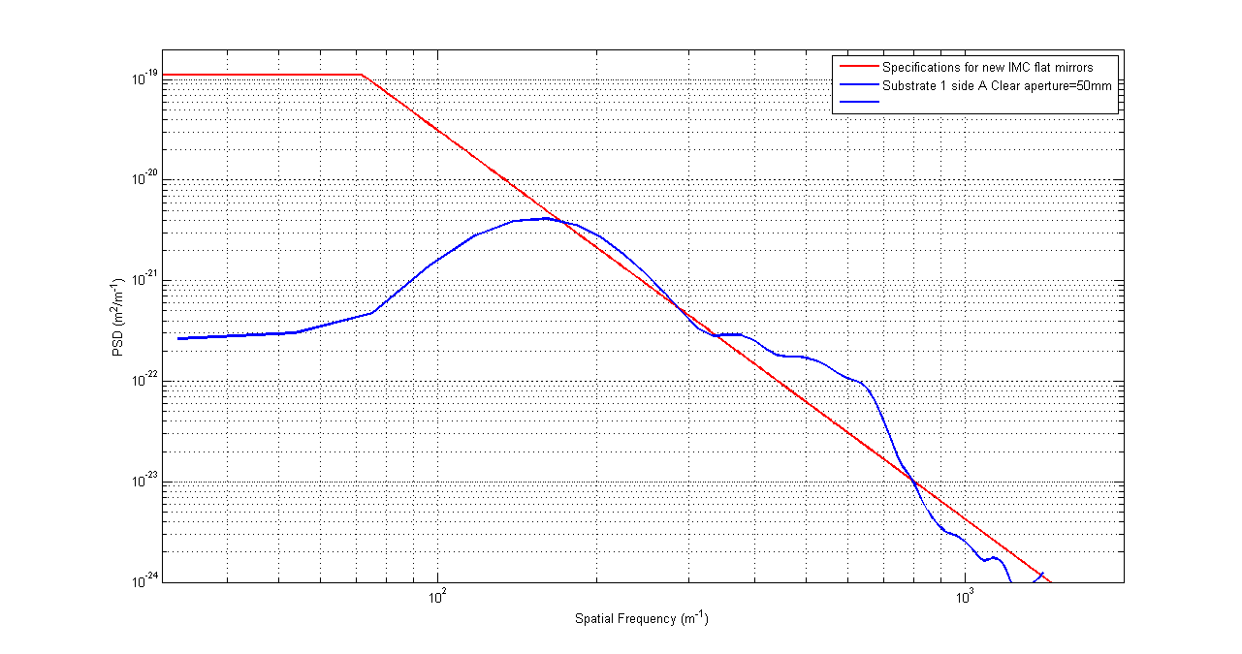
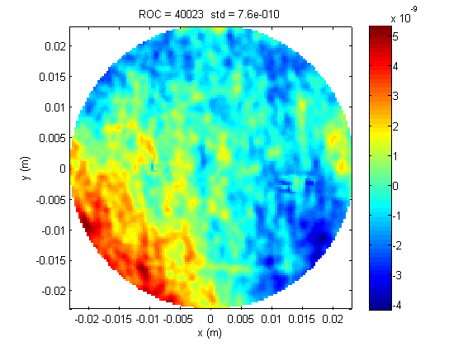
PSD – curves : Short Mirror – Side A (LMA)
Substrate 1 – side A clear aperture 50mm
PSD:
meets requirement

Slide 14
PSD – curves : Short Mirror – Side A (LMA)
Substrate 1 – side A clear aperture 50mm
PSD:
meets requirement
PSD:
le polishing semble bon

Slide 15
Dihedron - Status
Substrates
2 substrates have been polished;
surfaces measured by TNO;
sent to LMA for acceptance measurements and coating : “le polishing semble bon” ;

Slide 16
Dihedron - Status
Substrates
2 substrates have been polished;
surfaces measured by TNO;
sent to LMA for acceptance measurements and coating : “le polishing semble bon” ;
but: coating not before end Octobre ;

Slide 17
Dihedron - Status
Substrates
2 substrates have been polished;
surfaces measured by TNO;
sent to LMA for acceptance measurements and coating : “le polishing semble bon” ;
but: coating not before end Octobre ;
supports :

Slide 18
Dihedron - Status
Supports

Slide 19
Dihedron - Status
Supports
present support causes resonances around 80 Hz ;
we were working on soft support (ν ~ 10 ... 15 Hz) ;
problem: can this work without a control system ? ?

Slide 20
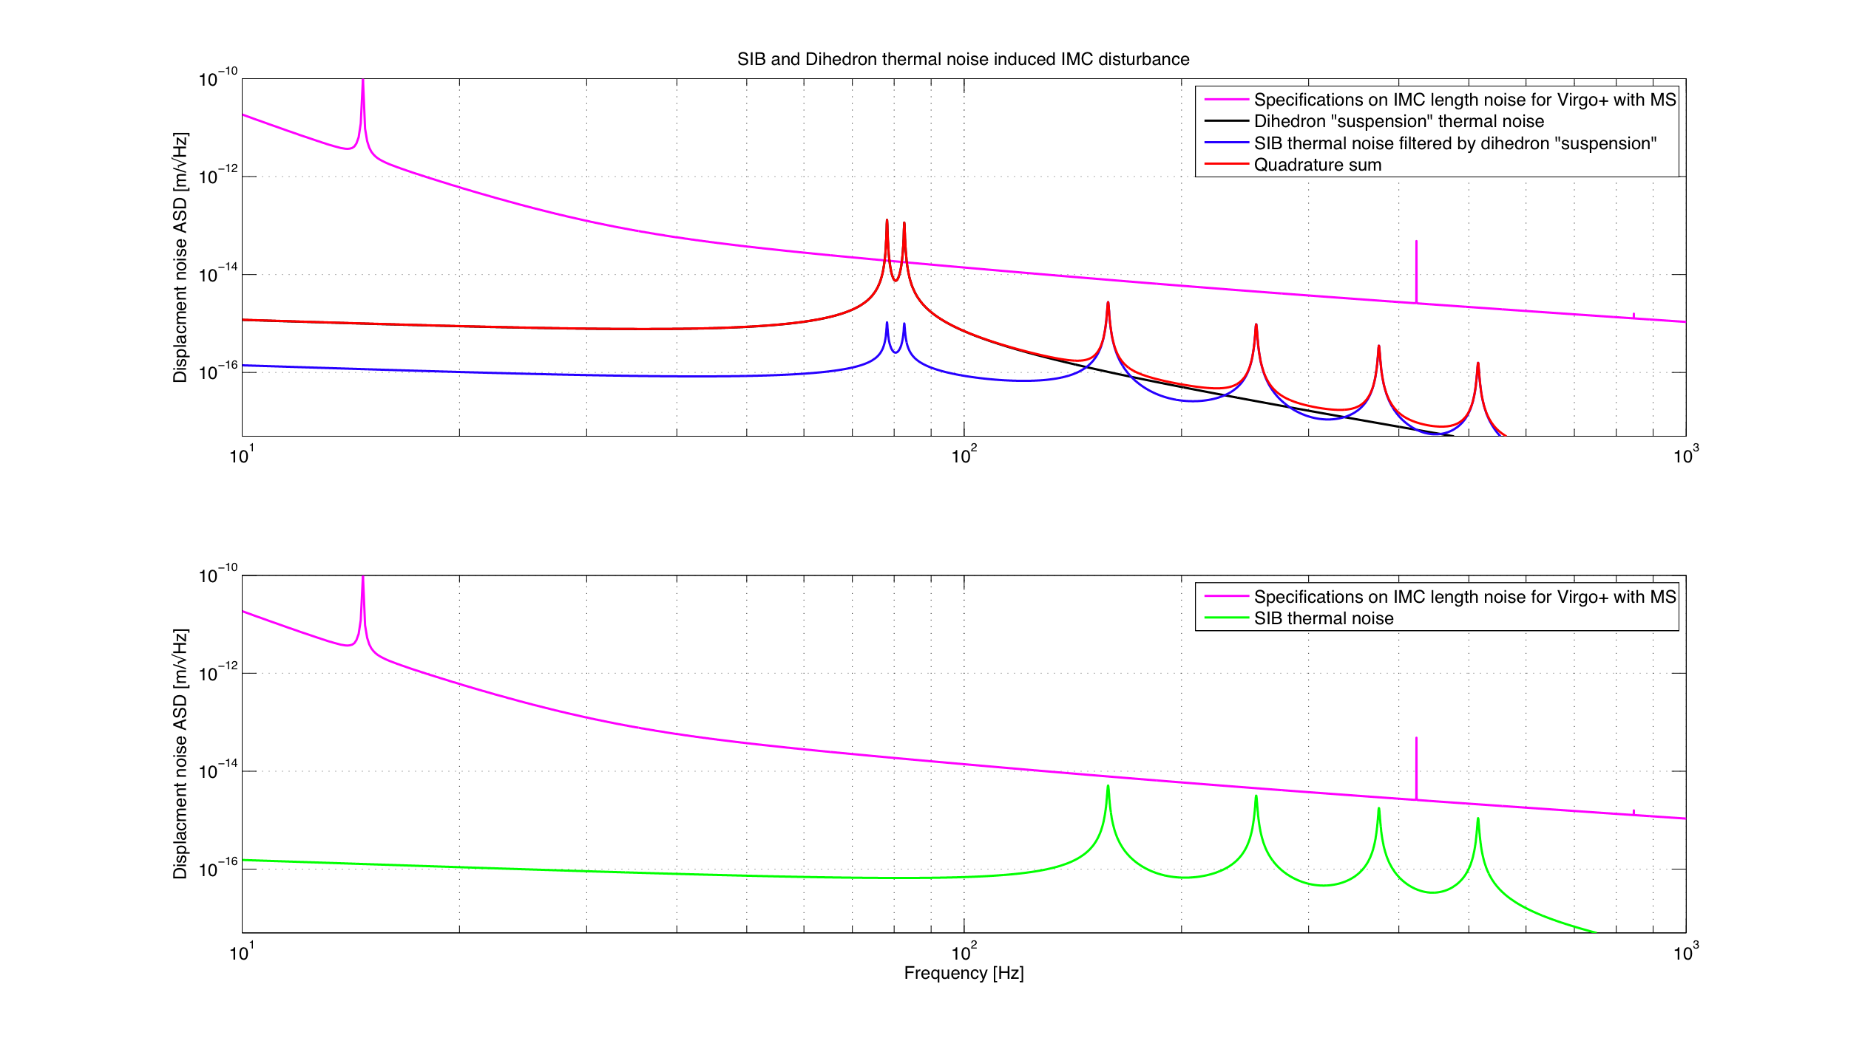
SIB thermal noise
support at ~ 80 Hz
V+MS - specs
sum
SIB_{th} - filtered
DiHe_{thermal}
F. Bondy, VIR-0558-10.pptx
V+MS - specs
SIB_{thermal}
10 Hz
100 Hz
1000 Hz
David Rabeling

Slide 21
Dihedron - Status
Supports
present support causes resonances around 80 Hz ;
had been working on soft support (ν ~ 10 ... 15 Hz) ;
problem: can this work without a control system ? ?
in fact, soft support might not be needed . . .
earlier this year decided to produce solid support :
  dubbed “monolithic” ;
2 solid supports with different contact points ;

Slide 22
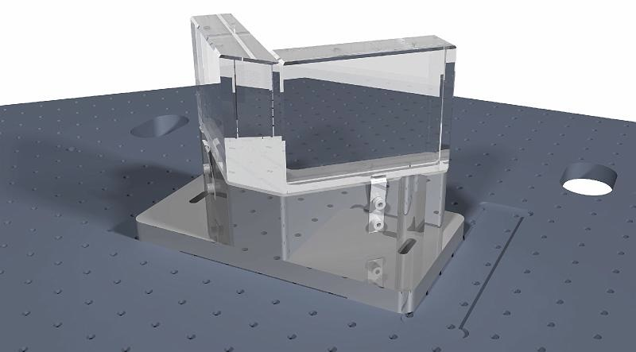
monolithic support
Flat tops

Slide 23
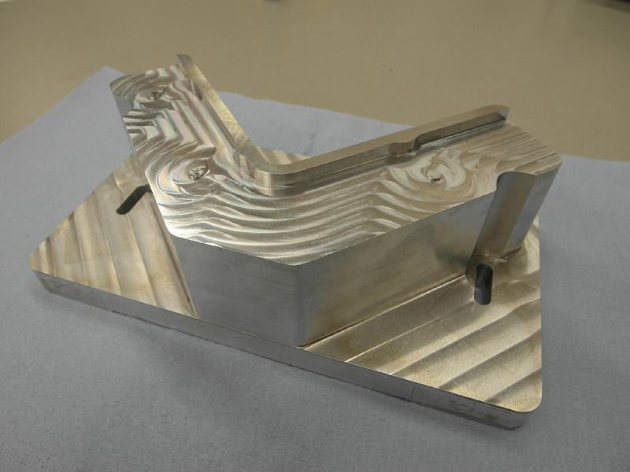
monolithic support
Flat tops
Flat tops:
Dihedron rests on
little protruding
circles;
positioned with springs against alignement points .

Slide 24
monolithic support
Flat tops
3 alignment
points
3 Flat tops

Slide 25
monolithic support
Flat tops
3 alignment
points
Flat top

Slide 26
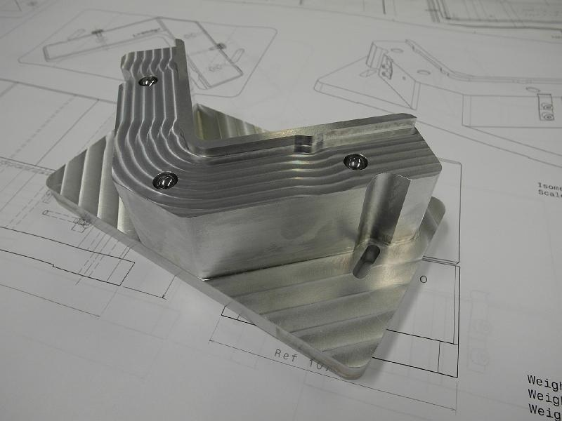
monolithic support
Steel spheres

Slide 27
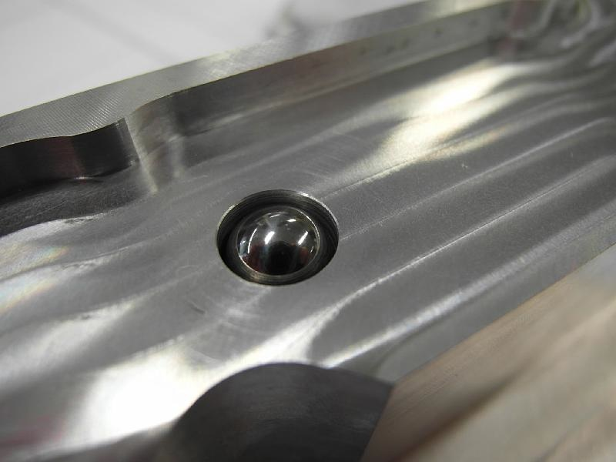
monolithic support
Steel spheres
sphere in
conical hole

Slide 28
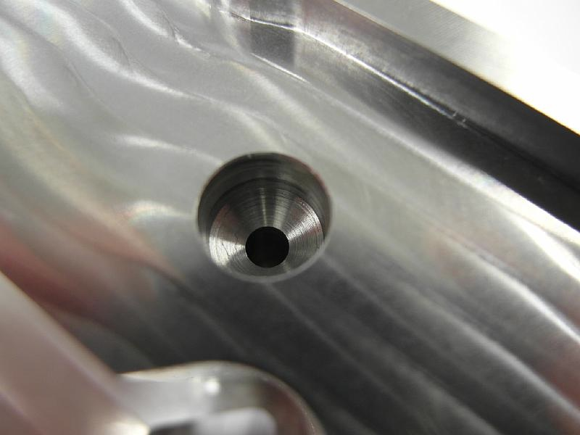
monolithic support
Steel spheres
conical hole
for sphere

Slide 29
Dihedron - Status
Question:

Slide 30
Dihedron - Status
Question:
is the plane defined by the 3 spheres
parallel to ground plate?

Slide 31
Dihedron - Status
Question:
is the plane defined by the 3 spheres
parallel to ground plate?
this has been measured,
deviation is < 3 μm (probably less than 1 μm)
( corresponding to angle of ~ 10⁻⁵ )

Slide 32
Dihedron - Status
Supports
coating not before end Octobre :
can we establish that
  either: monolithic support does not transmit thermal noiseof SIB;
  or: we need an attenuation of thermal noise of SIB ?
Solution:
  mount present dihedron on a monolithic support.
  this should eliminate resonances at ~ 80 Hz;
  if new resonances appear: must develope a controlled support . . .

Slide 33
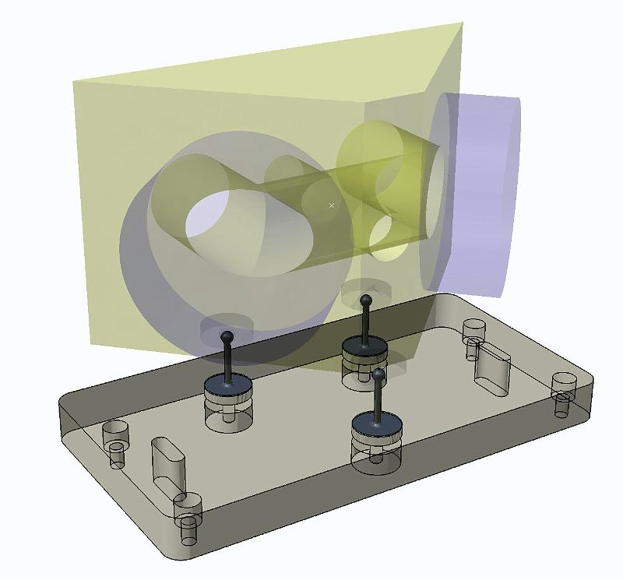
monolithic support
old Dihe +
actual situation:
Dihedron rests on legs;
positioned with
“point-straight-plane” method.

Slide 34
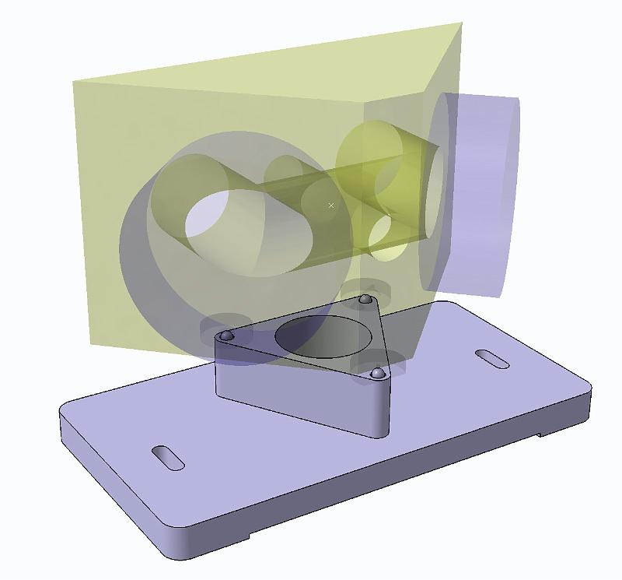
monolithic support
old Dihe +
replace legs by 3 spheres
position DiHe with
“point-straight-plane” method.

Slide 35
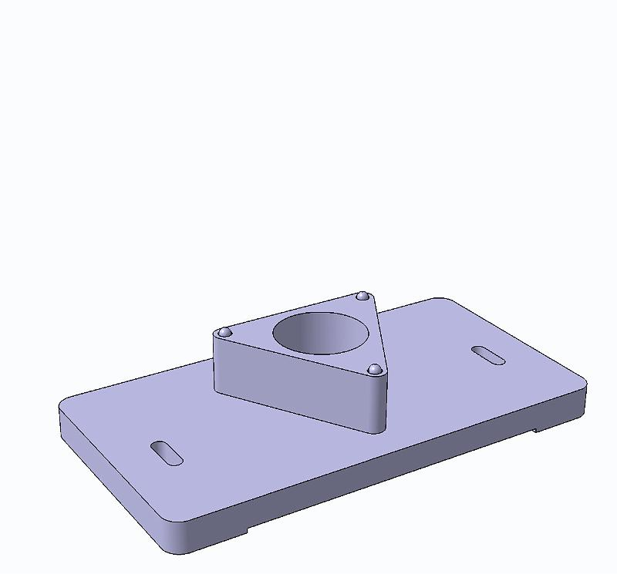
monolithic support
old Dihe +
design ready,
to be machined.

Slide 36
Summary
Dihedron advances:
2 substrates ready, surfaces measured ;
  cotating to be done by LMA ;
  ready by 2nd half Octobre .
3 leg support :
  not considered optimal ;
  2 new supports produced; “flat top” and “steel spheres” ;
  ready for characterization .
since coating is delayed :
  test if thermal noise of SIB requires attenuation :
  new support “steel spheres” for old DiHe designed ;
  ready for machining and characterization .

