Slide 1
Commissioning after VSR4
July 18 2011
E. Calloni for the commissioning crew

Slide 2
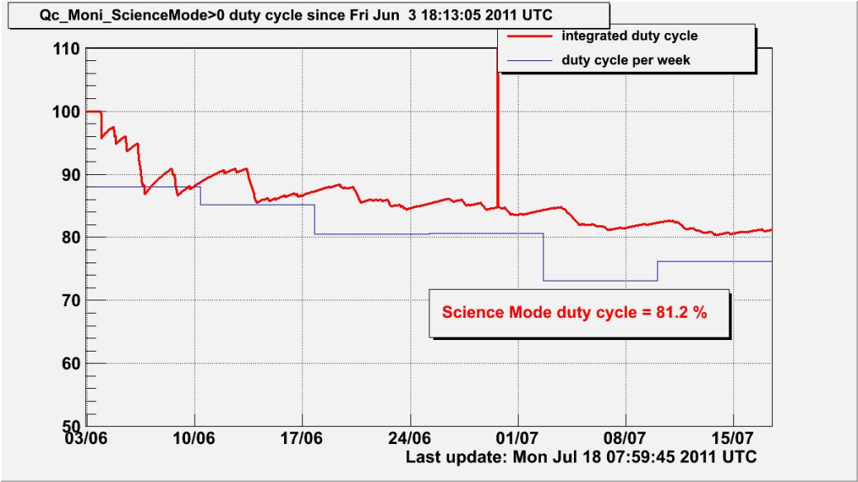
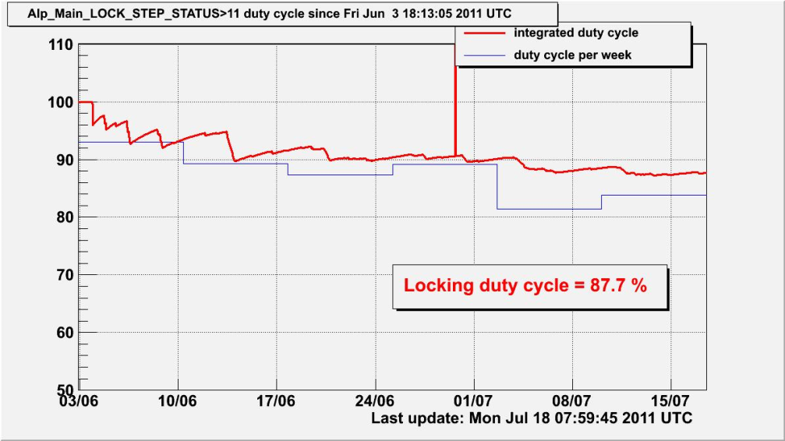
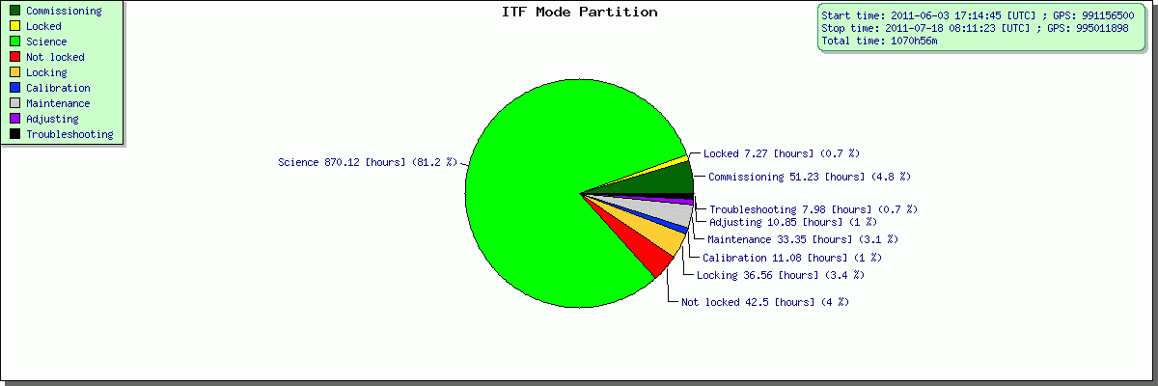
Science Mode duty cycle 81% -- Locking 87%
The locking duty cycle is almost 90%

Slide 3
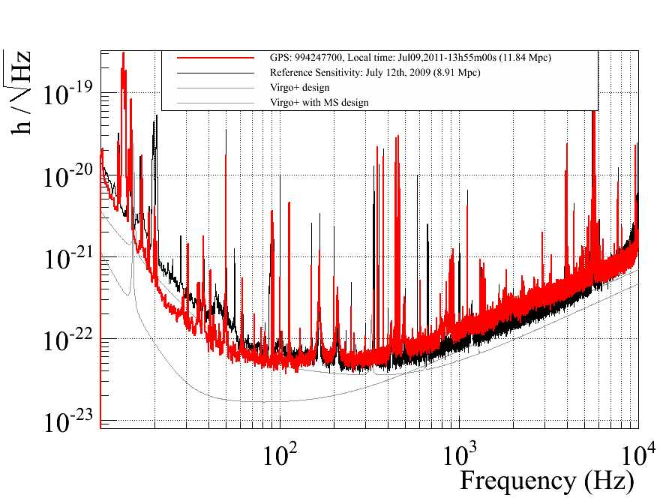
Sensitivity
Remarkable
Improvement
at low frequency

Slide 4
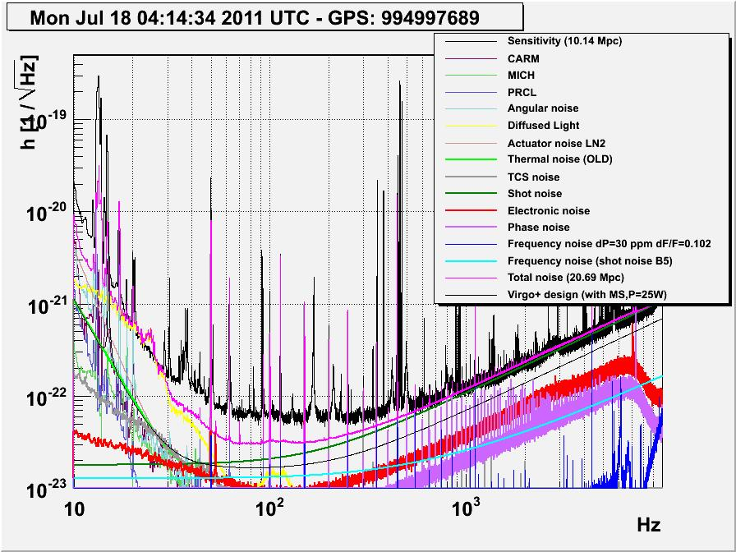
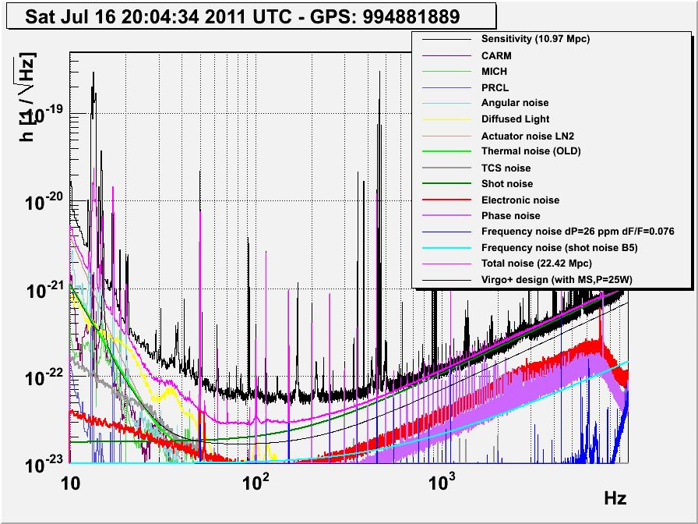
Diffused light noise
Microseism - antropic
Marionetta actuator
noise at very low frequency
Measurements on Qs for intermediate frequencies

Slide 5
Short term activities
New measurements on input mirrors if needed
Work to investigate and remove the diffused light noise
Lower the marionetta noise contribution
Control noises..

Slide 6
Longer term
The works after VSR4 will be works devoted to Adv-Virgo
Toghether with Henrich Heitmann we collected proposals for using the ITF for tests useful for Adv-Virgo
Some discussions during commissioning weekly meetings
Henrich Heitmann will start the discussion tomorrow

Slide 7
Proposed post-VSR4 works
Request for post-VSR4 work proposals open since April
  Works useful for AdV preparation / understanding important V+ issues
Demands received:
  INJ: installation/tests of new dihedron (3 weeks)
  INJ-SBE: installation/tests of EIB-SAS (10 weeks + commissioning)
  INJ: thermal compensation for MC mirror (7 days)
  DET: substituting end bench cameras (1 shift)
  DET: diaphragm installation on suspended DB (5 days)
  DET: test of alternative OMC locking scheme (2 shifts)
  ISC: ITF control from marionette (3 weeks)
  VAC: valves stiffening (1 week), leak search (4 weeks, can be split)
To be confirmed / clarified
  Commissioning: understand LF sensitivity / thermal noise
  Use of phase camera for TCS
  Others?
Planning to be set up
  Works to be done / sequence / priorities to be decided
Commissioning
Some impact on comm.
Construction/installation

