Slide 1
Infrared Camera Software Deployment & Architecture Proposal for Camera Data Acquisition, Processing and Distribution
G. Ballardin, F. Carbognani, E. Pacaud,D. Sentenac

Slide 2
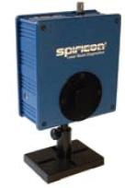
IR Camera Hardware Installation
IR Camera : PyrocamIII from SPIRICON
References :
http://www.ophiropt.com/laser-measurement-instruments/beam-profilers/products/industrial-applications/the-cameras/pyrocam
https://pub3.ego-gw.it/itf/hwii/index.php?content=2&step=2&thisPart=02629
https://workarea.ego-gw.it/ego2/ego/itf/software/auth-only/projects/infrared camera/infrared-camera
Installed :
  2 IR Cameras on NI & WI TCS benches
  PC Windows with FireWire PCI 3 ports, in between NI & WI

Slide 3
IR Camera Software Deployment (1)
Image acquisition through FireWire
Pieces of software supplied by SPIRICON :
    ActiveX Windows ieee-1394 driver (FireWire)
    Labview blocks ready for data acquisition
Virgo commissioning requirements :
  Remote image display (full 124x124 pixels)
  1Hz averaged images to DAQ
  Possibility to switch ON/OFF the camera remotely

Slide 4
IR Camera Software Deployment (2)
(Labview, 1 Windows PC) NICameraServer & WICameraServer :
  Acquire images up to 24 Hz through FireWire (2 ports)
  1Hz average NI & WI images
  Associated machine GPS timestamp
  Upload timestamped averaged images to bridge MySQL database at 1Hz
  Distribute instant images to any connected clients
(Labview, Linux) CamClientWI & CamClientNI
  Connect to WICameraServer & NICameraServer (ip,port address)
  Display instant images sent by servers at a quite fast rate (>10Hz)
DbFrGetImage (Linux, FdIOServer) :
  Grab NI & WI images at 1Hz, and captured image timestamp from bridge MySQL database
  Can perform data analysis with possibility to link to matlab function
  (like CtrlSrv for phase camera)
  Release images in clocked Virgo frames with timestamp difference to give a rough idea of real image capture time
Remote access to Windows PC using vncviewer
  Camera can be set ON/OFF using CHOPPED/PULSE modes

Slide 5
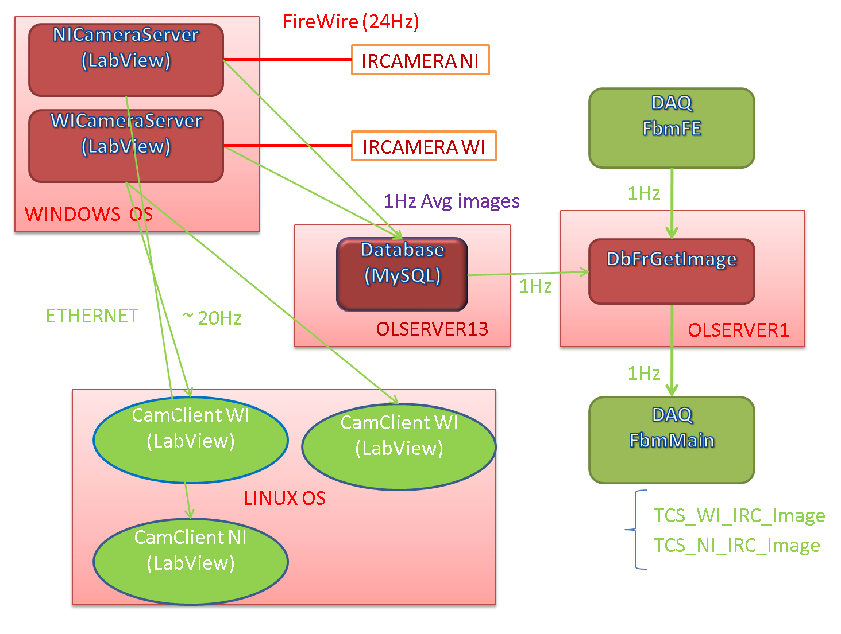
IR Camera Software Architecture
Possibility to
Integrate camera
controls
SMS GPSdiff

Slide 6
Proposal for Camera software architecture
Motivations :
Preliminary work done using DBK21AF04 camera from Imaging Source vendor
Investigations for possibility of ieee-1394 driver for Linux (better solution for Virgo framework integration)
  FireWire Camera standard IIDC (DCAM)
  Kernel module installation on rtpcvtf (from Linux distribution)
    ieee1394*: core of the IEEE 1394 subsystem
    raw1394*: higher-level module for bus access
    video1394: fast DMA frame transfer module
    a low-level host-card driver such as ohci1394
  Test some ready to use Open Source software
    coriander
    libdc1394

Slide 7
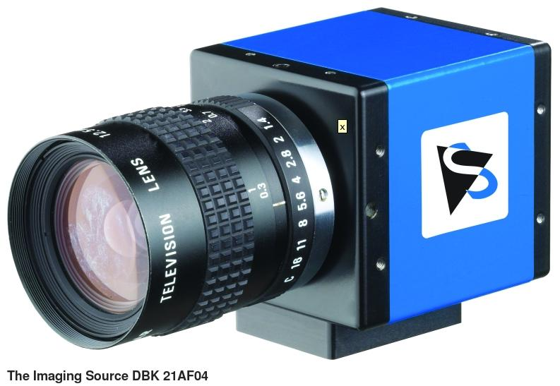
Setup (1)
Hardware :
RTPCVTF image acquisition machine
  1 FireWire port available
  512 KB memory
  CPU dual core 2.4 Ghz
  1024 KB of cache
CMPLxx image display machine :
  1GB ram memory
  CPU dual core 3.2 Ghz
  2048 KB of cache
DBK21AF04 camera from Imaging source:
  1 FireWire external link
  640x480 pixels, 8-bits image output
  Max 60 fps

Slide 8
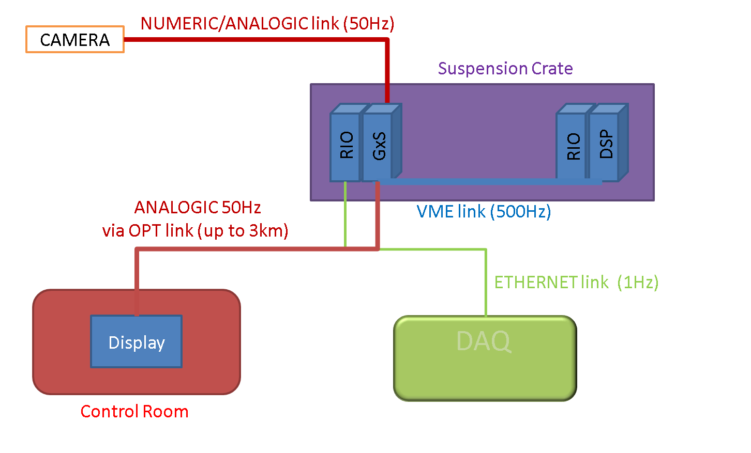
Virgo Camera Hardware Architecture

Slide 9
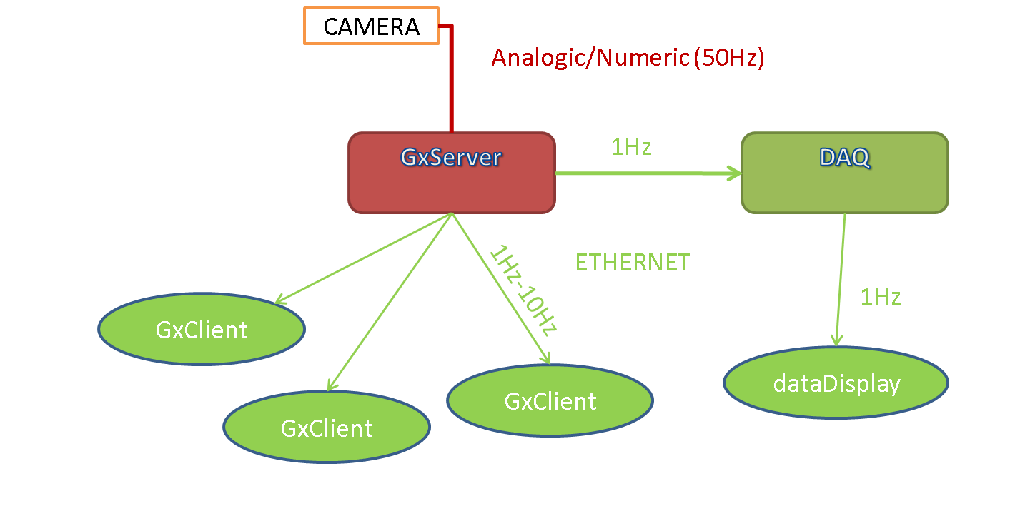
Virgo Camera Software Architecture
RIO
/ Cm
2/3-tier Architecture
1.GxServer
2.GxClient / DAQ
3. dataDisplay

Slide 10
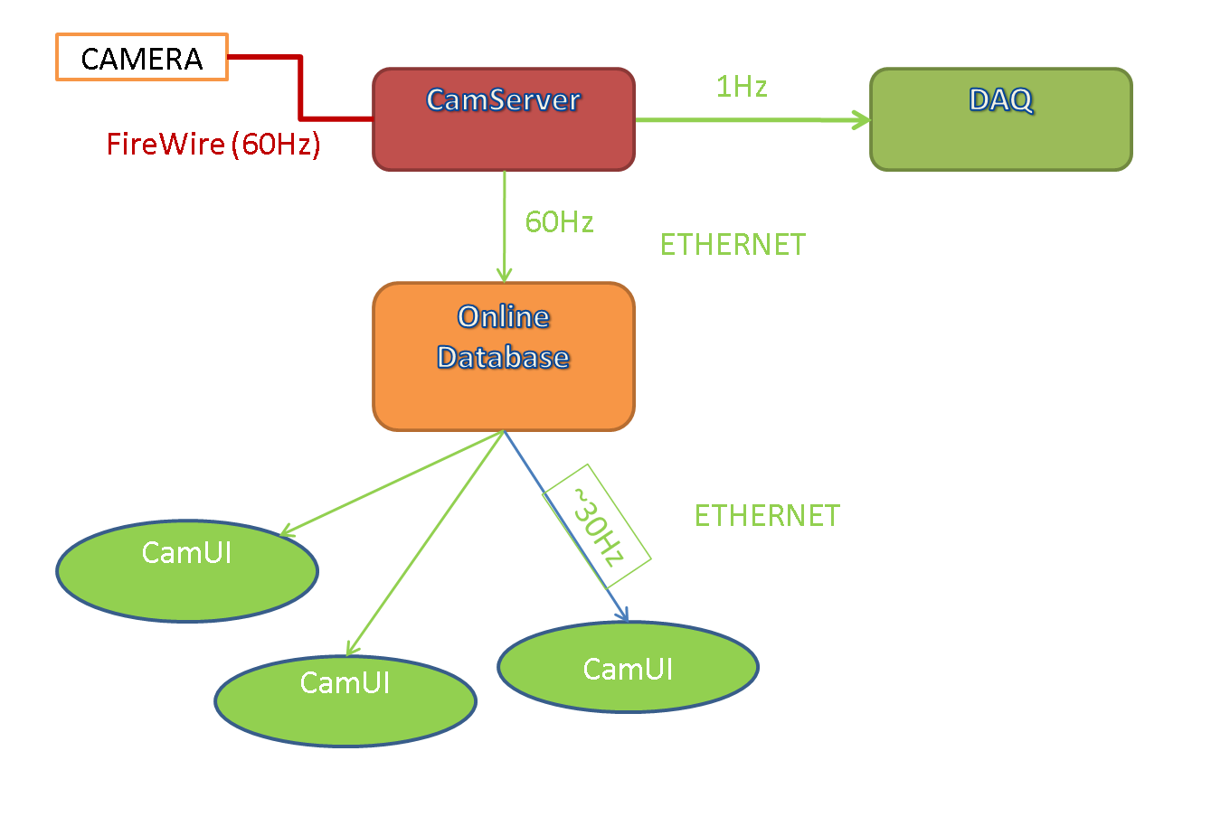
Setup (2)
(Cm messaging service)
rtpcvtf
Image table
(process multithreaded)
index | DMA timestamp (us) | Image (bytes) | Size (bytes)
1 | 124722053111941 | [BLOB - 300.0 KB] | 307200
rtpcvtf
3-tier Architecture
1.CamServer
2.DAQ / Database
3.CamUI / dataDisplay

Slide 11
Test Results
CamServer optimal writing thread cycle reached (60Hz):
  1 image written in database : ~2500 < eTime < 6000 usec
  Full cycle : 16660 usec (0.999600 seconds / 60Hz)
  Processing time available : ~3000 usec
  Estimation of DMA enqueue/dequeue operation time: ~ 4000 usec (tested in POLL mode)
CamUI client with 1 to 6 image display threads
Number of threads | Refresh rate (Hz) | Latency (ms) | CMPLxx CPU load(%) | RTPCVTF CPU load(%)
1 | 40 | 30 | 60 | 25
6 | 15 | 90 | 100 | 30
Increasing number of display threads does not alter the writing efficiency
of the database (CamServer keeps writing at 60Hz)
Display latency & refresh rate may be optimize by increasing CPU power

Slide 12
Conclusions (1)
The proposed architecture overcomes the issue of overloading the image acquisition server:
  1: data acquisition & processing tier
  2: data distribution tier (Database / DAQ)
  3: client tier (control and display image from everywhere)
We do not need direct analogic/optical link between control room and cameras to obtain quasi real-time remote beam imaging
1 display → 30 ms latencies for ~40Hz refresh rates
MySQL database is proven to be a very powerful service, not only for offline activities (HWII database) but also for intensive online activities like camera image distribution Why ?
Because a Mysql database can be used as a robust multithreaded process holding data in ram memory
More generally, this architecture could be thought to be applied to the DAQ
Could be used to replace the RFC Tra Image Beam camera

Slide 13
Conclusions (2)
This architecture can be used with an Ethernet camera (changes affects only image acquisition driver)
Does not cover the camera involved in control loops
Real-time loops involved in supension control require compatible (real-time) drivers :
For Firewire, would require adapted version of the low level library libraw1394 and kernel modules
https://workarea.ego-gw.it/ego2/ego/itf/software/auth-only/projects/r-d-camera-software/design-architecture

