Slide 1
Monolithic Suspension failures in Advanced Virgo
Flavio Travasso on behalf of AdVirgo Monolithic Group

Slide 2
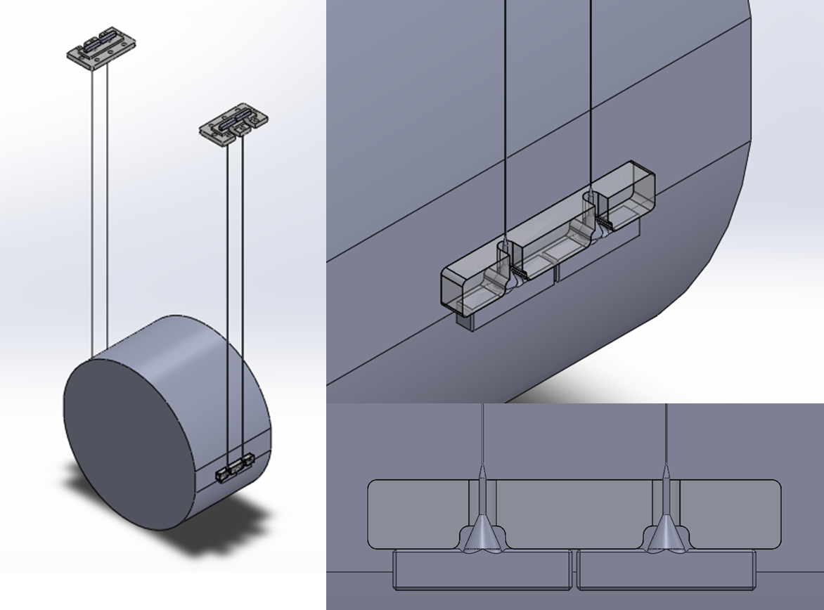
Overview of monolithic suspension assembly

Slide 3
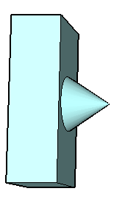
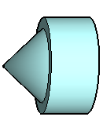
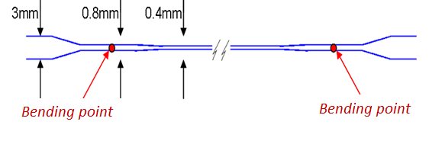
Monolithic suspension fibers
200 W CO2 laser
Dumb-bell shaped fiber (aLIGO)
fiber diameter 0.4mm
bouncing mode < 10Hz
violins modes > 400Hz
working load ~780MPa (reasonably safe, about the same of Virgo+)
Laser pulling of 1.5 mm thick silica bars:
Welding
Annealing
Controlled pulling

Slide 4
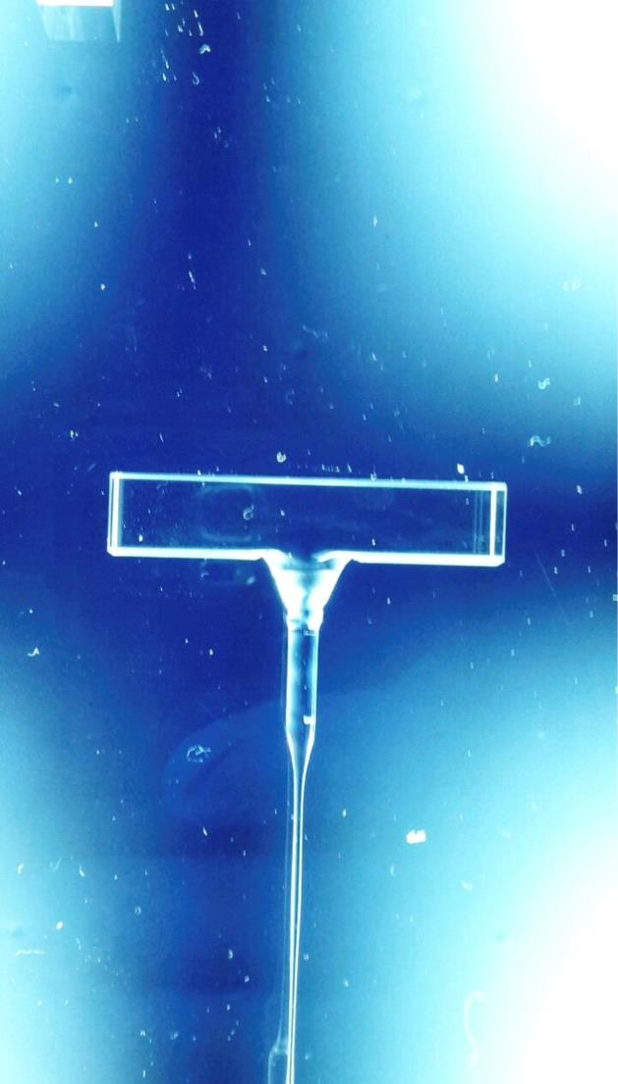
Overview of monolithic suspension assembly
The dumbell shaped fiber is produced and welded to the anchors.
Groove, necessary for polishing procedure
lambda/10 zone for silica bonding
The fibre with the anchors is tested with a load of 18/20 kg (nominal load is 10.5 kg).
The monolithic suspension is assembled, the tilt of the mirror verified.
The anchors are silica bonded to the mirror ears and to the steel support.

Slide 5
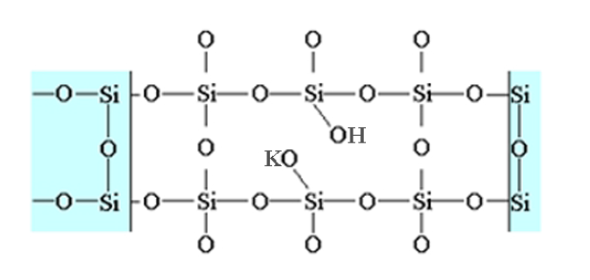
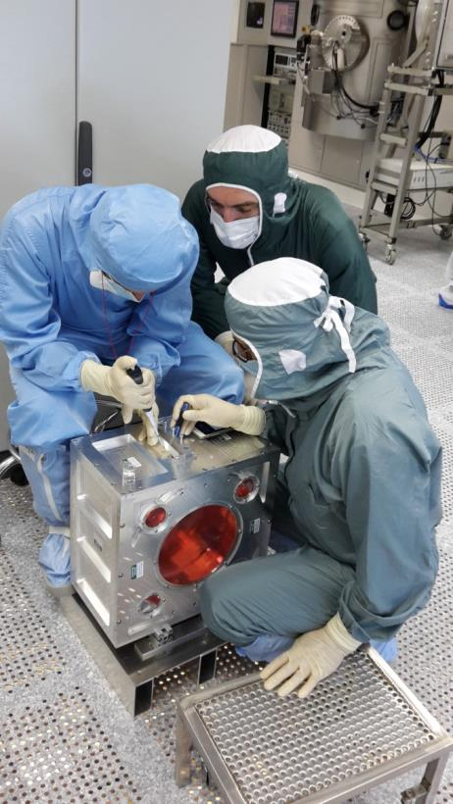
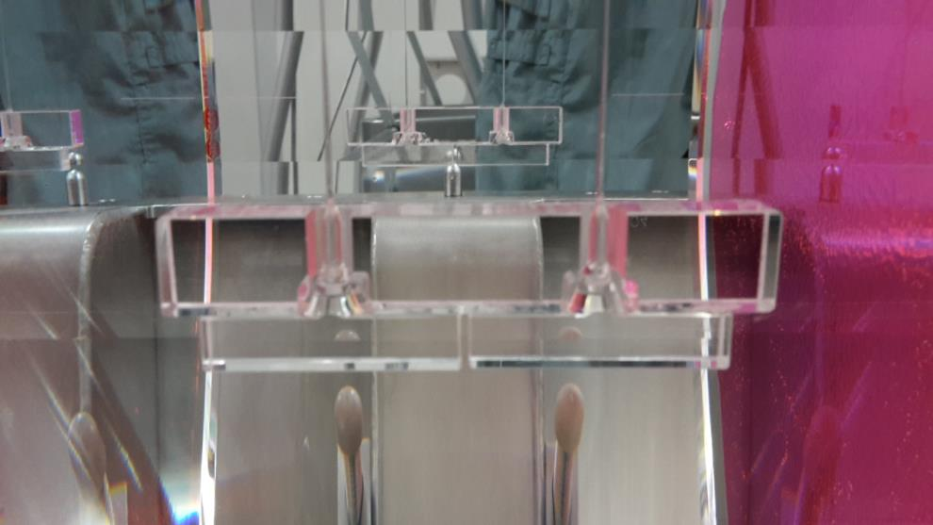
Gluing procedure
Silicate bonding technique
  very clean (piranha solution) and flat surface (λ/10)
  solution of pure water with KOH
LVC, Glasgow, Sep 1, 2016
F. Travasso on behalf of Monolithic Group

Slide 6
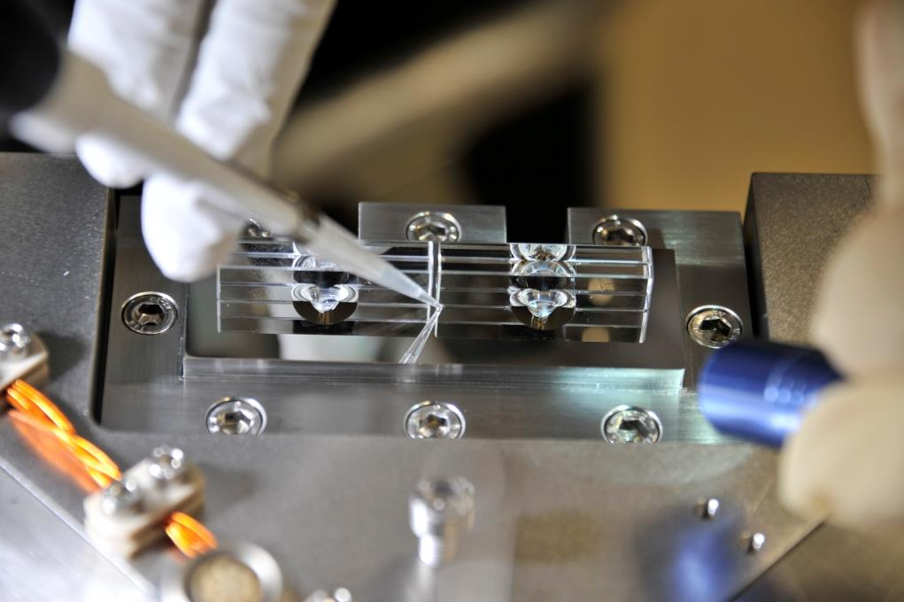
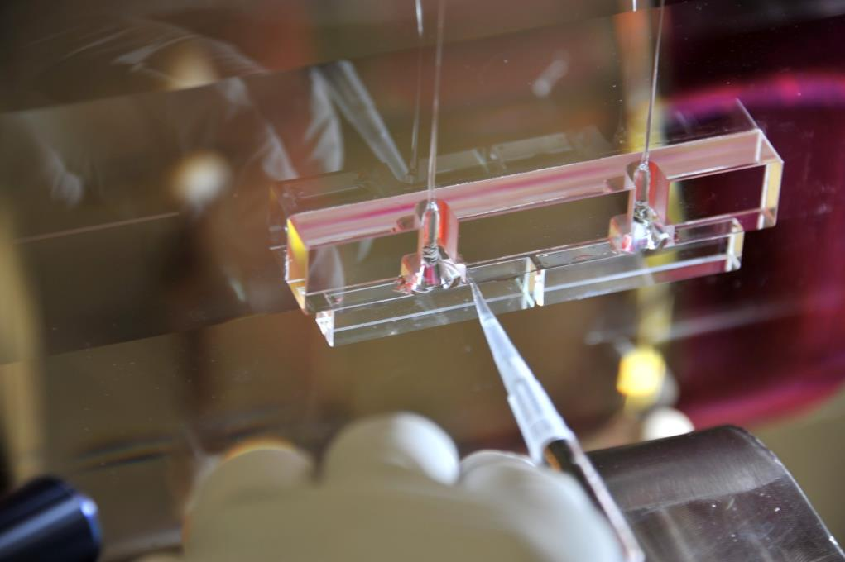
Upper clamp: the upper clamp system is formed by a steel plate with a λ/10 quality surface. The silica-steel parts are glued by the silicate bonding technique. For this kind of gluing, we measured a minimum breaking strength of 5MPa.
Lower Clamp: the anchors are glued to the ear by the silicate bonding technique.

Slide 7
Fibers Production and Validation
Procedure in detail
a) The two anchors are welded to the 3 mm silica rod;
b) The rod is laser polished (speed 0.03 mm/s, power about 50 W)
c) The fiber is pulled with a power 60 W.
Validation, length measurement:
d) The fiber is loaded with a loading rate of 0.2 kg/s up to 18/20 kg and then quickly unloaded;
e) Measurement of the lengths at 0 and 10.5 kg are extrapolated.
Bending points and violin mode measurements:
f) The fiber is loaded with 10.5 kg for about 30 minutes while the bending length and the violin frequency are measured.
Validation test just before suspension mounting:
g) Each fiber is loaded with a loading rate of 0.2 kg/s up to 12 kg and then quickly unloaded;

Slide 8
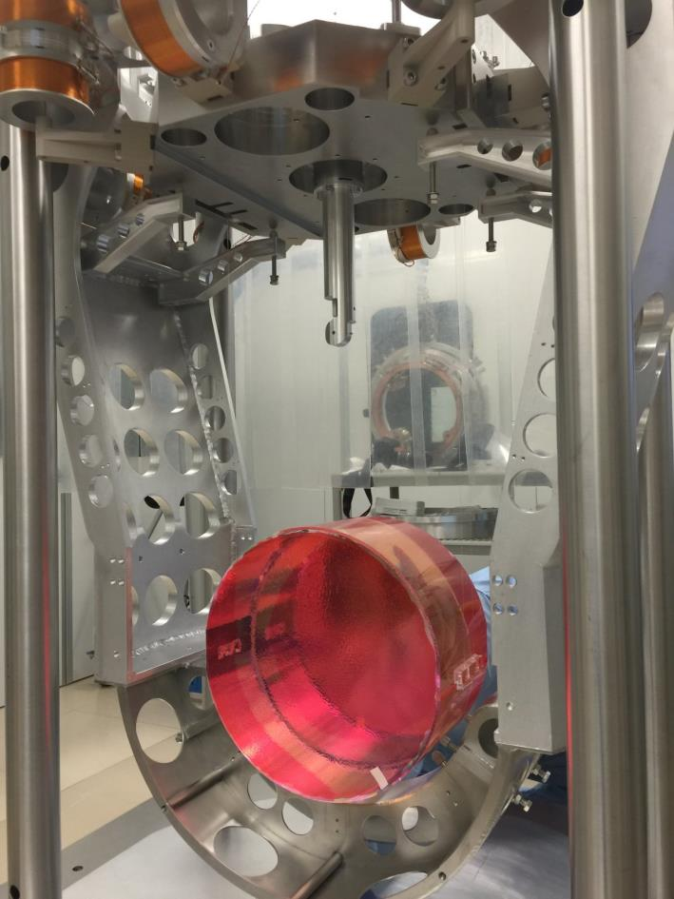
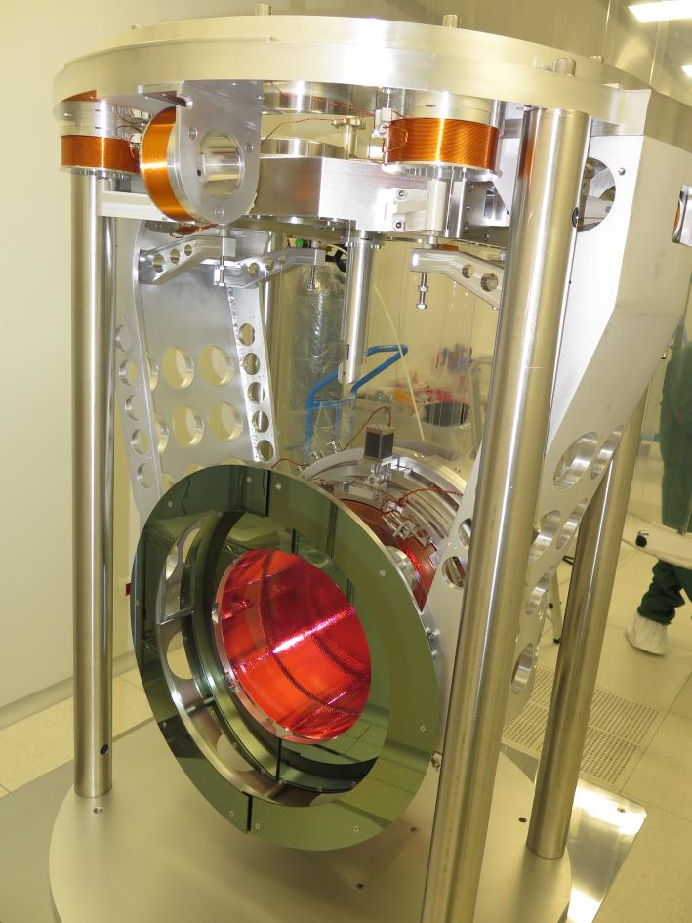
Mirror payload

Slide 9
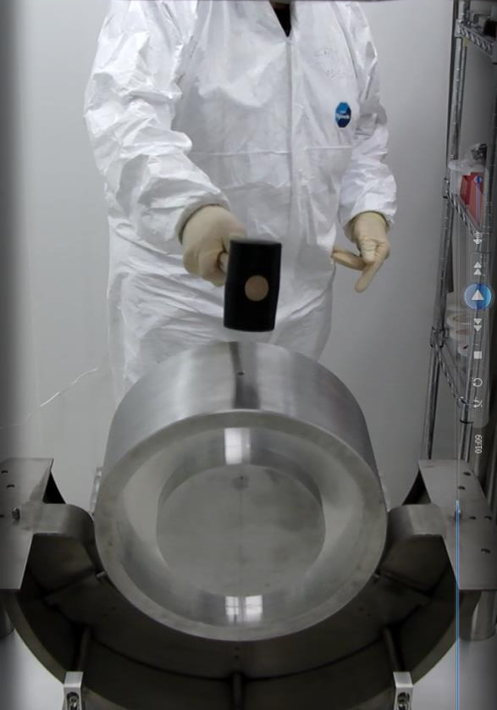
Hammer test
The hammer test was performed in November 2014 successfully
To download the video: https://www.dropbox.com/s/1txdt4ih0dmzxsw/CIMG3648.MOV?dl=0

Slide 10
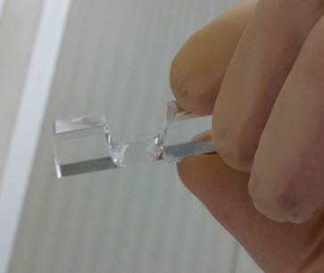
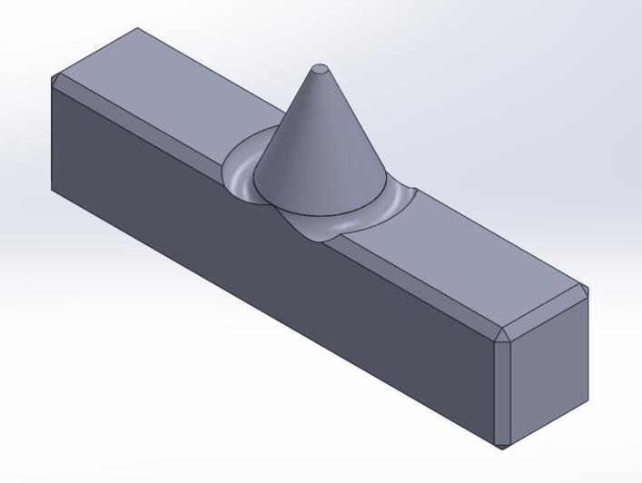
June 2015
VIR-0227B-16
In June 2015 we began to mount the WI payload with a new batch of anchors just arrived from Impex but a significant fraction of these anchors failed with a test load of 16-18kg (however the working load is 10.5 kg)
We tried some rapid tests to find out if a flame treatment of the surface of the cone and of the groove surrounding it: the load tests at 20 kg after this treatment showed no more breakings

Slide 11
Fused Silica Breaking Strength
In literature we found that the material breaking strength of fused silica (due to the molecular force) is about 7GPa.
For all our testes and designs, we used the nominal breaking strength of 50MPa that is about 100 times less than the material breaking strength: it is the quality of the surface to dominate (cracks)
e.g. the breaking strength of the fiber is 4GPa because without any crack is present on its surface (laser production). But if someone touches the fiber, he produces a little crack that reduces immediately its breaking strength and destroys the fiber

Slide 12
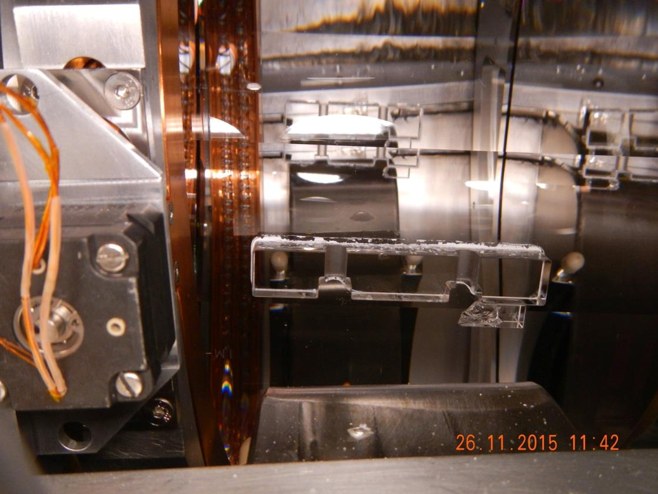
WI failure
The WI was in air for 5 months under the tower to be balanced (SA and Marionetta) => big mechanical stress/excitation without any problem. After 9 days in vacuum it failed

Slide 13
Mirror refence system
AR
1
4
2
3
HR
View from the top

Slide 14
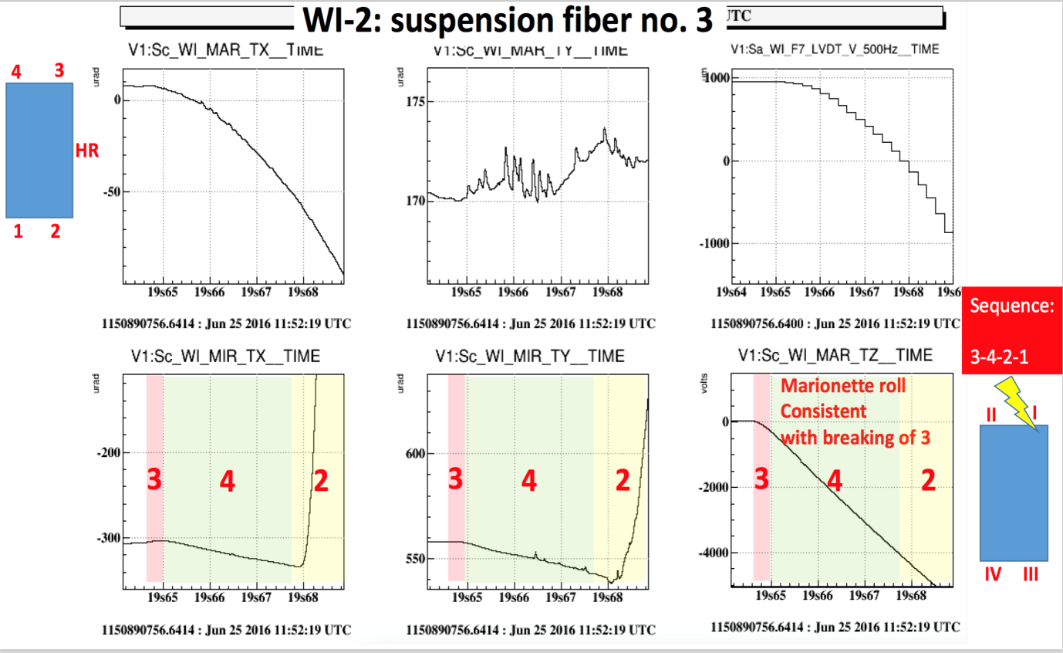
Fibers breaking sequence
Using the local control, it is possible to reconstruct the sequence of the breaking of fibers (Ettore Majorana)
VIR-0370A-16

Slide 15
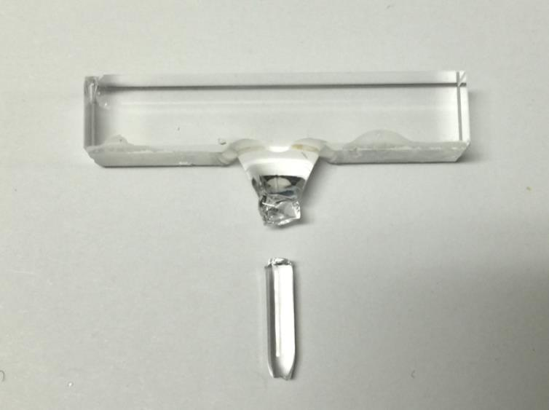
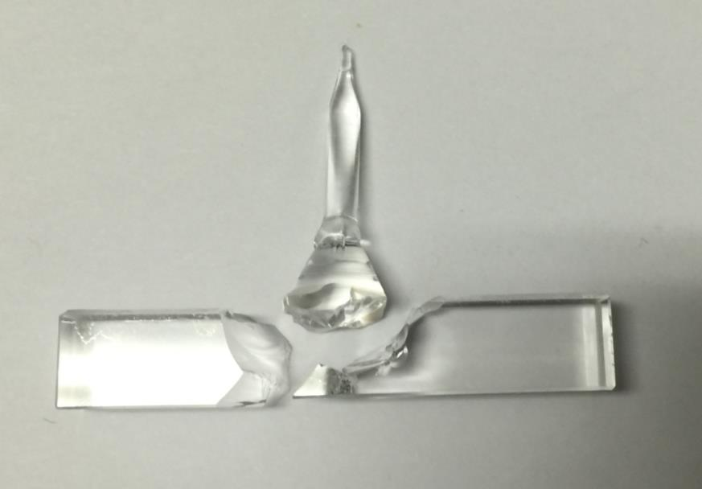
WI - Anchors n°3
According to the data the crash began from this fiber: it can be started from the lower cone (or at least from the upper welding…).
UP
DOWN
Very similar to the breaking we had during the test
VIR-0123A-16

Slide 16
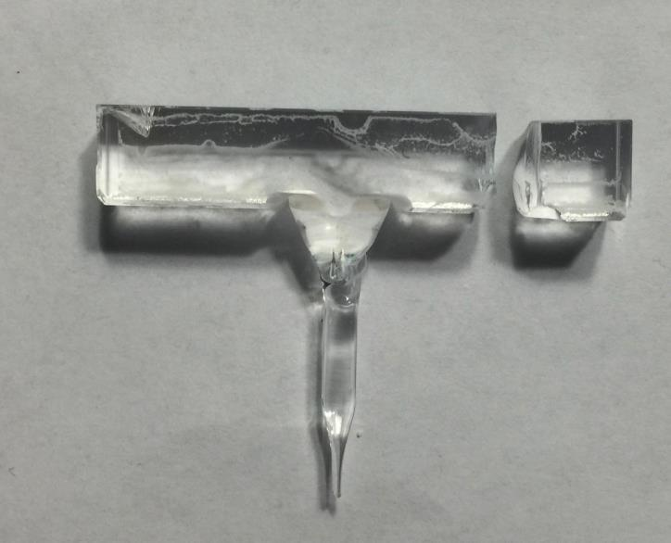
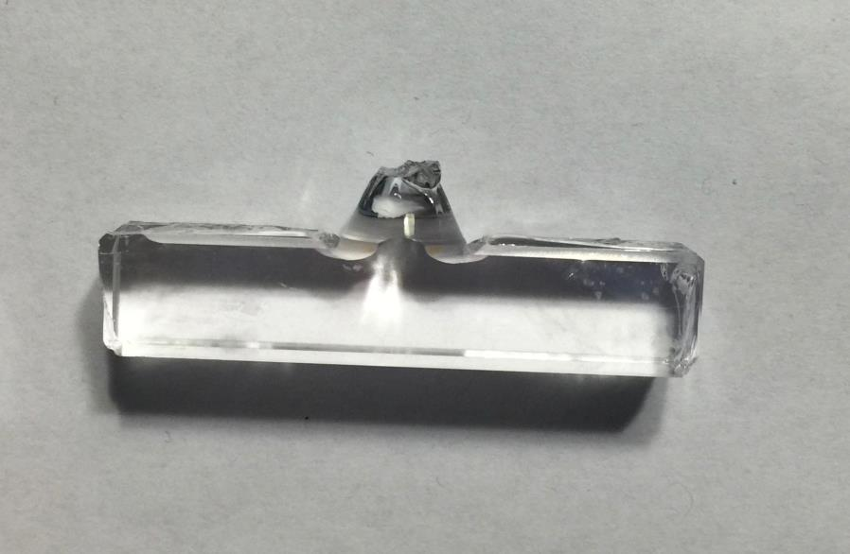
NI - Anchors n°2
According to the data the crash began from this fiber: it could be started by the fiber or lower welding point
UP
DOWN
In this case we don’t have a clear indication about the anchors
VIR-0123A-16

Slide 17
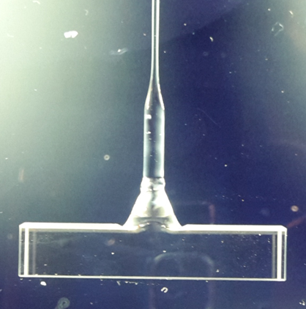
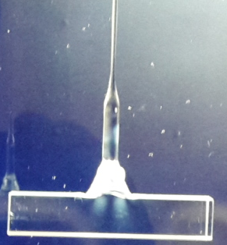
Polariscope
Although we had no clear indications that the problem could be in the anchors, we suspected them also for the analysis through the polariscope
Not Flamed
Flamed
Residual stress (about 1kg)

Slide 18
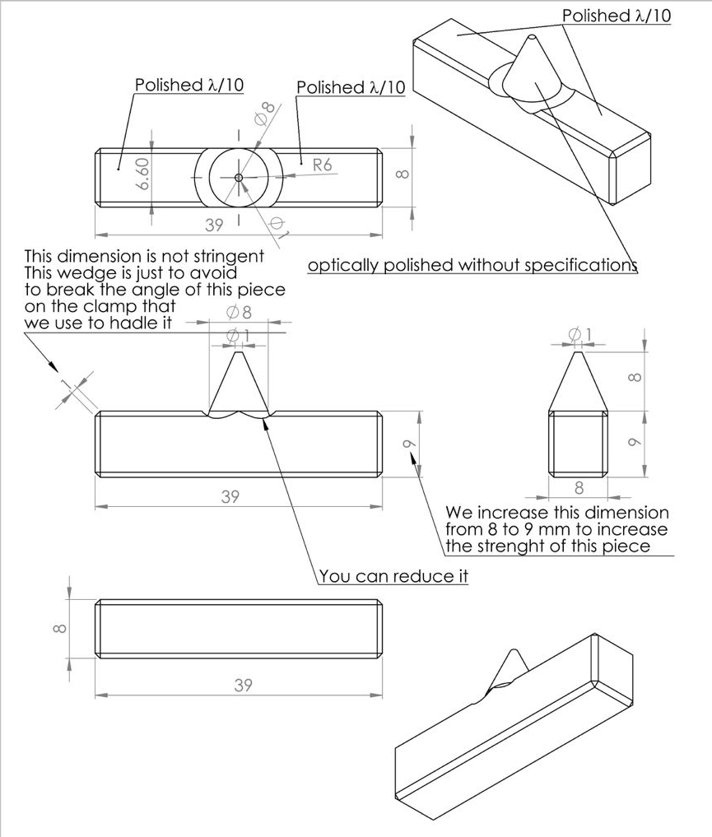
New anchors
The suspect and the fear of the problem with the anchors pushed to ask for new thicker and more polished anchors
The company used a new vendor for the fused silica, as well
VIR-0228A-16

Slide 19
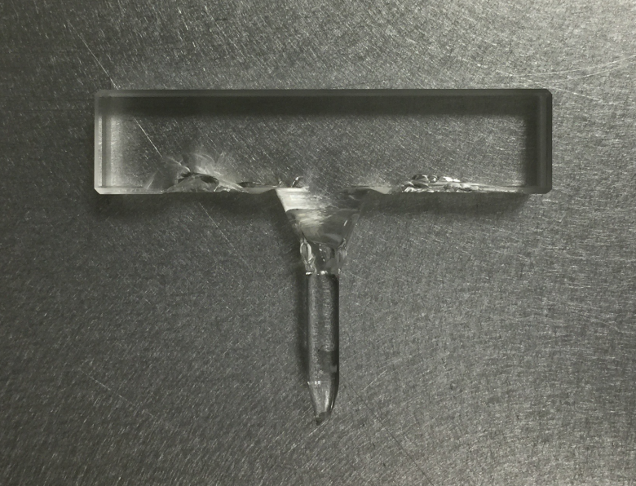
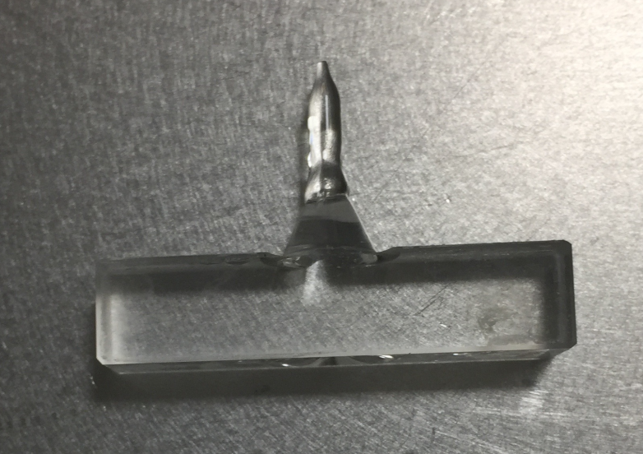
2° NI - Anchors n°2
According to the data the crash began from this fiber. The anchors performed as expected. The failure could be started at the level of the fiber or at the level of the 3mm bar close to the welding.
UP
DOWN
VIR-0123A-16

Slide 20
2° WI - Anchors n°3
According to the data the crash began from this fiber. The anchors performed as expected. The failure could be started at the level of the fiber or at the level of the 3mm bar close to the welding.
UP
DOWN
VIR-0123A-16

Slide 21
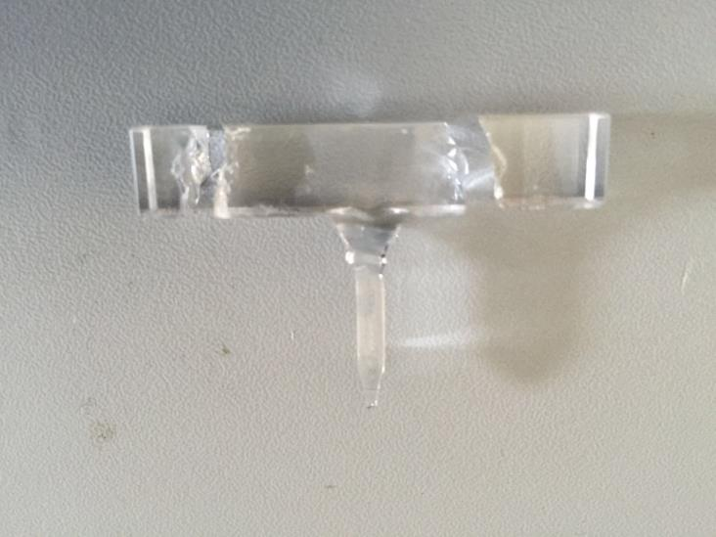
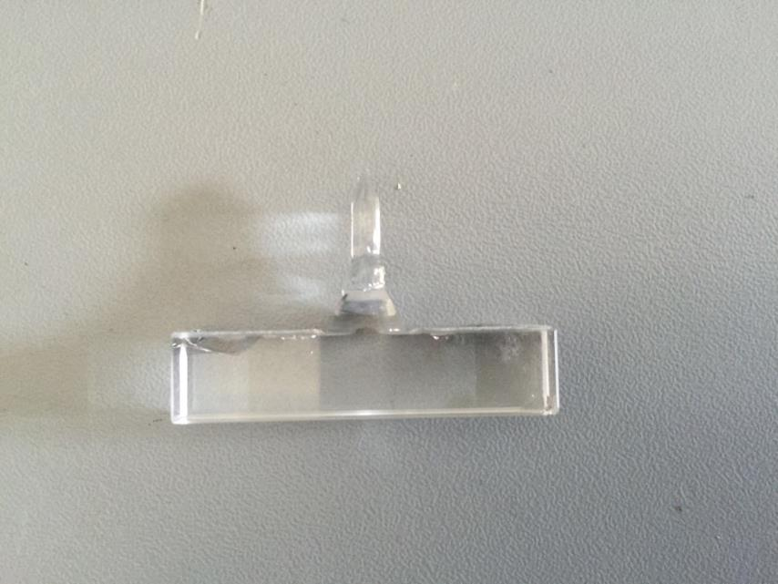
WE - Anchors n°3
According to the data the crash began from this fiber..it seems that the failure was induced by the fiber
UP
We have stroger anchors but it is not enough
There is another weak point and we are working on it using different tests
DOWN
VIR-0123A-16

Slide 22
Suspensions history
First failure likely originated by anchors
  more robust anchors designed and implemented
Last 4 failures likely originated from fiber/welding
All suspensions failed in vacuum also if 3 of them survived few months (4-7 months) under load in air
All of them passed standard compliance tests in air
VIR-0227B-16
Mirror failed | Failure date | Time in air | Time in vacuum | Anchor type | Likely cause
WI | Nov 18th, 2015 | 5 months | 9 days | old | Anchor collapse
NI | Dec 18th, 2015 | 4.5 months | 5 days | old | Fiber/welding failure
NI | Mar 1st, 2016 | 1 week | 5 days | new | Fiber/rod failure
NE | No failure | 6 months | 4 months (currently) | new | No failure
WI dummy | Apr 25th, 2016 | 1 week | 11 days | mixed old | Anchor collapse
WI dummy | No failure | 2 days | 2 weeks | mixed old | No failure
WI | Jun 25th, 2016 | 1 month | 30 days | new | Fiber/welding failure
WE | Jun 28th, 2016 | 7 months | 18 days | new | Fiber/welding failure

Slide 23
Project choices
Involvement of LSC experts (thanks to all of them!)
  First discussions with the LIGO team
  Close relationship with the Glasgow group. A Bell and G Hammond here to follow the assembly/integration phases of a payload
PL/commissioning coordinator pushed for suspending one mirror with steel wires
  Rough suspension realized on NI
  Allowed to start real commissioning!
Pushed to study a backup option (steel wires) allowing to catch O2 if new failures happen
  Solution used for WI and WE payload

Slide 24
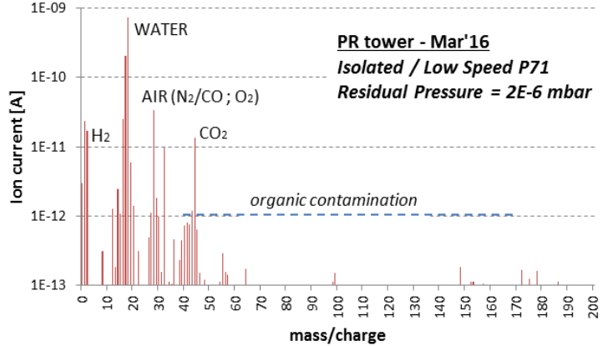
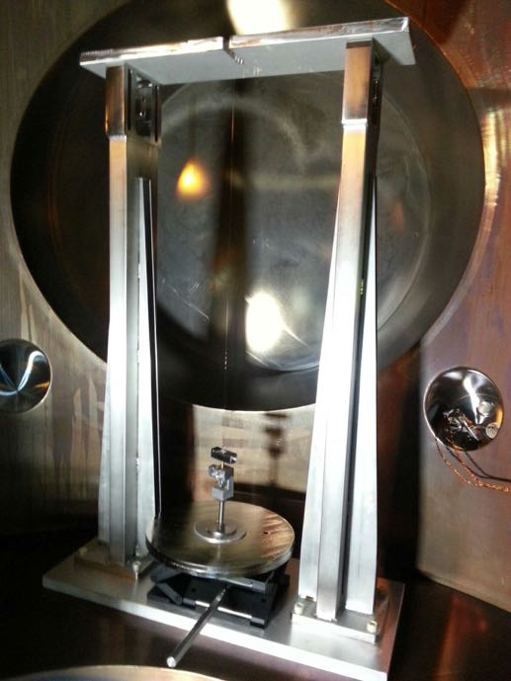
Vacuum Analysis
After the failure, checks of the vacuum contamination: No significant evidence
VIR-0227B-16
Moreover, one spare fiber produced for NI-WI payload was suspended with 10 kg for 2 weeks in vacuum in the NI tower without problems

Slide 25
Vacuum tests
Humidity and contaminants
Humidity (In literature the humidity increase the speed of the propagation of cracks)
  Test in Perugia and Urbino: OK – fiber survived
Vacuum contaminants:
  Soap, pickling, acid: all of them tested in Perugia and Urbino: OK – fiber survived
Air fluxes:
  Standard air conditioning in the Perugia lab was OK
  Different condition tested in Urbino and in LIGO: fibers OK
Hair touching fiber:
  hair blown with a speed of 1m/s on a fiber: survived for 4 months and then it broke in the point where the hair touched (Urbino)
Dust, metallic powder:
  Aluminum powder (10-100 μm) is blown against the fiber: the fiber failed after few minutes..as expected (Urbino)

Slide 26
Partial results
Humidity and water with soap does not cause breaks
Pickled metallic parts does not cause breaks
Human hair carried by air flux causes a break after few months (not weeks as in our cases)
Metallic powder hitting the fibers, even at moderate speed, produces an instantaneous break: is there metallic powder inside the tower? Could it put in motion by air fluxes inside the tower?

Slide 27
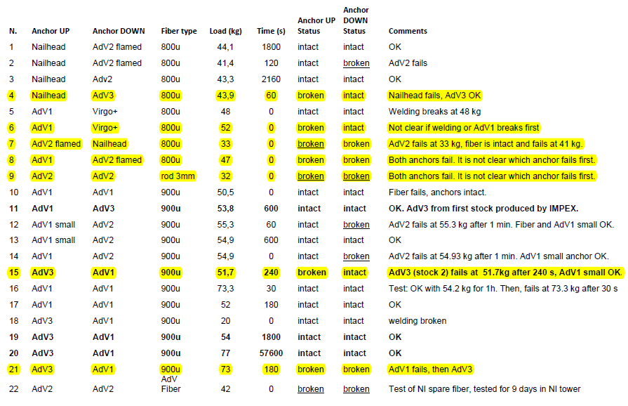
Anchors test 1 – BS for different anchors
VIR-0227B-16
It is clear that these tests are not systematic nor exhaustive: for the usual lack of time, but also because the cost of an anchor is about 1 kEuro, a large set of spares was not available, and we had to find a trade off between the necessity to make destructive tests and the requirement to have enough anchors for the assemblies

Slide 28
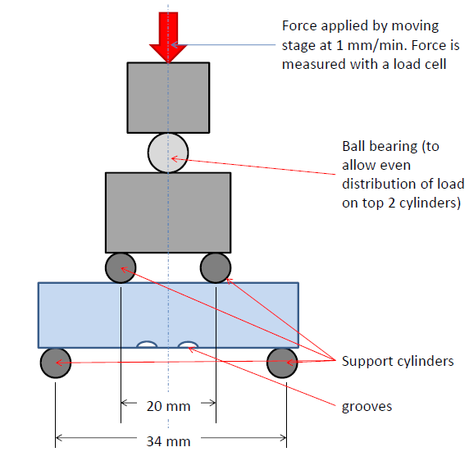
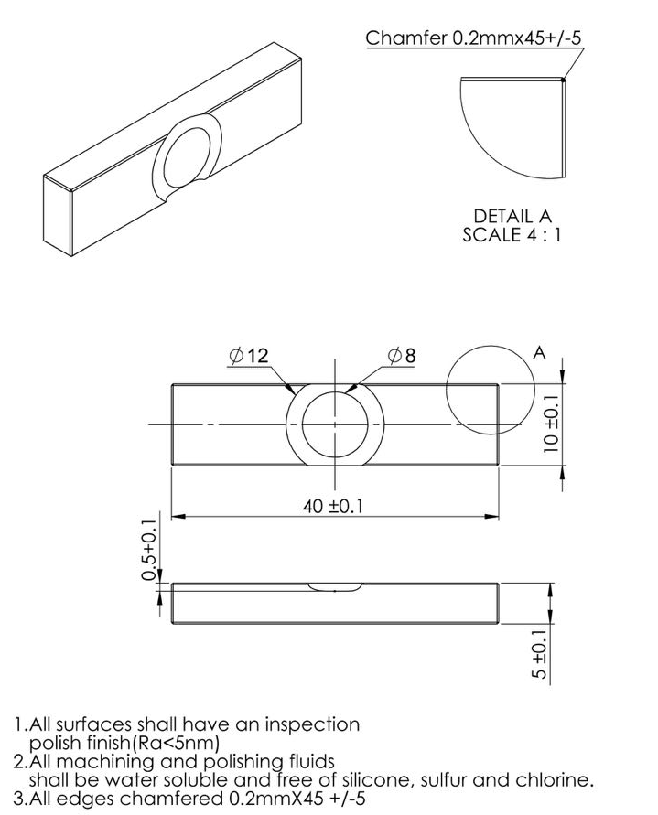
Anchors tests 2 – Testes in Glasgow

Slide 29
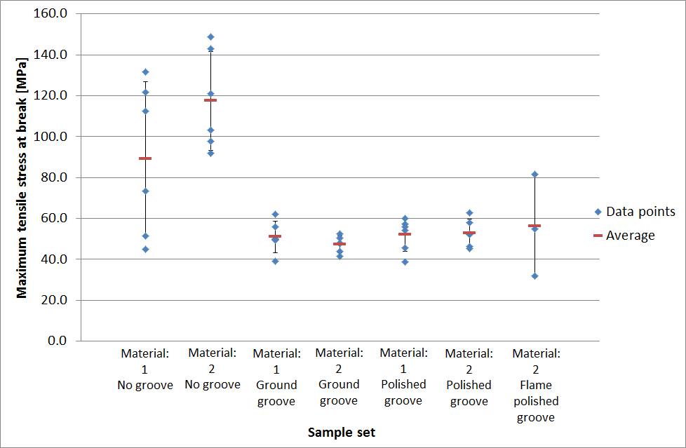
Anchors tests 2 – Testes in Glasgow
Thanks to Mariëlle van Veggel
Materials OK (breaking strength in literature: 50MPa)
Groove OK (expected breaking strength less that 50MPa)

Slide 30
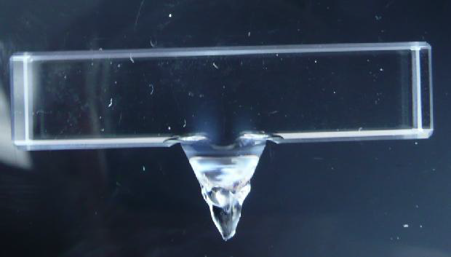
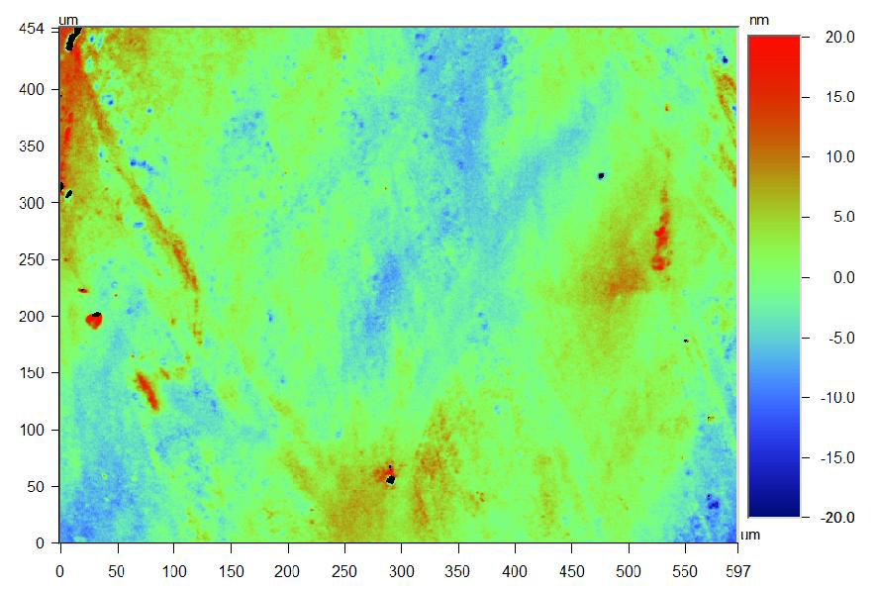
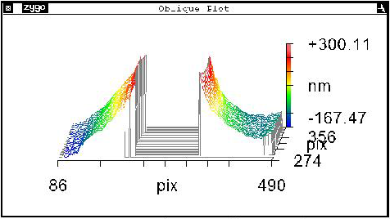
Anchors tests 3 – Tests in Glasgow
Analysis of anchors through crossed polarisers, taking flatness measurements using a ZYGO interferometers and roughness measurements using a Wyko NT1100 optical surface profiler on 2 AdV3 samples (one used for the test – one new)
Residual stress in the used anchor
No stress in the new anchor
The overall average roughness of the bonding surfaces is very good, better than 5 nm RMS
The P-V flatness is 217 nm so this does not meet spec

Slide 31
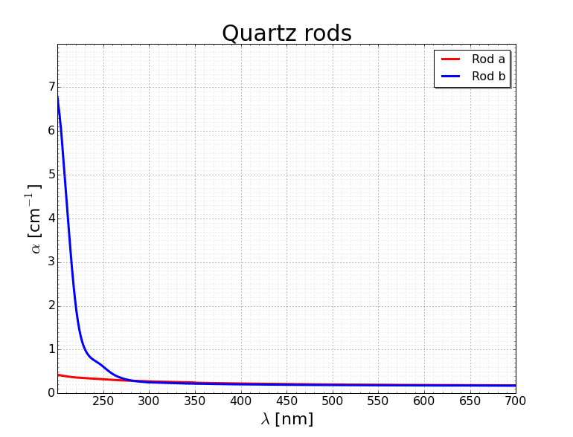
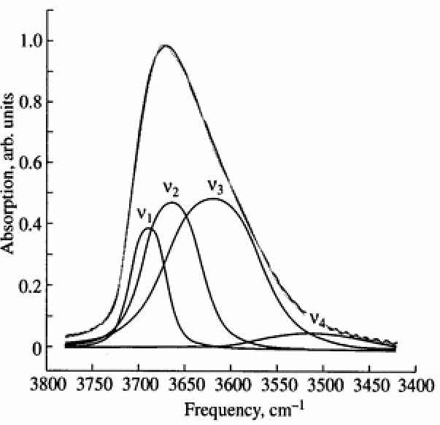
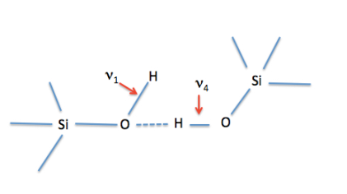
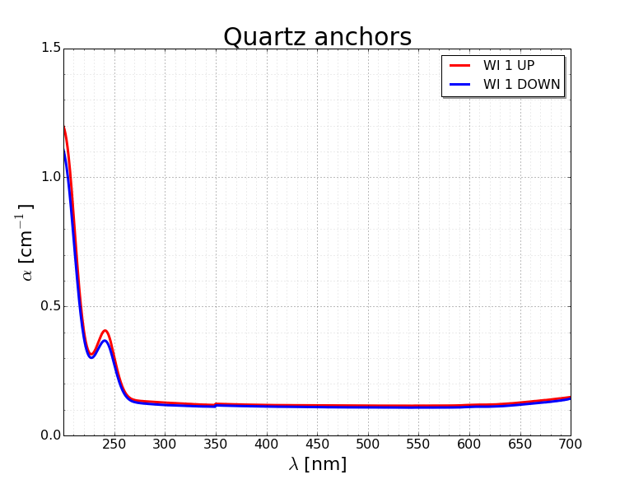
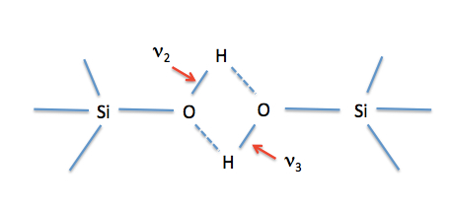
Anchors Analysis 1 - IR spectroscopy
Thanks to Mauro Tonelli
Rod a: Heraeus
Rod b: Provided by Impex
OH electronic transition
The OH should decrease the nominal material breaking strength (7GPA) by a factor 4(??)..but we are using 50MPA
OH electronic transition
200ppm

Slide 32
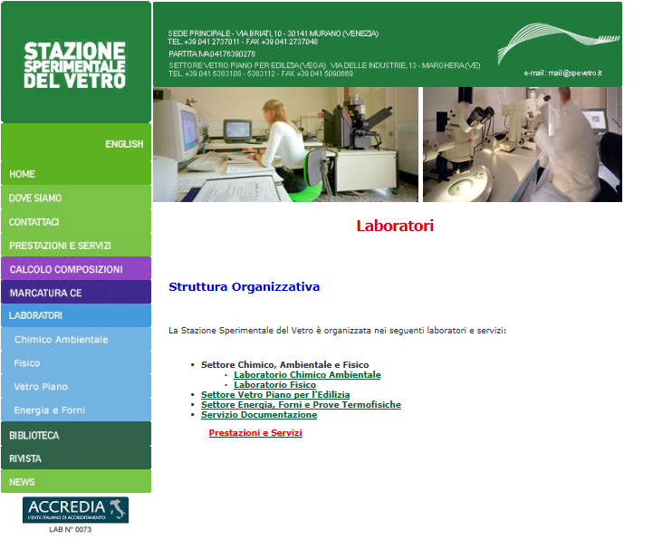
Anchor analysis 2 - SSV

Slide 33
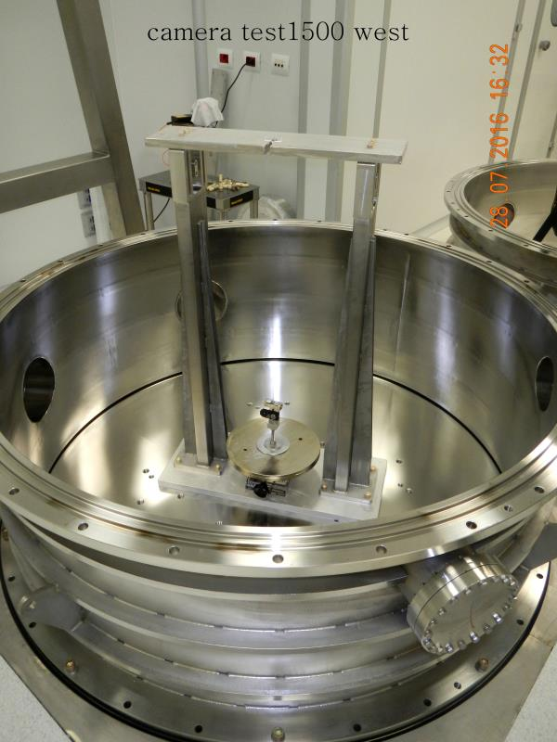
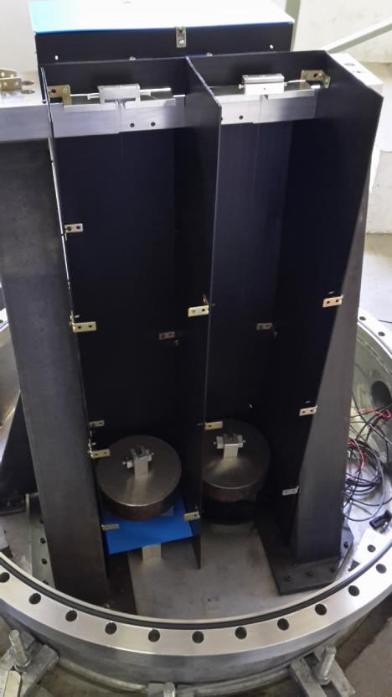
NE-WE Fibers tests
3 fibers produced for the NE-WE (spare ones) plus a new one, are under vacuum in Perugia: 2 fibers with 10kg or and 2 with15kg: everything OK after 10 days (still on going)
1 fiber produced for the NE-WE is under vacuum in Cascina with 10kg: everything OK after 1 month (still on going)

Slide 34
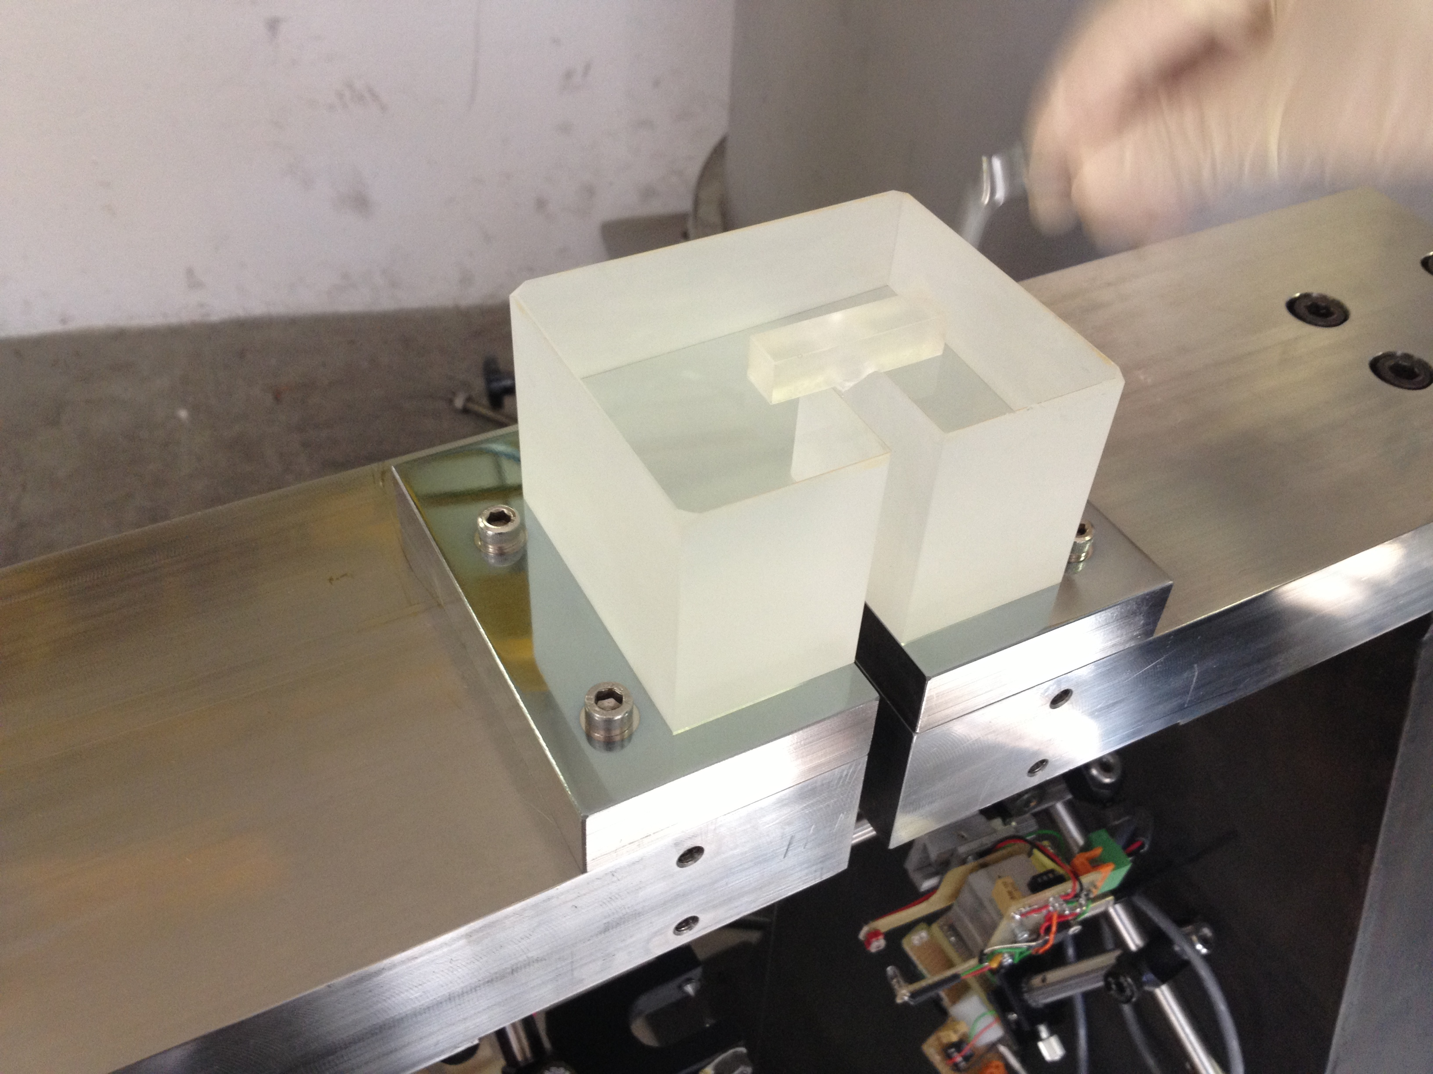
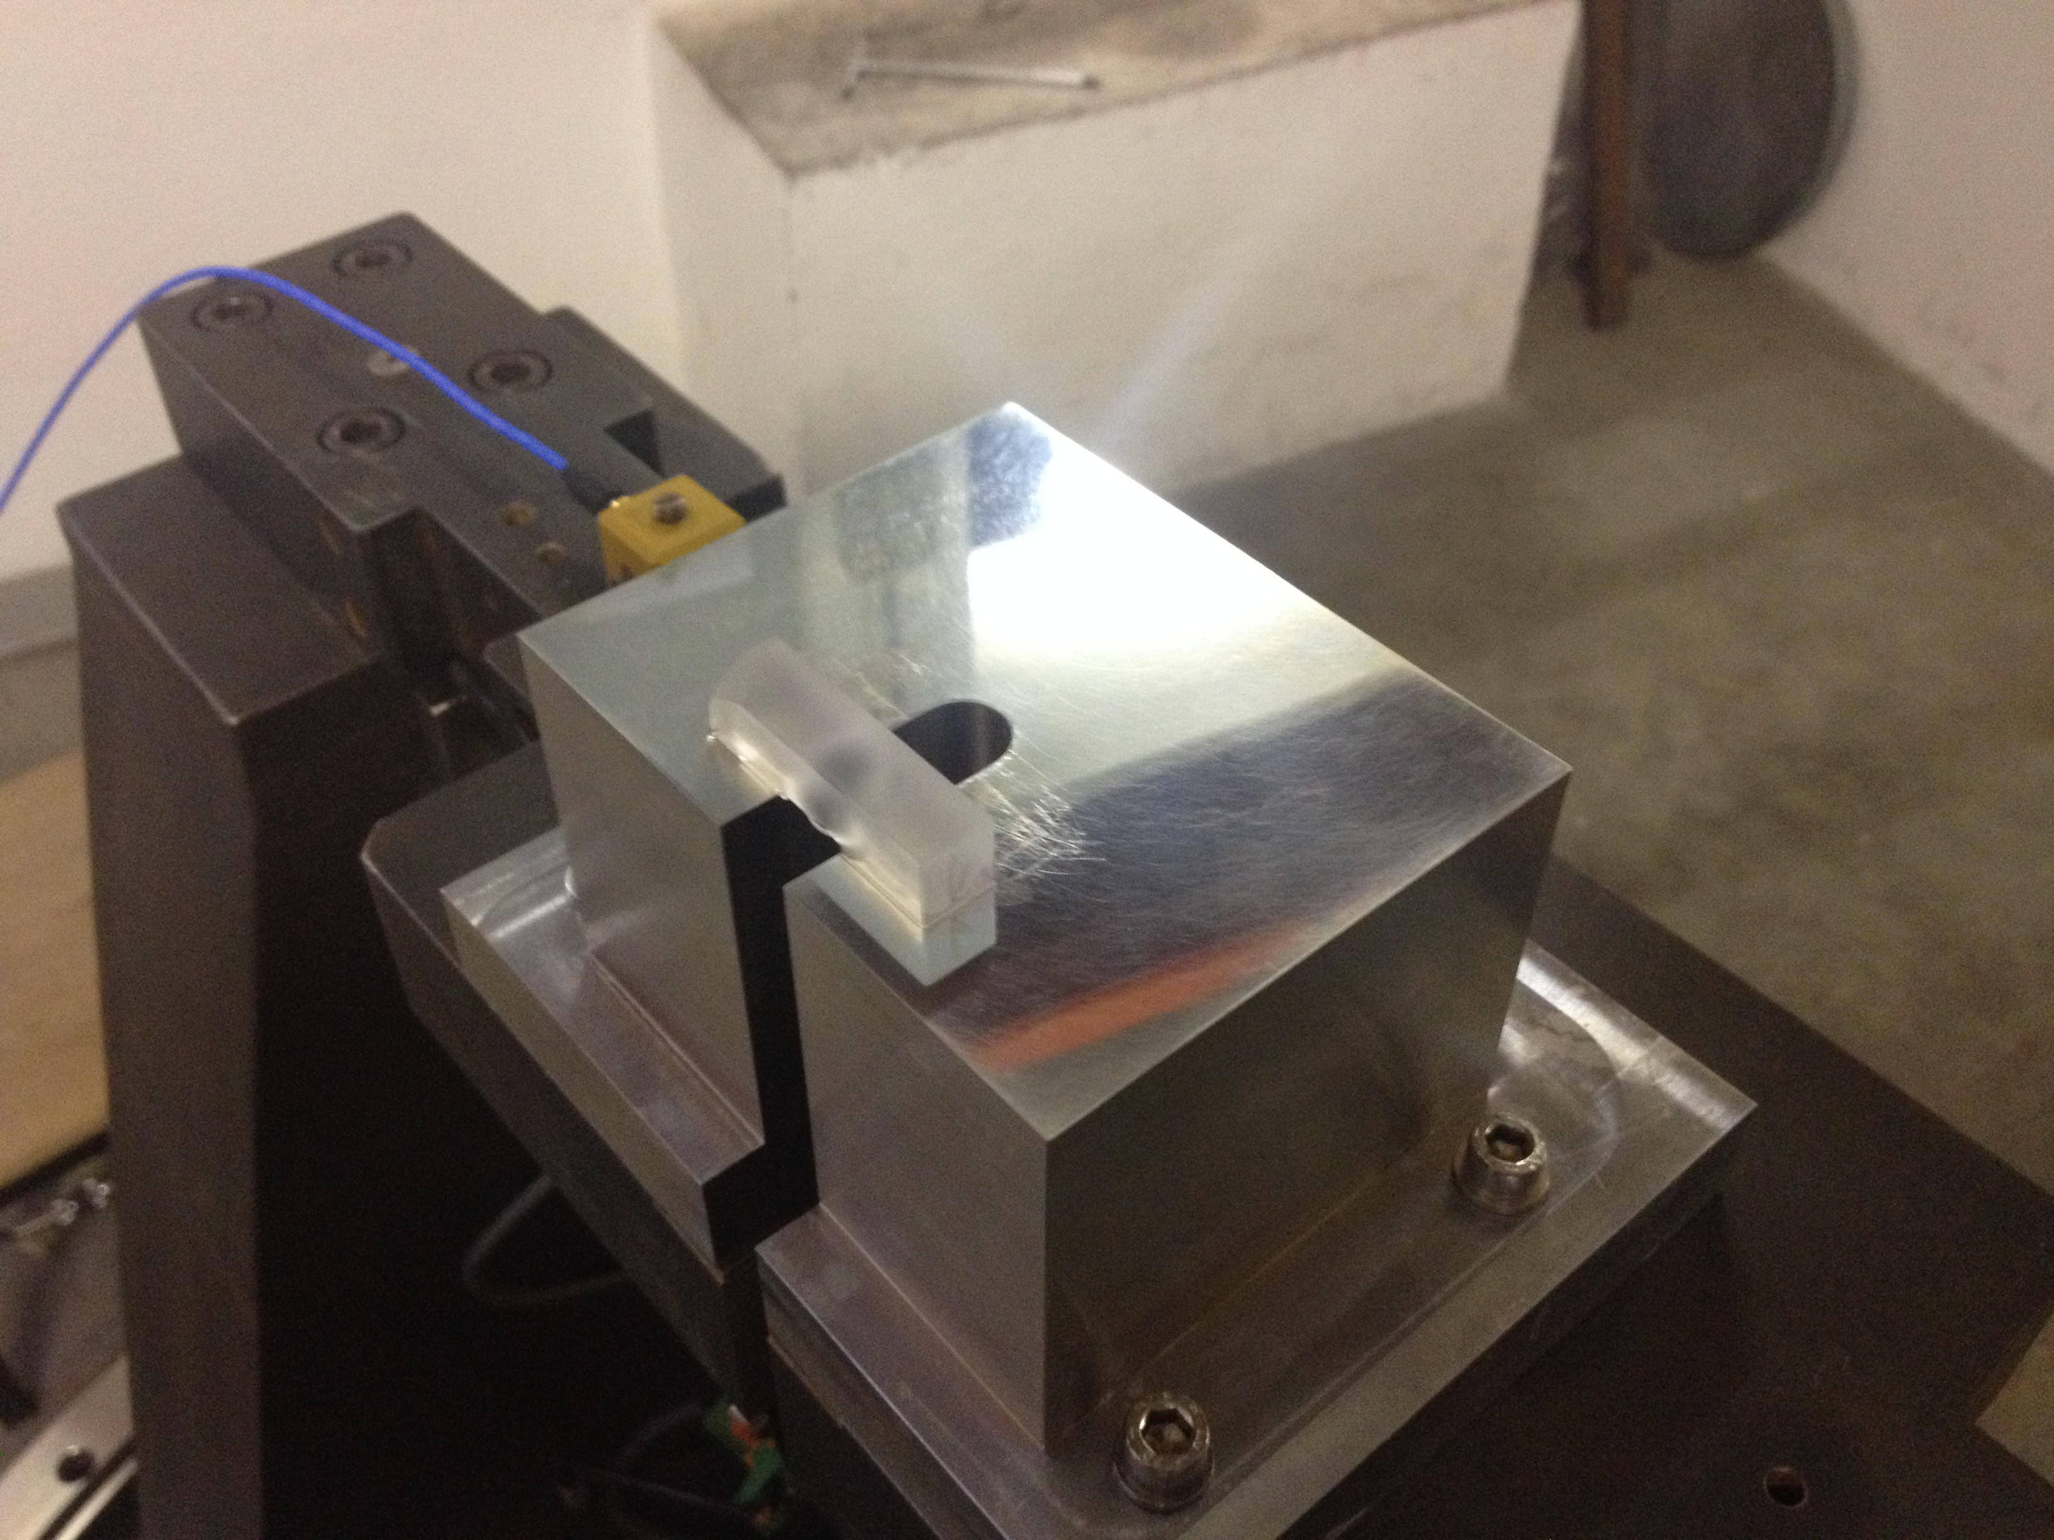
SB test 1 – Different supports and solutions
For few years in Perugia, different kind of gluing procedures (FS support, steel support, solution with different concentration, etc) were tested without any failure

Slide 35
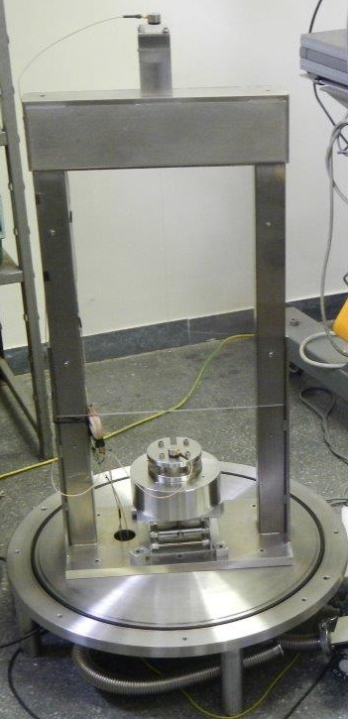
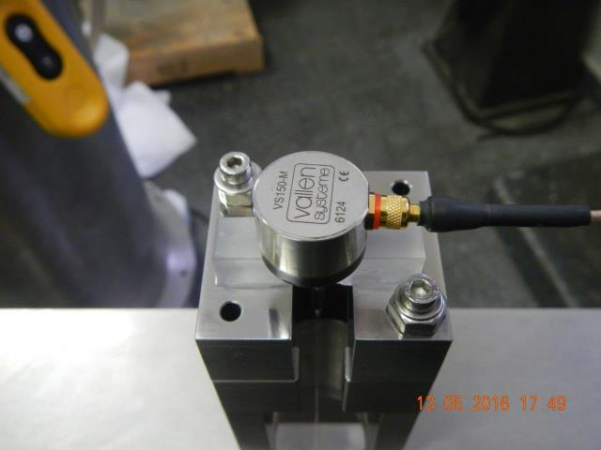
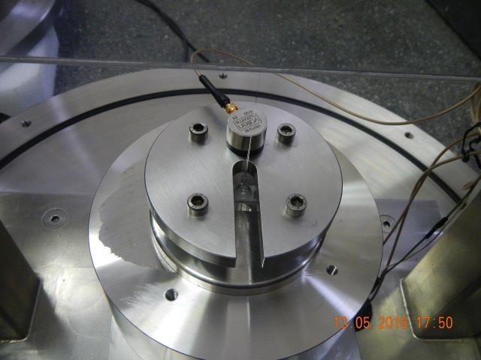
SB test 2 – Acoustic events (bubbles)
One fiber was suspended in Rome with 10 kg and the anchors were glued.
Two epitaxial accelerometers were put on the ends of the fiber to see if any acoustic event (bubble) is produced by the glued parts
Test on going: waiting for the comparison with a non glued fiber

Slide 36

SB test 3 – Step/bubbles
Few steps where induced on the anchor from 0.02mm to 1mm: no breaks

Slide 37


SB test 4 – Solution on fiber
The SB solution didn’t affect the fiber that was in vacuum for 10 days without problems
Than the fiber was hardly touched by hand and the fiber survived for one week: the solution created a protective coating on the fiber

Slide 38

SB test 5 - Thermal stress
In vacuum for 3 weeks with a temperature of 50°C: SB worked well
The shape of the stress changed but it didn’t increase

Slide 39



Second dummy mirror
In May, a second Dummy payload was put in vacuum for 2 weeks.
After that period, the breaking stress of each fiber was measured obtained a mean value of 2.5GPa.
During the test, the camera put in evidence a light emitted by the fiber when it explodes
Before Breaking
Breaking
After Breaking
Emitted light
Emitted powder

Slide 40

Dynamic stress
A standard fiber was stressed with a periodic load ranging from10kg to 20kg with a period of 20s for a total time of 13.5 hours. (about 2500 cycles)
After that dynamic stress test, the breaking stress of the fiber was performed. The fiber broke at 40kg (about 2.5GPa)

Slide 41

Radioactivity test
Alpha particles have a typical energy of 5MeV => they could be stopped by the air and hit the fibers in vacuum. The payload was analyzed but no radiation was found

Slide 42

Hydroxylic group OH
The spectroscopic analysis shows a difference between the material provided by Impex in Virgo+ and AdV
AdV glass uses for the anchors contain OH (~200 ppm according to our spectra), not present in the Virgo+ anchor glass
Hydroxyl group OH are usually removed by heating the glass at T>700°C
H₂ can
  Evaporate forming water
  Migrate through the network of polyhedral interstices in the glass
  Create bubbles trapped in the material during the welding

Slide 43

RECENT FINDING: BUBBLES IN THE WELDING
Investigations in progress on mechanism of formation
and possible effects (may originate cracks in vacuum?)
(Research triggered by the paper of Yongheng-Zhenan)
VIR-0364A-16
Thanks to Giovanni Losurdo

Slide 44


“Noses”
The noses are due to the 3 supports of the lower clamp
VIR-0364A-16

Slide 45

Raman measurement of bubbles
Thanks to Fiodor Sorrentino
- It is impossible to descriminate between the contribution of fused silica and the bubbles
- to identify H₂, a more powerful Raman (larger frequency range) is required

Slide 46



Welding tests
Is there a geometrical reason related to the anchors??
Urbino Group

Slide 47
Partial results
Bubbles found in several samples of AdV..not in all
Bubbles were found in particular formations, which present on the welding where there are 3 “noses” at 120°, associated to the ”shadow” of graphite holders on the machine
In the V+ samples available no bubbles have been found and in this case the welding has no noses
A series of test with different configuration was performed but it didn’t give a definitive answer

Slide 48


Bubble FEM Simulation
VIR-0378A-16
Paola Puppo simulated two different bubble sizes with three configurations:
a - bubbles of 5 um diameter distant 20um to each other and placed at 5um from the edge;
b - bubbles of 30 um diameter distant 5um one to the other placed at 5um from to the edge;
c - bubbles of 30 um diameter distant 5um one to the other placed at 20um from to the edge;

Slide 49
FEM partial results
VIR-0378A-16
A gas pressure of 1atm does not modify significantly the stress distribution inside it;
In the case a the stress distribution is not critical.
In the case b the stress reaches values greater than 130 MPa on the edge;
In the case c the stress reaches values greater than 40 MPa on the edge;
From this partial and still preliminary results we can say that the most important results is related to the distance the between the bubble and the edge.
Real distribution: there can be a configuration in which the stress on the edge is very close to the breaking stress of the glass so it is enough a small perturbation that can increase the stress up to the critical values.

Slide 50

Payload Test Facility
It looks like each single part works well, so the idea is to test a more complex system like the last stage of the AdVirgo payload (3 coupled pendulums) : we are developing a Payload Test Facility in the Virgo site:
Marionetta almost ready
Mirror to be ordered in one month
Magnets ready
Ear and anchors to be ordered in one month
Support structure to be ordered

Slide 51
Conclusions
many tests done so far on different aspects: no clear conclusion yet
priority given to joining O2: 3 test masses with steel wires
investigations on MS will continue: bubbles found in the welding might be an interesting path to pursue
fruitful collaboration with Glasgow group and LIGO experts (thanks!)

Slide 52
Extra

Slide 53

WI hits
During the balancing procedures in air, the mirrors received a lot of mechanical hits. Due to control issues, the suspension is excited in vacuum, as well

