Slide 1
Theory and Applications of Signal Processing Methods
The 1st Workshop
in Gravitational Waves Detection, Medical Science and Engineering

Slide 2
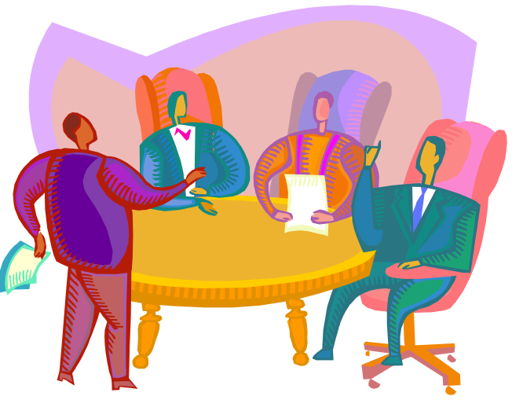
Workshop objective
Different scientific communities use similar techniques of signal processing
Often we have to face the same problem: find weak signals buried in background noise
Non linear and not stationary background
Put in contact scientists with different backgrounds to exchange ideas, learn new techniques, share competences
Notes:
We are aware that different scientific communities (GW communities, Medical Science, Engineering, Telecommunications...) use similar techniques of signal processing.
Often we have to face the same problem : find weak signals buried in background noise
One of the main objectives of this workshop is to put in contact scientists with different backgrounds to exchange ideas and learn new techniques.
We would like to share competences and give these different environments the occasion to interact.

Slide 3
Gravitational Waves data analysis
Common characteristic:
“they are all very weak signals”
Looking for gravitational waves emission by astrophysical phenomena
Continuous
Transient
Stochastic
These signals are buried in a noise background which can be Gaussian or not Gaussian, stationary or not stationary, full of fake events

Slide 4
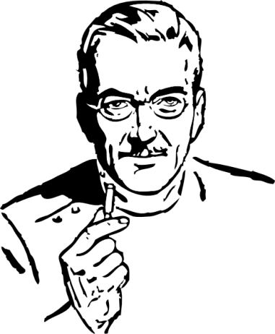

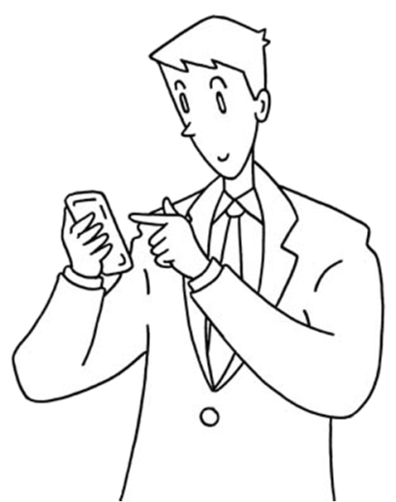
…and other disciplines
Techniques used in many other fields: the Wiener Filter or matched filter is used in medical science (see Chincarini’s talk)
The de-noising techniques can be similar to the ones use in radar analysis (Greco and Gini’s talks) or in telecommunications (Magarini and Barletta’ s talks)

Slide 5
Multidisciplinary event
As stated in the guidelines for Horizon 2020, the future European Framework Programme, Multidisciplinary research can be a driver for growth, innovation, understanding and solving problems
http://ec.europa.eu/research/horizon2020/

Slide 6
Multidisciplinary talks
Luca Barletta
“Digital communications: application”
G. Debreczeni
“Many-core computing in experimental gravitational wave physics. GPU”
A. Chincarini
“Medical science: Neuro-imaging”
F. Gini
“Coherent radar target detection”
M.S. Greco
“Statistical analysis and modeling of radar clutter echoes”
S. Klimenko
“GW Transient events for ground detectors”
M. Magarini
“Digital communications: theory”
I. Pinto
“Transient events analysis”
Not only gravitational waves data analysis but much more

Slide 7
EGO -Virgo
Prof. Ferrini – EGO director

Slide 8
Program 10/15/2012
1° Day
Understanding (and taming) glitches: threads in a Tapestry I.Pinto
Signals and noises in neuro-imaging A. Chincarini
Bayesian Inference in Digital Communication.Part 1: Theory M.Magarini
Bayesian Inference in Digital Communication.Part 1: Applications L. Barletta
2° Day
3° Day

Slide 9
Program 10/16/2012
2° Day
3° Day
1° Day
Searches for GW transients with the ground-based detectors S. Klimenko
Radar Clutter Modeling and Analysis M.S.Greco
Coherent Target Detection in Heavy-Tailed Compound-Gaussian Clutter F. Gini

Slide 10
Program 10/17/2012
2° Day
3° Day
1° Day
Understanding (and Taming) Glitches: Threads in a Tapestry I. Pinto
Many-core computing in experimental gravitational wave physics G. Debreczeni
Visiting Virgo

Slide 11
Let’s start
Thanks for participating at this workshop.
The committee
Local Scientific committee: E. Cuoco, F. Ferrini, M. Punturo, M. Tacca
Secretariat: S. Perus
Technical support: S. Cortese, G. Di Biase

