Slide 1
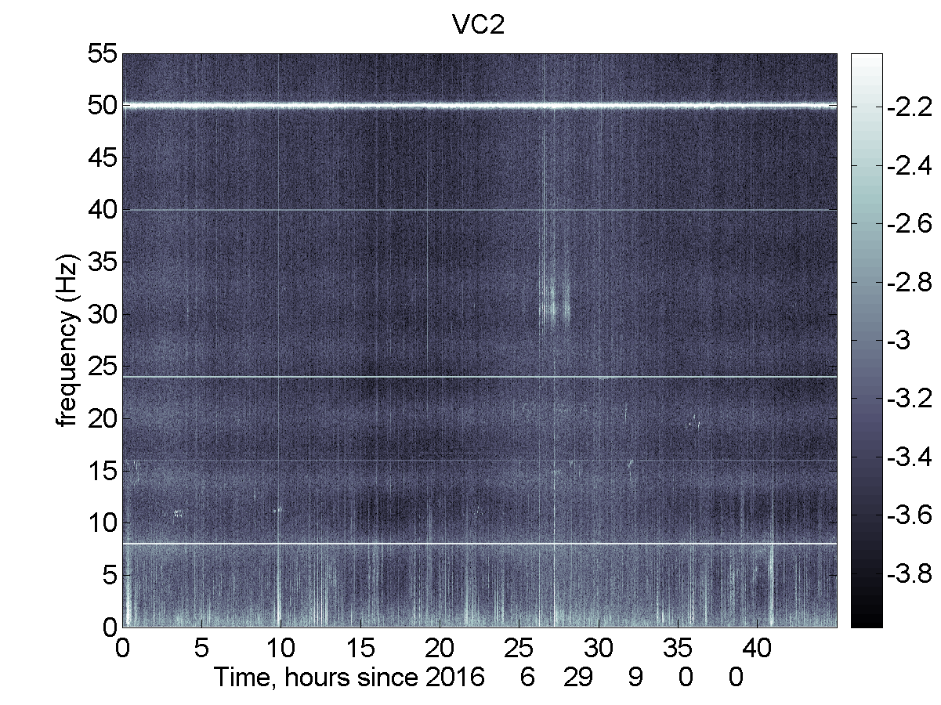


Virgo environmental noise works status
Irene Fiori
European Gravitational Observatory
LSC – Virgo Collaboration meeting Glasgow, August 29 – Sept 1 2016

Slide 2
Outline
Environmental monitoring
  sensors, status
  enhanced ITF infrastructure monitoring
  naming
Laser Lab environment
Magnetic coupling to TM, modelling work and mitigation actions
Global magnetic noise
Newtonian Noise
Conclusions

Slide 3
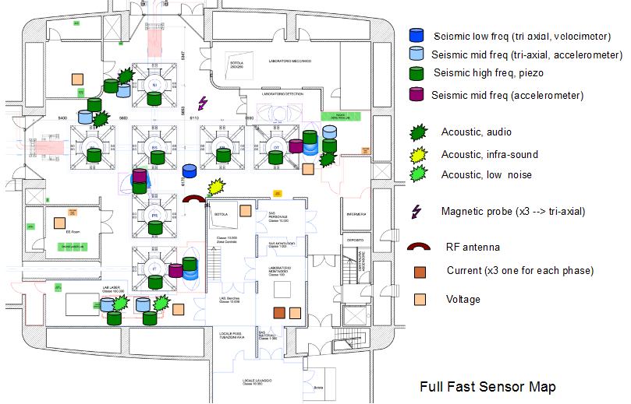
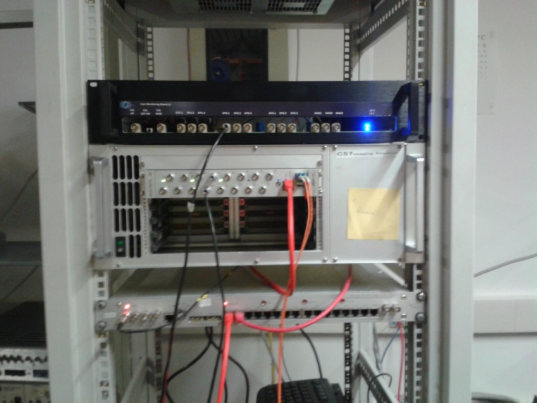
Environmental monitoring
Fast sensors
(R.DeRosa, F.Garufi - INFN-Napoli)
Buildings monitoring
Ground 3D seismometers (1x4 Bld.s) Guralp 40T-60s
Magnetometers 3D (3x4 Bld.s) MFS-06 low noise induction coil
Microphones (1x4 Bld.s) Brüel&Kjaer 4193 infrasound
RF antenna receivers (1x4 Bld.s x 3 bands) AAS-STA-5-AD
Mains ((3 IPS + 3 UPS) x 4 Bld.s) custom
Vacuum tanks monitoring (Towers, CryoTraps, Links)
Accelerometers PCB-393B12 and Meggit-731 (1x9 Tow + 1x6 CT)
Low frequency 1D acc, Kinemetrics Episensor (1x5 Links)
External Optical Benches monitoring
Accelerometers (1x 8 Bench )
Low frequency 3D acc. Episensor (1x6 Bench)
Sound (1x6 benches, 2 low noise)
Electronics rooms monitoring
Microphones (1 x 5)
Magnetometers and current probes: on demand
Installation: 80% completed, ongoing
Documentation: Hardware Inventory DB, http://slwebtest.virgo.infn.it/ifoapp/
Signal conditioning
custom boards
Differential output, anti-aliasing, calib input

Slide 4
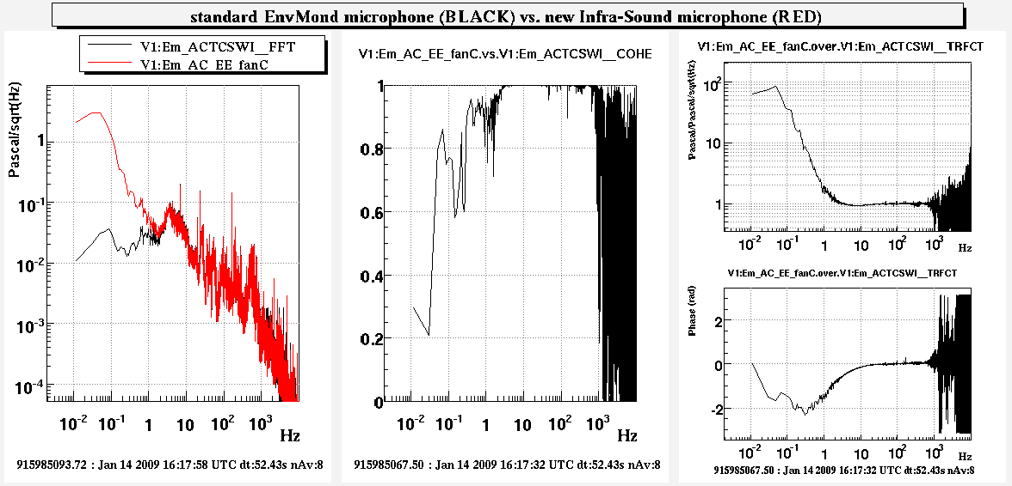
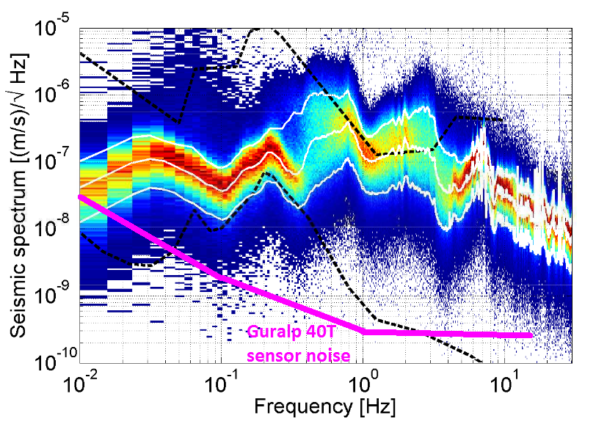
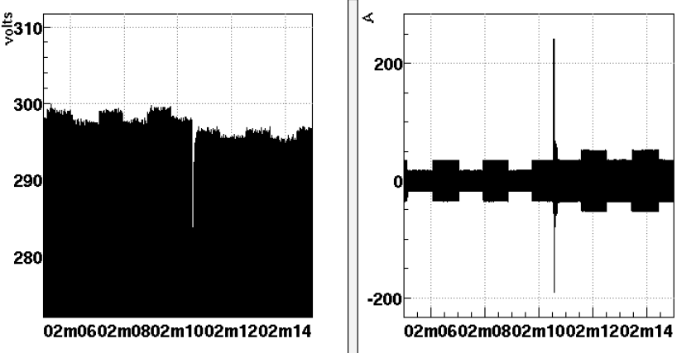
Fast sensors (2)
FOCUS on a few improvements
Building monitoring
Infrasound microphones (BK 4193): 0.05Hz (-3dB) extended sensitivity
Guralp 40T-60s: 0.015Hz extended seism sensitivity
Current probes on IPS and UPS mains switch-boards: offer high SNR for detecting machines start up

Slide 5
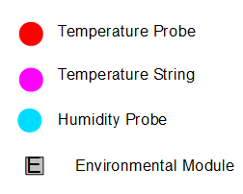
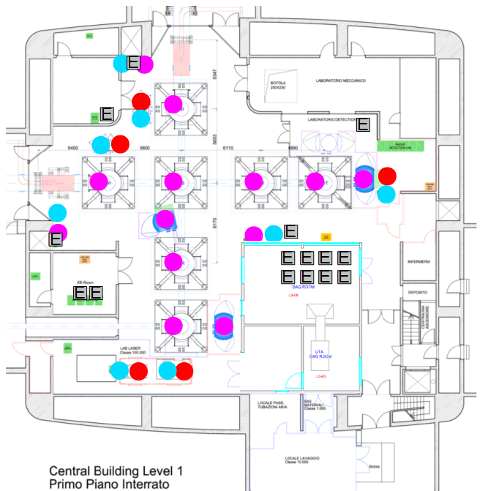
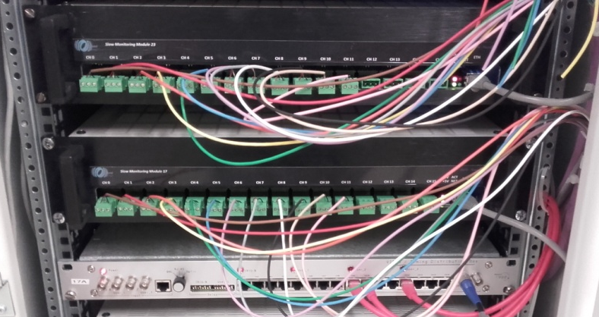
Environmental monitoring
Slow sensors (1Hz)
(R.DeRosa, F.Garufi - INFN-Napoli)
Building monitoring
temperature probes at 2,4,8,10m heights,
pressure, humidity, weather station
Towers monitoring
in-vacuum T probes, at each SA filter
Bench monitoring
Temperature and Humidity
Installation: completed
Missing Lightning detector, plan joining
www.blitzortung.org
New DAQ modules
16ch/18 bit ADC, anti-aliasing, decimation,
ethernet data exchange protocol
Cured RF noise emissions experienced in Virgo with old DAQ modules

Slide 6
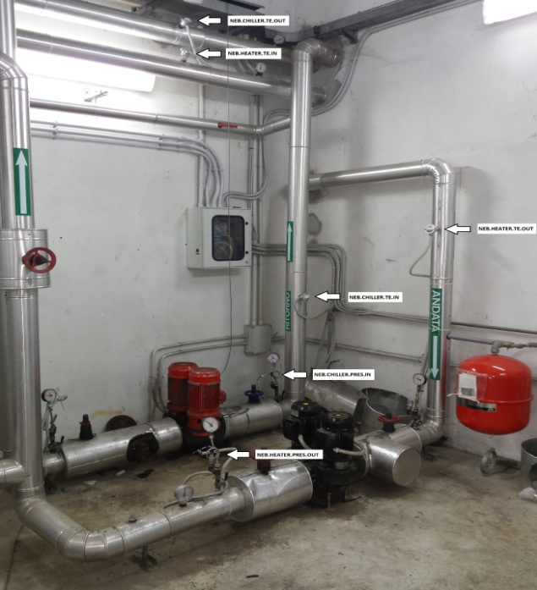
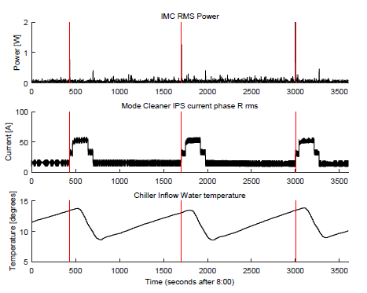
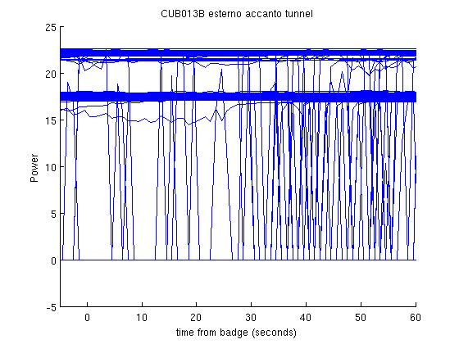
Infrastructure machines monitoring extended and improved
Credits: Roberto Cavalieri - EGO
We extended the existing monitoring of HVAC, VAC, UPS systems to help noise hunting and add redundancy to alarm sys.
More than 300 sensors, 1Hz, read by DAQ modules: air and water temperature, pressure, flux, over-pressure, HVAC control signals
Early noise hunting pointed out correlations of ISYS unlocks /misalignments and switching on-off big INF machines (e.g. water chillers) and with turning on-off E-rooms L-rooms illumination lights
NEW:
LUX sensors (Labs,
E-rooms, Halls)
RMS current sensors
at power switch boards or
big load machines

Slide 7
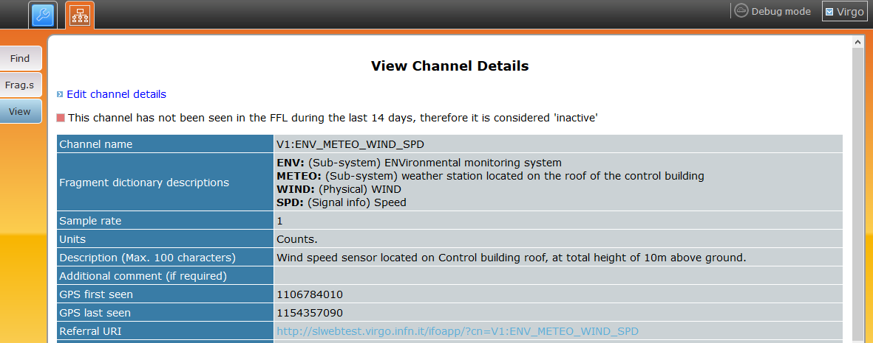
Channel naming conventions
Got rid of (most of) old cryptic names and redundant segments, Easing searches also by automated tools
Set a few general rules, but leave freedom to adapt to sub-sys needs
  General syntax (following LIGO doc ....)
  V1:SUBSYSTEM_XXX_YYY_..._ZZZ
  Example 1: V1:ENV_CEB_SEIS_N (i.e. XXX = LOCATION, YYY = SENSOR, ZZZ = ORIENTATION )
  Example 2: V1:DQ_BRMSMon_BRMS_MAGNETIC_ENV_NEB_MAG_W_32Hz_64Hz (i.e. XXX = process name)
  Fragment names uniquely defined
  Defined list of acronyms (rooms, labs, detector parts)
  Defined reference systems and orientation conventions
  See: VIR-0223B-14.pdf
  DetChar group naming conventions: https://www.virgo-gw.eu/DataAnalysis/Detchar/projects/channelnaming.html
Documented in VIC, Virgo Interferometer Channel Database: http://slwebtest.virgo.infn.it/ifoapp/
Gary Hemming - EGO
Didier Verkindt - LAPP

Slide 8
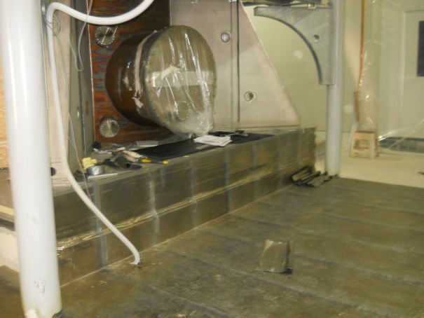
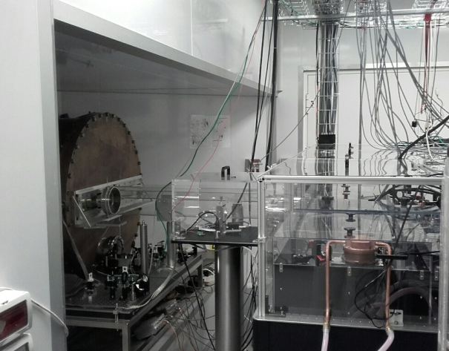
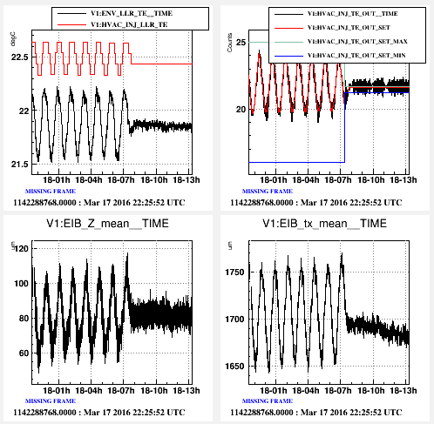
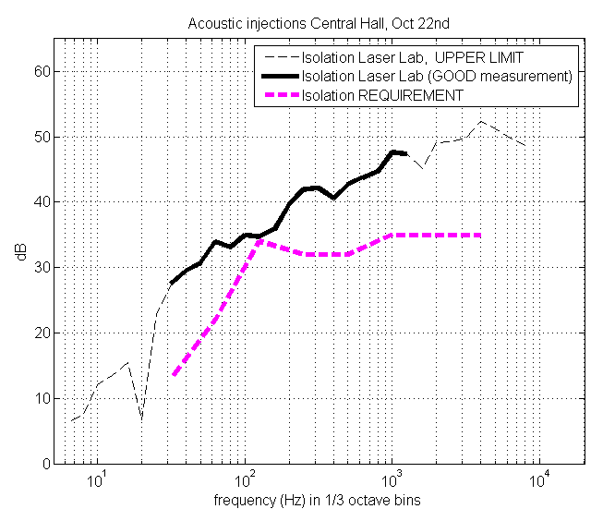
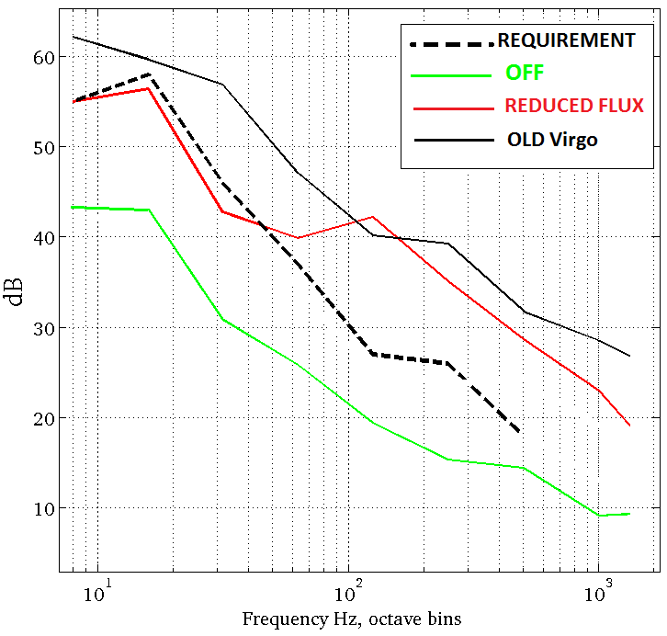
Laser Lab environment
Laser and Det Labs are now ISO 6 clean rooms
Acoustic works: good isolation from neighbours noisy environment (meet req.). But, acoustic noise from HVAC is still 10dB louder than required. Not presently an issue.
Temperature stability, accuracy is better than 0.1°C p2p over whole room volume, obtained thanks to a patch work to dump oscillations of the inaccessible PID control set up by K&P contractor (Maddalena Mantovani - EGO, eLog 3417)
Temperature and EIB Local Controls accuracy
HVAC acoustic noise
LL walls acoustic isolation
OFF
Reduced flux
Old Virgo

Slide 9
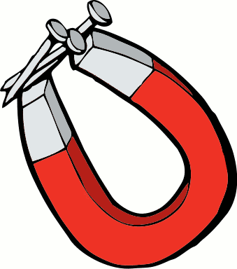
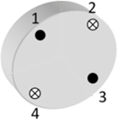
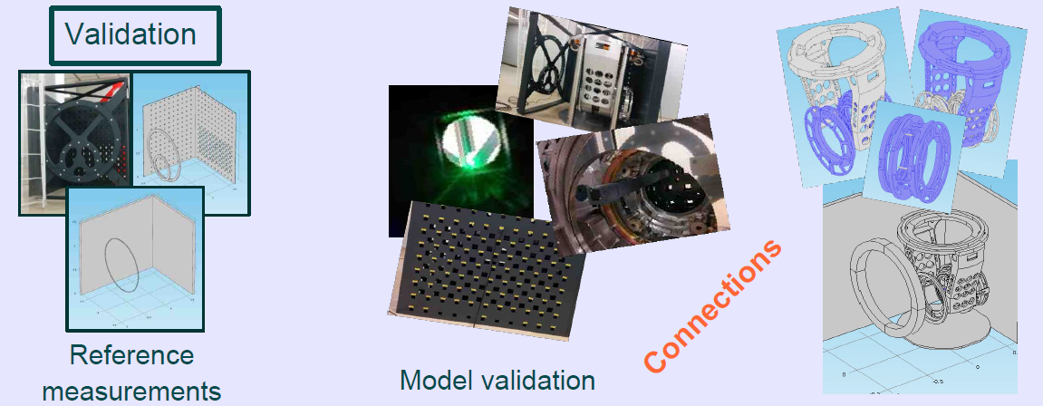
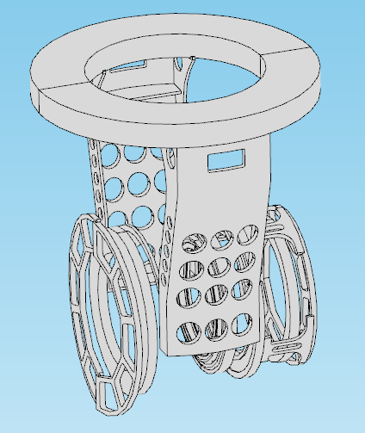
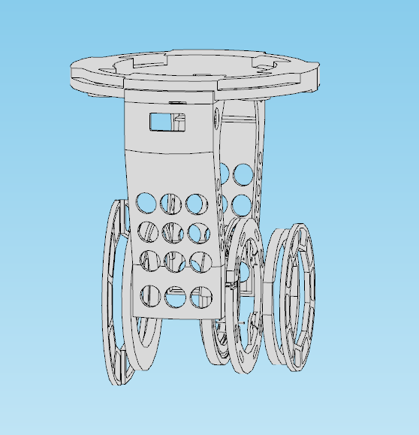
Magnetic coupling to payloads modelling work
AdV adopts magnetic actuation on TM, with magnets 5 times smaller than V+, and an optimized design to minimize mag. Gradients (i.e. low μ0 materials) and shorten Eddy currents paths.
Residual displacement force from 4 counter oriented magnets arise mainly from: local dishomogeneites in ambient B field gradients, uncertainty in magnets positioning and size.
Measurements on one payload assembly were used to tune a FEM model. Predictions critically depend on electrical “connections” at a few points. General model has more than 2⁷ configurations. Recursive Hadamard matrix minimization over model configurations selects 21 conf. compatible with experiment and mean rel. error < 5%.
Credits: M.Neri, A.Chincarini, S.Farinon – INFN Genova. VIR-0018A-16.

Slide 10
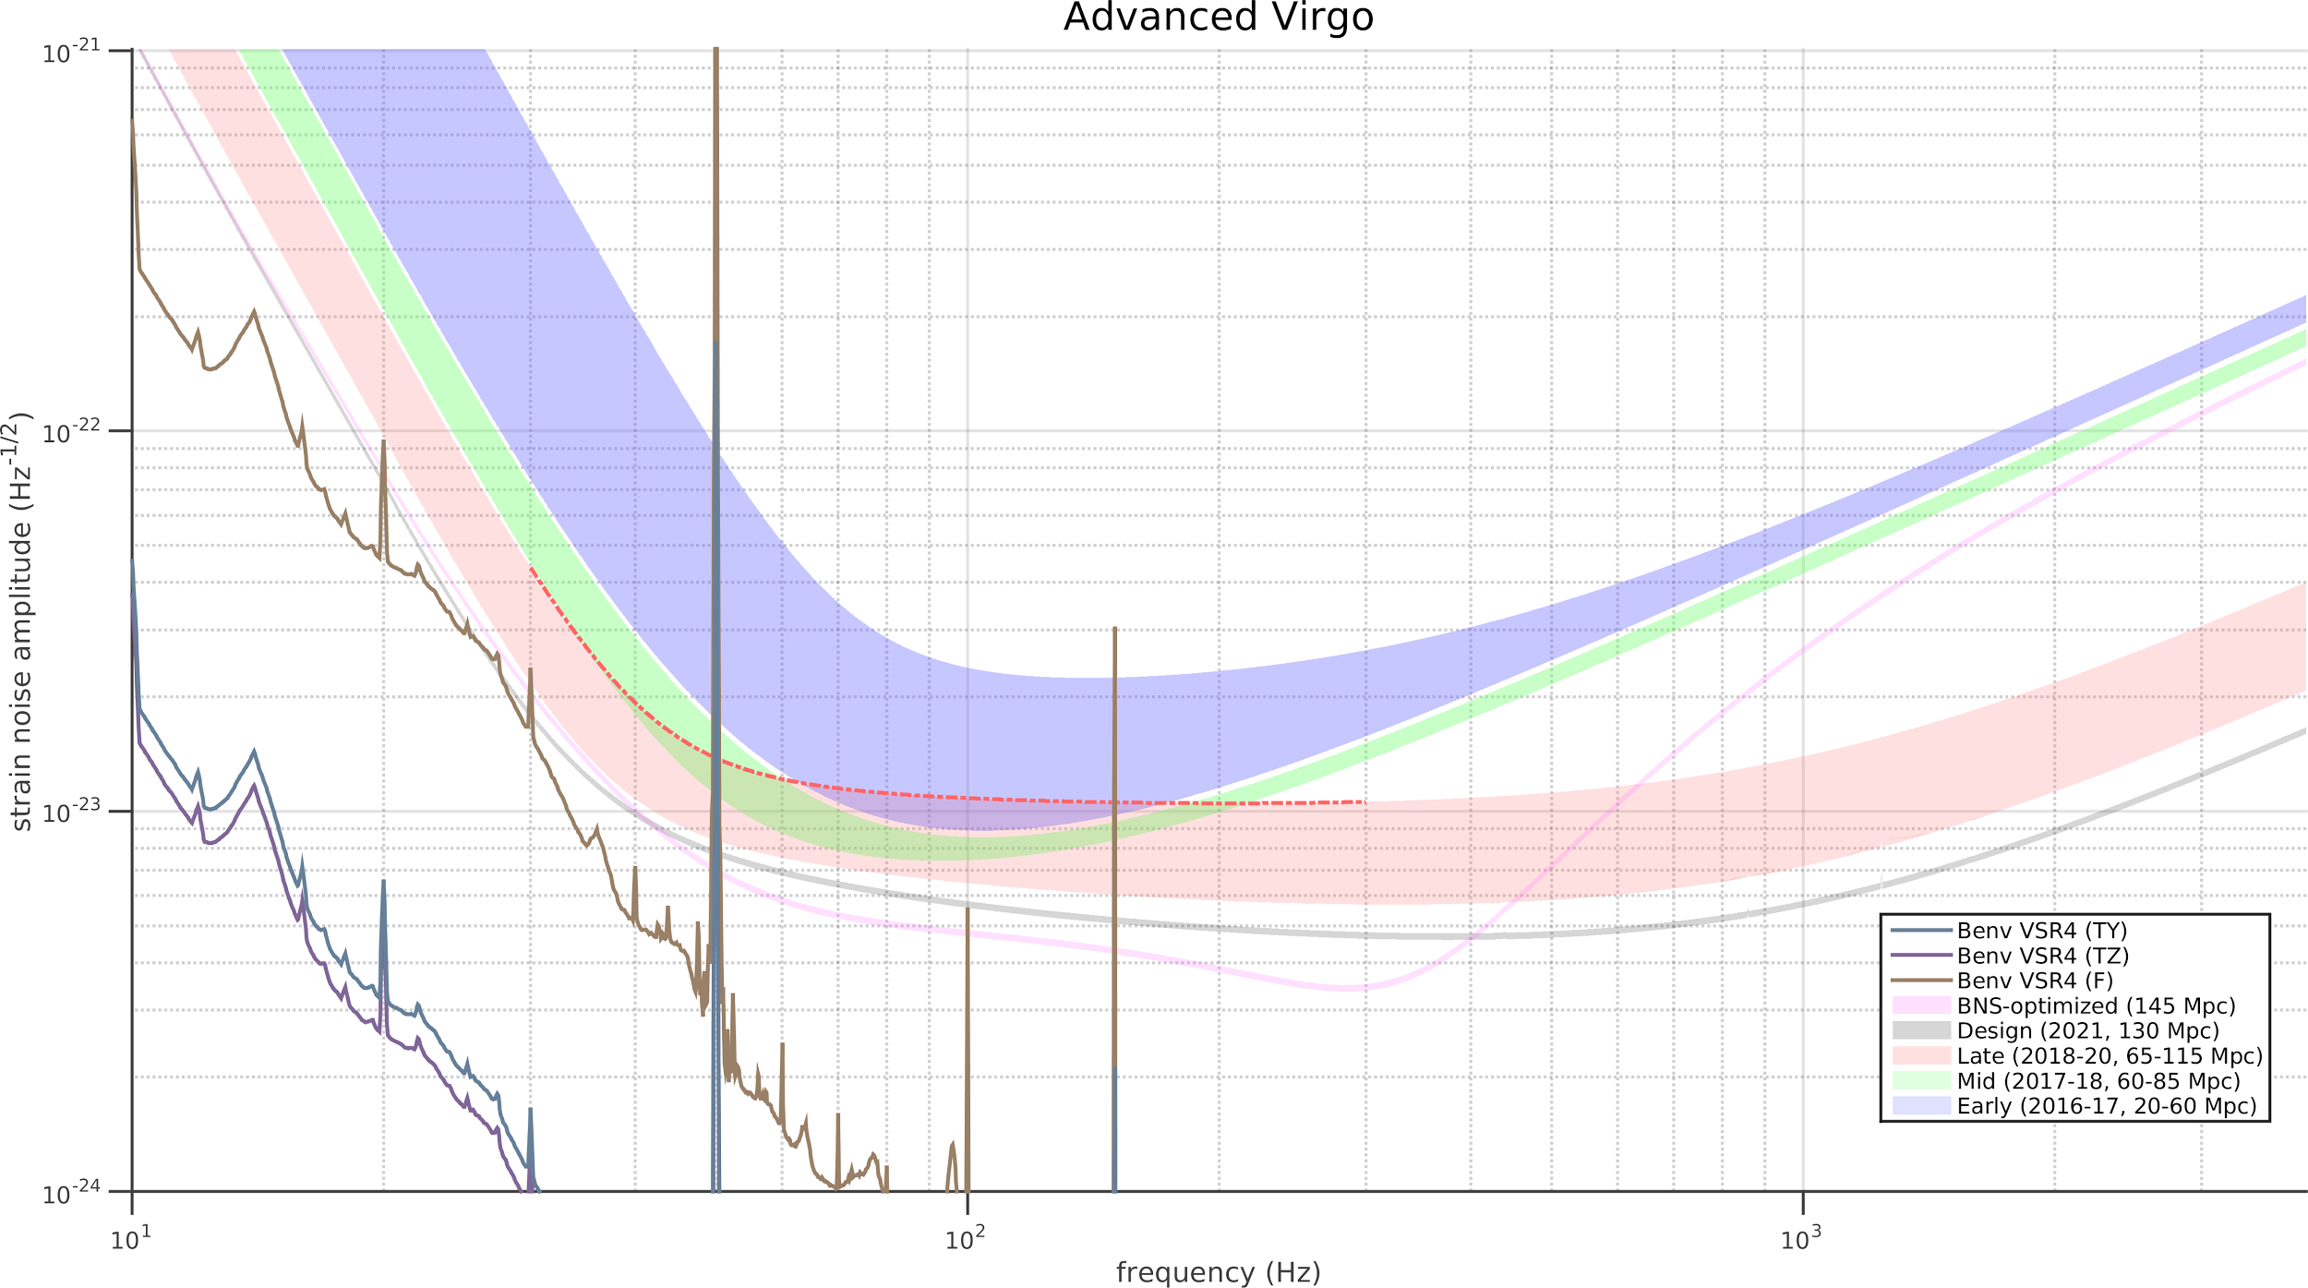
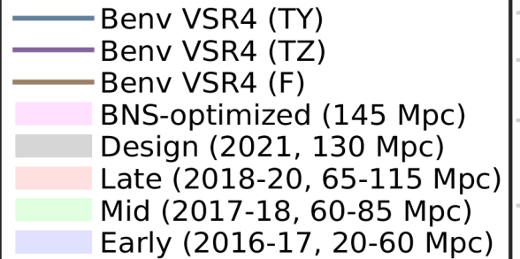
Magnetic coupling to payloads modelling work
Prediction from MonteCarlo simulation of 21 configurations that best matching experimental measurements (on one payload, assuming all are the same), tolerance of magnetic moment ± 15% of nominal value, +/- 1x1x1 mm³ tolerance in single magnet position around nominal value
mitigation strategies
reduce ambient fields
reduce total magnetic moment (magnets equalization)
passive Helmholtz coils to counteract and dump ambient fields ??
VSR4 B_{env} used.
in-axis force >> torque

Slide 11
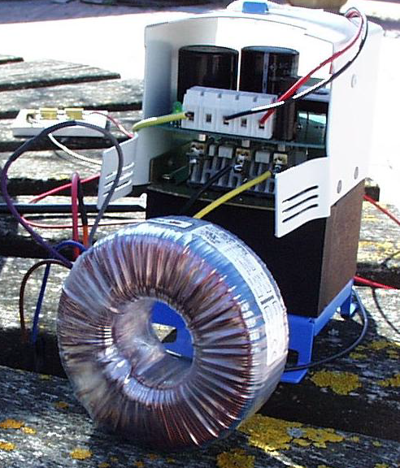
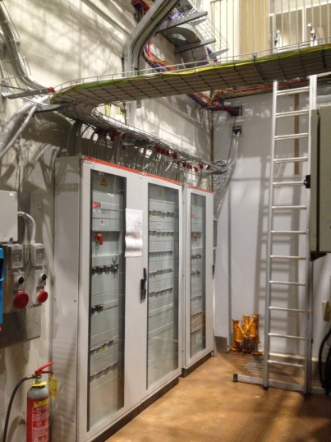
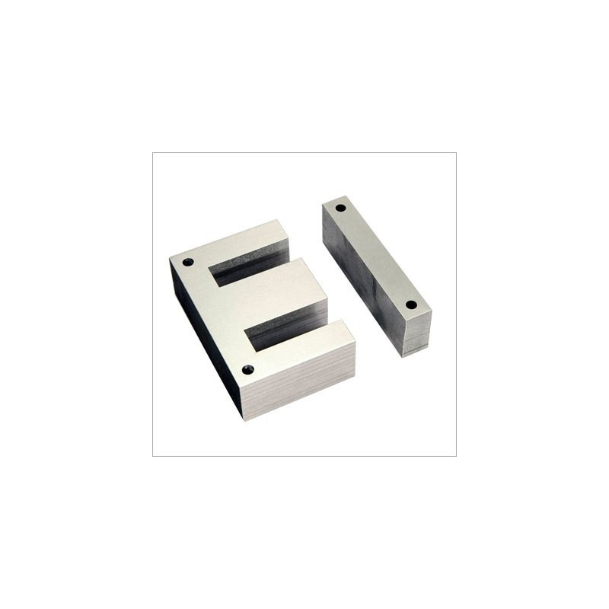
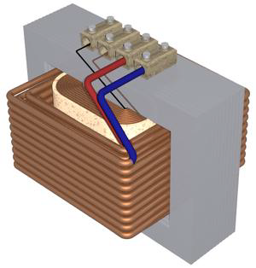
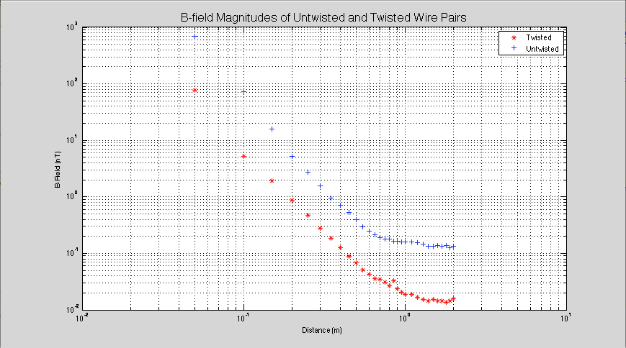
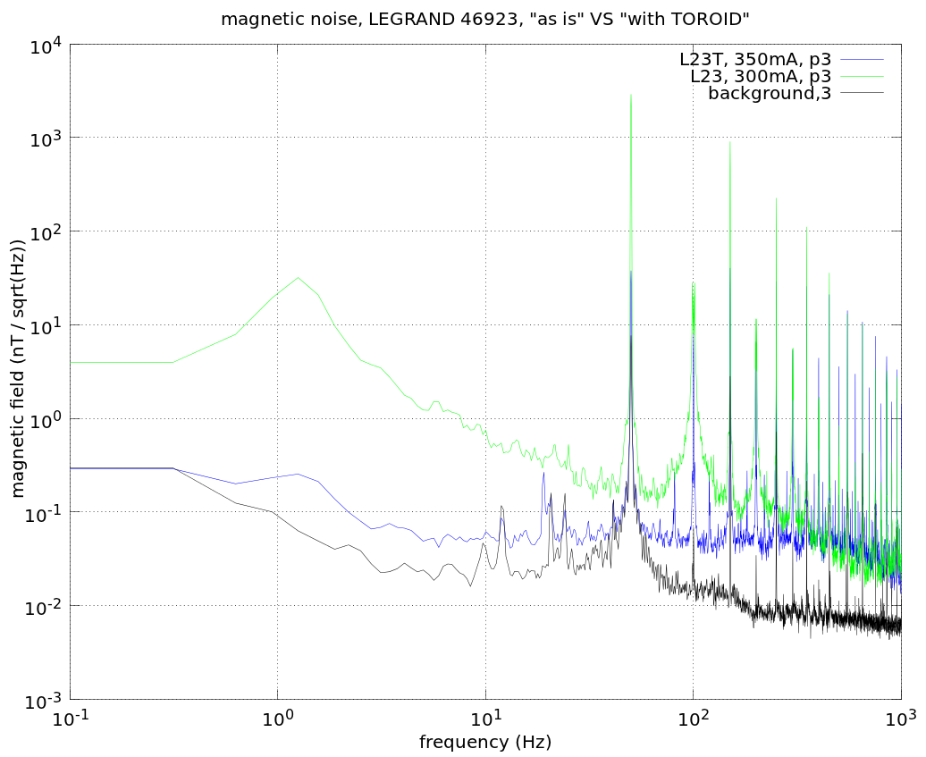

Magnetic Mitigations (1)
Limit stray fields close to payloads
  Optimize power cable paths, maximize ratio (distance from TM)/(current). Removed and reroute power cables who were in floor trenches around towers
  Adopt twisted wires cables for powering racks in experimental halls
  Use AC-DC voltage converters with toroidal core in place of standard E-I core
Credits: Federico Paoletti, Massimo D’Andrea – EGO
Blue: standard wires
Red: twisted wires
Blue: standard wires
Red: twisted wires

Slide 12
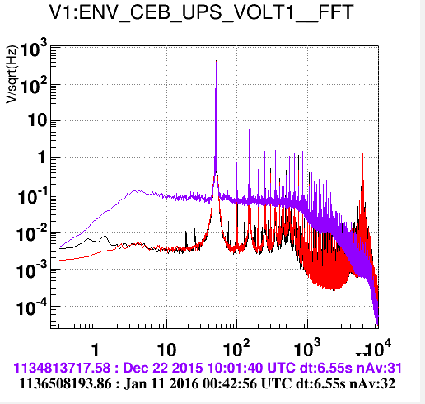
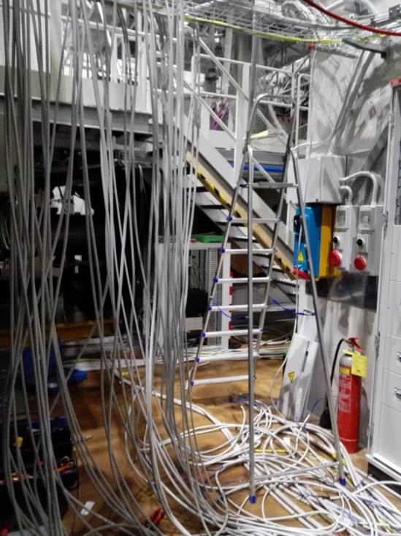
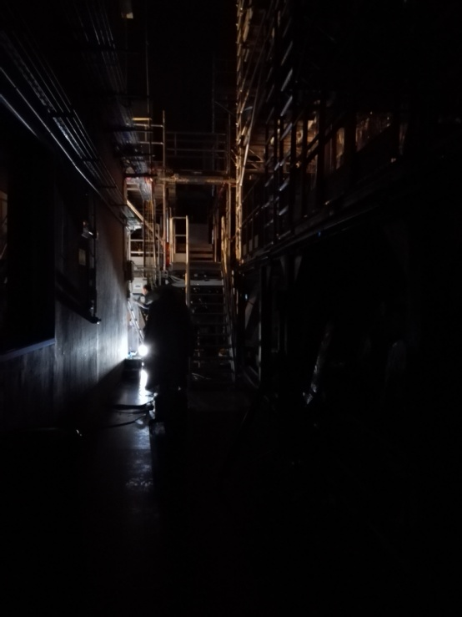
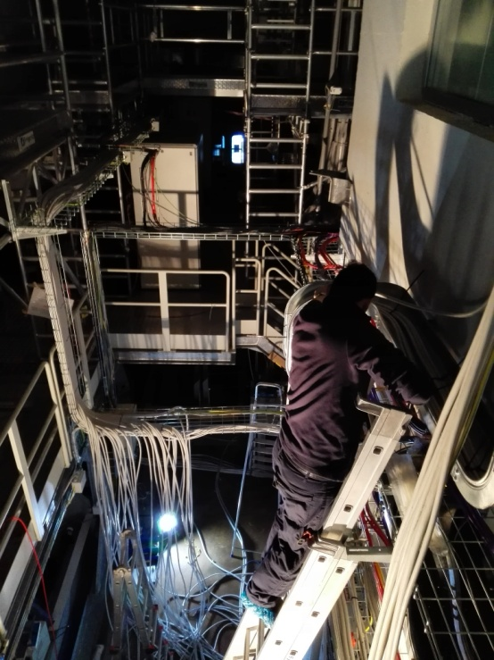
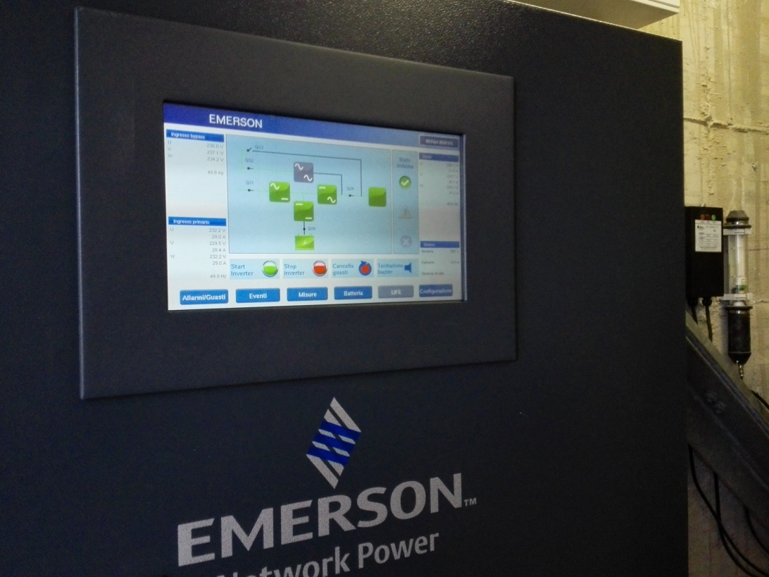
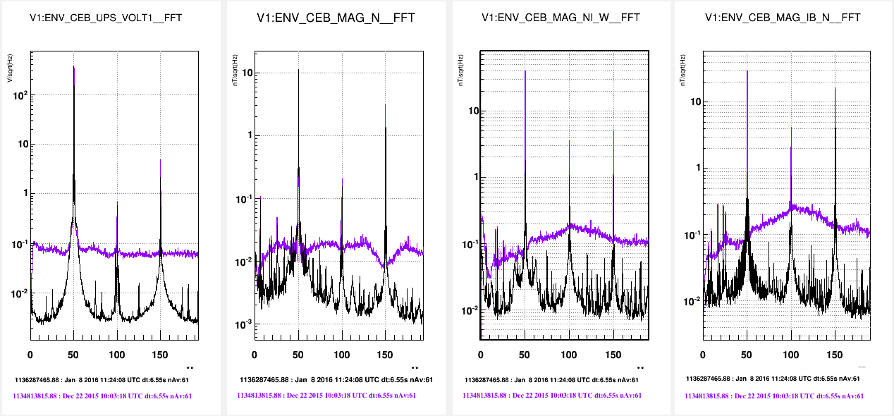
Magnetic Mitigations (2)
Reduce UPS noise
At Virgo we use Uninterruptible Power Supplies to power all sensitive electronics, to guarantee power continuity in case of power outage.
The voltage noise of the UPS reconstructed 230VAC - 50Hz sinusoid is the progenitor of stray magnetic fields in experimental areas
New UPS installed during Christmas break 2015
inverter “Power-DAC” clock. Output filter implemented soon
Magnetic noise in CEB hall
BEFORE
AFTER
Voltage noise, CEB UPS
Magnetic noise reduced
a factor 5 to 10

Slide 13
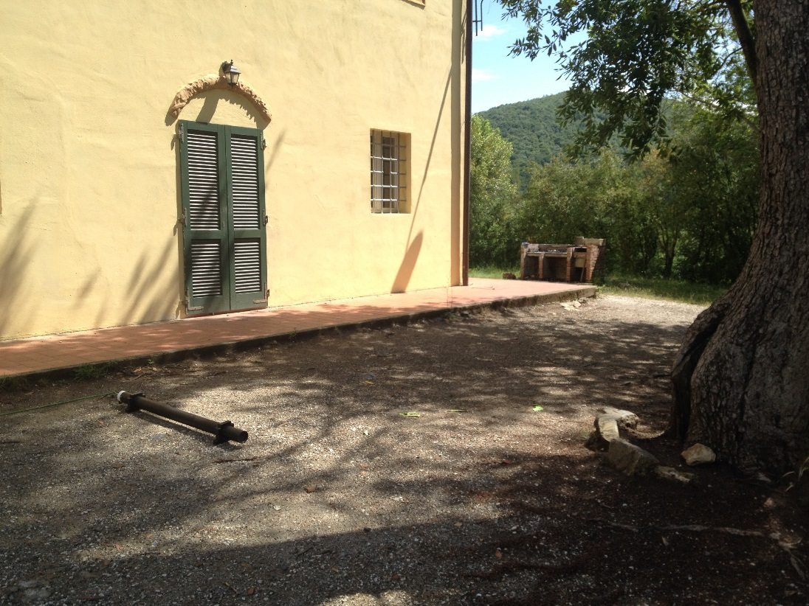
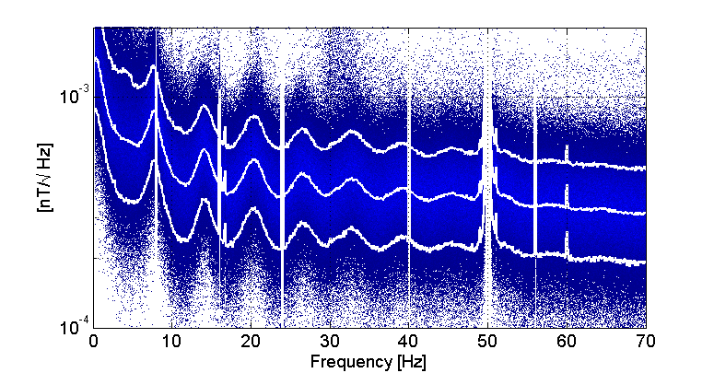
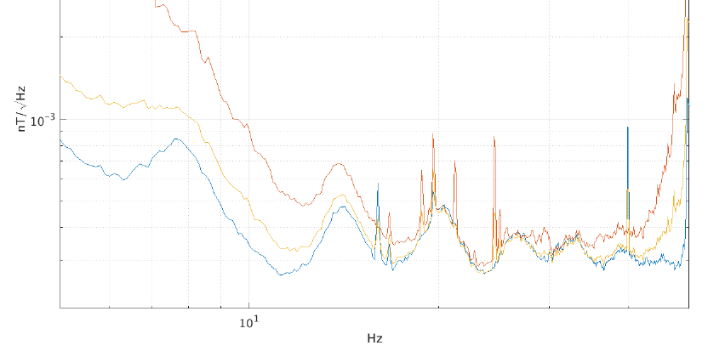
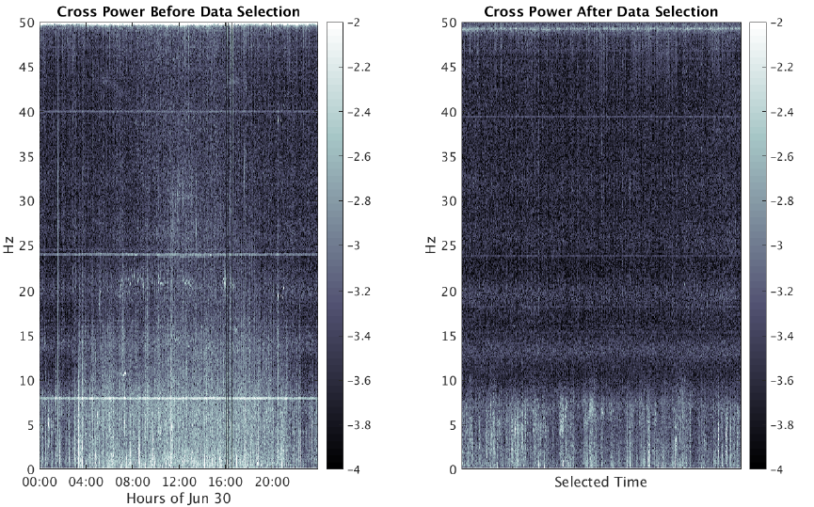

Global magnetic noise (1)
We surveyed the Virgo site and surroundings looking for sufficiently magnetically quiet locations to detect global magnetic noise.
Melissa Guidry (IREU 2015) Tristan Shoemaker (summer stage 2016)
Villa Cristina, scout house 12 km from Virgo, 7 Schumann peaks detected with >90% duty cycle!
Virgo site, outside buildings: noisier, yet 14, 21, 28 Hz peaks detected with approx. 30% duty cycle
10th, 50th, 90th percentiles
24hrs outside NEB
selected data

Slide 14
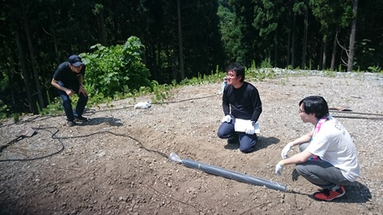
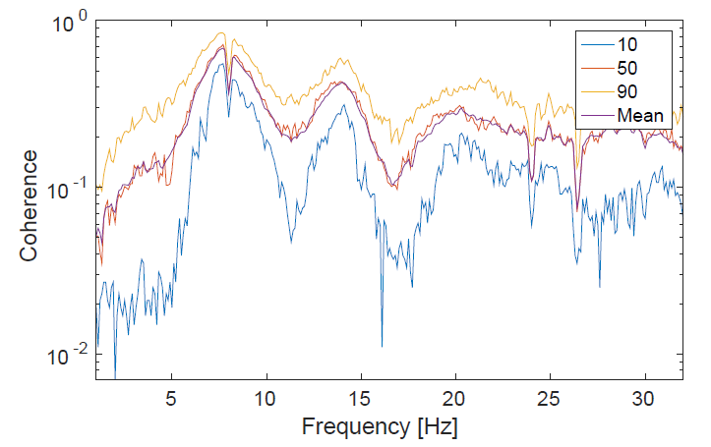
Global magnetic noise (2)
Inter-sites correlation studies
Credits: M.Coughlin, N.Chistensen, E.Thrane, J.Harms, K.Somiya and KAGRA team, Krakow ELF group
Coincident measurements with a net of low noise magnetometers at Villa-Cristina, KAGRA and ELF stations in Poland and Colorado (July 21-22, 2016). NS and EW directions.
Goal is studying correlation distance of global magnetic noise, inter-site correlation, noise subtraction studies using one magnetometer as mock GW detector
KAGRA also took short datasets with few kilometres distant magnetometers, to study correlation at the distance scale of ITF end-stations.
Preliminary
Coherences (VillaCristina – KAGRA)

Slide 15
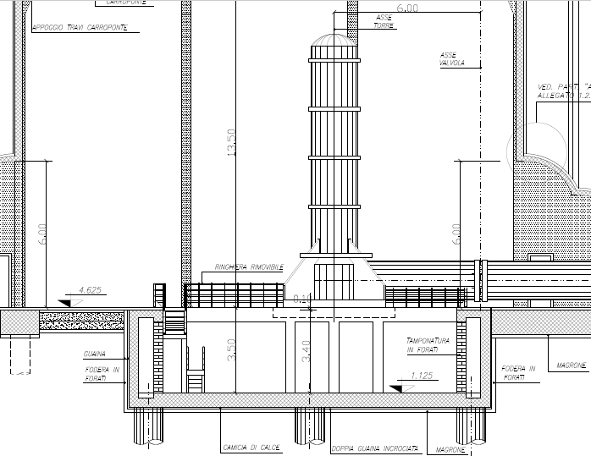
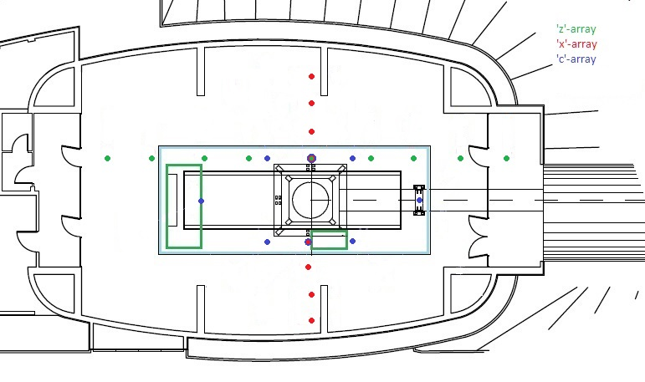
Newtonian Noise (1) characterization studies
Credits: Jan Harms, Susan Blackburn (IREU 2016)
Preliminary study of Virgo Building floor seismicity aimed at NN modelling: seismic levels, correlation lengths, seismic sources.
Modelling Virgo Bld. s is not simple, each building has two independent floor slabs: the first (aka “TM floor”) supports the TM vacuum tank and has 50m deep poles, it also includes a hollow space below TM hosting CleanRoom); the second surrounding floor (aka “Building floor”) is disconnected from TM floor and has shallower foundations, it supports all noisy devices (HVAC, VAC pumps, racks).
Deployed 3 seismic arrays of 9 Meggit-731 vertical accelerometers each
WE building
• • • Accelerometer arrays

Slide 16
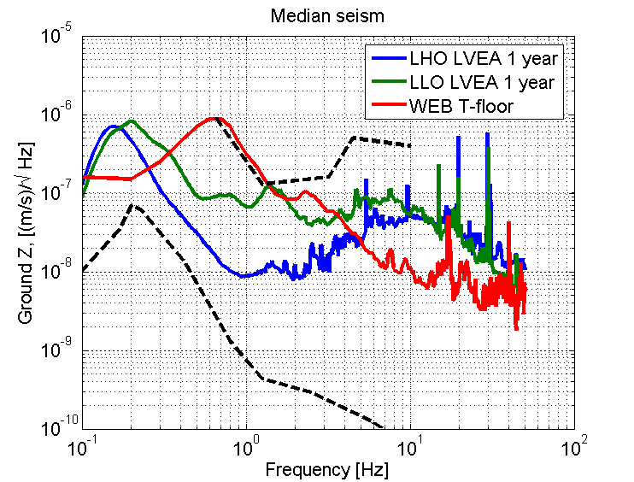
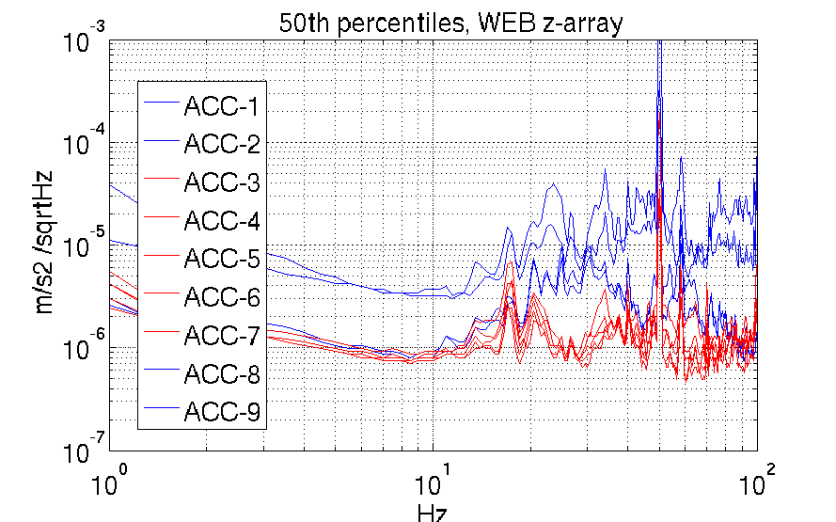
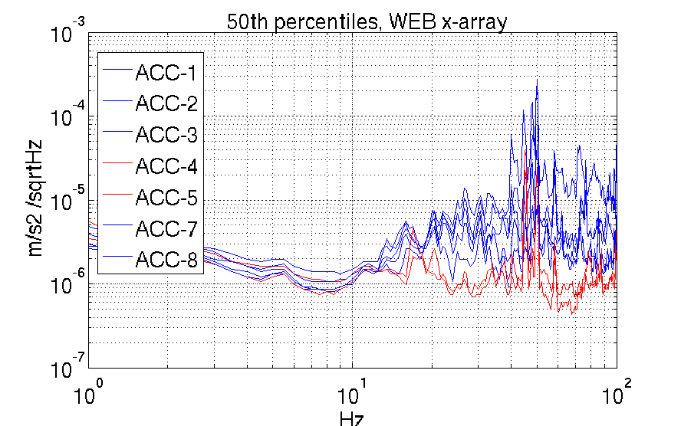
Newtonian Noise (2) characterization studies
Comparing all accelerometers on TM floor slab with all accelerometers on Building floor,
and comparing Virgo TM floor (one location) with LIGO LVEA floor.
BLUE: Building floor
RED: TM floor
Virgo TM floor is seismically quieter than Building floor above 10Hz. TM floor filters noisy devices placed on Building floor slab.
Virgo TM floor is seismically quieter (factor 5-3 above 5Hz) than LIGO LVEA (source J.Harms)

Slide 17
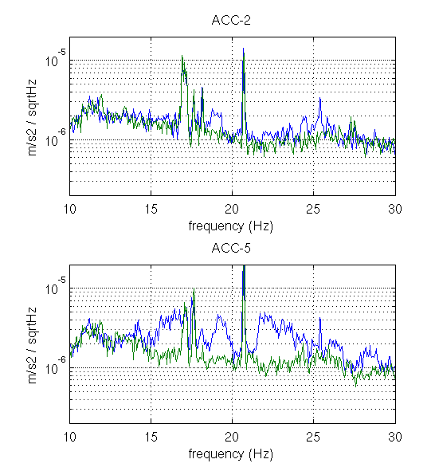
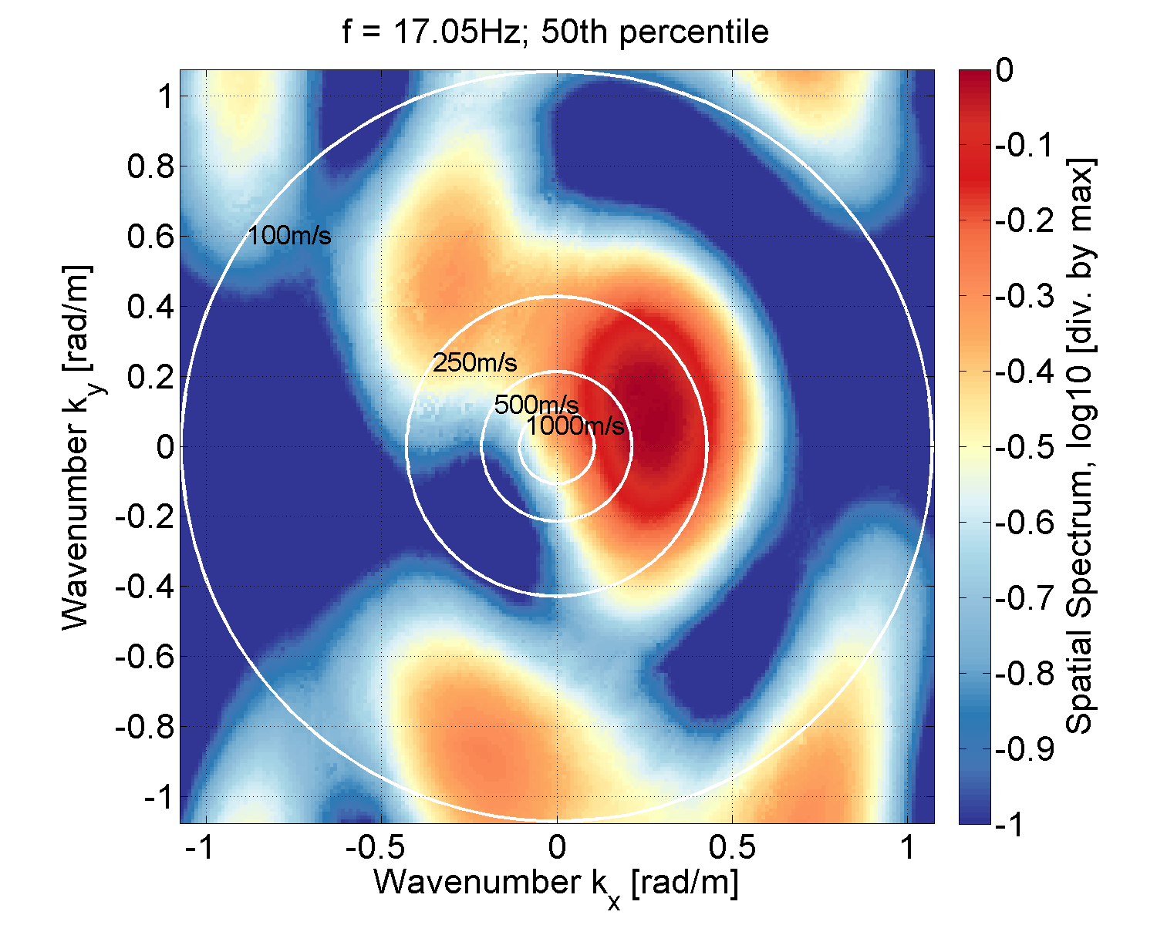

Newtonian Noise (3) sources characterization (preliminary)
k-f maps provide rough indications on source location and wave velocity, sources confirmed by switching off devices or hunting with portable probes
HVAC contributes a bit 15-30Hz
17Hz from SWEB clean room fans, wave speed 350 m/s
12 Hz bump, coherent through whole building, suspect it originates from outside, traffic??
Except for 12Hz noise, seismic waves from other sources have short correlation length (less than Jan measured for LIGO floors). It might indicate significant wave scattering .... likely makes NN sensing and subtraction a tougher job!
17 Hz line
HVAC off
Coherence between two Trillium-C20 on TM floor, increasing distance
12 Hz bump
HVAC off

Slide 18


NN, next
August: Soumen Koley and Maria Bader - Nikhef deployed array of 70 geophones covering an area of 1.5 km radius centred at Virgo. Two weeks data taking, ongoing.
Very interesting data, to study Virgo soil transmission properties, do sources triangulation (like 12 Hz noise).
September: Donatella Fiorucci - APS will perform preliminary measurements at EGO with infrasound microphones.
Study of inside – outside correlations, NN infrasound modelling and subtraction tests.

Slide 19
Conclusions
Environmental sensor network installation is almost completed, enhanced monitoring of infrastructure devices to help commissioning
Magnetic coupling to payloads: modelling works and ambient noise reduction give us confidence about it
Schumann noise: quiet detection possible within few km from Virgo site. First inter-site correlation studies ongoing
First steps in site seismic characterization aimed to NN subtraction studies. Virgo TM floor is relatively quiet at NN frequencies, but the short correlation length might require more dense subtraction arrays. Presently Nikhef array is recording a detailed seismic map of Virgo site external ground, promise interesting data.
.... looking forward to real noise hunting on full ITF!

Slide 20








...warming up tools!
Thank you
for your attention

