Slide 1
Advanced Virgo
Detector Monitoring and Data Quality
D. Verkindt
on behalf of the Virgo collaboration

Slide 2
Outline
Advanced Virgo in the GW observatories era
Current status of Advanced Virgo
Some Detector Monitoring tools
The Data Quality of Advanced Virgo
Gating and Glitch removal

Slide 3
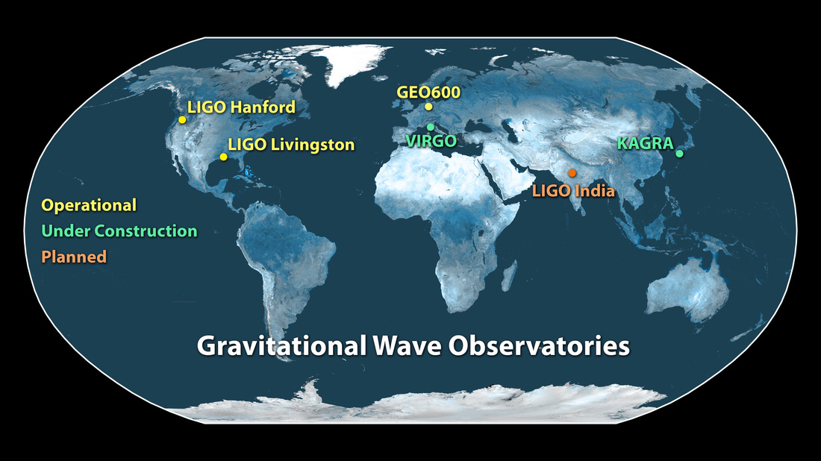
Advanced Virgo in the GW observatories era
Run O1: first GW detections (GW150914 and GW151226) made with Advanced LIGO detectors and LSC+Virgo analysis
Advanced Virgo detector soon included
within International GW observatories network
for runs O2 and O3.
Detector Monitoring and Data Quality are important components of Advanced Virgo
to select/confirm the events detected by the GW observatories network
and to propose them to EM followup.
VIRGO

Slide 4
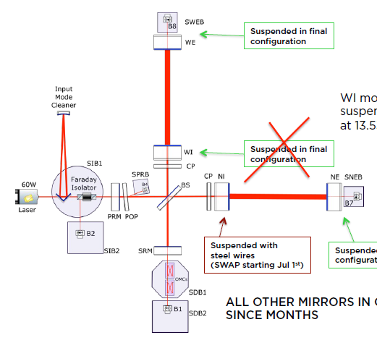
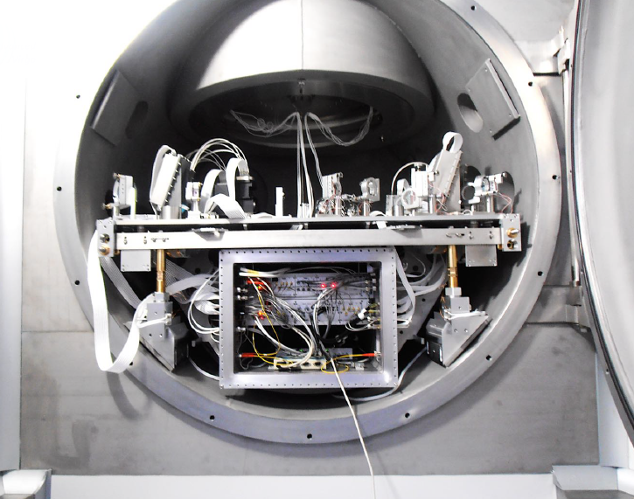
Advanced Virgo current status
Installation almost complete
North arm first lock at the end of April
Free Michelson data taken mid-June
Commissioning activity and noise investigation started on subsystems.
Advanced Virgo scheme
But problems with monolithic suspensions of mirrors.
Replacing them with steel wires, while investigating.
Current plan is still to start full interferometer lock and commissioning work before September 2016
And to be able to participate to run O2…
One of the new suspended benches

Slide 5
Detector Monitoring and Data Quality
Detector monitoring and data quality were already quite efficient in previous runs (2007 to 2011).
“The characterization of Virgo data and its impact on gravitational-wave searches”, CQG, Vol 29, Nbr 15, 2012
Some components have been improved
Some new components are under development.
I will present here only some of those components in which I am more deeply involved.

Slide 6
Some Detector Monitoring tools
The data Display : to visualize data online
The MonitoringWeb : to monitor in-time the trend of various Virgo components
The Detector Monitoring System : to monitor online the Virgo detector subsystems

Slide 7
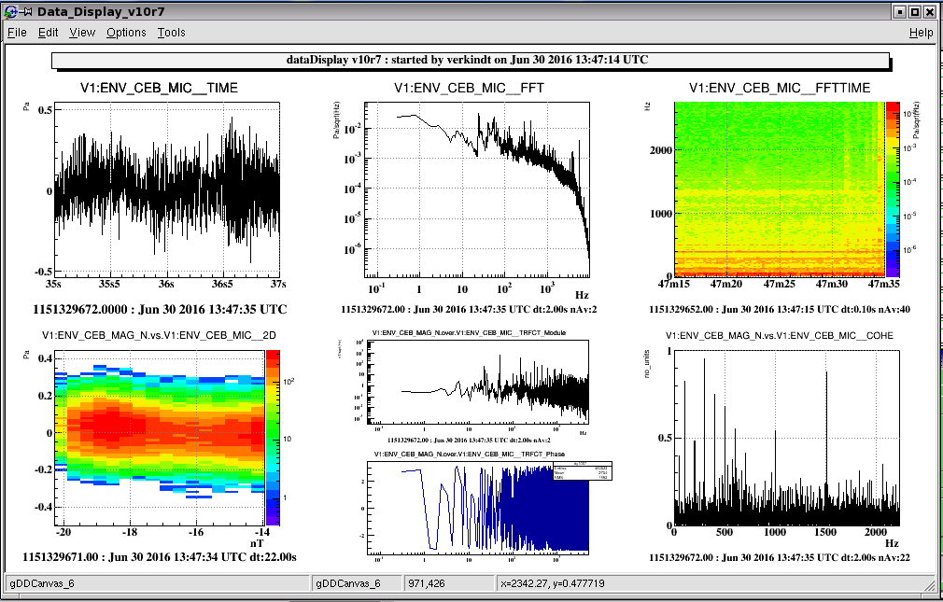
The data Display
Software tool based on ROOT
Read frame formatted data and visualize them offline and online
Provide various signal processings and various types of plots

Slide 8
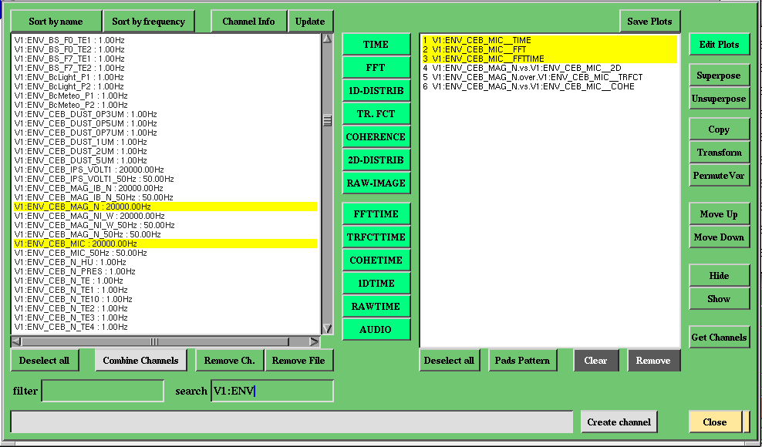
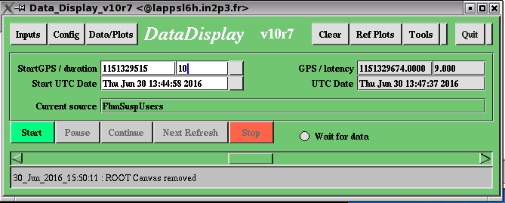
The data Display
Used daily in Virgo control room and for remote monitoring of the detector’s behaviour
Used also offline for noise/glitch/unlocks investigation

Slide 9
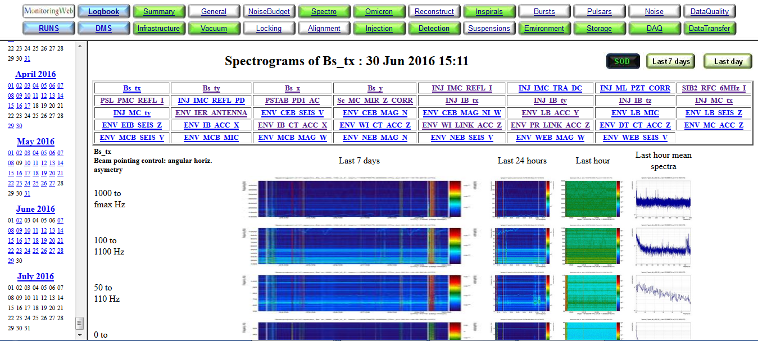
The MonitoringWeb
Similar to the LIGO Summary pages
Provide online and daily archived plots about the status of various Virgo subsystems
This includes also spectrograms, data transfer status , data storage status, online data
quality status, online GW search status, etc…

Slide 10
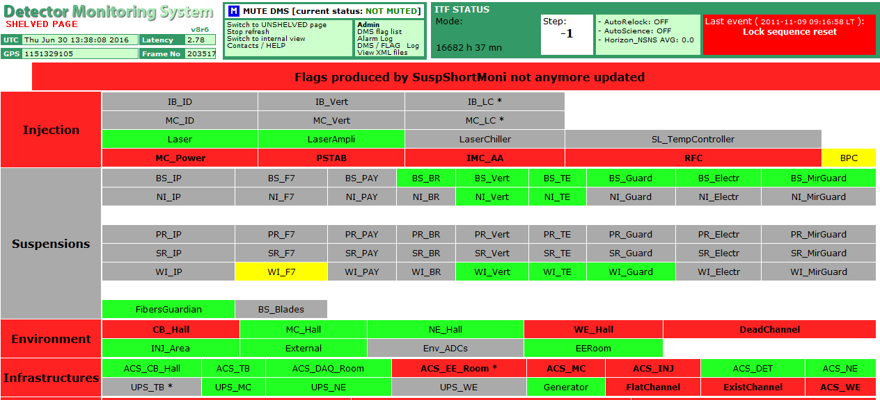
The DMS (Detector Monitoring System)
Provides online information with red/green flags and alarms about various parts of the Advanced Virgo detector
Provides also low latency Data Quality flags to be used by the online and offline GW searches

Slide 11
Advanced Virgo Data Quality
Main complement of detector monitoring is the Data Quality.
Its aims are:
To provide reliable online quality flags and efficient offline quality flags for O2 and O3 observing runs
To mitigate any impact of non-stationnary noise coming from sources not removed by commissioning work
To reduce as much as possible the data analysis backgrounds
while keeping low any deadtime not coming from detector unlocks.

Slide 12
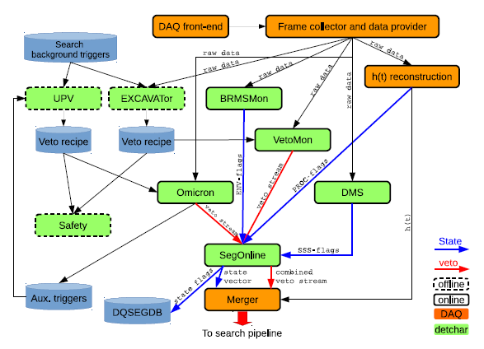
Advanced Virgo Data Quality
Main strategy for online Data Quality:
Provide a generic flag DQ_VECTOR at 1 Hz
Provide a set of reliable/efficient analysis-dependent vetos at 100 Hz
Base the online veto production on veto recipes updated periodically.
Veto recipes set offline using the searches background triggers
To be added : gating of data and glitch removal (new)

Slide 13
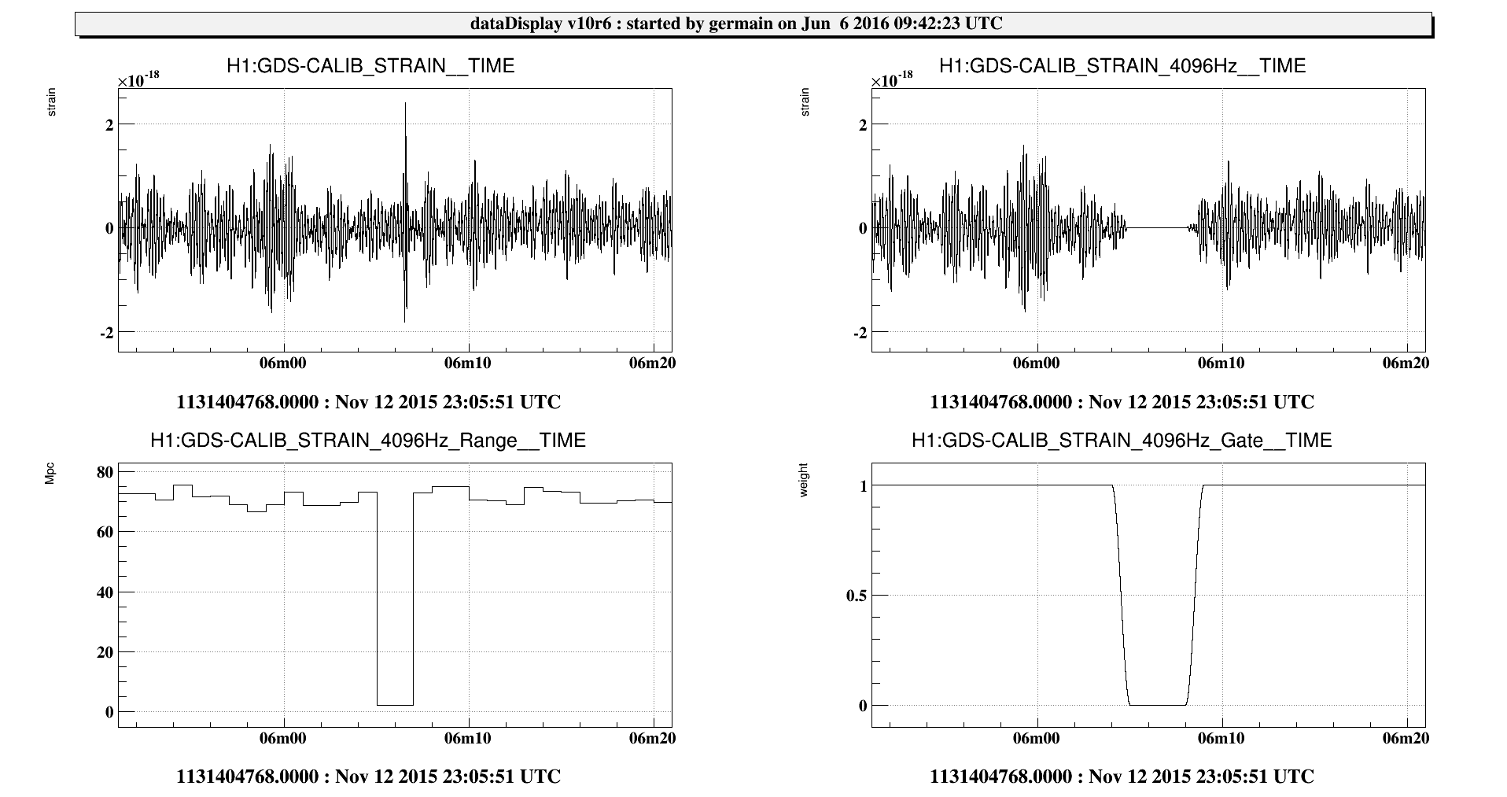
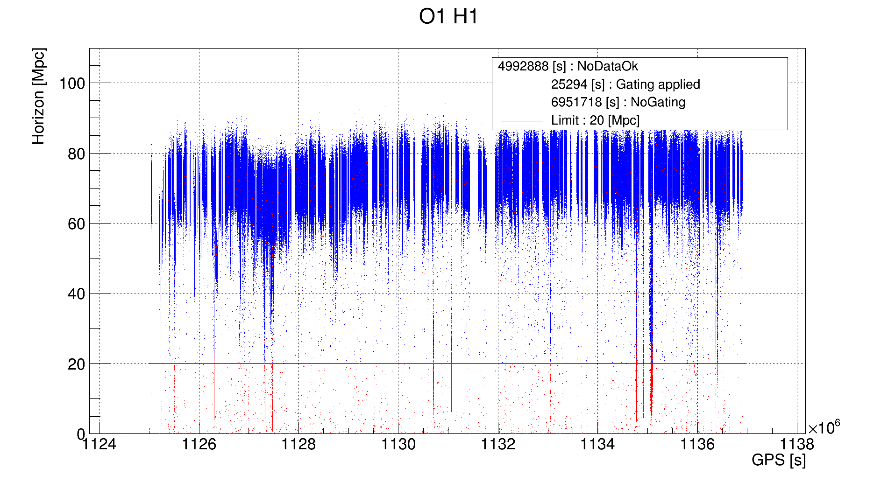
The Gating of data
Data put to zero
Gating : an alternative to the exclusion of data sets by vetos
Motivated by the need to keep data flow for the analysis pipelines
glitch
Hanford Detector BNS horizon during O1 run
Put a threshold on the inspiral range (for instance 20 Mpc)
and put to zero any data providing a range below this threshold
BNS = Binary Neutron Stars
AdVirgo Gating developed for MBTA online GW search in O1
One possible step further: the glitch removal (or mitigation)
Could help to reduce background while preserving as much as possible the percentage of data analyzed

Slide 14
Glitch removal in Advanced Virgo: Silentec
C code running a non-linear regression method based on Volterra series and Robust Fast Orthogonal Search
Initially developed in matlab by G. Guidi and F. Piergiovanni
Currently developed in C by V. Germain and myself
Properties:
  List of auxiliary channels to reconstruct the glitch in the main channel
  Linear & bi-linear reconstruction → Takes into account the up-conversions
  Orthogonality
  Estimation of the contribution Q of every auxiliary channel (and product of channels)

Slide 15
Glitch removal in Advanced Virgo: Silentec
C code running a non-linear regression method based on Volterra series and Robust Fast Orthogonal Search
Initially developed in matlab by G. Guidi and F. Piergiovanni
Currently developed in C by V. Germain and myself
Main channel
h(t)
Resampling
(option)
Pass-band filtering (option)
Channels sorted by Correlation
Correlation
Main <--> Witness
Auxiliary channels
Resampling
Products of channels
Pass-band filtering (option)
Robust Fast Orthogonal Search
Properties:
  List of auxiliary channels to reconstruct the glitch in the main channel
  Linear & bi-linear reconstruction → Takes into account the up-conversions
  Orthogonality
  Estimation of the contribution Q of every auxiliary channel (and product of channels)
Aux. channels Contributions removed
Clean main channel created

Slide 16
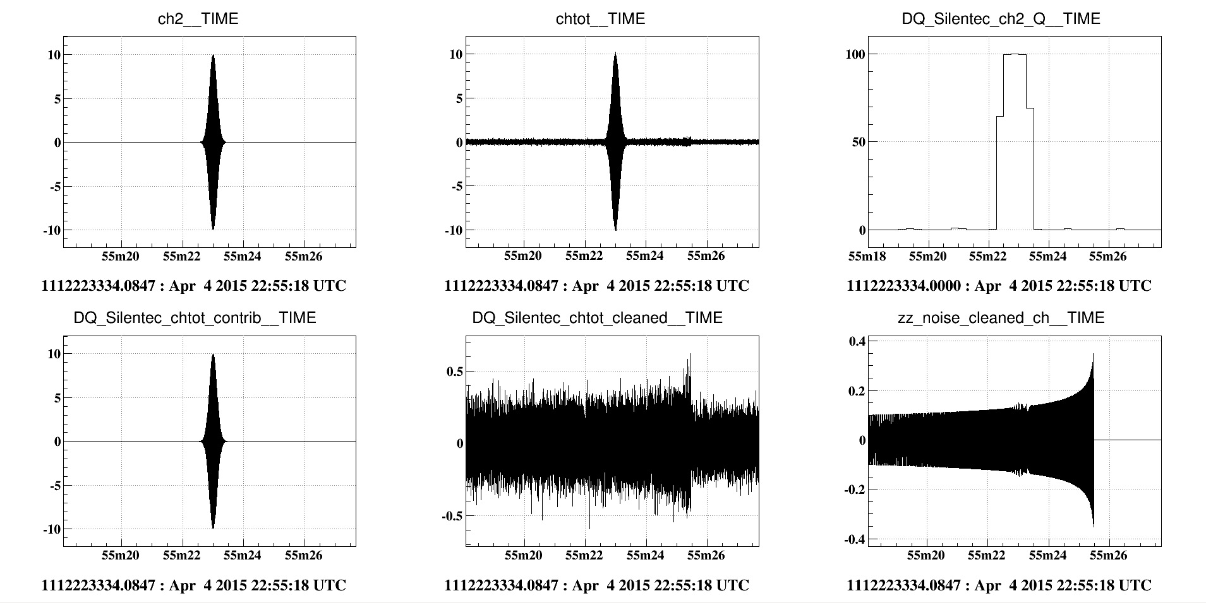
Glitch removal in Advanced Virgo: Silentec
A simple test: a simulated glitch superposed to a Binary Neutron Star (BNS) signal
Main channel
gaussian noise
+ aux. ch. + BNS
SilenteC
Aux. channel contribution up to Q=99%
Aux. channel
glitch
Aux. channel
Main channel
Q value of aux. channel
Cleaned main channel

Slide 17
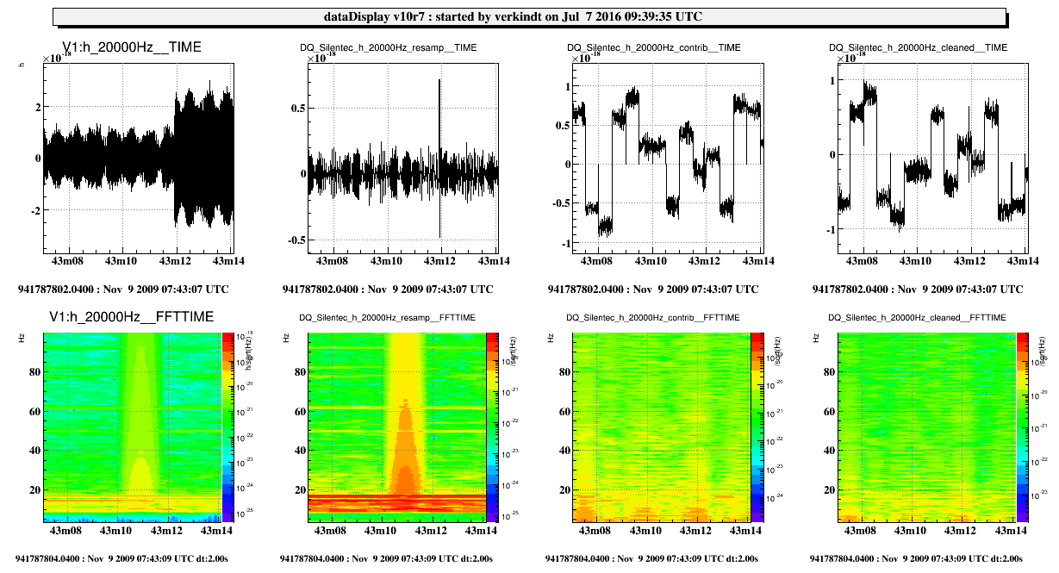

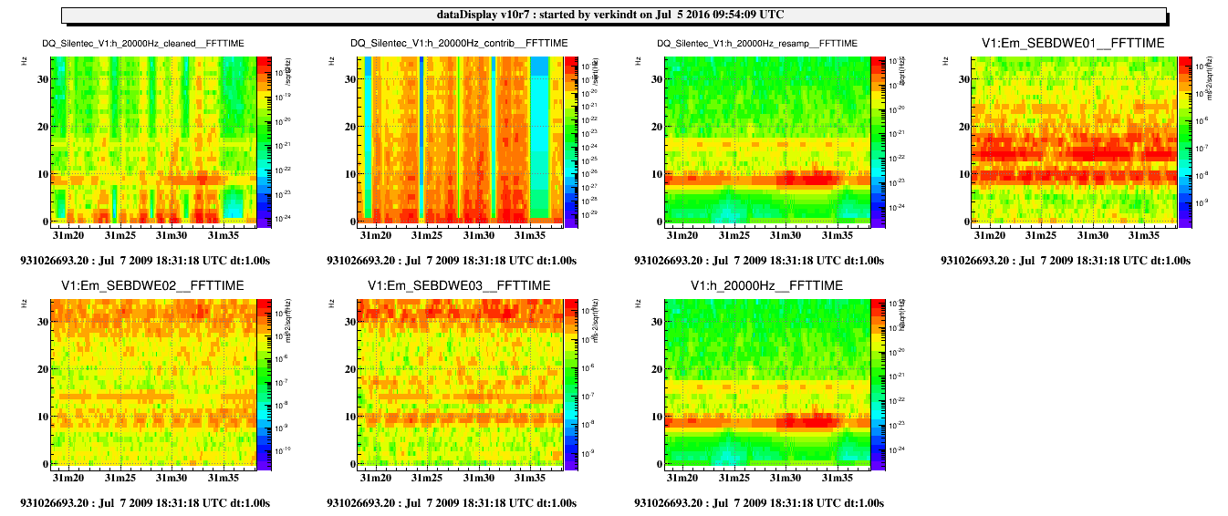

Glitch removal in Advanced Virgo: Silentec
h(t)
h(t) cleaned
A glitch in VSR2 data associated to a drop of Binary Neutron Star range below 2 Mpc
Quite successful cleaning in the frequency range of the glitch
Silentec trying to remove seismic, acoustic and magnetometer channels contributions
Preliminary
A glitch in VSR2 data associated to an identified seismic noise
Some cleaning in the frequency range of the glitch…
but additional noise introduced...
Still investigating
Silentec trying to remove all seismic channels contributions

Slide 18
Summary
Advanced Virgo is coming to full interferometer commissioning phase
and is pushing hard to be part of O2 run
Several monitoring tools are ready or under improvement
Data Quality strategy is going to be fully implemented and tested
New tools like « glitch removal » will help noise investigation and will improve data analysis results

Slide 19
Backup slides

Slide 20
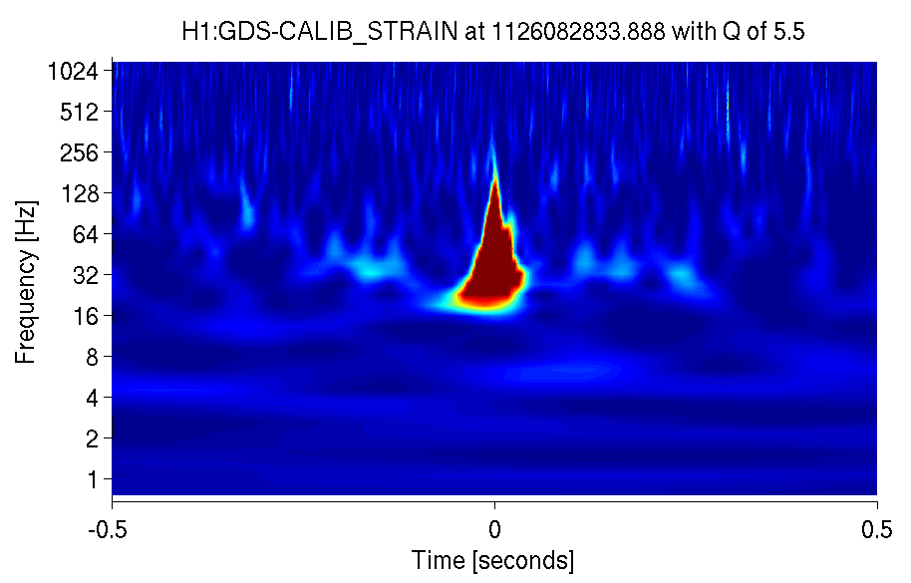
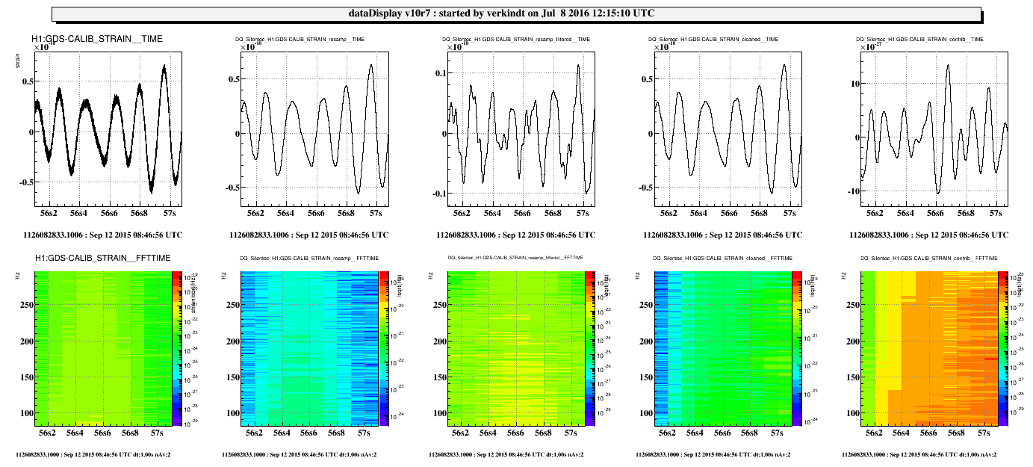
Glitch removal in Advanced Virgo: Silentec
Looking at a O1 blip glitch: searching for contributions from Output Mode Cleaner channels and part of Environment Monitoring channels
h(t) resampled at 1024 Hz
h(t) cleaned
sum of contributions above threshold of 5%
Threshold at 5%
The main contributing aux. channels are:
[1] H1:OMC-ASC_Y1_I_OUT_DQ : Q=5.86154%
[2] others : Q=13.7731%
[3] unmodeled : Q=80.3654%

Slide 21
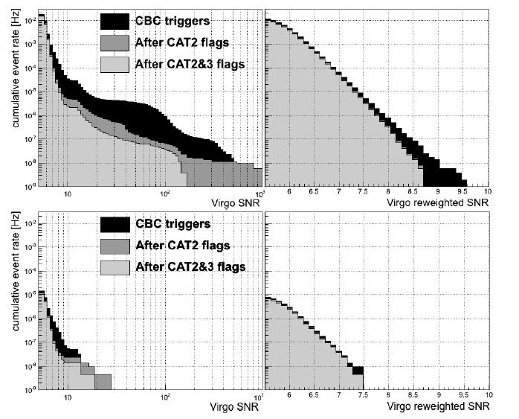
Virgo Data Quality: Impact on data analysis results
CBC search triggers distribution for S6/VSR2 data
Most of false alarms removed by coincidence with other GW detectors
Remaining coincident events are mainly glitches
Background whose distribution tail lowers the significance of any GW candidate.
HL, HV or LV coincidences
Data Quality vetos reduces this distribution tail.
HLV coincidences

Slide 22
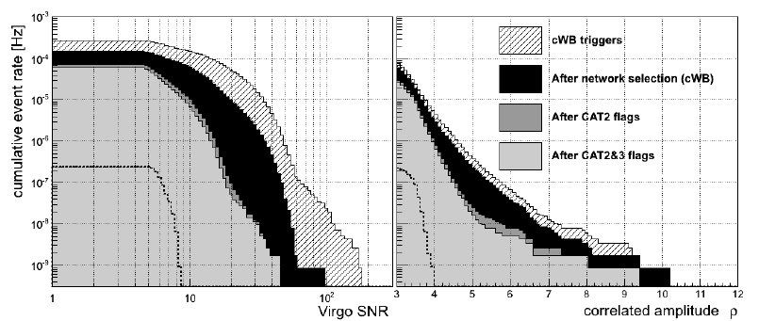
Detector Monitoring and Data Quality
Detector monitoring and data quality
were already quite efficient in previous runs (2007 to 2011).
Effect of DQ flags on the SNR distribution of the cWB burst search triggers for data of the run VSR2 (2009)
cWB triggers
cWB triggers after use of DQ flags
From “The characterization of Virgo data and its impact on gravitational-wave searches”, CQG, Vol 29, Nbr 15, 2012
Some components have been improved
Some new components are under development.
I will present here only some of those components in which I am more deeply involved.

Slide 23
Advanced Virgo Data Quality
The aims are:
To provide reliable online quality flags and efficient offline quality flags for O2 and O3 observing runs
To mitigate any impact of non-stationnary noise coming from sources not removed by commissioning work
To reduce as much as possible the data analysis backgrounds
while keeping low any deadtime not coming from detector unlocks.
The main components:
Data Quality flags based on the Omicron trigger generator and the UPV algorithm
Data Quality flags based on the Excavator algorithm
Data Quality flags provided by the Detector Monitoring System
Alternative or complementary new tools: gating of data and glitch removal

