Slide 1
Test of new stepper motor driver for AdV
Giulio Ballardin, Vincenzo Dattilo

Slide 2
Performed Test
I carried out tests of new software and hardware at the same time. I decided to follow the same protocol used in the Labview application provided to me by Massimo.
Before starting the tests, I inverted the management of the limit switches to follow what was done in Virgo.

Slide 3
Net Test
In the VTF I tested, with S. Cortese, the possibility of using DHCP on the hidden network with the new driver. The driver works with DHCP, but is not fully compatible with the LEASE mechanism.
Stefano has doubts about the use of a net switch inside the crate of drivers.

Slide 4
Virgo Test Facility tests
I built a simple C++ library to send ascii commands to a Galil (http://www.galilmc.com) driver. On the top of this library I created both a C++ user interface to send commands and check the output, and a simple command line application.

Slide 5
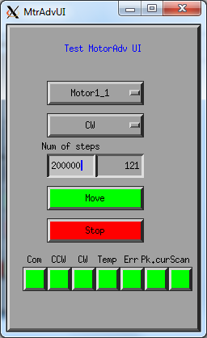
User Interface application
Through this application we can:
Select and start a relative movement with direction using 24 stepper motors
Check the number of steps done
Check the status of both limited switches
Check the communication status
Check the temperature of the driver used (if the temperature is above 80º C)
Check if peak current occurred on the driver board
Check if a scan error on the output occurred.
Stop the movement of a motor

Slide 6
Tests performed in VTF/PR (on air)
Using the UI
Motor Type | New | Freq | Location | Loaded | Duration | Temp (º C)
1A | YES | 1t/2sec | VTF | NO | 35h | 46
2A | YES | 2t/4sec | VTF | NO | 35h | 60
2A | YES | 1t/2sec | VTF | NO | 35h | 66
2A | YES | 1t/8sec | PR | NO | 4h | 44
1A | YES | 1t/8sec | PR | NO | 4h | 38
1A | NO | 1t/8sec | PR | NO | 4h | 46
2A | NO | 1t/8sec | PR | NO | 4h | 43

Slide 7
Problem report
During the test on WI we found limited switches inverted: it was necessary add some code to fix this problem, and asked for help from the Electronics group to setup the limited switches in the right way.
Scan problem during long test.
False limited switch alarms.

Slide 8
How fixe the problems
To solve the problem of limited switches I think the best solution is to modify the firmware of the driver (see “Command_reference.pdf”)

Slide 9
Status of work
I’m developing a Tango server to manage the drivers. Using this server it should be possible to run more than one motor at the same time

Slide 10
To be done
Finish the Tango server
Develop a TANGO User Interface (what library??, Xforms?)
Write the firmware for the driver

Slide 11
Possible improvements
Add USB socket on front panel
Add leds on front panel to show the movement of a motor
Build a simple tool to move a motor locally

Slide 12
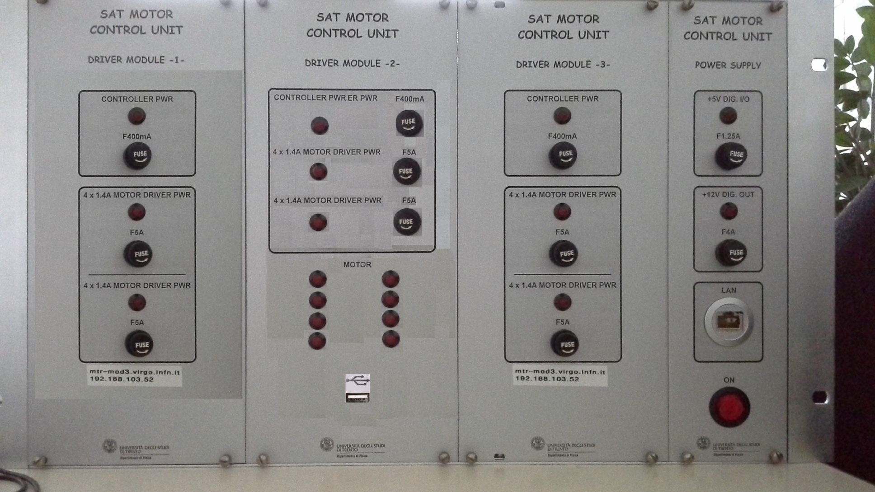
Possible new Front Panel

Slide 13
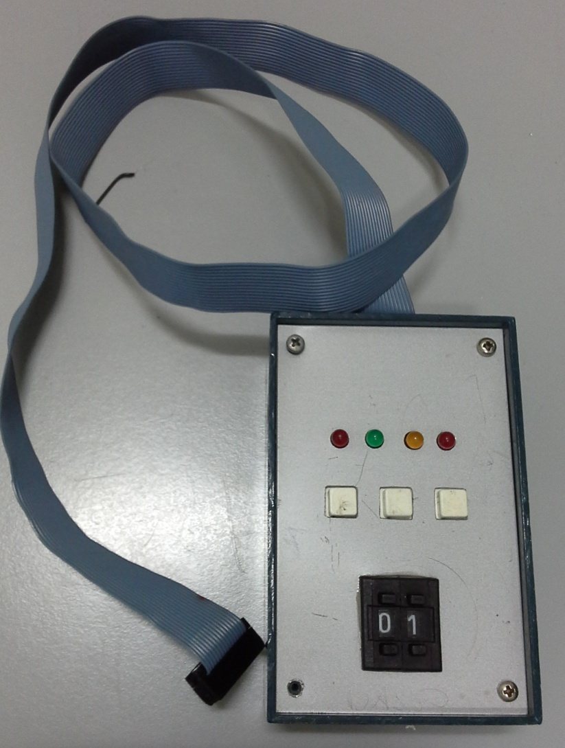
Tool to move motor locally

