Slide 1
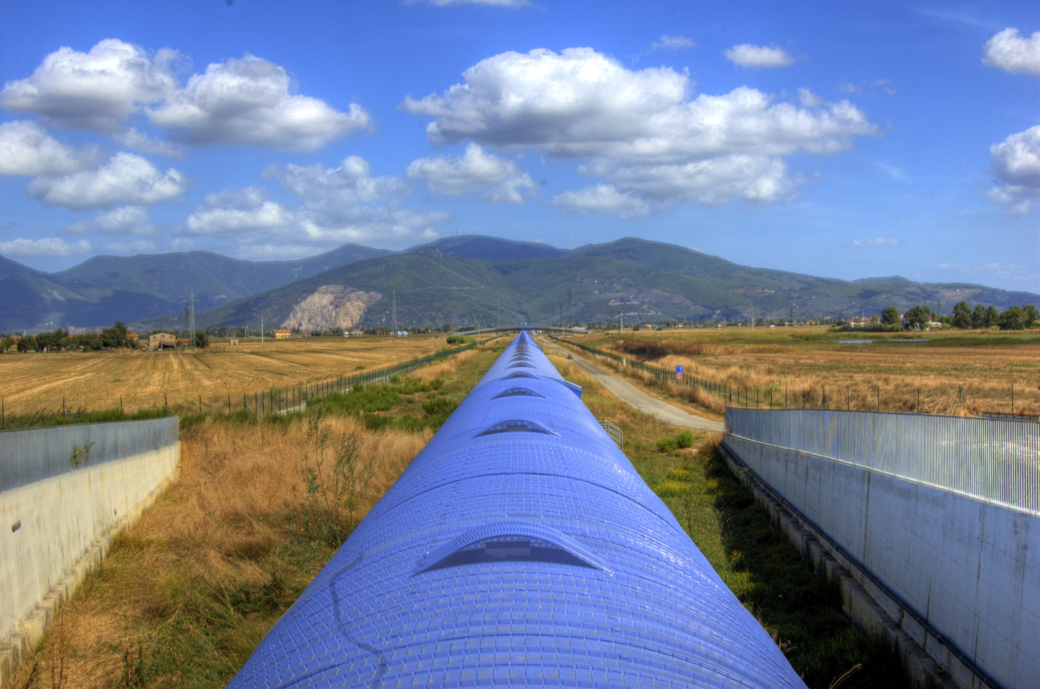

Advanced Virgo
GIOVANNI LOSURDO - INFN Firenze/EGO
Advanced Virgo Project Leader
For the Virgo Collaboration

Slide 2
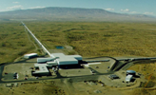
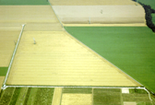
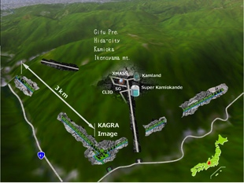
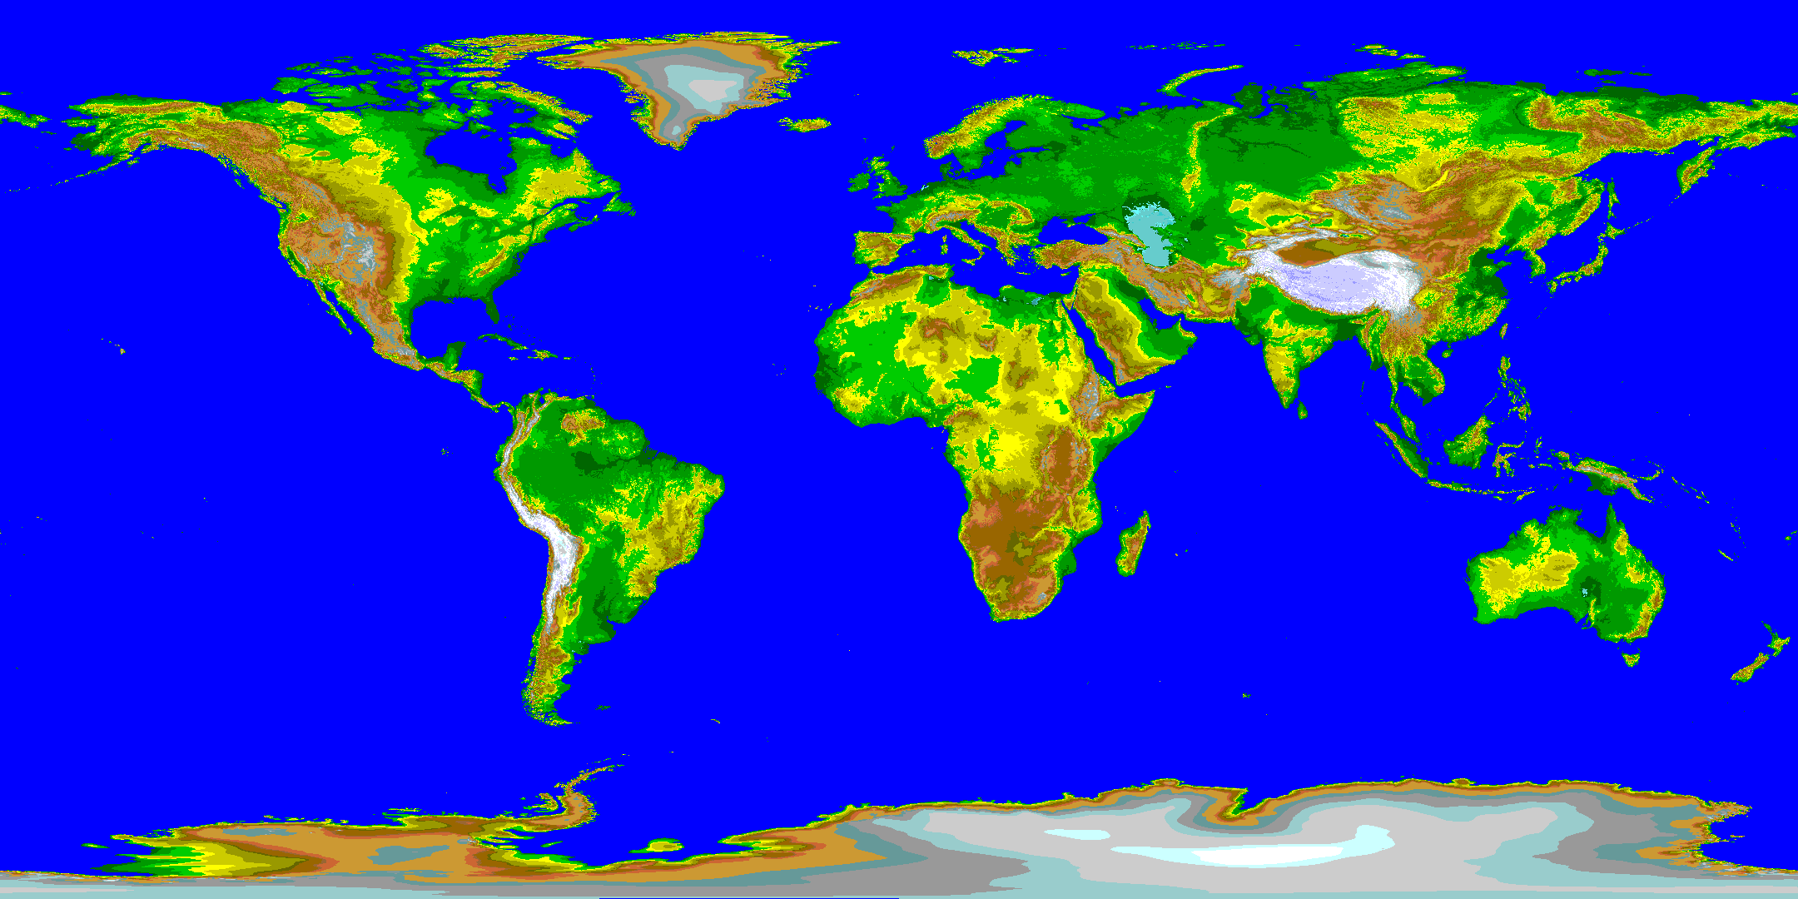
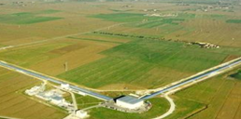
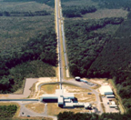

2nd GENERATION NETWORK
aLIGO-WA
KAGRA
GEO-HF
aLIGO-LA
Advanced
VIRGO
aLIGO-India

Slide 3
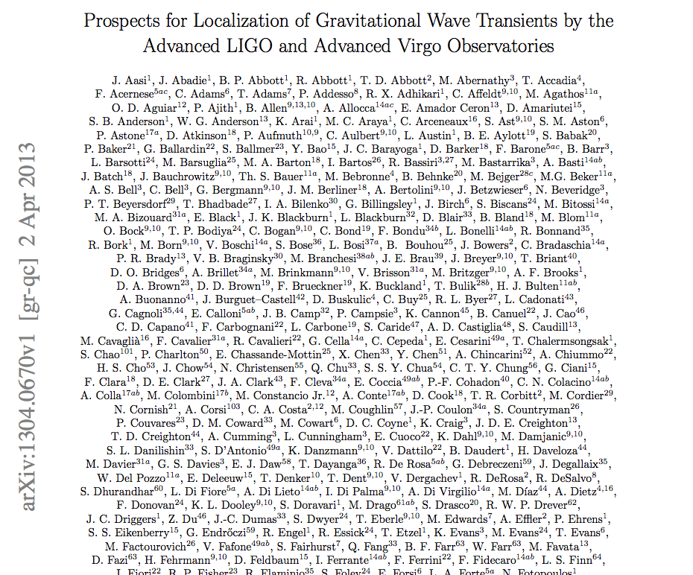
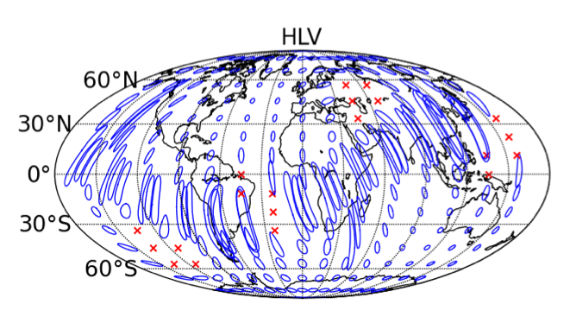
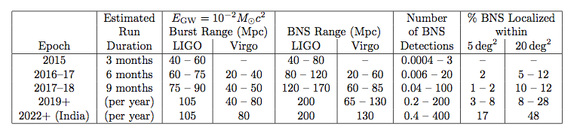
2nd GENERATION NETWORK
Aiming to source
localization in the sky

Slide 4
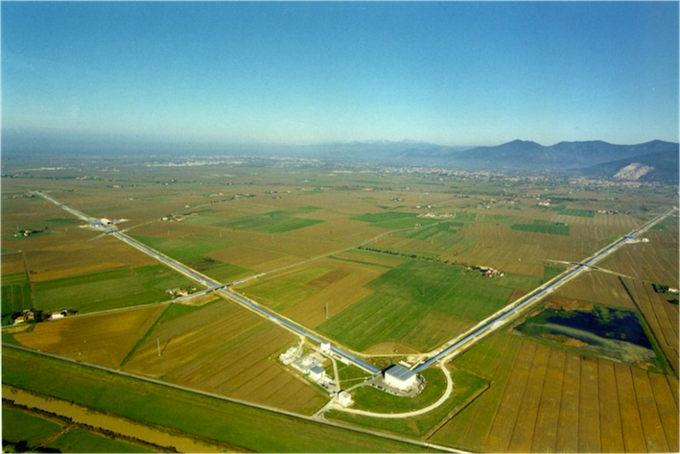





ADVANCED VIRGO
5 European countries
19 labs, ~200 authors
Advanced Virgo (AdV): upgrade of the Virgo interferometric detector of gravitational waves
Participated by scientists from Italy and France (former founders of Virgo), The Netherlands, Poland and Hungary
Funding approved in Dec 2009
Construction in progress. End of installation: fall 2015
First science data in 2016
APC Paris
ARTEMIS Nice
EGO Cascina
INFN Firenze-Urbino
INFN Genova
INFN Napoli
INFN Perugia
INFN Pisa
INFN Roma La Sapienza
INFN Roma Tor Vergata
INFN Trento-Padova
LAL Orsay – ESPCI Paris
LAPP Annecy
LKB Paris
LMA Lyon
NIKHEF Amsterdam
POLGRAW(Poland)
RADBOUD Uni. Nijmegen
RMKI Budapest

Slide 5
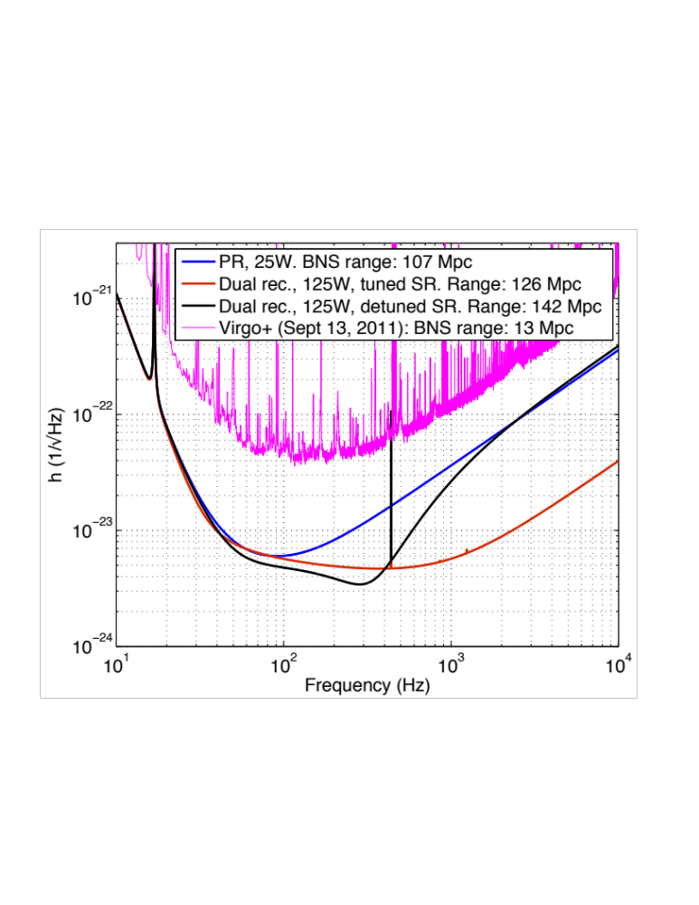
SENSITIVITY
Virgo+
Early configuration
Late configuration

Slide 6
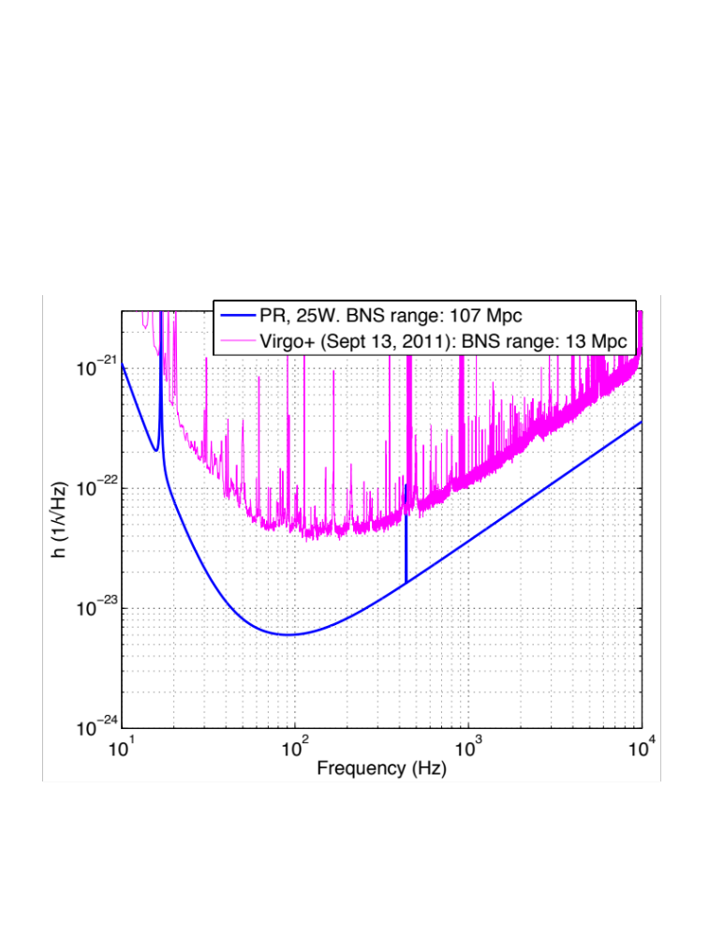
2015 CHALLENGE
Start in 2015 with a simplified configuration, similar to Virgo+: likely to reduce commissioning time
  No signal recycling (reduce locking complexity)
  Virgo+ laser (up to 60W)
  Low power (reduce risks with thermal effects and high power laser)
Target BNS inspiral range: >100 Mpc
Configuration upgrade schedule to be discussed with the partners

Slide 7
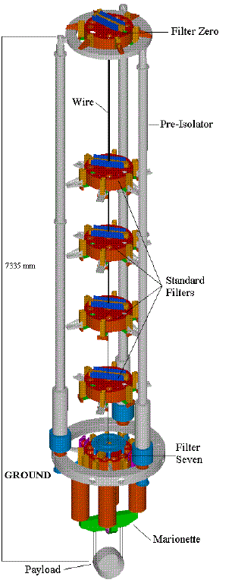
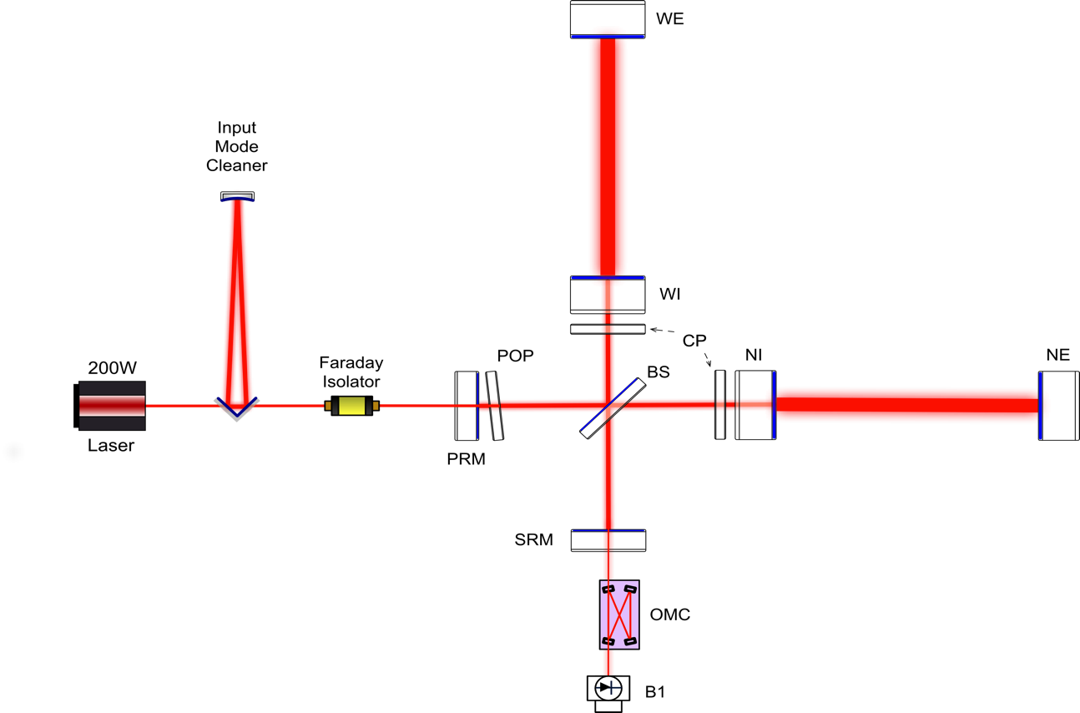
DETECTOR DESIGN
MAIN CHANGES wrt Virgo
  larger beam
  heavier mirrors
  higher quality optics
  thermal control of aberrations
  200W fiber laser
  signal recycling
Vibration isolation by Virgo superattenuators
  performance demonstrated
  large experience gained with commissioning at low frequency

Slide 8
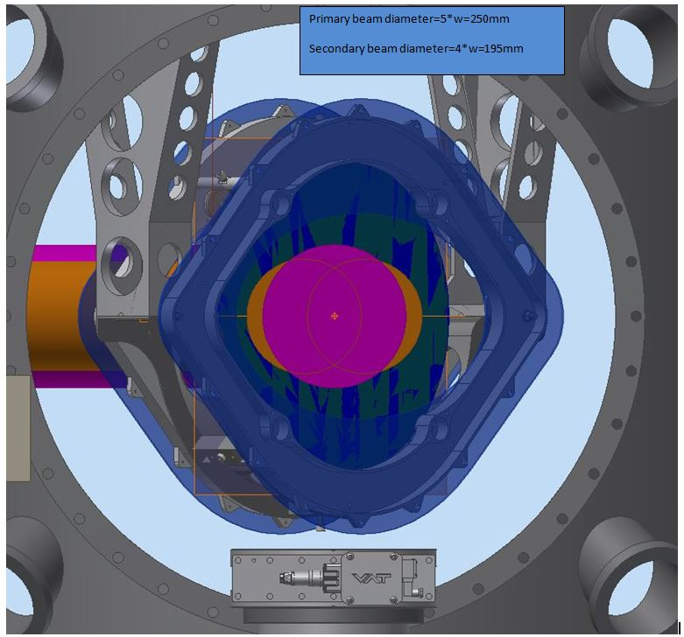
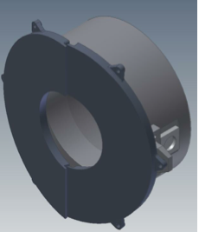
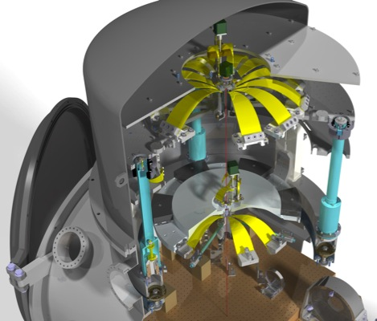
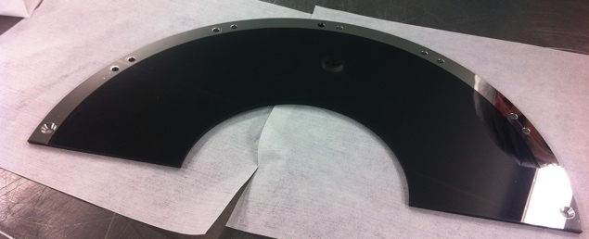
STRAY LIGHT MITIGATION
Learned form 1st generation: scattered light is one of the major risks towards the final sensitivity goal
Large investment to mitigate it
  Better optics quality
  Baffles to shield mirrors, pipes, vacuum chambers exposed to scattered light
  Photodiodes suspended in vacuum to isolate them from acoustic/seismic noise
  If required, control the position of the benches wrt the interferometer

Slide 9
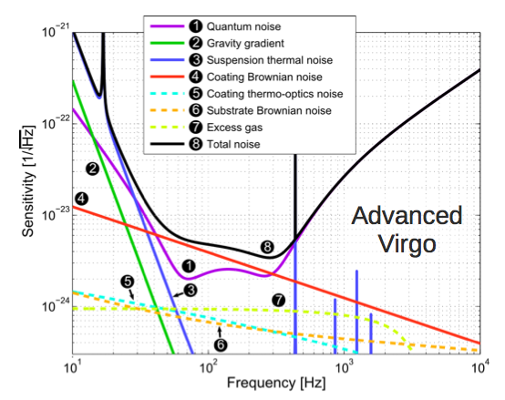
HIGH QUALITY OPTICS
Mirrors may limit the sensitivity in a wide frequency range…
REQUIREMENTS: large mass/diameter, good flatness/roughness, low absorption, good homogeneity, good coating uniformity, high Q
RADIATION PRESSURE
and SUSPENSION THERMAL
noises depend on mirror mass
Mirror geometry/flatness
may change the optical
gain and, thus, the
SHOT NOISE
Scattered light from
flatness/roughness
Aberrations depend on
coating absorption (thermal
lensing) and substrate
inomogeneity
Mid-frequency range
dominated by coating
THERMAL NOISE

Slide 10
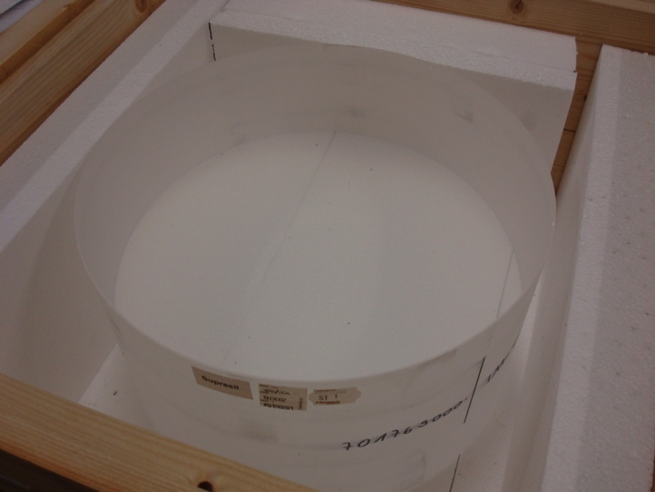
HIGH QUALITY OPTICS
Large test masses: 35cm diameter, 20cm thick, 42 kg
New fused silica grade (Suprasil 3002):
  Better bulk absorption (0.2 ppm/cm measured at LMA): better for thermal lensing
  refractive index homogeneity <0.3 ppm on 200 mm CA
  High quality factor > 10⁷
Polishing much improved: 0.2 nm rms on 160 mm diameter achieved
  ion beam figuring
  better metrology
Coatings much improved
  See talk by R Flaminio tomorrow
New metrology
AdV test mass

Slide 11
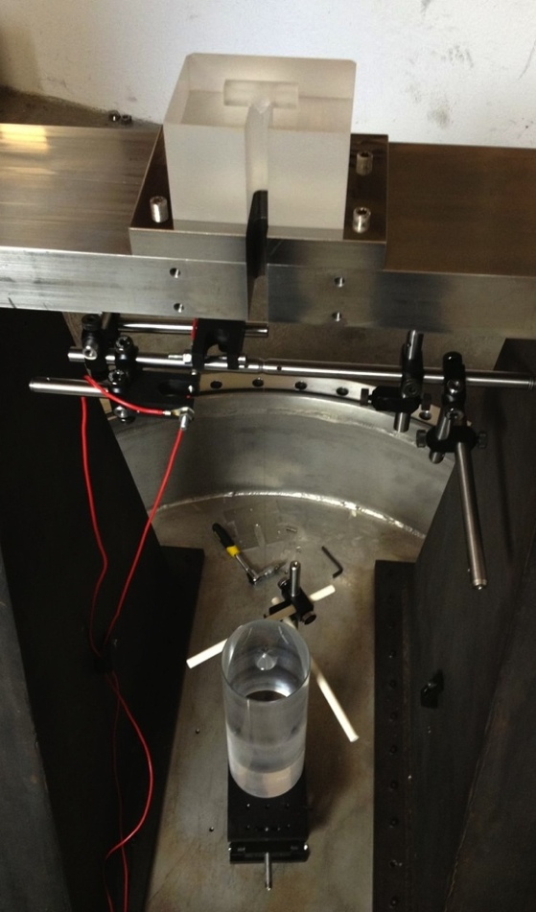
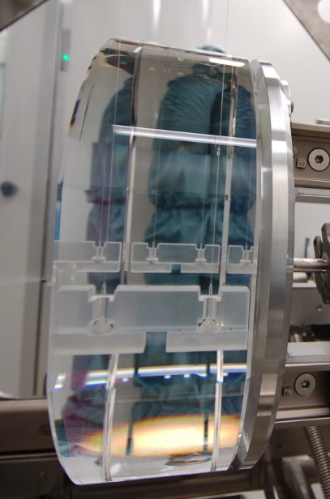
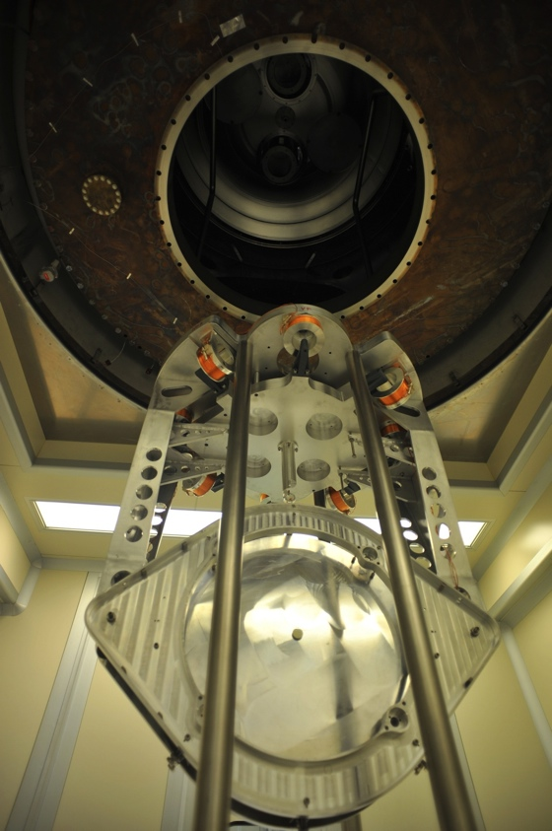
PAYLOADS
Use of larger mirrors plus need of baffles and compensation plates requires upgrading the payloads
Test masses suspended with silica fibers (as in Virgo+)
The silica-steel interface at the level of the upper stage will be improved
Virgo+ monolihic
suspension
AdV payload (BS)
Test for AdV monolithic
suspension

Slide 12
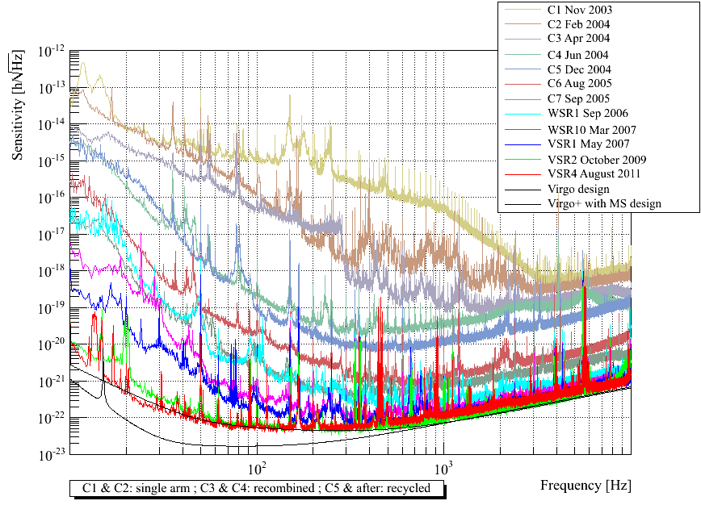
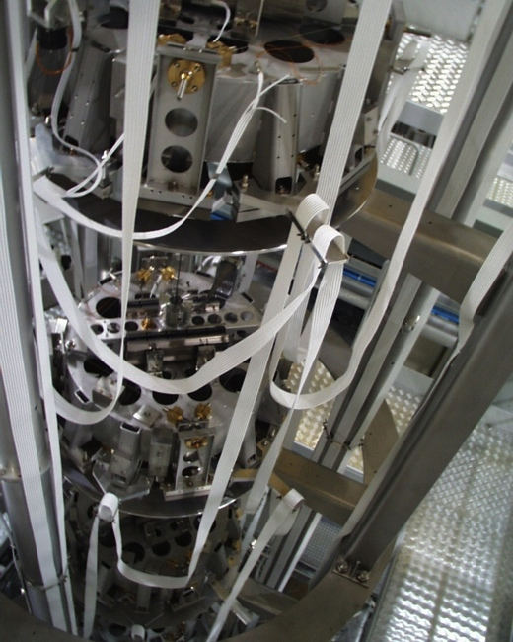
VIBRATION ISOLATION
Advanced Virgo will use the same superattenuators as Virgo
  but top platform to be controlled in 6 d.o.f.
Main advantages:
  Performance demonstrated
  Large experience gained with LF commissioning/operation

Slide 13
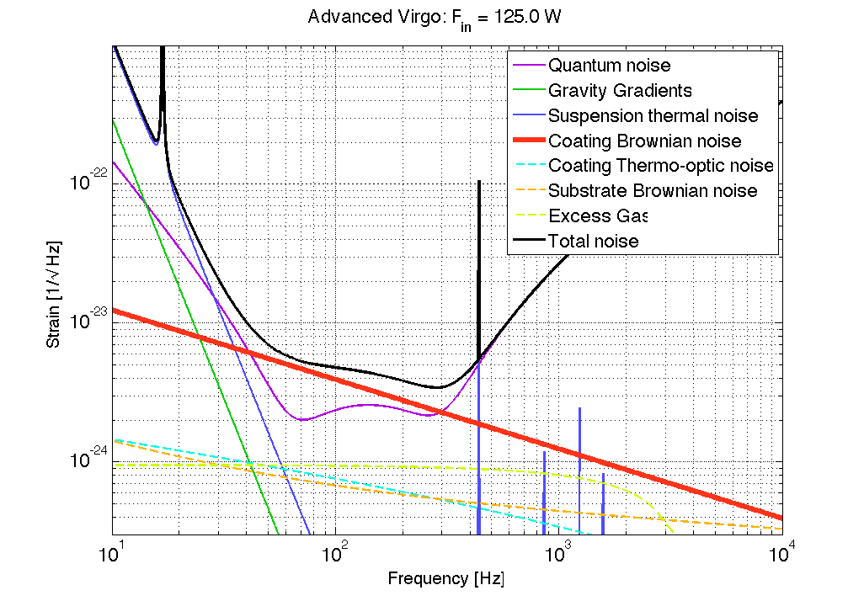
INCREASING THE BNS
INSPIRAL RANGE
Mirror coating thermal noise is the dominating noise in the mid frequency range (dissipation dominated by the high refractive index layer)
Doping Ta₂O₅ with Ti has improved it, but losses are still O(10⁻⁴)
Advanced Virgo to use large spot size (~5cm) on the test masses
  impact of size of the vacuum links/valves, BS size…

Slide 14
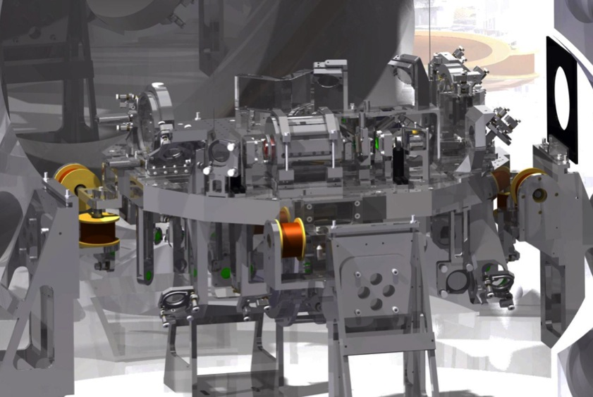
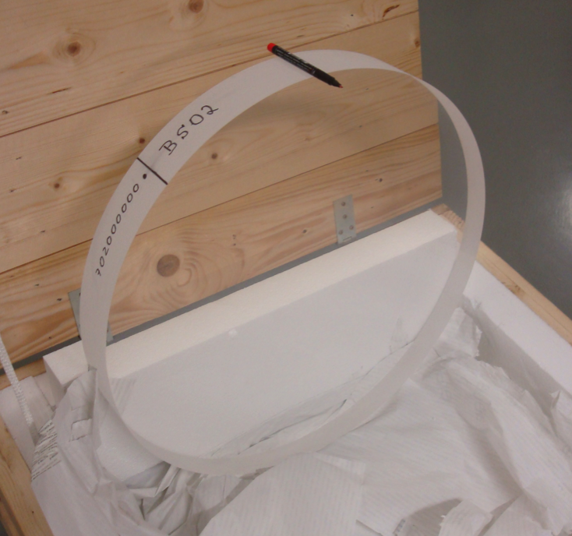
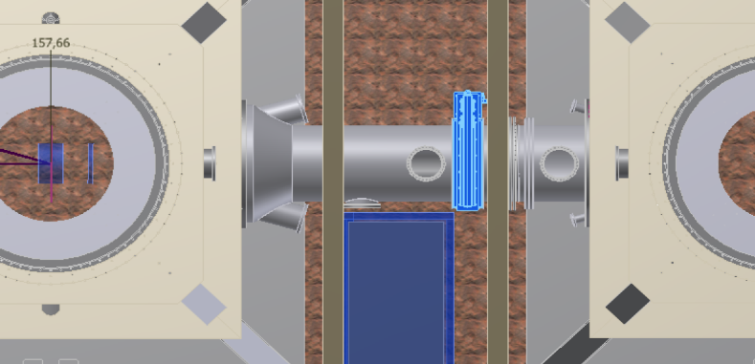
IMPACT OF LARGE BEAM
AdV input optics suspended bench
Larger beam:
  required new vacuum links
  re-design of input benches, telescopes
  large BS (55cm)
AdV beam splitter
vacuum link

Slide 15
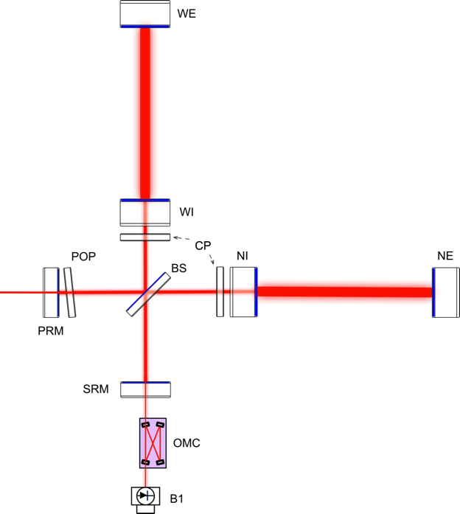
IMPACT OF LARGE BEAM
Recycling cavities: same Virgo design but larger beam → higher degeneracy
  Sidebands high order modes are nearly resonant
  Degeneracy of the sidebands very sensitive to thermal effects, substrate defects
Requires proper management of aberrations
  Optics quality
  Active aberrations control

Slide 16
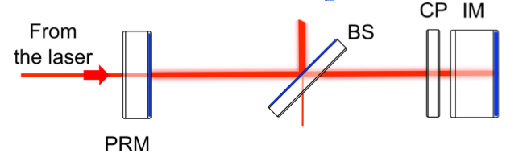
ABERRATIONS
Focus on the recycling cavities, where several kinds of aberrations play a role
  Inhomogeneity of the optics in transmission
  Imperfections of the numerous surfaces
  Thermal lensing in the IM due to absorption of laser power
CHALLENGE: get an aberrations free interferometer with correction of “cold” and “hot” defects

Slide 17
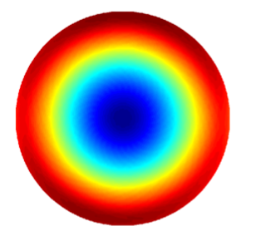
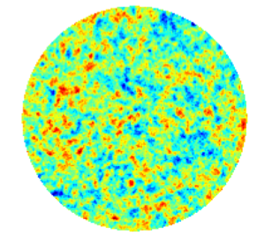
SOURCES OF ABERRATIONS
Cylindrical symmetry
  Polishing (RoC tolerance)
  Thermal lensing
  Substrate inhomogeneity
The residual
  Polishing (flatness)
  Imperfect correction (CO2, RH)
  Substrate inhomogeneity

Slide 18
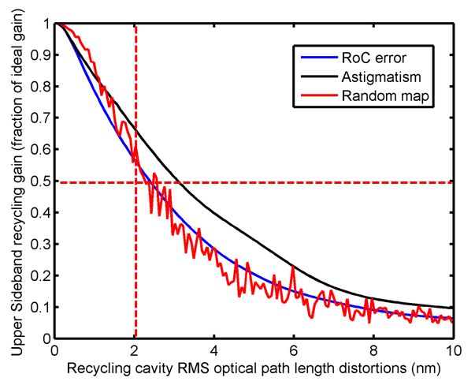
TACKLING ABERRATIONS
REQUIREMENT: total OPL distortions in rec. cavities < 2nm (constrained by the sidebands recycling gain)
Adequate sensing (phase cameras
Hartmann sensors) and detailed
simulations
Complex thermal compensation
system capable of managing
distortions of arbitrary geometry
Compensate the substrate
cold defects during polishing
(ion beam figuring of AR face
of input test masses)
Additional modulation frequency
(132 MHz) less sensitive to defects
capable to lock and control the
interferometer even in presence
of distortions
Improve the flatness of PR
mirror by corrective coating

Slide 19
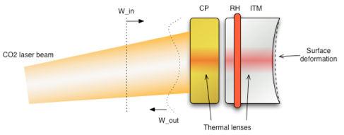
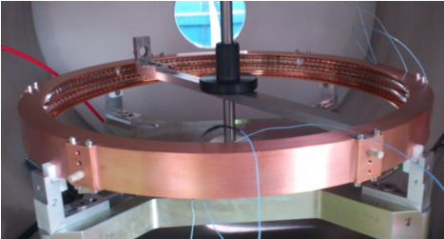
THERMAL COMPENSATION (I)
Adjust mirror radius of curvature (heating ring)
Compensate for thermal lensing and other cylindrically symmetric defect (CO2 laser shined on a auxiliary optics: the compensation plate)
CO2 laser shined on the mirror:
heat deposition where needed
to compensate for aberrations
Heating rings around
mirrors to tune RoC
(accuracy: ~1m over 1500m)

Slide 20
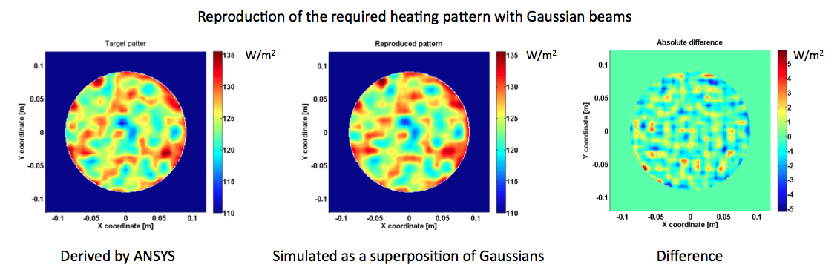
THERMAL COMPENSATION (II)
A scanning laser at lower power will compensate for defects with arbitrary geometry (first tested by R Lawrence @LIGO)
Being tested in lab, very promising
However, achievable optics quality + standard TCS might be sufficient to operate the interferometer

Slide 21
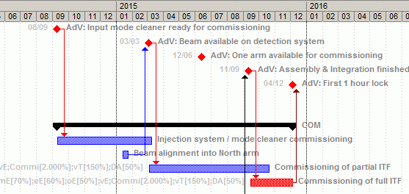
STATUS AND PLANS
~40% of budget committed so far
Infrastructure works complete in Oct ‘13: equipment installation starts
Early commissioning to start next year (input mode cleaner)
End of installation/integration: fall 2015

Slide 22
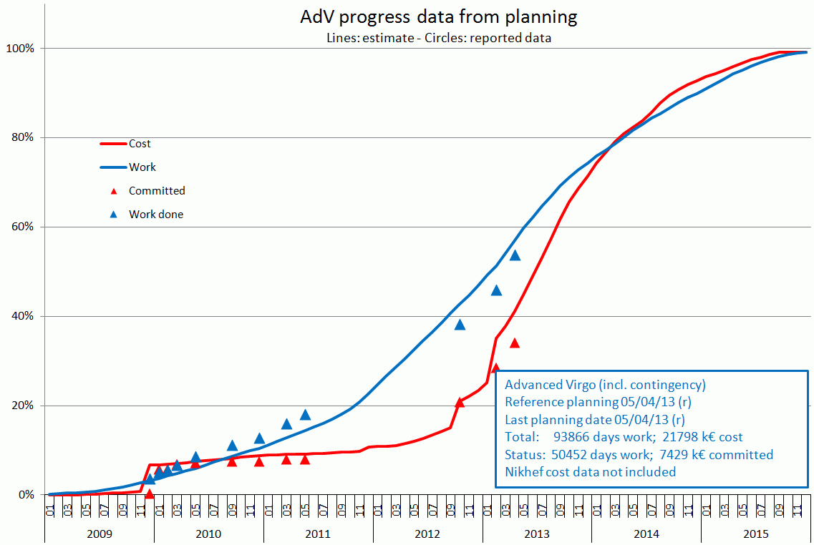
PROGRESS

Slide 23
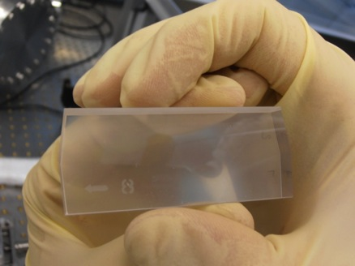
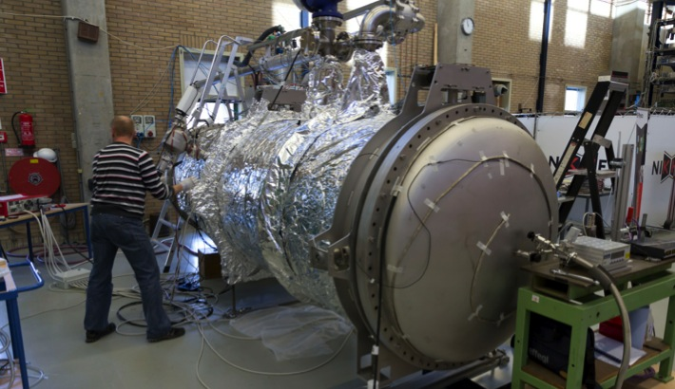
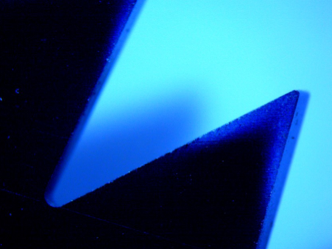
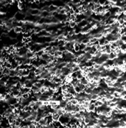
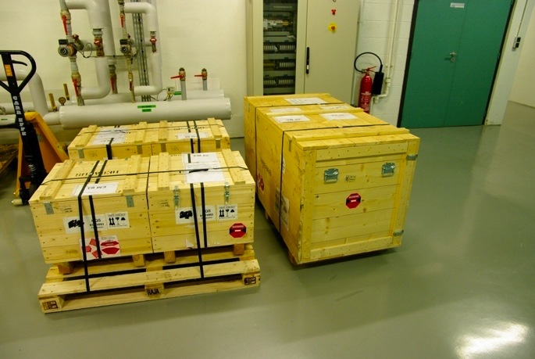
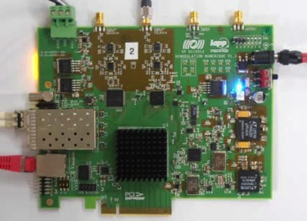
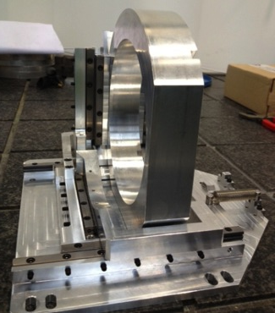
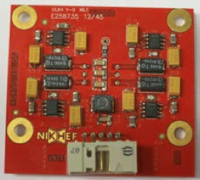
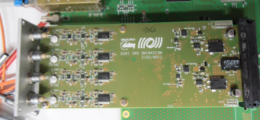
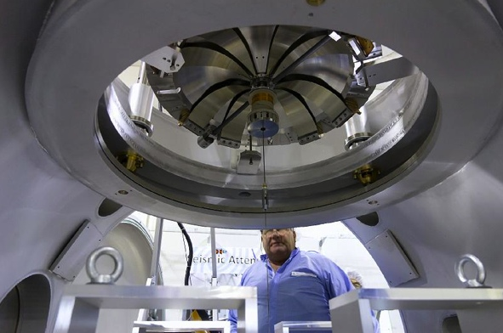
CONSTRUCTION

Slide 24



INTEGRATED TESTING
From standalone prototyping towards integrated tests to anticipate/tackle problems
  payload prototype suspended in vacuum. Control tests started
  MSAS being tested in vacuum
“Stress test” for subsystem interfaces, start creating a commissioning team

Slide 25

SPEED UP COMMISSIONING
Extensive use of simulation to predict the issues and understand the detector
  one dedicated subsystem, three FFT codes for AdV
Early commissioning of parts of the detector
  input mode cleaner cavity
  beam on detection system
  one arm test
Commissioning plan (v1) released, commissioning coordinator appointed (B Swinkels),

Slide 26


LEARN FROM THE PAST
Exchanging experiences is very important to speed up the commissioning
A “commissioning/simulation network” being realized (joint effort of LIGO/GEO/VIRGO/KAGRA
  3 meetings so far (2/yrs): Cascina, Livingston, Hannover

Slide 27
ADV RELATED TALKS
SESSION C3, TOMORROW starting at 2.30 pm
M Blom – New in-air seismic attenuation system
R Flaminio - Development of coatings for the AdV and aLIGO mirrors

Slide 28
ADV RELATED POSTERS
M Beker – C3.4 - State observation and MISO control for in-vacuum suspended optical benches in Advanced Virgo
P Puppo – C3.27 - Characterization of the mirror internal losses of the suspended test masses by means of an interferometric sensor
G Gemme – C3.13 - Finite element simulations of electromagnetic effects in the Advanced Virgo payload assembly
E Cesarini – C3.8 - Characterization of the LASY-50 CO2 laser to be used in the Advanced Virgo TCS
M Lorenzini – C3.25 Thermal Compensation System for non symmetric optical distortions in future gravitational wave detectors
G Vajente – C3.36 - In situ correction of mirror surface defects for second and third generation gravitational wave detectors
G Gemme – C3.14 - Temperature effects on the optical properties of highly uniform, porous, amorphous Ta2O5 coatings on silica
M Granata – C3.15 - Results from Raman spectroscopy and direct thermal noise measurements on tantala and silica.

Slide 29
SUMMARY
Advanced Virgo construction now well on track
Start with simplified configuration (>100 Mpc BNS inspiral range) to speed up the commissioning → data taking transition
Goal: first science data in 2016
[arXiv:1304.0670]

