Slide 1
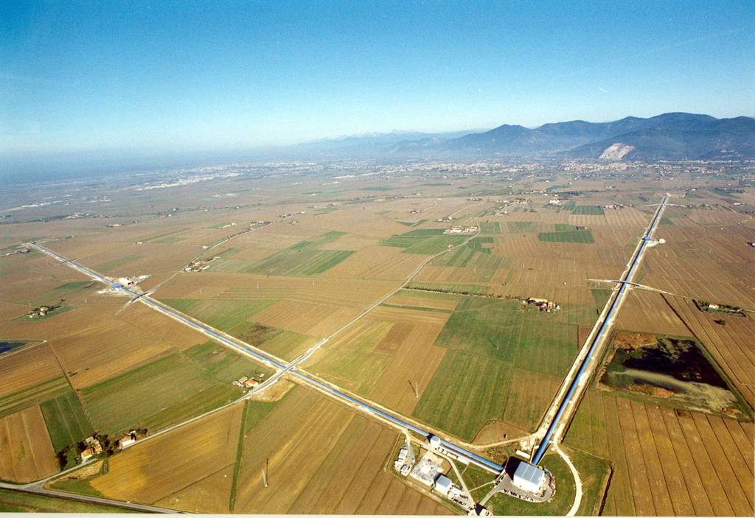





The Characterization of Magnetic Glitches in VSR4 data
Daniel Vander-Hyde
Friday, July 19th, 2013

Slide 2

Used Parameters
VSR4
  UTC time – August 2, 14:10:00 to August 7, 14:20:00 2011 (Good sensitivity)
Sources of Initial Data:
  OMICRON triggers (Fast Channels)
    GPS time
    Signal to Noise Ratio (SNR)
    Frequency
    Time (with respect to the beginning of the data set)
  Infrastructure Machines Monitoring System (IMMS) (Slow Channels)
More information on OMICRON: https://tds.ego-gw.it/itf/tds/index.php?callContent=2&callCode=9517&title=Omicron&author=Florent&startPage

Slide 3
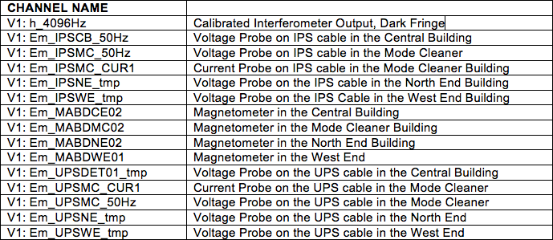
Data Sample (Fast Channels)
Triggers were produced (by OMICRON) for the following channels:
Notes:
Channels are sampled at 1 kHz and above.
Channels are chosen because all probes that monitor electromagnetic activity give important information about magnetic transients.

Slide 4
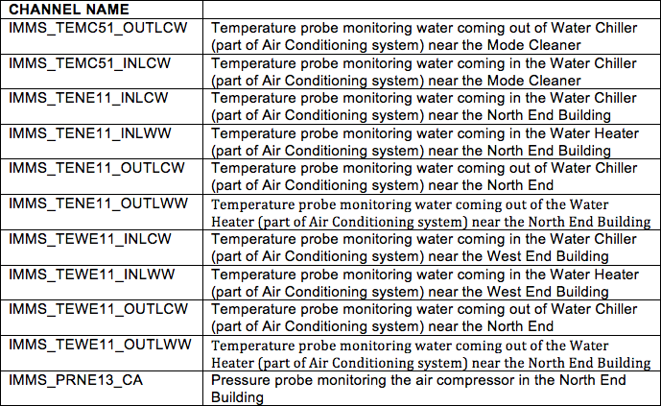
Data Sample (IMMS / Slow channels)
All of the following channels are IMMS channels, plotted in time with selected triggers:
Notes:
These channels are sampled at 1 Hz
Give time for people to read but also commentate on the channel names.
Information about IMMS channels (give information about the machinery incorporated into the VIRGO infrastructure)

Slide 5
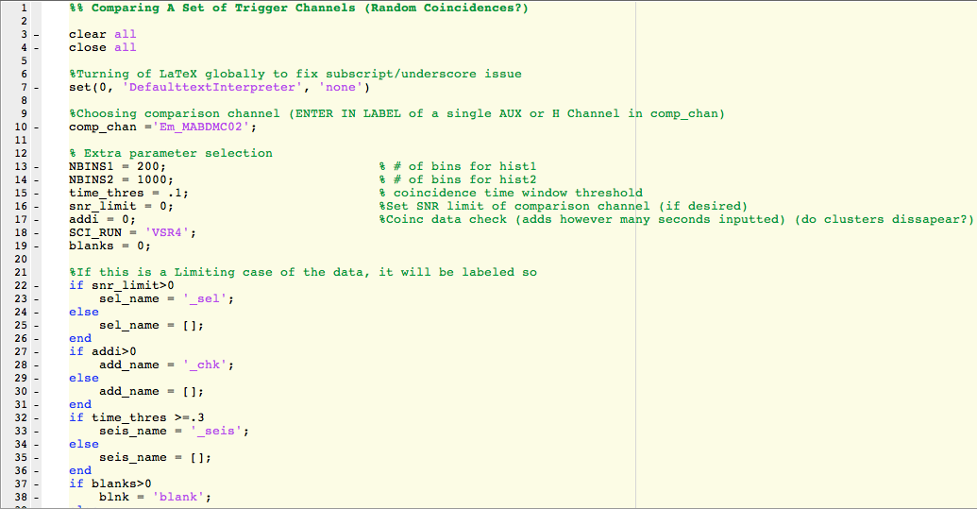
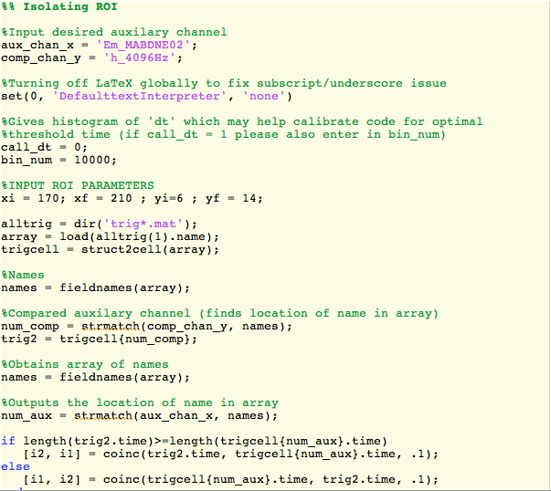
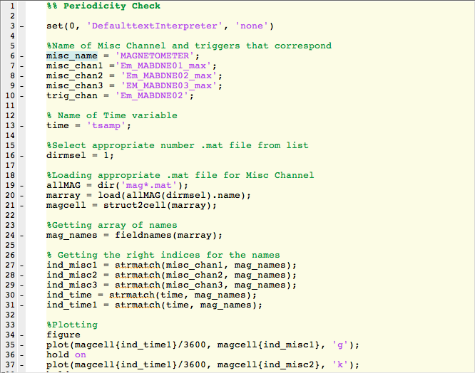
Data Analysis
With the usage of MatLab scripts, the following was performed between each fast channel pair:
  Time coincidences
  Plotting coincidences (SNR vs. SNR)
  Identifying a region of interest (ROI)
  Plot interesting data in time and compare with IMMS channels
Notes:
Summary

Slide 6
Time Coincidence
Auxiliary Channel vs. Dark Fringe
  PRIMARY INTEREST
  Gives information on how often this environmental and/or instrumental glitch couples into the Dark Fringe.
Auxiliary Channel vs. Auxiliary Channel
  For Magnetic noise, finding coincidences between Magnetometers, Voltage Probes and Current Probes gives a good indication if a noise is produced by the VIRGO infrastructure as well as the noise path.
Notes:
Why?

Slide 7
Time Coincidence
Done through a coincidence function in MatLab. (Thanks, Bas)
  [i1, i2] = coinc(t1, t2, th)
  Where t1 and t2 are a pair of time vectors from two channels and th is a threshold window. For all of the mentioned coincidences th = .1 sec
  The function gives back i1 and i2 which are indices that store the location of the coincident times for t1 and t2 respectively
Notes:
How?

Slide 8
SNR vs. SNR plot
Use index outputs from time coincidence to create SNR vs. SNR plot.
  Plotting one channel against another (AUX vs. H) or (AUX vs. AUX)
These plots tend to produce trigger clusters, which have potential of revealing useful information about noise sources.
  For high SNR events it can be easy to spot apparent clusters of data.
  For low SNR events, it can be more difficult. Not all time coincidences can be trusted as “real coincidence”
  Used MatLab script, with extra plotting features (i.e. visual statistics and fake time offsets) as a guide to choosing the best data.

Slide 9
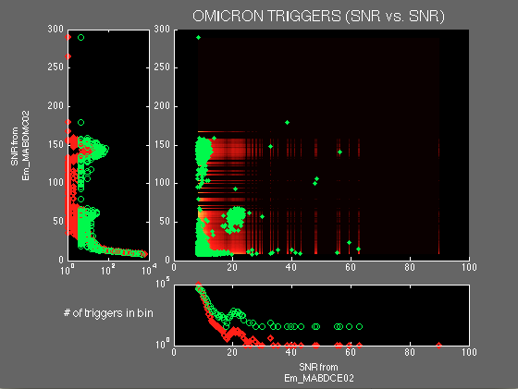
SNR vs. SNR plot
Notes:
Steadily introduce the plot:
Two auxiliary channels plotted against one another Specifically a Magnetometer in the Central Building (Em_MABDCE02) and a Magnetometer in the Mode Cleaner (Em_MABDMC02)
We care about these kinds of plots to verify if machinery at VIRGO is responsible.
Next slide will primarily focus on histograms along the axes

Slide 10
SNR vs. SNR plot
Total of 3 subplots
Two are along the axes of the SNR vs. SNR plot.
  Histograms designed to display the statistical significance of coincident data.
  The likeliness of finding a trigger in a specified bin are measured by the relative heights of the red and green dots:
    Red (all triggers):
    Green (coincident triggers):

Slide 11
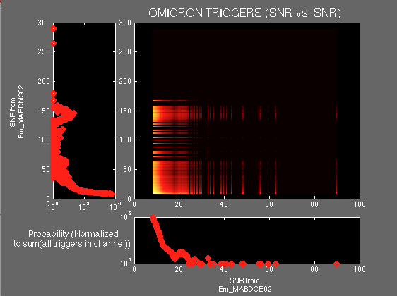

SNR vs. SNR plot
Notes:
Plot without coincident triggers

Slide 12
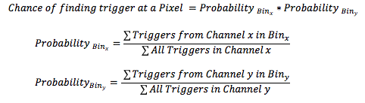
SNR vs. SNR plot
Central Subplot:
  Displays “hot” color map background which visually presents the probability of finding a trigger at a (Bin_{x,} Bin_{y}) pixel via intensity. This Two-Dimensional probability is defined:
    (Where Probability _{SNRx} and Probability _{SNRy} are defined as the individual probabilities at a specified SNR values for the respective channels )
    The final matrix displayed is plotted on MatLab’s “imagesc” function as log₁₀( 2-D probability) for cosmetic purposes.
  Green points are the plotted coincident triggers
Notes:
When mentioning the probabilities a little bit about the bin size will be mentioned

Slide 13
SNR vs. SNR plot
Notes:
Plot with coincident triggers

Slide 14
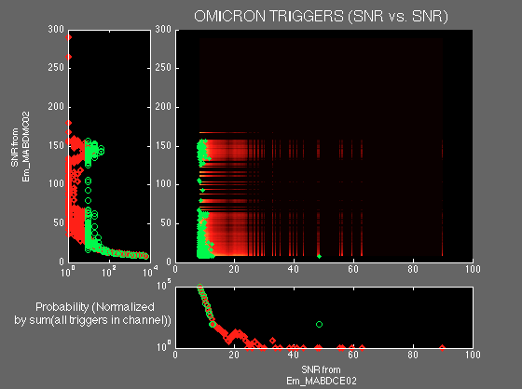
SNR vs. SNR plot
Sanity Check: Added 10 second offset to verify central cluster
Notes:
Plot with fake 10 second offset. Central cluster disappears, and now can consider “real coincidence”. Explain how this correlates to the statistics (review previous slide)

Slide 15

Region of Interest
Notes:
Can now identify a Region of Interest (disappearing cluster)

Slide 16
Region of Interest
These areas are clusters of triggers that contain interesting data (reveal information about noise sources)
A MatLab script stores the indices corresponding to these triggers on the workspace which will later be used to call time information and correlate with an IMMS channel

Slide 17
Results
There is much evidence that supports strong magnetic activity in the Mode Cleaner (MC) which is coupling into the Dark Fringe (H).
For documentation purposes, it is also important to note that the magnetometers in the Terminal buildings also produced a handful of interesting triggers.
The source of these glitches can be attributed to the inrush current pulse occurring at each periodic switching on of the Air Conditioning water chiller.
Notes:
In rush current refers to the phenomena that involves a large draw of current when an electrical electrical device is switched on. (For a motor, this occurs because the motor is not initially moving to begin with, which leads to the circuit having little to no resistance but once the motor is in motion, it begins to act as a voltage source opposing the current which leads to stabilization)

Slide 18
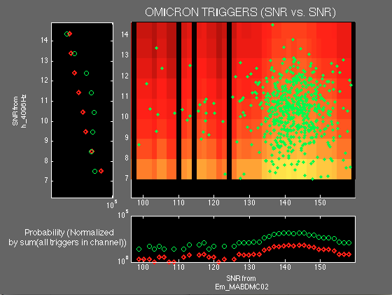
Interesting Triggers (MC vs. H)
Notes:
Mode Cleaner magnetometer triggers found in Dark Fringe Channel. Zoomed in ROI.
This plot indicates significant activity in the Dark Fringe due to some glitch in the Mode Cleaner.
SNR limits are accounted in order to complete analysis.

Slide 19
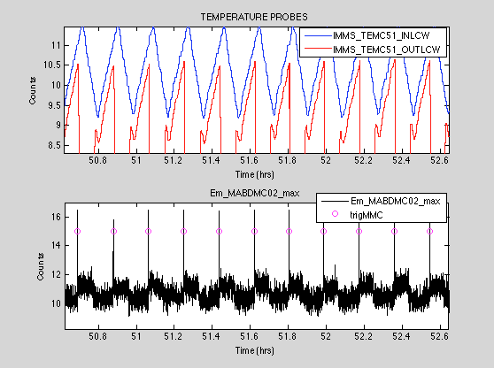
Periodicity Check
~ 600 seconds
Notes:
Where trigMMC are the triggers taken from the last slide
Em_MABDMC02_max is a channel that corresponds the the maximum reading read by the magnetometer in time

Slide 20
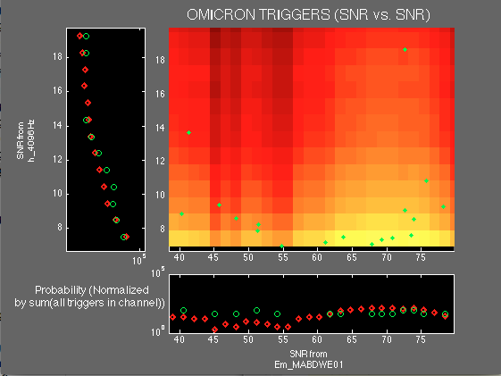
Interesting Triggers in Terminal Buildings
Notes:
West End triggers found in Dark Fringe Channel. This is zoomed into the ROI where only a handful only a handful of events can be seen. Only the left triggers (from an SNR of 40 – 55) can be trusted as interesting data since as shown by the the histograms (and follow up 10 second offset).

Slide 21
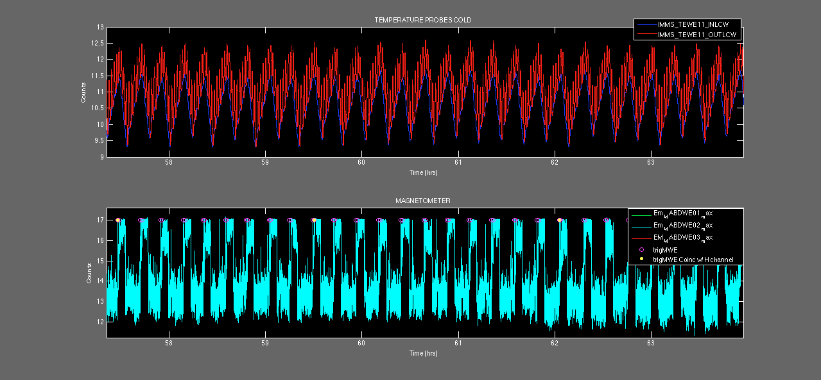
Periodicity Check (West End)
~ 600 seconds
Notes:
A small window within the five day run is displayed above
The magenta holes at the magnetometer peaks correspond to coincident triggers found between a Current Probe and a magnetometer in the West Terminal Building. These triggers can are associated to the chiller glitches as they can be paired with the sudden changes in temperature.
The triggers found in the dark fringe (yellow dots within holes), correlate to the triggers produced between Auxiliary channels, which correlate to the chiller which verifies the yellow triggers as chiller glitches

Slide 22
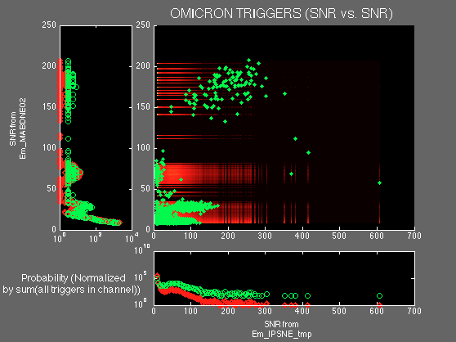
Other Sources?
Found another region of interest when comparing auxiliary channels
Notes:
Red ROI correlates to chiller glitches while the blue correlates to another (not so obvious) noise source.

Slide 23
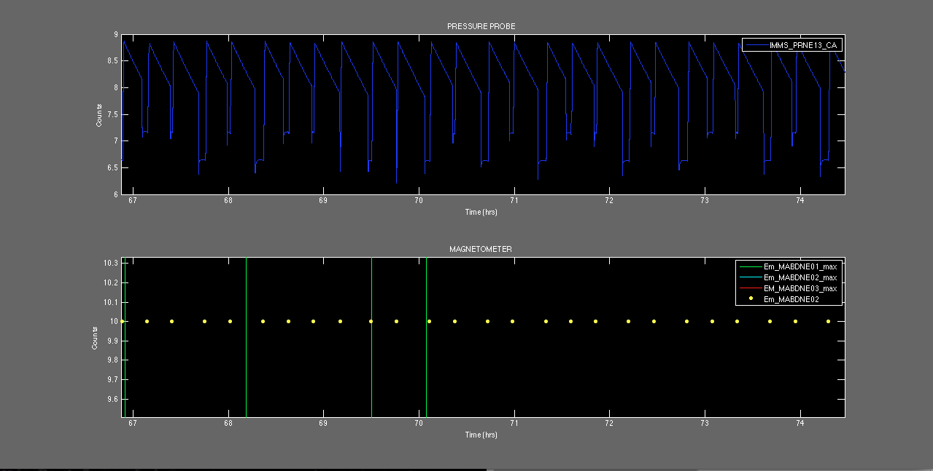
~ 900 seconds
The switching on and off of Air Compressor (again causes inrush current)
Activity is monitored by pressure probe (Em_PRNE13_CA)
These triggers do not show in the Dark Fringe
Notes:
Yellow dots correlate to coincident triggers found in Blue ROI on previous slide.

Slide 24
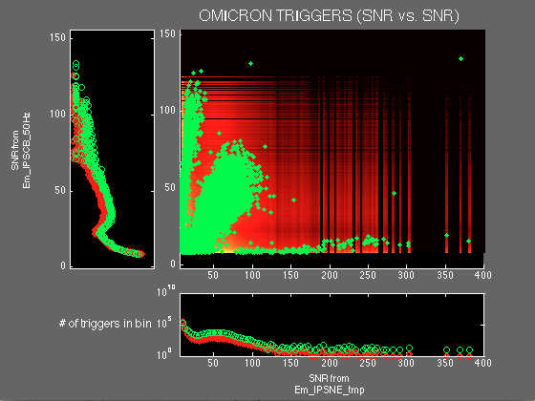
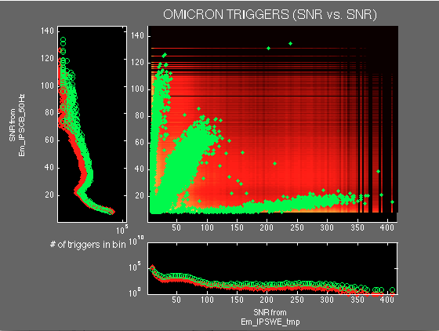
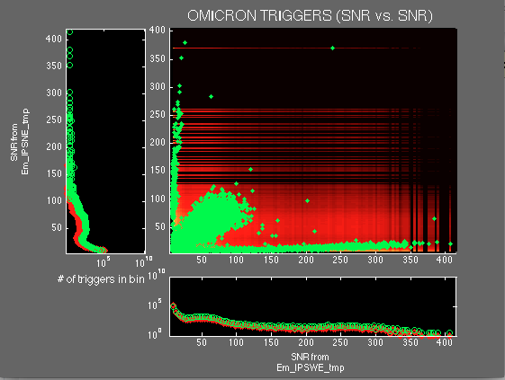
“Global” noise
Notes:
Voltage probes seem to be showing some same electromagnetic activity among distant buildings:
Top left plot: Voltage probe for IPS cable in North Building (Em_IPSNE_tmp) vs. Voltage probe for IPS cable in Central Building (Em_IPSCB_50Hz)
Top right plot: Voltage probe for IPS cable in West Building (Em_IPSWE_tmp) vs. Voltage probe for IPS cable in Central Building (Em_IPSCB_50Hz)
Bottom middle plot: Voltage probe for IPS cable in West Building (Em_IPSWE_tmp) vs. Voltage probe for IPS cable in North Building (Em_IPSNE_tmp)
Blue ROI is considered to be interesting data
This activity has not yet been paired with any particular source.
Possibly very low SNR values (hiding in noise) that other probes can’t read and are hard to spot when plotted in time with continuous data.

Slide 25
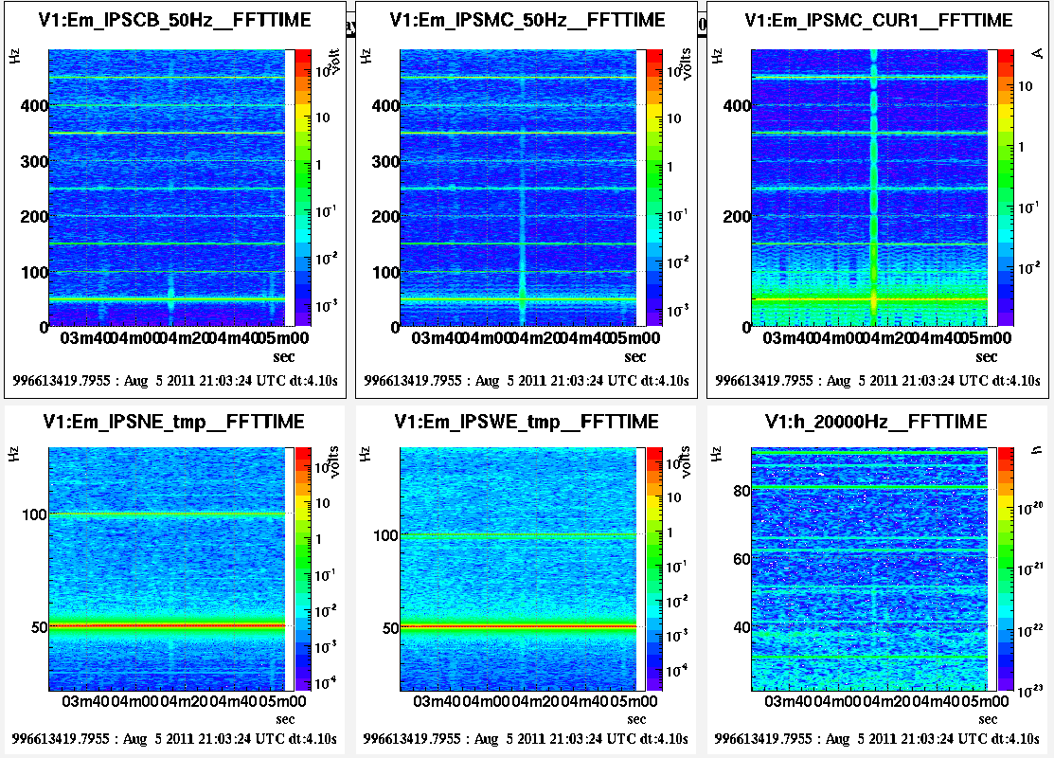
“Global Noise”
Notes:
Spectrogram above shows a moment in time that displays the same even among buildings via a spectral line. Disconcerting that this line shows up in Dark Fringe. Chiller Glitches? Shared Power lines?

Slide 26
Conclusion
Verified:
  Chiller glitches in Mode Cleaner are largely present in Calibrated Interferometer Output Channel.
  Chiller glitches are also present in Terminal Buildings due to North and West end chillers, but not nearly as much concern as those in the MC
  Air compressor glitches are a common noise source among auxiliary channels but not apparent in DF channel
  Voltage probes among buildings seem to give evidence that there is some site-wide activity
    Still to be investigated more thoroughly
SNR vs. SNR plots (with visual statistical analysis) along with other follow up checks help to identify and understand the physical phenomena behind these magnetic noise sources.

Slide 27
Acknowledgements
Big Thanks to:
  Dr. Bas Swinkels for the ideas behind this analysis.
  Dr. Irene Fiori for the mentoring and introduction to Data Analysis for Detector Characterization.
  Dr. Joshua Smith for his continued mentorship
  Dr. Florent Robinet for providing the OMICRON triggers which made this data analysis possible

