Slide 1
Education and Public Outreach
@EGO/Virgo
Elena Cuoco
EGO and INFN Pisa
On behalf of EGO/Virgo Outreach Team

Slide 2
March 2015: Larger EPO team and new direction/organization
Why?
The science phase of Advanced Virgo is approaching fast
There will be need of a coordinated campaign of public outreach
We should be prepared
What
Already a long tradition of EPO activities
Many visitors on the site
Existing archive of various material (media, text, flyers, etc)
How
Discuss and plan new activities
Work together to improve our impact on the public
Who?
Build a structured group of experts in EPO in the various countries
Support from the Virgo collaboration (e.g spokeperson and EGO director)
When?
ASAP!

Slide 3
What are the key elements of new public outreach strategy?
Virgo and the Web
Visit Virgo
Virgo and the external world
Academic impact
Virgo and the press

Slide 4
Virgo and the web
The Virgo public outreach website
Is different from the official Virgo website
Upgrade the current one (outreach.ego-gw.it)
Jointly present the EPO activities in our countries
Disseminate contents (e.g. news, etc)
Be social
Facebook, Twitter, etc...
Mantain an archive of material
Contents for the web
For public use (e.g. pics, videos)
Show the history of Virgo
Create new material
Images, videos, interviews

Slide 5
Visit Virgo
Already established tradition
Guided tours
Prepare local exhibition
Interact with local Institutes (Universities, city councils, etc)
Update written materials (e.g. flyers, etc)
Gadgets for visitors
Reorganization from September 2015

Slide 6
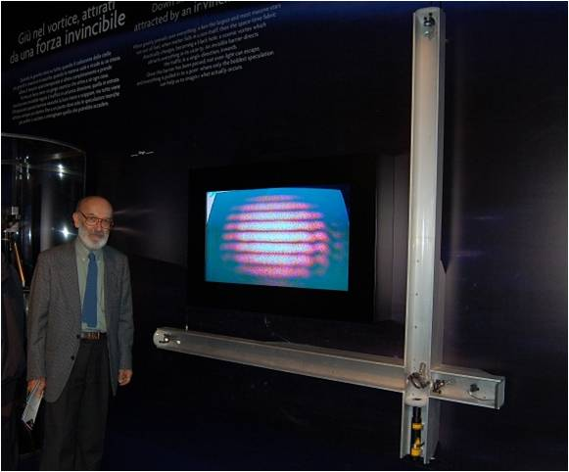
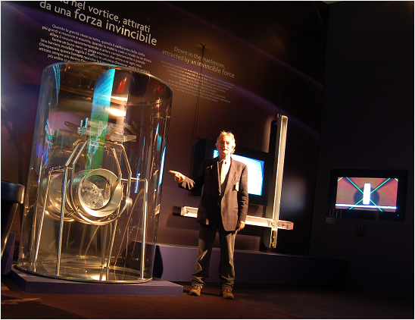
Virgo on the road
Traveling exhibitions (e.g. build the mini-interferometer)
Show results at science communication conferences
Keep contacts with local partners (Institutions, schools, associations)
Activities in the schools (including kids)
Tools and materials for educations
Virgo on the road

Slide 7

Academic Impact outreach
Promote the engagement of scientists with Virgo
Develop science/education problems around Virgo
  Be in contact with EPO of LIGO
  Help the collaboration to support the promotion of grad students and postdoc
  Help promoting our results to the scientific community
Example: GraWIToN

Slide 8
Virgo and the press
Organize a structured office for relation with journalists
Keep mailing list for credited media
Prepare press releases
(and define a “standard” for Virgo)
Prepare an updated press kit
Provide a selection of media resources to journalists

Slide 9
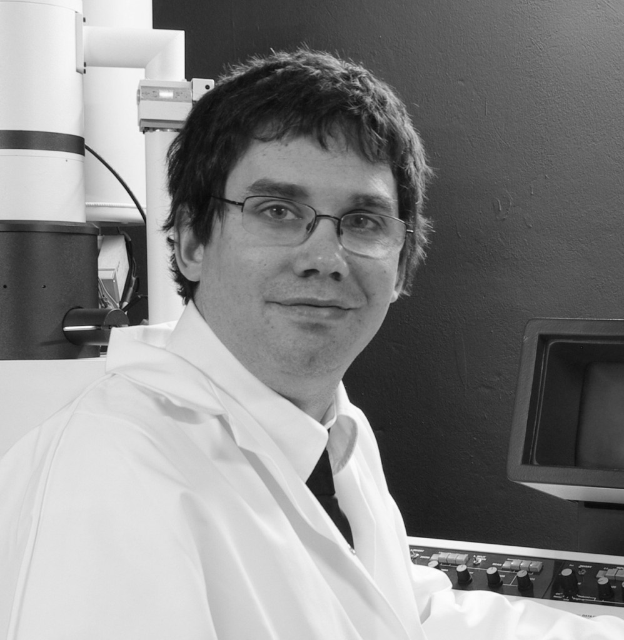
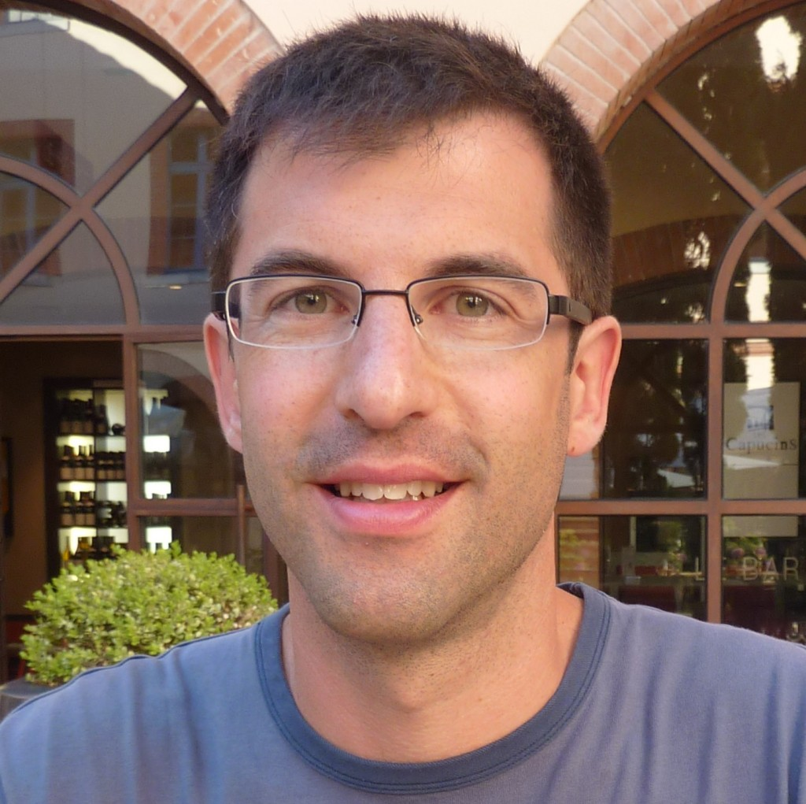
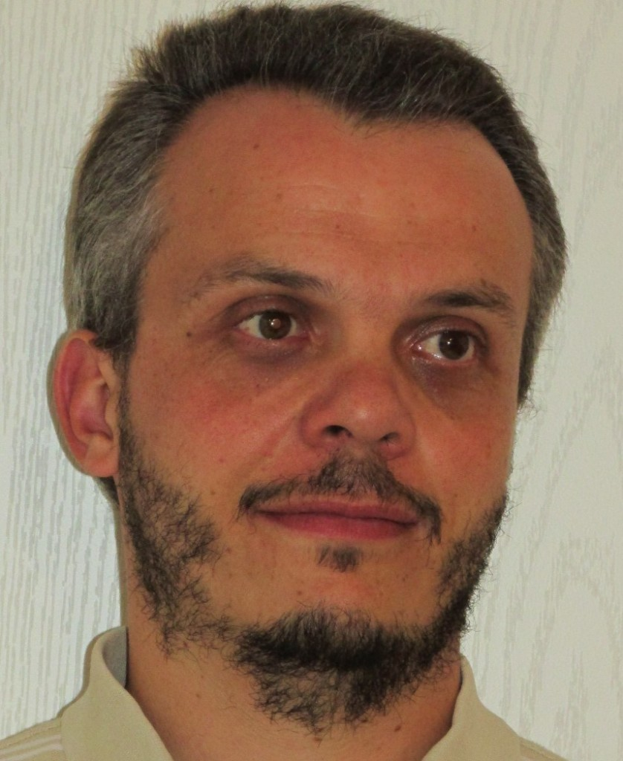
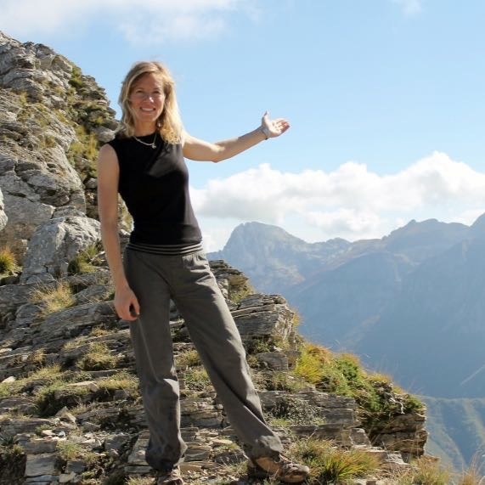
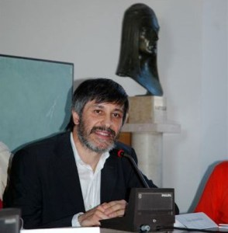
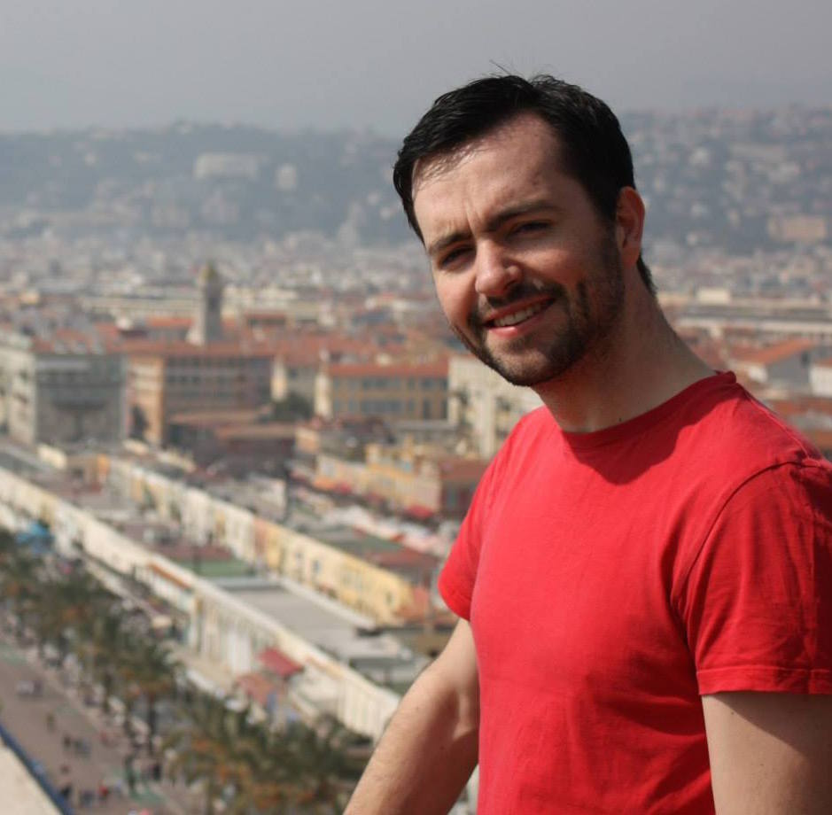
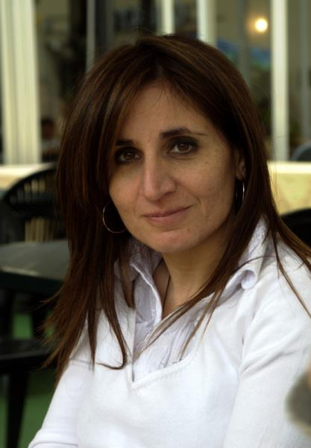
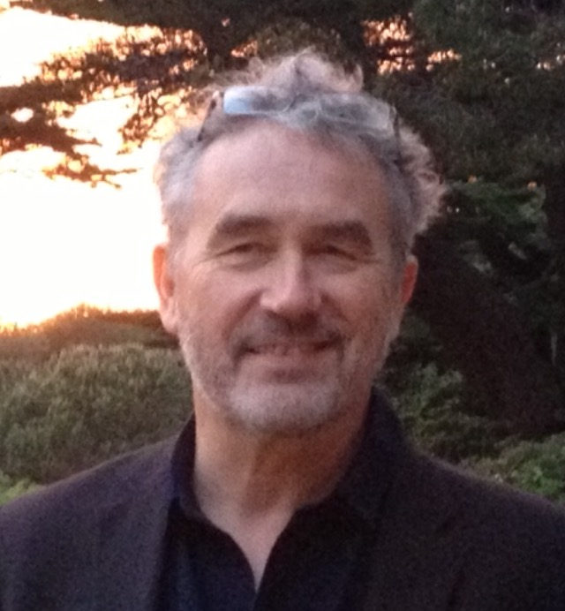
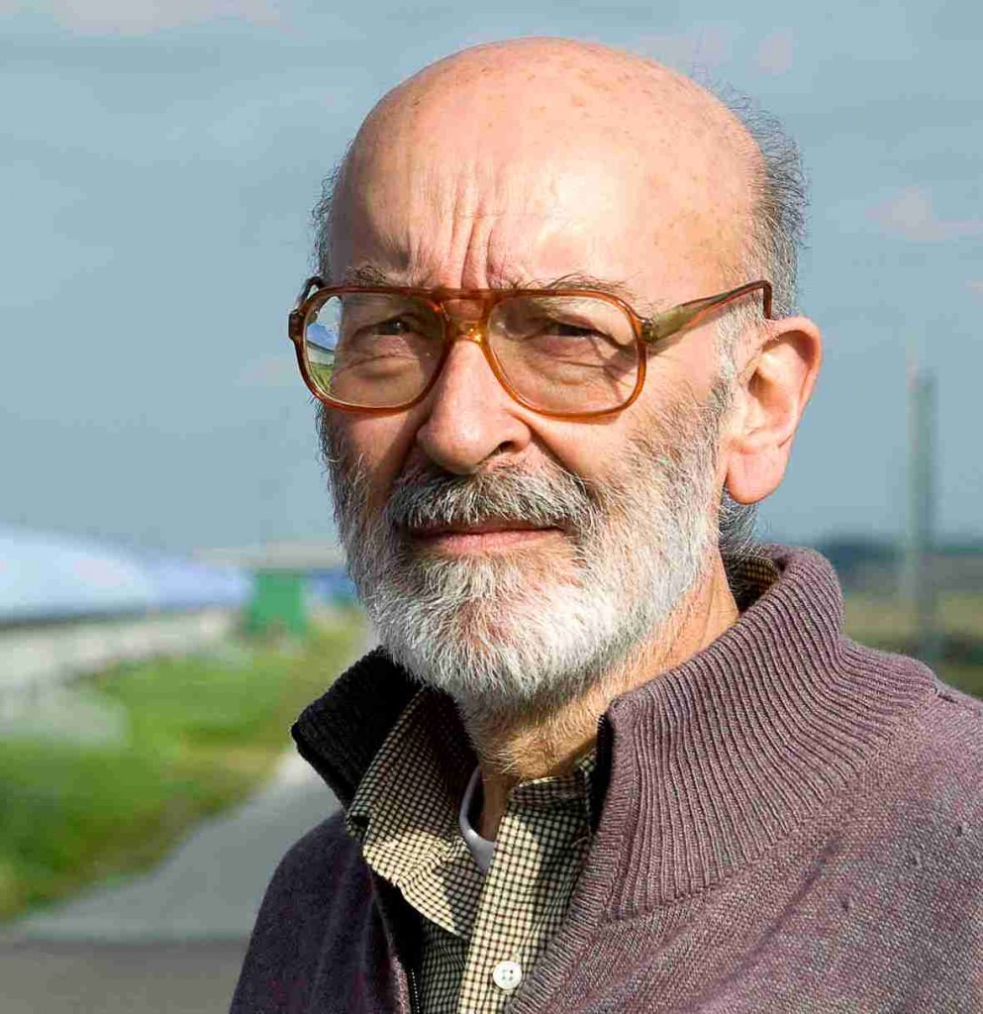
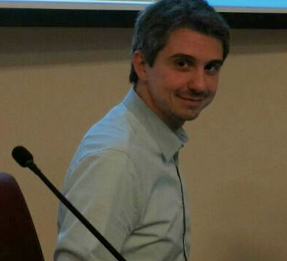
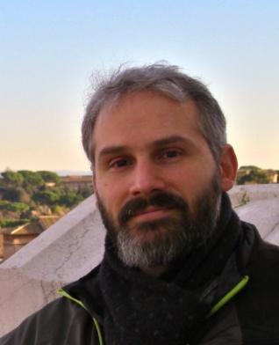
European EPO network outreachteam@ego-gw.it
Jerome Degalliaux, LMA, France
Franco Frasconi, INFN Pisa
Sverine Perus, EGO, Italy
Loic Rolland, Lapp, France
Nicolas Arnoud, LAL, France
Thomas Adam, Lapp France
Gilles Bogaert, Nice, France
Carlo Bradaschia, INFN Pisa
Massimiliano Razzano, Pisa University
Helios Vocca, INFN Perugia
Elena Cuoco, EGO, Italy
E-mail : comunicazione@ego-gw.it or pressoffice@ego-gw.it
…Mathyas Vasuth, Unghery, Henkjan, Nikhef and Bejger, Poland…
A local EGO/Virgo group:
Technical supports for web and graphics: G. Di Biase, A.Matteini
And many physicists help for Virgo visit and open lab day

Slide 10
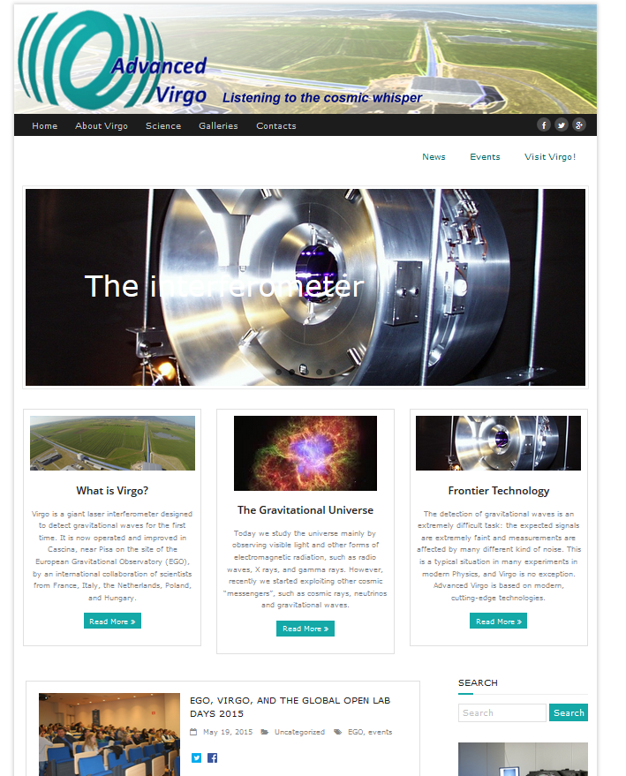
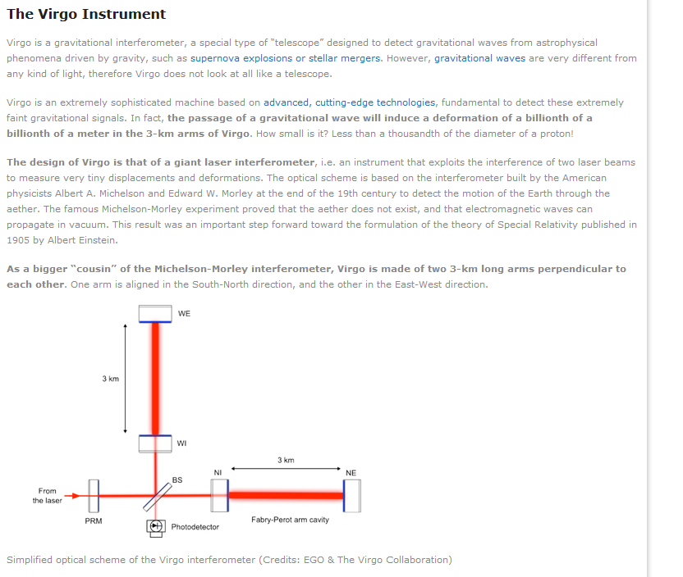
Website: http://public.virgo-gw.eu
Not the official Virgo website, but the EPO’s one
Contest for the slogan: “Listening to the cosmic whisper”
A series of introductory papers to describe Virgo and its science
Events preparation and report
…many more features we are working on (press kit, science for kids, booking visit via web)

Slide 11
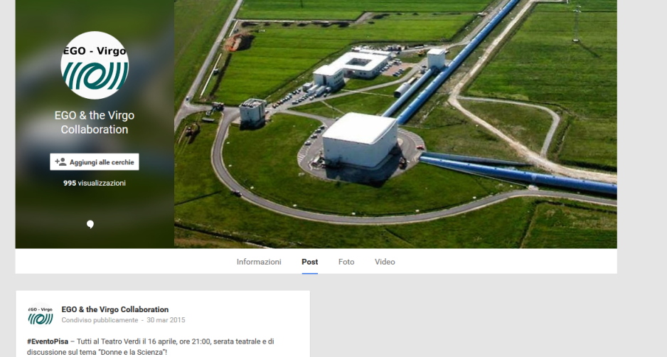
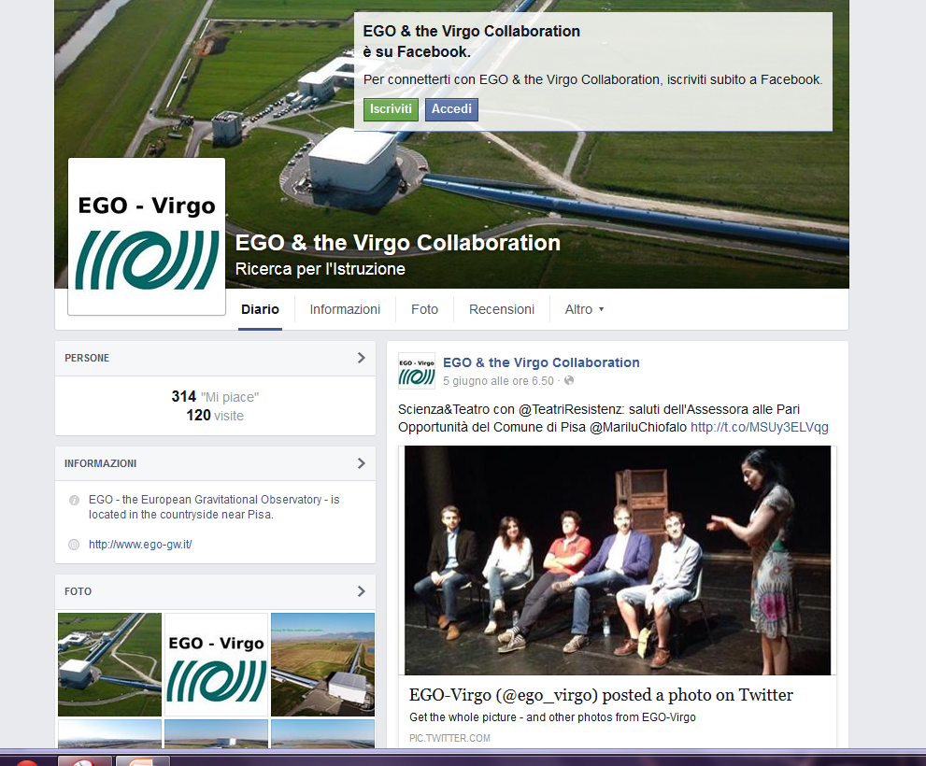
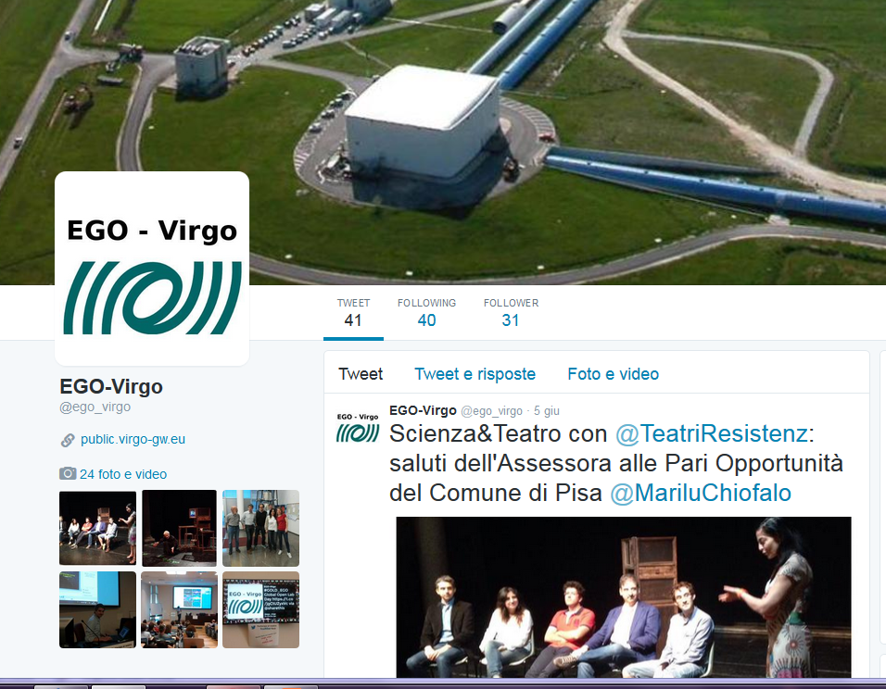
Social: Facebook ,Twitter and google+
Follow US
on Twitter: @ego_virgo
On Facebook: EGO & the Virgo Collaboration
On Google+: EGO & the VirgoCollaboration

Slide 12
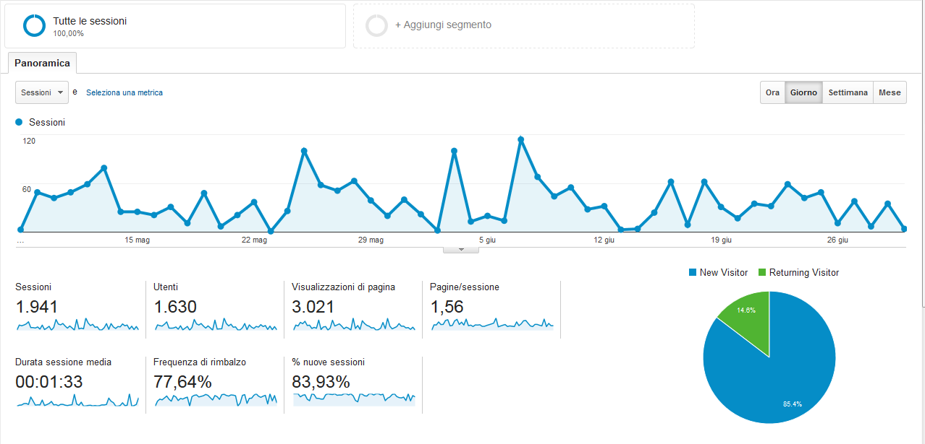
Statistics: Website

Slide 13
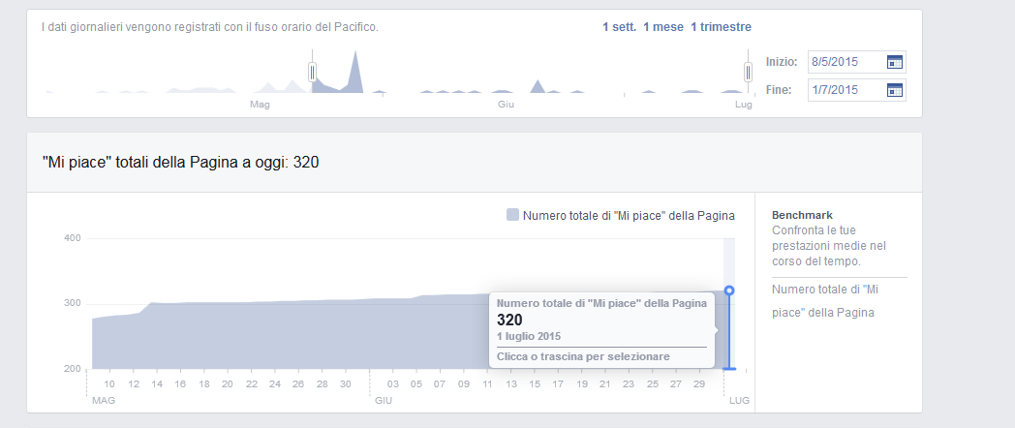
Statistics: Facebook

Slide 14
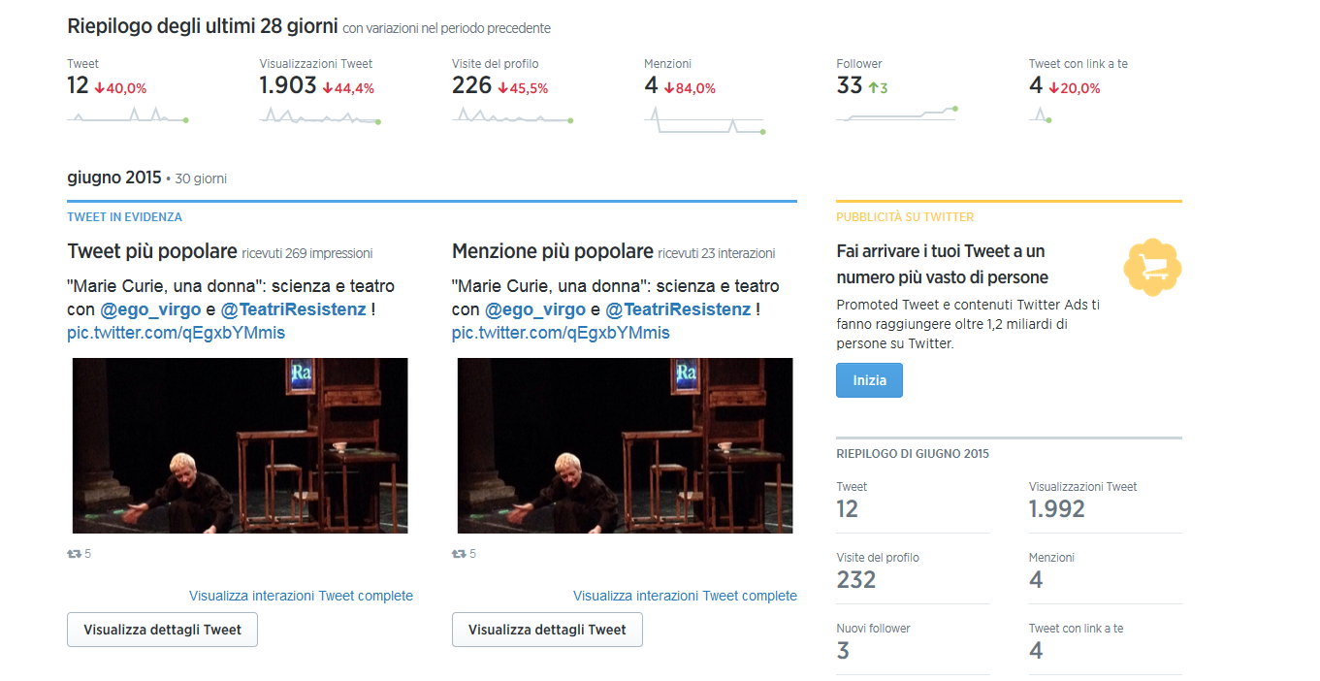
Statistics:Twitter

Slide 15
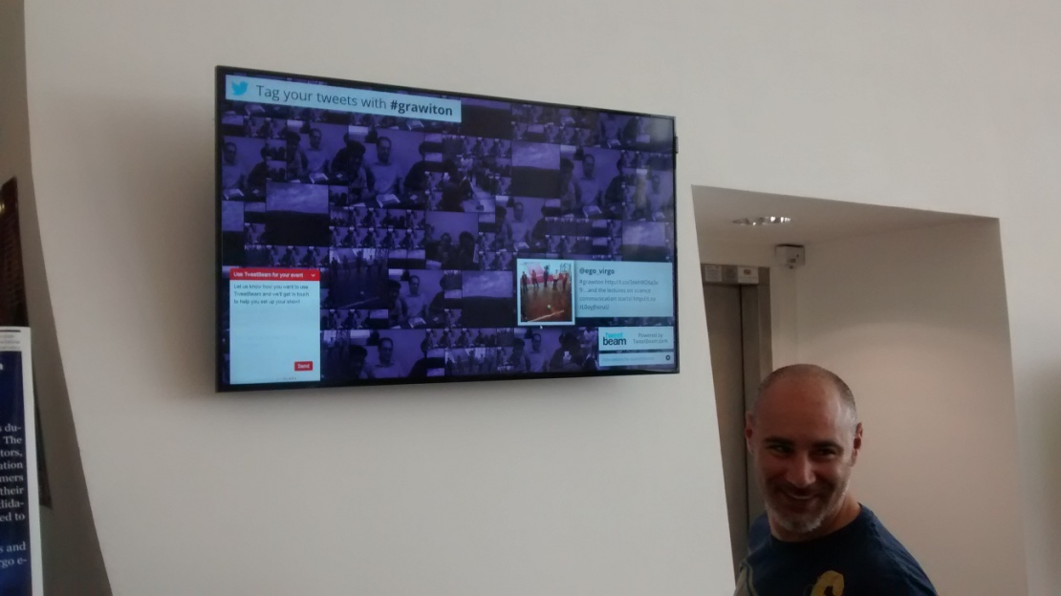
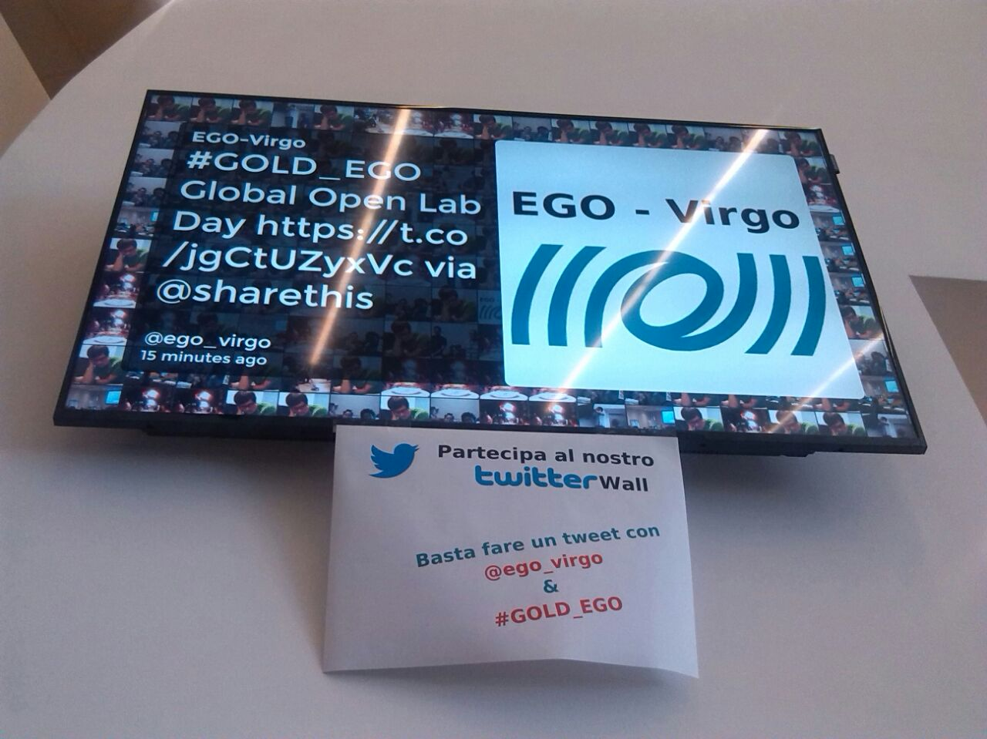
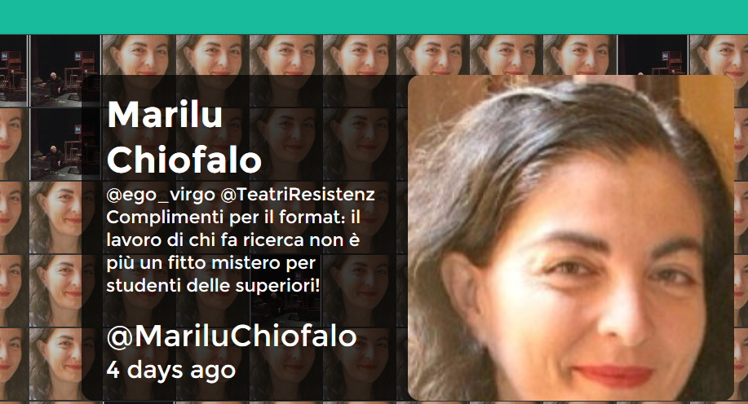
Twitter Wall
http://www.wallofsilver.net/
Cite @ego_virgo and It will be on Wall

Slide 16
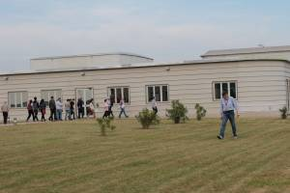
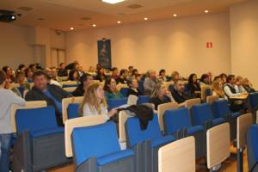
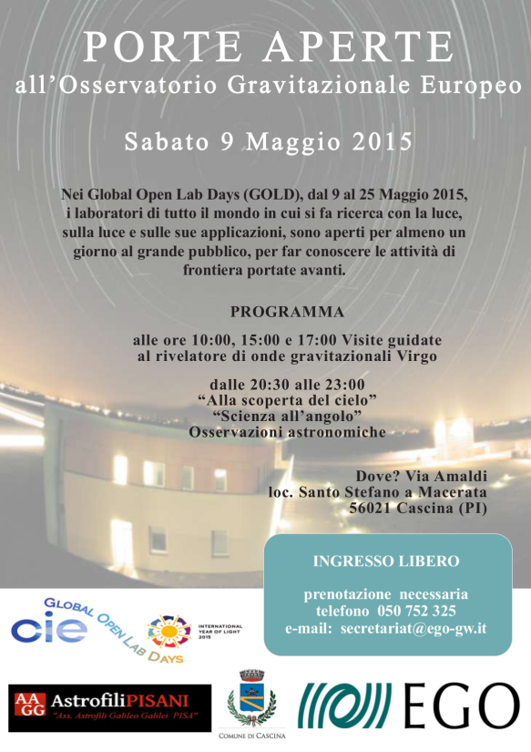
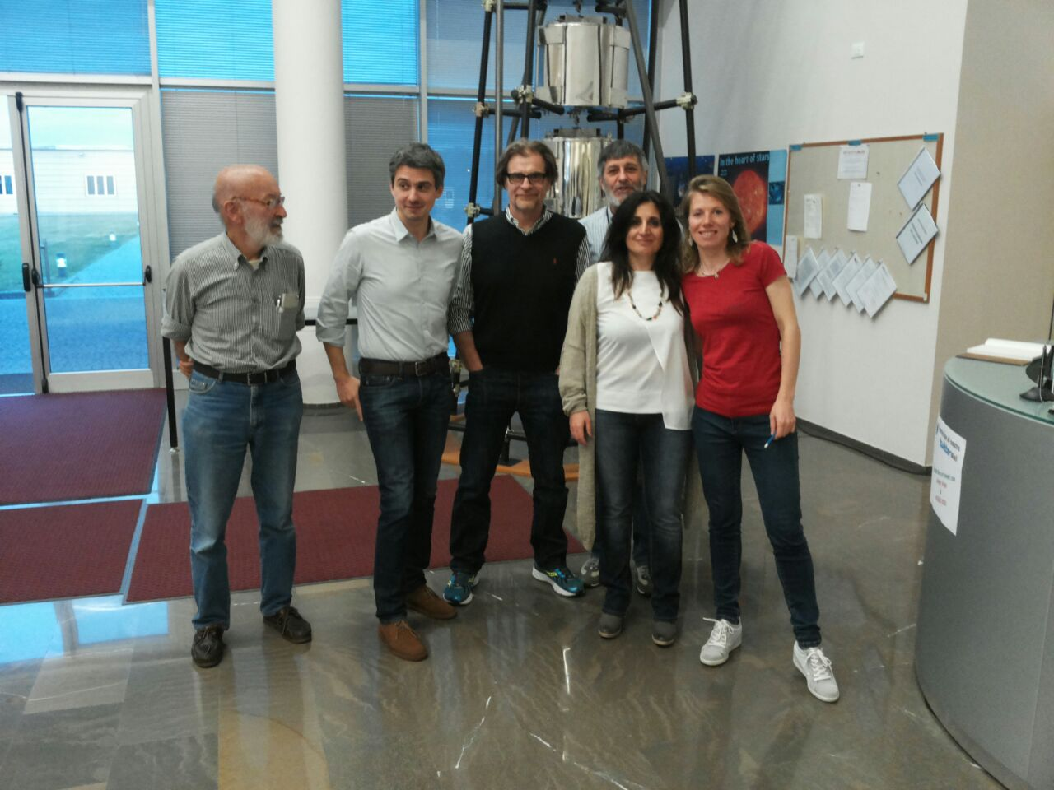
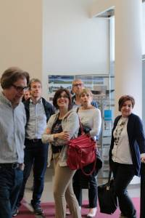
May 9th:
Global Open Lab Day
More than 120 visitors
in the day and 150 in the evening

Slide 17
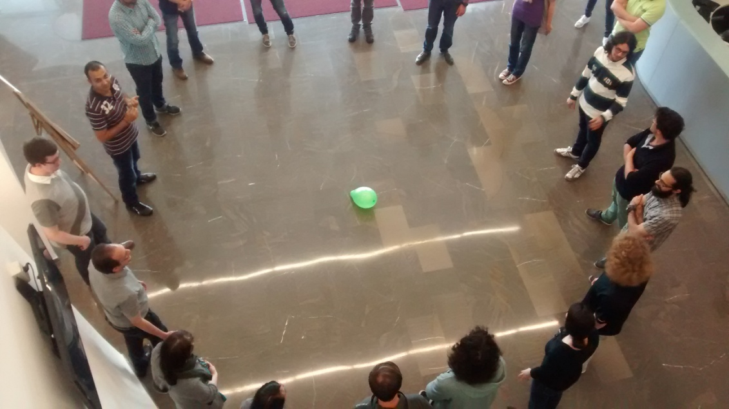
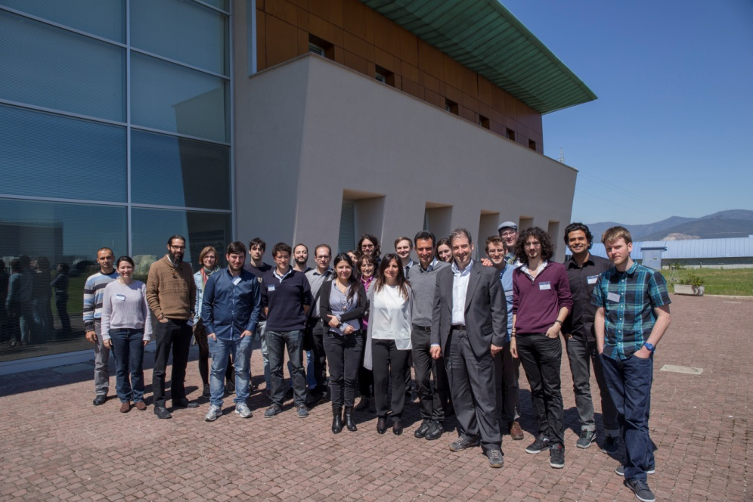
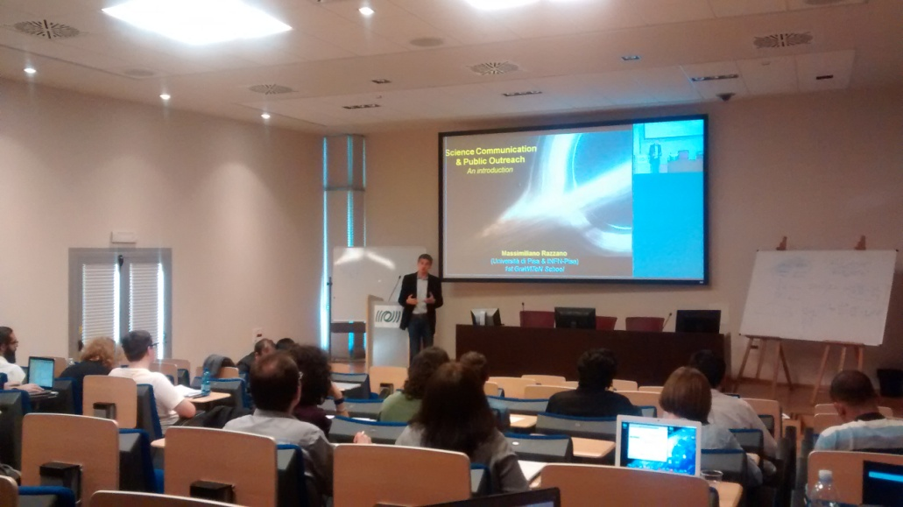
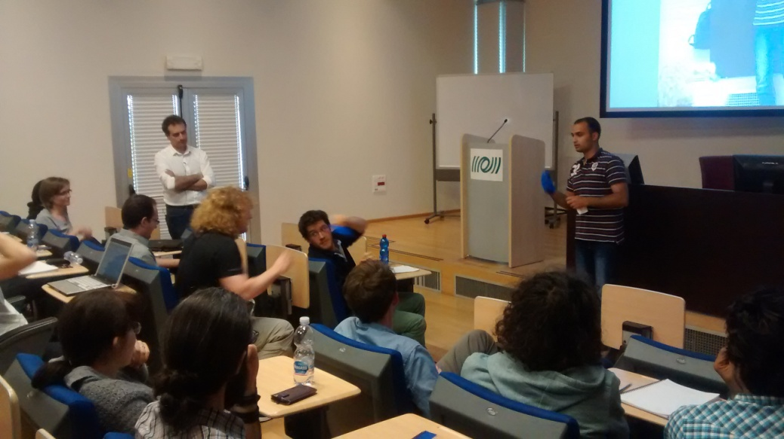
Academic impact
European Projects:
The GraWIToN experience

Slide 18

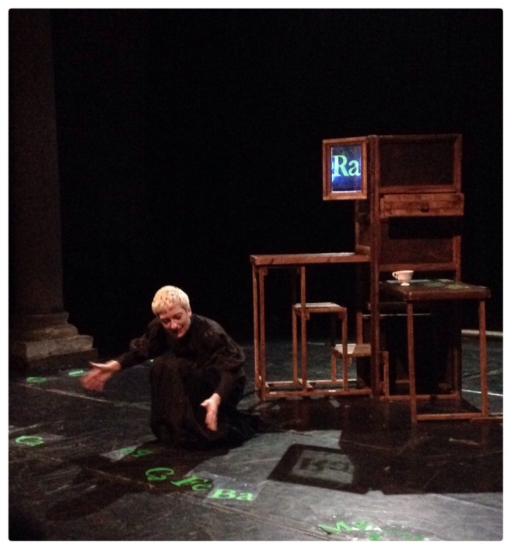
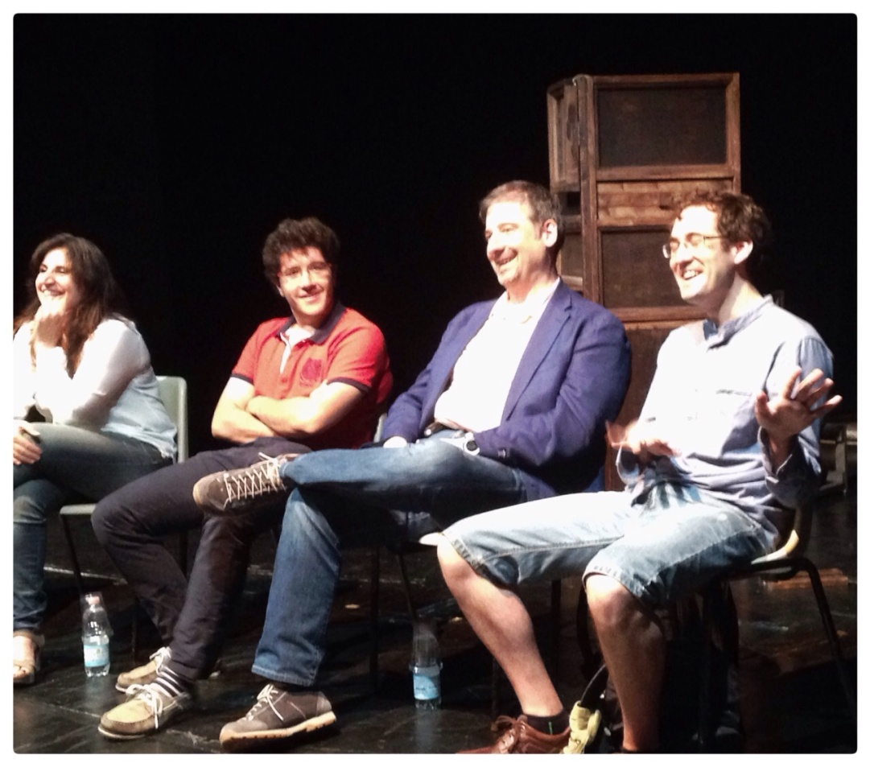
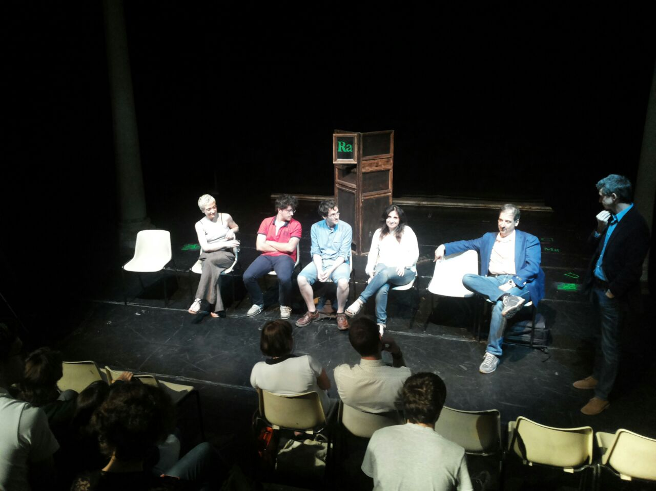
Teatri della Resistenza
Marie Curie, una donna
Meet High School students
GraWIToN ESRs as MarieCurie
Ambassadors

Slide 19
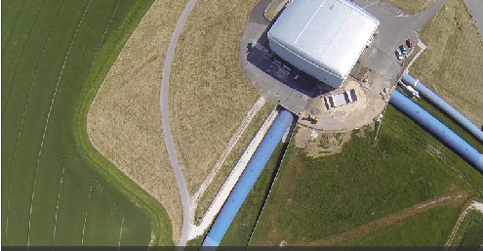
Filming at EGO
ARTE: for a series of documentaries about astronomy. It is called "Between heaven and earth", and 20 episodes of 26 minutes each will be broadcasted this year on Arte, the French-German cultural tv channel. One of the episode will be about Newton; in connection to that episode the ARTE team came for filming Virgo on February 26 and 27, 2015.
Euronews broadcasted a short documentary including materials filmed at EGO. Check it out here (from min. 2:50): http://www.euronews.com/2014/05/22/echoes-from-the-big-bang/
Graham Philips for www.abc.net.au/catalyst :10/11 June : half-hour special this year on the science of Einstein, and the search for gravity waves will form a big part of the documentary.

Slide 20


Towards Gravitational
Wave-based Masterclasses
International Masterclasses: one of the most successful education & outreach
Typical strucure
Morning: lectures about particle physics, the CERN, the LHC
Q&A sessions (scientific careers), visits (discovery of the host lab)
Afternoon: computer-based exercices using real (simplified/pre-processed) LHC data
4pm – 5pm: a videoconference in English moderated from CERN
 Great feedback
Students like being researcher for a day’
Teachers come back year after year with new students
Nicolas Arnaud (National Responsible For France)

Slide 21
A possible GW-based masterclass exercise
Lectures on:
Then they are given a chunk of real data and some software
At least one sine Gaussian signal injected
Signal injected as well in the corresponding datasets from the other ITFs
Suitable time delays between ITFs to locate the source
SNR high enough for a threefold coincidence detection
Auxiliary channel » which « monitors » the ITF
They choose their analysis SNR threshold
The « GW » is found during the videoconference by combining the individual ITF results
Matched filtering
Noise and duty cycle
Coincidence detection in a network of ITFs
1: good data; 0: bad data

Slide 22
On going activities
Exhibits and open days
Researcher night : September 25-26, in collaboration with Frascati Scienza and Toscana Bright 2015
Schools and academic activities
Visits and schools: Reorganization starting from September
Archive and Outreach Material
Still working on website: materials, press kit, science for kids, events booking
Isola di Einstein : September 4-6, with Perugia colleagues
IAU exhibits with LIGO and LISA colleagues: August 3-14
Master Class: Started discussion in the group. Trying to setup for next year.
Plan to have an outreach archive on disk , with codified document, photos, etc..
Press and WebSite
Regular Posting on website and social
Enforce the contacts with local and international press
Any collaboration and collaborator is welcome!

