Slide 1
“Classic” diffused light investigations: shaking, tapping and noise projecting
Irene Fiori - EGO
Workshop on scattered light, GEO – AEI Hannover, June 10-14 2013

Slide 2
Summary
(Introduction) A model of diffused light
- how sc. noise looks like in frequency domain
Experimental methods:
  Examples of various methods (2006 -->2010)
  Tools
Noise projections:
  Noise budget
Lessons ...

Slide 3
Credit for slides:
J.Marque,
B.Canuel,
E.Genin,
S.Braccini,
E.Tournefier

Slide 4
S.Braccini
2009
x(t) = scatterer’s displacement

Slide 5
Back-scattered light Model
“Coupling factor”
h
G ≡ K ⋅√ f_{sc}
G
K depends on optical recoupling path
f_{sc} depends of scatterer’s BRDF and dΩ
Non linear regime: x >> λ/4π ≈ 0.1μm
Noise repeats as the scatterer displaces by λ/2
→ noise frequency is proportional to scatterer’s velocity:
10Hz
f
f_{MAX}
in-band noise
for scatterer’s velocity: v_{MAX} > 5 μm/s

Slide 6
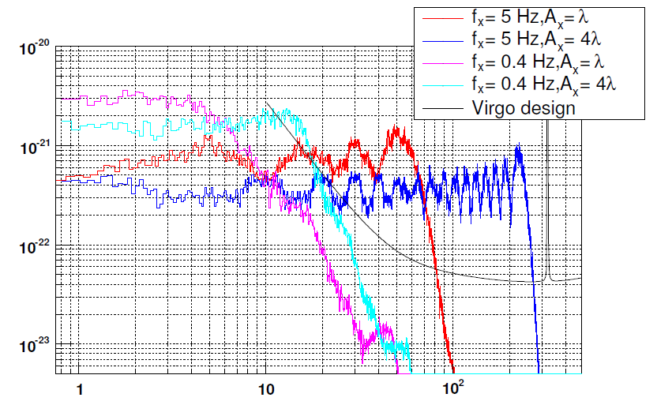
Upconversion patterns
(frequency views)
Simple simulation: scatterer has pure oscillatory motion + microseism
x(t) = A₀∙ sin( 2π f_{o}∙t ) + “microseism”
f₀ = mechanical mode
of optics mount,
or bench ....
at Virgo: bump at
0.3-0.4Hz ≈10⁻⁶ m
Assuming coupling
G=10⁻²¹
Examples:
Scattering optics is
oscillating at 5Hz:
in-band noise if oscillation
amplitude larger
than a few λ
Rough sea (0.4Hz)
can give in-band noise
A > 5λ

Slide 7
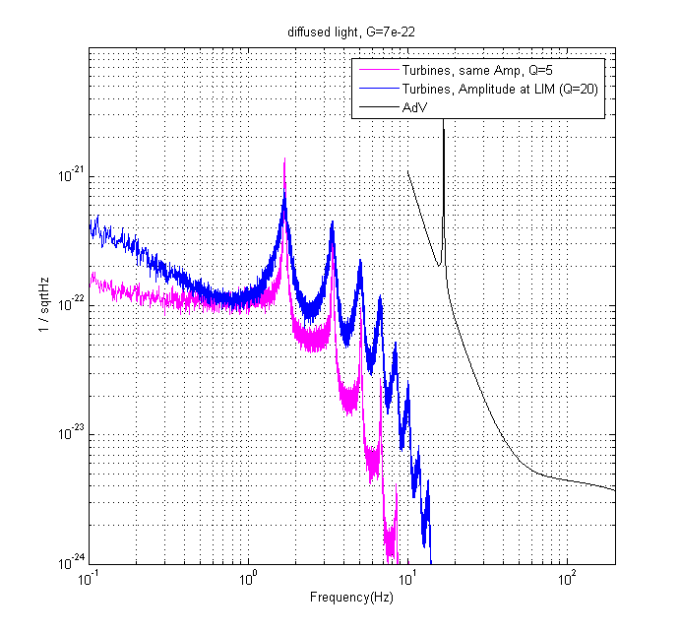
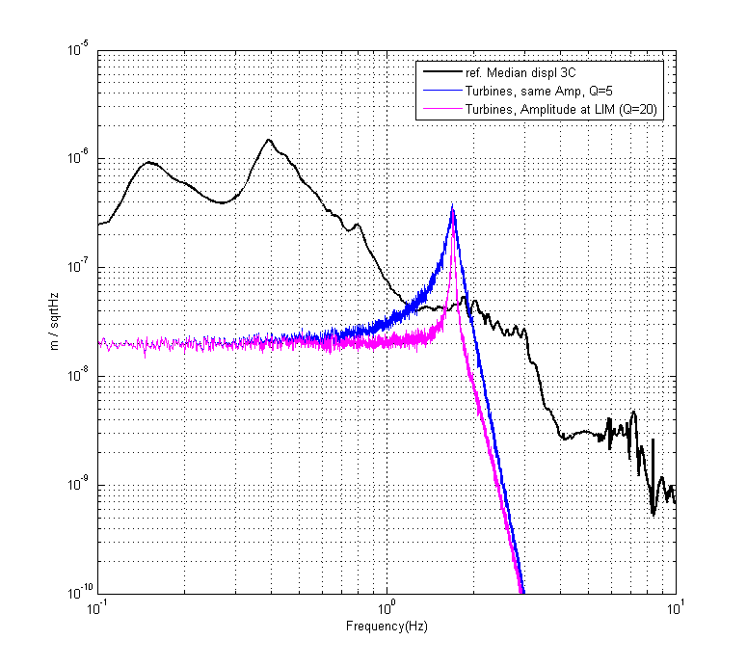
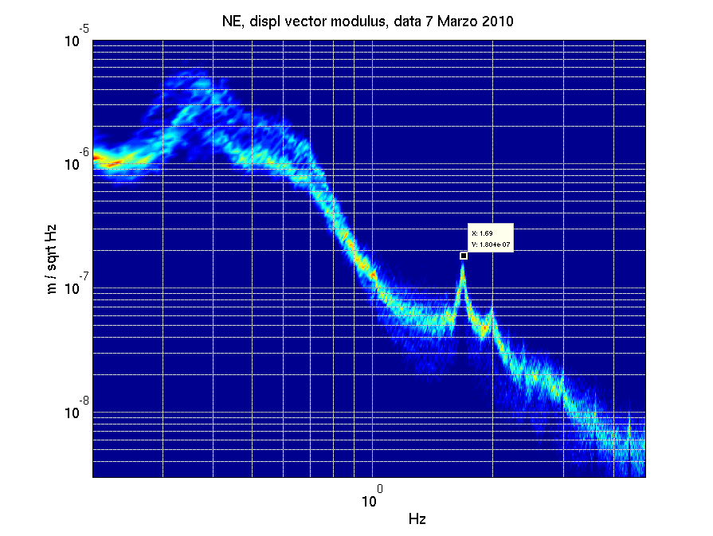

Slide 8
Scattered light noise hunting
Investigation on arm baffles
Feb. 2008,
by S.Braccini et al.
https://tds.ego-gw.it/itf/osl_virgo/index.php?callRep=19873

Slide 12
Scattered light noise hunting
Scattering from optical benches
2006/2007 (VSR1 preparation)
Tapping, acoustic injections, ...

Slide 13
First investigations ...
VSR1 preparation, 2006/2007
Possible diffused light locations: External Benches, Optical links:
NEB
End benches
(aux. photodiodes)
Injection bench
WEB
Laser
EIB
Brewster
window
Cryogenic-trap
Suspended detection bench
EDB
Detection bench
(dark fringe phD)

Slide 14
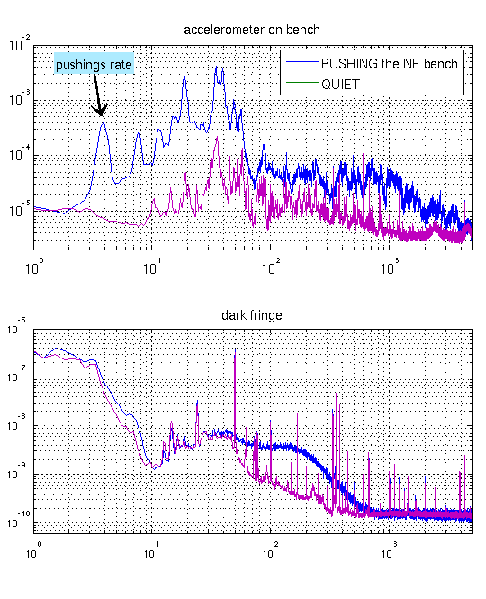
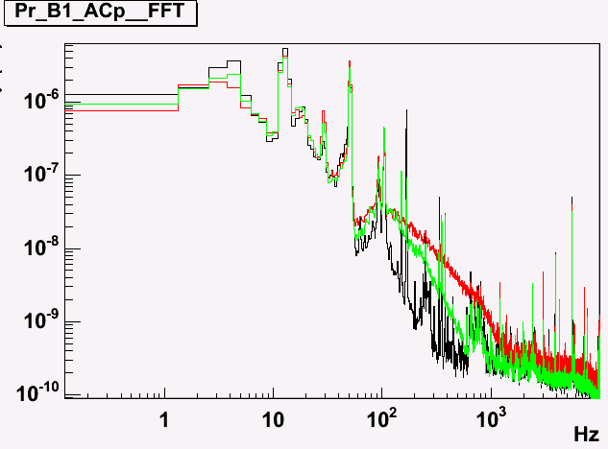
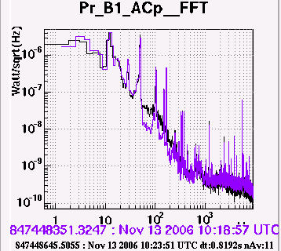
First investigations ...
VSR1 preparation (2006/2007)
First methods were a bit too rough: pushing/hammering on benches / link tubes.
Upconversion noise shoulder, clear signature of diffused light
Yet proved scattering light noise was critical at External benches...
NORTH BENCH
Red = tapping on lentone by hand
Green = tapping on tube connecting tower to bench
Black = reference
“Pushing” NE
bench
WEST BENCH
Purple = tapping on lentone by hand
Black = tapping on lentone with hammer

Slide 15
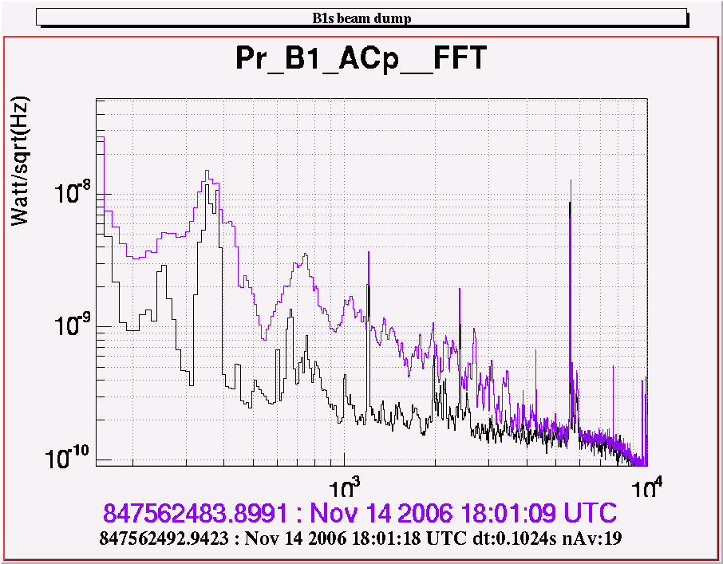
Tapping on optics
Thoroughful check of all External benches
Method: soft tapping on single optics while watching/listening effects on dark fringe
Credit for slides:
J.Marque,
B.Canuel,
E.Genin

Slide 16
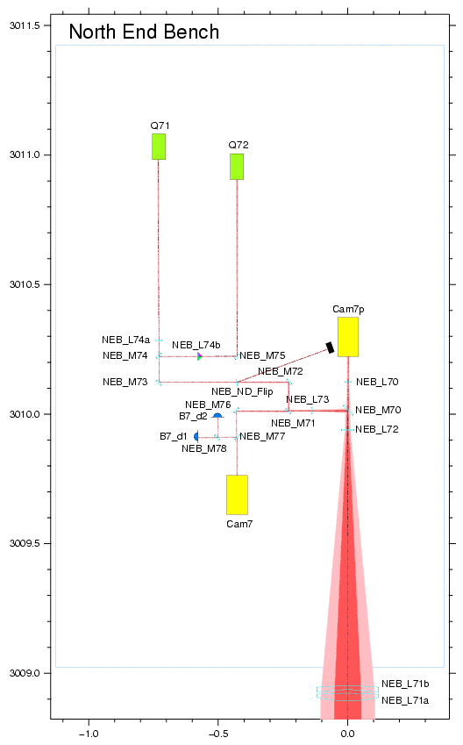
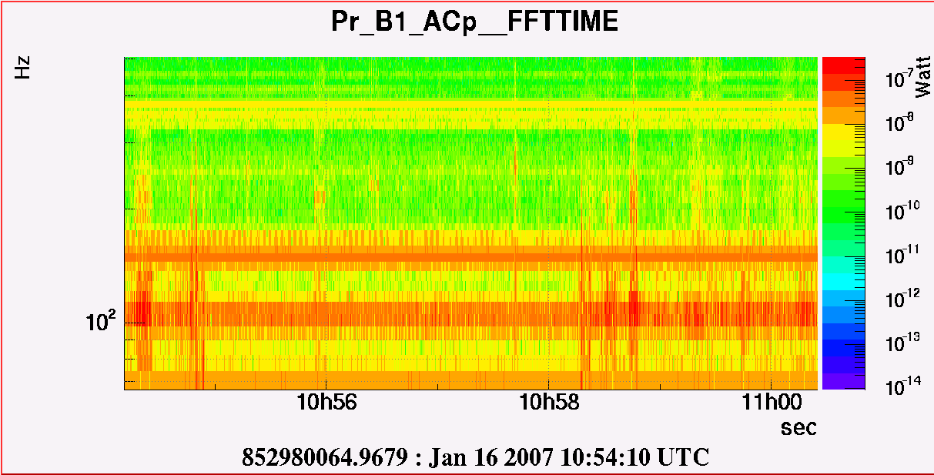
Bench
L72
L73
M70
L71
tube

Slide 17
Tapping is not quantitative, yet very selective:
amplyfing dark fringe existing structures, allowed straighforward identification of culprit optics

Slide 18
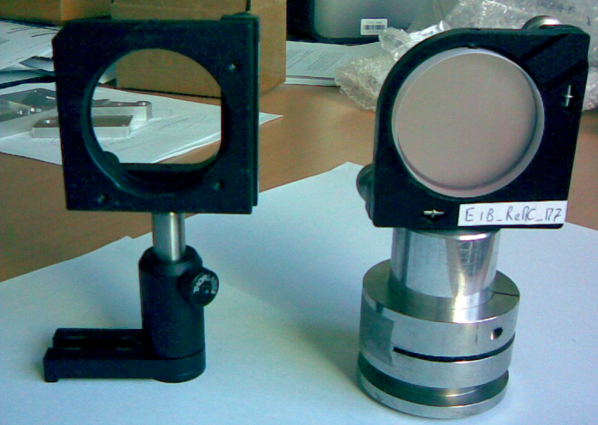
old
new

Slide 19
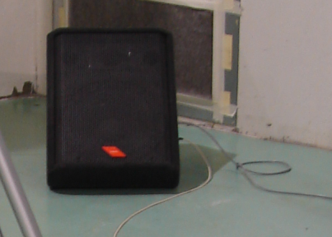
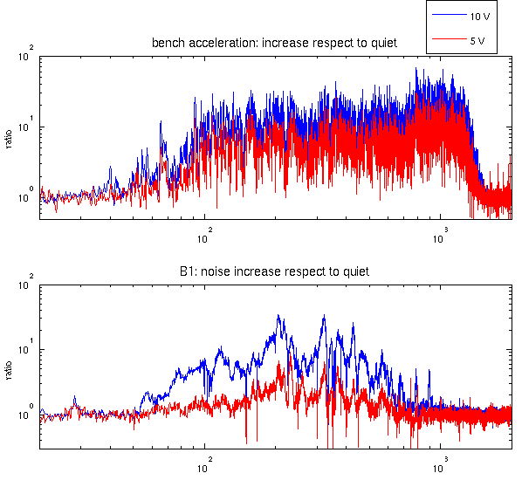
Acoustic injections / beam dump on NE bench
Description of the test:
1) Injection of acoustic white noise between 50 and 1000 Hz with 2 speakers;
…..
Sound pressure
shakes the bench
and optics on it
Piezo-acc. on bench
Dark fringe
Environmental monitoring:
- Piezo acc. Vertical
ratio

Slide 20
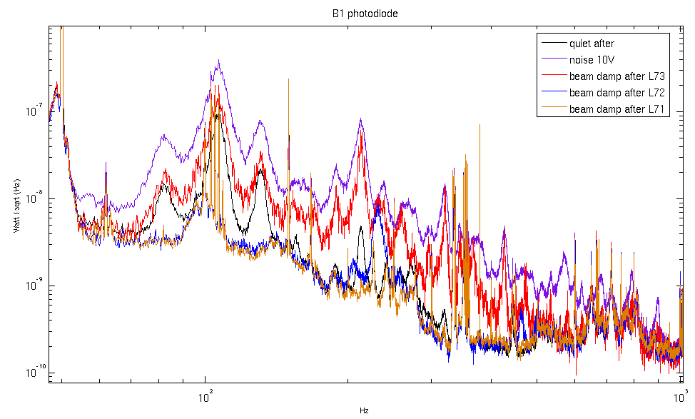
Acoustic injections
Description of the test: …
2) Dumped the beam at 3 different positions: after L73, after L72 and after L71.
3) Repeat acoustic injection, same sound level
and COMPARE noise level in dark fringe
white wide band 50Hz - kHz
Dark fringe
Environmental monitoring:
- Piezo acc. Vertical
ratio
Purple to brown:
beam dumped at different
locations, excluding more and
more optics from the beam path

Slide 21
Second round investigations:
Measure of G using our medium/small size shakers
      Advantage of shakers:
      Reproducible noise, allow quantitative measurements
      Advantages wrt loudspeakers:
      Shaker give access to bit lower frequency, down to ≈10Hz
      Shaker noise can be better confined than acoustic noise (expecially while we did not have yet acoustic enclosures around benches)
      Limitations:
      Not selective,
      i.e. good/sufficiently-good for exciting whole benches / tower tanks / link tubes, but won’t work for single optical components, nor for in vacuum suspended baffles

Slide 22
Back-scattered light modelling
X(t) = scatterer displacement along beam
Investigation method:
If we excite x(t) so to produce a measurable effect in the dark fringe
AND we have an accurate measurement of x(t)
We can measure G
A measure of G helps in:
identify mostly coupled locations
to check mitigation progresses (comparing before and after)
to determine the impact of the noise on the actual sensitivity by projecting the quiet noise condition (undisturbed x(t))
G ≡ K ⋅√f_{sc}

Slide 23
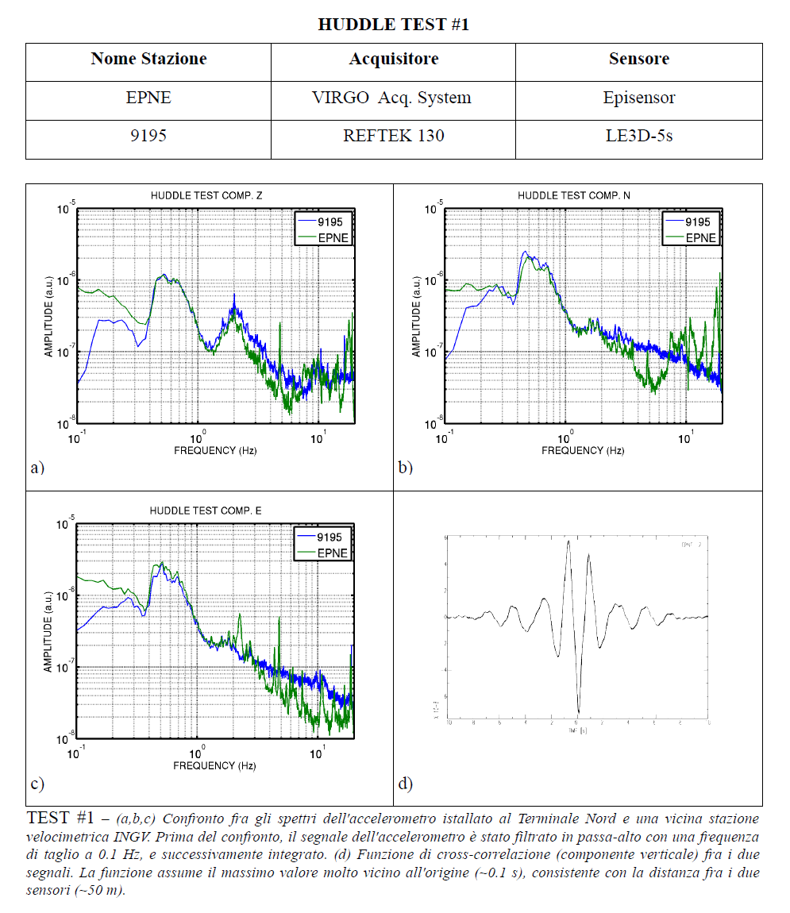
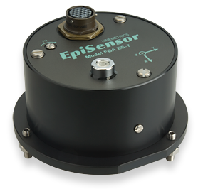
Seismometer on benches
Improved monitor of bench motion (horizontal, along beam)
Episensor FBA ES-T Kinemetrics
Tri-axial
Accelation output 10V/0.25g
0.2Hz to 100Hz (effective)
1.8 kg
155dB dynamic range

Slide 24
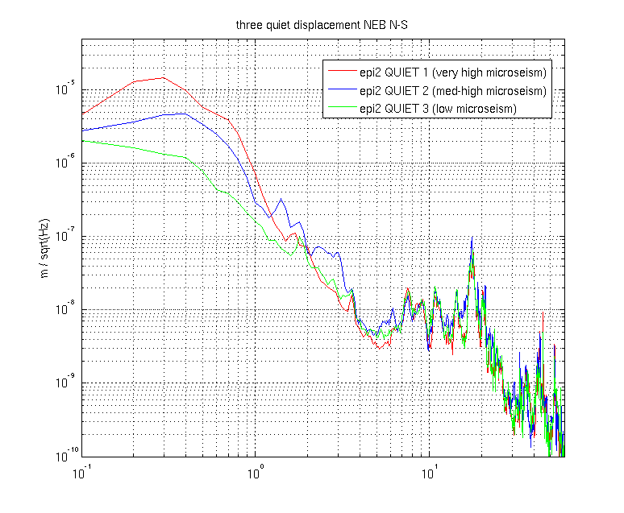
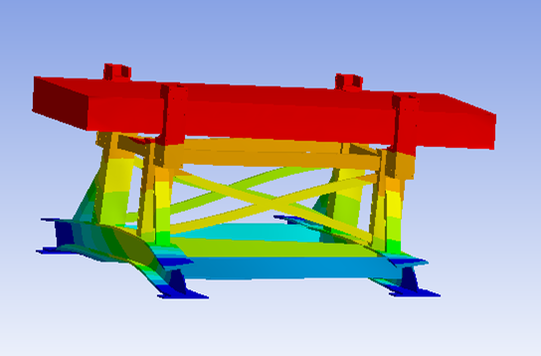
Bench horizontal movement
Episensor NE bench, N-S displacement
Table “rocking modes
~300mHz
Seismic noise
from sea waves
(“microseism”)
All our optical tables
have these modes
around 10-20Hz
(800kg on legs)

Slide 25
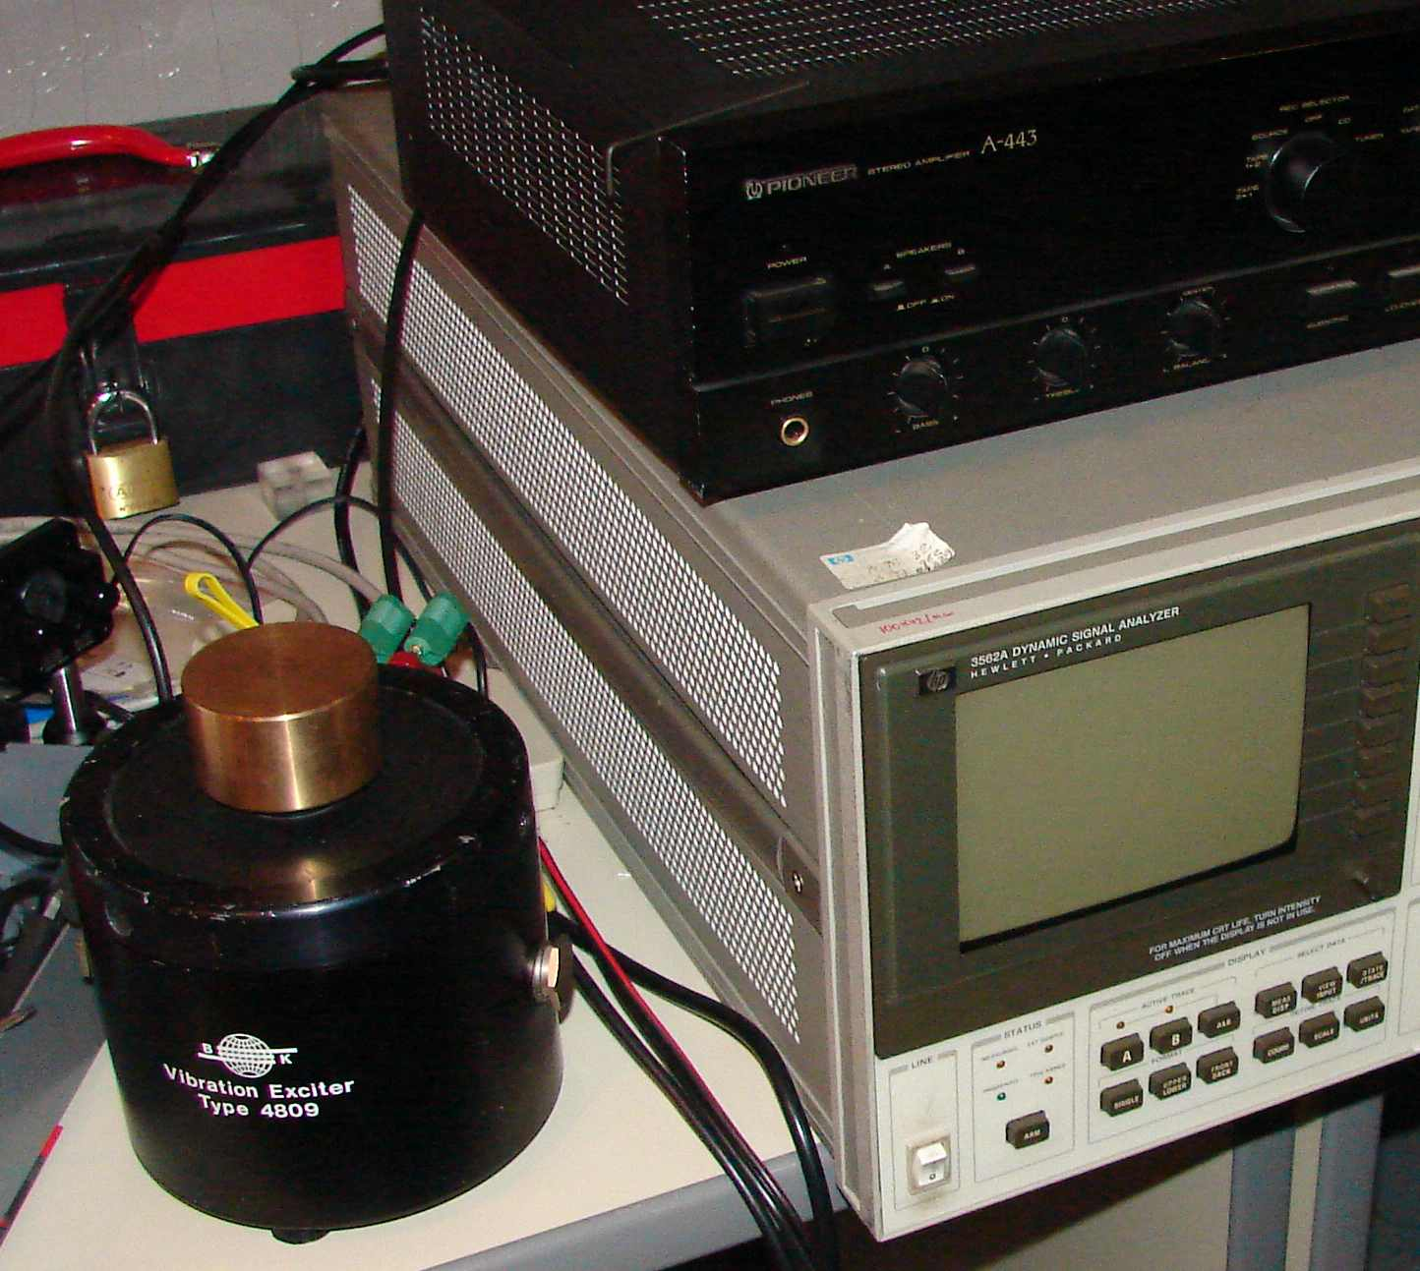
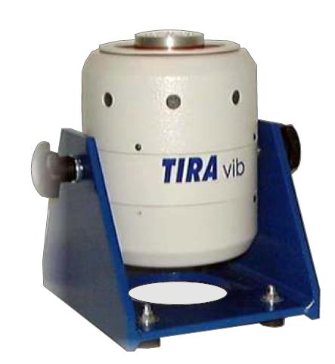
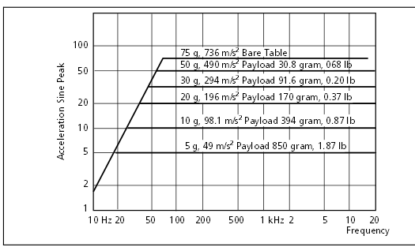
The shaker
B&K mod. 4809
then TiraVib mod.51110
Weight ≈10 kg
Used in recoil mode, just laying it on table
2kg mass on top helps a bit with low frequencies
(g)
B&K 4809
Driving signal: Vin(t)=sinus or narrow-band white noise,
Vin fed through signal generator (at first) then through Virgo DSP (by remote!)

Slide 26
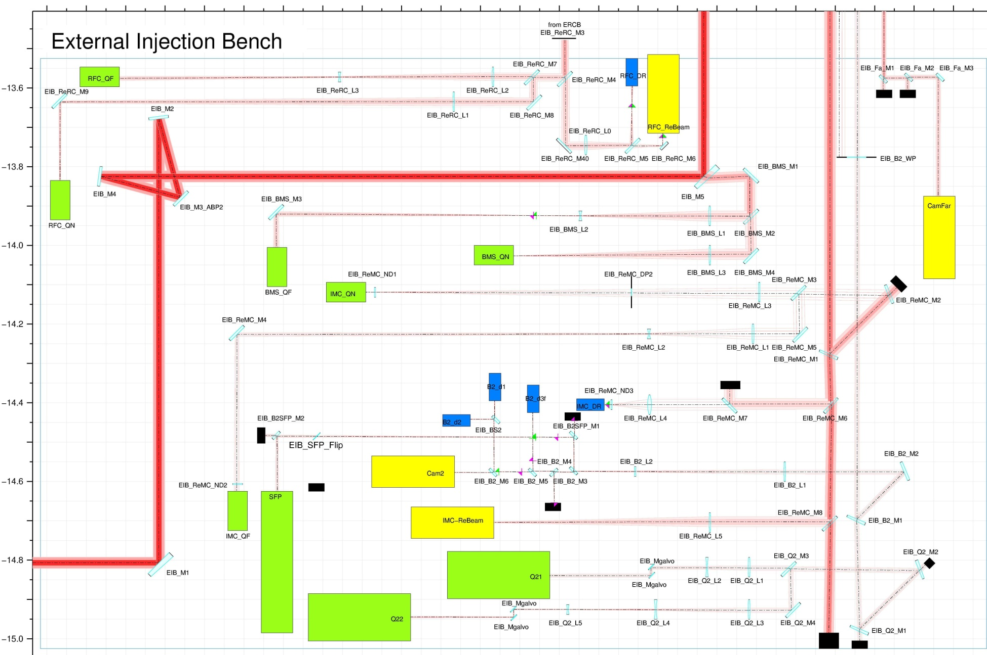
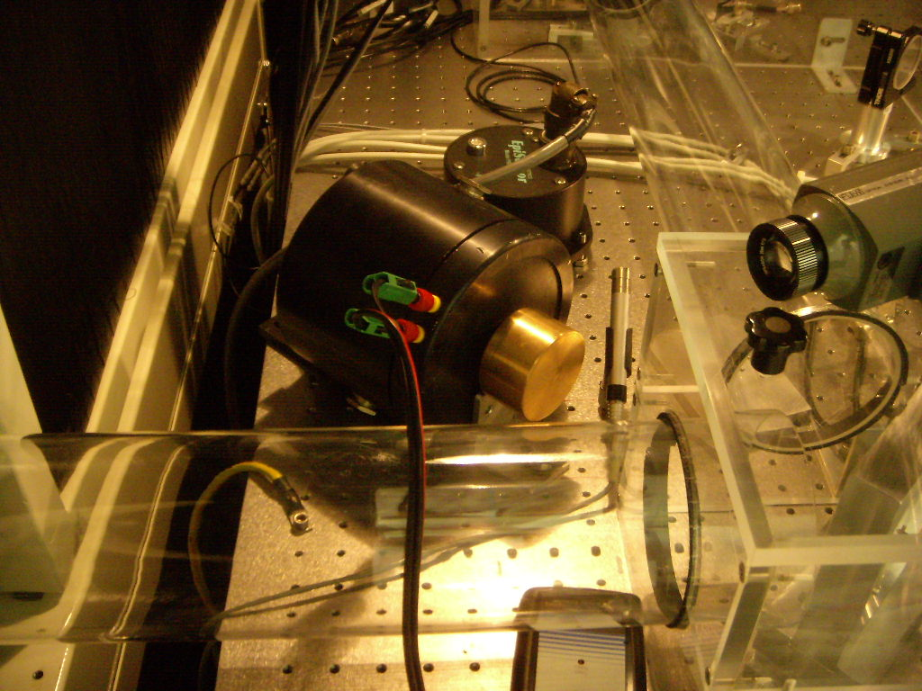
Setup for EIB investigations
episensor
Shaker
In horizontal position

Slide 27
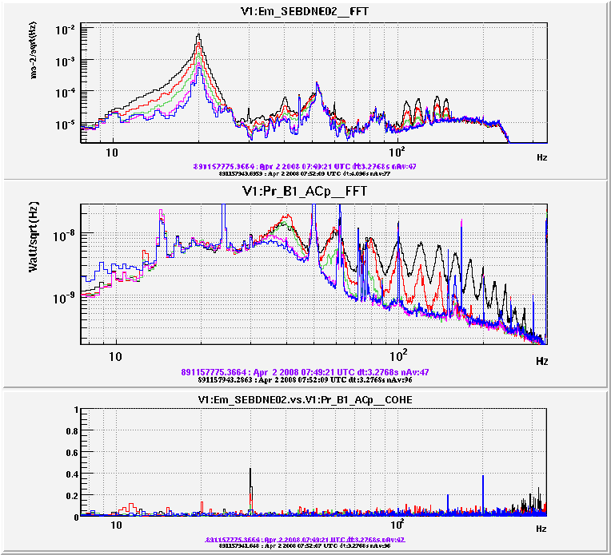
Bench is excited with white noise
around 15-20Hz
with Shaker put on top
Advantages of shaking at the bench modes:
Excite vibration more efficiently,
Maximize impact to dark fringe
Check if bench motion is presently limiting sensitivity

Slide 28
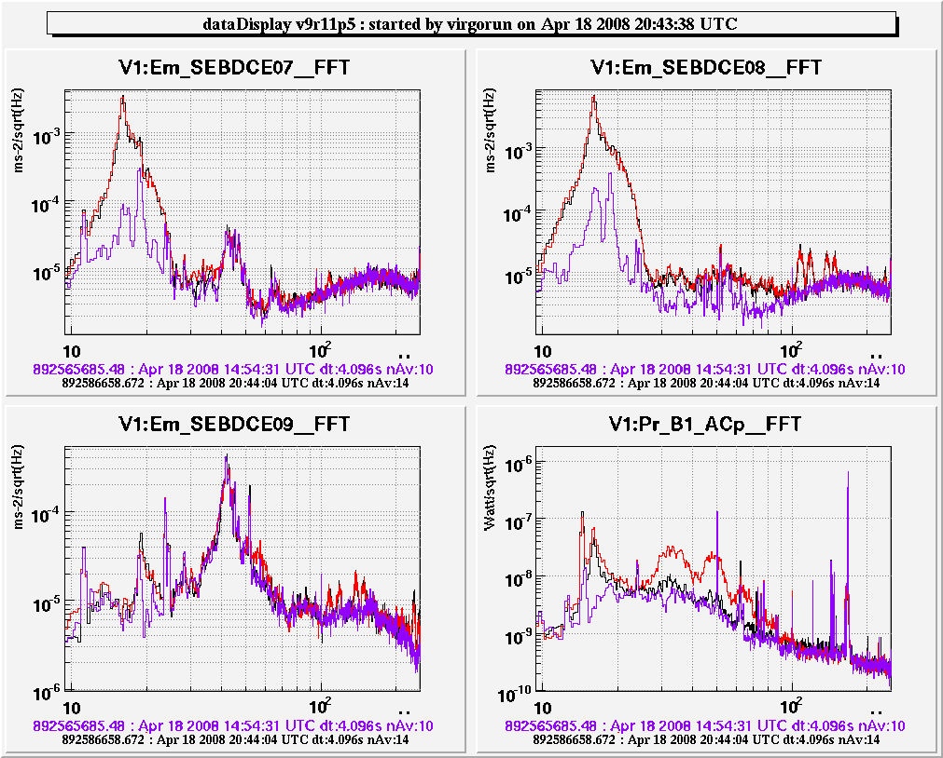
Improvement on the dark fringe …
quiet conditions
noise injection
before modifications
noise injection after modifications
Up-converted noise
much reduced

Slide 29
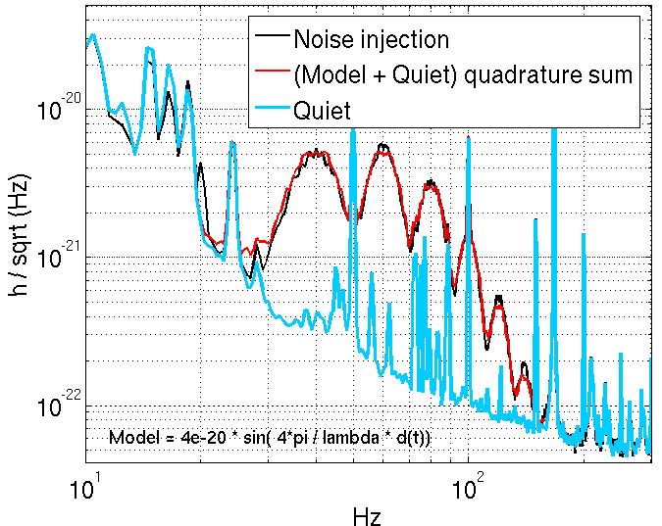
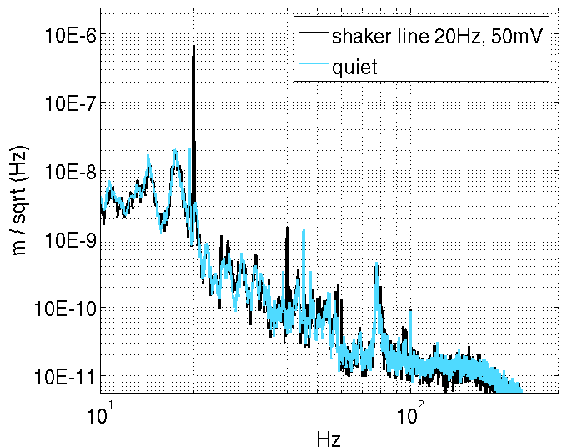
Measurement of G factor
hrec
Episensor on bench
d(t)

Slide 30
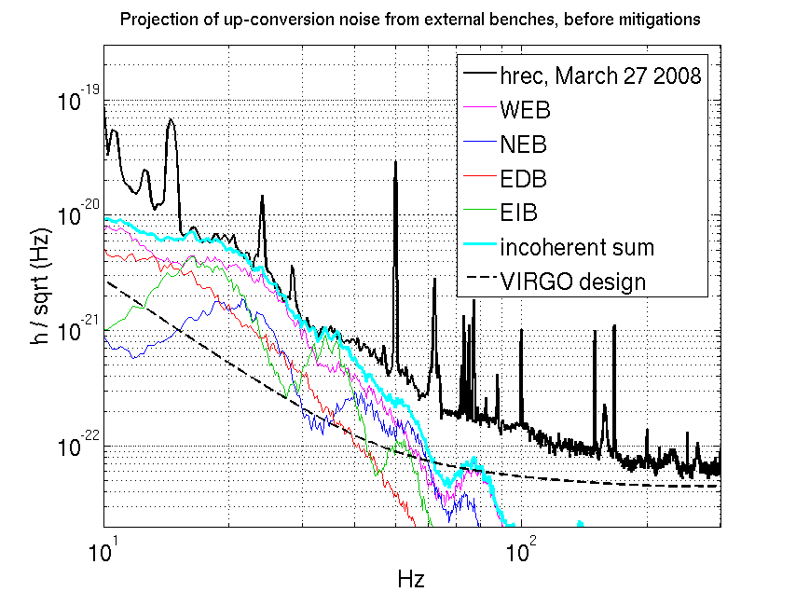
Diffused light noise, after VSR1:
Noise Projection
Measured G
March 27, 2008
QUIET bench displacement
by episensor
Notes:
In this way we found out that right after VSR1 the sensitivity was
limited by diffused light from external benches.

Slide 31
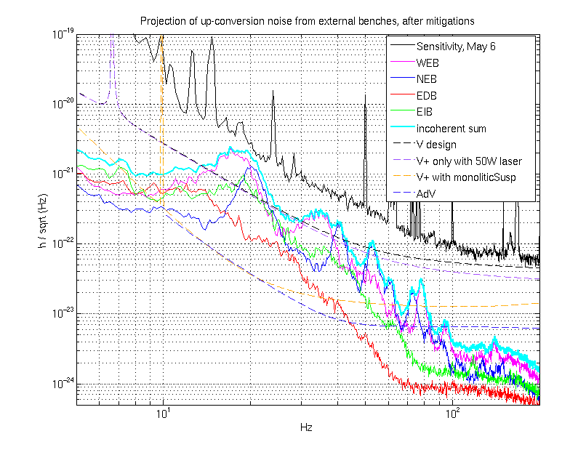
Noise Projection
Major noise contribution is associated to the bench mechanical resonances (10-20Hz).

Slide 32
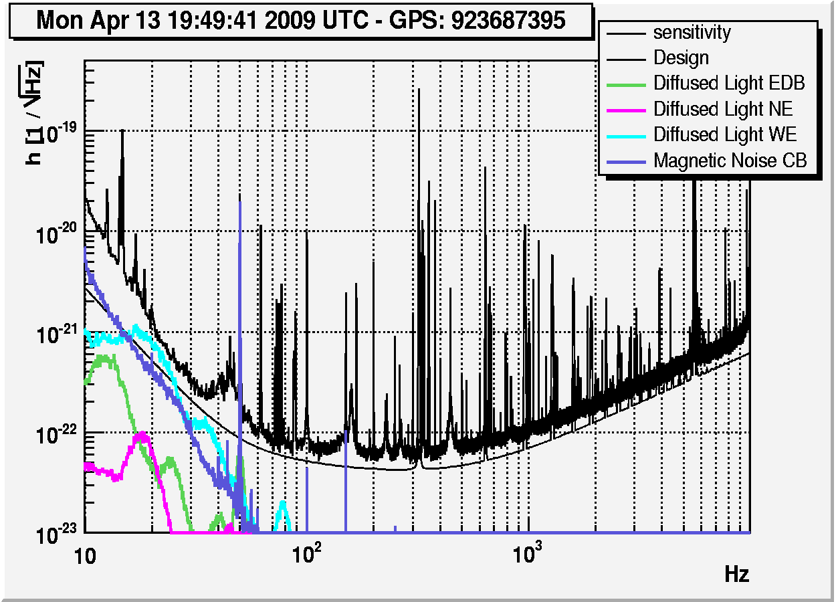
On-line noise budget
Diffused light projections added to on-line noise budget

Slide 33
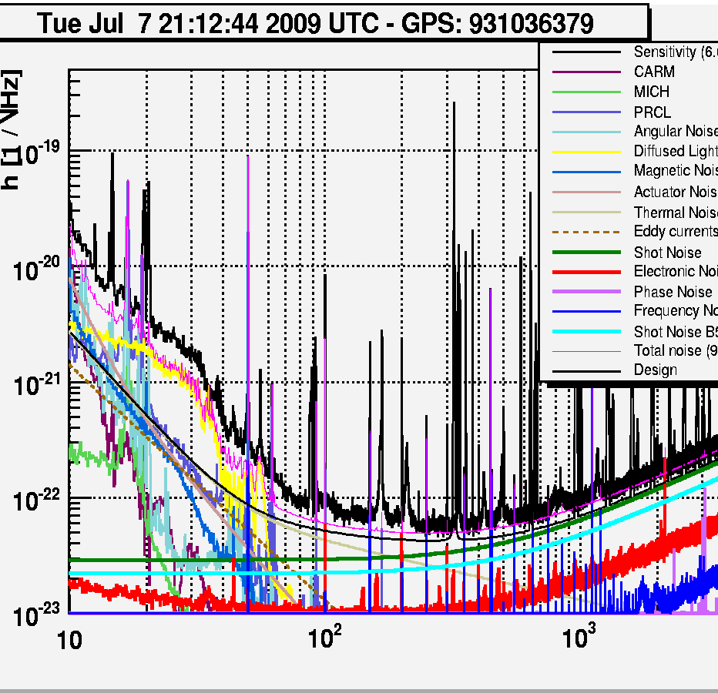
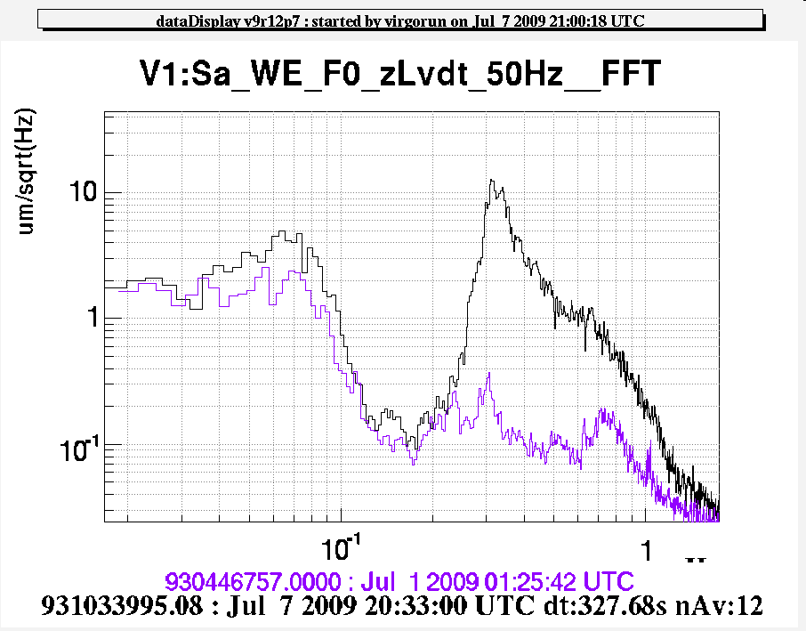
intense sea activity
In bad weather, large micro seismic noise (~10 μm @ 0.3 Hz)
>> Upconversion noise affects sensitivity up to ≈100Hz
Up-conversion model explains reasonably well h-rec noise increase.
Miscoseism
Upconversion
shoulder
33
Notes:
But, in case of intense sea activity,
WE CLEARLY SUFFERED of the upconversion noise, AFFECTING UP TO 100Hz.
The model explains reasonably well the upconversion shoulder.

Slide 34
Few Examples of noise hunting
where projection model proved useful

Slide 35
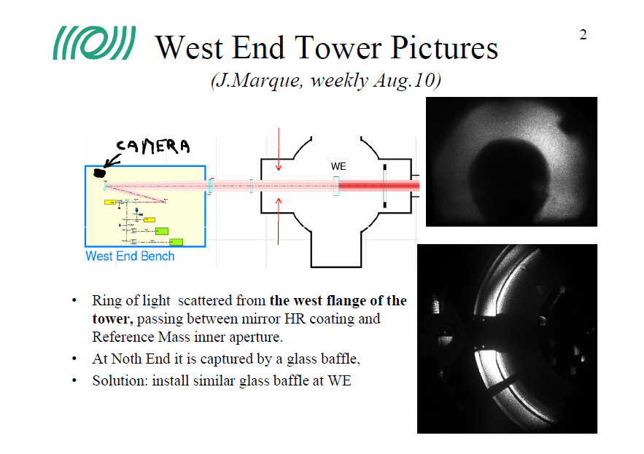

Slide 36
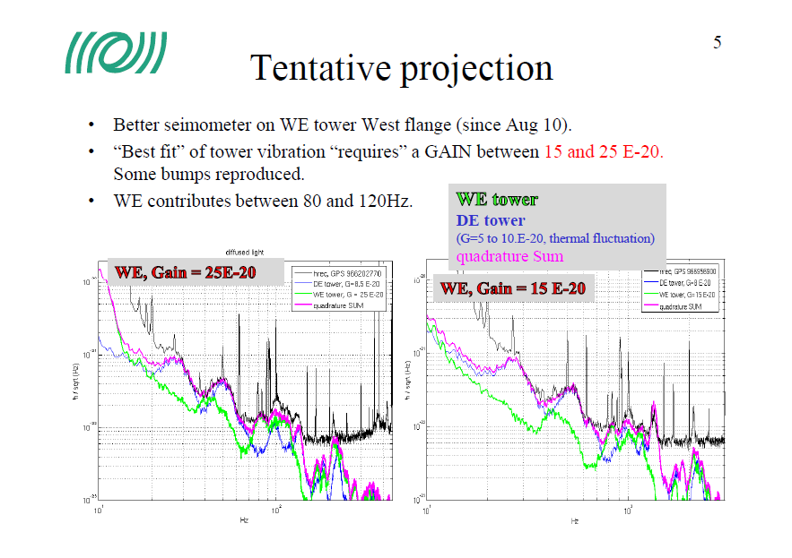

Slide 37
Etalino:
https://tds.ego-gw.it/itf/osl_virgo/index.php?callRep=27648

Slide 38
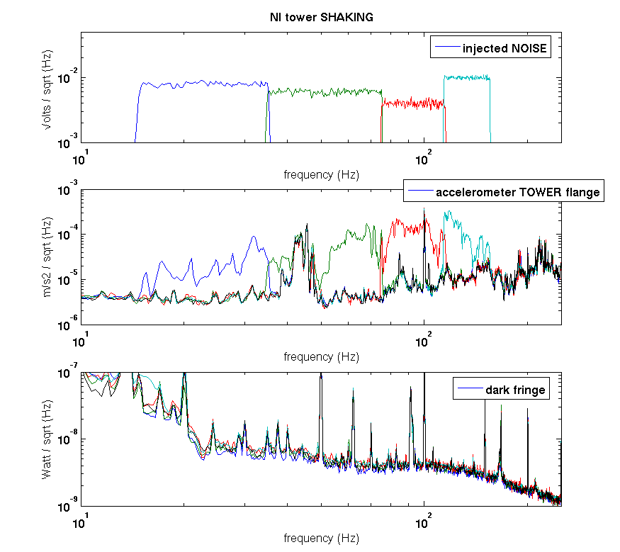
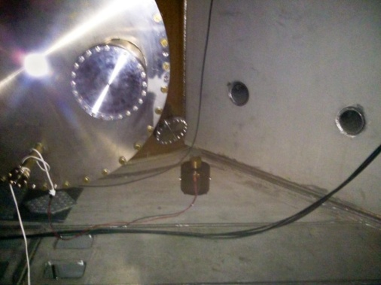
VSR4 preparation – “towers” shaking campaign
Shaker on tower base
Injections:
Sinus → measure “G” (or Upper Limit)
Random in narrow bands → check for “close to limiting” noise
I. Fiori , Virgo Week, June 2011
7

Slide 39
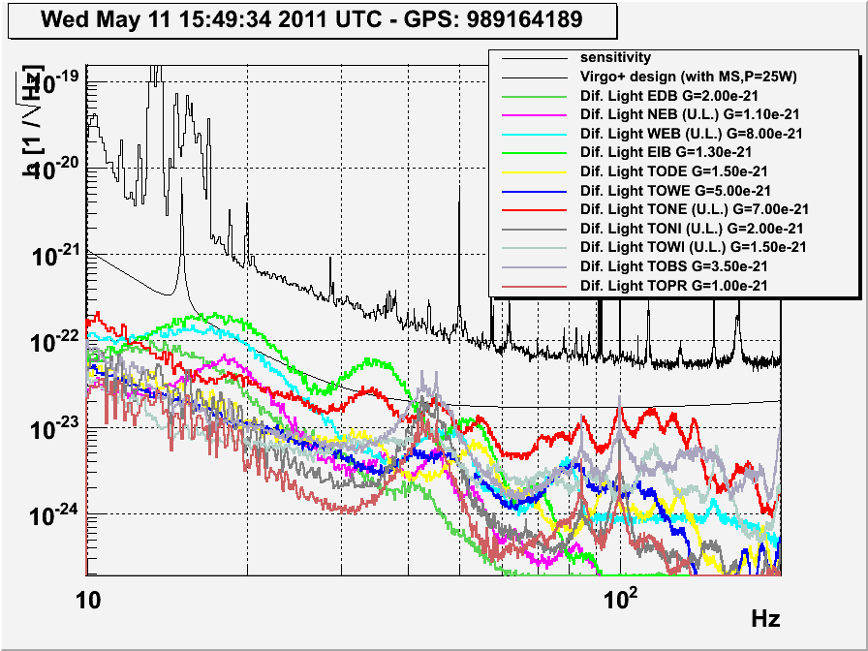
VSR4 preparation: scattered light noise budget of all towers
Notice: “big shaker + episensor” can measure G (or set UpperLimit) about 10 times below actual sensitivity

Slide 40
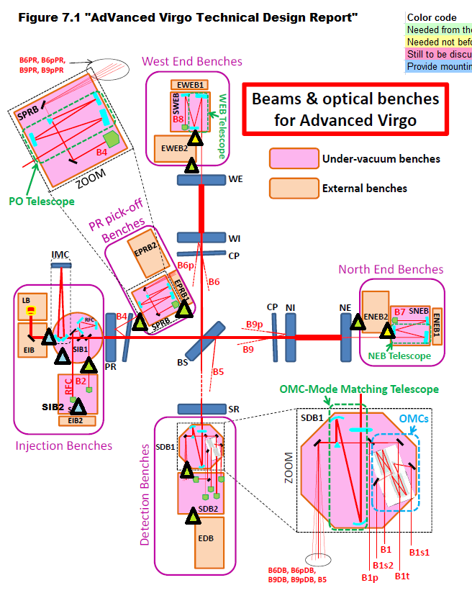
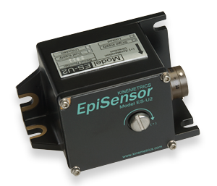
Preparing for AdV scattered light noise hunting
Monoaxial episensor at critical
optical links (n.12)
Mid range accelerometers at tower
flanges, benches, cryo-links (n.23)
Seismic sensors for in-vacuum baffles
Microphones and Episensors at benches (n.10, 7 in CB)
Shaker: prepared supports tor towers/links
Be prepared to disentangle effects of shaker’s stray magnetic fields (perform concurrent magnetic injectioons).
DSP channels dedicated to noise Injection SYS
6 x 6 x 10 cm
350gr
1-axis EPISENSORS

Slide 41
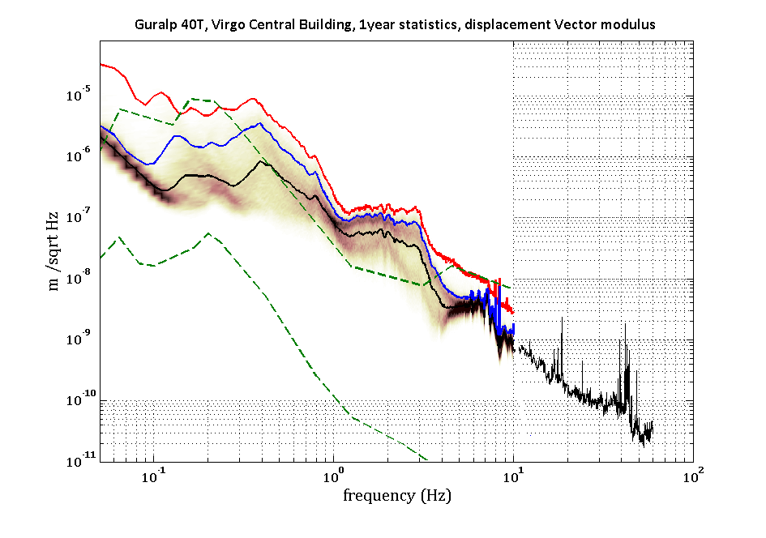
Virgo ground seism
50% Percentile Level
90% Percentile Level
99% Percentile Level
U.L. of in-band upconversion

Slide 42
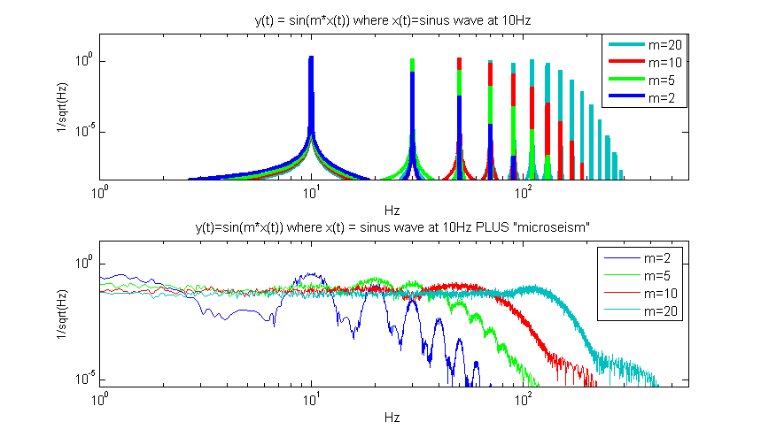
Upconversion patterns
(frequency views)
f₀ = mechanical mode
of optics mount,
or bench ....
Simple simulation
1) scatterer has pure oscillatory motion:
x(t) = A₀∙ sin( 2π f_{o}∙t )
h_{sc}(t) is frequency modulated by f₀
with modulation index
f₀=10Hz
Bandwidth:
“shoulder”
2) adding “microseism” ....
x(t) = A₀∙ sin( 2π f_{o}∙t ) + “microseism”
“Blurred” peaks
at Virgo: bump at
0.3-0.4Hz ≈10⁻⁶ m
For reproducing measured noise important to measure scatterer motion down to
microseism region (0.1Hz)
4/13

Slide 43
